Slide 1


Slide 2
Do or Make
Do Make
*Repetitive
*Obligation
*Multiple actions
*Replace verbs
*Create
*Something you choose
*Produce
*Speaking

Slide 3
DO: Generally → *You can see it, but can’t touch it. MAKE: Generally → *You can touch it.
DO:
Housework=>chores
*do the dishes
*do the laundry
*do (the) yard work
Work
*do homework (school)
*do business
*do a report
Body
*do your (nails/hair/bread) (clean, fix)
MAKE:
Communication:
*make a call
*make excuses
*make a complaint
#make the bed#
Food
*make a dinner
*make a meal
*make some coffee
Plans
*make a list
*make an exception

Slide 4
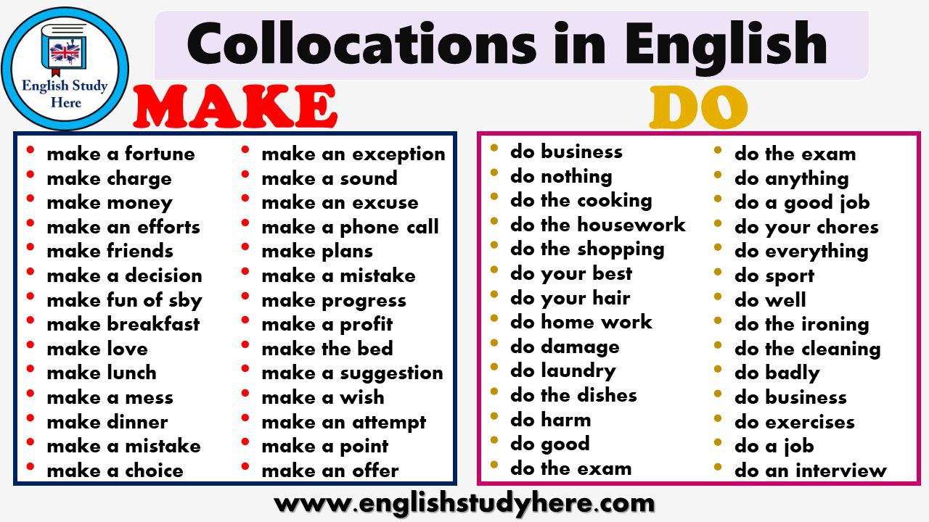

Slide 5
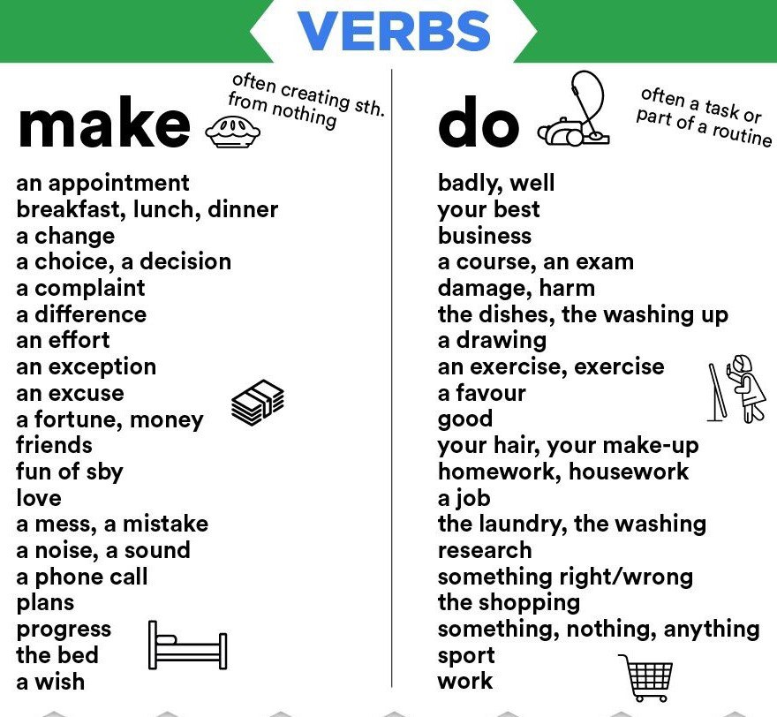

Slide 6
QUIZ:
Choose do or make.
1. I usually ______ the dishes after dinner.
2. Can you ________ a lot of money at your work?
3. I ______ the laundry yesterday.
4. I ______ my bed every morning.
5. I ______ everything to ________ you happy.
6. I’m not keen on ______ exercises.
7. I ____ a stupid mistake yesterday.

