Slide 1

HIGH-PERFORMANCE BIOLOGICAL COMPUTING
University of Illinois at Urbana Champaign
Using High Performance Computing
in Computational Genomics
Liudmila Sergeevna Mainzer
SPIN
June 27, 2016

Slide 2

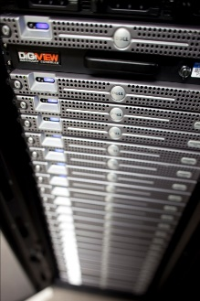

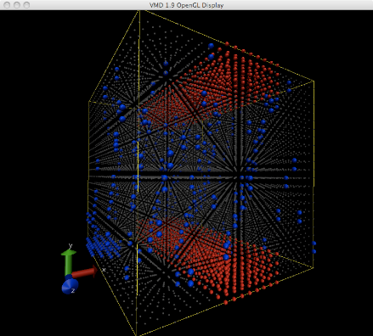
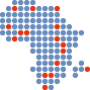
High Performance Biological Computing
A Core Facility Anchored in Research and Technology
IGB, Carver Biotechnology Center, NCSA
Infrastructure: hardware, software, data
Training: short courses, workshops
User support: experimental design, analysis, statistics
International engagement
Applied R&D: scalability, optimal HPC architectures
Mainzer, HPCBio SPIN 2016 Slide 2 of 18

Slide 3
Applied R&D at HPCBio
Testing and benchmarking new methods
Survey of literature and social media, technology trends
Benchmarking of new methods using our own datasets, comparison to current best practice
Establishing consistent benchmarks for accuracy and performance (synthetic data, consistency checks)
Scaling of existing methods
Sizes and numbers of datasets are constantly increasing → scaling issues
Explore how to best use large scale computational resources (Blue Waters, Clouds) for the analysis of large and complex datasets
Computational systems research
Explore the behavior of best practice workflows when deployed on different systems architectures
Mainzer, HPCBio SPIN 2016 Slide 3 of 18

Slide 4



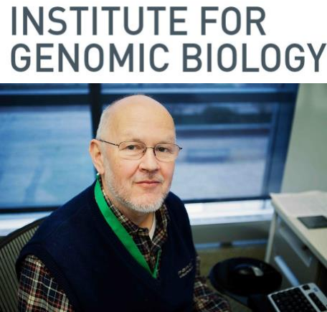
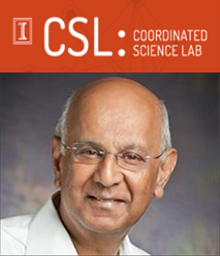



Computational Genomics at NCSA and UIUC
•
Architecture:
What kind of computer architecture is best suited for
bioinformatics work?
•
Performance bottlenecks:
Victor Jongeneel,
Director of HPCBio
What are the performance bottlenecks for bioinformatics work,
on different architectures?
•
Future:
How to structure the bioinformatics workflows for best
performance on the architectures upcoming in the next 5, 10, 20 years?
Ravi Iyer,
Professor of ECE
Mainzer, HPCBio SPIN 2016 Slide 4 of 18

Slide 5
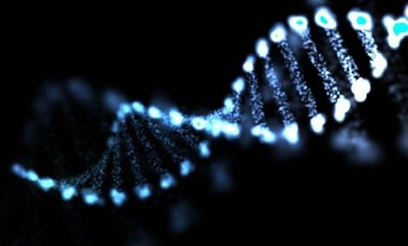
What is Genomic Variant Calling?
Why do we think it is important?
Why does it need high performance computing?

Slide 6

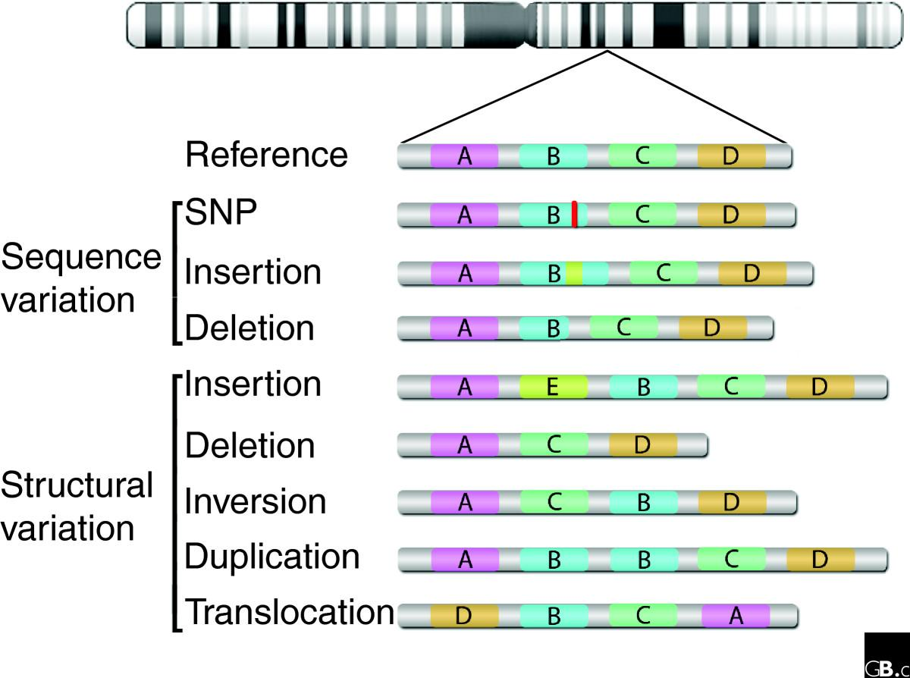
Genomic Variant = a difference in the genetic code
goodnightgoodnightpartingissuchsweetsorrow
htg-odnigh
nightg-od
Oetsorro
swOetsorr
uchswOets
oodnightg
Goodnigh
ghtpartingi
nightparti
issuchswO
g-odnightp
ghtg-odnig
dnightg-od
Rahim et al. Genome Biology 2008 9:215
6X
3X
4X
Mainzer, HPCBio SPIN 2016 Slide 6 of 18

Slide 7
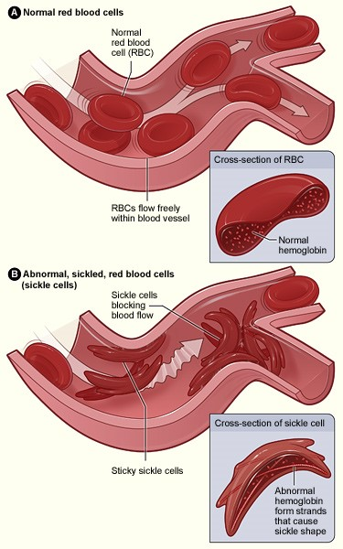
Even a single variant in a single gene
can lead to a drastic difference in phenotype
Sickle-cell anemia is a Mendelian disease.
NHGRI:
Since 2011, Centers for Mendelian Genomics sequenced >20,000 human exomes.
Human exome ~ 2% human genome
1 sample ~ 10 GB sequencing data
20,000 samples ~ 200 TB sequencing data
Image from http://www.nhlbi.nih.gov/
Mainzer, HPCBio SPIN 2016 Slide 7 of 18

Slide 8

Data footprint, scaling up
1 B “Hello World” = 12 B
x1000 = 1 KB 1 page of code ~ 6 KB
x1000 = 1 MB this presentation ~ 2.5 MB
x1000 = 1 GB Soybean sequencing data ~ 4 - 69 GB
x1000 = 1 TB human tumor/normal sample pair, WGS laptops, servers
x1000 = 1 PB daily data production clusters, supercomputers
Biocluster at IGB: 700 TB of project space
iForge at NCSA: 600 TB of project space
Blue Waters: 26 PB of disk storage
20,000 of the NHGRI WES samples ~ 200 TB sequencing data
floppies, memory sticks
www.qubole.com
Mainzer, HPCBio SPIN 2016 Slide 8 of 18

Slide 9
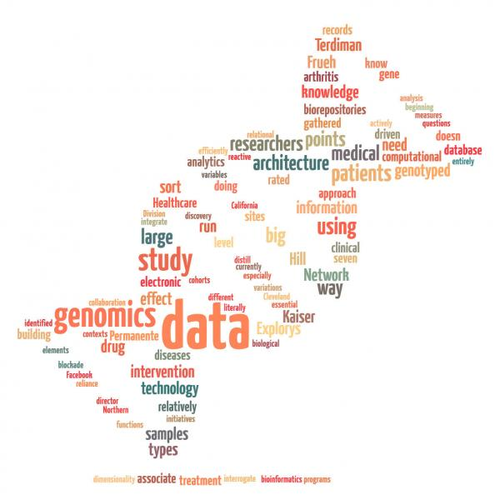
Petascale storage requirements
Complex traits are influenced by many variants, frequently outside coding regions:
BMI
Human height
Alzheimer’s disease
Diabetes
Stroke
Autism
Heart disease
Intelligence
Fertility
NHGRI:
Centers for Common Disease Genomics plan to sequence ~200,000 whole human genomes.
1 sample ~ 200 GB sequencing data (depth-dependent)
200,000 samples ~ 40 PB sequencing data → input data to the variant calling process
Mainzer, HPCBio SPIN 2016 Slide 9 of 18

Slide 10
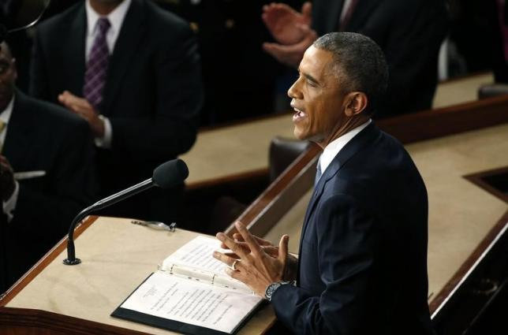
2015: Obama announced
Precision Medicine Initiative
" to bring us closer to curing diseases like cancer and diabetes – and to give all of us access to the personalized information we need to keep ourselves and our families healthier."
"I want the country that eliminated polio and mapped the human genome to lead a new era of medicine – one that delivers the right treatment at the right time,"
U.S. President Barack Obama delivers his State of the Union address to a joint session of the U.S. Congress on Capitol Hill in Washington, January 20, 2015.
Reuters/Jonathan Ernst
NIH http://www.nih.gov/precisionmedicine/
Precision medicine is an emerging approach for disease treatment and prevention that takes into account individual variability in genes, environment, and lifestyle for each person.
Mainzer, HPCBio SPIN 2016 Slide 10 of 18

Slide 11

Sustained Petascale and Exascale storage requirements
What
if we had to genotype every baby being born?
= 500 genomes/day in the state of
Illinois
NIH http://www.nih.gov/precisionmedicine/
NERVE CONDITION - PROBABILITY 60%,
MANIC DEPRESSION - 42%,
OBESITY - 66%,
ATTENTION DEFICIT DISORDER - 89%
HEART DISORDER - 99%
EARLY FATAL POTENTIAL
LIFE EXPECTANCY - 33 YEARS
Mainzer, HPCBio SPIN 2016 Slide 11 of 18

Slide 12
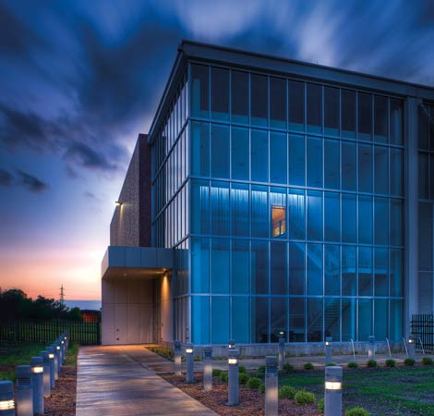
Sustained Petascale and Exascale storage requirements
What
if we had to genotype every baby being born?
= 500 genomes/day in the state of
Illinois
NIH http://www.nih.gov/precisionmedicine/
Input
300-600 GB/genome
150-300 TB/day when analyzing 500 genomes/day
Intermediary
3 TB per sample with intermediaries
0.3-1.5 PB/day when analyzing 500 genomes/day
Output
Tiny: < 500 M per sample
Mainzer, HPCBio SPIN 2016 Slide 12 of 18

Slide 13

Compute requirements: Node count, not flops
Input
split into chunks
Alignment
merge-sort
Alignment
500 jobs for BWA
If chunking input data: 5,000 jobs for Novoalign
Split by chromosome
25 chromosomes * 500 genomes = 12,500 jobs
Realign/Recalibrate
25 chromosomes * 500 genomes = 12,500 jobs
Variant calling
25 chromosomes * 500 genomes = 12,500 jobs
Split by chromosome
Realign/Recalibrate
Variant calling
Mainzer, HPCBio SPIN 2016 Slide 13 of 18

Slide 14
Blue Waters
Node Type | Cray XE6 | Cray XK7
CPU | 2 x AMD “Interlagos” Opteron 6276 | 1 x AMD “Interlagos” Opteron 6276
GPU | NA | 1 x Nvidia “Kepler” Tesla K20x
Total Nodes | 22,640 | 4,224
Total x86 Cores | 362,240 | 33,792
Cores/Node | 16 FP x86_64 cores, 2.45 GHz | 8 FP x86 Cores, 2.45 GHz; 2688 CUDA cores
Memory/Node | 64 GB | 32 GB (CPU) + 6 GB (GPU)
Storage | 26.4 petabytes (disk), 380 petabytes (nearline)
Interconnect | Cray “Gemini” 3D Torus
OS | Cray Linux 6
Mainzer, HPCBio SPIN 2016 Slide 14 of 18

Slide 15

Large scale plant and animal genotyping
Ongoing and future projects
1000+ Arabidopsis genomes
3,000 Rice varieties
1000 Fungal genomes project
Genome10K: 16,000 Vertebrates
5,000 Insect genomes
Complex traits of note
Plant biomass
Nutritive content of grain:
oil, protein, vitamins, minerals
Parasite resistance
Milk volume
Muscle mass
Purebreddairycattle.com
Mainzer, HPCBio SPIN 2016 Slide 15 of 18

Slide 16

It won’t stop here
Purebreddairycattle.com
Mainzer, HPCBio SPIN 2016 Slide 16 of 18

Slide 17

The best computer for genomics
Next generation of Blue Waters:
HPC expertise and a solid, dedicated support team like that on BW is absolutely essential
Must have ~>256 GB RAM per node
Nodes must have internal storage: 1-4 TB
We want lots of cores: 32-64
Mainzer, HPCBio SPIN 2016 Slide 17 of 18

Slide 18





Acknowledgements
Cray
Bob Fiedler
Carlos Sosa
Pierre Carrier
Richard Walsh
Bill Long
Jef Dawson
HPCBio
Victor Jongeneel
Gloria Rendon
Chris Fields
NCSA Industry Engagement
Evan Burness
Jim Long
Wayne Hoyenga
Blue Waters support team
Greg Bauer
Victor Anisimov
Ryan Mokos
Kalyana Chadalavada
Alex Parga Jeremy Enos Andriy Kot
Jason Alt
Craig Steffen
CompGen
Ravi Iyer
Subho Banerjee
Arjun Athreya
Zachary Stephens
Innovative Systems Lab
Volodymyr Kindratenko
H3A bionet: UCT
Gerrit Botha
Ayton Meintjes
Nicola Mulder

