Slide 1
LET’S START

Slide 2
1

Slide 3
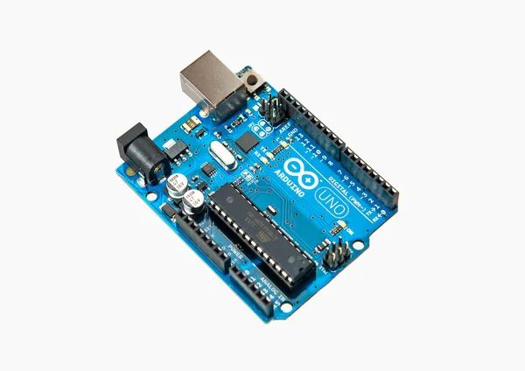
NAME THE ELECTRONIC COMPONENT BELOW
A) ARDUINO
B) RASPBERRY PI
C) LED BULB
D) ATMEGA 328

Slide 4
NAME THE ELECTRONIC COMPONENT BELOW
A) ARDUINO
B) RASPBERRY PI
C) LED BULB
D) ATMEGA 328

Slide 5
2

Slide 6
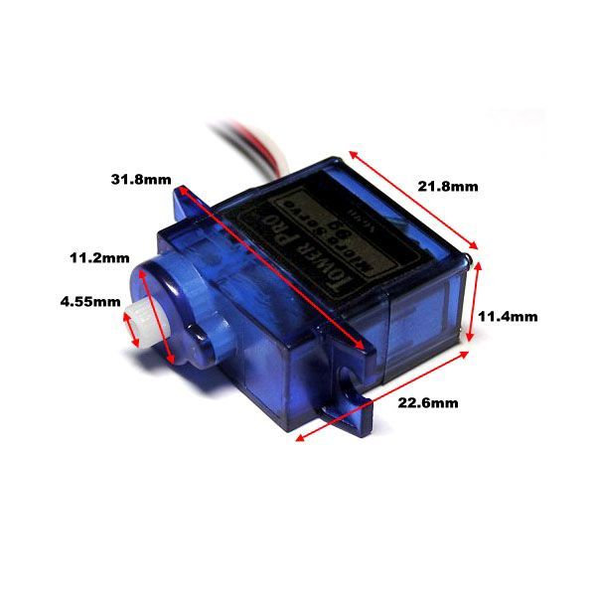
NAME THE ELECTRONIC COMPONENT BELOW
A) MINI MOTOR
B) MICRO CONTROLLER
C) ATMEGA 328
D) SERVO MOTOR

Slide 7
NAME THE ELECTRONIC COMPONENT BELOW
A) MINI MOTOR
B) MICRO CONTROLLER
C) ATMEGA 328
D) SERVO MOTOR

Slide 8
3

Slide 9

IDENTIFY THE AI
A) DAVINCI
B) BLACKBOX
C) CHAT GPT
D) CODEDEX

Slide 10
IDENTIFY THE AI
A) DAVINCI
B) BLACKBOX
C) CHAT GPT
D) CODEDEX

Slide 11
4

Slide 12

IDENTIFY THE PROGRAMMING LANGUAGE USING THE CLUE GIVEN BELOW
A) JAVA
B) SCRATCH
C) C
D) C++

Slide 13
IDENTIFY THE PROGRAMMING LANGUAGE USING THE CLUE GIVEN BELOW
A) JAVA
B) SCRATCH
C) C
D) C++

Slide 14
5

Slide 15

IDENTIFY THE PROGRAMMING LANGUAGE
A) JAVASCRIPT
B) JAVA
C) C#
D) PYTHON

Slide 16
IDENTIFY THE PROGRAMMING LANGUAGE
A) JAVASCRIPT
B) JAVA
C) C#
D) PYTHON

Slide 17
6

Slide 18

IDENTIFY THE MARKUP LANGUAGE
A) CSS
B) HTML
C) JAVASCRIPT
D) PYTHON

Slide 19
IDENTIFY THE MARKUP LANGUAGE
A) CSS
B) HTML
C) JAVASCRIPT
D) PYTHON

Slide 20
7

Slide 21
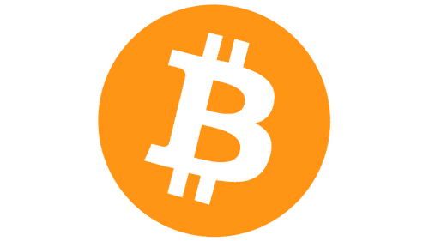
IDENTIFY THE CRYPTO CURRENCY
A) BITCOIN
B) ETHEREUM
C) LITECOIN
D) SOLANA

Slide 22
IDENTIFY THE CRYPTO CURRENCY
A) BITCOIN
B) ETHEREUM
C) LITECOIN
D) SOLANA

Slide 23
8

Slide 24

IDENTIFY THE CRYPTO CURRENCY
A) RVN
B) LITECOIN
C) ETHER
D) SOLANA

Slide 25
IDENTIFY THE CRYPTO CURRENCY
A) RVN
B) LITECOIN
C) ETHER
D) SOLANA

Slide 26
9

Slide 27

IDENTIFY THE SOFTWARE
A) BLENDER
B) GIMP
C) INKSCAPE
D) KOLOUR PAINT

Slide 28
IDENTIFY THE CRYPTO CURRENCY
A) BLENDER
B) GIMP
C) INKSCAPE
D) KOLOUR PAINT

Slide 29
10

Slide 30

IDENTIFY THE SOFTWARE
A) BLENDER
B) LIBRE OFFICE DRAW
C) INKSCAPE
D) KOLOUR PAINT

Slide 31
IDENTIFY THE SOFTWARE
A) BLENDER
B) LIBRE OFFICE DRAW
C) INKSCAPE
D) KOLOUR PAINT

