Slide 1

Work Summary / Plan / Report
BUSINESS PLAN
Fashion Summary
The user can demonstrate on a projector or computer, or print the presentation and make it into a film to be used in a wider field
Presenter: YPPPT

Slide 2

CONTENTS
1
Annual Overview
print the presentation and make it into a film a wider field
2
Work Progress
print the presentation and make it into a film a wider field
3
Areas to Improve
print the presentation and make it into a film a wider field
4
Next Year's Plan
print the presentation and make it into a film a wider field

Slide 3
PART 01
Annual Overview
The user can demonstrate on a projector or computer, or print the presentation and make it into a film to be used in a wider field

Slide 4


Annual Overview
print the presentation and make it into a film to be used in a wider field
Text Here
The user can demonstrate on a projector or computer, or presentation and make it film to be used in a wider field
Text Here
Text Here
The user can demonstrate on a projector or computer, or presentation and make it film to be used in a wider field
The user can demonstrate on a projector or computer, or presentation and make it film to be used in a wider field

Slide 5


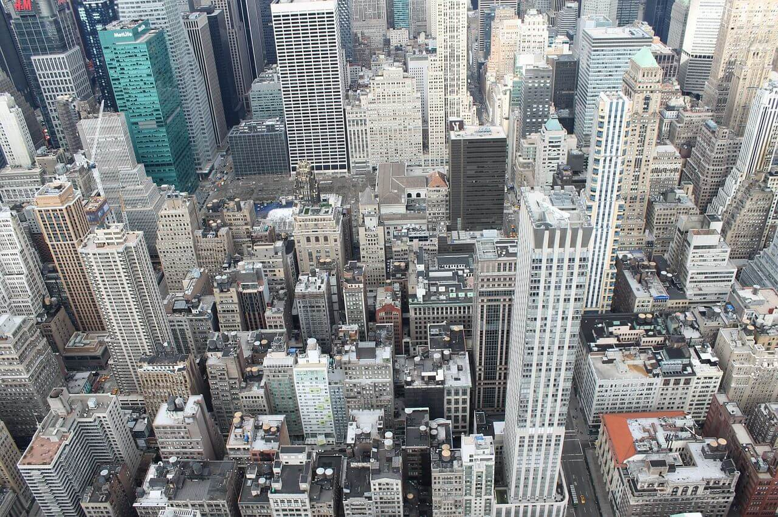

Annual Overview
print the presentation and make it into a film to be used in a wider field
Title Here
Title Here
The user can demonstrate on a projector or computer, or presentation and make it film to be used in a wider field
The user can demonstrate on a projector or computer, or presentation and make it film to be used in a wider field
Title Here
Title Here
The user can demonstrate on a projector or computer, or presentation and make it film to be used in a wider field
The user can demonstrate on a projector or computer, or presentation and make it film to be used in a wider field

Slide 6




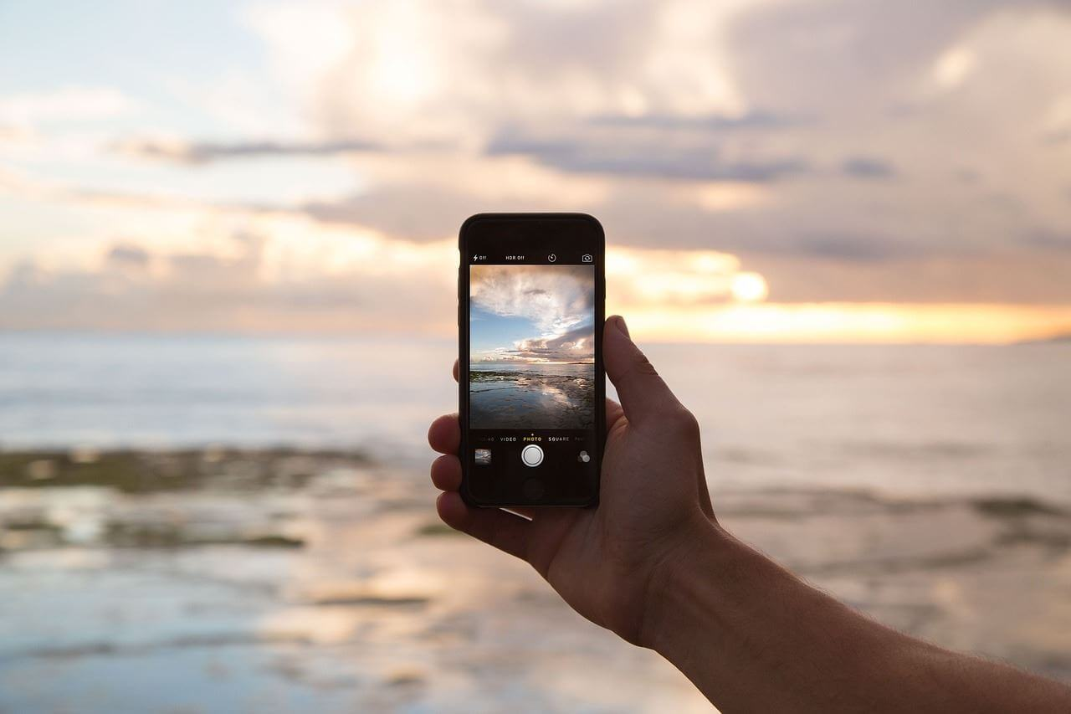

Annual Overview
print the presentation and make it into a film to be used in a wider field
Title Here
Title Here
Title Here
Title Here
Title Here
Title Here

Slide 7
Annual Overview
print the presentation and make it into a film to be used in a wider field
Text Here
Text Here
Text Here
Text Here
Text Here
presentation and make it film to be wider field
presentation and make it film to be wider field
presentation and make it film to be wider field
presentation and make it film to be wider field
presentation and make it film to be wider field

Slide 8
Annual Overview
print the presentation and make it into a film to be used in a wider field
Title Here
Title Here
presentation and make it film to be used in a wider field
presentation and make it film to be used in a wider field
Title Here
Title Here
presentation and make it film to be used in a wider field
presentation and make it film to be used in a wider field

Slide 9
PART 02
Work Progress
The user can demonstrate on a projector or computer, or print the presentation and make it into a film to be used in a wider field

Slide 10
Work Progress
print the presentation and make it into a film to be used in a wider field
Title Here
Title Here
print the presentation and make it film to be used in a wider field
print the presentation and make it film to be used in a wider field
Title Here
Title Here
print the presentation and make it film to be used in a wider field
print the presentation and make it film to be used in a wider field
Title Here
Title Here
print the presentation and make it film to be used in a wider field
print the presentation and make it film to be used in a wider field

Slide 11
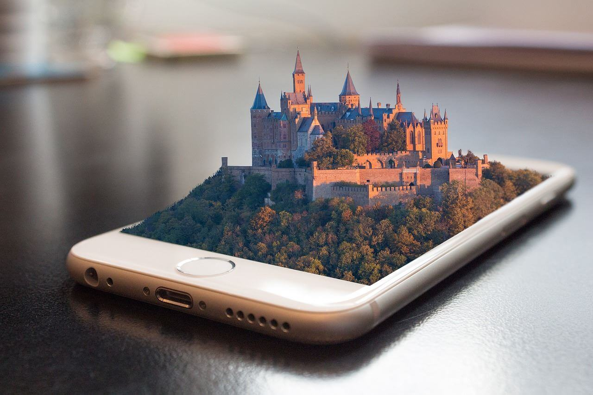
Work Progress
print the presentation and make it into a film to be used in a wider field
Title Here
Title Here
The user can demonstrate on a projector or computer
The user can demonstrate on a projector or computer
Title Here
Title Here
The user can demonstrate on a projector or computer
The user can demonstrate on a projector or computer
Title Here
Title Here
The user can demonstrate on a projector or computer
The user can demonstrate on a projector or computer

Slide 12
Work Progress
print the presentation and make it into a film to be used in a wider field
01
Title Here
Title Here
01
Title Here
The user can demonstrate on a projector or computer
The user can demonstrate on a projector or computer
The user can demonstrate on a projector or computer, or presentation and make it film to be used in a wider field
02
Title Here
02
Title Here
The user can demonstrate on a projector or computer
The user can demonstrate on a projector or computer
Title Here
03
Title Here
The user can demonstrate on a projector or computer, or presentation and make it film to be used in a wider field
03
Title Here
The user can demonstrate on a projector or computer
The user can demonstrate on a projector or computer

Slide 13

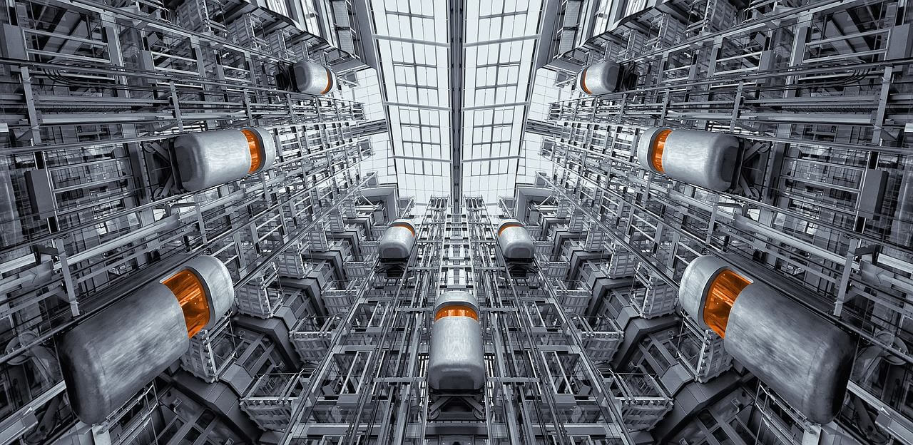


Work Progress
print the presentation and make it into a film to be used in a wider field
Title Here
Title Here
The user can demonstrate on a projector or computer, or presentation and make it film to be used in a wider field
The user can demonstrate on a projector or computer, or presentation and make it film to be used in a wider field
Title Here
Title Here
The user can demonstrate on a projector or computer, or presentation and make it film to be used in a wider field
The user can demonstrate on a projector or computer, or presentation and make it film to be used in a wider field

Slide 14
PART 03
Areas to Improve
The user can demonstrate on a projector or computer, or print the presentation and make it into a film to be used in a wider field

Slide 15
Areas to Improve
print the presentation and make it into a film to be used in a wider field
Preset Title
Title Here
The user can demonstrate on a projector or computer
Preset Title
Title Here
The user can demonstrate on a projector or computer
Preset Title
Title Here
The user can demonstrate on a computer
Preset Title
Title Here
The user can demonstrate on a projector or computer

Slide 16
Areas to Improve
print the presentation and make it into a film to be used in a wider field
Text Here
The user can demonstrate on a projector or computer, or presentation and make it film to be used in a wider field
Text Here
Text Here
The user can demonstrate on a projector or computer, or presentation and make it film to be used in a wider field
The user can demonstrate on a projector or computer, or presentation and make it film to be used in a wider field

Slide 17
Areas to Improve
print the presentation and make it into a film to be used in a wider field
Text Here
Text Here
Text Here
Text Here
The user can demonstrate on a projector or computer, or presentation and make it film to be used in a wider field
The user can demonstrate on a projector or computer, or presentation and make it film to be used in a wider field
The user can demonstrate on a projector or computer, or presentation and make it film to be used in a wider field
The user can demonstrate on a projector or computer, or presentation and make it film to be used in a wider field

Slide 18

Areas to Improve
print the presentation and make it into a film to be used in a wider field
Title Here
Title Here
The user can demonstrate on a projector or computer, or presentation and make it film to be used in a wider field
The user can demonstrate on a projector or computer, or presentation and make it film to be used in a wider field
Title Here
Title Here
The user can demonstrate on a projector or computer, or presentation and make it film to be used in a wider field
The user can demonstrate on a projector or computer, or presentation and make it film to be used in a wider field

Slide 19
Areas to Improve
print the presentation and make it into a film to be used in a wider field
Add Text Here
The user can demonstrate on a projector or computer
Add Text Here
The user can demonstrate on a projector or computer
Add Text Here
The user can demonstrate on a projector or computer
Add Text Here
The user can demonstrate on a projector or computer
Add Text Here
The user can demonstrate on a projector or computer

Slide 20
PART 04
Next Year's Plan
The user can demonstrate on a projector or computer, or print the presentation and make it into a film to be used in a wider field

Slide 21
Next Year's Plan
print the presentation and make it into a film to be used in a wider field
40%
30%
85%
65%
35%
Title Here
Title Here
Title Here
Title Here
Title Here

Slide 22
Next Year's Plan
print the presentation and make it into a film to be used in a wider field
Text Here
Text Here
Text Here
The user can demonstrate on a projector or computer, or presentation and make it film to be used in a wider field
The user can demonstrate on a projector or computer, or presentation and make it film to be used in a wider field
The user can demonstrate on a projector or computer, or presentation and make it film to be used in a wider field

Slide 23
Next Year's Plan
print the presentation and make it into a film to be used in a wider field
Title Here
01
Title Here
02
The user can demonstrate on a projector or computer, or presentation and make it film to be used in a wider field
03
The user can demonstrate on a projector or computer, or presentation and make it film to be used in a wider field
04
Title Here
Title Here
The user can demonstrate on a projector or computer, or presentation and make it film to be used in a wider field
The user can demonstrate on a projector or computer, or presentation and make it film to be used in a wider field

Slide 24
Next Year's Plan
print the presentation and make it into a film to be used in a wider field
Add Title Here
Add Title Here
Add Title Here
Add Title Here
Add Title Here
Add Title Here
Jan
Feb
Mar
Apr
May
Jun
Jul
Aug
Sep
Oct
Nov
Dec
Add Title Here
The user can demonstrate on a projector or computer, or print the presentation and make it into a film to be used in a wider fieldThe user can demonstrate on a projector or computer, or print the to be used in a wider field

Slide 25
Work Summary / Plan / Report
BUSINESS PLAN
Thank You
The user can demonstrate on a projector or computer, or print the presentation and make it into a film to be used in a wider field
Presenter: YPPPT

