Slide 1
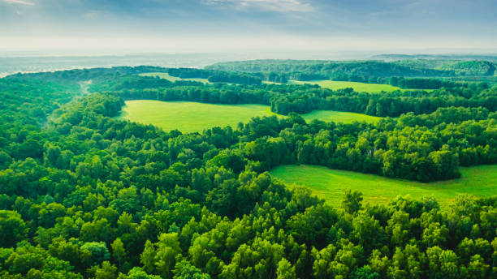
Forest Ecology Research
Ecosystem Mechanisms for Maintaining Biodiversity in Natural Forests
An Exploration of Ecological Processes Sustaining Forest Biological Diversity
2026
Ecological Science

Slide 2
Overview
Contents
01
Introduction to Forest Biodiversity
02
Structural Complexity
Global significance and conservation challenges
Habitat heterogeneity and vertical structure
03
Species Interactions
04
Disturbance Regimes
Competition, facilitation, and coexistence
Gap dynamics and succession processes
05
Belowground Processes
06
Animal-Mediated Processes
Mycorrhizal networks and nutrient cycling
Seed dispersal and keystone species
07
Latitudinal Gradients
08
Conservation Implications
Biome variation and climate adaptations
Management strategies and future directions

Slide 3
01 • Introduction
Forests as Biodiversity Reservoirs
Understanding the global significance of forests for terrestrial biodiversity conservation
Global Forest Coverage
31%
Forests cover approximately 31% of Earth's land surface, representing one of the most extensive terrestrial ecosystems. These complex biological systems harbor over 80% of terrestrial biodiversity, providing habitat for millions of species across all taxonomic groups.
Global Land Coverage
~4 billion hectares
From the towering emergent trees of tropical rainforests to the resilient conifers of boreal zones, forests create three-dimensional habitats that support intricate food webs and ecological interactions essential for planetary health.
80%
Terrestrial Biodiversity
Species habitat
The Biodiversity Challenge
Understanding the mechanisms that maintain high species diversity in natural forests remains a fundamental challenge in ecology. Unlike simplified plantation forests, natural forests sustain hundreds of tree species coexisting within the same landscape—a phenomenon that defies simple competitive exclusion principles and requires explanation through complex ecological mechanisms.
Ecosystem Services
Carbon sequestration
Water regulation
Soil protection
Climate regulation
Notes:
Conclusion: Preserving forest ecosystems requires integrated approaches combining conservation biology, sustainable forestry, and climate change mitigation strategies.

Slide 4
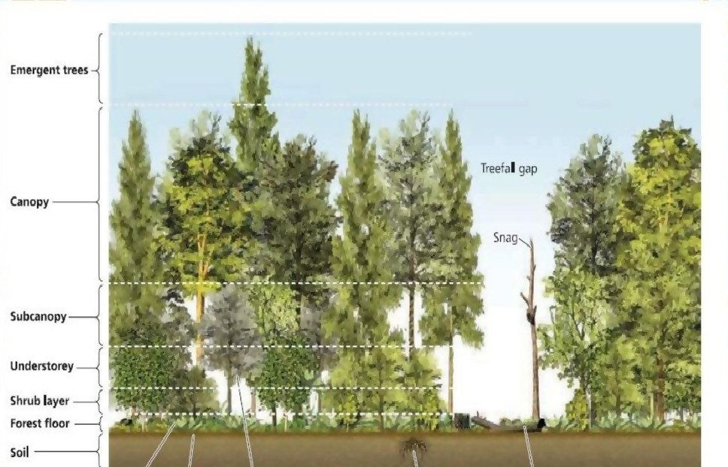
02 • Structural Complexity
The Foundation of Forest Biodiversity
How forest structural heterogeneity creates diverse habitats
Habitat-Heterogeneity Hypothesis
First proposed by MacArthur and MacArthur (1961), this foundational theory posits that increased environmental heterogeneity supports greater species diversity by creating more ecological niches. Forests with complex structures provide diverse microhabitats that accommodate species with varying ecological requirements.
"Structural complexity promotes biodiversity by increasing environmental heterogeneity, microclimate, and microhabitat variations."
Vertical Structure
Horizontal Structure
Key Structural Elements
• Emergent layer (>40m)
• Canopy gaps
• Main canopy (20-40m)
• Forest edges
Dead Wood: Critical habitat for saproxylic organisms
• Subcanopy (10-20m)
• Interior habitats
Veteran Trees: Support epiphytes and cavity nesters
• Understory (<10m)
• Stand mosaics
Canopy Gaps: Create regeneration opportunities
• Ground vegetation
• Microtopography
Bark Diversity: Various textures support epiphytes

Slide 5
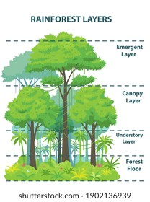
02 • Structural Complexity
Vertical Structure & Canopy Layering
Three-dimensional stratification creates distinct microclimates and niche spaces
Forest Stratification
Vertical stratification in forests creates distinct microclimates and niche spaces that support specialized communities. Each layer differs in light availability, temperature, humidity, and wind exposure—factors that determine which species can thrive.
E
Emergent Layer (>40m)
Full sun exposure, wind-resistant species, raptors
C
Canopy Layer (20-40m)
Filtered light, primary productivity zone, arboreal mammals
U
Understory (<20m)
Low light, shade-tolerant species, high humidity
Research Evidence
Foliage Height Diversity (FHD) strongly correlates with bird species richness
Vertical structural diversity explains 41.8% of variance in community stability
Simpson's Diversity Index on tree heights best differentiates forest types

Slide 6
02 • Structural Complexity
Microhabitat Heterogeneity & Niche Provision
Fine-scale habitat diversity enables species coexistence
Microhabitat Types & Their Biodiversity Value
Key Finding
Research demonstrates that microhabitat heterogeneity is a stronger predictor of species richness than microhabitat frequency alone . Natural forests contain numerous specialized microhabitats that support distinct ecological communities.
Microhabitat heterogeneity in unmanaged forests (mean = 15 types) exceeds that in managed forests (mean = 12 types), explaining higher biodiversity in natural stands.
Bark Surfaces
Dead Wood
Support epiphytic lichens, mosses, and invertebrates. Chemistry and texture determine species composition.
Critical for saproxylic beetles, fungi, and cavity-nesting birds. Decay stages create temporal niches.
Research Insights
Tree Cavities
Moist Microsites
Amphibian communities can change abruptly across microclimate gradients of only a few meters
Rot holes and woodpecker cavities provide nesting sites for birds, mammals, and insects.
Support bryophytes and moisture-dependent species. Critical in fragmented landscapes.
Old-growth stands offer higher substrate density, quality, and diversity for epiphytes
Veteran trees host unique microhabitats including rot holes and dead branches
Habitat Continuity Importance
Studies of epiphytic lichens in fragmented temperate forests reveal that spatiotemporal habitat continuity is crucial for maintaining species-rich communities. Hotspots of diversity capture substantial portions of regional species pools but require ongoing protection to ensure long-term persistence.
19
Microhabitat Types Identified
in Central European forests

Slide 8
03 • Species Interactions
Competition & Facilitation
Dual processes structuring forest communities
The Stress-Gradient Hypothesis
Research Evidence: Boreal Forest
The stress-gradient hypothesis predicts that competitive interactions decrease and facilitation increases under harsh environmental conditions . This dynamic shift shapes community assembly across environmental gradients.
Studies in Kanas boreal forest reveal that positive interactions are more common than competition for tree survival and growth:
Most intra- and interspecific interactions showed positive or no significant correlations
Favorable Conditions
Stressful Conditions
Facilitation mainly exists between individuals with different shade tolerances
Competition dominates as species vie for abundant resources
Facilitation increases as species benefit from mutual support
Negative associations less common than positive associations
Hydraulic Redistribution Example
Interaction Types in Forests
Oak species with deep taproots uptake water and release it in upper soil layers at night, providing additional water for shallow-rooted species like beech—a clear facilitation mechanism.
Competition
Negative effects on growth/survival; strongest among similar-sized trees
Facilitation
Source: Caldwell & Richards (1989); Loreau & Hector (2001)
Positive effects; nurse plants, hydraulic redistribution, microclimate buffering
Competitive Reduction
Co-regulation
Interspecific competition less than intraspecific due to niche differentiation
Competition & facilitation simultaneously influence spatial patterns

Slide 9
03 • Species Interactions
Community Assembly & Coexistence Mechanisms
How diverse species coexist in forest communities
Niche Differentiation & Resource Partitioning
Mass-Ratio Hypothesis
Species coexistence is enabled through niche differentiation —the partitioning of limited resources along multiple dimensions. This reduces competitive overlap and allows multiple species to occupy the same landscape.
Dominant species drive ecosystem processes through their traits. Species with:
Acquisitive traits: Fast carbon capture
Light
Water
Nutrients
Conservative traits: Long-term carbon sequestration
Shade-tolerant vs. shade-intolerant species partition light gradients
Deep vs. shallow rooting strategies access different soil layers
Species vary in N, P requirements and use efficiency
Diversity Effects
Temporal Partitioning
Spatial Partitioning
Complementarity Effect
Resource partitioning and facilitation enhance productivity
Phenological differences reduce competition by separating resource demands in time:
Microhabitat specialization allows species to occupy distinct physical spaces:
Selection Effect
• Early vs. late growing season activity
• Topographic preferences (ridge vs. valley)
Higher diversity increases probability of including productive species
• Different flowering and fruiting times
• Soil moisture gradients
• Seasonal leaf senescence patterns
• Distance to streams or gaps
• Staggered germination periods
• Vertical stratification niches
Phylogenetic Diversity
Stronger predictor of biomass than species richness alone

Slide 10
04 • Disturbance Regimes
Gap Dynamics & Forest Regeneration
Natural disturbances maintain diversity through regeneration opportunities
Gap-Phase Regeneration Theory
Gap Characteristics: Korean Pine Forest
First proposed by Watt (1947), the gap-phase regeneration theory explains how canopy gaps created by tree death drive forest dynamics . These gaps initiate localized succession, preventing competitive exclusion and maintaining species diversity.
18.1%
12.5%
Expanded gaps in landscape
Canopy gaps in landscape
Canopy Gap (CG)
Expanded Gap (EG)
~700 yr
20-60%
Area directly under canopy opening. Average: 52-75 m²
Includes CG plus area to surrounding tree trunks
Gap return interval
Gap diameter/canopy height
Gap Closure Timeline
Gap Formation Mechanisms
Small gaps
≥10 years
Uprooting
Large gaps
30-40 years
Creates pit-mound topography, exposes mineral soil
Gap closure occurs through lateral canopy expansion of surrounding trees and vertical growth of gap-fillers.
Stem Breakage
Leaves standing dead wood (snags), creates debris
Intermediate Disturbance
Natural Mortality
Maximizes diversity by preventing competitive exclusion
Senescence, disease, or insect damage

Slide 11
04 • Disturbance Regimes
Succession & Regeneration Dynamics
Forest development pathways maintain biodiversity over time
Successional Pathways
Diversity Maintenance
Forest succession progresses from pioneer to climax communities , with gap dynamics creating a mosaic of successional stages that supports diverse species assemblages.
Gap dynamics prevent competitive exclusion by:
Creating opportunities for pioneer species
Allowing late-successional species to reach canopy
Maintaining resource heterogeneity
Pioneer Stage
Mid-Successional
Late-Successional
Supporting species with different life histories
Fast-growing, light-demanding species colonize gaps
Intermediate shade-tolerant species establish
Shade-tolerant climax species dominate
Research Findings
Ontogenetic Strategies
Gap regeneration promotes renewal of late-successional species in secondary forests
Tree species employ different regeneration strategies based on their shade tolerance and growth patterns:
Resource heterogeneity allows early- and late-successional species to coexist
Shade-Intolerant
Shade-Tolerant
• Require full light for establishment
• Can establish under canopy
Functional traits of shade-tolerant species shift less under drought
• Fast initial growth rates
• Slow but sustained growth
• Depend on large gaps
• Survive in small gaps
• Early successional species
• Late successional species
Mosaic Structure
Multiple successional stages support higher diversity

Slide 12
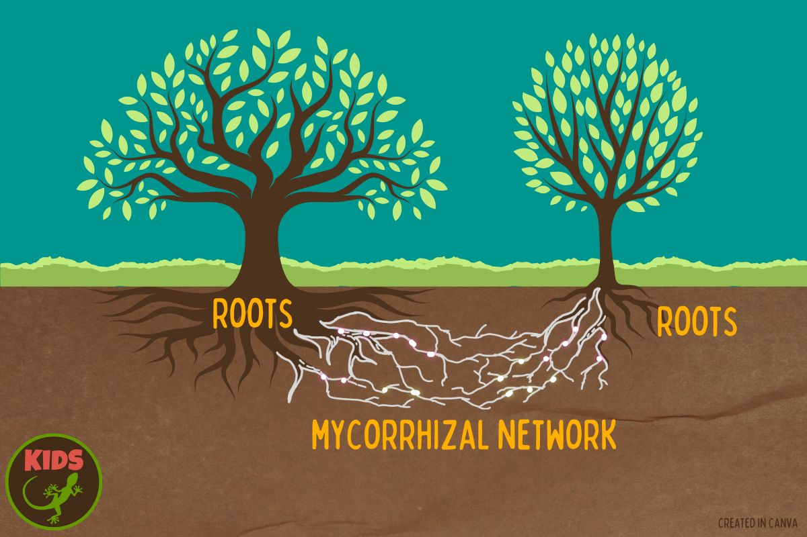
05 • Belowground Processes
Mycorrhizal Networks: The Wood Wide Web
Belowground fungal connections facilitate inter-plant communication and resource sharing
The Hidden Network
Research by Simard et al. (1997) revealed that trees communicate and share resources through mycorrhizal fungal networks —the "wood wide web." These belowground connections enable carbon and nutrient transfer between plants, fundamentally changing our understanding of forest communities.
"A more even distribution of carbon among plants as a result of belowground transfer may have implications for local interspecific interactions, maintenance of biodiversity, and therefore for ecosystem productivity, stability and sustainability."
— Simard et al. (1997)
Mycorrhizal Types
AM
Arbuscular Mycorrhizal
Most common; penetrate root cells. Associated with tropical diversity maintenance.
ECM
Ectomycorrhizal
Network Functions
Form sheath around roots; dominate temperate/boreal forests. Protect hosts from pathogens.
Carbon Transfer: Photosynthates move between trees via fungal hyphae
Pathogen Protection: ECM fungi defend host plants from soil-borne diseases
Warning Signals: Trees communicate stress and herbivore attacks
Resource Sharing: Nutrients redistributed from source to sink plants
Latitudinal Variation
AM-tropical, ECM-temperate associations explain biodiversity patterns

Slide 13
05 • Belowground Processes
Nutrient Cycling & Resource Partitioning
Biogeochemical processes support diverse forest communities
Forest Nutrient Cycling
Litter Quality Effects
Nutrient cycling is the exchange of elements between living and non-living components of ecosystems. Different tree species have varying nutrient requirements and strategies , enabling coexistence through resource partitioning.
Litter chemistry determines decomposition rates:
High-quality litter: Fast decomposition, rapid nutrient release
Low-quality litter: Slow decomposition, nutrient immobilization
Uptake
Cycling
Return
Root absorption of N, P, K from soil
Litter decomposition, mineralization
Nutrient release to soil for reuse
Microbial Diversity
Species-Specific Strategies
Biome Variation
Diverse forests support more diverse soil microbial communities, which:
Nitrogen Fixers
Tropical
Rapid cycling, low soil nutrients
Legumes enhance soil N availability for neighbors
Control nitrogen cycling rates
Phosphorus Specialists
Temperate
Moderate cycling, seasonal patterns
Enhance litter decomposition
Mycorrhizal associations improve P uptake
Increase soil fertility
Boreal
Slow cycling, high organic matter
Conservative Species
Create positive feedback loops
Slow growth, nutrient retention, high lignin litter
Climate is the primary driver of nutrient cycling rates
Key Drivers
Climate > Species composition > Soil properties

Slide 14
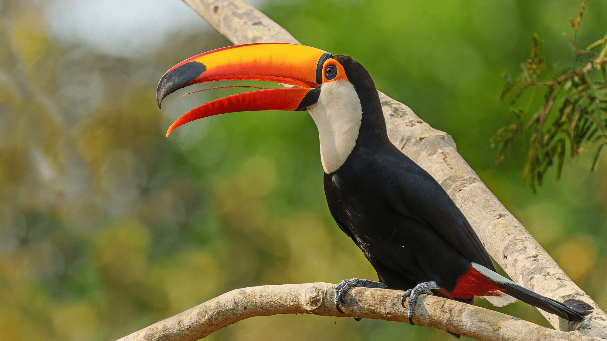
06 • Animal-Mediated Processes
Animal-Mediated Seed Dispersal
Critical role of animals in forest regeneration and diversity maintenance
The 81% Finding
Recent research reveals that 81% of tropical tree species depend on animals for seed dispersal . This mutualistic interaction is fundamental to forest dynamics, with frugivores increasing seed rain diversity and accelerating community turnover during succession.
"Without animal seed dispersal, trees have lower survival rates and a harder time keeping up with environmental changes."
— Fricke et al. (2025)
Disperser Groups
Birds
Small birds colonize early; large birds increase in older forests. Generalist species play keystone roles.
Rare-Biased Dispersal
Mammals
Generalist birds increase plant diversity through antiapostatic foraging—preferentially consuming fruits of rare species:
Flightless mammals dominate in well-preserved landscapes. Dispersal of large-seeded species critical.
Increases odds for rare species establishment
Bats
Prevents competitive exclusion by common species
Key during early succession. Decline in importance as forests mature.
Maintains diversity in regenerating communities
Carbon Connection
Seed dispersal affects forest carbon storage capacity

Slide 15
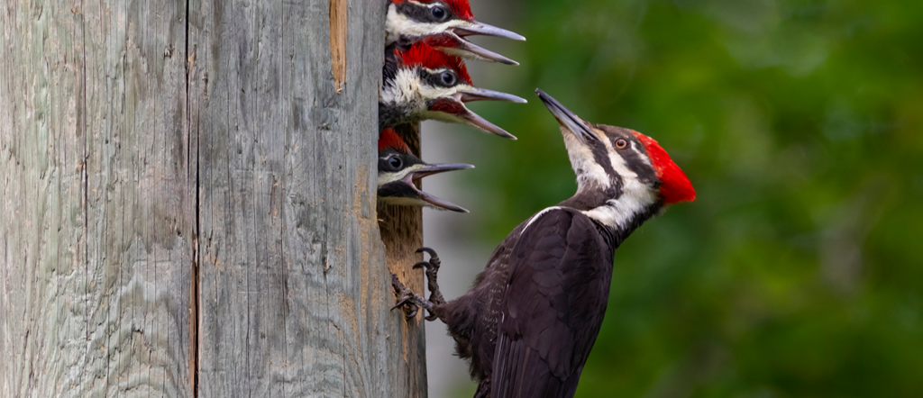
06 • Animal-Mediated Processes
Keystone Species & Ecosystem Engineers
Species with disproportionate impacts on forest biodiversity
Defining Keystone Species
Keystone species have a disproportionate impact on ecosystem structure and function relative to their abundance. Their presence or absence can cause cascading effects on community composition and ecosystem processes .
Keystone vs. Dominant
Ecosystem Engineers
Keystone: Low abundance, high impact
Dominant: High abundance, proportional impact
Species that physically modify habitats, creating resources for other species
Additional Examples
Old-Growth Trees: Support epiphytes, lichens, saproxylic organisms
Fig Trees (Ficus)
Woodpeckers
Keystone resource in tropical forests. Fruit available year-round when other foods are scarce.
Ecosystem engineers creating cavities used by birds, mammals, insects, and amphibians.
Large Mammals: Dispersers of large-seeded trees, create trails
Mutualists: Fig wasps (pollinators), fruit bats, primates, birds
Cavity users: Owls, squirrels, bats, bees
Beavers: Create wetlands, alter hydrology, increase habitat diversity
Acacia Trees: Provide specialized niches for ant mutualists
Cascading Effects
Loss of keystone species triggers community-wide changes

Slide 16
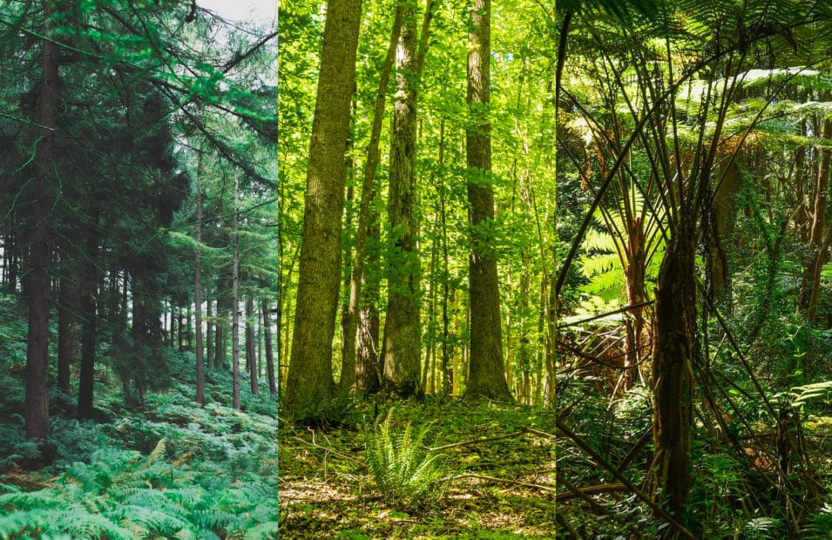
07 • Latitudinal Gradients
Tropical to Boreal: Biome Variation
Different mechanisms dominate across forest biomes
The Latitudinal Diversity Gradient
One of ecology's most consistent patterns: species diversity declines from tropics to poles . Recent research reveals that different mechanisms maintain biodiversity in tropical vs. temperate forests.
"The combination of animal seed dispersal and mycorrhizal associations underpins the negative aggregation–abundance relationship and supports biodiversity maintenance across forest biomes."
— Wang et al. (2025), Nature
Tropical
Temperate
Boreal
Dominant Mechanism:
Dominant Mechanism:
Dominant Mechanism:
Animal seed dispersal
Mycorrhizal associations
Disturbance regimes
Mycorrhizal:
Mycorrhizal:
Mycorrhizal:
Arbuscular (AM)
Ectomycorrhizal (ECM)
Ectomycorrhizal (ECM)
Diversity:
Diversity:
Diversity:
Aggregation-Abundance Relationship
Highest (>200 tree species/ha)
Moderate (10-30 species/ha)
Lowest (1-5 species/ha)
Abundant species tend to be less spatially aggregated than rare species:
Temperate: Stronger negative relationship—ECM fungi promote clustering
Tropical: Weaker relationship—animal dispersal stabilizes coexistence
Biome-Specific
Conservation must account for regional mechanisms

Slide 17
08 • Conservation Implications
Climate Change & Biodiversity Trade-offs
Emerging challenges to forest biodiversity maintenance
Climate Change Impacts
The Mitigation-Conservation Trade-off
Climate change threatens forest biodiversity through altered disturbance regimes, shifting species distributions, and changing ecosystem stability . Understanding these impacts is critical for conservation planning.
Higher climate change mitigation scenarios (RCP1.9) show more biodiversity loss than reference scenarios (RCP7.0) due to:
Increased bioenergy demand
Altered Disturbance Regimes
Intensified forest management
Increased fire frequency, extreme weather events, pest outbreaks
Habitat conversion to plantations
Range Shifts
Species migrate poleward and upslope; trailing edge populations decline
Solutions
Ecosystem Stability
Biodiversity-Conscious Management
Forest stability increases with climate predictability; low stability areas need protection priority
Can reduce global biodiversity loss by 10% with minor economic changes
Strategic Approaches
The Vicious Cycle
• Shift bioenergy production to energy crops
• Increase unmanaged secondary forest areas
Biodiversity loss and climate change form a positive feedback loop:
• Reduce management intensity
• Reallocate biomass production regionally
Biodiversity Loss
Reduced Carbon Storage
Climate Change
Integrated Solutions
Address biodiversity and climate together

Slide 18
08 • Conservation Implications
Conservation Strategies & Management
Translating ecological mechanisms into practical approaches
Ecosystem-Based Management Strategies
Protected Area Strategies
Effective forest conservation requires management approaches that maintain the ecological mechanisms sustaining biodiversity . Close-to-nature forestry and retention forestry aim to preserve structural complexity and natural processes.
Prioritize unprotected hotspots: High biodiversity + carbon areas
Manage low-stability areas: Active intervention in protected hotspots
Structural Complexity
Natural Regeneration
• Maintain vertical layering
• Promote native species
Comprehensive protection: Integrated regime for vulnerable areas
• Retain dead wood and snags
• Maintain seed sources
• Preserve veteran trees
• Protect dispersers
• Create canopy gaps
• Minimize soil disturbance
Community Engagement
Certification Schemes
Key Interventions
Community Forestry
Extended rotations: Promote structural complexity
Local stewardship and sustainable livelihoods
FSC (Forest Stewardship Council)
Environmental, social, economic standards for responsible management
Mixed-species stands: Enhance diversity
Indigenous Rights
Retention forestry: Leave habitat trees
Recognize traditional knowledge and land tenure
PEFC (Programme for Endorsement of Forest Certification)
Ecological corridors: Connect fragments
Promotes sustainable forest management through independent certification
Payment for Ecosystem Services
Compensate landowners for conservation
Nature Restoration
EU targets: 30% by 2030, 90% by 2050

Slide 19
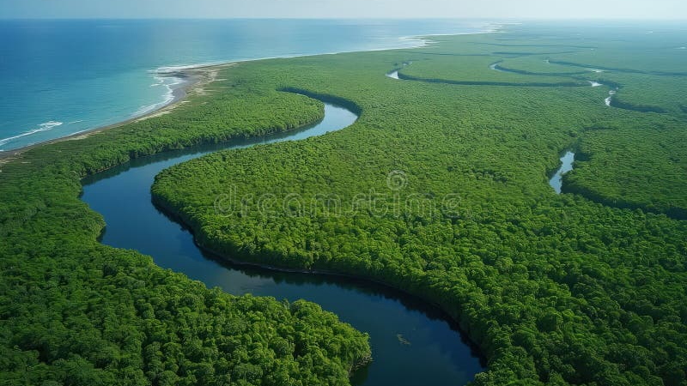
Synthesis
Integrated Mechanisms for Forest Biodiversity
Forest biodiversity emerges from the interplay of multiple mechanisms—structural complexity creates habitat diversity, species interactions enable coexistence, disturbances reset competitive hierarchies, belowground networks facilitate resource sharing, and animal-mediated processes drive regeneration.
Structure
Interactions
Dynamics
Vertical & horizontal heterogeneity
Competition, facilitation, networks
Disturbance, succession, dispersal
Understanding these integrated mechanisms is essential for effective conservation in an era of rapid environmental change. The future of forest biodiversity depends on our ability to manage ecosystems while preserving the natural processes that sustain them.

