Slide 1
FINANCIAL LECTURE SERIES
BITCOIN
THE DIGITAL REVOLUTION
A Comprehensive Analysis of History, Present & Future
March 2026
▶ 27 SLIDES

Slide 2
CONTENTS
01
THE GENESIS
02
TECHNICAL FOUNDATION
Bitcoin's Origin Story
How Bitcoin Works
03
HISTORICAL EVOLUTION
04
MARKET DYNAMICS
From Cypherpunk Dream to Global Asset
Halving Cycles & Price Patterns
05
CURRENT LANDSCAPE
06
INSTITUTIONAL ADOPTION
2024-2025 Market Status
Wall Street Embraces Bitcoin
07
MINING ECONOMICS
08
DIGITAL GOLD THESIS
The Backbone of Security
Store of Value Debate
09
SCALING SOLUTIONS
10
CHALLENGES & RISKS
Lightning Network & Layer 2
The Road Ahead
11
FUTURE OUTLOOK
12
CONCLUSION
Predictions & Scenarios
The Path Forward

Slide 3

01
THE GENESIS
Bitcoin's Origin Story
▶ From Cypherpunk Vision to Financial Revolution

Slide 4
THE BIRTH OF BITCOIN: 2008-2009
▶
October 31, 2008
★ THE MOTIVATION
Satoshi Nakamoto publishes the Bitcoin whitepaper: "Bitcoin: A Peer-to-Peer Electronic Cash System" to the cypherpunk mailing list.
2008 Financial Crisis
Bank failures, government bailouts, currency devaluation
Core Innovation: Decentralized digital currency without trusted third parties
Cypherpunk Philosophy
Privacy, decentralization, mathematical trust over institutional trust
▶
January 3, 2009
The Genesis Block is mined, marking Bitcoin network's official launch. Embedded message references bank bailouts.
Double-Spending Problem
First digital currency to solve this without central authority
"The Times 03/Jan/2009 Chancellor on brink of second bailout for banks"
▶
January 12, 2009
■ CORE PRINCIPLES
First Bitcoin transaction: Satoshi sends 10 BTC to computer scientist Hal Finney, validating the system works.
Fixed Supply: 21 Million Coins
Decentralized: No Single Point of Control
Trustless: Cryptographic Verification
Transparent: Public Blockchain Ledger
Immutable: Transactions Cannot Be Reversed
Notes:
Key talking point: The Genesis Block was mined on January 3rd, 2009, embedding a headline about bank bailouts as a political statement by Satoshi Nakamoto.

Slide 5

02
TECHNICAL FOUNDATION
How Bitcoin Works
▶ Proof of Work, Blockchain & Decentralized Consensus

Slide 6
BLOCKCHAIN & PROOF OF WORK: THE SECURITY MODEL
■ THE BLOCKCHAIN
★ NETWORK SECURITY
A distributed ledger recording all transactions across a network of computers. Each block contains a cryptographic hash of the previous block, creating an immutable chain.
Hash Rate
400M+ TH/s
880K+
~10min
1.2B+
Global computing power
Blocks Mined
Block Time
Transactions
Attack Cost
$10B+
For 1 hour 51% attack
▶ PROOF OF WORK MECHANISM
Miners compete to solve cryptographic puzzles using SHA-256 hashing. The winner adds the next block and earns the block reward.
Difficulty Adjustment
Every 2,016 Blocks
Maintains 10-min block time
The Mining Process:
1. Bundle transactions into a block
2. Find nonce making block hash < target
● WHY IT WORKS
3. First to solve broadcasts to network
Energy as Security: Massive electricity cost makes attacks economically irrational
4. Other nodes verify and add to chain
Game Theory: Miners earn more by following rules than attacking
Decentralization: Thousands of independent miners globally
Immutability: Changing history requires redoing all subsequent work

Slide 7

03
HISTORICAL EVOLUTION
From Cypherpunk Dream to Global Asset
▶ 15 Years of Price Discovery, Crashes & Resilience

Slide 8
BITCOIN'S JOURNEY: KEY MILESTONES 2009-2024
2009-2010
2011
2012
2013
THE BEGINNING
FIRST BUBBLE
FIRST HALVING
$1,000 MILESTONE
First real-world transaction: 10,000 BTC for two pizzas at $0.003/BTC
Price spikes to $31, then crashes to $2. Media declares Bitcoin dead.
Block reward drops from 50 to 25 BTC. Sets stage for next bull run.
First major bull run to $1,200. Mt. Gox becomes dominant exchange.
Price: $0.003 → $0.30
Peak: $31 | Crash: -94%
Price: $12 → $13.50
Peak: $1,242
2014-2015
2016
2017
2018-2019
MT. GOX COLLAPSE
SECOND HALVING
$20,000 PEAK
CRYPTO WINTER
Exchange hack wipes out 850K BTC. Price falls below $200. Bear market.
Block reward drops to 12.5 BTC. Ethereum launches, ICO era begins.
ICO mania drives parabolic rise. CME/CBOE futures launch. Mainstream FOMO.
80%+ crash from peak. Regulatory crackdowns. Institutional interest quietly builds.
Low: $152
Price: $650 → $960
Peak: $19,800
Low: $3,200
2020
2021
2022
2024
THIRD HALVING
$69,000 ATH
BEAR MARKET
$100K+ BREAKTHROUGH
Block reward drops to 6.25 BTC. COVID-19 triggers institutional adoption wave.
MicroStrategy, Tesla add BTC to treasury. First Bitcoin futures ETF. NFT boom.
Fed rate hikes, Terra/LUNA collapse, FTX bankruptcy. Price falls to $16K.
Fourth halving. SEC approves spot ETFs. Price breaks $100K milestone.
Price: $8,000 → $29,000
Peak: $69,000
Low: $15,600
Peak: $126,173
FOUR HALVINGS: 2012 | 2016 | 2020 | 2024
→ Each Followed by Major Bull Run

Slide 9

04
MARKET DYNAMICS
Halving Cycles & Price Patterns
▶ Programmed Scarcity Driving Market Cycles

Slide 10
THE HALVING EFFECT: PROGRAMMED SCARCITY IN ACTION
■ WHAT IS THE HALVING?
★ STOCK-TO-FLOW MODEL
Every 210,000 blocks (~4 years), Bitcoin's block reward is cut in half. This pre-programmed monetary policy reduces new supply issuance, creating supply shocks that have historically preceded major bull runs.
Bitcoin's scarcity can be measured by stock-to-flow ratio (existing supply / annual production). Higher ratios indicate greater scarcity.
Gold S2F
62
Halving Schedule & Price Performance:
2012: 50 → 25 BTC
2016: 25 → 12.5 BTC
120
+9,300%
+3,200%
Bitcoin S2F (Post-2024)
$12 → $1,100
$650 → $19,800
2020: 12.5 → 6.25 BTC
2024: 6.25 → 3.125 BTC
Silver S2F
22
+700%
IN PROGRESS
$8,800 → $69,000
$43,000 → $126K
Bitcoin is now scarcer than gold
▶ SUPPLY IMPACT
Daily New Supply
450 BTC
Down from 900 BTC pre-halving
Inflation Rate
0.85%
● THE 2024 CYCLE: WHAT'S DIFFERENT?
Down from 1.75% pre-halving
ETF Approval
Corporate Treasury
Nation-State Adoption
Total Supply Mined
First spot ETFs create institutional demand never seen before
MicroStrategy holds 714K BTC worth $54B+
El Salvador makes BTC legal tender
93.75%
~19.7M of 21M BTC in circulation

Slide 11
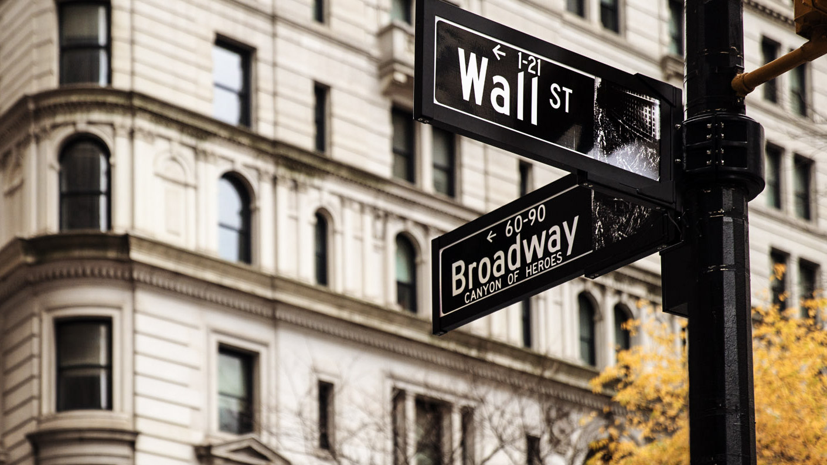
05
CURRENT LANDSCAPE
2024-2025 Market Status
▶ Institutional Adoption, ETF Success & Price Discovery

Slide 12
BITCOIN TODAY: MARKET METRICS & ADOPTION DATA
■ PRICE PERFORMANCE
★ ON-CHAIN METRICS
Current Price (Mar 2026)
All-Time High
Long-Term Holder Supply
$74,532
$126,173
62%
of BTC unmoved for 1+ year
October 6, 2025
Market Cap
24h Volume
Lightning Network Volume
$1.47T
$28.5B
$1.17B
Monthly transaction volume (Nov 2025)
Network Hash Rate
▶ INSTITUTIONAL HOLDINGS
880 EH/s
All-time high network security
Total Institutional BTC
1.4M+ BTC
~7% of circulating supply
● PERFORMANCE VS TRADITIONAL ASSETS
ETF Assets Under Management
$85B+
5-Year Returns (2020-2025):
BlackRock IBIT leads with $52B+
Bitcoin
+940%
MicroStrategy Holdings
714,644 BTC
Nasdaq 100
+110%
Cost basis: $54.4B ($76,056/BTC)
S&P 500
+80%
Gold
+25%

Slide 13

06
INSTITUTIONAL ADOPTION
Wall Street Embraces Bitcoin
▶ From Fringe Asset to Mainstream Portfolio Allocation

Slide 14
FROM FRINGE TO MAINSTREAM: INSTITUTIONAL ENTRY
▶
JANUARY 2024: THE TURNING POINT
★ THREE-PHASE ADOPTION TIMELINE
SEC approves 11 spot Bitcoin ETFs, marking the most successful ETF launch in history. This removed the final barrier for institutional capital.
1
2025-2027
$52B+
$85B+
1 Year
Pension & 401(k) Integration
Early pension fund allocations, 401(k) plans add Bitcoin ETF options, 2-5% standard allocation models
BlackRock IBIT AUM
Total ETF AUM
To Reach $50B+
2
2028-2030
■ KEY INSTITUTIONAL PLAYERS
Corporate Treasury Expansion
MicroStrategy (Strategy)
714,644 BTC
European/Asian ETFs launch, 2028 halving cuts supply, corporate treasuries follow MicroStrategy model
Pioneered corporate treasury Bitcoin strategy
$54.4B value
3
2030-2032
Tesla
11,509 BTC
Added BTC to balance sheet in 2021
~$850M value
Infrastructure Embedding
Bitcoin becomes operational infrastructure for custody, lending, trading services. Switching costs make removal prohibitively expensive.
Block (Square)
8,027 BTC
Financial services embracing Bitcoin
~$600M value
● MAJOR BANKS ENTERING
JPMorgan
Accepting BTC as collateral
Goldman Sachs
Crypto trading desk active
Morgan Stanley
Offering BTC funds to clients
SoFi
First US bank with direct crypto trading

Slide 15

07
MINING ECONOMICS
The Backbone of Security
▶ Post-Halving Profitability & Industry Consolidation

Slide 16
MINING INDUSTRY: POST-HALVING ECONOMICS
■ REVENUE MODEL
★ HASH RATE CONCENTRATION
Block Subsidy
3.125 BTC
Top 5 Mining Pools
Down from 6.25 BTC pre-2024 halving
~55%
of total network hashrate
Transaction Fees
~0.5 BTC
Foundry USA
Variable based on network congestion
~35%
Largest mining pool
Daily Network Revenue
~450 BTC
Down from 900 BTC pre-halving (~$33M/day)
Publicly Traded Miners
~25%
Marathon, Riot, CleanSpark, etc.
▶ COST STRUCTURE BREAKDOWN
● POST-HALVING REALITY
Electricity
60-80%
Breakeven Electricity Rate
$0.05-0.08/kWh
Hardware Depreciation
10-20%
For efficient ASIC miners at $75K BTC
Industry Consolidation
Facilities & Cooling
5-10%
Small miners shut down, large operations with cheap electricity dominate
3-5%
Shift to Fee Revenue
Personnel & Overhead
Miners increasingly dependent on transaction fees as subsidy declines
Renewable Energy Trend
~55% of mining uses renewable energy (hydro, wind, solar)

Slide 17

08
DIGITAL GOLD THESIS
Store of Value Debate
▶ Can Bitcoin Replace Gold as the Ultimate Store of Value?

Slide 18
BITCOIN VS GOLD: THE NEW STORE OF VALUE?
■ BITCOIN'S ADVANTAGES
★ GOLD'S ADVANTAGES
Portability
3,000+ Year Track Record
Transfer $1B across borders in minutes vs. tons of physical gold
Proven store of value across civilizations vs. Bitcoin's 16 years
Divisibility
Physical Tangibility
Divisible to 8 decimal places (0.00000001 BTC) vs. gold bars/ounces
Can hold in your hand, no internet or electricity required
Verifiability
Central Bank Demand
Cryptographic proof vs. expensive purity testing for gold
Record-high official gold purchases (1,000+ tonnes/year)
Fixed Supply
Lower Volatility
21M BTC hard cap vs. unknown total gold supply in Earth's crust
Gold's annual volatility ~15% vs. Bitcoin's ~60-80%
Programmable
Industrial & Jewelry Use
Smart contracts, multisig, time-locks vs. inert physical metal
Real utility beyond speculation (electronics, dentistry, ornament)
▶ PERFORMANCE COMPARISON
● THE INFLATION HEDGE DEBATE
5-Year Returns (2020-2025):
2022 Inflation Test
Bitcoin
+940%
U.S. inflation hit 9% (40-year high). How did assets perform?
-60%
+0.5%
Bitcoin
Gold
Gold
+25%
Key Insight
Bitcoin has shown high correlation with risk assets (tech stocks) rather than acting as a crisis hedge like gold. During the 2022 bear market, BTC crashed alongside equities while gold held steady.
Bitcoin has outperformed gold by 37x over 5 years
The Verdict
Bitcoin may become "digital gold" as it matures and volatility decreases, but it hasn't consistently fulfilled that role yet. Gold remains the proven safe haven.

Slide 19

09
SCALING SOLUTIONS
Lightning Network & Layer 2
▶ Solving Bitcoin's Throughput Limitations

Slide 20
LIGHTNING NETWORK: BITCOIN'S PAYMENT LAYER
■ THE PROBLEM
★ ADOPTION METRICS
Bitcoin Base Layer
~7 TPS
Monthly Volume
$1.17B
Transactions per second limited by block size and block time
November 2025 (River data)
Visa Network
65,000 TPS
Monthly Transactions
5.22M
Global payment network capacity
Average transaction size: ~$224
Transaction Fees
Network Capacity
5,500+ BTC
Base layer fees spike during congestion ($5-50+), making micropayments impractical
Total BTC locked in channels
Active Nodes
18,000+
▶ HOW LIGHTNING WORKS
Decentralized network participants
1. Payment Channels
Users lock BTC in multi-signature channels, enabling unlimited off-chain transactions
● REAL-WORLD USE CASES
2. Off-Chain Transactions
Payments routed through network of channels without touching base layer
El Salvador
Bitcoin legal tender using Lightning for everyday payments (coffee, groceries)
3. Settlement
Channel closes broadcast final balance to Bitcoin blockchain
Strike App
Cross-border remittances: Send USD → Receiver gets local currency, sub-cent fees
Result: Near-instant, sub-cent fees, millions of TPS capacity
Streaming & Gaming
Micropayments for content (pay-per-minute video, in-game purchases)
AI Agent Payments
Lightning Labs toolkit enables autonomous machine-to-machine transactions

Slide 21
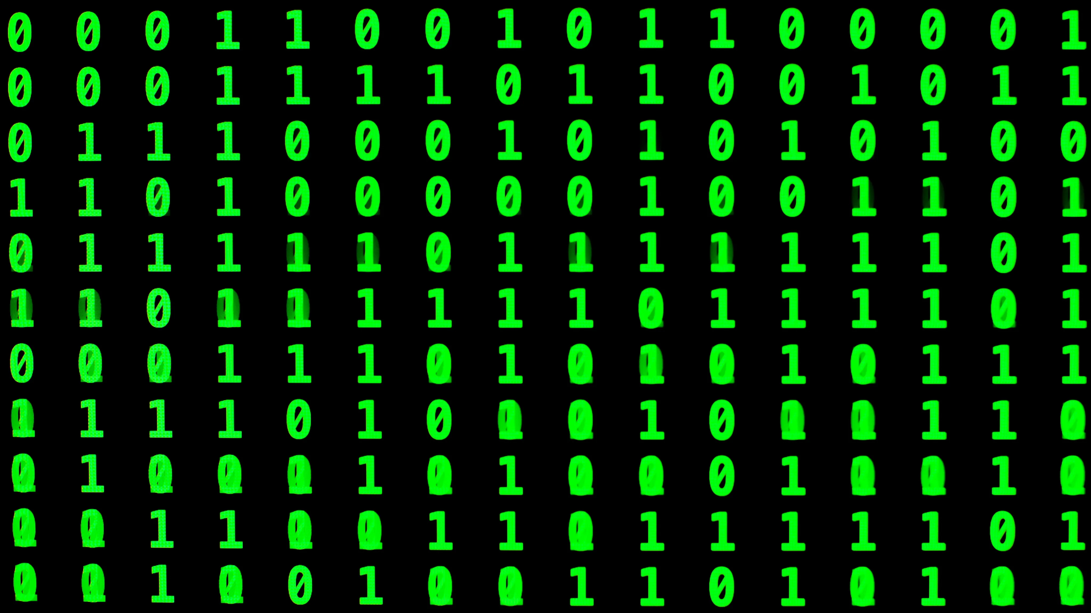
10
CHALLENGES & RISKS
The Road Ahead
▶ Obstacles Bitcoin Must Overcome

Slide 22
CRITICAL CHALLENGES: WHAT COULD GO WRONG?
▶
SCALABILITY
▶
ENVIRONMENTAL
▶
REGULATORY
Base Layer Limitations
Energy Consumption
Government Bans
~7 TPS is insufficient for global payment network. Block size debates led to Bitcoin Cash fork in 2017.
Bitcoin uses ~150 TWh/year, comparable to Argentina or Poland. Critics argue this is wasteful.
China banned mining and trading in 2021. Other countries could follow, restricting adoption.
Fee Volatility
Carbon Footprint
Taxation & Reporting
During congestion, fees spike to $5-50+, making small transactions uneconomical.
Estimated 65-70 Mt CO2/year. Coal-powered mining in some regions contributes to climate change.
Complex tax treatment. Heavy reporting requirements could deter mainstream adoption.
Mitigation
Mitigation
Mitigation
Layer 2 solutions (Lightning, sidechains) process transactions off-chain, settling on base layer.
~55% of mining uses renewable energy. Stranded energy (flared gas, hydro surplus) increasingly utilized.
Regulatory clarity emerging (US ETF approval, EU MiCA). Compliance infrastructure improving.
▶
COMPETITION
▶
CENTRALIZATION
▶
TECHNICAL RISKS
Ethereum & Smart Contracts
Mining Pool Concentration
Quantum Computing
Superior programmability, DeFi ecosystem, NFTs. ETH market cap ~$300B+.
Top 5 pools control ~55% of hashrate. Foundry USA alone has ~35%.
Future quantum computers could break SHA-256. Bitcoin would need to upgrade cryptography.
Solana & High-Speed Chains
Large Holder Influence
Protocol Bugs
65,000 TPS, sub-cent fees, growing ecosystem. Could capture payment use cases.
"Whales" with 1,000+ BTC can move markets. Satoshi's 1M BTC remains untouched.
Critical vulnerability could be exploited. 2010 inflation bug created 184 billion BTC (quickly fixed).
CBDCs
Mitigation
Mitigation
Central bank digital currencies (China's e-yuan) could compete for digital payments.
Stratum V2 protocol gives miners more control. Geographic distribution improving.
Conservative development, extensive testing, slow upgrade process minimizes risk.

Slide 23

11
FUTURE OUTLOOK
Predictions & Scenarios
▶ Expert Forecasts & Price Targets for 2025-2030

Slide 24
BITCOIN 2025-2030: EXPERT PREDICTIONS & SCENARIOS
■ INSTITUTIONAL PRICE TARGETS
★ THREE SCENARIOS
2025 Targets
$120K - $285K
B
BEAR CASE
Standard Chartered: $200K
Fundstrat: $250K
$50K - $75K
H.C. Wainwright: $225K
21st Capital: $285K
Triggers: Regulatory crackdowns, major exchange failure, prolonged recession, quantum computing breakthrough
2026 Targets
$78K - $142K
Bitcoin survives but struggles to gain mainstream traction. Volatility remains high, institutional interest wanes.
Consolidation after 2025 peak, continued ETF inflows
2030 Targets
$109K - $1.5M
B
BASE CASE
Jack Dorsey: $1M+
Cathie Wood: $1.5M
$150K - $250K
JPMorgan: $170K-266K
Conservative: $109K
Triggers: Steady ETF inflows, corporate adoption, favorable regulation, 2028 halving
Bitcoin becomes established store of value, "digital gold" thesis validated. Volatility decreases as market matures.
▶ KEY CATALYSTS
★ ETF Inflows
★ Corporate Treasury
B
BULL CASE
Continued institutional buying through regulated vehicles
More companies following MicroStrategy's Bitcoin strategy
$500K+
Triggers: US strategic Bitcoin reserve, mass corporate adoption, nation-state FOMO, dollar crisis
★ Nation-State Adoption
★ 2028 Halving
Bitcoin becomes global reserve asset, challenges gold's $16T market cap. Widespread use as savings technology.
More countries making Bitcoin legal tender or reserve asset
Next supply shock reduces new issuance to 1.5625 BTC/block
★ Favorable Regulation
★ Layer 2 Growth
Pro-crypto US administration, global regulatory clarity
Lightning Network enables everyday payments at scale

Slide 25
12
CONCLUSION
The Path Forward
▶ Key Takeaways & Final Thoughts

Slide 26
BITCOIN'S TRAJECTORY: KEY TAKEAWAYS
1
FROM EXPERIMENT TO ASSET CLASS
2
INSTITUTIONAL ADOPTION CROSSED THE RUBICON
Bitcoin has evolved from a cypherpunk experiment to a globally recognized financial asset with $1.47 trillion market cap. What started as an idea in a whitepaper is now held by institutions, corporations, and nation-states.
The January 2024 ETF approval was a watershed moment. Wall Street has embraced Bitcoin, with $85B+ in ETF AUM, corporate treasury strategies, and major banks offering crypto services. This genie cannot be put back in the bottle.
3
HALVING CYCLES CREATE PREDICTABLE PATTERNS
4
CHALLENGES REMAIN, BUT SOLUTIONS EMERGE
The programmed scarcity mechanism has historically preceded major bull runs. The 2024 halving reduced daily new supply to 450 BTC (0.85% inflation), setting the stage for the next supply-demand imbalance.
Scalability, energy consumption, and regulation are real challenges. However, Layer 2 solutions (Lightning Network), renewable energy adoption (~55% of mining), and regulatory clarity are addressing these issues.
5
"DIGITAL GOLD" STILL EVOLVING
6
2024-2030: THE CRITICAL DECADE
Bitcoin's scarcity and decentralization provide unique value, but it hasn't consistently acted as a crisis hedge like gold. As the asset matures and volatility decreases, the digital gold thesis may be validated—or Bitcoin may carve out a different role.
The next 6 years will determine Bitcoin's long-term trajectory. ETF adoption, corporate treasuries, nation-state accumulation, and the 2028 halving could propel Bitcoin to $150K-$500K+ or higher. The foundation is being laid for mainstream integration.
THE BOTTOM LINE
2026-2030
WILL DEFINE
THE FUTURE
Bitcoin represents both transformative potential (decentralized, scarce, borderless money) and significant risks (volatility, regulation, competition). Approach with understanding of both.

Slide 27
THANK YOU
Questions & Discussion
In a world of infinite money printing,
can a fixed-supply digital asset
become the ultimate store of value?
▶ Bitcoin: The Digital Revolution | March 2026

