Slide 1
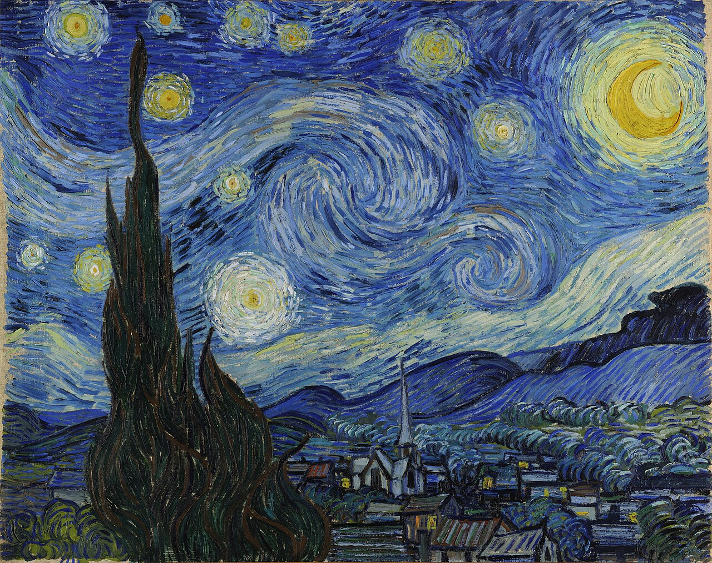
Art History Lecture
Vincent van Gogh:
A Life of Passionand Color
Exploring the Art, Struggles, and Legacy of a Post-Impressionist Master
1853 - 1890
860+ Oil Paintings

Slide 2
Lecture Overview
Contents
01
Early Life and Artistic Beginnings
02
The Evolution of Style
The journey from a troubled youth to a passionate artist
From dark realism to vibrant expression across five periods
03
Masterpieces That Define an Era
04
Mental Health and the Price of Genius
Iconic works that continue to captivate the world
The complex relationship between creativity and struggle
05
The Unbreakable Bond
06
Enduring Legacy and Influence
Vincent and Theo: A brotherhood that sustained genius
From obscurity to becoming one of history's most celebrated artists

Slide 3
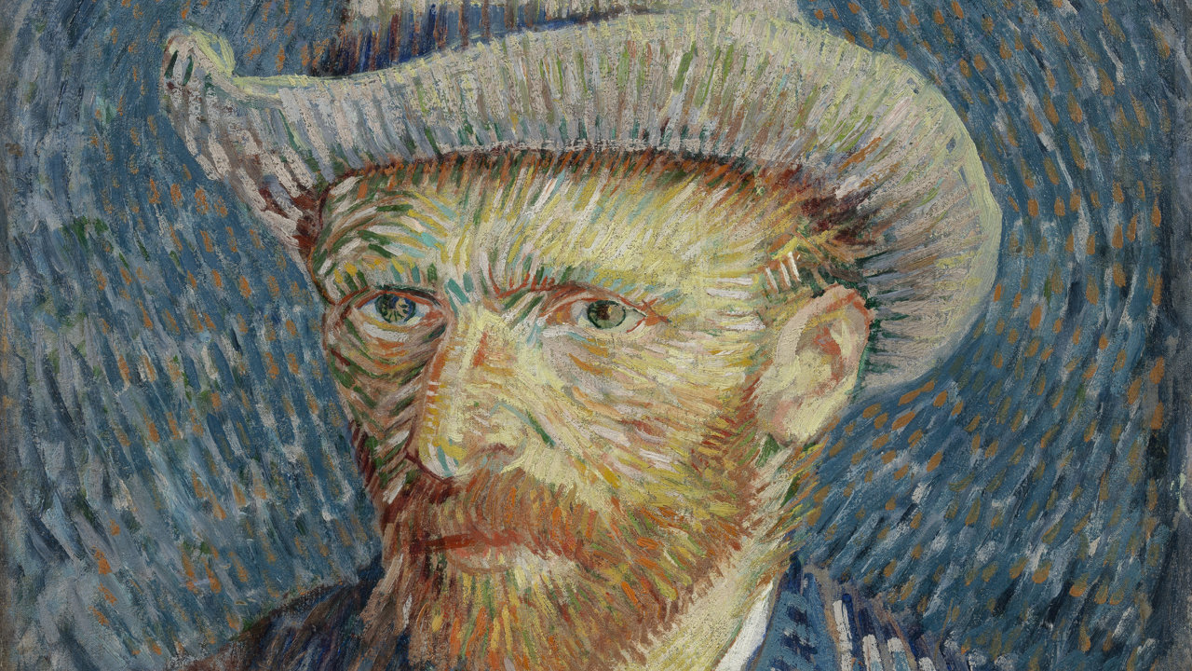
01
Early Life and
Artistic Beginnings
The journey from a troubled youth to a passionate artist

Slide 4
Chapter 01
From Zundert to the Canvas
Birth and Childhood
Key Timeline
March 30, 1853 — Vincent Willem van Gogh was born in Zundert, Netherlands. His childhood was marked by tragedy: a stillborn brother, also named Vincent, had been buried exactly one year earlier at the same church. This ghostly namesake haunted him throughout his life, contributing to his sense of being a replacement child.
1853
Born in Zundert, Netherlands
1869
Begins work as art dealer
1879
Dismissed as preacher
Career Struggles
1880
Commits to art at age 27
Before becoming an artist, Van Gogh tried multiple careers: art dealer at Goupil & Cie (The Hague, London, Paris), teacher in England, and preacher among poor miners in Belgium. Each attempt ended in failure or dismissal, deepening his sense of isolation and purposelessness.
The Turning Point
"I am seeking, I am striving, I am in it with all my heart."
1880, Age 27 — After years of wandering and despair, Van Gogh finally committed himself to art. This late start meant he had only ten years to create his entire body of work, making his subsequent productivity all the more remarkable.
— Vincent van Gogh

Slide 5
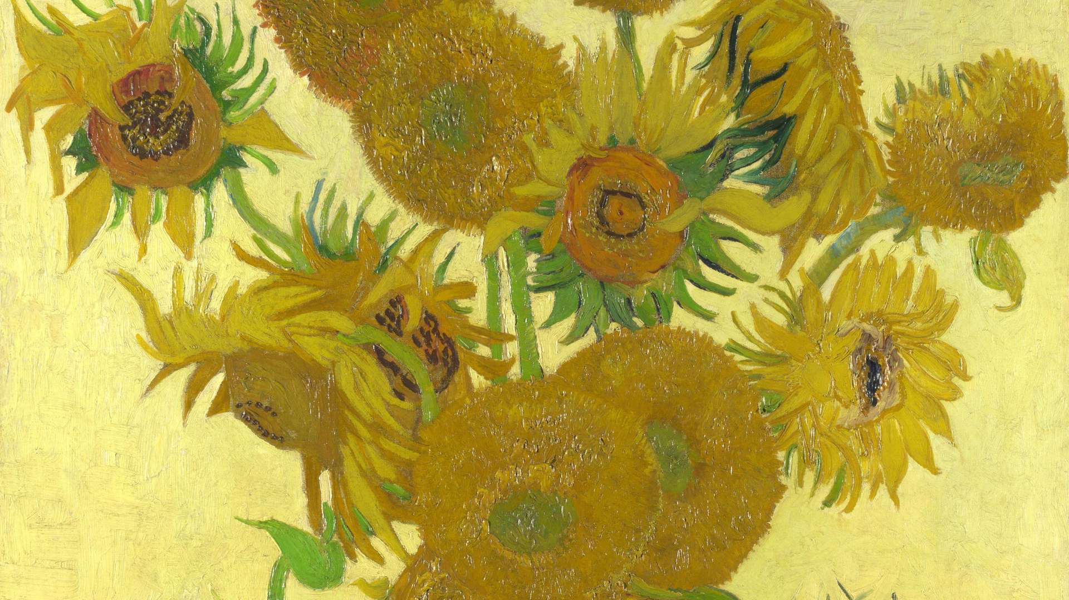
02
The Evolution
of Style
A decade of transformation across five distinct artistic periods

Slide 6
Chapter 02
Five Periods of Artistic Revolution
The Hague / Nuenen
1880-1886
Paris Period
1886-1888
Van Gogh's early period was characterized by dark, earthy tones and a focus on peasant life. Influenced by Dutch Realism and artists like Millet, he depicted the harsh realities of rural existence with rough textures and somber colors.
Moving to Paris transformed his palette. Through brother Theo, he met Impressionists like Pissarro, Degas, and Seurat, embracing brighter colors, broken brushwork, and the influence of Japanese ukiyo-e prints.
Masterpiece:
Key Development:
The Potato Eaters (1885)
Discovery of pure color
Dark Earth Palette
Bright Impressionist Palette
Arles Period
1888-1889
Saint-Rémy
1889-1890
Seeking the "Japanese" light of the South, Van Gogh created his most iconic works. The intense Provençal sun pushed his colors to pure saturation, developing his signature bold brushwork and emotional expression.
During his asylum stay, Van Gogh painted over 150 works in one year. Confined but prolific, he created swirling, visionary masterpieces that channeled his inner turmoil into transcendent beauty.
Masterpieces:
Masterpiece:
Sunflowers, The Bedroom
The Starry Night (1889)
Pure Color Expression
Visionary Palette
Auvers-sur-Oise Period
In his final two months, Van Gogh produced 70+ paintings with urgent, dramatic brushwork. Works like "Wheatfield with Crows" show heightened emotional intensity and a sense of impending tragedy.
1890 • Final Months
Notes:
Art historians consider Starry Night, painted during Van Gogh's time at Saint-Remy asylum in June 1889, as one of the most recognized paintings in Western culture.

Slide 7
Chapter 02
Signature Techniques: Impasto and Expressive Brushwork
The Impasto Technique
Color Theory Mastery
Van Gogh revolutionized painting with impasto—applying paint so thickly that brush or palette knife strokes remain visible, creating a textured, three-dimensional surface. This technique transformed paint from mere color into physical matter with its own presence.
Van Gogh used complementary colors (blue-orange, yellow-purple, red-green) in bold contrasts to create visual vibration and emotional intensity. He painted not what he saw, but what he felt.
Technical Characteristics:
• Paint applied straight from tubes without pre-mixing
Blue/Yellow
Red/Cyan
Brown/Sky
• Thick ridges and valleys catch light dynamically
• Creates tactile, sculptural quality on canvas
Philosophy:
• Enhances emotional intensity through physical texture
"Color expresses something in itself... I use color arbitrarily to express myself more forcefully."
Directional Brushwork
Japanese Influence
His brushstrokes follow the form of what he painted—radiating like sunlight, undulating like earth, swirling like wind. This creates visual movement that makes static paintings feel alive with energy.
Van Gogh collected hundreds of ukiyo-e woodblock prints, which influenced his use of bold outlines, flat areas of color, cropped compositions, and decorative patterning—liberating him from Western academic conventions.

Slide 8
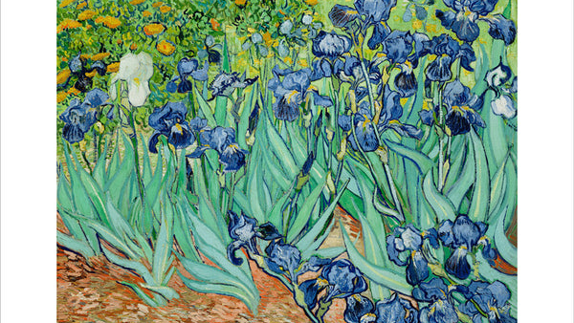
03
Masterpieces That
Define an Era
Iconic works that continue to captivate the world

Slide 9
Chapter 03 • Masterpiece Analysis
The Starry Night: A Visionary Masterpiece
A View from the Asylum
Painted during his stay at Saint-Paul-de-Mausole asylum in Saint-Rémy-de-Provence, "The Starry Night" depicts the view from his bedroom window just before sunrise. However, Van Gogh painted this masterpiece from memory during the day, transforming observation into visionary experience.
The painting represents both his inner turmoil and his transcendent hope—the swirling chaos of the sky contrasted with the peaceful village below, suggesting that even in madness, beauty and meaning can be found.
Scientific Revelation
In 2006, scientists analyzing the painting's swirling patterns discovered something remarkable: Van Gogh's turbulent brushstrokes accurately depict the physics of fluid turbulence—mathematical patterns that scientists wouldn't fully understand until decades after his death.
Key Insight:
The spiral patterns in "The Starry Night" follow Kolmogorov's theory of turbulence, showing Van Gogh's intuitive grasp of natural phenomena that science would later formalize.
Painting Details
Year
Medium
"This morning I saw the countryside from my window a long time before sunrise, with nothing but the morning star, which looked very big."
June 1889
Oil on canvas
Dimensions
Location
— Letter to Theo, June 1889
73.7 × 92.1 cm
MoMA, New York

Slide 10
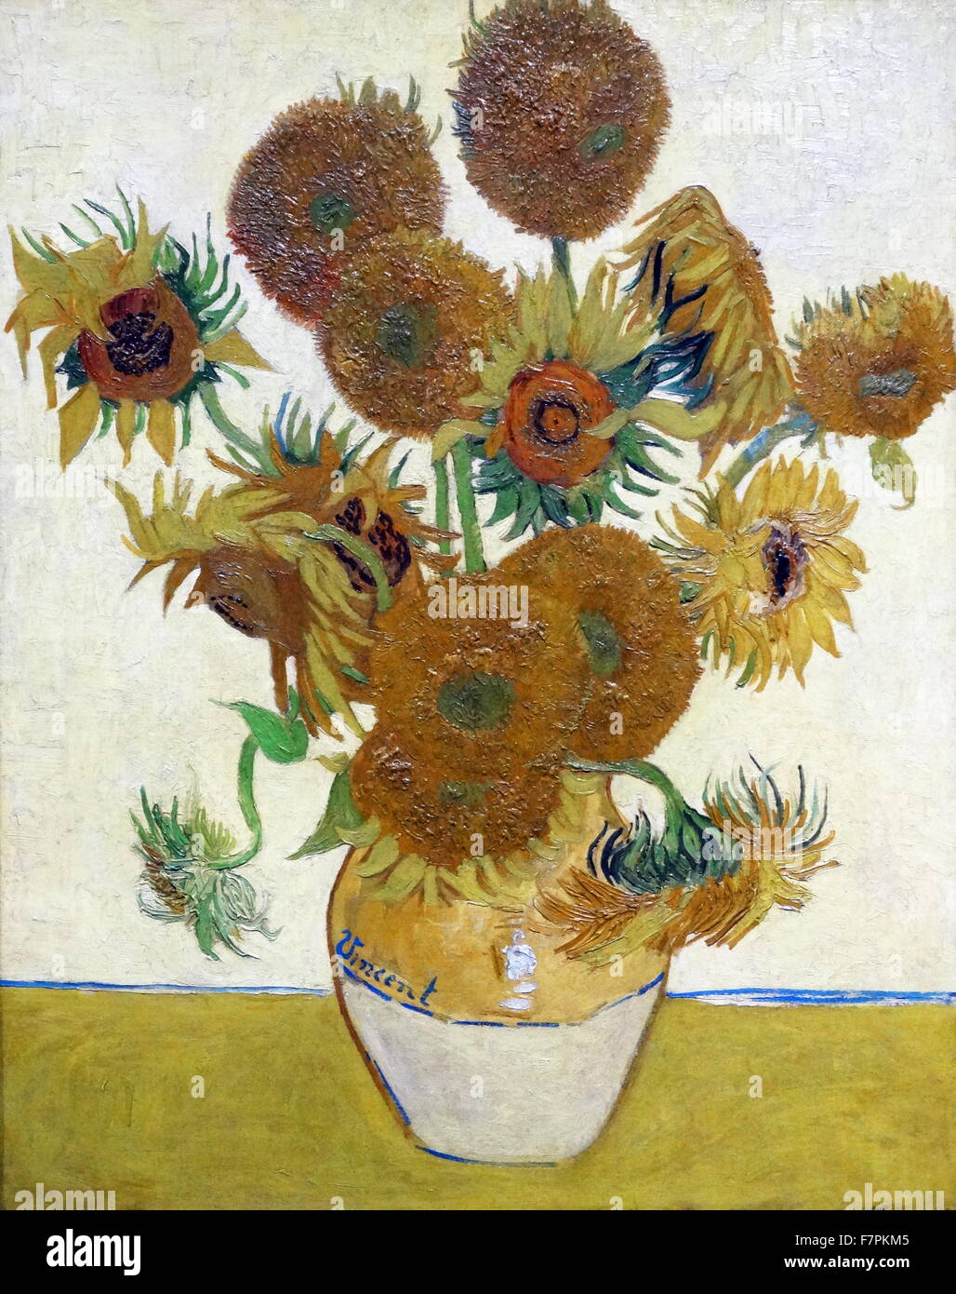
Chapter 03 • Masterpiece Analysis
Sunflowers: The Celebration of Color and Light
A Series of Joy
Van Gogh painted five versions of sunflowers in Arles between 1888-1889, using only three shades of yellow and nothing else. This deliberate limitation was an artistic challenge—to create variety and depth using a single color family.
The flowers represent gratitude and friendship. Van Gogh painted them to decorate the room where his friend Paul Gauguin would stay, hoping to create an artist's colony in the Yellow House. The series embodies his search for joy and connection.
Color as Emotion
The vibrant yellows were revolutionary. Van Gogh used newly developed chrome yellow pigments that were more intense than any previously available. The thick impasto technique makes the petals feel almost three-dimensional, as if reaching toward the viewer.
Symbolic Meaning:
Sunflowers follow the sun—turning their faces toward light. For Van Gogh, they represented faith, adoration, and the pursuit of light even in darkness.
"The sunflower is mine, in a way."
— Vincent van Gogh
Series Overview
Versions Painted
5 major versions
Time Period
1888-1889
Primary Color
Chrome Yellow
Current Value
$100+ million

Slide 11
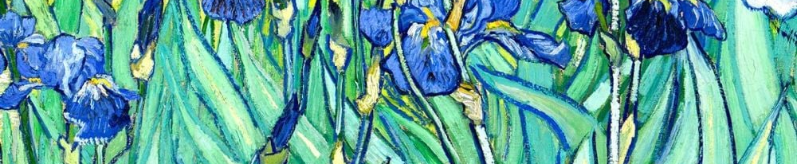
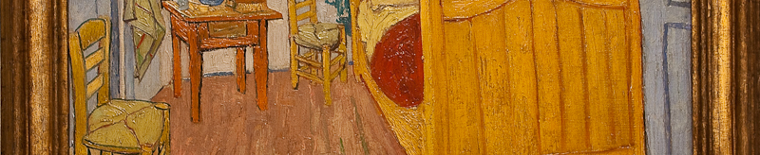
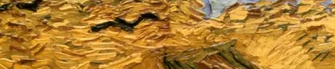
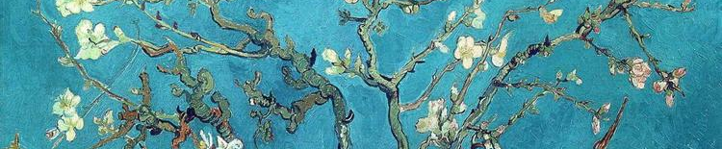
Chapter 03
Other Iconic Works: From Irises to Wheatfields
Irises
1889
The Bedroom
1888
Painted in the asylum garden, this work showcases Van Gogh's study of color with vibrant blues and greens. Originally the irises were purple, but the pigment faded over time to cobalt blue.
A glimpse into Van Gogh's personal space in Arles, featuring distorted perspective and bold colors. The painting reflects his desire for tranquility and simplicity.
Location: Getty Center, Los Angeles
Location: Van Gogh Museum, Amsterdam
Wheatfield with Crows
1890
Almond Blossom
1890
Often considered his final painting, this work shows menacing skies, dark crows, and a dead-end path—interpreted as expressing his emotional turmoil and foreshadowing his death.
Painted as a gift for his newborn nephew, this work shows delicate branches against turquoise sky. It represents new life and hope, heavily influenced by Japanese prints.
Location: Van Gogh Museum, Amsterdam
Location: Van Gogh Museum, Amsterdam

Slide 12
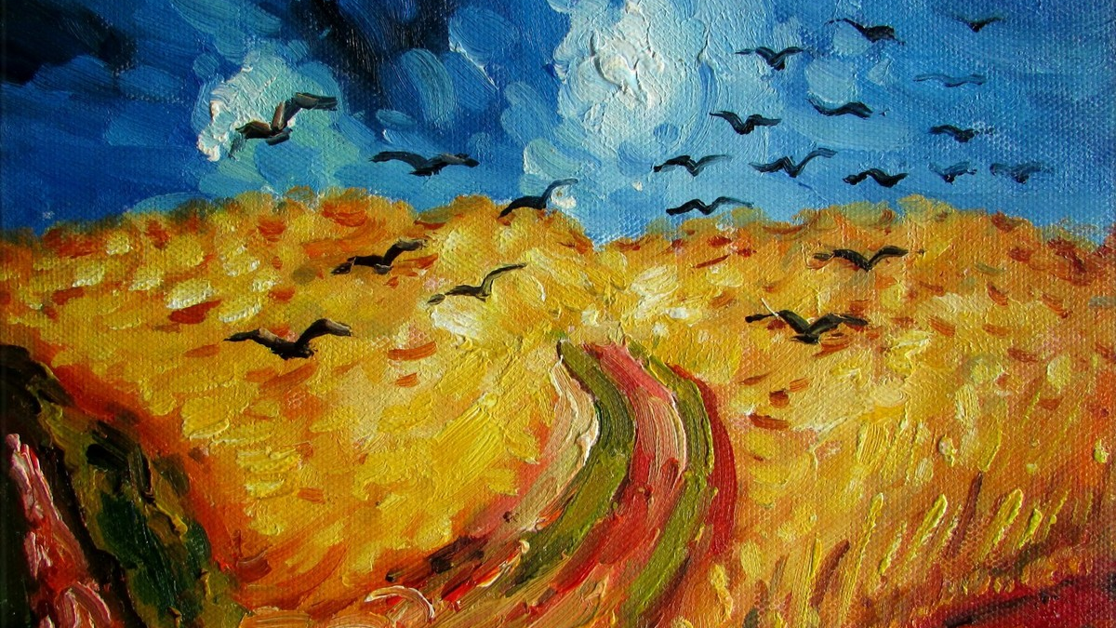
04
Mental Health and
the Price of Genius
The complex relationship between creativity and psychological struggle

Slide 13
Chapter 04
The Struggle Within: Mental Health and Artistic Creation
Possible Diagnoses
The Ear Incident
Modern psychiatrists have proposed various diagnoses for Van Gogh's condition, though no consensus exists. The leading theories include:
December 23, 1888 — After a heated argument with Paul Gauguin in Arles, Van Gogh suffered a severe mental breakdown. He severed part of his left ear with a razor, wrapped it in paper, and delivered it to a woman at a nearby brothel.
Bipolar Disorder
The incident marked a turning point. Gauguin left Arles permanently, and Van Gogh was hospitalized. The exact circumstances remain debated—some theories suggest Gauguin may have been involved, while others attribute it solely to Van Gogh's psychosis.
Cycles of intense creativity and deep depression match his productive patterns
Temporal Lobe Epilepsy
Could explain his religious fervor, altered perceptions, and aura experiences
Aftermath:
Schizophrenia
Van Gogh painted "Self-Portrait with Bandaged Ear" (1889) as both documentation and artistic transformation of trauma.
His psychotic episodes, paranoia, and hallucinations support this theory
Asylum Productivity
The Paradox of Creativity
Paradoxically, his time at Saint-Rémy was one of his most productive periods. Despite confinement and mental anguish, he created over 150 works in one year, including "The Starry Night" and "Irises." His art became both therapy and transcendence.
Van Gogh's mental illness both tormented him and fueled his art. His suffering gave him unique vision, while his art provided temporary relief from suffering. This complex relationship between madness and genius continues to fascinate scholars and artists today.

Slide 14
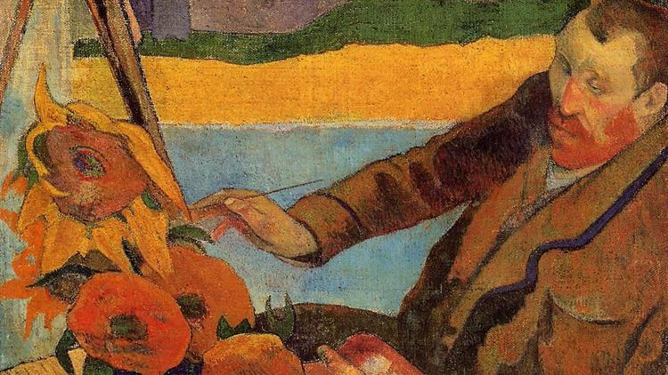
05
The Unbreakable
Bond: Vincent and Theo
A brotherhood that sustained an artistic genius

Slide 15
Chapter 05
Theo van Gogh: The Brother Behind the Artist
600+ Letters: A Lifelong Dialogue
Vincent and Theo maintained an extraordinary correspondence throughout their lives. These 600+ letters provide unparalleled insight into Vincent's artistic process, philosophical thoughts, daily struggles, and emotional states.
A Tragic End
The bond between the brothers was so profound that Theo's health declined rapidly after Vincent's death. Just six months later, on January 25, 1891, Theo died at age 33, likely from complications of syphilis and dementia paralytica.
The letters reveal Vincent's theories on color, his admiration for other artists, his religious doubts, his mental health battles, and his unwavering commitment to art. They form one of the most important documents in art history.
Theo was buried in Utrecht, but in 1914, his remains were exhumed and reinterred beside Vincent's grave in Auvers-sur-Oise, fulfilling their wish to be together in death as they were in life.
Historical Value:
Published as "The Letters of Vincent van Gogh," these documents are essential reading for understanding his life and work.
Jo van Gogh-Bonger's Role:
Theo's widow Johanna dedicated her life to promoting Vincent's work, organizing exhibitions and publishing his letters, ensuring his posthumous recognition.
Financial and Emotional Support
Theo, an art dealer at Goupil & Cie in Paris, provided Vincent with monthly financial support throughout his career—approximately 150 francs per month, enough for basic living expenses and art supplies. Without this support, Vincent could not have devoted himself fully to painting.
Theo's Legacy
Enabled Vincent to create 860+ paintings
Beyond money, Theo offered unwavering emotional encouragement. He believed in Vincent's talent when no one else did, defended him against critics, and promoted his work to galleries and collectors, though with little success during Vincent's lifetime.
Preserved Vincent's letters and artworks
Laid foundation for Van Gogh Museum (1973)
Symbol of artistic patronage and brotherly love

Slide 16
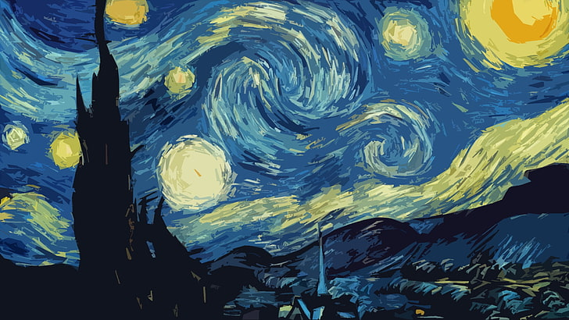
06
Enduring Legacy
and Influence
From obscurity to becoming one of history's most celebrated artists

Slide 17
Chapter 06
Posthumous Recognition and Global Impact
From Obscurity to Fame
Market Value Today
During his lifetime, Van Gogh sold only one painting—"The Red Vineyard" (1890), purchased by Belgian artist Anna Boch for 400 francs. He died in poverty and relative obscurity, considered a madman and failure by most.
Van Gogh's works now command some of the highest prices in the art market:
Portrait of Dr. Gachet (1990)
$82.5 million
After his death, Theo and later Theo's widow Johanna van Gogh-Bonger worked tirelessly to promote his work. Johanna organized exhibitions across Europe, published his letters, and built relationships with collectors and critics who gradually recognized his genius.
Held record for most expensive painting for 16 years
Irises (1987)
$53.9 million
Set record at the time; now worth $100+ million
Turning Point:
Sunflowers (private sale)
$100+ million
A 1901 retrospective in Paris brought Van Gogh to the attention of the avant-garde, sparking his posthumous rise to fame.
Estimated value if sold today
The dramatic contrast between his poverty in life and the value of his work today symbolizes the tragedy of unrecognized genius.
Van Gogh Museum
Established in 1973 in Amsterdam's Museumplein, the Van Gogh Museum houses the world's largest collection of his works—over 200 paintings, 500 drawings, and 700 letters.
Global Recognition
The museum, founded by Vincent's nephew Vincent Willem van Gogh, attracts 2+ million visitors annually, making it one of the world's most popular art museums and a testament to his enduring appeal.
Van Gogh is now one of the most recognized artists worldwide. His works are housed in major museums across the globe, from the MoMA in New York to the Musée d'Orsay in Paris, attracting millions of admirers annually.

Slide 18
Chapter 06
Inspiring Generations: Van Gogh's Artistic Descendants
German Expressionism
Fauvism
Symbolism
Artists of Die Brücke (The Bridge) and Der Blaue Reiter (The Blue Rider) movements saw Van Gogh as their spiritual predecessor. Ernst Ludwig Kirchner, Erich Heckel, and Karl Schmidt-Rottluff adopted his raw emotional intensity, bold colors, and distorted forms.
The Fauves—Henri Matisse, André Derain, Maurice de Vlaminck—pushed Van Gogh's chromatic freedom even further. They liberated color from descriptive representation, using pure, saturated hues for emotional impact, directly following Van Gogh's example.
Symbolist artists found in Van Gogh's landscapes and night skies a visual translation of spiritual and emotional states. His ability to imbue nature with psychological meaning resonated with their desire to express the ineffable.
Key Influence:
Van Gogh's use of color to express inner states became central to Expressionist philosophy
Key Influence:
Key Influence:
Van Gogh's arbitrary color choices validated their wild palette
Van Gogh's symbolic use of cypresses, stars, and wheatfields
Individual Artists
Edvard Munch
Wassily Kandinsky
Continuing Influence
Adopted emotional line and psychological intensity
Drew from Van Gogh's color symbolism toward abstraction
Van Gogh's influence extends into contemporary art, street art, and popular culture. His techniques, color theories, and emotional approach continue to inspire artists worldwide, proving that his vision transcends time and movements.
Francis Bacon
Jackson Pollock
Inspired by Van Gogh's emotional rawness and distortion
Abstract expressionism echoes Van Gogh's gestural energy

Slide 19
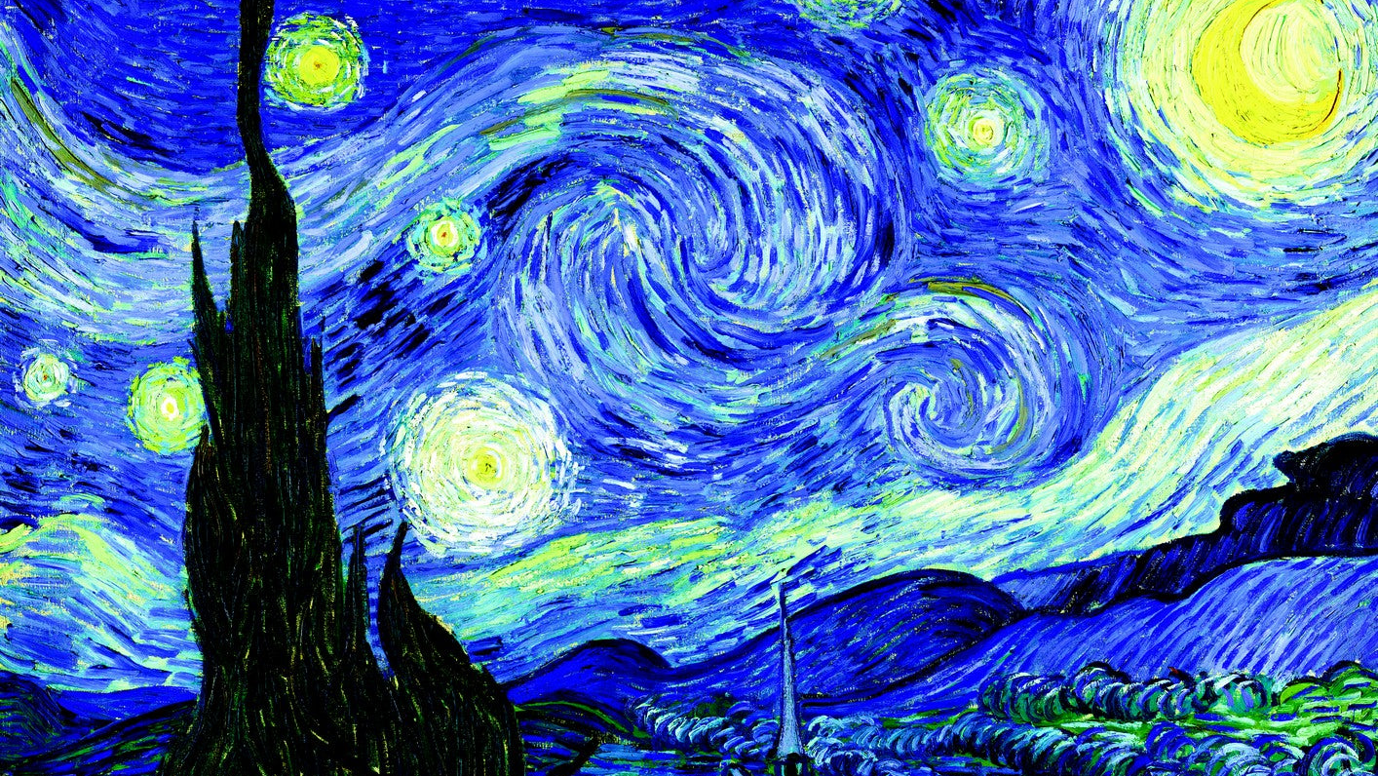
The Eternal
Starry Night
Vincent van Gogh's life reminds us that true artistic genius often comes with great personal cost. His ability to transform pain into beauty, isolation into connection, and madness into masterpieces continues to inspire millions worldwide.
As he once wrote to Theo:
"What would life be if we had no courage to attempt anything?"
— Vincent van Gogh
860+ Paintings
134 Years of Inspiration
Eternal Legacy

