Slide 1

DS-UA 112 Introduction to Data Science
Final Exam Review
Notes:
DEMO POSTED BEFORE CLASS WITH DEPENDENCIES
SLIDES POSTED AFTER CLASS WITH ANNOTATIONS
PIAZZA LOG ON
VOLUME (NO FEEDBACK)
ZOOM
REFERENCE DON’T REVIEW WITH EMPHASIS ON ASSIGNMENTS

Slide 2
Announcements
The exam will be open note and open textbook. However you cannot use search engines.
You can access the exam on Gradescope
The exam will be available for 24 hours starting 6:00PM EST on Wednesday May 13
You have a 120 minute time limit.
The exam focuses on the second half of the semester. Questions will involve true/false, multiple choice, short answer and calculations

Slide 3

Agenda
Review
Week 9 through Week 15
Case Study
Notes:
5 MINUTES + DELAYS
(<4:58 PM)

Slide 4
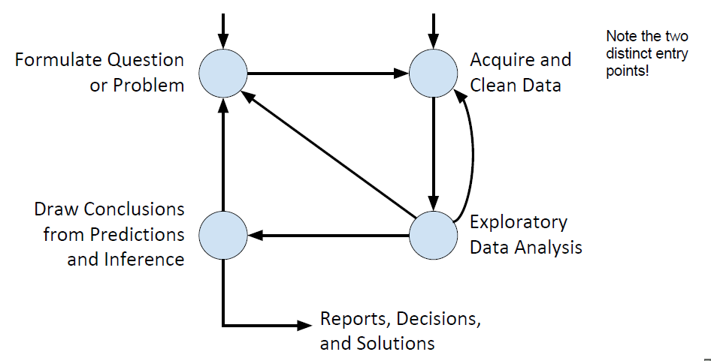
Steps for Data Science
Formulate
Process
Predict
Visualize
Evaluate
Notes:
5 minutes
study different approaches to data science
Similarity:
empower to solve problems with data in different fields humanities sciences
enable to purse opportunities in growing field
prepare courses in undergraduate
Difference:
CSCI 2/3/101 or DSE
programming
point of programming is not numbers
connect questions and answers through information determined from data
goals of class:
fairness, equality/equity, diversity, privacy
digital world everywhere – growing changing what’s possible for research
check it out 121 Meyer Mon Wed 4:55-6:10
take a look at HW1
tricky consider taking another semester

Slide 5
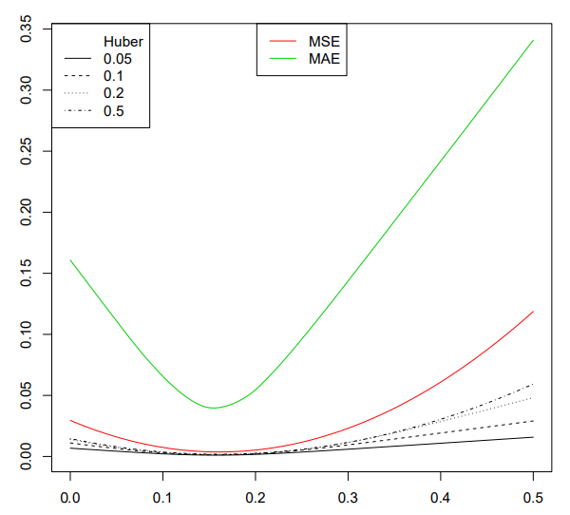
Loss Functions
The mean square error has derivatives at all values of the function. Derivatives are helpful for finding minimum values.
However, the mean square error has large output for large input. The function is not robust to outliers
While the mean absolute error has a tricky derivative, the function does not have the same problem with outliers
Huber Loss combines benefits of both loss functions
Notes:
Huber Loss has minimum value at the median of the data
However we can split up the summation in the loss function to make the calculation easier

Slide 6

Risk
For example the square loss is L(θ, X) = (θ - X)²
Suppose we have a loss function L depending on dataset x_{1,…,}x_{n} and unknown quantity θ
For fixed value of θ, we can compare the value of L(θ, x₁,…,x_{n}) across different datasets
We can take the datasets to correspond to different values of a random variable. If we repeatedly observe n values of a random variable X, then we can compute L(θ, x₁,…,x_{n}) for each dataset
Risk is the expectation of a loss function for random variable
E[L(θ, X)]
We need to know the probability distribution of X to compute the expectation.
If we can compute the expectation, then we better understand the value of the loss function across different random samples

Slide 7
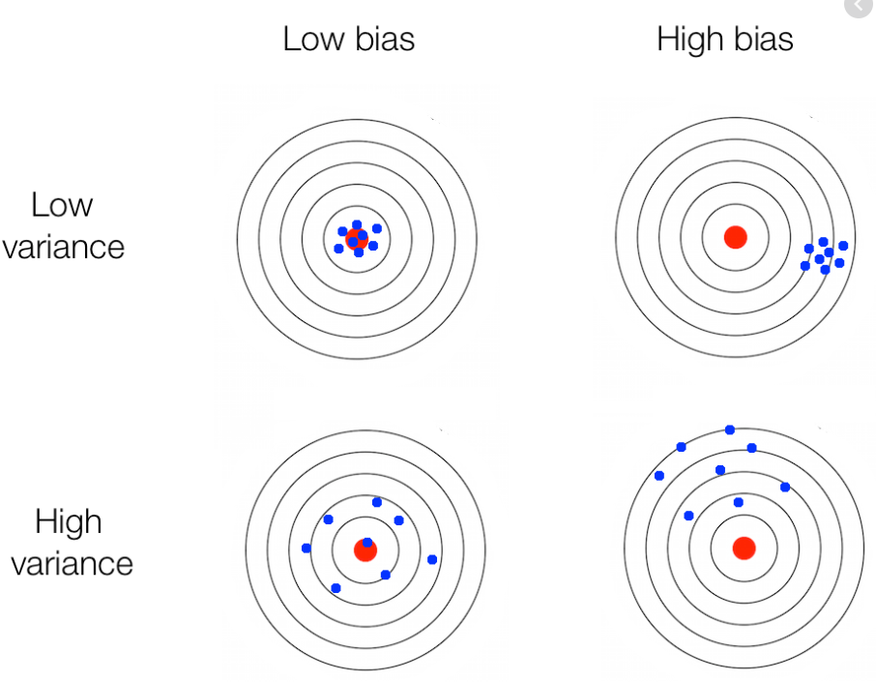
Bias and Variance
We want to choose θ to make E[L(θ, X)] small. The choice of θ that makes the expectation smallest is $\hat{θ}$. We can write $\hat{θ}$_{n} to remind us that the estimate from n samples.
For the square loss, we can break the risk into two components
Bias measuring the accuracy of the estimator
Variance measuring the consistency of the estimator
Here bias does not refer to a property of data but to a tendency of estimators

Slide 8
Correlation
Correlation measures the concentration around a line in a scatter-plot of the independent and dependent variables.
Correlation is a number between -1 and 1. Around 1 or -1 we have strong positive or negative correlation. Around 0 we have no correlation.
Correlation measures association between variables. We cannot measure causation.

Slide 9
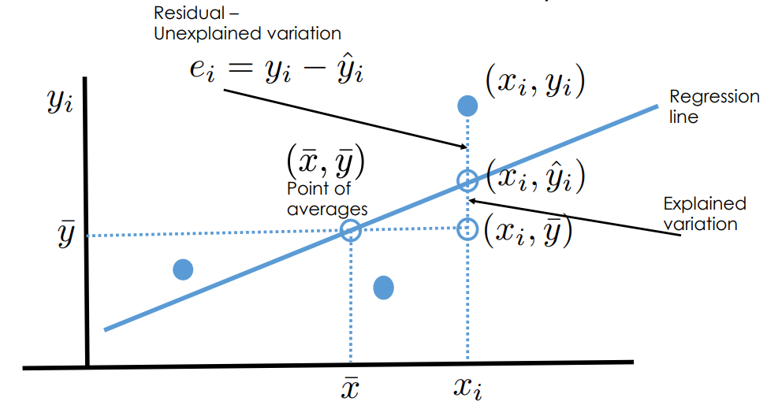
Linear Regression

Slide 10
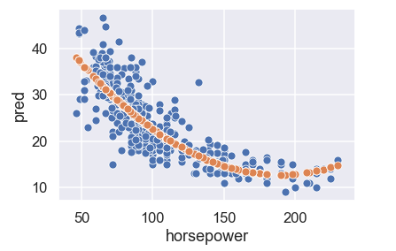
Polynomial Transformations
If we replace an independent variable x with powers 1,x,x²,x³,… then we have a polynomial transformation
If we have multiple independent variables then we can multiply them to model interactions between the features.

Slide 11
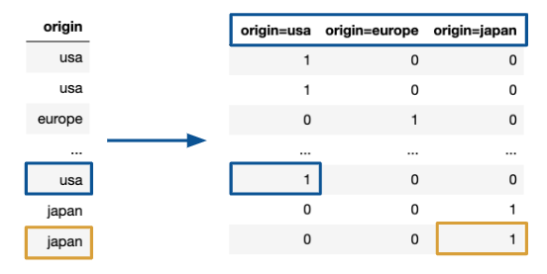
One-Hot Encoding
If we have qualitative data, then we must transform it to quantitative data. However we should be careful with the encoding of the categories.
We can add another independent variable for each category. The additional variables take the value 0 or 1. We call it a one-hot encoding

Slide 12
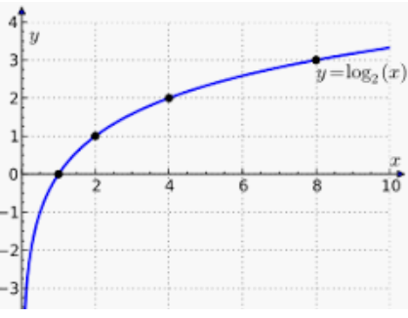
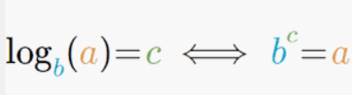
Logarithmic Transformations
Remember that logarithmic transformations help us with visualization. We can transform a large range of numbers to a small range of numbers suitable for a chart.
If the independent variable and dependent variable have different scales, then we can apply logarithms to straighten out the data.

Slide 13
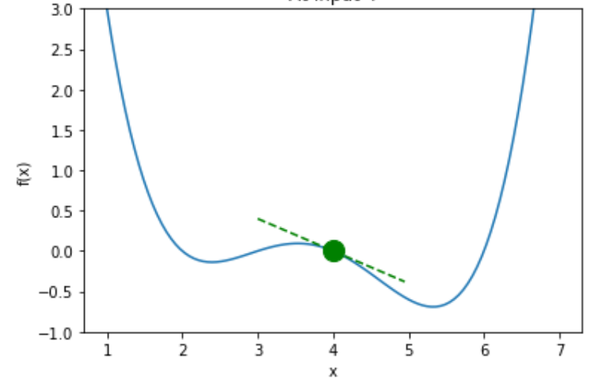
Gradient Descent
Derivatives capture the rate of change of a function
By minimizing the average loss, we obtain parameters that fit the model to the data.
We should not guess inputs and check outputs to minimize the function because that approach is inefficient and inaccurate.
Instead we will just make one guess and use the derivative to update the guess. We call the approach gradient descent.

Slide 14
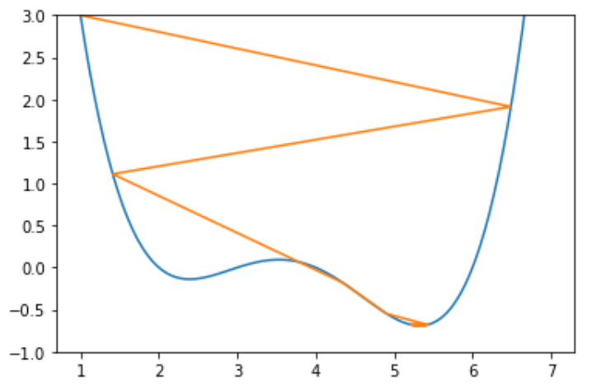
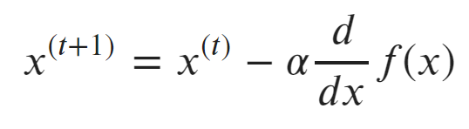
Gradient Descent
Starting from an initial guess x⁽⁰⁾ we update the guess with the formula
Here α denotes the learning rate. If α is large, then guesses can change a lot between iterations. If α is small, then guesses can change a little between iterations
If the learning rate is too large then gradient descent might diverge from the minimum

Slide 15
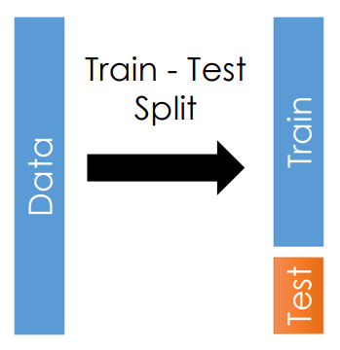
Testing Set
Instead of studying one sample, we need to study two samples
training set
testing set
We will fit the model to the data in the training set. We will check the accuracy of the predictions on the testing set.
Usually we take 80% of the data for the training set and 20% of the data for testing set.

Slide 16
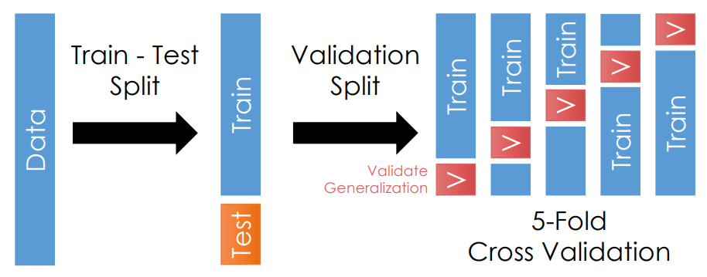
Validation Set
We split one sample into two sample to generate the training set and testing set. Next we split the training set into k folds. Each fold has a training set and a validation set

Slide 17
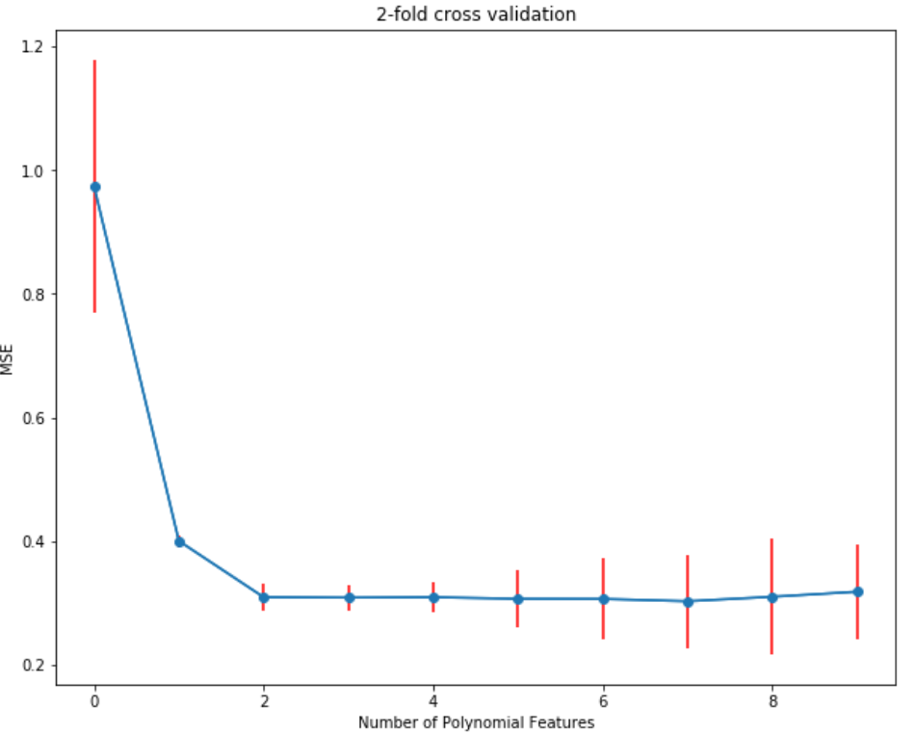
Cross Validation
We want to choose models that are both accurate and consistent.
With cross validation we measure the difference between predictions and observations on many datasets.
Small errors give us accuracy
Similarity between errors give us consistency
We can visualize both the accuracy and consistency through a line chart with error bars

Slide 18
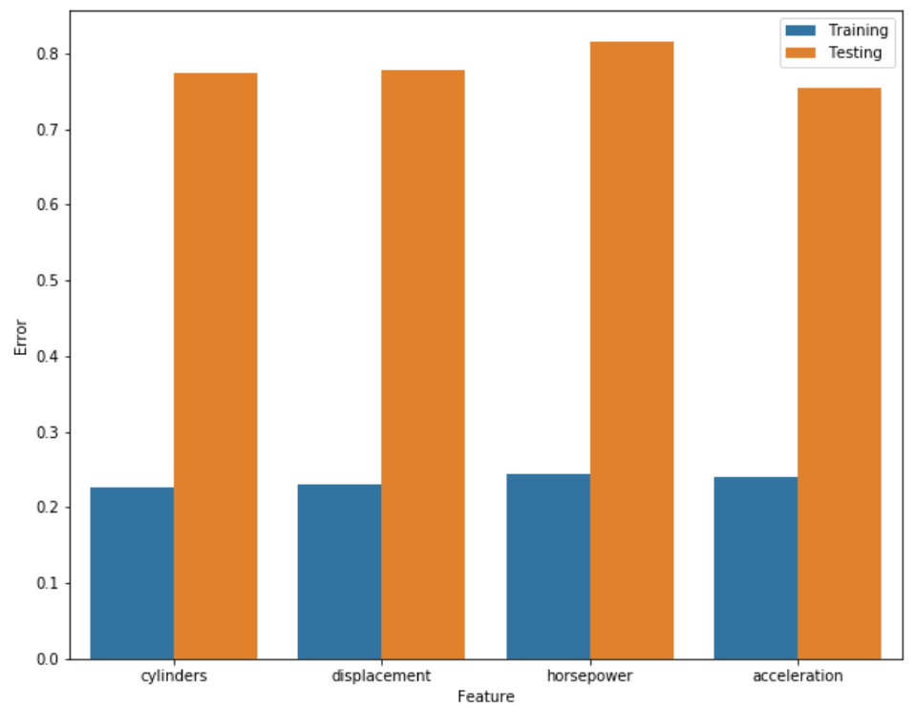
Feature Selection
If we want to remove features to prevent against overfitting, then we could try to assess the effect of dropping combinations of features.
In backward feature selection we
select a feature
drop it from the table
fit a model to the data
calculate average loss
The feature that led to the smallest increase in loss should be excluded from predictions

Slide 19
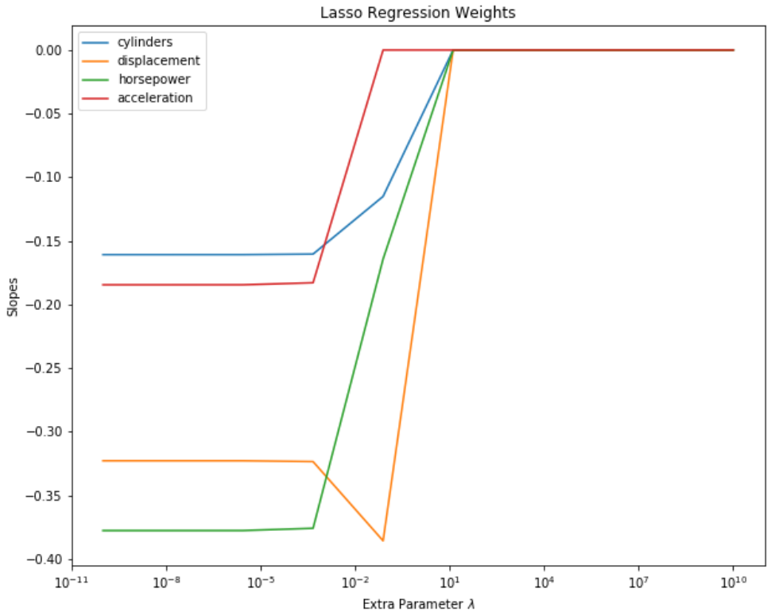
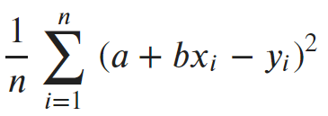
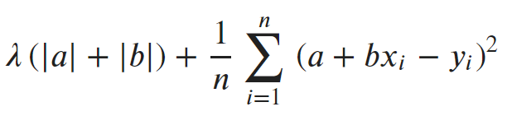
Lasso Regression
We can replace the average loss for linear regression
with regularized average loss for lasso regression

Slide 20
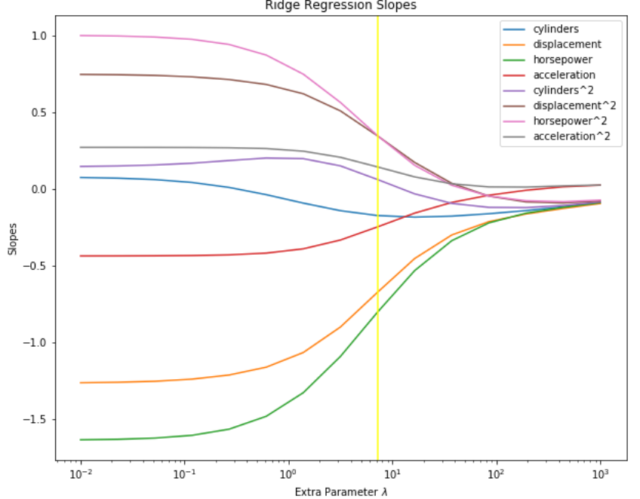

Ridge Regression
We can replace the average loss from linear regression
with regularized average loss for ridge regression

Slide 21
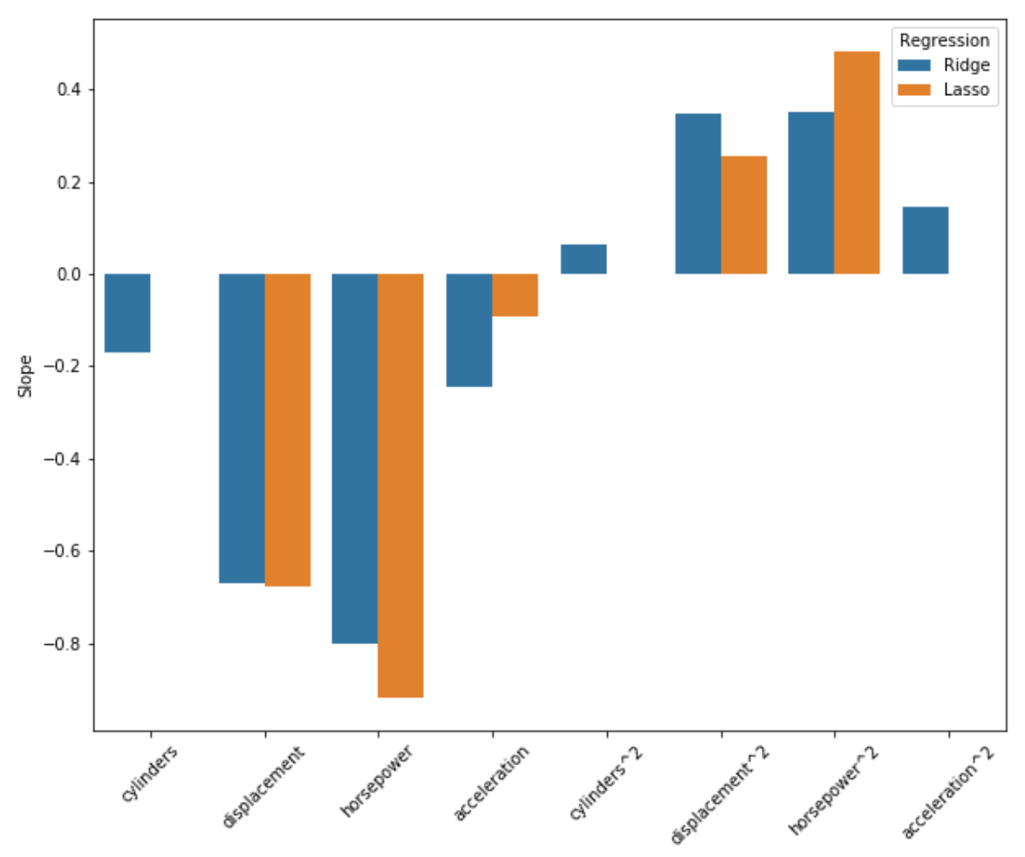
Regularization
Lasso Regression tends to shrink parameters down to zero.
Helpful to eliminate features from the model
Erratically chooses between associated features
Ridge Regression tends to shrink parameters close to zero.
Helpful to average out the values of the parameters among associated features
Cannot eliminate features from the model

Slide 22
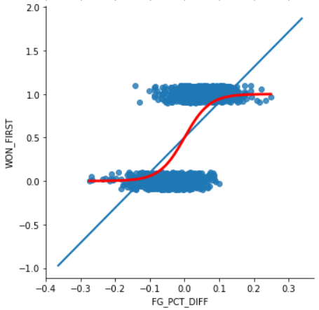
Logistic Regression
We use linear regression to predict a quantitative response variable.
We use logistic regression to predict a qualitative response variable.
Usually we encode the categories with numbers like 0 and 1

Slide 23
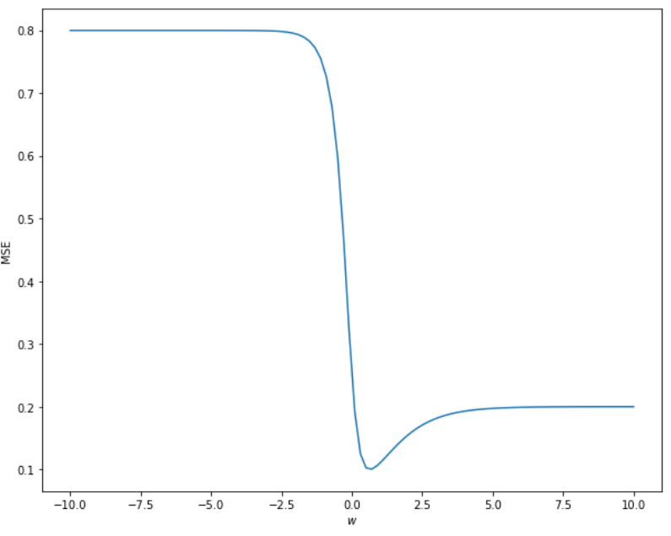
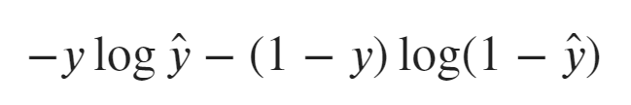
Logistic Loss
Instead of the square loss we should take the logistic loss.
Unlike the square loss, the logistic loss does not generate flat regions that prevent gradient descent from finding the minimum.

Slide 24
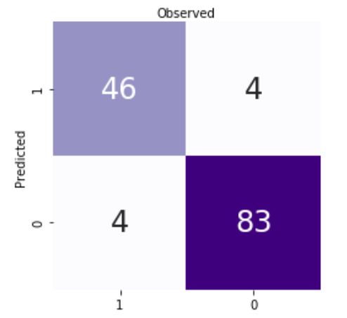
Confusion Matrix
The observation take the value 1 or 0. The predictions take the value 1 or 0. So we have four possibilities
True Positive
False Positive
False Negative
True Negative
We can visualize the number of each possibility for a dataset with a confusion matrix

Slide 25
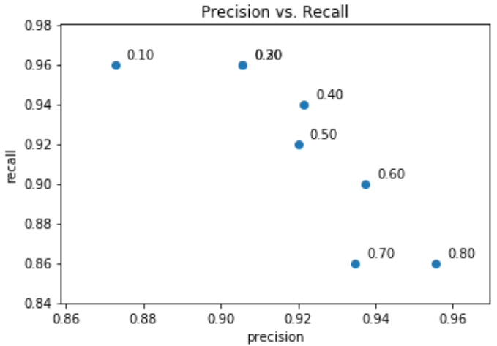
Precision Recall Curve
Accuracy might not capture the differences between observations and prediction with an imbalance between categories
Precision penalizes false positives
Recall penalizes false negative
We can visualize the trade-off between recall and precision through a precision-recall curve

Slide 26
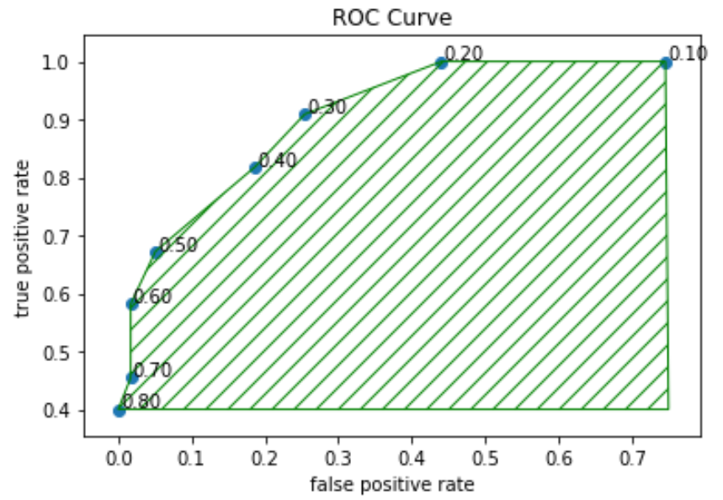
ROC Curve
A ROC curve plots the true positive rate and the false positive rate
The acronym ROC stands for Receiver Operating Characteristic.
We can summarize the ROC curve with the area under the curve. We abbreviate the area under the curve as AUC.

Slide 27
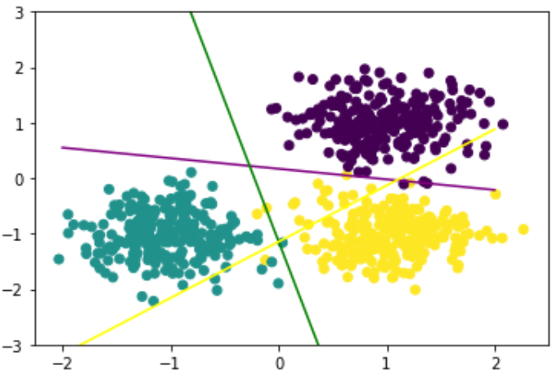
Multiple Categories
If we have three or more categories, then we can split the classification problem into multiple problems with two categories.
Each problem try to classify one category versus the other categories. We call the approach One-versus-Rest.

Slide 28
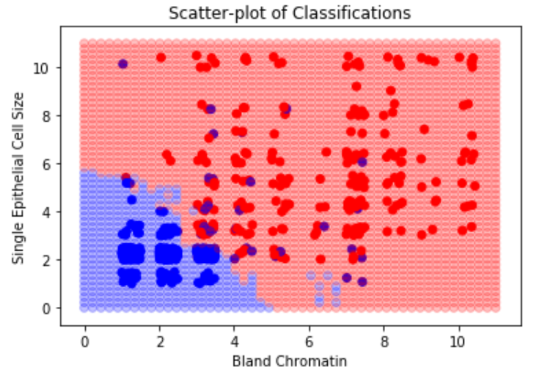
Nearest Neighbors
We determine the category of the unlabeled records from the categories of the nearest labeled records.
If we predict categories for many unlabeled records then we can determine the decision boundary

Slide 29
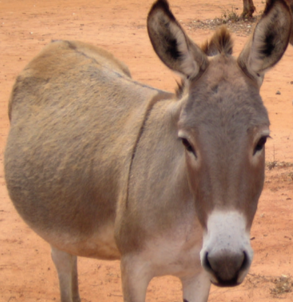
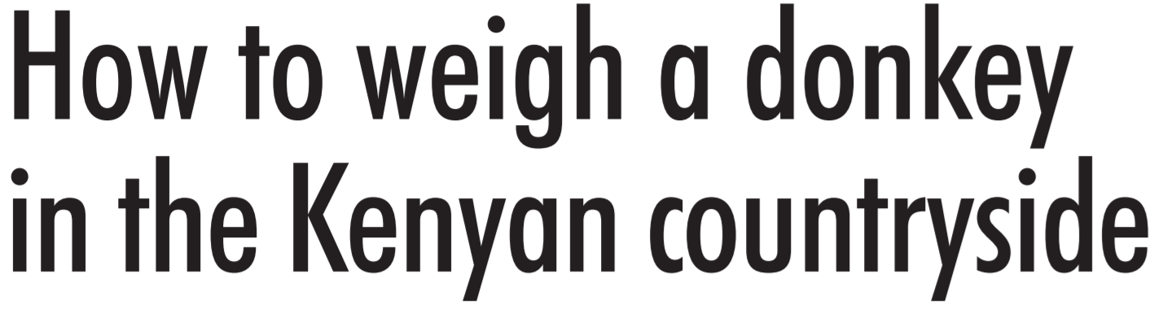
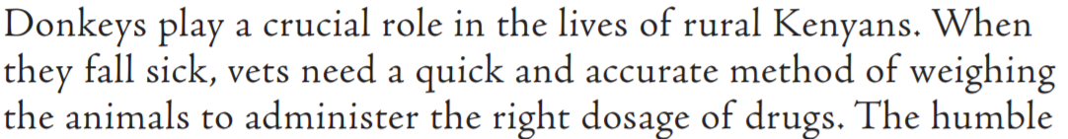
Case Study

Slide 30
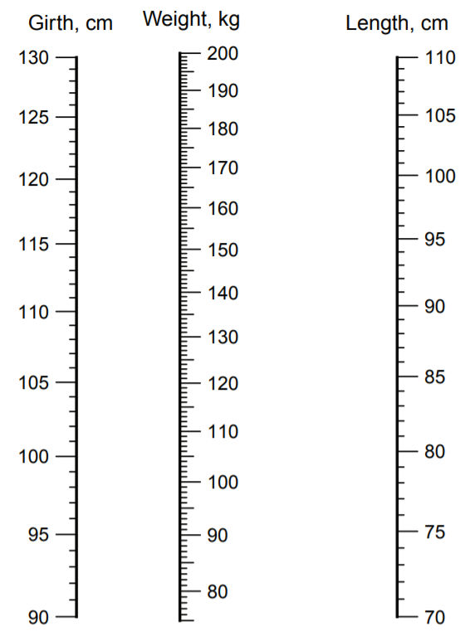
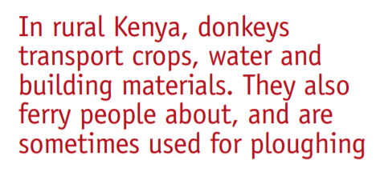
Case Study

Slide 31
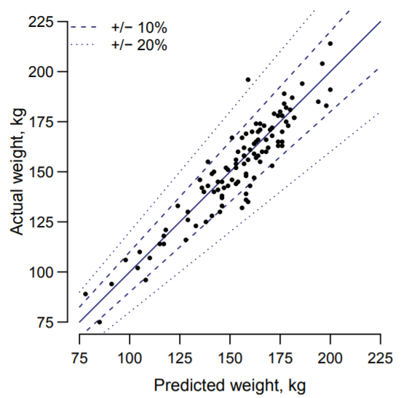
Case Study
How can a vet prescribe medication without knowing the weight of the donkey?

Slide 32
Case Study
Loss function should reflect the cost to the donkey’s health of prescribing the wrong dose
Antibiotics:
Effect is less sensitive to the weight of the donkey
Better to overdose: otherwise infection might not be treated. An under-dose could lead to drug resistance
Anesthetics:
Effect is more sensitive to the weight of the donkey
Better to under-dose: the effect can be observed and adjusted

