Slide 1
X-Video Understanding
By Hina Amano

Slide 2
Introduction
This is an Open-Source AI System for Video Understanding.
Frontend: React.js
Backend: Node.js
Database: AWS based MongoDB
Video Understanding AI: Twelve Labs (As OpenInterX only supports Python API).

Slide 3
Function
1. Video Storing
2. Video Info Displaying.
3. Video Question Answering.
1. Video Searching.
2. Video Editing.
3. Video Clip generating.

Slide 4
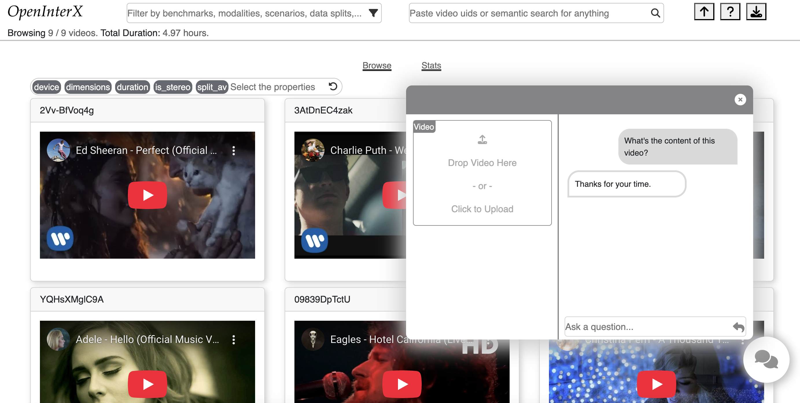
Demo

Slide 5
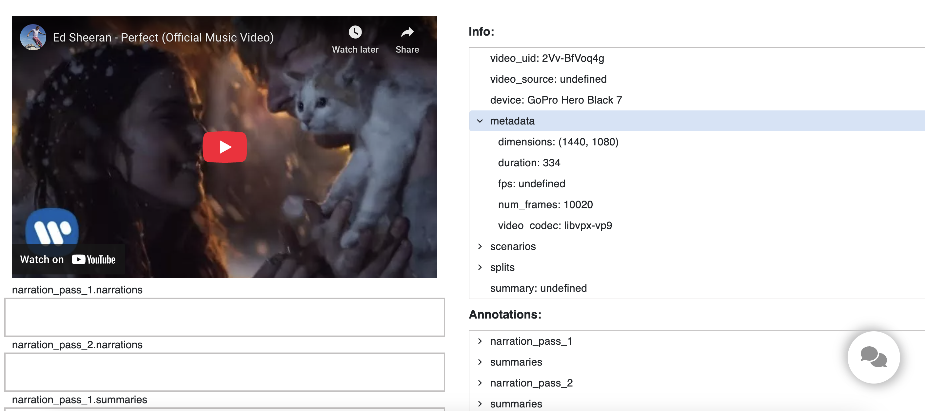
Demo

Slide 6
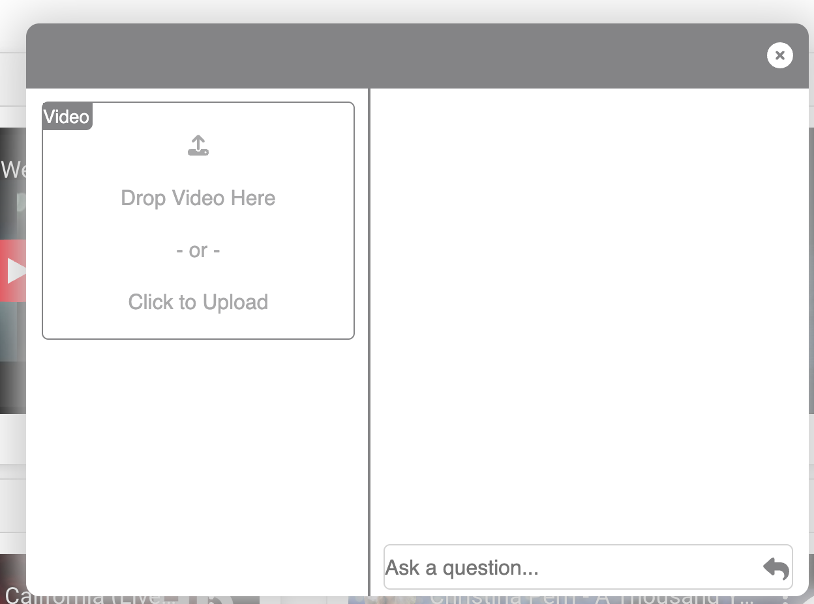
Demo

Slide 7
Thanks for your listening!

