Slide 1
Ames Housing Prices Analysis
Team: GGGG
Yilin Gao Mengrui Yin Wenqi Cheng Liyu Gong

Slide 2
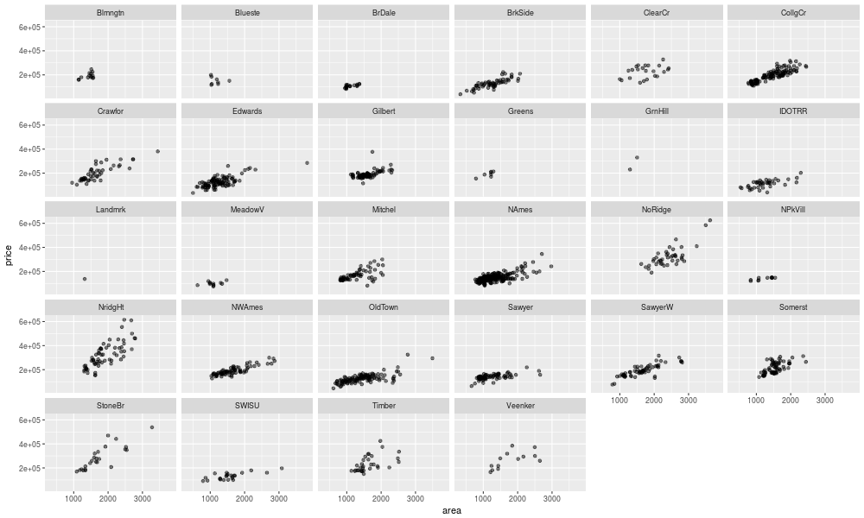
Most interesting graphic

Slide 3
Best Model
Motivation: Need a Simple, Interpretable model for brokers
Model: LASSO with interactions between area and house quality measures
Reason:
Linear model (easy interpretation)
Similar performance on training and testing dataset (no overfitting)

Slide 4
Best Insights into predicting Sales Price
Houses in the Green Hills neighborhood is 60% higher than the baseline
Every 100 sq ft increase in area have different effect on price:
Brokers:
Avoid North Ames area
Sell 1 story or split foyer houses
Buyers:
Avoid Brookside, Stone Brook, Northridge Heights neighborhood
Buy houses with brick common masonry veneer type, mansard roof type

Slide 5
2 Best Houses to purchase
Based on the difference between the predicted price and the actual price in the testing set, the 2 most undervalued houses are:
PID = 906402200, diff = 60760.297
PID = 533251110, diff = 47936.105
Take other factors into consideration besides the model:
Hidden variables in determining house prices
Buyers’ preferences

