Slide 1

STELLAR PRO HACKATHON 2026
duly.
A shared treasury
for your building
Spending rules residents can verify
Istanbul, September 19–20
Notes:
Cover / 0:00–0:10 / 10 seconds
ENGLISH SCRIPT
This is Duly, a shared treasury for apartment buildings.
TÜRKÇE PROVA
Duly, apartmanlar için ortak bir kasa.
STAGE CUE
Ürün adını söyle ve kısa bir duraklama yap. Ana açıklamayı problem slaytına bırak.
Sources: README.md; duly/docs/handbook.md, Judging & Submission Criteria; duly/docs/stories/02-building-governance.md; duly/contracts/duly-building/src/lib.rs. Project scope and target users come from the supplied repository. No market size or adoption count is claimed.
Sources: README.md; duly/docs/stories/02-building-governance.md; duly/docs/stories/03-monthly-dues.md; duly/deployments/building-testnet-v3.json; user-supplied docs.pdf pages 8–11. Official template foundation: Cover, The Solution, PMF, Technical Workflow, The Team; https://docs.google.com/presentation/d/1oRWx77PH3WsQ67Is9Xhg3GVNmkwVO7lU4Ab241__ahE/edit . Visual design adapted to Duly branding.
Cover art: Higgsfield / Recraft V4.1, job 415d0b59-862c-48b7-8dbf-1c3e3ace8a04. Generated architectural illustration, not a real building.

Slide 2
THE PROBLEM
Shared money is hard
to track and control
Example: an elevator repair paid from residents’ dues.
BALANCE
DECISION
PAYMENT
How much is left?
Who approved it?
Where did it go?
Residents depend on
the manager’s records.
Residents may hear about
an expense after payment.
The building needs a payment
trail everyone can see.
Residents need a shared record and a say
before the money leaves.
duly
02
Notes:
The Problem / 0:10–0:35 / 25 seconds
ENGLISH SCRIPT
Residents pay dues, but often depend on the manager for answers. How much is left? Who approved the repair? Where did the money go?
TÜRKÇE PROVA
Sakinler aidat ödüyor ama cevaplar için çoğu zaman yöneticiye bağımlı. Kasada ne kaldı? Tamiri kim onayladı? Para nereye gitti?
STAGE CUE
Slayttaki üç soruyu yavaşça oku. Asansör tamiri örneğini göster. Anket sayıları veya genelleştirilmiş pazar istatistiği kullanma.
Sources: README.md; duly/docs/handbook.md, Judging & Submission Criteria; duly/docs/stories/02-building-governance.md; duly/contracts/duly-building/src/lib.rs. Project scope and target users come from the supplied repository. No market size or adoption count is claimed.
The elevator repair is an illustrative scenario from README.md, not a documented incident or a market prevalence claim. The problem is fragmented visibility and limited participation before spending.

Slide 3
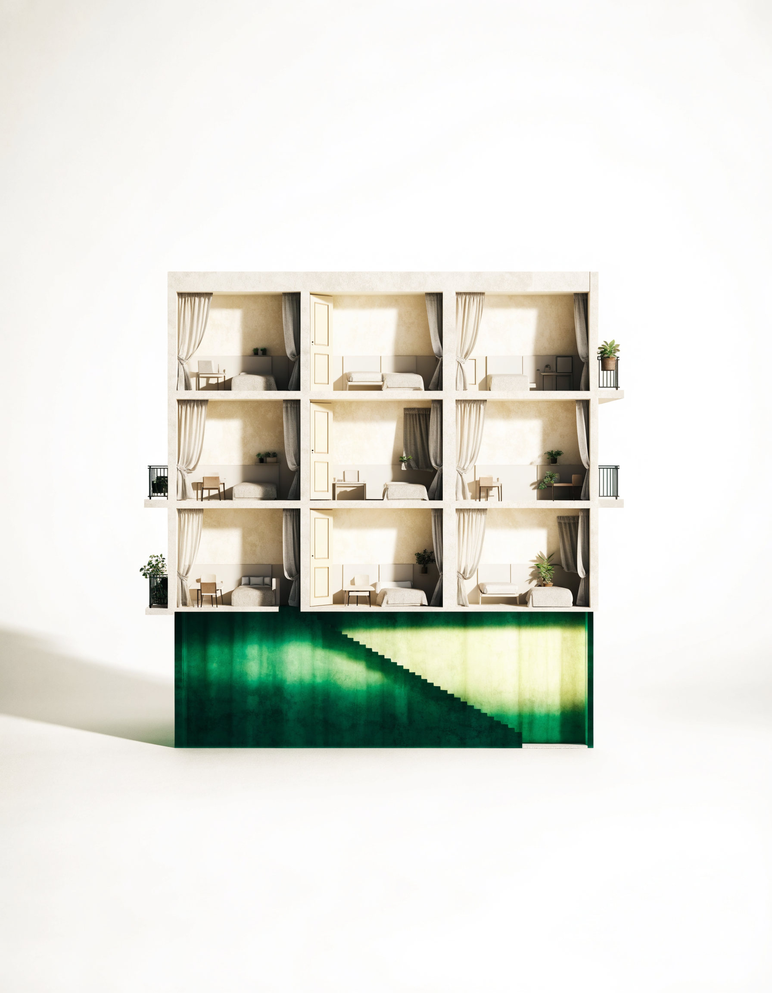
THE SOLUTION
One shared treasury.
Rules before spending.
01
See what is left
Dues and expenses in one shared view.
02
One apartment, one vote
A majority can approve early. Residents can object.
03
Track the payment
Amount, manager IBAN and payment status.
Stellar checks the rules before funds leave.
duly
03
Notes:
The Solution / 0:35–1:00 / 25 seconds
ENGLISH SCRIPT
Duly puts the balance and spending decisions in one shared treasury. Each apartment has one vote. Residents can approve or object. Stellar checks the rules before funds leave.
TÜRKÇE PROVA
Duly, bakiyeyi ve harcama kararlarını ortak kasada birleştiriyor. Her dairenin bir oyu var. Sakinler onaylayabiliyor ya da itiraz edebiliyor. Para çıkmadan önce Stellar kuralları kontrol ediyor.
STAGE CUE
Önceki slayttaki her soruyu bu slayttaki karşılığıyla eşleştir. Her rutin gider için yeni oy gerektiğini söyleme. İki oy, üç daireli örnekte çoğunluktur.
Sources: README.md; duly/docs/handbook.md, Judging & Submission Criteria; duly/docs/stories/02-building-governance.md; duly/contracts/duly-building/src/lib.rs. Project scope and target users come from the supplied repository. No market size or adoption count is claimed.
A majority can allow early execution. Routine spending within an approved budget to an approved recipient may proceed without a fresh vote. New-recipient or budget exceptions can also proceed after the normal objection window if no objection is raised. The current MVP pays the manager’s saved IBAN, not a verified supplier. Artwork: existing Higgsfield / Recraft V4.1 conceptual apartment illustration, job b41c0373-c9d8-4ace-a1df-4e896a098395.
Sources: README.md; duly/docs/stories/02-building-governance.md; duly/docs/stories/03-monthly-dues.md; duly/deployments/building-testnet-v3.json; user-supplied docs.pdf pages 8–11. Official template foundation: Cover, The Solution, PMF, Technical Workflow, The Team; https://docs.google.com/presentation/d/1oRWx77PH3WsQ67Is9Xhg3GVNmkwVO7lU4Ab241__ahE/edit . Visual design adapted to Duly branding.
Art: Higgsfield / Recraft V4.1, job b41c0373-c9d8-4ace-a1df-4e896a098395. The illustration is conceptual. Payout is to the current manager’s saved IBAN, not a verified supplier payment.

Slide 4
TECHNICAL WORKFLOW
Stellar connects the rules
to the payment
Apartment signatures
Resident
Treasury
Bank adapter
TRY anchor
Manager
Test USDC
Soroban rules
Escrow + memo
SEP sandbox
Saved IBAN
Simulated bank settlement
DeFindex reserve
The vault sits in the funds flow. The bank adapter remains trusted.
Deposit and redeem
duly
04
Notes:
Technical Workflow / 1:00–1:15 / 15 seconds
ENGLISH SCRIPT
The reserve connects to DeFindex. Bank payments use a TRY anchor. This is Testnet, with simulated bank settlement. Let’s see the product.
TÜRKÇE PROVA
Rezerv DeFindex akışına bağlı. Banka ödemelerinde TRY anchor kullanılıyor. Testnet üzerindeyiz ve banka ödemesi simülasyon. Şimdi ürünü görelim.
STAGE CUE
Şemayı tek tek okumak zorunda değilsin. Rezervi ve banka bağlantısını göster. Simülasyon sınırını açık söyle ve videoya geç.
Sources: README.md; duly/docs/handbook.md, Judging & Submission Criteria; duly/docs/stories/02-building-governance.md; duly/contracts/duly-building/src/lib.rs. Project scope and target users come from the supplied repository. No market size or adoption count is claimed.
Sources: README.md; duly/docs/stories/02-building-governance.md; duly/docs/stories/03-monthly-dues.md; duly/deployments/building-testnet-v3.json; user-supplied docs.pdf pages 8–11. Official template foundation: Cover, The Solution, PMF, Technical Workflow, The Team; https://docs.google.com/presentation/d/1oRWx77PH3WsQ67Is9Xhg3GVNmkwVO7lU4Ab241__ahE/edit . Visual design adapted to Duly branding.
The diagram describes outflow. TRY on-ramp deposits fund a classic account before a signed contribution. DeFindex reserve is liquid with no active yield strategy. The integration is a compatible deployed vault called by Soroban, not a claim to use @defindex/sdk.

Slide 5
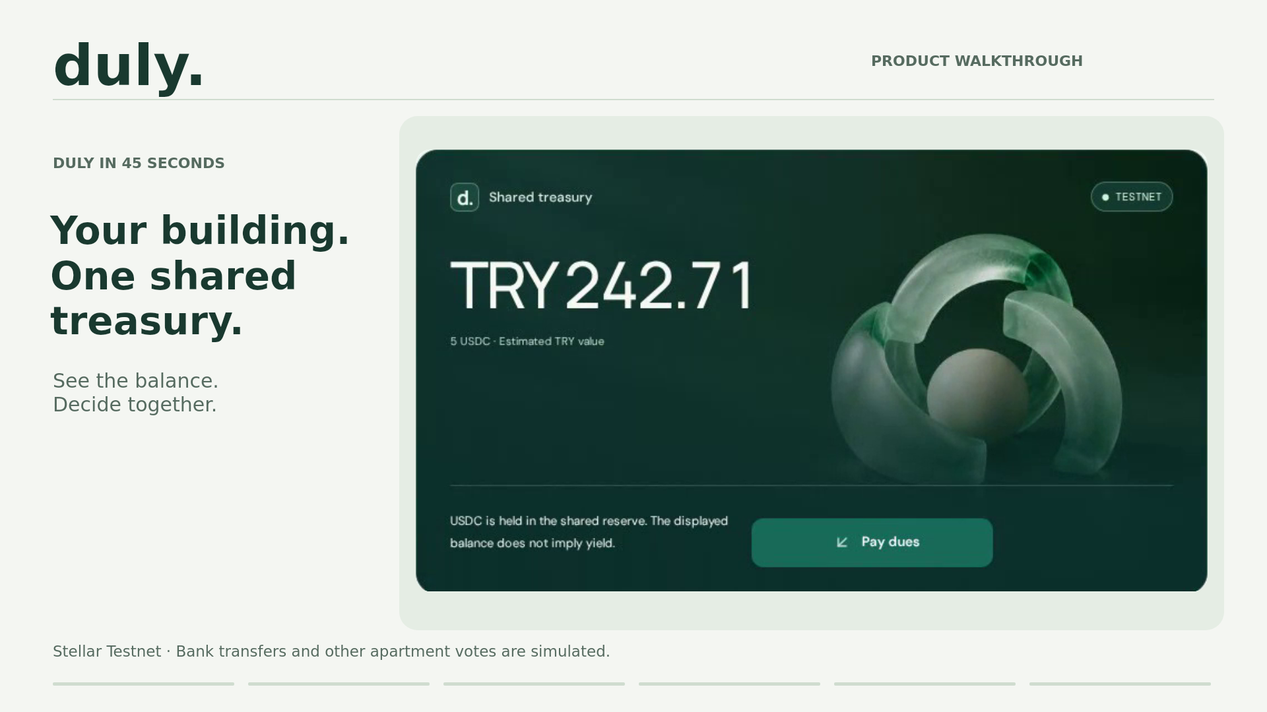
Notes:
Product Demo Video / 1:15–2:00 / 45 seconds
ENGLISH SCRIPT
[Play the 45-second silent product demo. No additional speech is needed.]
TÜRKÇE PROVA
45 saniyelik ürün videosunu oynat. İngilizce başlıklar akışı anlatıyor; konuşmak gerekmiyor.
STAGE CUE
Video gömülü ve otomatik başlayacak şekilde ayarlı. Gerekirse video alanına bir kez tıkla. Bitince kullanıcı kazanma planına geç.
Sources: README.md; duly/docs/handbook.md, Judging & Submission Criteria; duly/docs/stories/02-building-governance.md; duly/contracts/duly-building/src/lib.rs. Project scope and target users come from the supplied repository. No market size or adoption count is claimed.
VIDEO EVIDENCE
Recorded from https://duly-sepia.vercel.app/ on 2026-09-20 using an isolated solo demo in Higgsfield.
Edited and rendered with native Higgsedit: 1920×1080, H.264, 30 fps, 45 seconds, silent.
Sequence: building QR; 5 test USDC contribution; shared balance; 100 TRY repair; automatic 2.27 USDC ceiling; majority of two out of three apartments; simulated bank settlement.
Waiting times have been removed. The other apartment votes are simulated demo signatures, not audience participants.
Treasury: CBQJI2UVQHCMQSWRBIK7ULUX4N5Y7UO23LQMAKWEZEVVJCXH5VO6RY4T
Bank reference: FAST-MTHN5NPR0A (workshop simulation).
On-chain receipt: https://stellar.expert/explorer/testnet/tx/b7cecf6c5c7d3a2e0be1bb20ce3fd9735d54482da4ef01cf4431d3cabfe3c285
The old 100 TRY proof remains only in the appendix as separately dated evidence.

Slide 6
PMF / USER ACQUISITION PLAN
One manager can bring
a whole building
First users: volunteer managers of small apartment buildings.
01 REACH
02 ACTIVATE
03 RETAIN
04 EXPAND
Direct
outreach
Guide the
first cycle
Measure
repeat use
Manager
referrals
Our network and local
resident groups.
QR invitations, test dues
and a shared repair vote.
Do residents return for
the next dues cycle?
Ask active managers to
introduce another building.
Pilot goal: complete one dues cycle and one approved expense.
Planned Testnet pilots
06
Notes:
User Acquisition Plan / 2:00–2:35 / 35 seconds
ENGLISH SCRIPT
We will reach volunteer managers through our network and local groups. Each manager invites residents by QR. We guide the first dues cycle, measure repeat use, and ask active managers for referrals. These are planned pilots.
TÜRKÇE PROVA
İlk olarak çevremiz ve yerel gruplar üzerinden gönüllü bina yöneticilerine ulaşacağız. Yönetici sakinleri QR ile davet edecek. İlk aidat döngüsünü birlikte tamamlayacağız, sonraki dönemde geri dönüşü ölçeceğiz ve aktif yöneticilerden başka bir bina için referans isteyeceğiz. Bu, planladığımız pilot süreci.
STAGE CUE
Ulaşma kanalı, bina içi davet ve tekrar kullanım sırasını koru. Gerçekleşmiş pilot, müşteri veya anlaşma gibi anlatma. Pilot hedefi bir aidat dönemi ve bir onaylı gider.
Sources: README.md; duly/docs/handbook.md, Judging & Submission Criteria; duly/docs/stories/02-building-governance.md; duly/contracts/duly-building/src/lib.rs. Project scope and target users come from the supplied repository. No market size or adoption count is claimed.
This slide proposes a pilot acquisition hypothesis. It does not claim existing pilots, partnerships, paying customers or validated retention. Initial outreach would use the team’s own network and local resident groups. Manager onboarding is the proposed acquisition unit, followed by resident QR invitations. Track manager contacts, building activation, repeat participation next dues cycle and referred buildings. Run the first pilots on Testnet with test funds. Real payment pilots require a suitable bank/anchor partner, legal review and independent security work. Subscription pricing and willingness to pay remain unvalidated.

Slide 7
THE TEAM / LIVE DEMO
Let’s run a building
together
I will be the manager.
01
Pay test dues
You are the residents.
02
Vote on a repair
One shared building.
Your own accounts.
03
See the result
Stellar Testnet. Test funds only.
duly-sepia.vercel.app
duly
07
Notes:
The Team & Live Demo / 2:35–3:00 / 25 seconds
ENGLISH SCRIPT
We built the app, treasury rules and payment flow. Now let’s run a building together. I will be the manager. You are the residents. Let’s pay test dues and vote.
TÜRKÇE PROVA
Uygulamayı, kasa kurallarını ve ödeme akışını geliştirdik. Şimdi birlikte bir bina yönetelim. Ben yönetici olacağım, siz sakinlersiniz. Test aidatı ödeyip oy verelim.
STAGE CUE
Üç dakikalık bölüm burada biter. Hazır iki gönüllüye dön. Ardından canlı oturum için hazırlanan binanın gerçek QR ekranını aç.
Sources: README.md; duly/docs/handbook.md, Judging & Submission Criteria; duly/docs/stories/02-building-governance.md; duly/contracts/duly-building/src/lib.rs. Project scope and target users come from the supplied repository. No market size or adoption count is claimed.
Sources: README.md; duly/docs/stories/02-building-governance.md; duly/docs/stories/03-monthly-dues.md; duly/deployments/building-testnet-v3.json; user-supplied docs.pdf pages 8–11. Official template foundation: Cover, The Solution, PMF, Technical Workflow, The Team; https://docs.google.com/presentation/d/1oRWx77PH3WsQ67Is9Xhg3GVNmkwVO7lU4Ab241__ahE/edit . Visual design adapted to Duly branding.
Live audience session follows the three-minute spoken introduction. Suggested format: presenter as manager and apartment 1, two volunteers as apartment owners 2 and 3, each using a separate account in one normal testnet building. Accounts, seat assignments and test USDC must be ready before the talk. Show the actual building QR from the app Share building panel. A generic homepage QR would not identify this building. QR access does not grant voting rights. Actual team names and track remain unconfirmed.

Slide 8
APPENDIX / ARCHITECTURE
Where the guarantees stop
On-chain enforcement
Trusted services
Outside the MVP
USDC custody and vault shares
Bank settlement and FX
Legal owner identity
Fixed seats and signatures
TRY dues accounting
Supplier payment after IBAN payout
Expense rules and execution
Scheduling and fee sponsorship
Independent security audit
Bank confirmation is a separate fact from treasury disbursement.
duly
08
Notes:
APPENDIX. Outside the three-minute presentation. Open only for questions.
Use for questions about trust, custody, identity or whether the app is fully decentralized. Payout to the manager does not prove a supplier receives funds.
Sources: README.md; duly/docs/evaluation-guide.md; duly/docs/stories/02-building-governance.md; duly/docs/stories/03-monthly-dues.md.

Slide 9
APPENDIX / GOVERNANCE
Normal rules and demo timers
Rule | Normal building | Solo demo
Objection window | 3 days | 20 seconds
Missing-owner recovery | 7 days | 60 seconds
Budget / dues period | 30 days from setup | 10 minutes
Apartment votes | Real owner signatures | 3 simulated apartments
A separate demo WASM accelerates time. Managers cannot shorten deployed timers.
duly
09
Notes:
APPENDIX. Outside the three-minute presentation. Open only for questions.
The audience session uses a normal testnet building with real separate participant signatures. Two yes votes in a three-seat building form a majority and may authorize earlier. Solo demo is only a separately labelled fallback. Both timestamp and ledger boundaries must pass when relying on a notice period. The fixed budget does not reset spent amounts when changed. Dues periods are not calendar months.
Sources: README.md; duly/docs/evaluation-guide.md; duly/docs/stories/02-building-governance.md; duly/docs/stories/03-monthly-dues.md.

Slide 10
APPENDIX / LIVE DEMO
Our shared building for the demo
Participant | Apartment | Action
Presenter / manager | 1 | Propose a shared repair
Volunteer 1 | 2 | Pay test dues and vote
Volunteer 2 | 3 | Pay test dues and vote
Two of three apartment votes form a majority.
Each participant signs from their own account. QR opens the building.
duly
10
Notes:
APPENDIX. Outside the three-minute presentation. Open only for questions.
Suggested session setup, not a claim that this audience session already happened. Use normal building setup with three distinct pre-created accounts and test USDC balances. Presenter is the manager. Participants choose Yes or Object in the expense interface. An objection without majority approval keeps the payment waiting. The QR shares the building URL, while voting rights come from fixed owner/delegate records. Sources: duly/web/src/BuildingApp.tsx eligibleSeats, createExpense, voteExpense, setup and transfer/delegate forms; duly/web/src/components/BuildingAccess.tsx ShareBuilding.
Sources: README.md; duly/docs/evaluation-guide.md; duly/docs/stories/02-building-governance.md; duly/docs/stories/03-monthly-dues.md.

Slide 11
APPENDIX / EVIDENCE
The jury can inspect the implementation
Live product
duly-sepia.vercel.app
Source code
github.com/mryavascann/aidat
Deployment manifest
building-testnet-v3.json
Payment evidence
building-demo-ux-testnet-v3.json
Normal treasury on Stellar Testnet
CBIGWOYBTFHV32OZWTZSYKP2TLDPHJIDJJSG5XAGG22K6VRSSP2MLIMM
duly
11
Notes:
APPENDIX. Outside the three-minute presentation. Open only for questions.
Payment transaction: https://stellar.expert/explorer/testnet/tx/8037e829426810484107dc51389a648f030c9f67c522e443ac54995a56a54bb0 . The payment proof belongs to a separate demo building; do not conflate it with the normal treasury.
Sources: README.md; duly/docs/evaluation-guide.md; duly/docs/stories/02-building-governance.md; duly/docs/stories/03-monthly-dues.md.

