Slide 1
QuesTUBE
Team Victims

Slide 2
AGENDA
Introduction​
Problem Statement
​Solution Overview
Implementation
Market Potential​
Challenges Faced
Future Development

Slide 3
Introduction

Slide 4
Problem statement

Slide 5
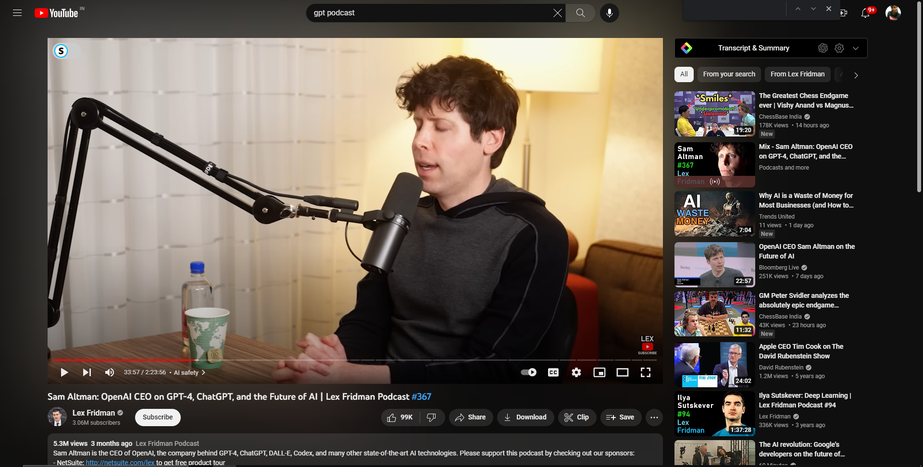


Slide 6
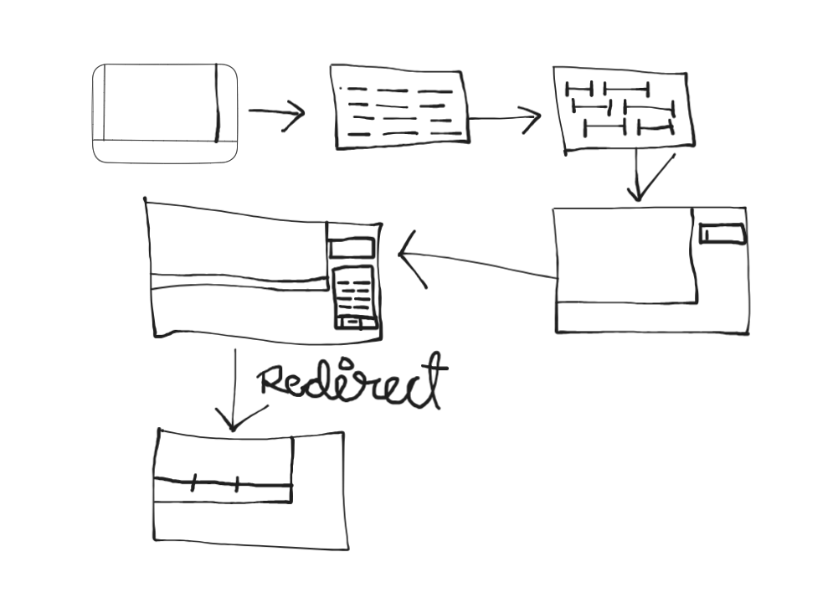
Solution Overview

Slide 7
Implementation
Chrome Plugin Development: Create a Chrome plugin that can extract video transcripts from web pages or accept user-provided transcripts. The plugin should have a user interface for displaying the video transcript and accepting user queries.
Transcript-to-Text Conversion: Implement functionality in the plugin to convert the video transcript into plain text. This can involve using browser APIs to extract text from the video player or integrating with existing transcription services.
GPT-3.5 Turbo Integration: Utilize the OpenAI GPT-3.5 Turbo model to process user queries and generate responses. You can use the OpenAI Python library or their API to interact with the model. Send the user query as input to the model and receive the generated response.
Matching Questions to Video Timestamps: Associate each question with the corresponding timestamp in the video transcript. This will allow users to navigate the video and find the specific part where the answer is relevant.
User Interface Enhancement: Enhance the user interface of the Chrome plugin to display the generated responses along with the corresponding video timestamps. Provide controls for navigating the video based on the timestamps associated with each question.

Slide 8



Market Potential
video-based learning
Accessibility and inclusivity
Content creation and media industries
Online learning has experienced tremendous growth, and have become a popular medium for educational content.
The ability to extract text from videos and facilitate question-answering functionality meets the increasing demand for interactive and personalized learning experiences.
There is a growing focus on accessibility and inclusivity in digital content. By providing video transcripts and enabling users to ask questions, your project addresses the needs of individuals with hearing impairments, language barriers, or different learning preferences. This expands the potential user base and taps into a market seeking accessible solutions.
Content creators, journalists, and researchers regularly work with video material. Your project offers a streamlined solution for converting video transcripts to text, searching for specific information, and obtaining accurate answers.

Slide 9
Future developments
Enhance Search Capabilities
Multi-Language Support
Collaboration Features
Personalization and recommendation engine
Voice Recognition and speech-to-text conversion
User Feedback and sentiment analysis
Continuous model improvements

Slide 10
SUMMARY
Our project, QuesTube, is a Chrome plugin that revolutionizes the way users interact with video content. With the ability to convert video transcripts to text and facilitate question-answering capabilities, our solution empowers users to delve deeper into video material, gain valuable insights, and enhance their learning experience.
With our project, we aim to bridge the gap between video content and user inquiries, transforming the way we engage with videos. Join us on this exciting journey as we revolutionize video-based learning, accessibility, and media analysis. Together, we can unlock the full potential of video and audio content."

Slide 11
THANK YOU
P Sai Kiran
saivostro2001@gmail.com

Slide 12
THANK YOU
P Sai Kiran
saivostro2001@gmail.com

