Slide 1
Proxy service Virtual things and their management
Ryuichi Matsukura, Fujitsu
26 October, 2020

Slide 2
Overview
Proxy discovers new physical devices and generate virtual devices associate with them.
Proxy provides a single interface for applications to operate physical devices.
Proxy manages device information including the device status and the latest data and settings.
Application
Single interface
Virtual A
Virtual B
Virtual C
Proxy
Protocol binding
Protocol binding
Protocol binding
Multiple interfaces
Device A
Device B
Device C

Slide 3
System diagram
Physical devices broadcast messages to search a proxy with mDNS and gets the address to register their TDs to the Proxy.
The Proxy generates their virtual devices after the registries and exposes their TDs to applications as a single interface.
Proxy
Device management
Expose a single interface
Directory
Discovery w/ mDNS
HTTP w/ basic auth.
Virtual device
Protocol binding
Physical Device
Application
HTTP
Virtual device
Protocol binding
Physical Device
CoAP
The proxy involves a directory function to manage physical devices to be connected.

Slide 4
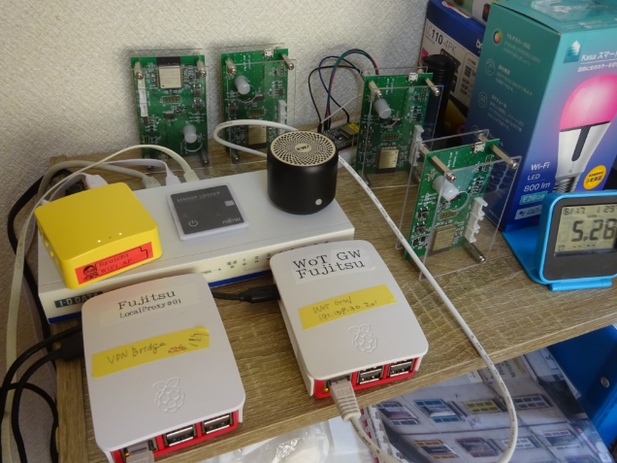
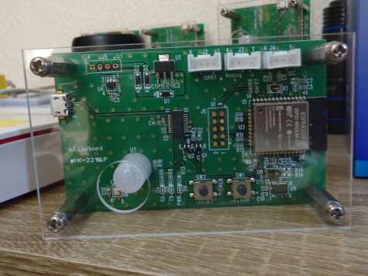
Outcomes in the plugfest
The Proxy aggregates some devices both inside and outside VPN and exposes their virtual devices to the NodeRED with node-gen.
NodeRED
w/ node-gen
Inside VPN
Outcomes in the last 2 plugfests on June and September.
Proxy
Proxy
VPN bridge
Sensor unit
Hitachi LED
TUM coffee machine
Intel camera
Siemens coffee machine
Motius MoSenso
Oracle simulator
Sensor unit

