Slide 1
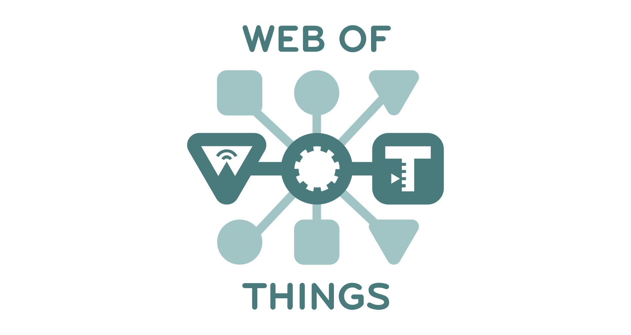
W3C WoT architecture

Slide 2
contents
1. Introduction
2. Terminology
3. Use cases
4. Functional requirements
5. Abstract architecture
6. WoT servient architecture
7. Deployment
8. Security

Slide 3
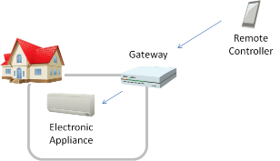
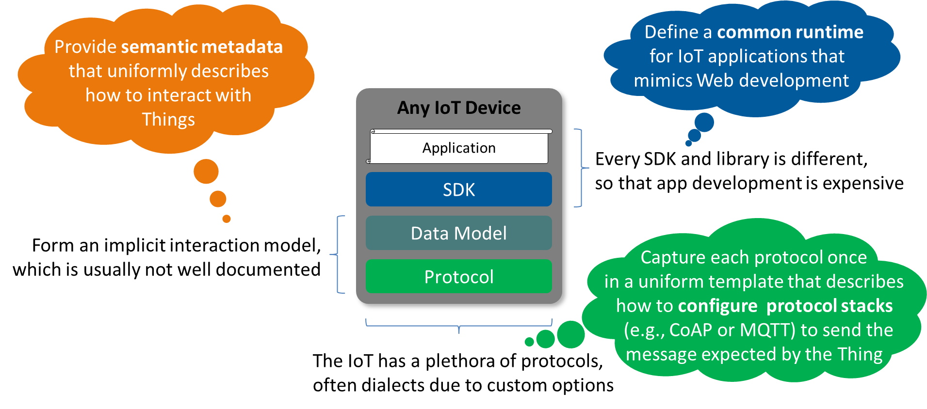
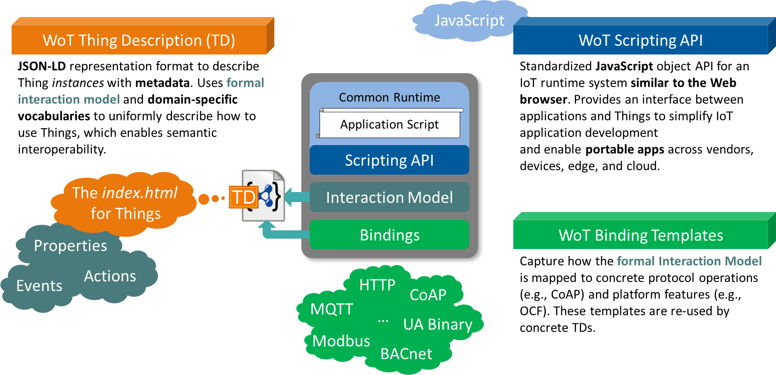

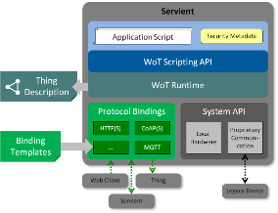
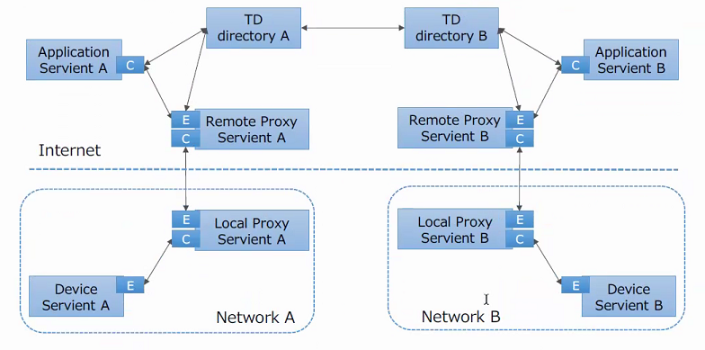
リヨン会議での目次案
Introduction
Terminology
Use Cases
Functional Requirements
Abstract Architecture
(Terminology and concepts)
Message flows
WoT Building Blocks
(Specifications)
WoT Servients
(Implementation)
Lifecycle
WoT Deployments
  Device Servients
  Proxy Servients
  Application Servients
  Directories
  Integrations
Security and Privacy Considerations

Slide 4
Introduction
Note: 文書の概要を示すものであり、ドラフトのアブストラクトからテキストをコピー。
The W3C Web of Things (WoT) is intended to enable interoperability across IoT Platforms and application domains. Primarily, it provides mechanisms to formally describe IoT interfaces to allow IoT devices and services to communicate with each other, independent of their underlying implementation, and across multiple networking protocols. Secondarily, it provides a standardized way to define and program IoT behavior.
This document describes the abstract architecture for the W3C Web of Things. It is derived from a set of use cases and can be mapped onto a variety of concrete deployment scenarios, several examples of which are given. This document is focused on the standardization scope of W3C WoT, which consists of three initial building blocks that are briefly introduced and their interplay explained.
The WoT Thing Description (TD) provides a formal mechanism to describe the network interface provided by IoT devices and services, independent of their implementation. Provision of a TD is the primary requirement for a device to participate in the Web of Things. In fact, defining a Thing Description for an existing device allows that device to participate in the Web of Things without having to make any modifications to the device itself. WoT Binding Templates define how a WoT device communicates using a concrete protocol. The WoT Scripting API—whose use is not mandatory—provides a convenient mechanism to discover, consume, and expose Things based on the WoT Thing Description.
Other non-normative architectural blocks and conditions underlying the Web of Things are also described in the context of deployment scenarios. In particular, recommendations for security and privacy are included, while the goal is to preserve and support existing device mechanisms and properties. In general, W3C WoT is designed to describe what exists rather than to prescribe what to implement.

Slide 5
Terminology
Action
Application
Binding templates
Client API
To consume a thing
Discovery API
Domain-specific vocabulary
Event
Execution environment
To expose a thing
Interaction
Interaction model
Interaction pattern
IoT platform
Local discovery
Manual discovery
Nearby discovery
Network discovery
Property
Protocol binding
Remote discovery
Scripting API
Server API
Servient
TD
TD vocabulary
Thing
Thing Description (TD)
Thing directory
WoT Client
WoT Interface
WoT Object
WoT Runtime
WoT Server
CoAP
CWT
JSON-LD
JWT
RDF

Slide 6
Use case
This section presents the use cases targeted by the W3C WoT and which are used to derive the abstract architecture discussed in 5. WoT Building Blocks. While Smart Home use cases might appear predominant in this section, they should be seen as simply a vehicle to identify fundamental requirements inherent to most application domains. The Smart Home domain is suitable for identifying such general requirements, as most stakeholders can relate to it.

Slide 7
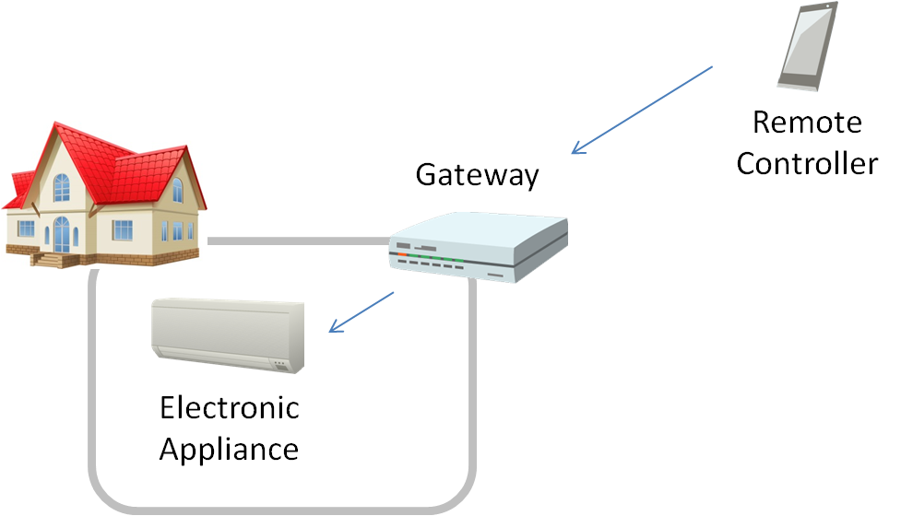
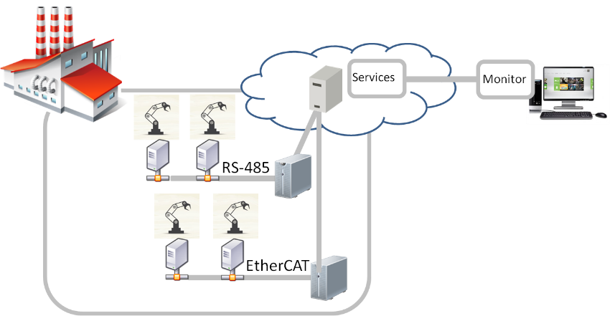
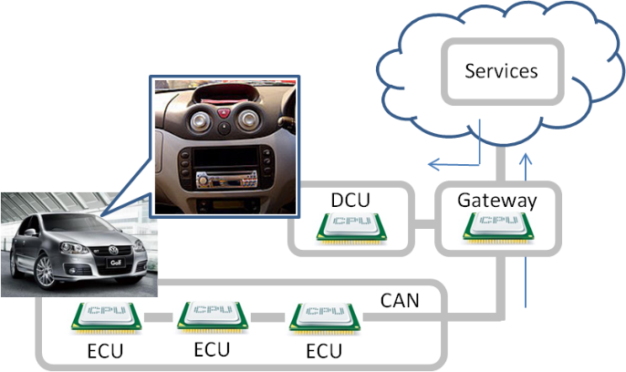
Use cases for WoT
Note: 様々な適用が考えられることで、バリエーションを説明する。実際のプロトコル等も記載
Smart home
Smart factory
Connected car
…
A variety of devices that support diverse communication protocols have been connected in many fields. Common way to manage and handle devices are required for the application developers.

Slide 8

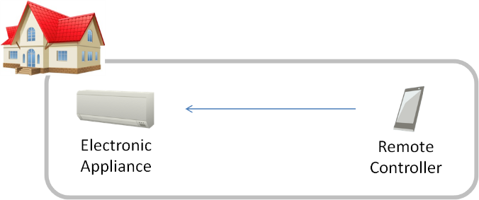
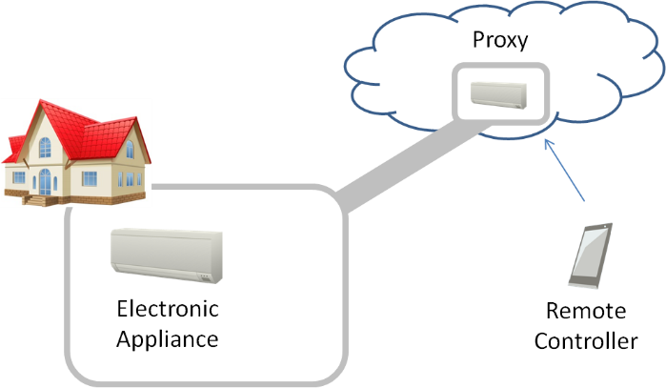
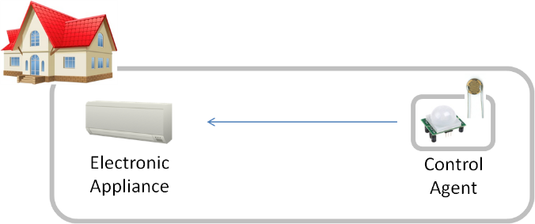
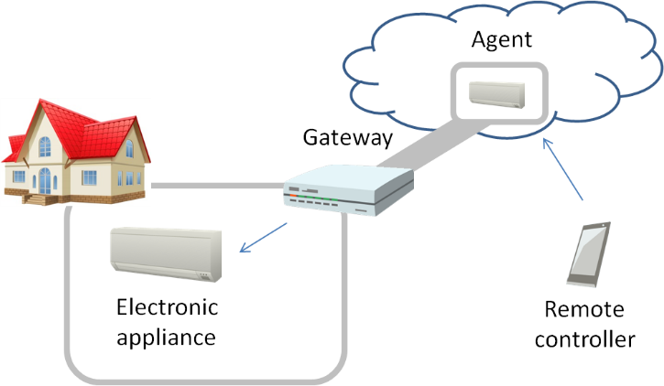
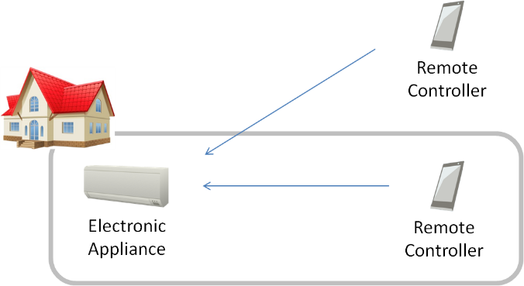
Use cases of various deployment
Note: アーキテクチャ構成のバリエーションを記載する
ID管理、デバイスの発見等？
Various way to connect applications and devices are required for the real situation. Direct connections, gateways supporting their connection, connecting via cloud, …

Slide 9
Use cases
ユースケース
どのようなプロトコルでつながっているか
→プロトコルバインディングの必要性
→ID管理、デバイス管理
デプロイメント
デバイス、アプリケーション、プロキシ
抽象アーキテクチャ→構成要素を明確にする

Slide 10
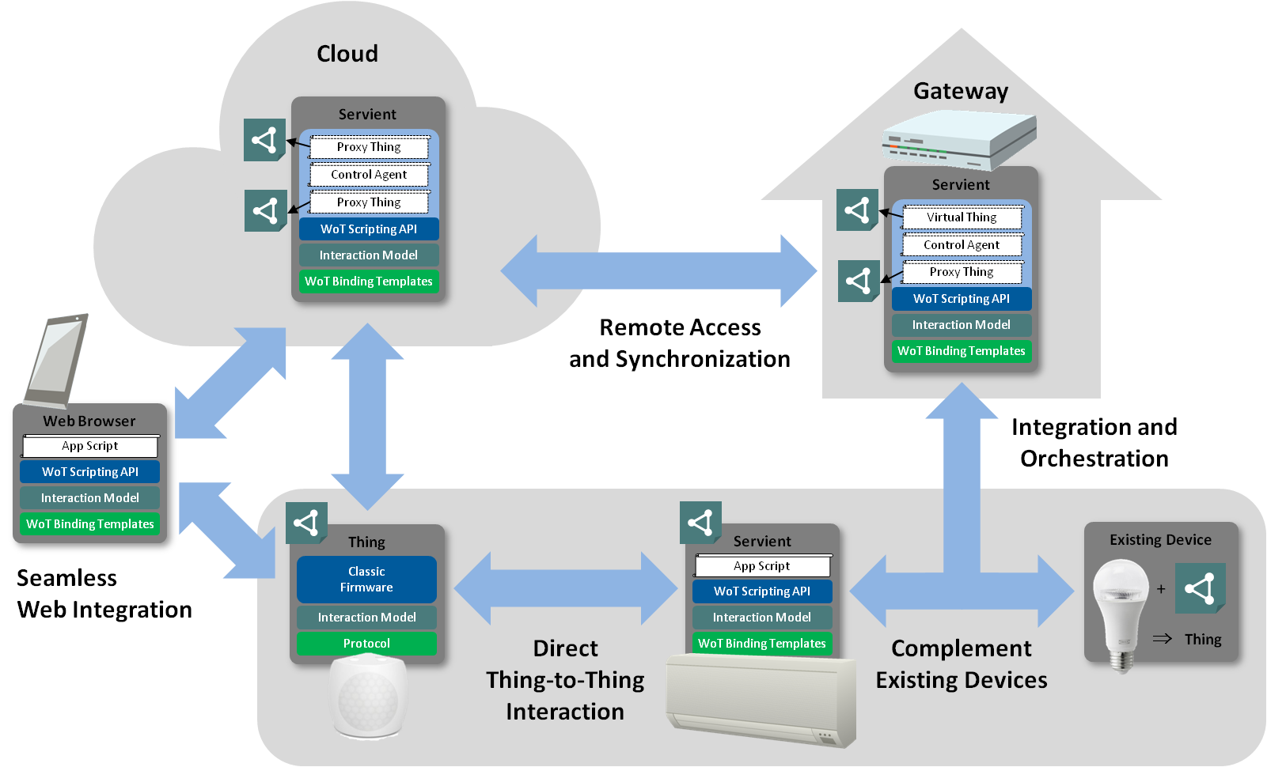
Summary of use cases
As described above, various ways to connect with applications, devices, cloud and gateway are aggregated into the same architecture regardless of the fields.

Slide 11
Functional requirements
分野を問わずにアプリケーションから同じインタフェースでデバイスにアクセスできる。デバイスが同じ情報モデルを共有する必要がある（Thing Description）
分野固有の規格を共通のインタフェースに変換する必要がある（Protocol binding）
アプリケーションとデバイスとの様々な接続形態に対応するために、アプリ、デバイス、ゲートウェイ（プロキシ）の基本要素を定義し、共通のアーキテクチャを定義する必要がある（Servient）
複数のネットワークを超えて、アプリとデバイスが接続される（Proxies architecture）
アプリケーションからデバイスを発見する方法が必要。そのために、デバイスの情報モデルを登録し、それをネットワークを経由して検索することができる。（Discovery）

Slide 12
Abstract architecture
This section presents the initial WoT building blocks that build up the abstract architecture for the Web of Things. This architecture is derived from the use cases in Section 3. Use Cases and the requirements in Section 4. Functional Requirements. Figure 9 summarizes the high-level goals and requirements and shows the three levels where the WoT building blocks can be applied:
  the device level,
  the gateway level (or "edge"), and
  the cloud level.

Slide 13
Simple configurations of WoT
Note: 基本的な考え方として、機能ブロックのみを記載します
Simple configuration 1: Application and Device
Application servient
Application
登録(manual)
Runtime(client)
ConsumedThing
TD manager
TD
Device servient
Scripting APIでの想定は、TDをDirectoryに登録する
Runtime(server)
取得(manual)
または何もしない
ExposedThing
TD manager
Hardware

Slide 14
Servients
Device servient (former 5.1 Thing)
  A Thing is the abstraction of a physical or virtual entity that needs to be represented in IoT applications. This entity can be a device, a logical component of a device, a local hardware component, or even a logical entity such as a location (e.g., room or building).
  Things provide a network-facing API for interaction (WoT Interface) based on a formal model. These WoT Interfaces are a superset of Web APIs, as Things can also be available over non-Web protocols such as MQTT or ZigBee. The outward-facing WoT Interface is not to be confused with the Scripting API, which is optional and interfaces with application scripts inside the software stack of a Thing.
  There can be Things, however, that do not provide a WoT Interface and only consist of metadata that is relevant to the application (e.g., the room in which devices are located). In W3C WoT however, a Thing must have a Thing Description; therefore, everything that has a Thing Description is a Thing.
Application servient

Slide 15
Thing description (former 5.2)
The WoT Thing Description (TD) is structured data that adheres to a formal model and closes the gap between Linked Data vocabularies and functional APIs of IoT systems. It can be seen as the "HTML for Things". A TD provides general metadata of a Thing as well as metadata about the Interactions, data model, communication, and security mechanisms of a Thing. Usually, TDs make use of domain-specific metadata for which WoT provides explicit extension points. However, any domain-specific vocabulary is out-of-scope of the W3C standardization activity.
The WoT Thing Description is built around a formal Interaction Model that can support multiple messaging paradigms (i.e, request-response, publish-subscribe, and message passing). The default Interaction Patterns are Property, Action, and Event. These were found to be able to cover the network-facing APIs provided by most IoT Platforms. Properties abstract data points that can be read and often written. Actions abstract invokable processes that may run for a certain time; yet they can also abstract RPC-like interactions in general. Events abstract interactions where the remote endpoint pushes data asynchronously.
Thing Descriptions are serialized to JSON-LD [JSON-LD] by default. More serialization formats are planned in the future, in particular more concise formats for resource-constrained Things. For now, JSON-LD offers a good trade-off between machine-understandable semantics and usability for developers.
Thing Descriptions can be managed in Thing Directories, which are aligned with the CoRE Resource Directory [CoRE-RD]. They provide a Web interface for registration, registration updates, and removal, and automatic removal after a given lifetime expired without registration update. Thing Directories also provide a Web interface for lookups, usually including a SPARQL endpoint for semantic queries in addition to simple CoRE Resource Directory [CoRE-RD] lookups.
The WoT Thing Description fosters interoperability in two ways: First, and foremost, TDs enable machine-to-machine communication in the Web of Things. Second, TDs can serve as a common, uniform format for developers to document and retrieve all details necessary to access IoT devices and make use of their data.

Slide 16
Simple configurations of WoT
Simple configuration 1: Application and Device
Application servient
Application
Fetch (specified in Scripting API)
Runtime(client)
ConsumedThing
TD manager
TD directory
Device servient
Runtime(server)
Register/Unregister
ExposedThing
TD manager
Hardware

Slide 17
Simple configurations of WoT
Internal application interface (optional)
Property, action and event
Scripting API is an example.
Application servient
Application
Fetch (specified in Scripting API)
Runtime(client)
ConsumedThing
TD manager
This diagram shows remote discovery
WoT Interface (network-facing interface)
Property, action and event
TD directory
Device servient
Runtime(server)
Register/Unregister
ExposedThing
TD manager
Internal device interface
ECHONET Lite is an example.
Hardware
ただし、この説明は不自然
Runtimeとハードウェアの間には、何らかのアダプタが必要

Slide 18
Simple configurations of WoT
Simple configuration 2: Proxy
Application servient
Application
Fetch
Runtime(client)
ConsumedThing
TD manager
TD directory (global)
Proxy servient
Register/Unregister
Runtime(proxy)
ConsumedThing
Fetch
ExposedThing
TD manager
TD directory (local)
Device servient
Runtime(server)
Register/Unregister
ExposedThing
TD manager
Hardware

Slide 19
Servients
Proxy servient
説明を追加予定

Slide 20
WoT servient architecture
Application servient
Integrated servient (application/device integrated with runtime)
Application
Runtime(client)
ConsumedThing
TD manager
Protocol binding
WoT interface
Protocol binding for the applications that bind to Web-based interface such as REST/HTTP, CoAP and MQTT. It can also support existing IoT-PF like Oracle IoT Service Cloud.
Device servient
Protocol binding
Runtime(server)
Protocol binding for the device interfaces that transform various information model describing device functionarities and communication protocols.
ExposedThing
TD manager
Protocol binding
Device interface (propriety)
Hardware

Slide 21
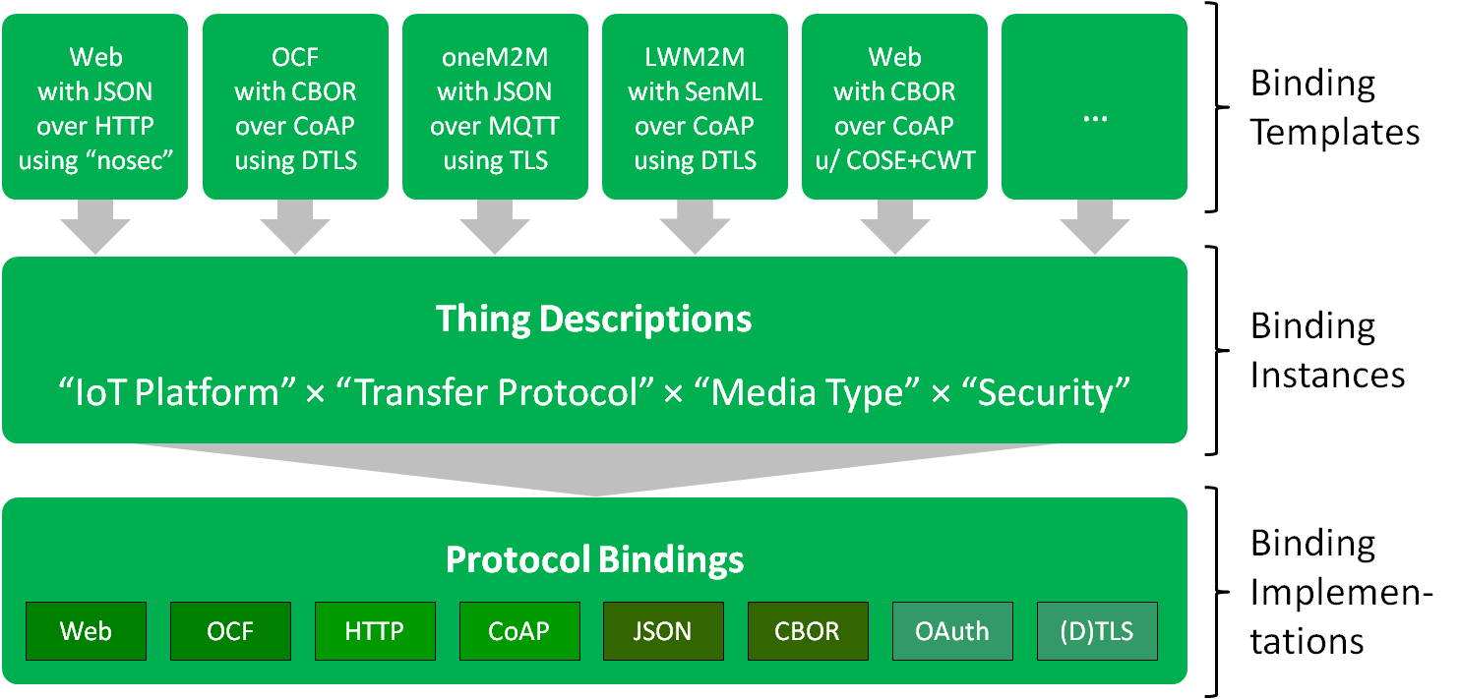
Protocol binding
A great challenge for the WoT is to enable interactions with a myriad of different IoT Platforms (e.g., OCF, oneM2M, RESTful devices not following any particular standard but providing an HTTP or CoAP interface, etc.). The IoT uses a variety of protocols for accessing devices, since no one protocol is appropriate in all contexts. W3C WoT is tackling this variety by including communication metadata in the Thing Description. This metadata can be used to configure the communication stack to produce compliant messages for a wide variety of target IoT Platforms and protocols.
The WoT Binding Templates are an informal collection of communication metadata blueprints that explain how to interact with different IoT Platforms. When creating a Thing Description for a particular device, the Binding Template for the corresponding IoT Platform can be used and instantiated in the Thing Description for that device.

Slide 22
Binding template
1.1 Protocol Adaptation
Protocol Binding Templates enable clients to adapt to the underlying protocol and network-facing API constructions. Once the base protocol (e.g., HTTP, CoAP, MQTT, etc.) is identified, the following adaptions specifiy the particular use within the given Platform.
1.1.1 Protocol Methods and Options
Most protocols have a relatively small set of methods that define the message type, the semantic intention of the message. As a starting point, a superset of REST and PubSub can cover most standard communication patterns. Common methods are GET, PUT, POST, DELETE, PUBLISH, and SUBSCRIBE.
The protocol methods are mapped to the abstract WoT Interaction verbs readproperty, writeproperty, observeproperty, invokeaction, subscribeevent, unsubscribeevent.
Possible protocol options are also specified in the Protocol Binding. They are used to select transfer modes, to request notifications from observable resources, or otherwise extend the semantics of the protocol methods.
1.1.2 Media Types
Maximum use should be made of IANA-registered Media Types (e.g., application/json) in order to decouple applications from connected Things. Standard bridges and translations from proprietary formats to Web-friendly languages such as JSON and XML are part of the adaptation needed.
WoT Protocol Bindings depend on consistent use of Media Types for customization of the upper layers.
1.1.3 Payload Structure
Data serialized to a standard Media Type still remains in a structure specific to the Platform data model and needs to be understood by clients (cf. various types of JSON documents).
The data definition language of DataSchema elements, described in [TD], allows for describing arbitrary structures by nesting of arrays and objects. Constants and variable specifications may be intermixed.

Slide 23
WoT servient architecture
Application
Separated servient (application/device separated from each runtime)
Servient is a WoT adapter for application/device to connect the runtime.
Application servient
Runtime(client)
ConsumedThing
TD manager
Protocol binding
WoT interface
Protocol binding for the applications that bind to Web-based interface such as REST/HTTP, CoAP and MQTT. It can also support existing IoT-PF like Oracle IoT Service Cloud.
Device servient
Protocol binding
Runtime(server)
Protocol binding for the device interfaces that transform various information model describing device functionarities and communication protocols.
ExposedThing
TD manager
Protocol binding
Device interface (propriety)
Hardware

Slide 24
Application
Application servient
Runtime(client)
ConsumedThing
TD manager
Protocol binding
Proxy servient
Protocol binding
WoT servient
Runtime(proxy)
Runtime(proxy)
ExposedThing
TD manager
ExposedThing
TD manager
ConsumedThing
ConsumedThing
Protocol binding
Protocol binding(device)
Protocol binding(application)
Protocol binding(serivent)
Device servient
Protocol binding
Runtime(server)
Devices
(ECHNET, OCF,…)
Applications
ExposedThing
TD manager
アプリケーションは、様々なIoT-PF上のアプリケーションやoneM2M等のアプリケーションが含まれる
Protocol binding
Hardware

Slide 25
Legacy device binding
Device servient
Application servient
Protocol binding
Application
Runtime(server)
ExposedThing
TD manager
Runtime(client)
ConsumedThing
TD manager
Protocol binding
Protocol binding
Hardware
Hardware
デバイスのbindingについては、多くの場合にはテンプレートをもとに変換することはできず、トランスポート、データ形式をそれぞれ変換する必要がある。
デバイスのインタフェースが、HTTP/CoAP/MQTTの場合には、
変換なしにデバイスを接続することができる。

Slide 26
Deployment scenario
Application Servient
C
E
ExposedThing
C
ConsumedThing
E
Device Servient

Slide 27
Application Servient
C
E
Proxy Servient
C
Device Servient
E

Slide 28
Application Servient
C
E
Remote Proxy Servient
C
E
Local Proxy Servient
C
Device Servient
E

Slide 29
Application Servient
C
Device Servient
E
Remote Proxy Servient
E
C
Application Servient
E
Local Proxy Servient
C
C
Device Servient
E

Slide 30
Application Servient
C
Device Servient
E
Remote Proxy Servient
E
C
Application Servient
E
Local Proxy Servient
C
C
Device Servient
E

Slide 31
Application Servient
C
TD directory
Device Servient
E

Slide 32
Application Servient
TD directory
C
E
Proxy Servient
C
Device Servient
E

Slide 33
TD directory
Application Servient
C
E
Remote Proxy Servient
C
E
Local Proxy Servient
C
Device Servient
E

Slide 34
TD directory A
TD directory B
Application Servient A
Application Servient B
C
C
E
Remote Proxy Servient A
Remote Proxy Servient B
E
Internet
C
C
E
Local Proxy Servient A
Local Proxy Servient B
E
C
C
Device Servient A
E
E
Device Servient B
Network A
Network B

Slide 35
Application Servient
C
WoT interface
E
Device Servient
Bridge
propriety
Non-WoT Device

Slide 36
Application Servient
C
E
Proxy Servient
C
Bridge
Non-WoT Device

Slide 37
Non-WoT Application
Bridge
Application Servient
C
E
Device Servient

Slide 38
Non-WoT Application
Bridge
E
Proxy Servient
C
Device Servient
E

