Slide 1
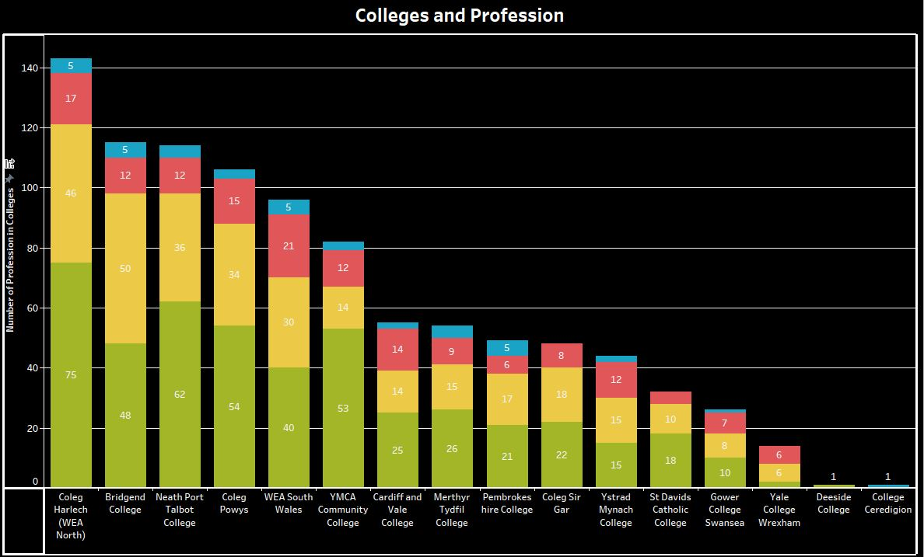
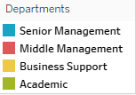
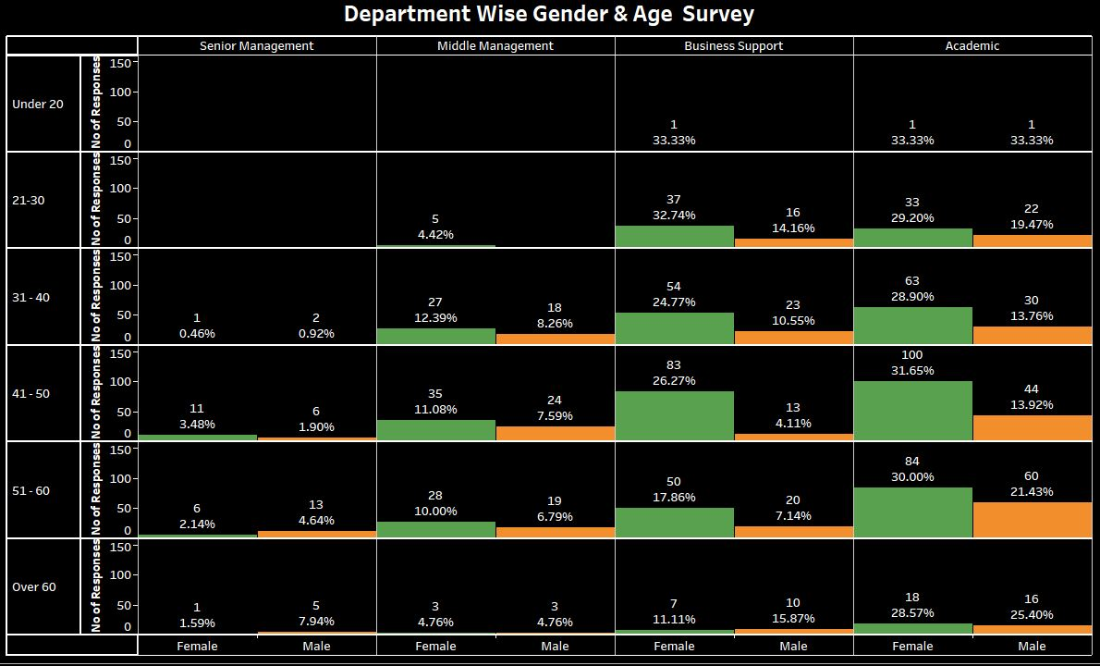
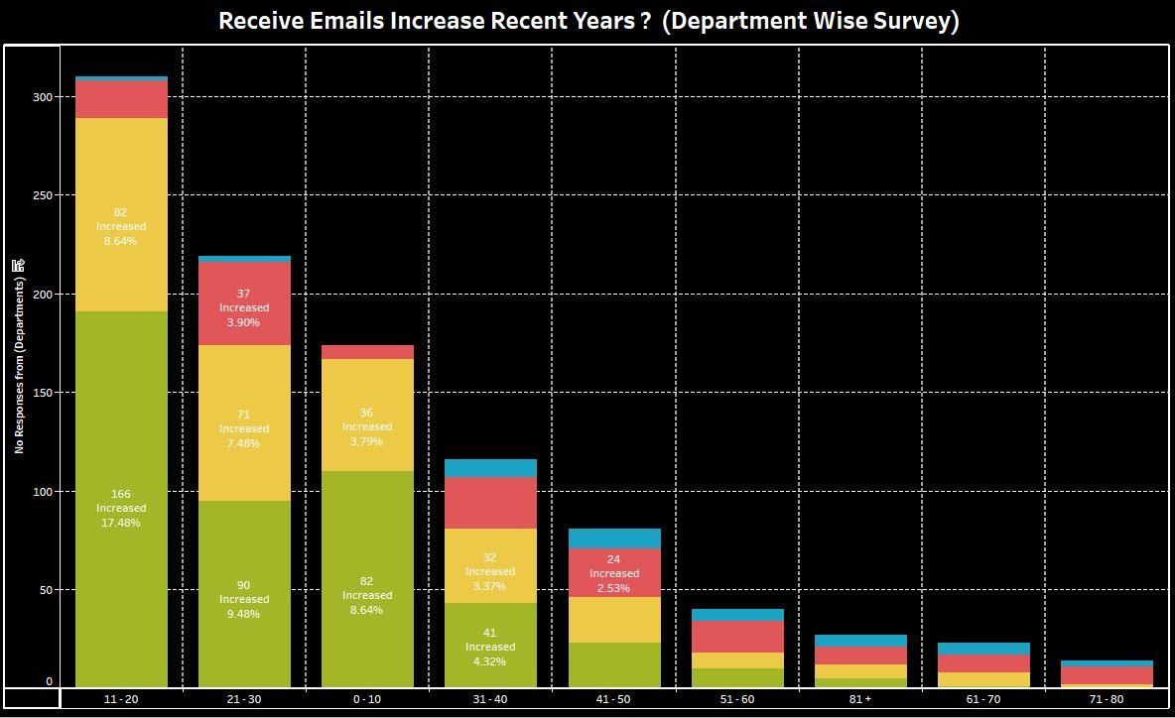
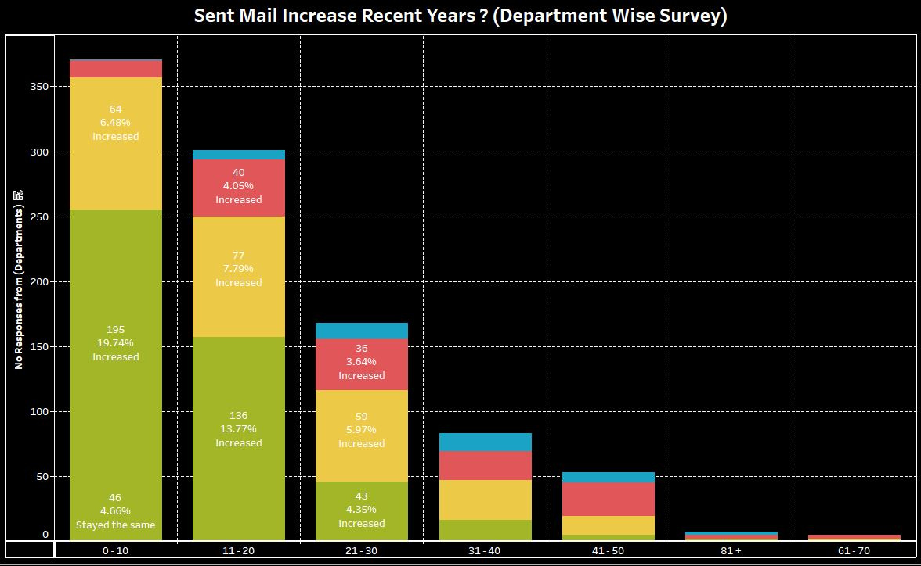
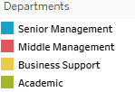
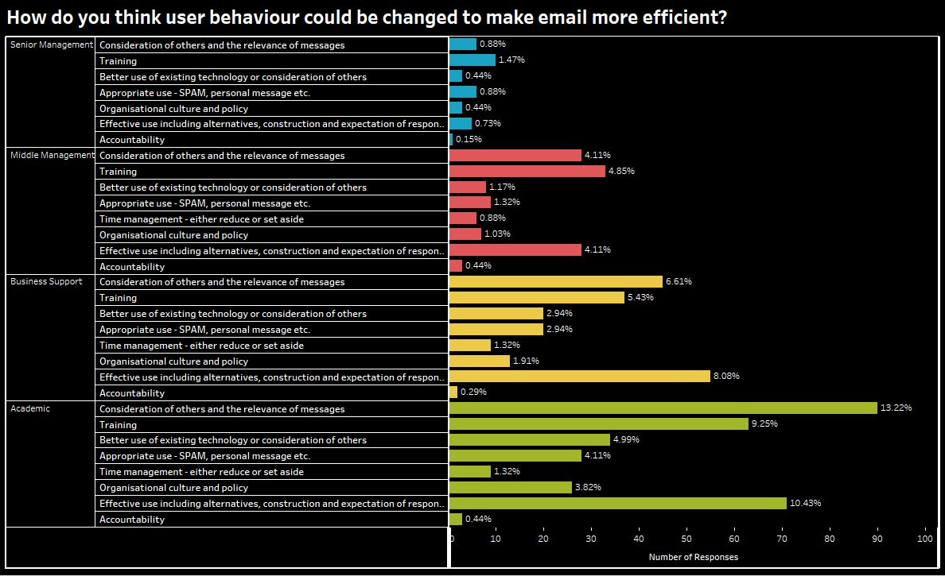
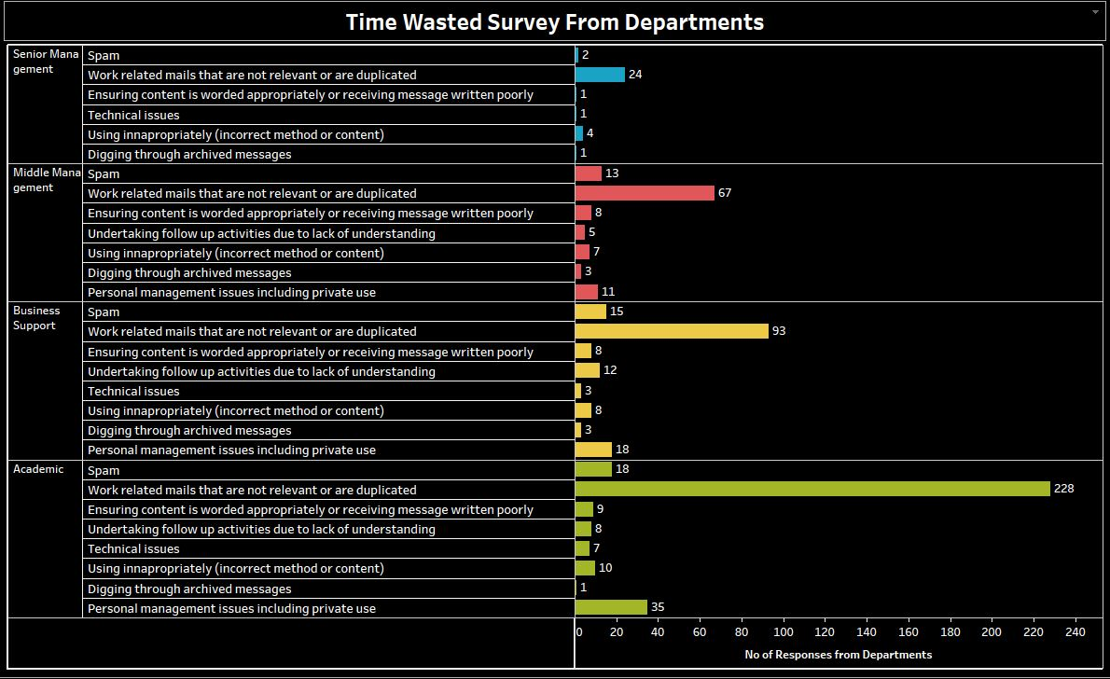
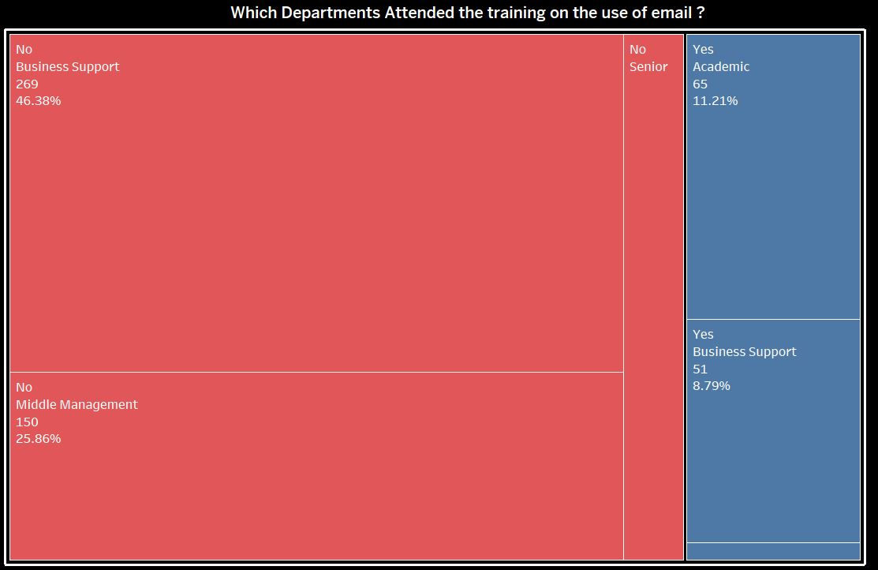
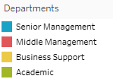
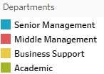

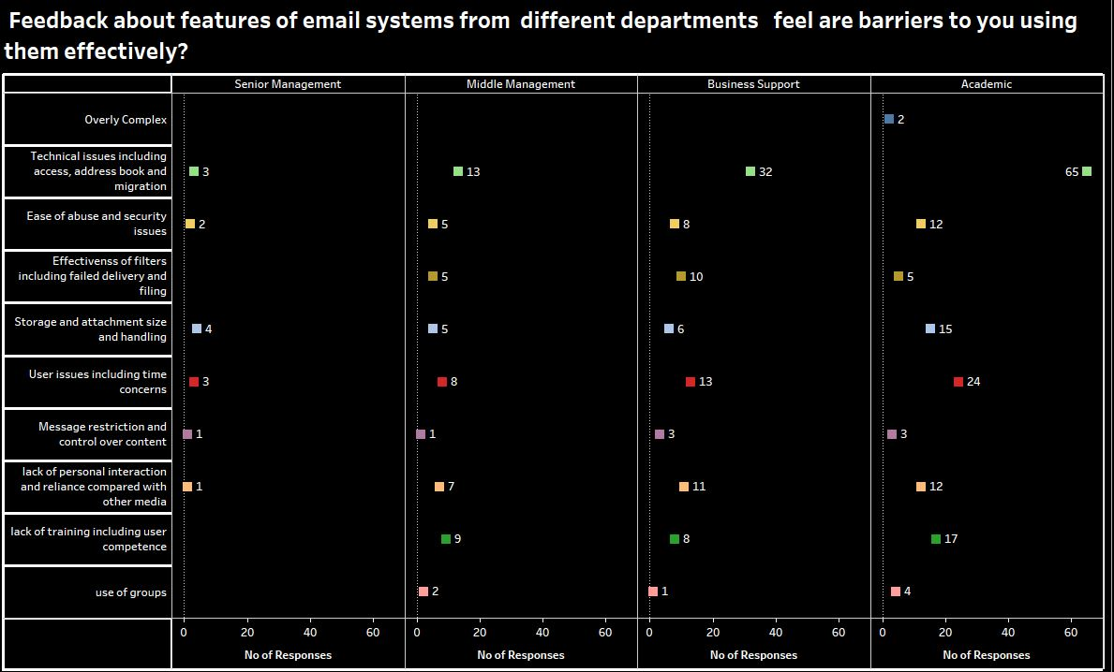
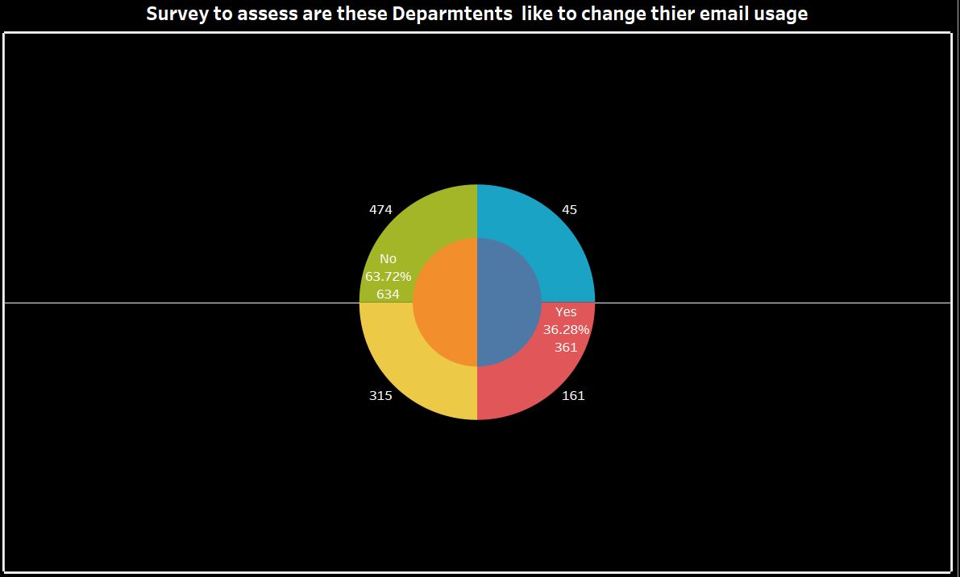
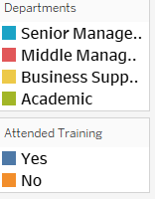
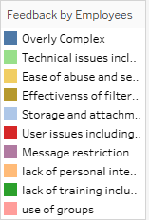
EMAIL SURVEY
INTRODUCTION – These visualizations are created in Tableau
with the help of a survey which was conducted by Ben Silverstone.I
have reviewed created 9 charts of visualizations mainly graphs
consists of different components like gender,age, departments and
feedback of different employees with the help of these graphs I
found a problem with the insights of Graph 3 and Graph 4 and then
I concluded a solution by the feedback of different employees that how
this problem can be solved
Notes:
Speaker Notes
INTRODUCTION : These visualizations are created in Tableau with help of survey which was conducted by Ben Silverstone.I have created 9 charts of visualizations mainly graphs consist of different components like gender,age,departments, with the help of these graphs I found a problem and suggested a solution which was given by feedback of departments peoples.

Slide 2
COLLEGES AND PROFESSIONS
Notes:
GRAPH 1 : College and Profession
In first bar graph,I have used two survey questions Colleges and Professions,with the help of these I have visualize that How many colleges have each profession employees like in graph we can see that there are nineteen colleges and four Professions.
Overall from first graph visualization we see that highest majority profession is Academic in most of colleges,and the least one profession is Senior Management in colleges.Business Support Employees are slightly more than Middle Management.

Slide 3
DEPARTMENTS WISE GENDER & AGE SURVEY
Notes:
GRAPH 2 : Department wise Gender & Age Survey
In second stacked bar graph,I have used three survey questions which represents Age,Gender and Departments with the help of these I have visualize and get more detailed insights. From this graph I can visualize that the number of Employees overall in each department are starting from 21-30 age below 20 there are very less departments which have hired employees.In this graph I have visualize that (Over 60) there are very less employees in each department.Lastly I have concluded that for Senior Management positions the mainly age bracket is 40 to 60 below this there are only one or two people that have been hired.

Slide 4
RECIEVE AND SENT MAIL INCREASE RECENT YEARS ?
Notes:
GRAPH 3 : Receive Email Increase Recent Years In third graph,I have used three questions which represents Departments,No of Emails,and Volume with the help of these I have visualize and get insights.By visualizing this graph I concluded that the most email receiving department are Academic and Business Support which have increased recent years,Middle Management also slightly increased but not much in comparison of Academic and Business Support Departments.In last I analyzed that only there is one Senior Management Department which is not increased in recent years like other departments. GRAPH 4 : Sent Email Increase Recent Years
In fourth graph,I have used three questions which represents Departments,No of Sent Emails,and Volume with the help of these I have visualize and get insights.By visualizing this graph I concluded that the most email sent department are Academic and Business Support which have increased recent years,Middle Management also slightly increased but not much in comparison of Academic and Business Support Departments.In last I analyzed that only there is one Senior Management Department which is not increased in recent years like other departments.
(In poster I have merged these graphs) After visualization of Graph 3 and Graph 4,I analyzed a problem that there are only two Departments Middle Management and Senior Management which are not sending and receiving emails in comparison to other departments.Now I have to solve this problem by doing more visualization in other graphs.

Slide 5
SURVEY HOW USER BEHAVIOUR COULD BE CHANGED TO MAKE EMAIL MORE EFFICENT
Notes:
GRAPH 5 : Feedback about features of email systems from different departments that feels are barriers to using them effectively
As in previous Graphs 3 and 4 I have found a problem,now I have to find a solution,So for fourth graph I have used two questions Departments and Feedback that are barriers with the help of these I have visualize different feedback from departments.But now I will focus on only Senior and Middle Management Departments there sending and receiving email usage is very low.So by visualizing fifth graph I concluded that most of Department Employees stated that Technical Issues , Ease of abuse Security Storage and attachment size and handling and lack of training including user competence are barriers of email system which reduce them it using effectively.

Slide 6
TIME WASTED SURVEY FROM DEPARTMENTS
Notes:
GRAPH 6 : Time Wasted Survey from Departments Employees
In sixth graph,I have used two different questions of Departments and Feedback of Employees regarding Time wastage with the help of these I have done visualization.
In this graph I will only discuss on Senior and Middle Management because as I have earlier said that their email usage is very low.
In sixth graph I have concluded that majority of Employees from Senior and Middle Management responded that work emails that are not relevant or duplicated ,Spam emails,incorrect method or content and Personal Management issues including private use are the causes of time wastage in emails.

Slide 7
WHICH DEPARTMENTS ATTENDED THE TRAINING ON THE USE OF EMAIL
Notes:
GRAPH 7 : Which Departments attended the training on the use of email ?
In seventh graph I have used tree-maps,it consists of two questions related to Departments and Are Employees attended the training “YES” or “NO”,with the help of these I have done visualizations and concluded that Middle and Senior Management are the department which have not attended training on the use of email.

Slide 8
FEEDBACK ABOUT FEATURES OF EMAIL SYSTEMS FROM DIFFERENT DEPARTMENTS
Notes:
GRAPH 8 : How do you think that user behaviour could be changed to make email more efficient ?
In eighth graph,I have used two questions related to Department and Feedback from employees that how user behaviour could be changed to make email more efficient. From this graph I analyzed that from four different department employees gives a feedback that how behaviour can be change in order to make email more well-organized.As Senior and Middle Management responded that Consideration of others and relevance of messages,Time Management ,Appropriate use - SPAM,personal messages etc and Training

Slide 9
SURVEY TO ASSESS ARE DEPARTMENTS WILLING TO CHANGE THIER EMAIL USAGE
Notes:
GRAPH 9 : How do you think that user behaviour could be changed to make email more efficient ?
In ninth graph I have used Pie Chart and Doughnut chart,it consists of two questions Departments and a question are Departments Employees are will to change their email usage “YES” or “NO”.From this graph I visualize that 36.28% Employees are willing to change their email usage and 63.72% .

Slide 10
Conclusion
Overall I concluded that as I found a problem in graph
(3,4) where Senior and Middle Management are not
sending or receiving emails,So we have used different
questions and visualize the feedback of employees of
from Senior and Middle Management as some of
employees from these departments think that email
waste time,some of employees feels that few features
of email systems are barrier to using them
effectively,and the main thing I analyzed that most
employees from these two departments have not
been participating in a training in comparison to other
departments,Due to this they are not sending or
receiving email.And in last question the employees
from Senior and Middle Management are willing to
change their email usage,So I analyzed if they will get
proper training where attendance is mandatory then
this problem can be solved easily.

