Slide 1
Lab Experience in Signals and Data Processing
Traditional Kalman Filter and Unsupervised Kalman Filter
Prof. Mattia Brambilla
Mohammadreza Zamani
Asal Abbas Nejad Fard
Yuzhu Feng
December 2025
Notes:
Hello everyone. Our project compares traditional Kalman filtering and unsupervised KalmanNet for vehicle trajectory estimation.

Slide 2
Contents
Trajectory
Plan A: Traditional Method
Plan B: Kalmannet
Comparison
Notes:
This presentation includes trajectory setup, two method descriptions, and result comparisons.

Slide 3
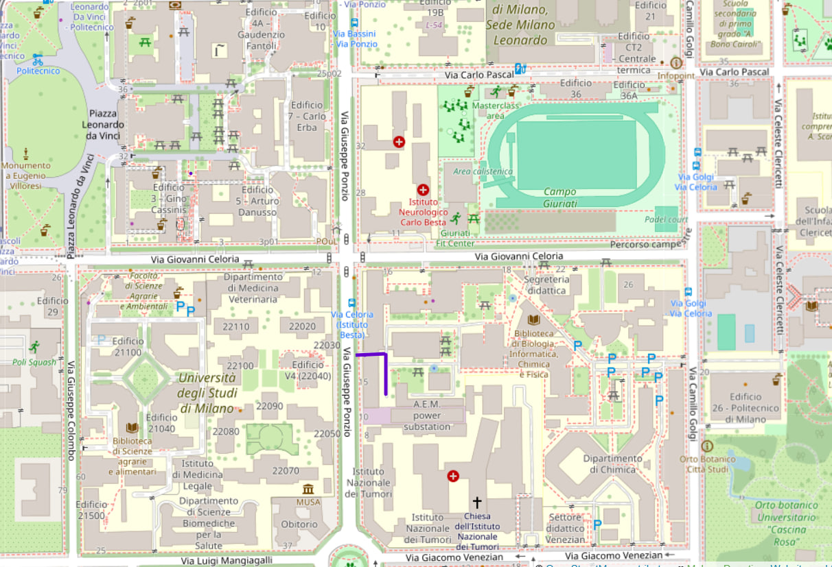
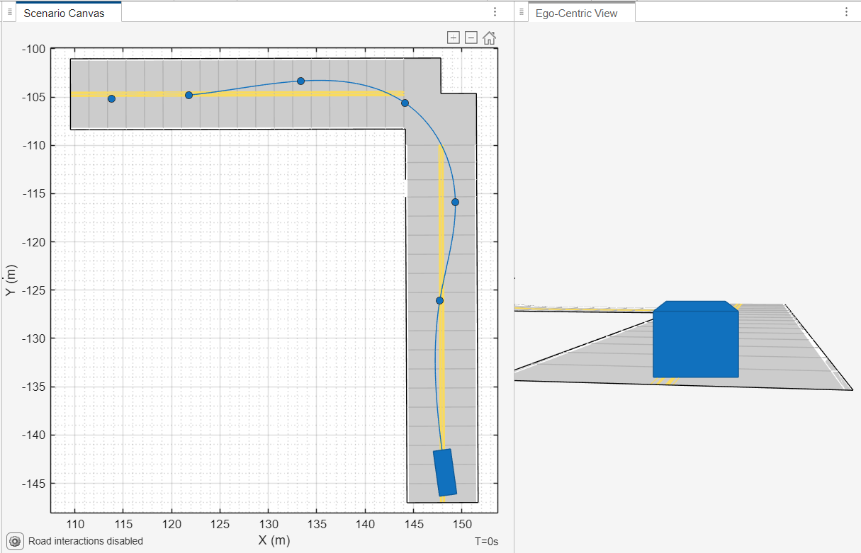
Trajectory
Notes:
The vehicle trajectory is generated using MATLAB drivingScenario, providing accurate ground truth positions.

Slide 4
Setup
Vehicle Tracking with Noisy GPS
Vehicle Trajectory Generated using MATLAB drivingScenario
Ground truth position is known
GPS measurements corrupted with Gaussian noise
Standard deviation: 5 m
Objective: reduce GPS error using a model-based tracking filter
Notes:
Gaussian noise with 5 m standard deviation is added to simulate GPS measurements.
The goal is to reduce localization error under GPS-only conditions.

Slide 5
Ego Vehicle Modeling
Create an ego vehicle as the main controlled object
Vehicle type: passenger car
Define initial position and vehicle mesh
Trajectory Planning
Waypoints define the vehicle driving path
The ego vehicle follows the waypoints sequentially
Constant speed is applied along the trajectory
Notes:
An ego vehicle is created as a passenger car and serves as the tracked object.
This ego vehicle is used consistently throughout the trajectory generation and trajectory estimation experiments.
The vehicle follows predefined waypoints at a constant speed to simplify modeling.
This setup generates smooth, repeatable trajectories, providing a unified reference for fair comparison between methods.

Slide 6
Plan A: Traditional Method

Slide 7
Traditional Baseline
Simulate a vehicle trajectory using a driving scenario
Generate noisy GPS-like position measurements
Estimate the true trajectory using a classical state estimation approach
Data Generation
Ground truth obtained from egoVehicle.Position
Automatic selection of the dominant 2D motion plane
Notes:
it adaptively estimates the Kalman gain within a classical Kalman filtering framework.

Slide 8
Filtering Method
Interacting Multiple Model (IMM) filter with:
Constant Velocity (CV) model
Constant Acceleration (CA) model
Model transition probabilities fixed a priority
Measurement update with NIS-based gating
Statistical Consistency
NIS evaluated at each time step
Mean NIS close to theoretical expectation, indicating a well-tuned filter

Slide 9
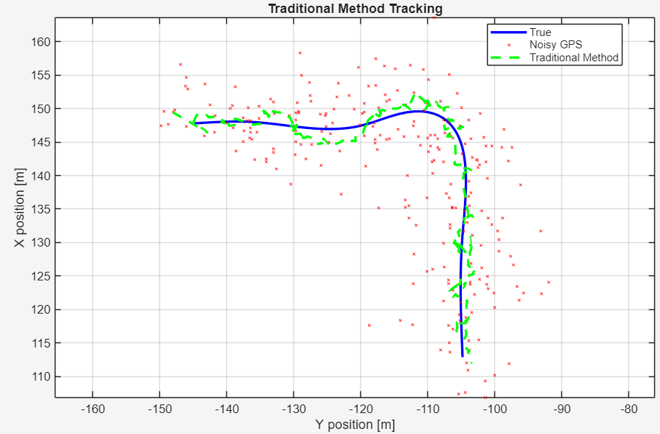
Results1
Notes:
Deviations are observed in high-curvature turning regions, indicating limited modeling of complex dynamics.

Slide 10
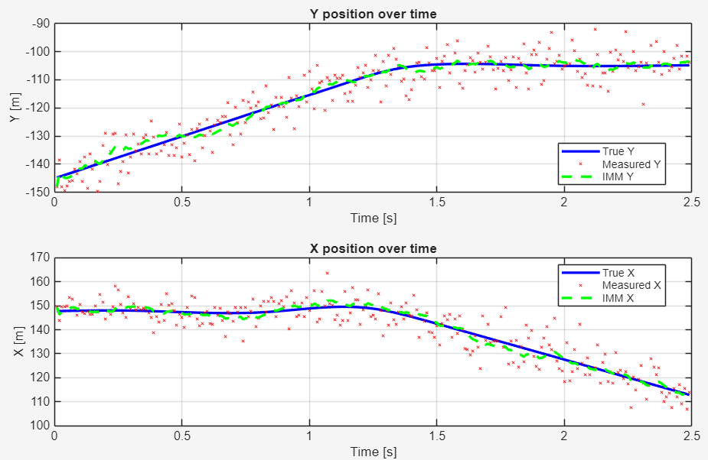
Results2
Notes:
Over-smoothing and slight lag occur during rapid motion changes.

Slide 11
Results3
Metric | Noisy GPS | Traditional Method
RMSE [m] | 7.1674 | 1.9211
MAE [m] | 6.3535 | 1.7107
MAX [m] | 16.8064 | 4.3493
Bias X [m] | -0.0005 | 0.1800
Bias Y [m] | 0.1159 | -0.0226
Notes:
RMSE, MAE, and maximum error are substantially reduced compared to noisy GPS.
A residual bias remains in the Y direction, suggesting limitations of the unsupervised loss.
The unsupervised KalmanNet effectively reduces measurement noise while preserving motion trends, but shows limitations in high-curvature and fast-changing dynamics.

Slide 12
Plan B: Unsupervised Learning (kalmannet)

Slide 13
Overview
Model based Kalman Filter with Constant Acceleration (CA) dynamics
Noisy GPS position measurements as observations
Process noise and measurement noise are time varying and learned from innovations
Training is unsupervised using innovation negative log likelihood (NLL)
Notes:
Position is measurable, but velocity and acceleration are not.
Hidden states are estimated recursively through filtering.

Slide 14

Constant Acceleration (CA) Motion Model
Acceleration is assumed constant within each sampling interval.
Linear state transition model
Model | Expressiveness | Robustness | Complexity
CV | Low | High | Low
CA captures short-term vehicle dynamics better than CV
More expressive than CV, but more stable than higher-order models
Suitable for noisy GPS-only scenarios

Slide 15
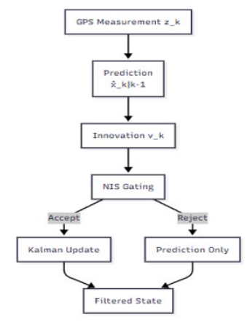
Filtering Framework and NIS Gating

Slide 16
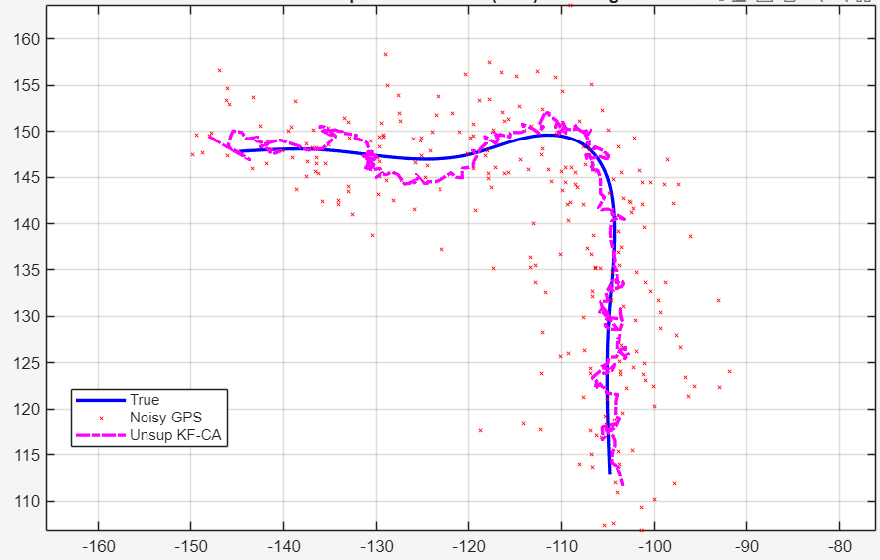
Results 1
Notes:
The filtered trajectory closely follows the ground truth throughout the motion.
Stable and smooth behavior is observed in both straight and turning segments.
The trajectory is physically consistent with vehicle motion.

Slide 17
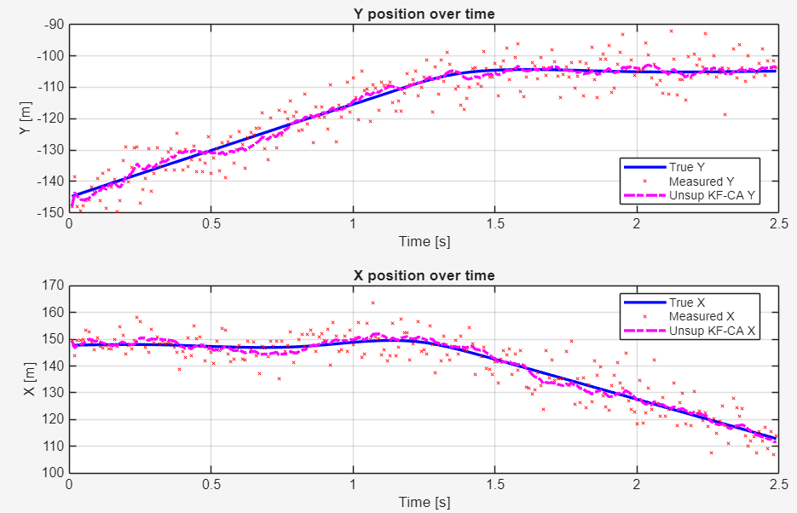
Results 2
Notes:
The temporal evolution of X and Y positions is accurately tracked.
No noticeable lag is observed at turning points or during dynamic changes.
Estimated positions are nearly indistinguishable from the ground truth

Slide 18
Results 3
Metric | Noisy GPS | Unsupervised
RMSE [m] | 7.1674 | 1.9375
MAE [m] | 6.3535 | 1.7240
MAX [m] | 16.8064 | 4.1024
Bias X [m] | -0.0005 | -0.0258
Bias Y [m] | 0.1159 | 0.0265
Notes:
Low RMSE, MAE, and maximum error indicate high positioning accuracy.
Near-zero bias in both X and Y directions.
Mean NIS ≈ 1.99 confirms the statistical consistency of the filter.
Explicit motion and noise modeling with strong interpretability.
Robust to measurement noise and outliers.
Stable and reliable performance when the model is well matched.

Slide 19
Comparison 1
Notes:
Plan 1 (KalmanNet) smooths noisy GPS but shows deviation and lag in high-curvature turns.
Plan 2 (CA KF) closely follows the ground truth in both straight and turning segments.

Slide 20
Comparison 2
Notes:
Plan 2 shows accurate and responsive tracking of X/Y positions.
Plan 1 exhibits over-smoothing and slight temporal l

Slide 21
Comparison 3
Metric | Noisy GPS | Plan A | Plan B
RMSE [m] | 7.1674 | 1.9211 | 1.9375
MAE [m] | 6.3535 | 1.7107 | 1.7240
MAX [m] | 16.6480 | 4.3493 | 4.1024
Bias X [m] | -0.5014 | 0.1800 | -0.0258
Bias Y [m] | 0.6168 | -0.0226 | 0.0265

