Slide 1

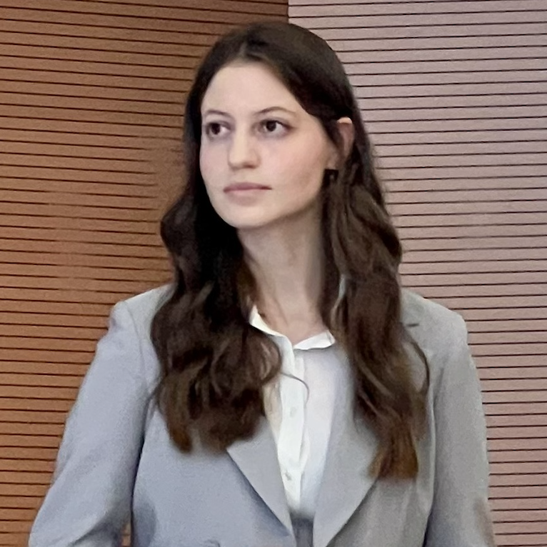


Project on GPR
Geophysical Data Processing
Concrete Wall, May 2022
Team Members:
Alessia Radicula
Mohammadreza Zamani
Asal Abbas Nejad Fard
December 2025

Slide 2
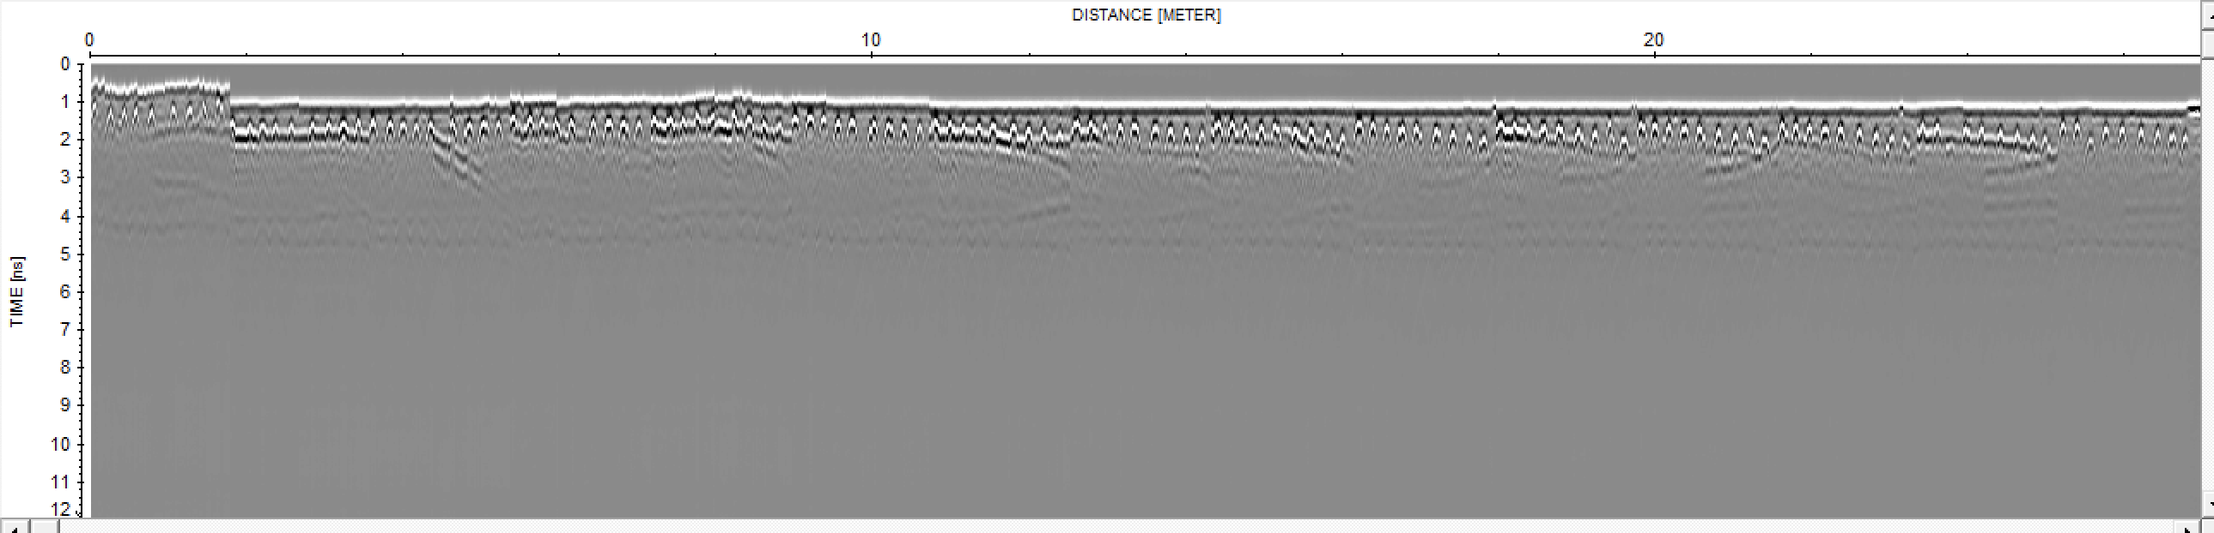
Geophysical Data Processing
Raw Data
Objective:
Process the data to see the 15 parallel vertical profiles on a concrete wall of a car box in the basement of a new building.
To take into consideration:
Bars are close to the surface (no Gain needed for the processing).
It is fundamental to align the background signal of all the profiles.

Slide 3
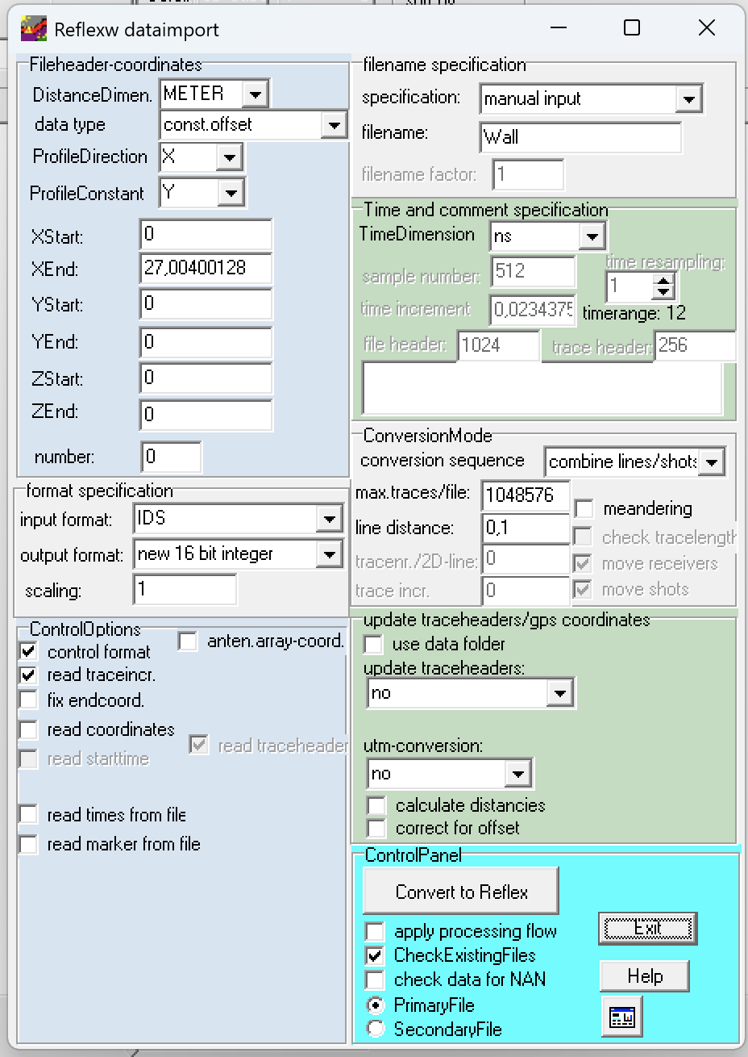
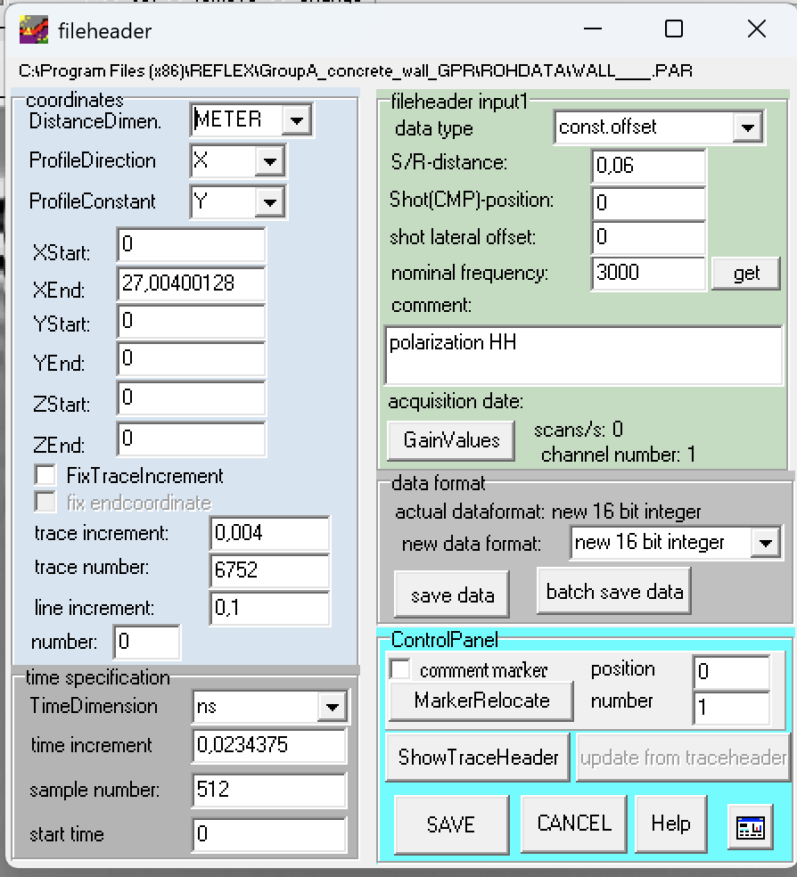
Geophysical Data Processing
Data Import and 2D Settings
Nominal frequency: 3GHz
TX‐RX distance: 6 cm
Profile Interdistance: 10 cm
Polarization: HH
Trace increment: 4 mm
Trace number: 6752

Slide 4
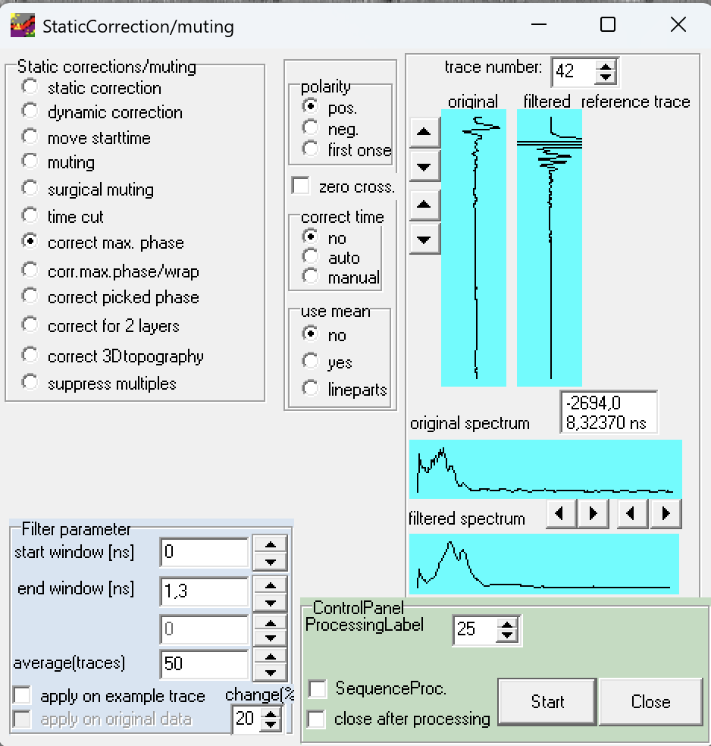
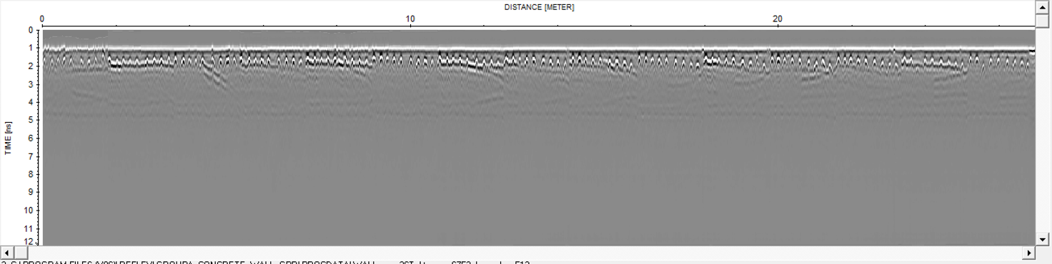
Geophysical Data Processing
Profile Alignment
We applied the correct max. phase two times to align all the profiles in the best way possible.
First correct max. phase operation
Window parameters:
Start: 0 ns
End: 1,3 ns
Average traces: 50

Slide 5
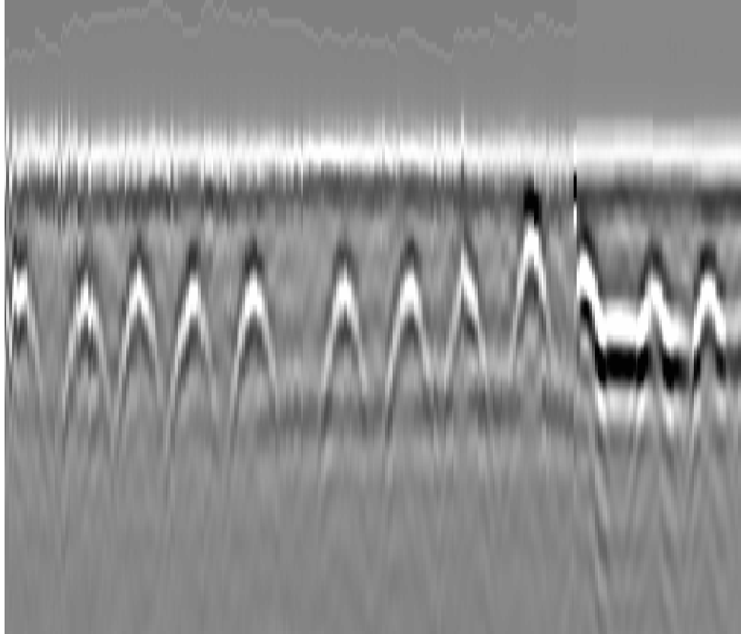
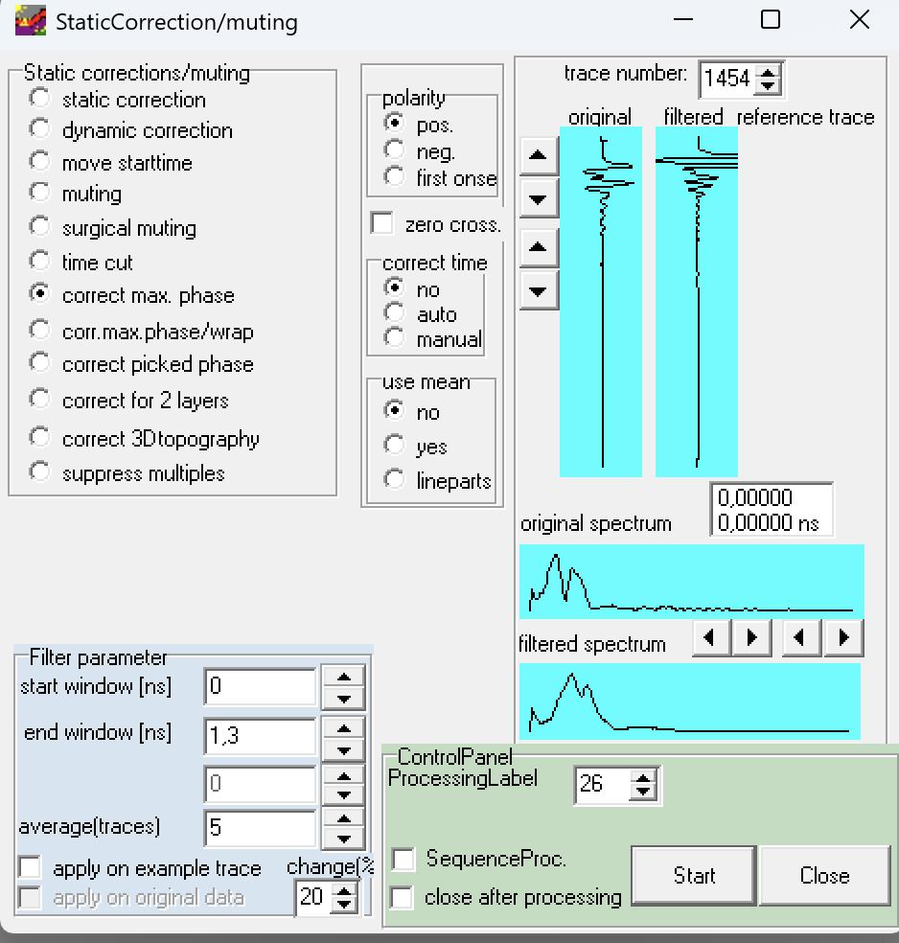
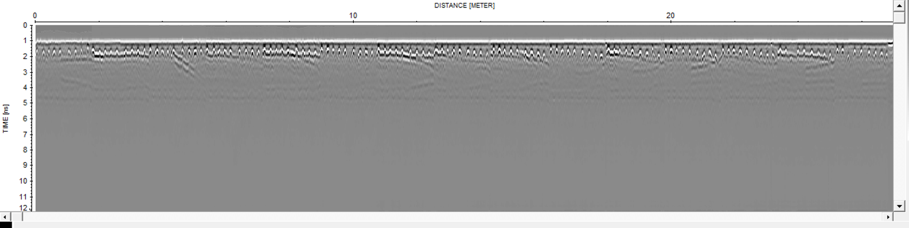
Geophysical Data Processing
Profile Alignment
We applied the correct max. phase 2 times to align all the profiles in the best way possible.
Second correct max. phase operation
Window parameters:
Start: 0 ns
End: 1,3 ns
Average traces: 5

Slide 6
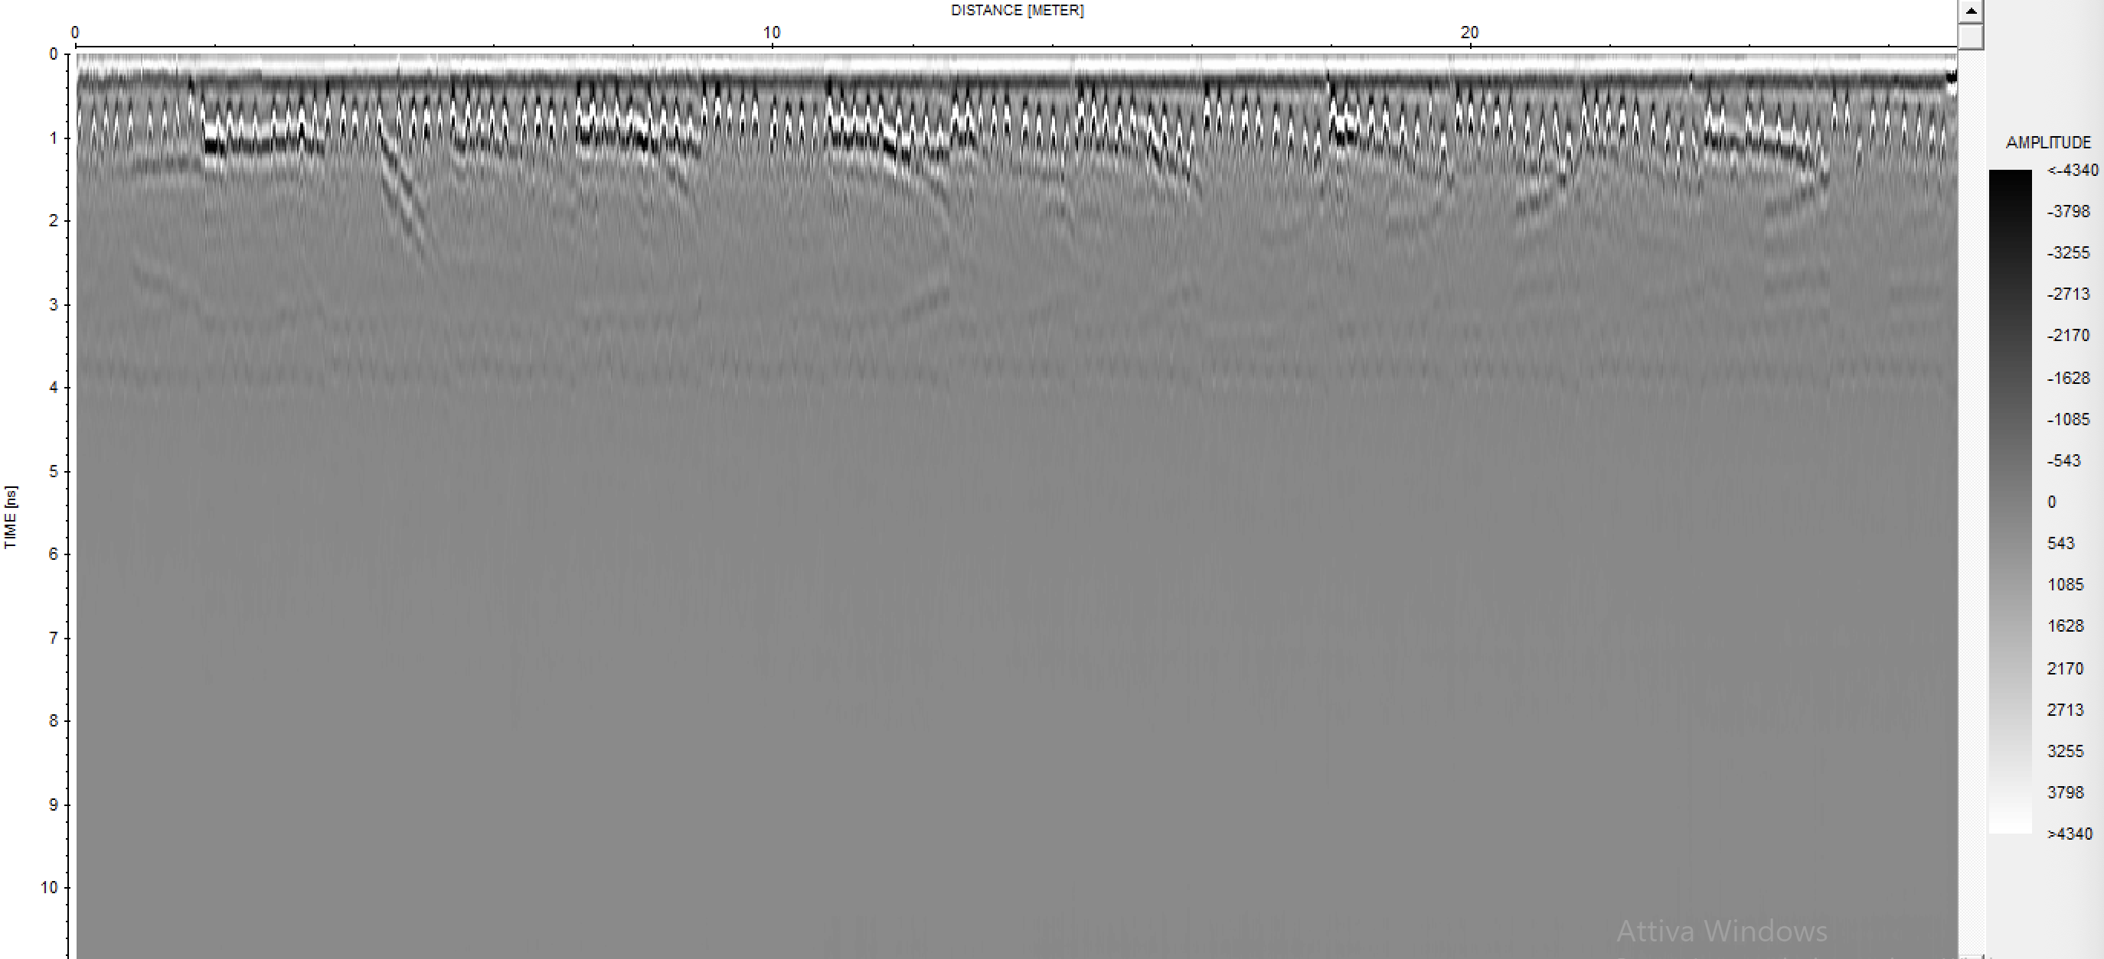
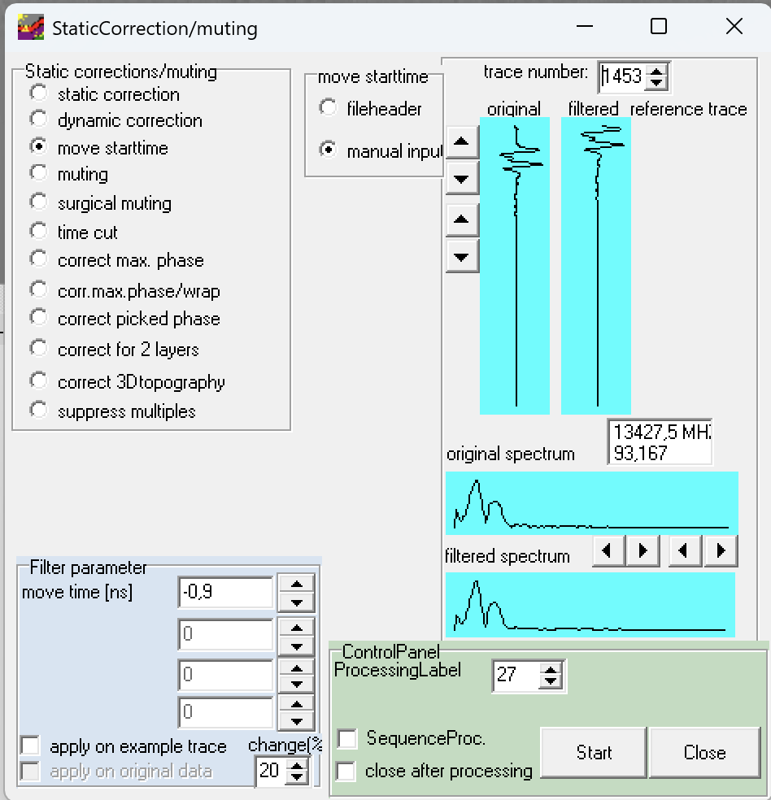
Geophysical Data Processing
Time Calibration
We moved up the data by 0,9 ns using the move start-time option.

Slide 7
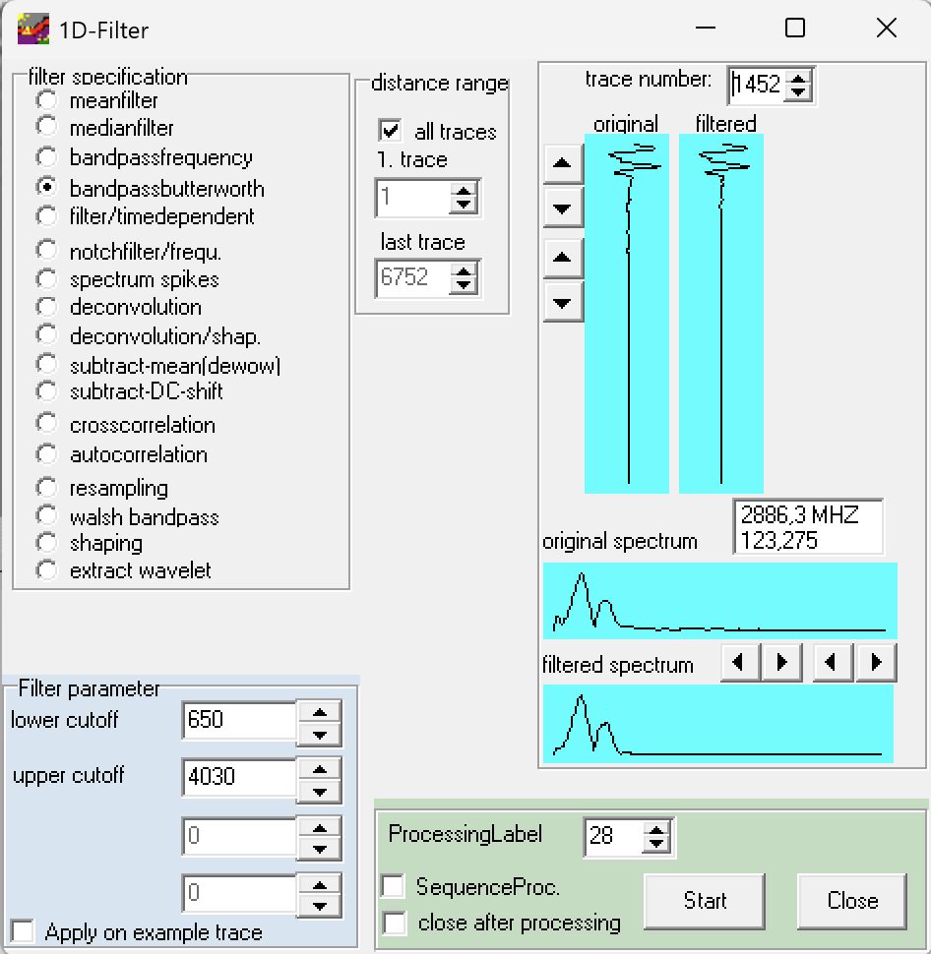
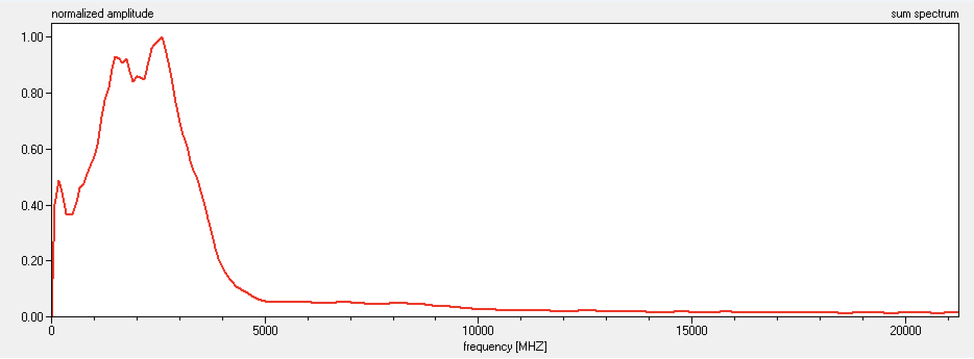
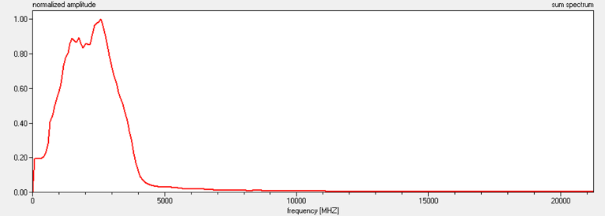
Geophysical Data Processing
Filtering
We filter the data to obtain the most energetic region of the spectrum
Spectrum before filtering
Spectrum after filtering

Slide 8
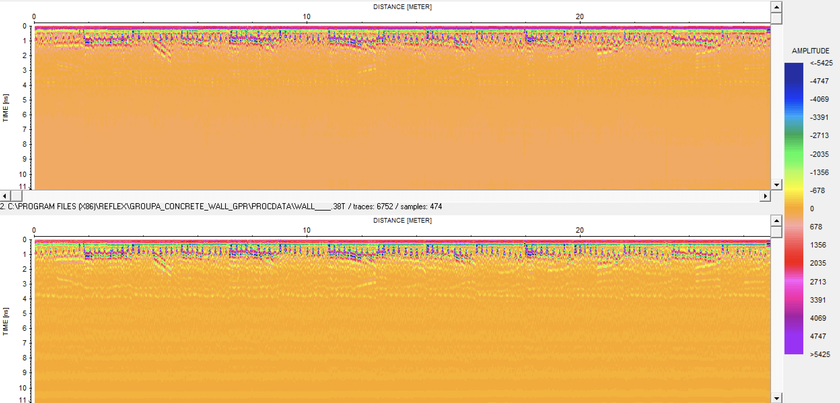
Comparison Original vs Bandpassbutterworth
Geophysical Data Processing

Slide 9
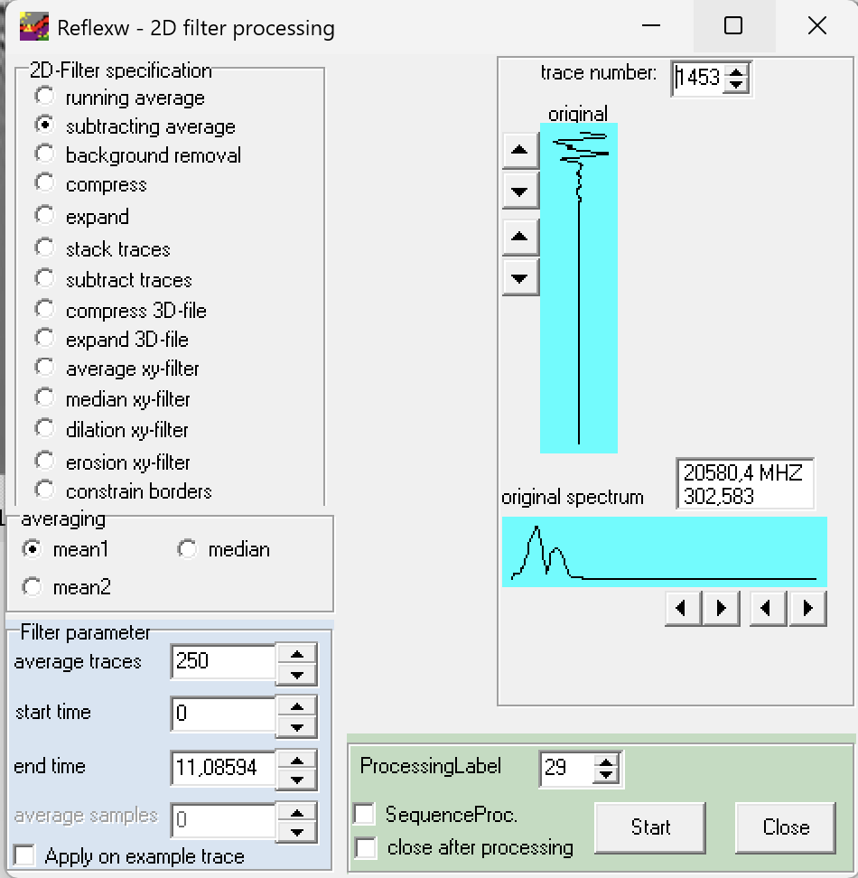
Background Subtraction
Geophysical Data Processing
We used a subtracting average procedure to find the best result for our data by removing efficiently the background noise.
Average traces parameter was calculated based on the data to consider half the profile for each averaging window.
Parameters:
Profile total length: 2m
Trace increment: 0,004m
Average traces: 250

Slide 10
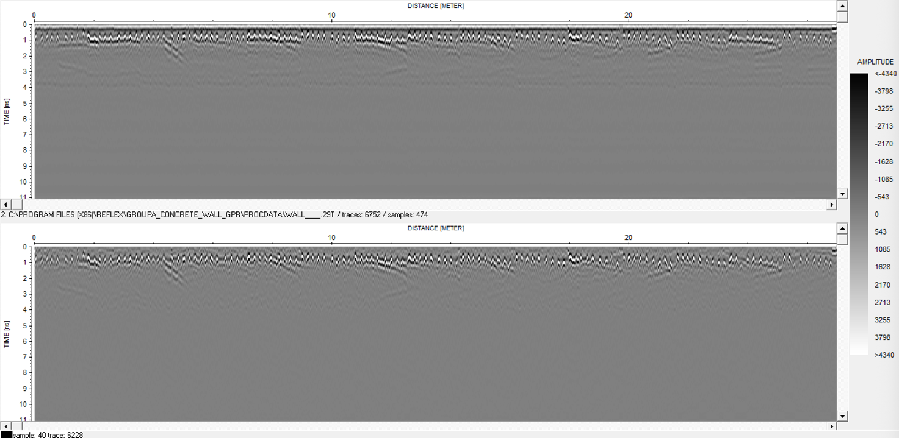
Background Subtraction
Geophysical Data Processing

Slide 11
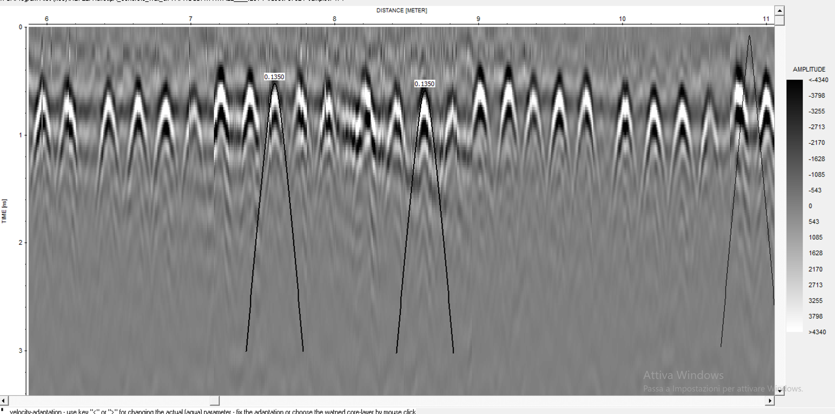
Geophysical Data Processing
Velocity Analysis
We noticed that the velocity changes across the data, however 0,135m/ns produces a good result for migration.

Slide 12
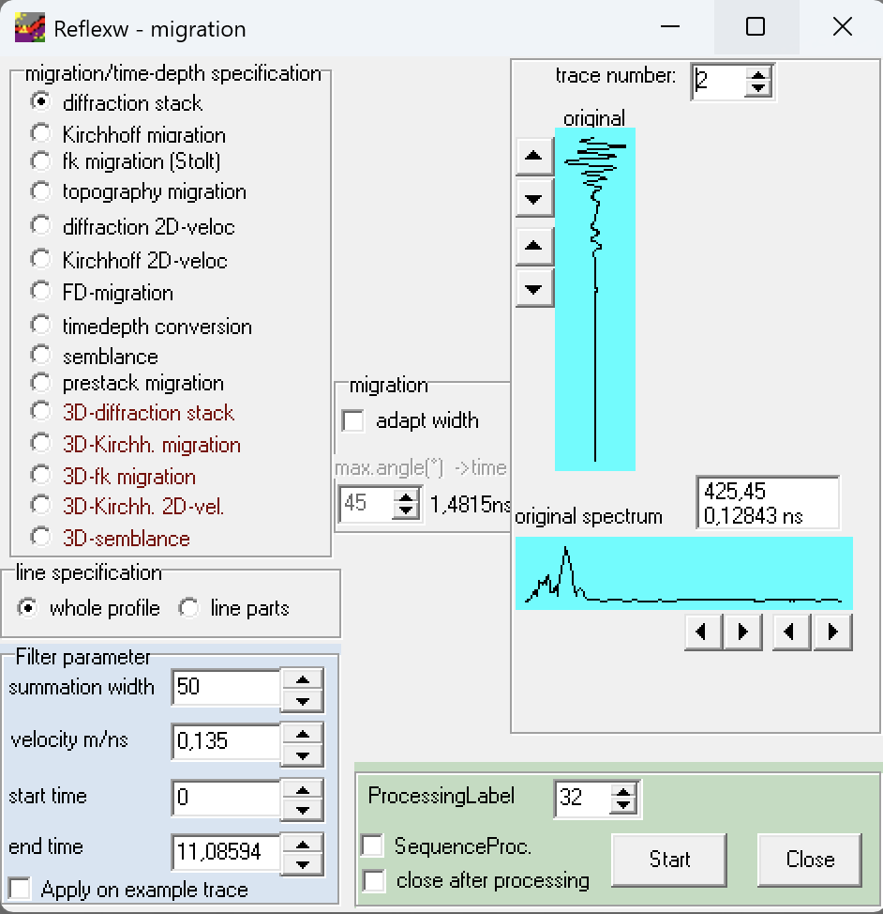
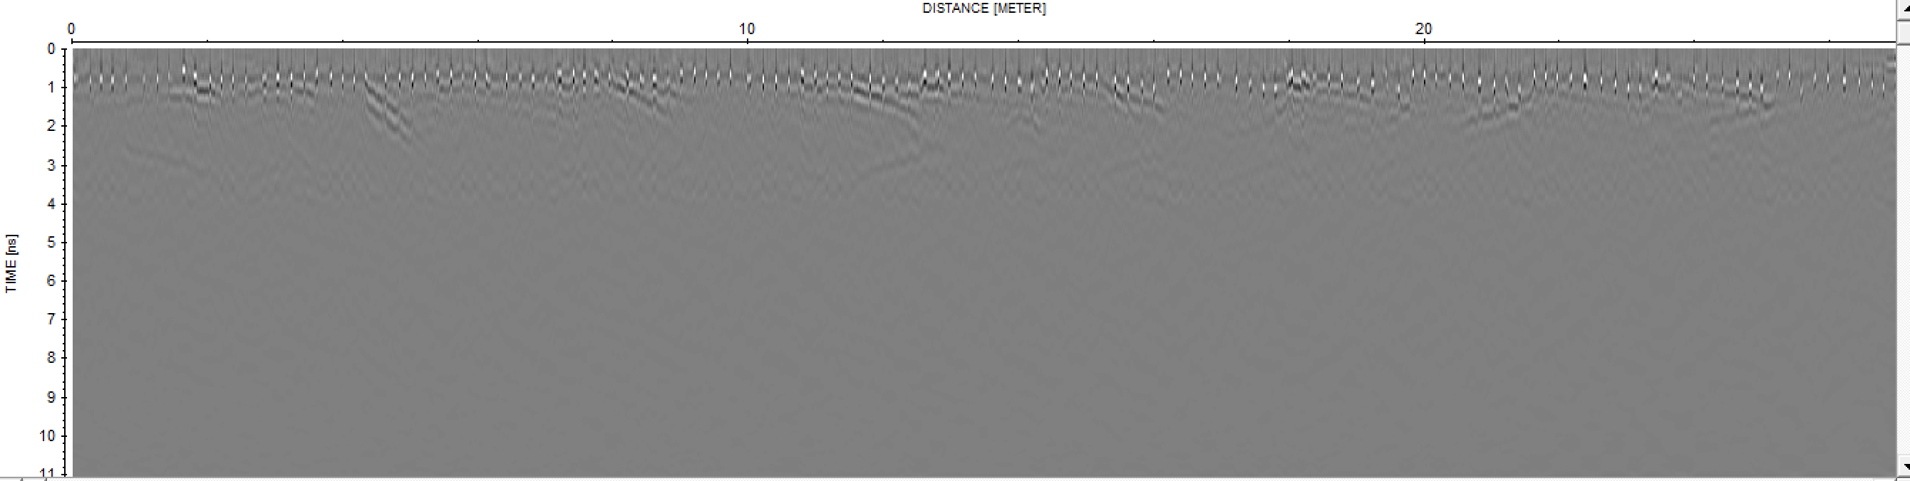
Geophysical Data Processing
Migration
The summation width has been chosen to reduce the noise in the data and better localize the rebars in the wall.
We calculated the summation width by estimate the aperture of the diffraction parabolas (almost 0,2m) and considering the trace increment (0,004m) → we obtain a width of 50

Slide 13
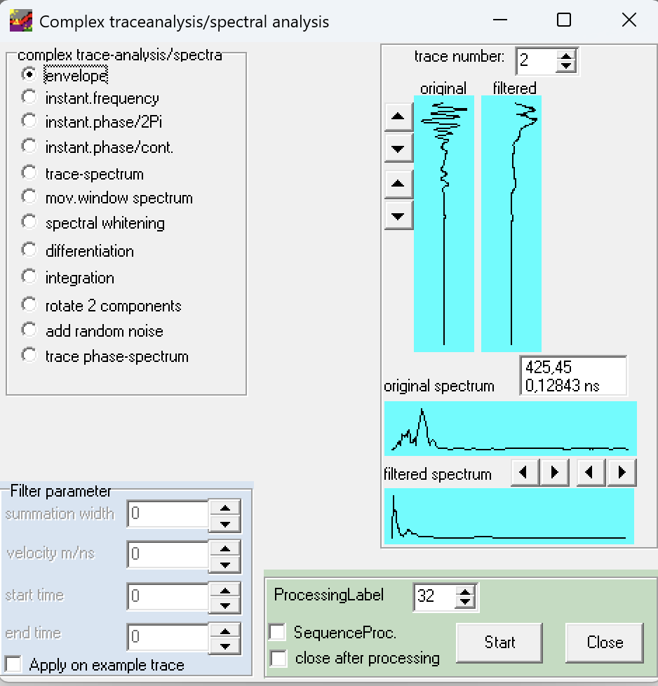
Geophysical Data Processing
Envelope Extraction
We performed the migration to have better results.
We consider just the positive values as shown in the color bar on the right side of the graph.
We also added the depth axis using the velocity of 0,135m/ns

Slide 14
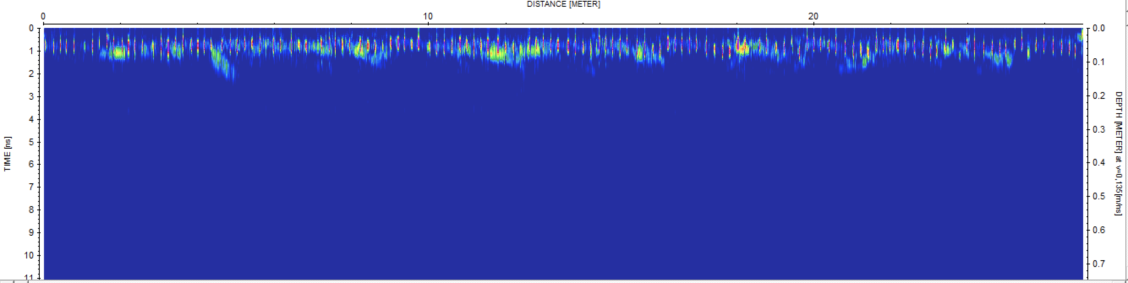
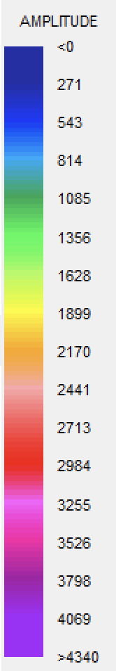
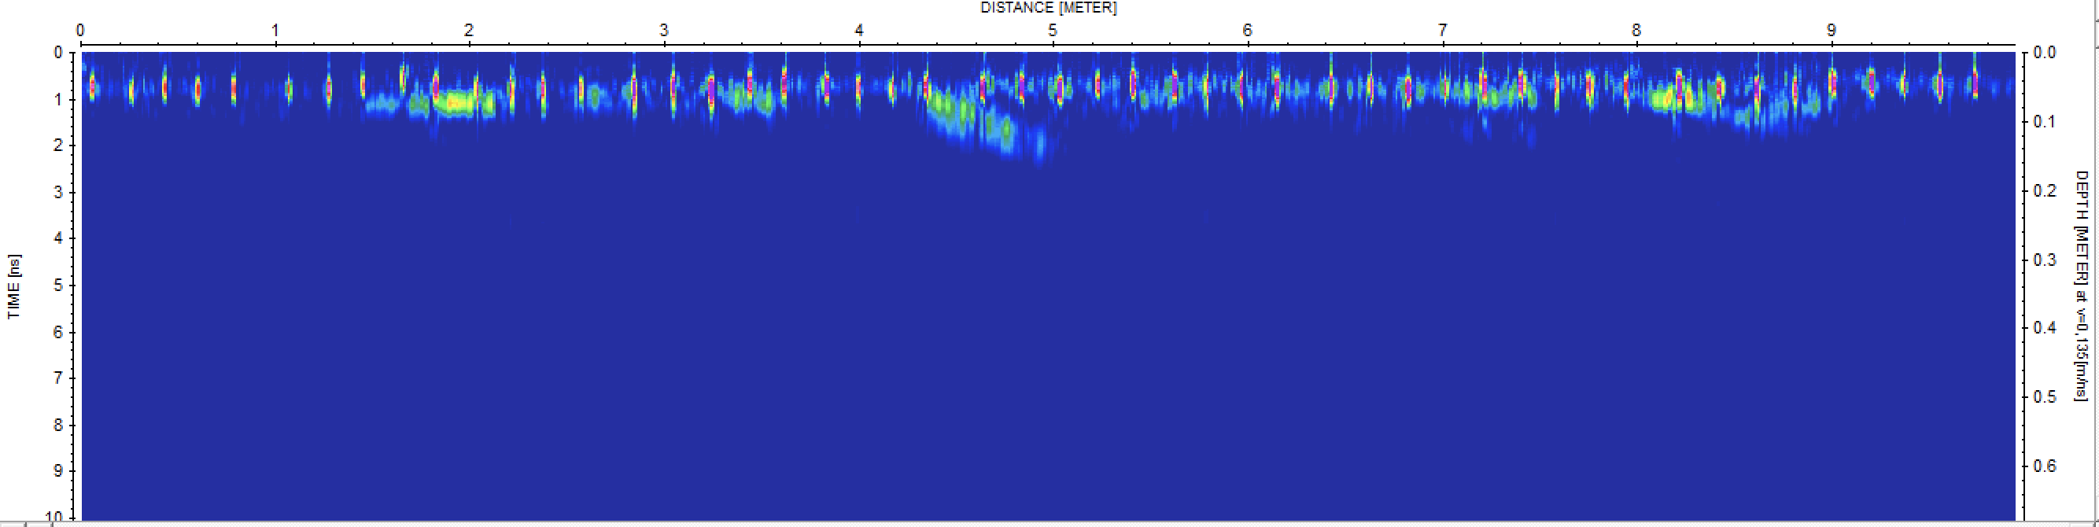
Geophysical Data Processing
Envelope Extraction
Full
dataset
Zoomed
dataset

Slide 15
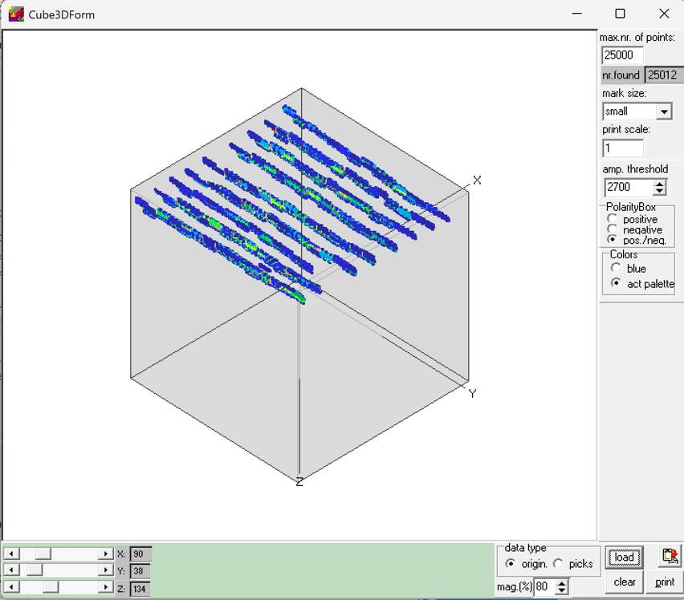
Geophysical Data Processing
3D model
We observed the rebars by using the 3D cube representation that shows clearly the rebars in the wall
We notice that the rebars are not straight due to some variation during data collection

Slide 16
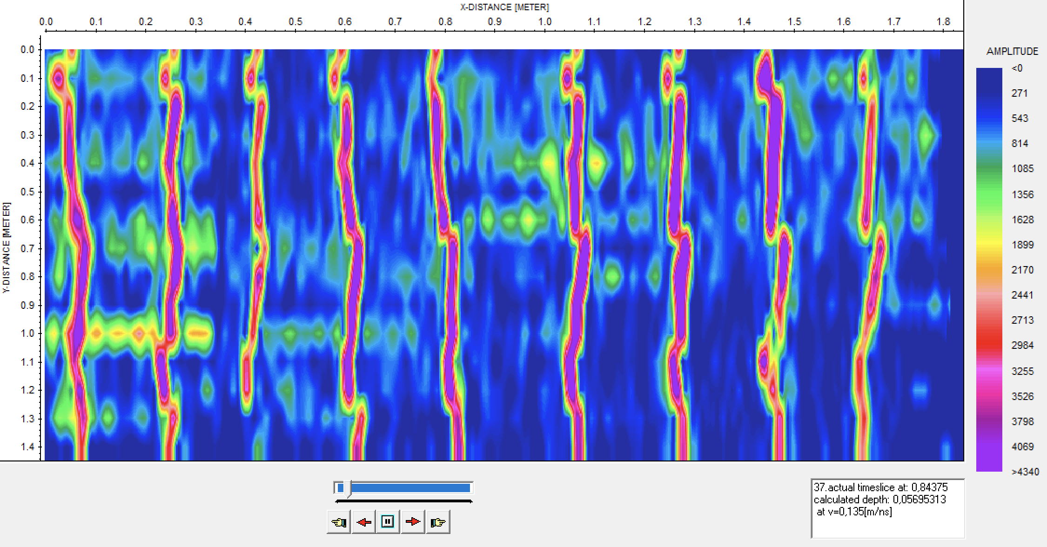
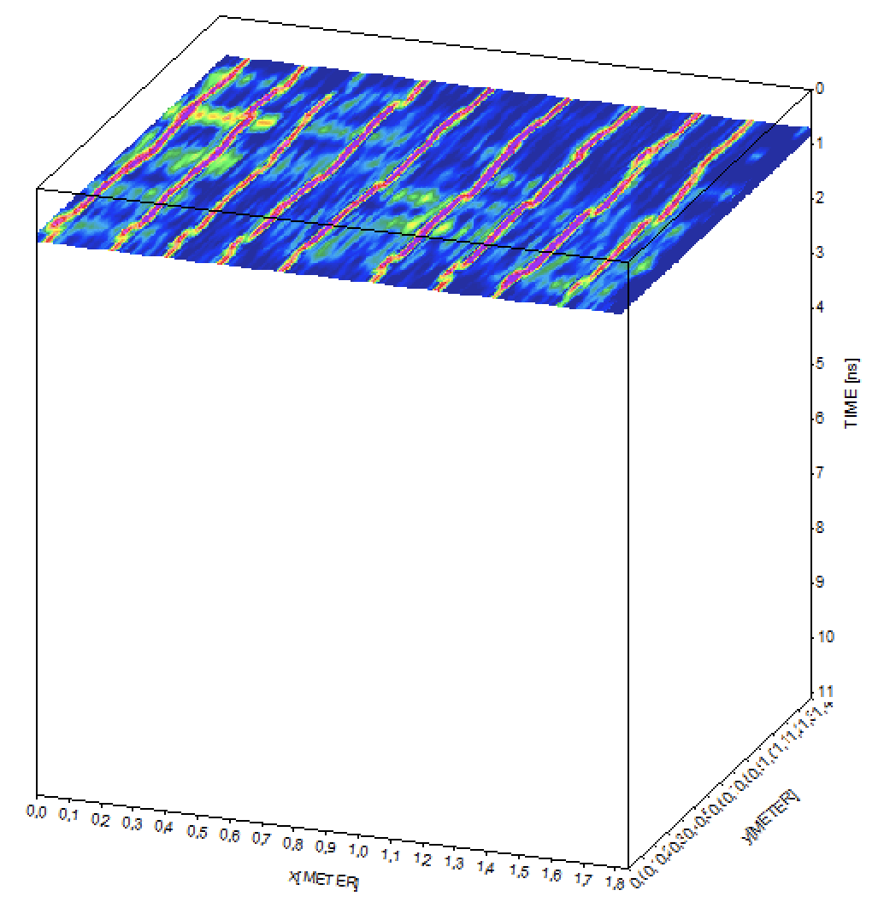
Geophysical Data Processing
Slices Visualization
9 rebars are clearly visible with a 0,2m spacing
Some noise in between the rebars is also visible

Slide 17
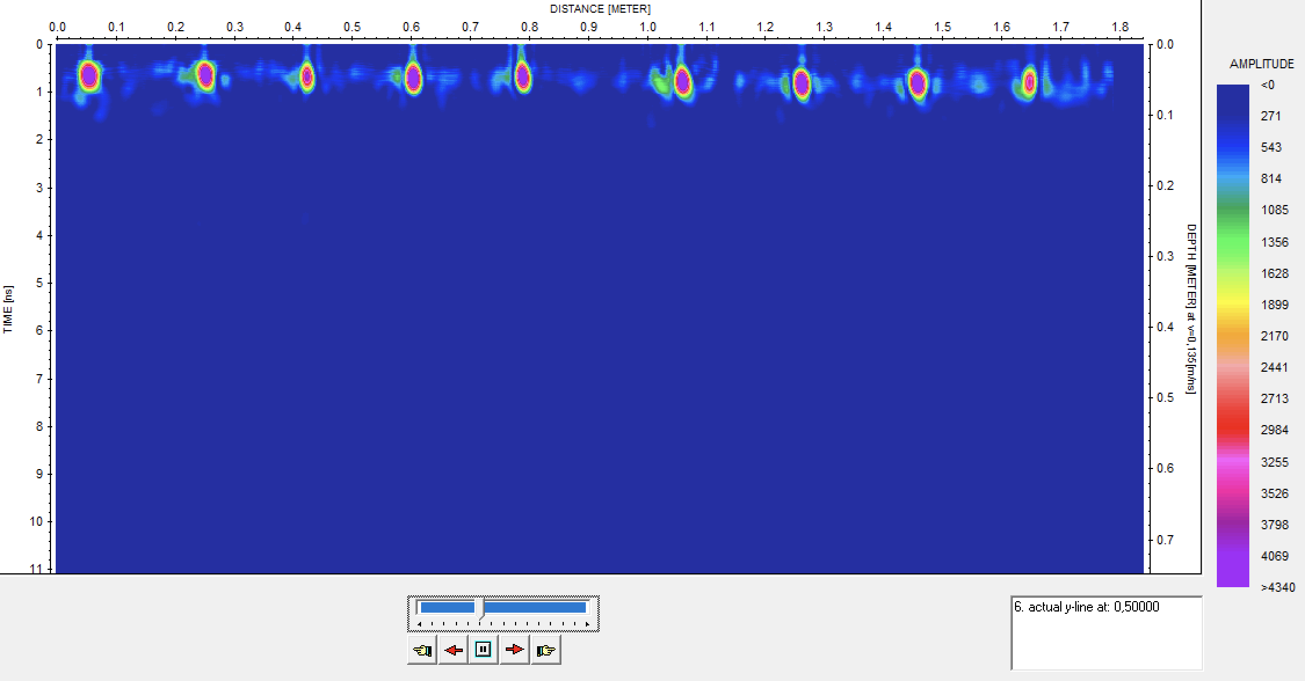
Geophysical Data Processing
Depth Analysis
In this Y-cut we can see that the rebars spacing is around 20cm and that the depth of the targets is around 5cm

