Slide 1
TinyML · IMU GESTURE RECOGNITION
TinyML Compression and Feature Engineering
for Real-Time IMU Gesture Recognition
on Arduino Nano 33 BLE
Mohammadreza Zamani · Erasmus Student
Asal Abbas Nejad Fard · Erasmus Student
Università di Trento · Trento, Italy
September 2026

Slide 2
MOTIVATION
Why TinyML for gesture recognition?
Deploying neural networks on microcontrollers means balancing accuracy against memory, energy, and latency — and physical hardware measurements, not simulations, are what actually prove a design works.
FOUR GESTURE CLASSES
◯
Circle
Class 0 · 80 windows
1
Resource limits
↔
Left / Right
Arduino Nano 33 BLE offers only kilobytes of Flash and RAM — every parameter and MAC counts.
Class 1 · 80 windows
·
Rest
2
Real-time constraint
Gesture prediction must run continuously on-device.
Class 2 · 80 windows
↕
Up / Down
3
Two open levers
Class 3 · 80 windows
Compress the network itself, or re-express the input signal — this work tests both, controlled and combined.
02

Slide 3
SYSTEM DESIGN
From raw IMU signal to on-device prediction
1
2
3
4
5
→
→
→
→
6-Axis IMU
128-Sample Window
Preprocessing
INT8 TinyML Model
Gesture Prediction
aX aY aZ · gX gY gZ
128 × 6 = 768 values
Train-only normalization
Quantized inference
4-class output
TWO OPTIMIZATION STRATEGIES EVALUATED
Study 1
Study 2
Neural-Network Compression
Feature Engineering
Standard vs Depthwise-separable CNNs, in FP32 and INT8.
Raw, RMS, FFT, and Spectral representations, all fed to the same controlled Dense classifier.
03

Slide 4
EXPERIMENTAL SETUP
Dataset & train / validation / test split
320
IMU windows total (80 per class)
SAMPLES PER SPLIT (256 / 32 / 32 WINDOWS)
128 × 6
samples × channels per window
768
raw values per window
80 / 10 / 10
stratified split, train-only normalization
Why train-only normalization matters
Mean and std are estimated only from the training windows, then applied unchanged to validation and test — preventing evaluation information from leaking into the pipeline.
04

Slide 5
STUDY 1 · NEURAL-NETWORK COMPRESSION
Standard CNN vs. Depthwise-Separable CNN
Both operate directly on the normalized 128×6 raw IMU window.
Standard CNN
Depthwise CNN
Conv1D(16, k=5)
SeparableConv1D(16, k=5)
↓
↓
MaxPooling1D(2)
MaxPooling1D(2)
↓
↓
Conv1D(32, k=3)
SeparableConv1D(32, k=3)
↓
↓
GlobalAveragePooling1D
GlobalAveragePooling1D
↓
↓
Dense(16) → Dense(4)
Dense(16) → Dense(4)
2,660 params
160,320 MACs
1,330 params
52,544 MACs
05

Slide 6
STUDY 1 · RESULTS
Compression cuts compute — accuracy holds at 100%
Model | Params. | NN MACs | Size (KB) | Acc.
Standard CNN FP32 | 2,660 | 160,320 | 15.12 | 100%
Standard CNN INT8 | 2,660 | 160,320 | 9.80 | 100%
Depthwise CNN FP32 | 1,330 | 52,544 | 10.82 | 100%
Depthwise CNN INT8 | 1,330 | 52,544 | 10.13 | 100%
NEURAL-NETWORK MAC COUNT
Depthwise convolutions cut parameters by 50% and neural-network MACs by ~67%. INT8 quantization shrinks the Standard CNN from 15.12 KB to 9.80 KB.
06

Slide 7
STUDY 1 · PHYSICAL DEPLOYMENT
Measured on real hardware — Arduino Nano 33 BLE
Metric | Standard CNN | Depthwise CNN
Flash (B) | 194,408 | 205,424
Tensor Arena (B) | 6,644 | 7,156
Inference (ms) | 25.370 | 16.880
Total (ms) | 26.760 | 18.330
Although Depthwise CNN needs fewer params and MACs, its Flash and Tensor Arena are slightly higher.
07

Slide 8
STUDY 2 · FEATURE ENGINEERING
Does a smarter representation beat raw signal?
All four representations feed the same controlled classifier — Input → Dense(64) → Dense(32) → Dense(4).
SELECTED
Raw Signal
RMS
FFT
Spectral
768 features
6 features
48 features
12 features
All raw values from the 128×6 window
Root-mean-square per IMU channel
First 8 non-DC magnitude bins / channel
Dominant frequency + peak PSD / channel
Params
Accuracy
Params
Accuracy
Params
Accuracy
Params
Accuracy
51,428
100.000%
2,660
100.000%
5,348
100.000%
3,044
96.875%
08

Slide 9
STUDY 2 · RESULTS
RMS: same accuracy, 19× fewer parameters than raw
TEST ACCURACY
Raw Signal
768
100.000%
RMS
6
100.000%
FFT
48
100.000%
Spectral
12
96.875%
09

Slide 10
MODEL
The RMS Tiny INT8 model
Selected after the controlled Study-2 comparison as the most efficient representation achieving 100% test accuracy.
6 RMS Features
6
284
↓
Dense(16), ReLU
Input Features
Parameters
↓
Dense(8), ReLU
256
3.414 KB
↓
NN MACs
INT8 TFLite Size
Softmax(4)
10

Slide 11
FINAL COMPARISON · PHYSICAL DEPLOYMENT
RMS Tiny INT8 vs. the two CNN baselines
Model | Flash (B) | Arena (B) | Inf. (ms) | Total (ms)
Standard INT8 | 194,408 | 6,644 | 25.370 | 26.760
Depthwise INT8 | 205,424 | 7,156 | 16.880 | 18.330
RMS Tiny INT8 | 165,960 | 948 | 0.165 | 0.346
INFERENCE LATENCY (ms)
99.35%
98.11%
948 B
less NN inference latency vs. Standard CNN
less total processing time vs. Depthwise CNN
Tensor Arena — down from 6,644 / 7,156 B
11

Slide 12
ROBUSTNESS CHECK
Is 100% accuracy an artifact of the split?
No duplicate leakage
RANDOM 80/10/10 vs. BLOCKED 60/20/20
✓
Model | Random Acc. | Blocked Acc. | Δ (pp)
1-NN Raw Signal | 100.0% | 100.0% | 0.0
RMS Tiny FP32 | 100.0% | 100.0% | 0.0
No exact-duplicate IMU windows found across train / validation / test partitions.
✓
Alternative blocked split
A stricter 60/20/20 blocked split (no random shuffling within class) was evaluated as a supplementary check.
✓
1-NN baseline agrees
A simple 1-nearest-neighbor raw-signal baseline also reaches 100% under the blocked split.
12

Slide 13
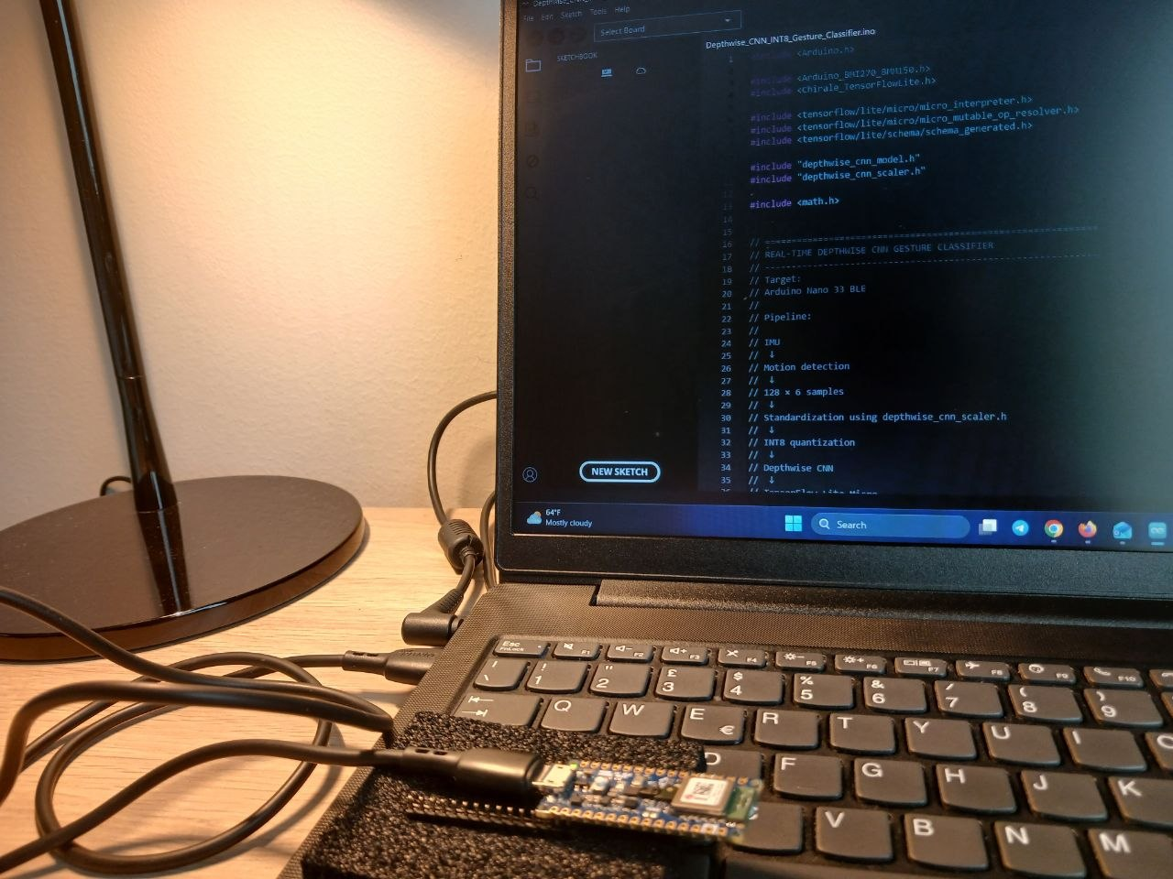
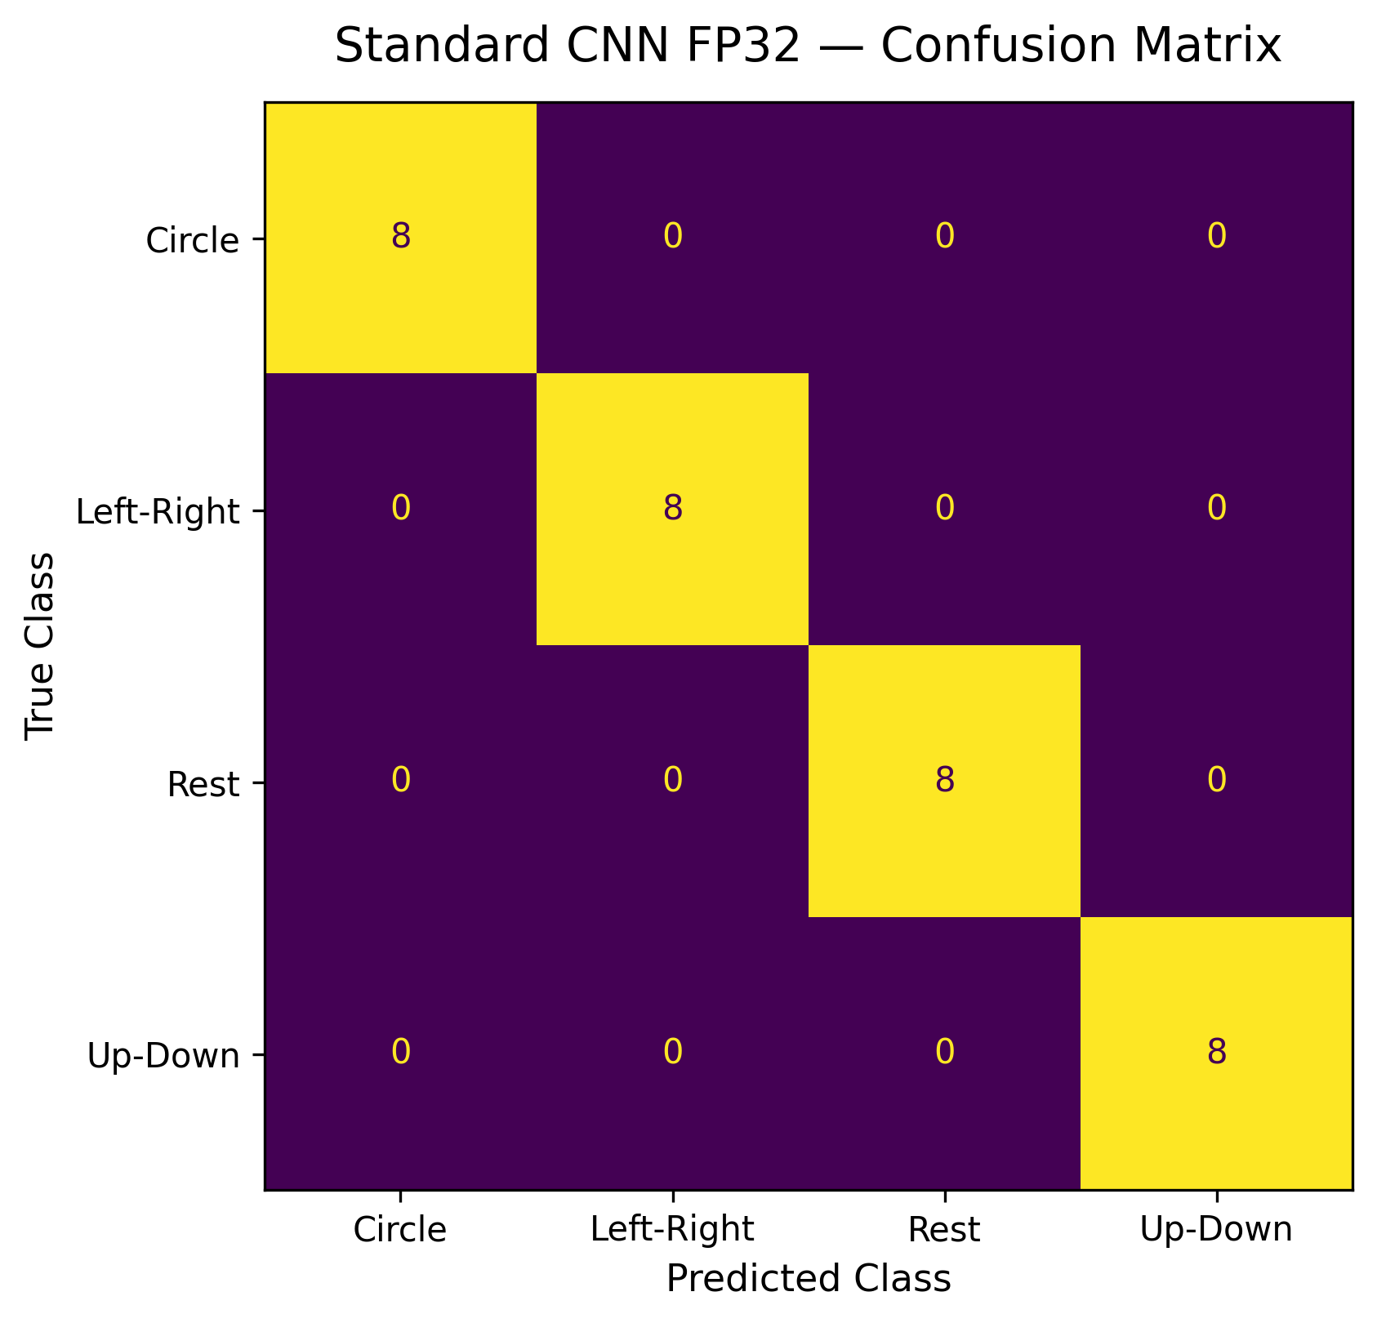
PHYSICAL VALIDATION
Not just simulation — real hardware, real measurements
Arduino Nano 33 BLE running the Depthwise CNN INT8 classifier via TensorFlow Lite Micro.
Standard CNN FP32 — perfect diagonal (8/8) on every gesture class in the fixed 32-window test set.
13

Slide 14
CONCLUSION
Feature engineering beat network compression
Both strategies helped — Depthwise CNN cut MACs by ~67% and latency by ~33.5% — but RMS feature engineering delivered the largest overall gain: compressing 768 raw values to 6 features with zero accuracy loss.
1
The final RMS Tiny INT8 model runs in 0.165 ms per inference — 99%+ faster than both CNN baselines, on the same hardware.
2
Power and energy consumption were not directly measured — a natural next step alongside latency and memory.
3
284
256
3.41 KB
0.165 ms
100%
Parameters
NN MACs
Model Size
Inference
Accuracy
Zamani & Abbas Nejad Fard · Università di Trento

Slide 15
REFERENCES
Related works
[1] L. L. Custode, P. Farina, E. Yildiz, R. B. Kilic, K. S. Yildirim, G. Iacca. "Fast-Inf: Ultra-Fast Embedded Intelligence on the Batteryless Edge." Proc. 22nd ACM Conf. on Embedded Networked Sensor Systems (SenSys '24), ACM, 2024, pp. 239–252.
[2] I. Fodor, R. Lorenzon, G. Pin, S. Antonello, K. S. Yildirim. "Embedded-AI Based Fault Detection in Domestic Dishwashers: A Tale of On-Device Time Series Deep Classification." IFAC-PapersOnLine, vol. 59, no. 26, 2025, pp. 371–376.
[3] M. A. Hasanpour, M. Kirkegaard, X. Fafoutis. "EdgeMark: An Automation and Benchmarking System for Embedded Artificial Intelligence Tools." Journal of Systems Architecture, vol. 167, 2025, art. 103488.
Code, datasets, and deployment files: github.com/mrzamaniiii/TinyML-Compression-Benchmark
15

