Slide 1
TinyML · IMU GESTURE RECOGNITION
TinyML Compression and Feature Engineering
for Real-Time IMU Gesture Recognition
on Arduino Nano 33 BLE
Mohammadreza Zamani · Erasmus Student
Asal Abbas Nejad Fard · Erasmus Student
Università di Trento · Trento, Italy
284
0.165 ms
100%
3.41 KB
Parameters
Inference Latency
Test Accuracy
Model Size

Slide 2
MOTIVATION
Why TinyML for gesture recognition?
Deploying neural networks on microcontrollers means balancing accuracy against memory, energy, and latency — and physical hardware measurements, not simulations, are what actually prove a design works.
FOUR GESTURE CLASSES
◯
Circle
Class 0 · 80 windows
1
Resource limits
↔
Left / Right
Arduino Nano 33 BLE offers only kilobytes of Flash and RAM — every parameter and MAC counts.
Class 1 · 80 windows
·
Rest
2
Real-time constraint
Gesture prediction must run continuously on-device, with no cloud round-trip.
Class 2 · 80 windows
↕
Up / Down
3
Two open levers
Class 3 · 80 windows
Compress the network itself, or re-express the input signal — this work tests both, controlled and combined.
02

Slide 3
SYSTEM DESIGN
From raw IMU signal to on-device prediction
1
2
3
4
5
→
→
→
→
6-Axis IMU
128-Sample Window
Preprocessing
INT8 TinyML Model
Gesture Prediction
aX aY aZ · gX gY gZ
128 × 6 = 768 values
Train-only normalization
Quantized inference
4-class output
TWO OPTIMIZATION STRATEGIES EVALUATED
Study 1
Study 2
Neural-Network Compression
Feature Engineering
Standard vs Depthwise-separable CNNs, in FP32 and INT8, on the raw 128×6 IMU window.
Raw, RMS, FFT, and Spectral representations, all fed to the same controlled Dense classifier.
03

Slide 4
EXPERIMENTAL SETUP
Dataset & train / validation / test split
320
IMU windows total (80 per class)
SAMPLES PER SPLIT (256 / 32 / 32 WINDOWS)
128 × 6
samples × channels per window
768
raw values per window
80 / 10 / 10
stratified split, train-only normalization
Why train-only normalization matters
Mean and std are estimated only from the training windows, then applied unchanged to validation and test — preventing evaluation information from leaking into the pipeline.
04

Slide 5
STUDY 1 · NEURAL-NETWORK COMPRESSION
Standard CNN vs. Depthwise-Separable CNN
Both operate directly on the normalized 128×6 raw IMU window, with identical train/val/test partitions — only the convolution type changes.
Standard CNN
Depthwise CNN
Conv1D(16, k=5)
SeparableConv1D(16, k=5)
↓
↓
MaxPooling1D(2)
MaxPooling1D(2)
↓
↓
Conv1D(32, k=3)
SeparableConv1D(32, k=3)
↓
↓
GlobalAveragePooling1D
GlobalAveragePooling1D
↓
↓
Dense(16) → Dense(4)
Dense(16) → Dense(4)
2,660 params
160,320 MACs
1,330 params
52,544 MACs
05

Slide 6
STUDY 1 · RESULTS
Compression cuts compute — accuracy holds at 100%
Model | Params. | NN MACs | Size (KB) | Acc.
Standard CNN FP32 | 2,660 | 160,320 | 15.12 | 100%
Standard CNN INT8 | 2,660 | 160,320 | 9.80 | 100%
Depthwise CNN FP32 | 1,330 | 52,544 | 10.82 | 100%
Depthwise CNN INT8 | 1,330 | 52,544 | 10.13 | 100%
NEURAL-NETWORK MAC COUNT
Depthwise convolutions cut parameters by 50% and neural-network MACs by ~67%. INT8 quantization shrinks the Standard CNN from 15.12 KB to 9.80 KB — the Depthwise model's gain is smaller since TFLite metadata is a larger share of its already-compact file.
06

Slide 7
STUDY 1 · PHYSICAL DEPLOYMENT
Measured on real hardware — Arduino Nano 33 BLE
Metric | Standard CNN | Depthwise CNN
Flash (B) | 194,408 | 205,424
Tensor Arena (B) | 6,644 | 7,156
Inference (ms) | 25.370 | 16.880
Total (ms) | 26.760 | 18.330
Although Depthwise CNN needs fewer params and MACs, its Flash and Tensor Arena are slightly higher — but it still cuts measured inference latency by ~33.5% (25.37 → 16.88 ms).
07

Slide 8
STUDY 2 · FEATURE ENGINEERING
Does a smarter representation beat raw signal?
All four representations feed the same controlled classifier — Input → Dense(64) → Dense(32) → Dense(4) — so only the input encoding changes.
SELECTED
Raw Signal
RMS
FFT
Spectral
768 features
6 features
48 features
12 features
All raw values from the 128×6 window
Root-mean-square per IMU channel
First 8 non-DC magnitude bins / channel
Dominant frequency + peak PSD / channel
Params
Accuracy
Params
Accuracy
Params
Accuracy
Params
Accuracy
51,428
100.000%
2,660
100.000%
5,348
100.000%
3,044
96.875%
08

Slide 9
STUDY 2 · RESULTS
RMS: same accuracy, 19× fewer parameters than raw
TEST ACCURACY BY REPRESENTATION
Raw Signal
768 in
100.000%
RMS
6 in
100.000%
FFT
48 in
100.000%
Spectral
12 in
96.875%
Takeaway
RMS reduces the input from 768 raw values to just 6 features and the classifier from 51,428 to 2,660 parameters — with zero accuracy loss. Spectral compresses too far, losing information useful for classification.
09

Slide 10
FINAL MODEL
The RMS Tiny INT8 model
Selected after the controlled Study-2 comparison as the most efficient representation achieving 100% test accuracy.
6 RMS Features
6
284
↓
Dense(16), ReLU
Input Features
Parameters
↓
Dense(8), ReLU
256
3.414 KB
↓
NN MACs
INT8 TFLite Size
Softmax(4)
RMS𝑐 = √( (1/N) Σ xᶜ[n]² ), N = 128
100.000%
1.0000
Test Accuracy
Macro F1
10

Slide 11
FINAL COMPARISON · PHYSICAL DEPLOYMENT
RMS Tiny INT8 vs. the two CNN baselines
Model | Flash (B) | Arena (B) | Inf. (ms) | Total (ms)
Standard INT8 | 194,408 | 6,644 | 25.370 | 26.760
Depthwise INT8 | 205,424 | 7,156 | 16.880 | 18.330
RMS Tiny INT8 | 165,960 | 948 | 0.165 | 0.346
INFERENCE LATENCY (ms)
99.35%
98.11%
948 B
less NN inference latency vs. Standard CNN
less total processing time vs. Depthwise CNN
Tensor Arena — down from 6,644 / 7,156 B
11

Slide 12
ROBUSTNESS CHECK
Is 100% accuracy an artifact of the split?
Additional checks were run to see whether strong test performance could be explained by data leakage rather than genuine class separability.
No duplicate leakage
RANDOM 80/10/10 vs. BLOCKED 60/20/20
✓
Model | Random Acc. | Blocked Acc. | Δ (pp)
1-NN Raw Signal | 100.0% | 100.0% | 0.0
RMS Tiny FP32 | 100.0% | 100.0% | 0.0
No exact-duplicate IMU windows found across train / validation / test partitions.
✓
Alternative blocked split
A stricter 60/20/20 blocked split (no random shuffling within class) was evaluated as a supplementary check.
Interpretation
The blocked experiment is descriptive, not a strict isolation test — it also reduces the training fraction from 80% to 60%. Results should be read as a consistency check, not final proof of generalization. Larger datasets and multiple users are needed to confirm real-world robustness.
✓
1-NN baseline agrees
A simple 1-nearest-neighbor raw-signal baseline also reaches 100% under the blocked split — not just the neural model.
12

Slide 13
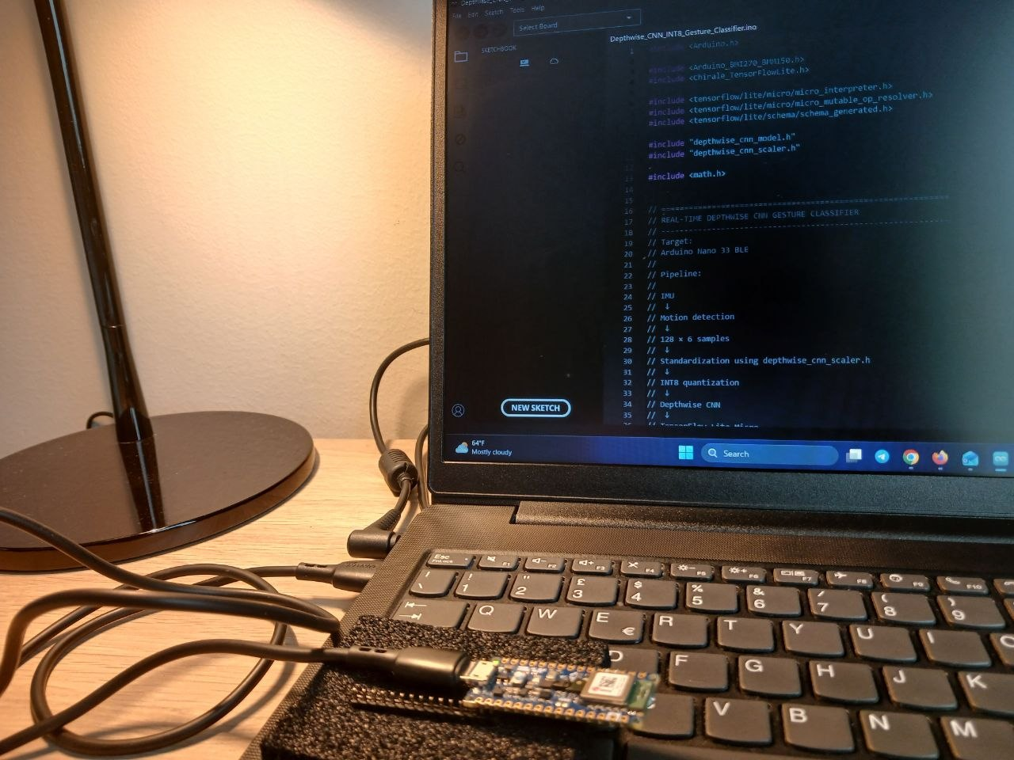
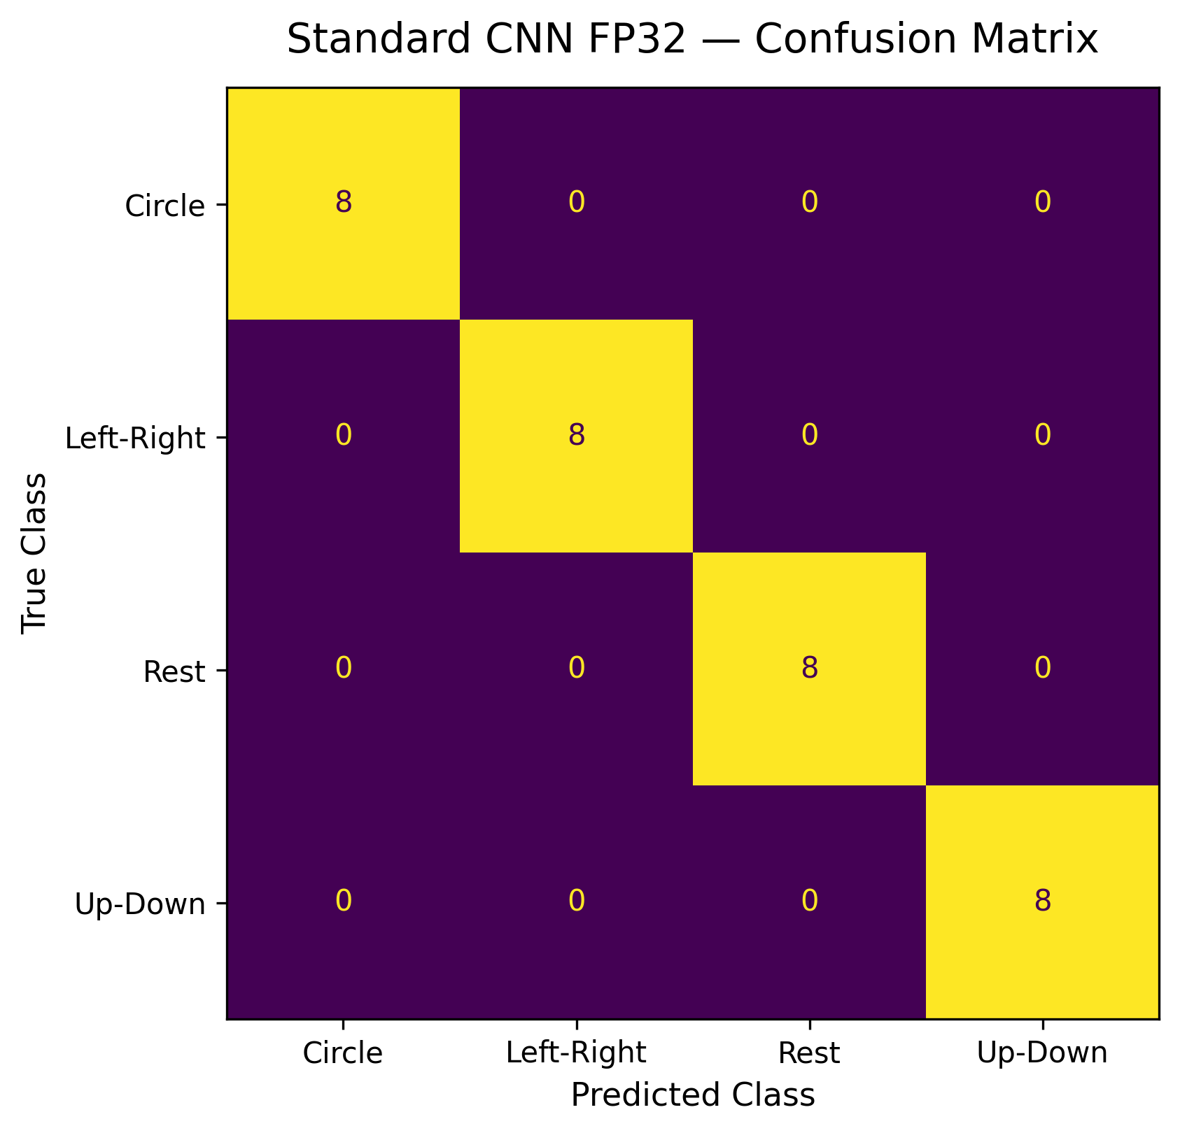
PHYSICAL VALIDATION
Not just simulation — real hardware, real measurements
Standard CNN FP32 — perfect diagonal (8/8) on every gesture class in the fixed 32-window test set.
Arduino Nano 33 BLE running the Depthwise CNN INT8 classifier via TensorFlow Lite Micro, connected to a host laptop for benchmarking.
13

Slide 14
CONCLUSION
Feature engineering beat network compression
Both strategies helped — Depthwise CNN cut MACs by ~67% and latency by ~33.5% — but RMS feature engineering delivered the largest overall gain: compressing 768 raw values to 6 features with zero accuracy loss.
1
The final RMS Tiny INT8 model runs in 0.165 ms per inference — 99%+ faster than both CNN baselines, on the same hardware.
2
Reported 100% accuracy holds on the current 32-window test set; larger, multi-user datasets are needed to confirm broader generalization.
3
Power and energy consumption were not directly measured — a natural next step alongside latency and memory.
284
256
3.41 KB
0.165 ms
100%
Parameters
NN MACs
Model Size
Inference
Accuracy
Zamani & Abbas Nejad Fard · Università di Trento

Slide 15
REFERENCES
Cited works
[1] L. L. Custode, P. Farina, E. Yildiz, R. B. Kilic, K. S. Yildirim, G. Iacca. "Fast-Inf: Ultra-Fast Embedded Intelligence on the Batteryless Edge." Proc. 22nd ACM Conf. on Embedded Networked Sensor Systems (SenSys '24), ACM, 2024, pp. 239–252.
[2] I. Fodor, R. Lorenzon, G. Pin, S. Antonello, K. S. Yildirim. "Embedded-AI Based Fault Detection in Domestic Dishwashers: A Tale of On-Device Time Series Deep Classification." IFAC-PapersOnLine, vol. 59, no. 26, 2025, pp. 371–376.
[3] M. A. Hasanpour, M. Kirkegaard, X. Fafoutis. "EdgeMark: An Automation and Benchmarking System for Embedded Artificial Intelligence Tools." Journal of Systems Architecture, vol. 167, 2025, art. 103488.
[4] I. Hossan, Mst. N. J. Mary, M. A. Motin. "TinyHAR-Net: Design and Implementation of a TinyML-Based Human Activity Recognition Framework on STM32." IEEE Embedded Systems Letters, 2025.
[5] H. Zhou, X. Zhang, Y. Feng, T. Zhang, L. Xiong. "Efficient Human Activity Recognition on Edge Devices Using DeepConv LSTM Architectures." Scientific Reports, vol. 15, 2025, art. 13830.
Code, datasets, and deployment files: github.com/mrzamaniiii/TinyML-Compression-Benchmark
15

