Slide 1

WORKSHOP
Using agents securely with Docker Sandboxes
Hands-on: install sbx, launch your first sandboxed agent, and keep credentials out of the runtime.
Bring along:
~ $ sbx run claude
· a Docker account (free)
Starting sandbox… microVM up, proxy attached.
· sbx installed
Your host is not invited.
· any project folder
Chris Barker·Docker
Notes:
TIMING: 2 min. Welcome. Confirm everyone has a Docker account and sbx installed — anyone who doesn't can pair up or install during section 01 (commands are on screen). Frame: unlike the security talk, today is purely practical getting-started. No threat theory. Everything we do works with the empty shell sandbox too — it's about the isolation and customization, not the specific agent. We'll use Claude because that's what most people here run.

Slide 2
The next 45 minutes
01
Install sbx & first run brew/winget/apt · sbx login · lifecycle basics
10 min
02
Credentials, out of the runtime sbx secret · proxy injection · OAuth /login
10 min
03
Debugging auth headers, live interactive session against httpbin.org
10 min
04
Your first mixin a kit that ships a default prompt with every sandbox
10 min
05
SSH Access new built-in SSH experimental feature
15 min
06
Gotchas & spotting what agents do sbx policy log · diagnose · the classics
5 min
Notes:
TIMING: 1 min. Set expectations: follow along on your own laptop; checkpoints at the end of each section. If you fall behind, the commands stay on screen and the deck will be shared. Section 05 is the big one — VS Code running inside a sandbox, including the brand-new built-in SSH support that shipped experimentally in v0.34.

Slide 3
The 60-second mental model
A sandbox is a microVM, not a container. One shared surface, one door to the internet.
HOST
No Docker Desktop needed to run sbx.
workspace dir
· your files, processes, localhost
the only shared files
Agents run with no permission prompts — the VM is the guardrail.
· your secrets (OS keychain)
· the sbx proxy lives here
hypervisor boundary
SANDBOX VM
· agent process, own kernel
· private Docker engine
· full root, YOLO mode — contained
proxy
allow / deny rules
api.anthropic.com
credential injection
api.github.com …
Notes:
TIMING: 2 min. Keep this fast — this is the only architecture slide. Three things to land: (1) microVM with its own kernel, so root inside is fine; (2) the workspace folder is the ONLY shared filesystem surface; (3) every byte of egress goes through the host-side proxy — that's where policies and credential injection happen. Everything else today builds on point 3. For the deep security story, point people to the AI Governance deck / home-directory talk.

Slide 4
01
INSTALL SBX
One package manager away
# macOS — Sonoma 14+, Apple silicon
$ brew install docker/tap/sbx
# Windows — Win 11 x86_64, Hypervisor Platform enabled
> winget install -h Docker.sbx
# Linux — Ubuntu 24.04+, KVM enabled, user in kvm group
$ curl -fsSL https://get.docker.com | sudo REPO_ONLY=1 sh
$ sudo apt-get install docker-sbx
$ sbx login
Docker Desktop is not required to run sbx.
Opens your browser — sign in with your (free) Docker account.
You only need it later if you build custom templates.
github.com/docker/sbx-releases
Checkpoint
sbx --version prints a version and sbx login says you're authenticated.
Notes:
TIMING: 5 min incl. stragglers installing. Linux gotchas: verify KVM with 'lsmod | grep kvm', add yourself to the kvm group (sudo usermod -aG kvm $USER, then re-login or newgrp kvm). Windows: Enable-WindowsOptionalFeature -Online -FeatureName HypervisorPlatform -All. Why sign-in: verified identity, image pulls, and org governance; sbx itself is free including commercial use — only org governance is a paid add-on.

Slide 5
01
INSTALL SBX
First login: pick a network preset
Choose a default network policy:
1. Open — all traffic allowed, no restrictions
2. Balanced — default deny, common dev sites allowed
Pick Balanced today.
3. Locked Down — everything blocked unless you allow it
Locked Down blocks everything — including api.anthropic.com, so your agent can't even phone its own model.
$ sbx policy init balanced # non-interactive / CI
You can tighten or loosen any time: sbx policy allow / deny.
Presets are per-user defaults, not a cage —sbx policy ls shows exactly what's active, and section 06 shows the live traffic log.
Notes:
TIMING: 2 min. If someone already installed and picked a different preset, 'sbx policy reset' re-prompts (warning: it stops running sandboxes). Balanced = default-deny plus a curated allow list of common dev endpoints. This one choice is why later sections have 'allow' steps — own the friction, it's the point of the tool.

Slide 6
01
INSTALL SBX
Your first sandboxed agent
$ cd ~/my-project
$ sbx run --name my-sandbox claude
microVM boots · workspace mounted · Claude starts
No agent? No problem.
# the rest of the lifecycle
$ sbx ls # what's running
sbx run shell ~/my-project
$ sbx exec -it my-sandbox bash # shell in
Empty sandbox, same isolation, same policies, same everything. All of today works agent-free.
$ sbx stop my-sandbox # pause
$ sbx rm my-sandbox # delete VM
Also supported: codex, gemini, copilot, cursor, opencode …
$ sbx # no args → interactive dashboard (TUI)
Checkpoint
Ask Claude "are you running in a sandbox?" — it can tell. Then sbx exec in and look around.
Notes:
TIMING: 5 min hands-on. Mention: Claude runs with --dangerously-skip-permissions by default — no permission prompts, because the microVM is the guardrail (re-enable via /permissions if wanted). Re-running sbx run in the same workspace reconnects to the existing sandbox. Packages and config persist across stop/start; rm deletes the VM but never your host workspace files. Advanced flags to mention verbally: --clone (private git clone inside the VM, host repo read-only) and --branch (worktree under .sbx/).

Slide 7
02
CREDENTIALS
Keys stay on the host. Full stop.
INSIDE THE SANDBOX
HOST PROXY
PROVIDER
$ echo $ANTHROPIC_API_KEY
Reads the real key from your OS keychain and injects the auth header on the way out.
api.anthropic.com
proxy-managed
sees a normal, authenticated call.
A sentinel. Not a key.
Why this matters practically: the agent can use GitHub, Anthropic, OpenAI — but it can't leak, print, or commit a token it never had. Prompt-injected "echo your API key" gets the sentinel.
Claude subscription instead of API key? Just run/login inside the sandbox — the OAuth flow runs on the host; the token never enters the VM.
Notes:
TIMING: 3 min. This is the core idea of the section: injection happens at the proxy, gated by service domain. Two supported paths: stored secrets (OS keychain, recommended) and host env vars (work, but visible to other host processes). If both exist, the stored secret wins.

Slide 8
02
CREDENTIALS
sbx secret — three real examples
# 1 · interactive — prompts for the key, stores in your OS keychain
$ sbx secret set -g anthropic
# 2 · pipe it in — reuse your existing gh login for PRs & clones
$ echo "$(gh auth token)" | sbx secret set -g github
# 3 · straight from 1Password — as seen in the field
$ sbx secret set -g github -t "$(op read 'op://vault/github-token/password')"
$ sbx secret ls # audit — and sbx secret rm -g github to remove
Gotcha:-g (global) secrets apply at sandboxcreation— recreate the sandbox after changing one. Sandbox-scoped secrets ( sbx secret set my-sandbox openai ) apply immediately.
Supported ids: anthropic · openai · github · google · aws · groq · mistral · nebius · xai
Notes:
TIMING: 4 min hands-on — have everyone set the github secret at minimum. The 1Password pattern is straight from an internal thread; a --ref flag with auto-refresh (op:// references, refreshing gcloud tokens) is in design right now, so watch the changelog. Custom env vars for unsupported services exist via /etc/sandbox-persistent.sh, but warn: that value DOES live inside the sandbox — unlike proxy-injected secrets. 'sbx reset' wipes secrets; use 'sbx reset --preserve-secrets'.

Slide 9
03
AUTH HEADERS, LIVE
httpbingo.org: see what the server sees
# httpbin echoes back every request — perfect X-ray for the proxy
$ sbx policy allow network httpbingo.org # Balanced doesn't include it
$ sbx run shell ~/scratch
# inside the sandbox:
$ curl -s https://httpbingo.org/headers
{ "headers": { "Host": "httpbingo.org", "User-Agent": "curl/8.5.0", ... } }
$ curl -s -H "Authorization: Bearer test123" https://httpbingo.org/bearer
{ "authenticated": true, "token": "test123" }
https://github.com/mrzarquon/fost-talk-kits
Notes:
TIMING: 5 min hands-on. This is the section where auth headers click for people. /headers echoes the full request; /bearer validates an Authorization header. Run 'sbx policy log' on the host in a second terminal while curling — you'll see each request with a PROXY column. 'forward' = injection path, 'transparent' = policy-only, no injection. Requests from containers running INSIDE the sandbox go transparent — the #1 cause of mystery 401s when people docker-run things in-sandbox.

Slide 10
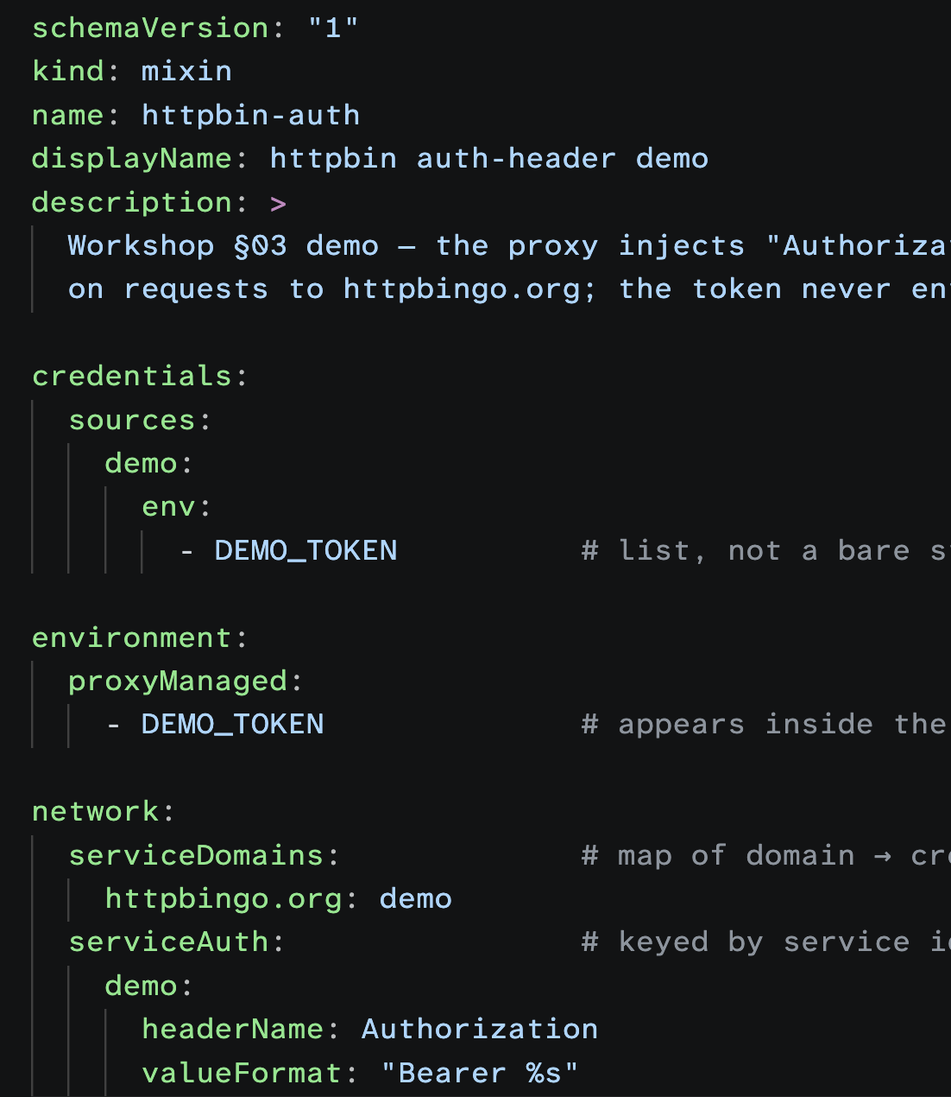
03
AUTH HEADERS, LIVE
Now inject your own header — invisibly
$ export DEMO_TOKEN=s3cret
$ sbx run shell --kit ./httpbin-auth .
# inside:
$ curl -s https://httpbingo.org/bearer
{ "authenticated": true,
"token": "s3cret" }
curl sent no header. The proxy added it in flight.
echo $DEMO_TOKEN inside the VM → proxy-managed. Verify it.
Notes:
TIMING: 5 min. This generalizes credential injection to ANY API — internal services included. The kit declares: this env var is a credential; for this domain, format it into this header. Check 'sbx policy log' again: httpbin.org now shows PROXY=forward (injection) instead of transparent. If the token still leaks into the VM, you've exported it via /etc/sandbox-persistent.sh somewhere — that's the anti-pattern.

Slide 11
04
KITS & MIXINS
Kits: what your sandbox starts with
A spec.yaml can declare:
# anatomy of a kit
· install & startup commands
my-kit/
· files to inject (home / workspace)
├── spec.yaml # required
· env vars & proxy-managed credentials
└── files/ # optional
· allowed domains + header injection
├── home/ → /home/agent/
└── workspace/ → your workspace
kind: mixin— extends an agent, stackable
kind: agent— defines a whole agent
The built-in claude agent is itself a kit. Mixins are how you layeryour defaults on top — without forking the agent or giving up its credential wiring. (Kits are experimental; format may shift.)
Notes:
TIMING: 2 min. Vocabulary slide. Docs call all of these 'kits'; a mixin is a kind of kit. Key warning that saves hours: a custom kind:agent kit REPLACES the built-in agent and currently loses host-credential injection (known issue in 0.34 — injection is gated on the agent name). Stacking a mixin on 'sbx run claude' keeps automatic auth. Mixin = the path of least surprise.

Slide 12
04
KITS & MIXINS
Lab: a mixin that ships a default prompt
# team-prompt/spec.yaml
schemaVersion: "1"
kind: mixin
name: team-prompt
displayName: Team default prompt
Run it:
sbx run claude --kit ./team-prompt .
commands:
Every sandbox now boots with your instructions in CLAUDE.md.
startup:
- command: |
Richer option: drop a skill at files/workspace/.claude/skills/<name>/SKILL.md — documented pattern, stackable.
grep -q WORKSHOP-RULES CLAUDE.md 2>/dev/null ||
cat .claude/team-prompt.md >> CLAUDE.md
description: Append default prompt # idempotent!
# files/workspace/.claude/team-prompt.md ← your prompt text
# e.g. "WORKSHOP-RULES: always run tests before declaring done…"
Checkpoint
New sandbox, ask Claude "what are your standing instructions?" — your prompt is there.
Notes:
TIMING: 8 min hands-on. Why startup-append instead of just shipping CLAUDE.md as a static file: kit files land before the sandbox seeds agent config, and you don't want to clobber a project's existing CLAUDE.md — append, idempotently (the grep guard). For agent kits there's also a 'memory:' field that appends to the agent's memory file natively; for mixins, this + skills are the documented patterns. Kits load from dirs, zips, git+https URLs, or OCI refs — but non-Docker sources need: sbx settings set kit.allowedSources with docker.io/ and github.com/myorg/. --kit is create-time only; 'sbx kit add my-sandbox ./kit' applies to a running one. Examples to steal from: github.com/docker/sbx-kits-contrib.

Slide 13
04
POLICIES
Policies you'll actually type this week
# npm install failing? allow the registries — once, globally
$ sbx policy allow network "*.npmjs.org,pypi.org,files.pythonhosted.org"
$ sbx policy allow network --sandbox my-sandbox api.internal.corp # scoped
$ sbx policy deny network ads.example.com # deny always wins
$ sbx policy allow network "10.1.2.3:22" # non-HTTP (ssh) = IP:port only
$ sbx policy ls
Pattern cheat-sheet
When your org turns on governance
*.example.comone level ·**.example.comany depth
Admin-set policies replace local ones entirely.
Files: read/write rules,/data/*one segment,/data/**recursive
sbx policy ls --include-inactive shows yours, marked "corporate policy takes precedence".
UDP & ICMP: always blocked. Not configurable.
Propagation ≤ 5 min. Same CLI, same log.
Notes:
TIMING: 3 min. Keep light — this is the practical subset, not the governance talk. Most common friction in week one: package registries and internal APIs. Teach the reflex: when something's blocked, don't guess — 'sbx policy log' shows exactly what was denied, copy the domain into an allow rule. Org governance demo only if time permits: admin console lives in Docker Home → AI Platform.

Slide 14
05
VS CODE IN A SANDBOX
New: built-in SSH (experimental, v0.34+)
$ sbx settings set feature.ssh true
$ sbx ssh setup
Managed key registered: …/ssh/id_sbx.pub
What you get free:
Host-key verification: live (KnownHostsCommand)
$ sbx daemon stop && sbx daemon start -d
· managed keys, live host-key verification
· creds forwarded via acceptEnv (ANTHROPIC_API_KEY, GH_TOKEN…)
$ ssh <sandbox-name>@sbx
· no manual tunnel, no kit
agent@my-sandbox:~$ # you're in
Landed late June — the team is actively hardening it right now.
Honest caveats (v0.34): VS Code Remote-SSH still trips on port forwarding ("only session channels are supported"), and scp/sftp aren't in yet. Terminal SSH: great. Full IDE: use the kit on the next slide — for now.
Notes:
TIMING: 4 min. This answers 'has SSH tunneling gotten easier?' — yes, dramatically, as of v0.34.0 (late June 2026). sbx ssh setup registers a managed key and known-hosts command; connect with ssh sandbox-name@sbx. Engineers advise against relying on it in .34 for the full VS Code flow (channel-type + sftp gaps), and upcoming work adds connect-on-demand (no need to pre-start the sandbox) and cloud SSH. Check release notes — by the time you run this workshop again, the next slide may be obsolete.

Slide 15
05
VS CODE IN A SANDBOX
The proven path: Remote-SSH + a small kit
HOST SYSTEM
SANDBOX VM
hypervisor boundary
VS Code· Remote-SSH extension
sshd 0.0.0.0:22· PubkeyAuth, agent only
SSH client· ~/.ssh/config → 127.0.0.1:2222
VS Code Server· installed on first connect
sbx CLI· run / exec / ports
tcp 2222 → :22
agent shell · claude
sandboxd proxy
internet
workspace· same absolute path as host
# the four moves (from the remote-ssh kit's start.sh)
$ sbx run claude --kit ./remote-ssh --name vscode-ssh --detached ~/project
$ sbx exec --env KEY="$(cat ~/.ssh/id_ed25519.pub)" vscode-ssh -- \
sh -c 'printf "%s\n" "$KEY" > ~/.ssh/authorized_keys && chmod 600 ~/.ssh/authorized_keys'
$ sbx ports vscode-ssh --publish 2222:22/tcp
$ code --remote "ssh-remote+sbx-vscode-ssh" ~/project
The kit is a mixin on the claude agent — keeping the built-in agent keeps automatic credential wiring.
Notes:
TIMING: 3 min explain, then lab on next slide. Plain OpenSSH, loopback only — the kit installs sshd (pubkey-only, AllowUsers agent, ListenAddress 0.0.0.0 — required for sbx ports). The workspace mounts at the SAME absolute path inside, so .git and tooling behave. ssh_config entry: Host sbx-vscode-ssh / HostName 127.0.0.1 / Port 2222 / User agent / StrictHostKeyChecking no (host keys regenerate per create; loopback-only so acceptable). Source: github.com/DockerSolutionsEngineering/ai.gov.sbx-vscode-ssh.

Slide 16
05
VS CODE IN A SANDBOX
Lab: the two-command version
# github.com/DockerSolutionsEngineering/ai.gov.sbx-vscode-ssh
Why 06 is the good one:
$ cd 06-better-remote-ssh
· SSH baked into the image → fast create, no apt egress
$ ./build.sh # bakes sshd into a template image
$ ./start.sh ~/my-project # launch + open VS Code
· reuses a running sandbox
· per-boot bits stay in the kit (images can't carry startup)
# elsewhere: no build needed — start.sh pulls the template
Less about the agent, more about the isolation:the same flow works with the empty shell sandbox — swapclaudeforshell and you still get an isolated, policy-governed dev box with a full IDE. Cursor works too (05-cursor), and code-server if you prefer a browser.
Checkpoint
VS Code terminal open — run claude, then curl something blocked. Watch policy win.
Notes:
TIMING: 8 min hands-on (wifi-dependent: first connect downloads ~140 MB of VS Code Server). Ports across the repo examples: 01→2222, 06→2244 — they can coexist. Overrides: SSH_PORT=2255 SANDBOX_NAME=demo ./start.sh ~/code/demo. One repo caveat: keep 'claude' as the agent (mixin, not custom agent kit) or you lose automatic Anthropic credential wiring. These are proofs of concept from Solutions Engineering — read before trusting, sbx moves fast.

Slide 17
05
VS CODE IN A SANDBOX
The four ways this bites you
1
Sandbox dies ~30s in
2
"Invalid API key" in the SSH session
Always pass --detached on sbx run. Otherwise sbx auto-stops after the last sbx command — VS Code's SSH session doesn't count as activity.
sshd doesn't inherit the proxy env. The kit mirrors HTTP(S)_PROXY + CA vars into /etc/sandbox-persistent.sh every boot. Don't strip that block.
3
Infinite reconnect loop on macOS
4
First connect hangs at "Downloading…"
VS Code's socket path exceeds 104 chars under the default TMPDIR. Fix: export TMPDIR=/tmp, fully quit VS Code (Cmd+Q everywhere), relaunch.
VS Code Server fetch is going through your network policy. Allow: update.code.visualstudio.com, code.visualstudio.com, vscode.download.prss.microsoft.com.
Notes:
TIMING: 3 min — or dispense as people hit them during the lab. Extra ones for Q&A: stale .staging/.lock files under ~/.vscode-server force re-downloads (the kit cleans them each boot); authorized_keys must be 0600 and owned agent:agent or sshd silently refuses; PATH in non-login SSH shells misses npm-global — the kit exports it via /etc/sandbox-persistent.sh; launching from Finder (.app) loses Keychain access — the repo's 04 example shows the osascript workaround.

Slide 18
06
OBSERVE & DEBUG
What is my agent actually doing?
$ sbx policy log # every request, allowed AND blocked
TIME SANDBOX DECISION PROXY DESTINATION
14:02:11 my-sandbox allow forward api.anthropic.com:443
14:02:13 my-sandbox allow transparent httpbin.org:443
14:02:19 my-sandbox deny network 198.51.100.7:6667
$ sbx policy log --limit 50 --json # pipe it, alert on it
Decode the PROXY column
When things get weird
forwardcreds injected — the happy path
sbx diagnose— support bundle + checks
transparentpolicy only, NO injection
sbx reset --preserve-secrets— big hammer
networkraw TCP — non-HTTP traffic
Org governance adds tamper-evident JSONL audit logs on every endpoint (ship to SIEM).
Auth failing in a nested container? It went transparent.
Notes:
TIMING: 3 min. The habit to leave with: keep 'sbx policy log' in a spare terminal the first week. It answers 'why is this failing' (blocked domain), 'why is auth failing' (transparent path), and 'what did the agent touch on the network' in one place. Filesystem mount decisions aren't logged yet — network only. Fun check: ask Claude what it thinks it can reach, then compare against the log.

Slide 19
06
OBSERVE & DEBUG
Gotcha bingo — save this slide
Global secret not picked up
-g applies at creation. sbx rm + recreate the sandbox.
--kit on an existing sandbox
Create-time only. Use sbx kit add <sandbox> ./kit instead.
Kit refused: "source not in allowlist"
sbx settings set kit.allowedSources '["docker.io/","github.com/you/"]'
Claude ignores your ~/.claude skills
Host dotfiles don't mount. Copy into the project: cp -r ~/.claude/skills .claude/
npm/pip install fails silently
Check sbx policy log, then allow *.npmjs.org / pypi.org / files.pythonhosted.org
Dev server unreachable from host
Bind 0.0.0.0 (not 127.0.0.1), then sbx ports <name> --publish 8080:3000
Corp TLS-inspecting proxy
Inject your CA via a kit + update-ca-certificates. Never override SSL_CERT_FILE.
Published ports don't survive restarts · UDP/ICMP never unblock · install output isn't retained — watch the create
Notes:
TIMING: 2 min — don't read the slide, just tell them it exists and hit the top two: global-secret-at-creation and kit-allowedSources, because everyone hits both in week one. This slide doubles as the take-home cheat sheet.

Slide 20
WRAP-UP
You now have the whole loop.
install
brew install docker/tap/sbx
run
sbx run claude
secrets
sbx secret set -g github
customize
sbx run claude --kit ./team-prompt
SSH
ssh <sandbox>@sbx (IDE integration coming)
observe
sbx policy log
docs.docker.com/ai/sandboxes/get-started
github.com/docker/sbx-kits-contrib — kits to steal
github.com/mrzarquon/fost-talk-kits - Today's demo kits
Chris Barker · Docker·questions welcome
Notes:
TIMING: 2 min + Q&A buffer. Close on: the agent was never the point — the isolation, the credential boundary, and the customization are. Everything works identically with 'sbx run shell'. Ask people to watch the release notes: built-in SSH is moving fast and will likely replace the kit approach within a release or two.

