Slide 1
Practical Language Processing Project
Review Insight System
Business-oriented language processing for e-commerce review analytics
Review Insight System

Slide 2

1. Business Problem
2. Dataset
3. System Architecture
4. Solution
5. Evaluation Results
6. Conclusion
7. System Demo

Slide 3
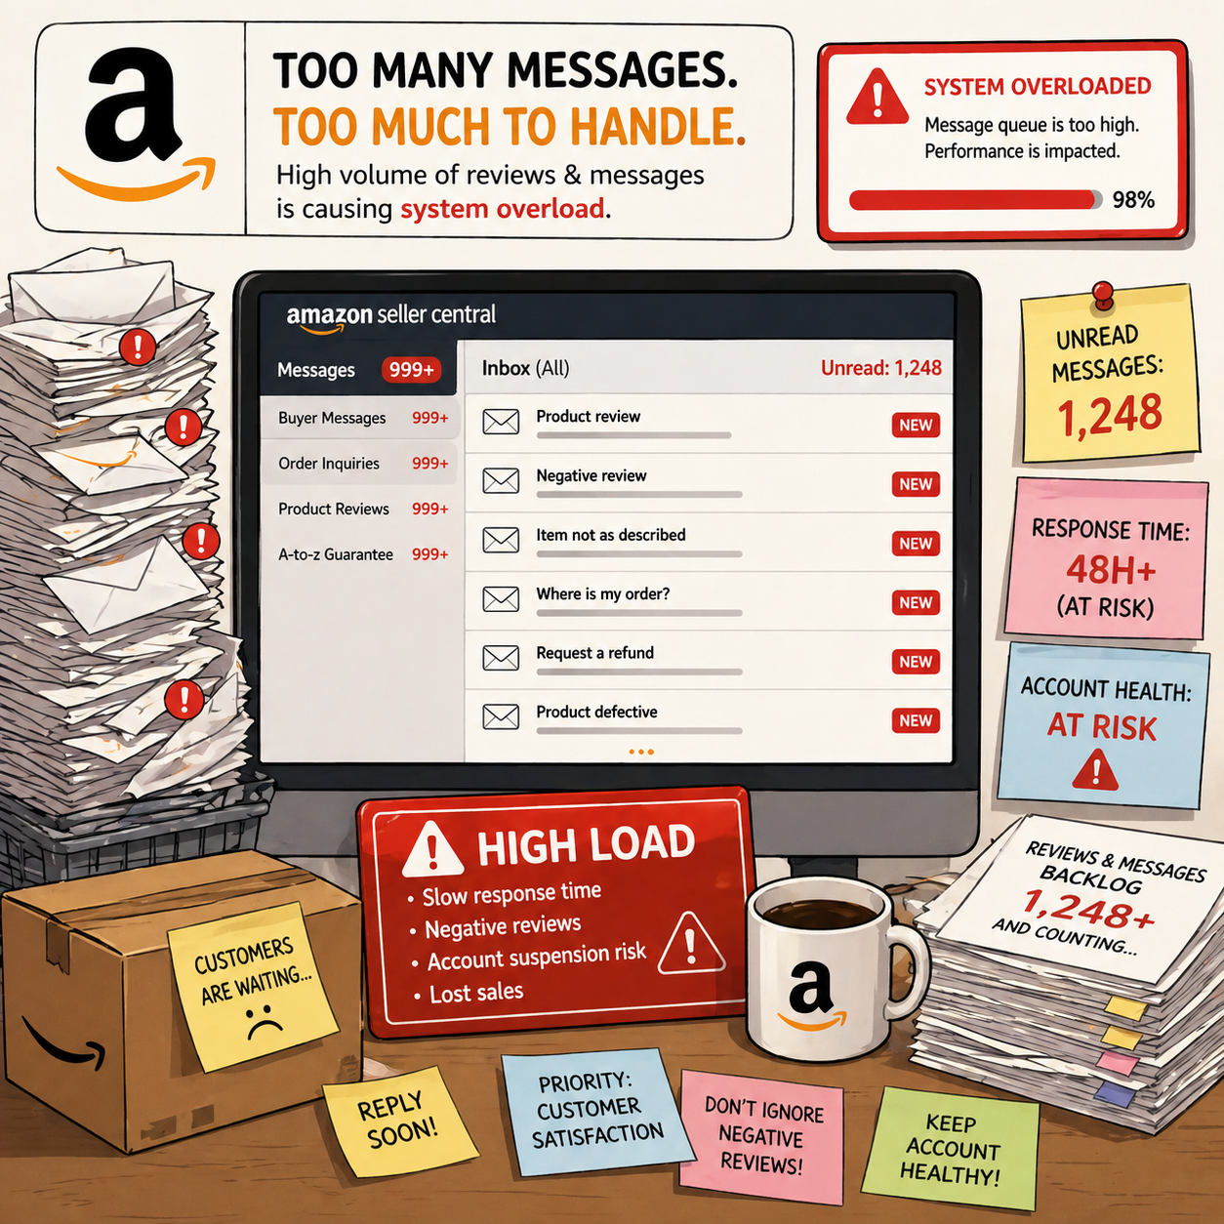
Business Problem
Review overload blocks merchant decision-making
Raw reviews contain direct evidence of quality, delivery, satisfaction, and recurring complaints, but they are unstructured and too numerous to inspect manually.
Prioritize
Detect
Identify reviews likely to contain useful business information.
Find negative customer experience through sentiment mining.
Summarize
Explore
Generate concise complaint titles for negative reviews.
Present results through dashboard filters, upload analysis, and Merchant Copilot.
The project converts unstructured reviews into structured decision-support signals.

Slide 4
Dataset - Raw Data Source
The dataset provides customer review text and product metadata from multiple Amazon product categories. This project uses five selected categories to keep the training and dashboard scope manageable while still covering different product types and complaint styles.
Fields used
review text · review title · rating · helpful votes · verified purchase ·product ID · product title · category
Category | Description
All_Beauty | Beauty product reviews
Amazon_Fashion | Fashion and apparel reviews
Appliances | Appliance product reviews
Handmade_Products | Handmade product reviews
Health_and_Personal_Care | Health and personal care reviews

Slide 5
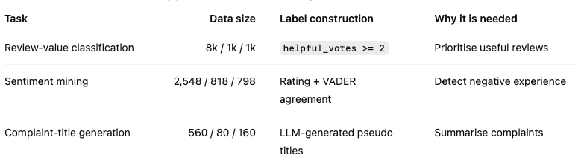
Dataset - Preprocessed
Three task-specific datasets support the review workflow
Label design
Review value: uses helpful votes as a proxy business-value signal.
Sentiment: keeps only high-confidence cases where rating and VADER agree.
Complaint titles: uses an LLM teacher to create pseudo labels for negative reviews.

Slide 6
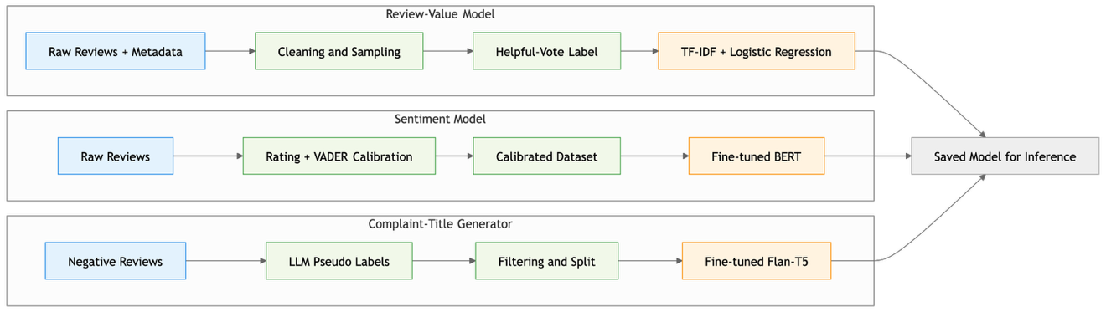
System Architecture
Offline Training Pipeline
Online Analysis Pipeline
The offline pipeline produces evaluated model artifacts; the online pipeline integrates them into a merchant-facing dashboard.
System design

Slide 7
Solution - Review-Value Classification
Purpose
Why this method?
Identify reviews that are more likely to contain useful business information.
01
Simple and interpretable
Method idea
Fits noisy helpful-vote proxy labels.
02
Captures useful phrases
Finds defect, delivery, and detailed-experience language.
TF-IDF + Logistic Regression
03
Easy dashboard inference
Convert review text into TF-IDF features, then classify high-value vs low-value.
Lightweight and stable for interactive use.
DataFlow
Review text
->
TF-IDF features
->
Logistic Regression
->
High / Low value
clean input
words + phrases
binary classifier
priority signal
Role
Soft prioritisation signal before manual reading.
Limitation
Helpful votes are not expert business-value labels.

Slide 8
Solution - Sentiment Mining
Purpose
Why this method?
Detect negative customer experience so merchants can focus on complaints and product issues.
01
Context matters
Sentiment depends on negation and full review context.
Method idea
02
Better complaint understanding
Captures indirect and domain-specific complaint language.
Fine-tuned BERT
03
Practical transfer learning
Pass cleaned review text into BERT, then predict positive vs negative sentiment.
Fine-tuning is more feasible than training from scratch.
DataFlow
Clean review text
->
Fine-tuned BERT
->
Sentiment label
->
Negative pool
input review
context encoder
positive / negative
issue candidates
Role
Filters negative reviews for issue exploration and title generation.
Limitation
Labels come from rating + VADER calibration, not human annotation.

Slide 9
Solution - Complaint-Title Generation
Purpose
Why this method?
Summarize a negative review into a short, actionable complaint title.
01
Text-to-text mapping
A review naturally maps to a short issue title.
Method idea
02
More fluent than keywords
Teacher-student Flan-T5 generation
Flan-T5 summarizes the issue instead of only extracting terms.
An LLM teacher creates pseudo titles; local Flan-T5 students learn this title style.
03
Less API dependence
The local student reduces runtime reliance on external LLMs.
DataFlow
Negative review
->
LLM teacher
->
Pseudo title pairs
->
Flan-T5 student
->
Complaint title
filtered input
creates pseudo titles
training signal
learns title style
local short issue label
Example
Long review about confusing Miele instructions -> "Incorrect instructions for Miele appliances"
Role
Turns long negative reviews into scan-friendly issue labels.
Limitation
Titles are learned from pseudo labels, not human-written summaries.

Slide 10
Results
Results are reported on held-out test splits and should be interpreted together with their label sources.
Task
Test Result
Notes
Review value (TF-IDF + LR)
Accuracy 0.795; Positive F1 0.255
Positive-class recall remains the main weakness.
Sentiment (BERT)
Accuracy 0.966; F1 0.981; Macro-F1 0.910
Strong performance on calibrated labels.
Title generation (Flan-T5-small, tuned)
ROUGE-1/2/L: 0.322 / 0.149 / 0.306; BERTScore F1 0.816
Trained on pseudo titles.
Title generation (Flan-T5-base, tuned)
ROUGE-1/2/L: 0.399 / 0.178 / 0.373; BERTScore F1 0.830
Best current title model.
Strongest component
Main limitation
Preferred generator
BERT performs strongly on rating + VADER calibrated sentiment labels.
Review-value detection is useful as a soft signal, but positive-class recall remains weak.
Flan-T5-base is the best current local complaint-title model.

Slide 11
Conclusion
Review Insight System converts raw reviews into business-facing insights.
The final dashboard connects weak-label datasets, trained NLP models, and merchant-facing exploration.
1
2
3
End-to-end NLP workflow
Multiple language tasks
Practical but honest prototype
Raw reviews -> weak labels -> trained models -> Streamlit dashboard.
Review-value classification, sentiment mining, and complaint-title generation.
The dashboard is usable, but labels are proxy or pseudo labels.
Future work
human-annotated evaluation set | stronger high-value detection | dashboard usability testing | better Copilot grounding

Slide 12
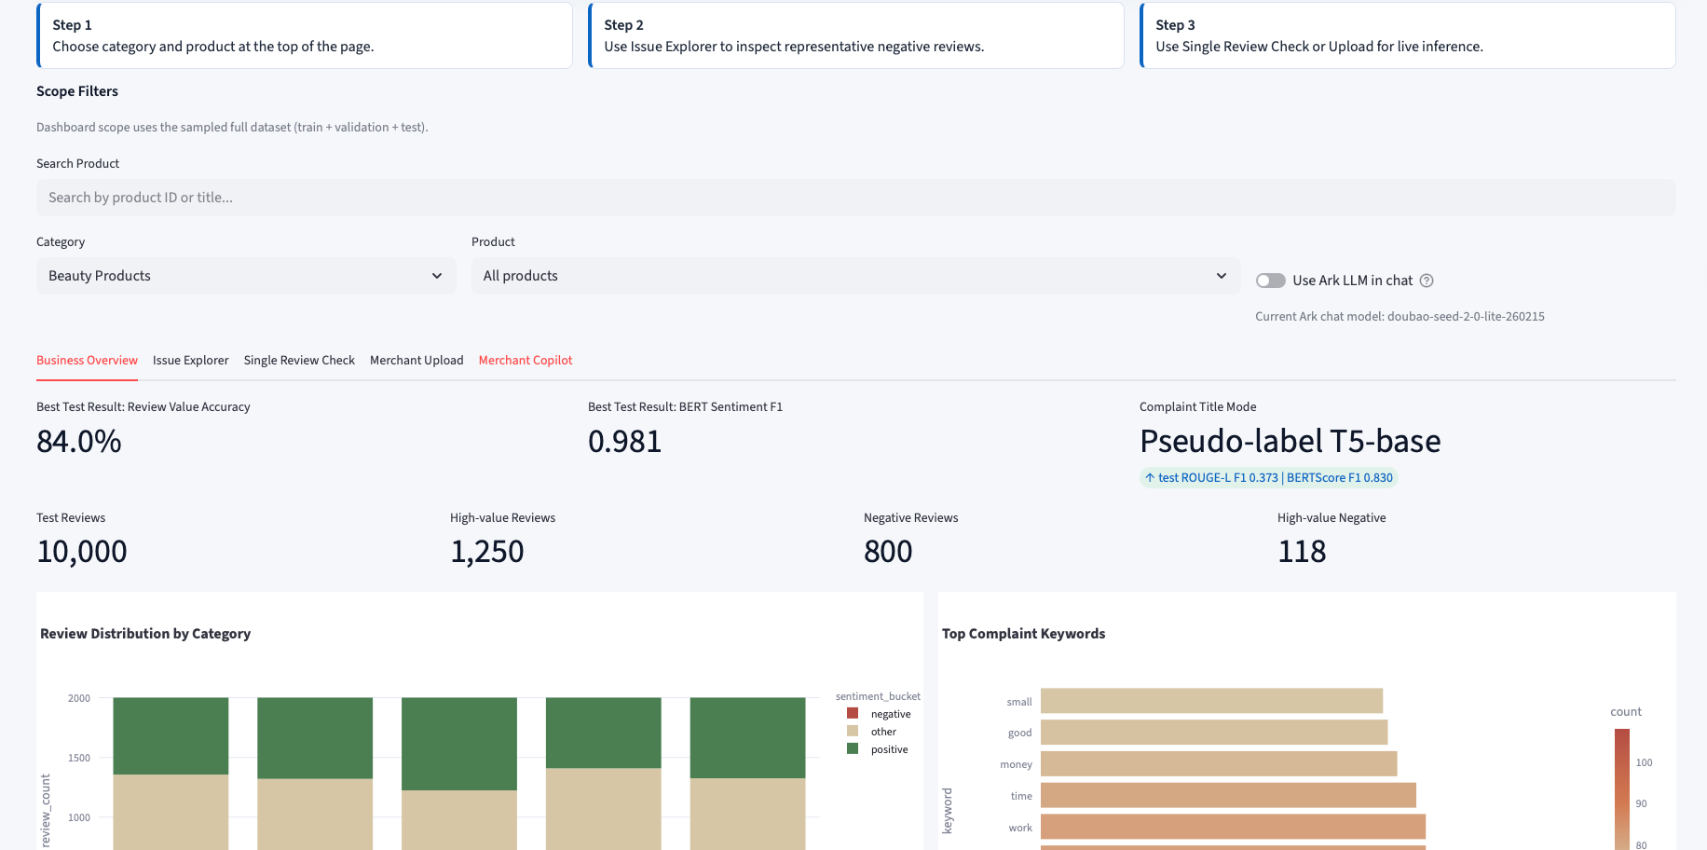
System Demo

Slide 13
Thank You!

