Slide 1
Perfecting Intrusion Detection System using Machine Learning
By: Avi Singh Rathore, Sumitra Sharma,
Deependra Singh Rathore, Mohammed Rizwan
To: Prof. G. L. Saini

Slide 2
Introduction
Intrusion Detection Systems Using Machine Learning – We have pursued a topic
related to Cyber security and Machine Learning. As we know today that the most
important thing in today’s technological world is security which is hard to keep
up with lot’s of intervention with the same. As we also know that the current
field that attract most of the attention is Artificial Intelligence, using such
technique we have created an automated security system that is used to detect
network packets as normal or anomalous. Since this device is popularly know as
the Intrusion Detection Systems as has been in the industry for a while but with
the advancement in technology and in the decrement in time it is found that
Artificial Intelligence could be a better solution for the Problem.

Slide 3
Need Of The Project ?
An Intrusion Detection System using Machine Learning can serve many purpose in the Field of Cyber Security, such as it would minimize the human intervention level while detecting or tackling with threats, not only that but also it can be used to optimize and expand the field of searching while looking and analyzation of threats.

Slide 4
Project analysis slide 11
Introduction
INTRUSION:
Intrusions are the activities that violate the security policy of system.
i.e., an intrusion attempt or a threat to be the potential possibility of a deliberate unauthorized attempt to
Access information/resources
Manipulate information
Render a system unreliable or unusable.
Intrusion Detection is the process used to identify intrusions.

Slide 5
Project analysis slide 11
Introduction
Intrusion Detection System (IDS):
An intrusion detection system (IDS) is a device or software application that monitors a network or systems for malicious activity or policy violations.
Intrusion Detection is a set of techniques and methods that are used to detect suspicious activity both at the network and host level.

Slide 6
Project analysis slide 2
Project Analysis
Increase rate of cyber crimes
Traffic monitoring
IDS
Why we need IDS?
Debugging is easy
Notify Administrator

Slide 7
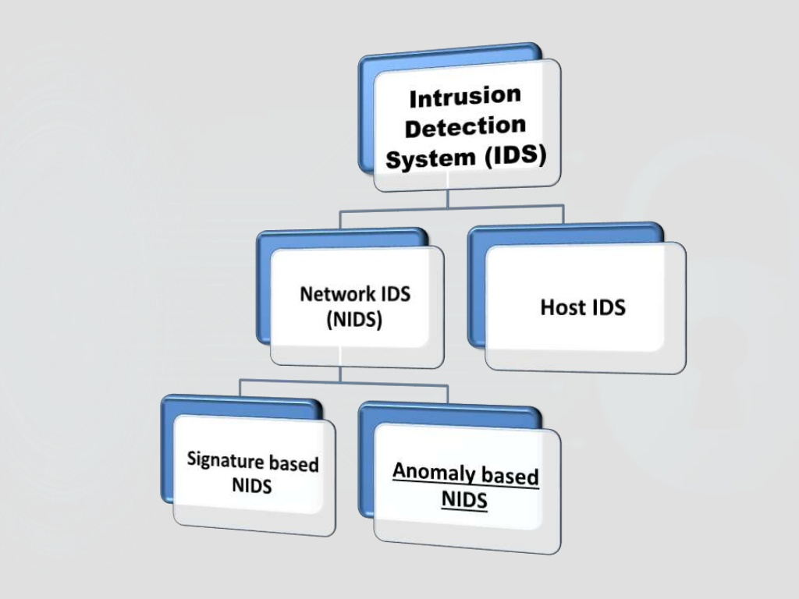
Project analysis slide 11
Introduction

Slide 8
Project analysis slide 11
Introduction
Network Intrusion Detection System:
There are a variety of tools available to detect attacks and exploits and take steps to block or stop cyber attacks. Things like firewalls to prevent unauthorized traffic from entering the network, spam filters to reject unwanted email messages. Another valuable security tool that is almost as ubiquitous is a network IDS—or intrusion detection system.
Firewall v/s NIDS
Need of NIDS

Slide 9
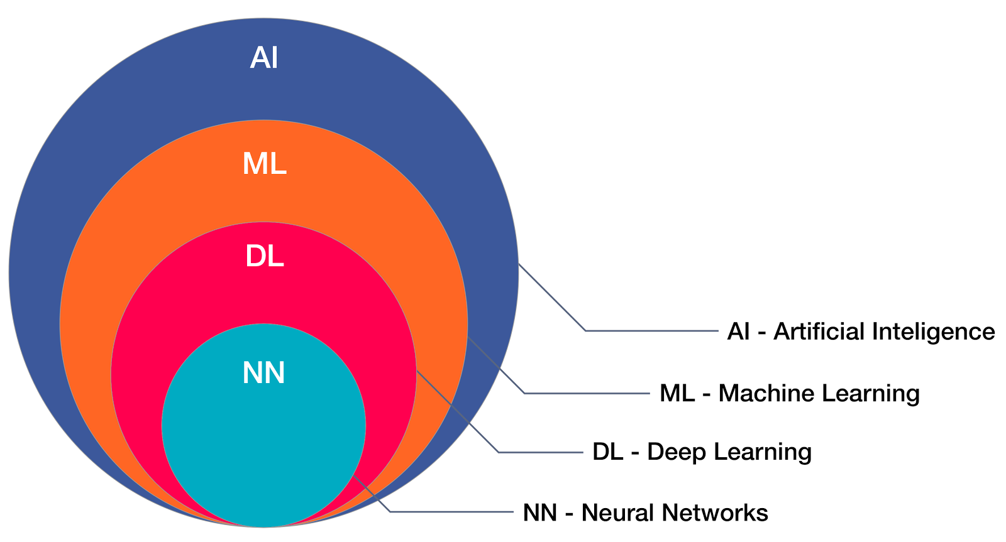
INTRODUCTION TO DATA SCIENCE & MACHINE LEARNING
Data Science is a blend of various tools, algorithms, and machine learning principles with the goal to discover hidden patterns from the raw data.

Slide 10
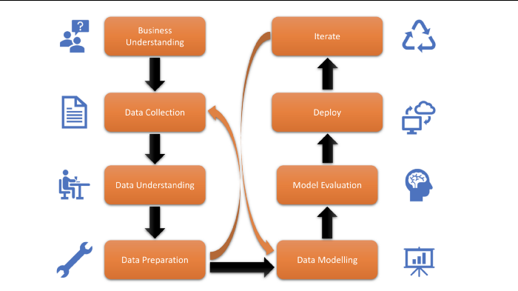
LIFECYCLE OF A DATASCIENCE PROJECT

Slide 11
DATA COLLECTION
1. Data collection is defined as the procedure of collecting, measuring and analysing accurate insights for research using standard validated techniques.
2. The most critical objective of data collection is ensuring that information-rich and reliable data is collected for statistical analysis so that data-driven decisions can be made for research.
3. For this project I have collected data from the online platform Kaggle. I have collected the dataset of cardekho which is a company which deals with the selling of old cars.

Slide 12
Data Collection Methods: Phone vs. Online vs. In-Person Interviews
In-Person Interviews Pros: In-depth and a high degree of confidence on the data Cons: Time consuming, expensive and can be dismissed as anecdotal
Mail Surveys Pros: Can reach anyone and everyone – no barrier Cons: Expensive, data collection errors, lag time
Phone Surveys Pros: High degree of confidence in the data collected, reach almost anyone Cons: Expensive, cannot self-administer, need to hire an agency
Web/Online Surveys Pros: Cheap, can self-administer, very low probability of data errors Cons: Not all your customers might have an email address/be on the internet, customers may be wary of divulging information online.

Slide 13
DATA UNDERSTANDING / ANALYSIS
The main goal of data understanding is to gain general insights about the data that will potentially be helpful for the further steps in the data analysis process.
STEPS THAT MAY BE INVOLVED :-
IMPORTING THE DATASET
CLEANING THE DATASET TO GET THE IMPORTANT INFORMATION
VISUALIZING THE DATASET

Slide 14
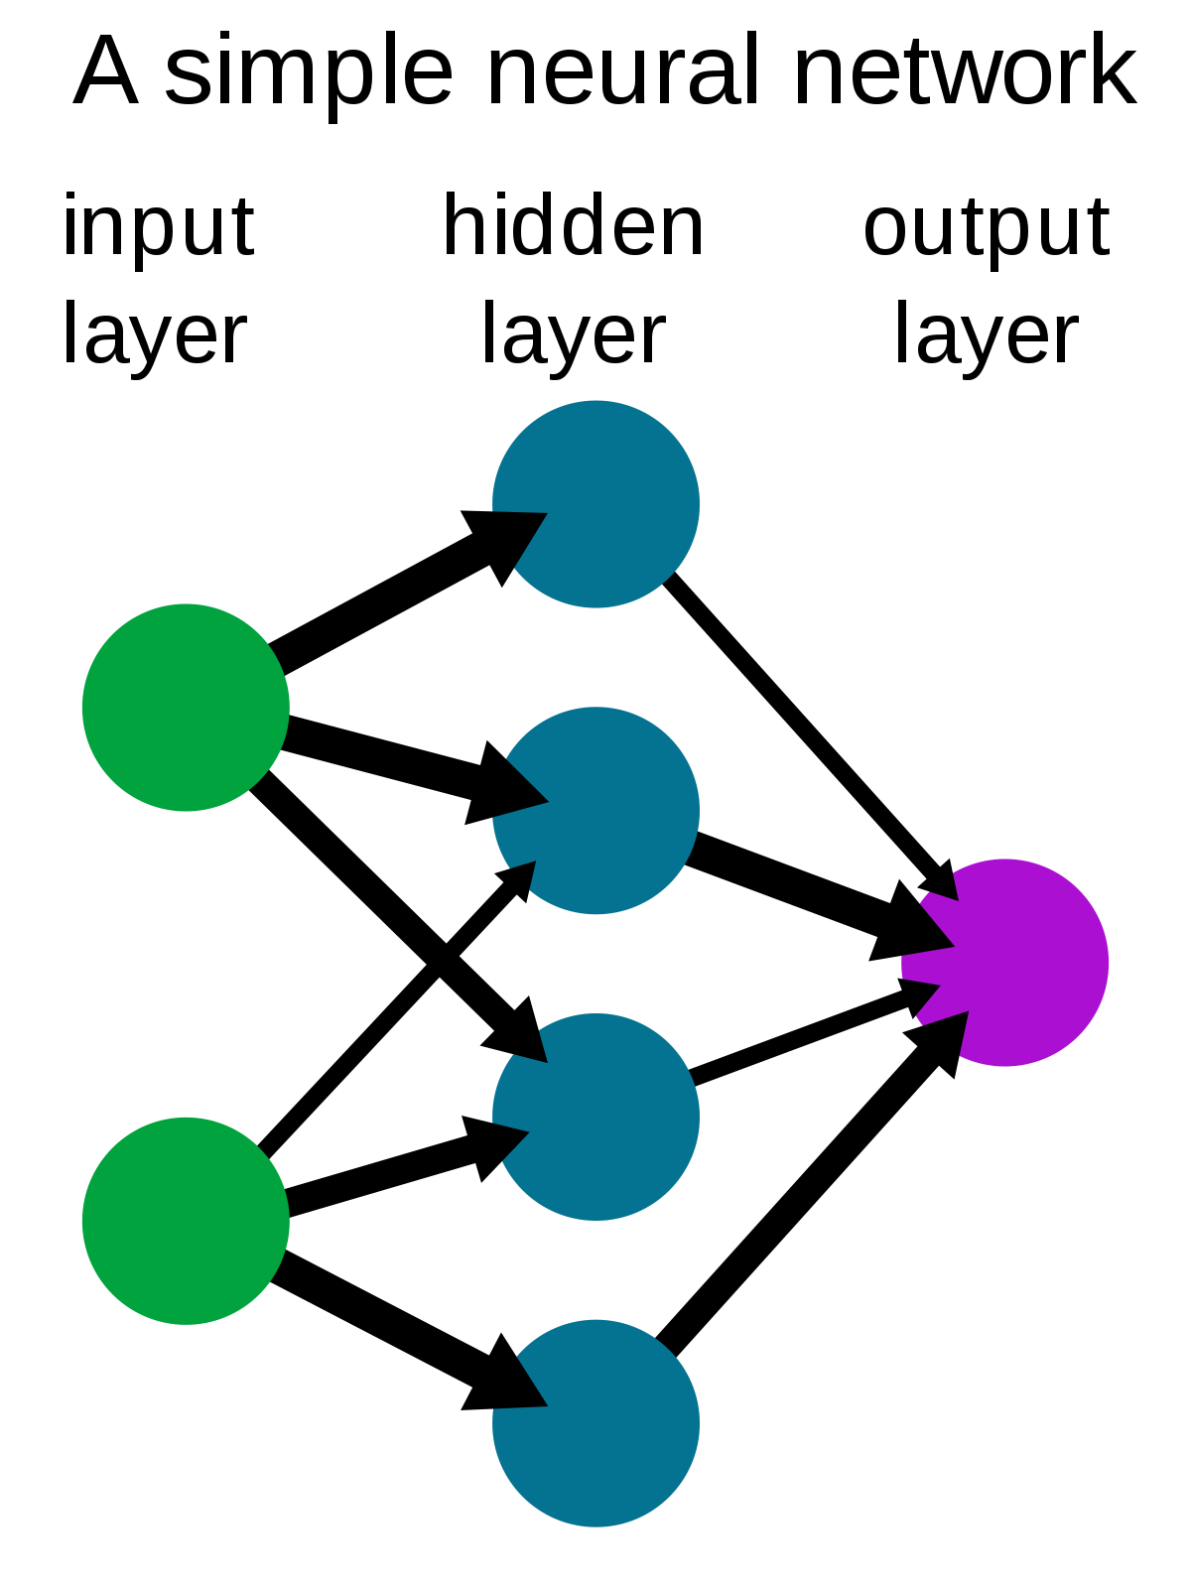
What is a Neural Network and How it Works
Neural Network – It forms the base of Deep Learning(A Sub-Field
Of Machine Learning), it works same as a work is done
by a Human Brain.
Input Layer – Take the input for the neural network
Whether linear or non-linear.
Hidden Layer – A layer where most of the
Computations take place including operations on input data
Weights of the channel and the Bias.
Output Layer – Contains the output given by the Previous Neurons

Slide 15
What is a Neural Network and how it works (contd.)
Input Layer Gives :-
X1 And X2 – These input could be linear(y= mx+y) or Non_linear(x + y = 5)
Hidden Layer Gives :-
The Input Data is Multiplied with the Channels(Given By Line) Weights which is :-
(X1 * 0.2)
Then the data is Transferred to the output layer with a activation function and the Equation is :-
(X1 * 0.2 + B1)
Output Layer : -
The Final Layer receives the computer equation which then is used to predicts the data further. Output Equation :-
Y1 = (X1 * 0.2 + B1 + X1 * 0.4 + B2)
Y2 = (X2 * 0.6 + B3 + X2 * 0.8 + B4)
0.2
B1
X1 * 0.2 + B1
x1
0.4
X1 * 0.4 + B2
Y1
B2
0.6
X2 * 0.6 + B3
x2
B3
0.8
Y2
Input Layer
X2 * 0.8 + B4
B4
Output Layer
Hidden Layer

Slide 16
Technologies Used

Slide 17
Developed by Travis Oliphant.
Python library used for large multi-dimensional array and matrix processing.
Used for fundamental scientific computations in Machine Learning.
Linear algebra, Fourier transform, and random number capabilities.

Slide 18

Developed by Wes McKinney.
Pandas is Python library for data analysis.
Developed specially for data extraction and preparation.
It provide high-level data structures and wide variety tools for data analysis.
It provides many inbuilt methods for groping, combining and filtering data.

Slide 19

Machine learning library for classical Machine learning algorithms.
Built on top of two python libraries NumPy and SciPy.
Supports most of the supervised and unsupervised algorithms.
Also used for data-mining and data-analysis.

Slide 20
Developed by Google Brain Team.
TensorFlow is a software library for numerical computation works on the basis of data flow graphs that have nodes and edges,
It is used for both research and production.
It focus on training and inference of deep neural network.
It was developed for large numerical computations.
It accepts data in form of multi-dimensional arrays of higher dimensions called Tensors.

Slide 21

Developed by Francois Chollet.
Keras is high-level neural networks API capable of running on top of TensorFlow, CNTK, or Theano.
Used to build and design a Neural Network
Runs seamlessly on both CPU and GPU.
Allows for fast and easy prototyping.
It is Microsoft integrated cognitive toolkit that serves as backend.

Slide 22

Stream-Lit is an open-source app framework in Python Language.
It helps to create web apps for data science and machine learning.
It is an absolute tool that brings your idea to the internet.
Less code is needed since widgets are treated as variables

Slide 23
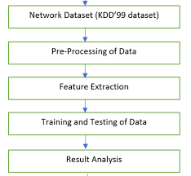
Project analysis slide 11
Dataset Analysis
Kdd99 Dataset:
KDD99
10% KDD99

Slide 24
Project analysis slide 4
Dataset Analysis
Basic features
Connections which fit the expected profile.
.
Normal
Classification
FEATURES
Content features
Connections which do not fit the expected profile.
Dataset was classified into 5 categories.
Features required to analyze the dataset.
Malicious
Traffic features

Slide 25
Project analysis slide 3
Dataset Analysis
NORMAL
Denial of Service (DOS)
Scanning/Probing
Remote to local (R2L)
User to root (U2R)
Connections that fit the expected profile in the network.
Connections trying to prevent legitimate users from accessing the service in the target machine.
Connections scanning a target machine for information about potential vulnerabilities.
Connections in which the attacker attempts to obtain non-authorized access into a machine or network .
Connections in which a target machine is already invaded, but the attacker attempts to gain access with superuser privileges.

Slide 26
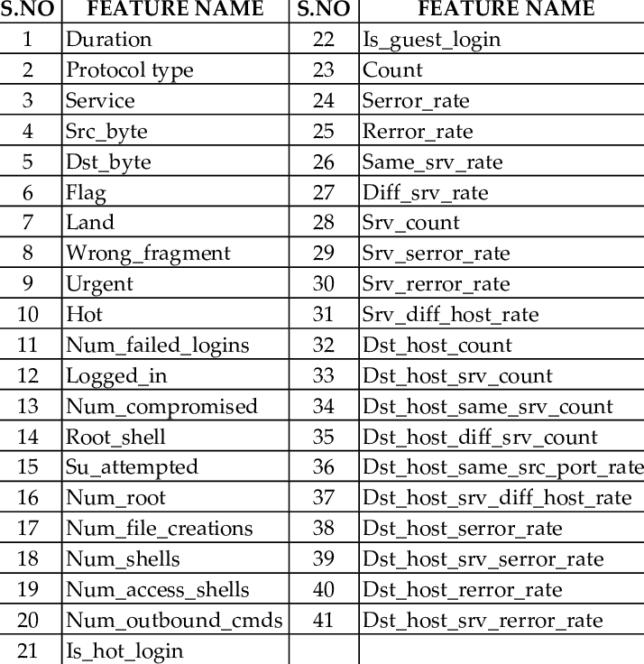
Project analysis slide 11
Dataset Analysis

Slide 27
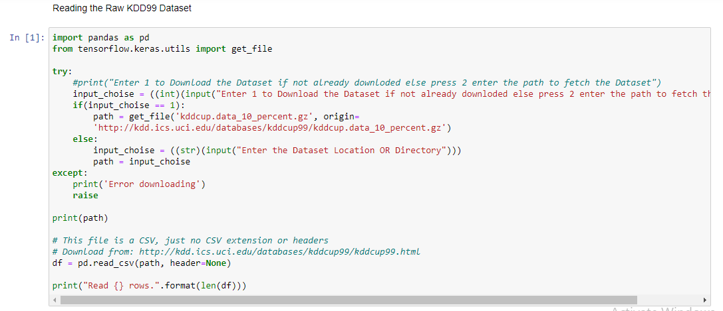
Implementation Of the Project
1. Reading the Dataset

Slide 28
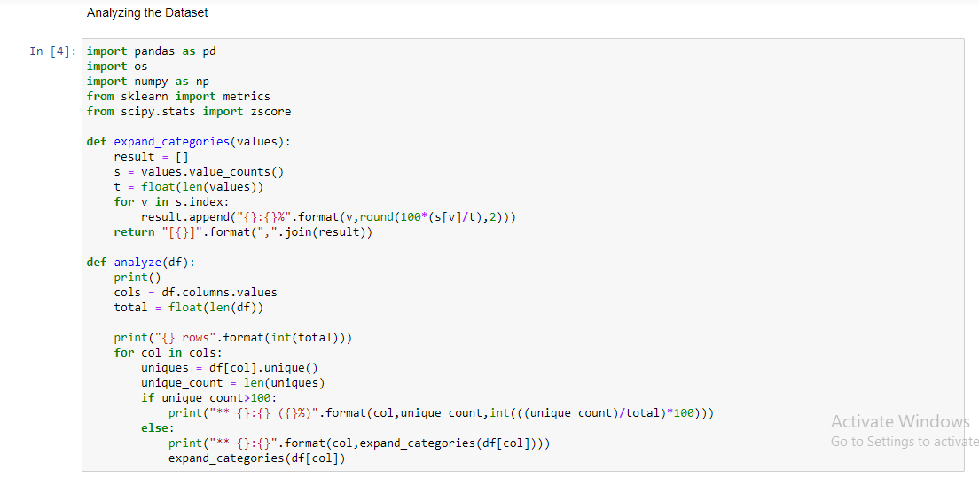
2. Analysing the Dataset

Slide 29
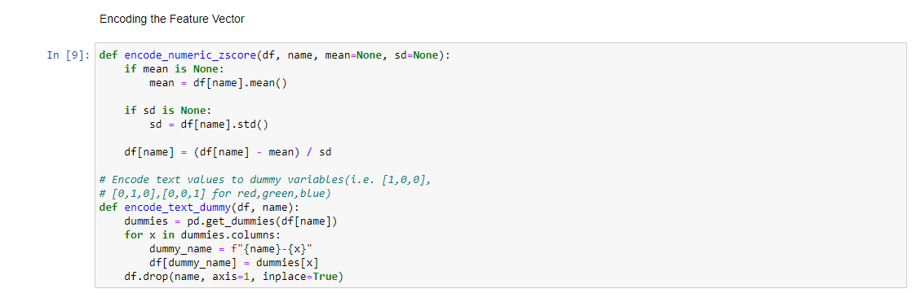
3. Encoding the Feature Vector

Slide 30
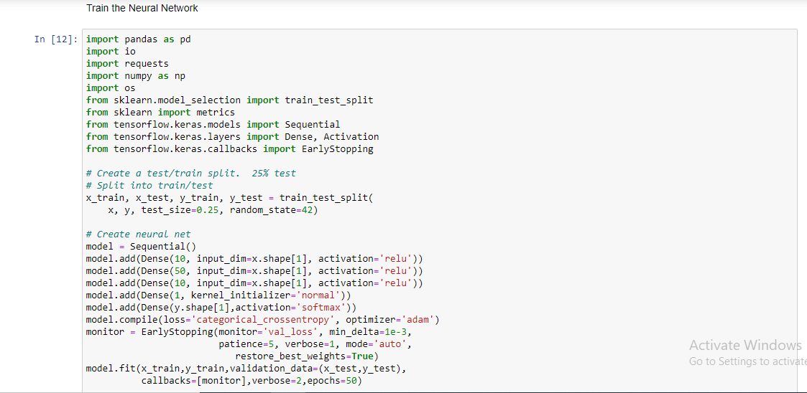
4. Creating the Neural Network and Training the Neural Network

Slide 31
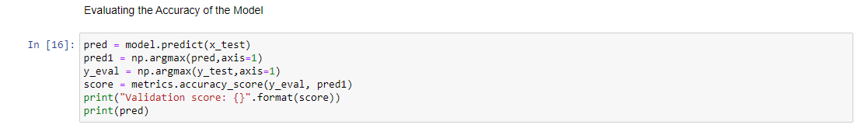
5. Testing the Accuracy of the Neural Network and Performing the Prediction on the Neural Network

Slide 32
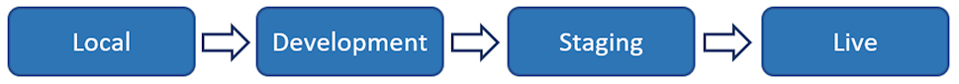
What is deployment?
Examples:
Amazon Web Services (AWS), Google Cloud Platform, Microsoft Azure, Heroku and Streamlit etc.

Slide 33
Why Streamlit?
Quick Build and Highly Interactive Web applications.
No Pre-requisite Knowledge of Web development required.
Use Python only.
Large and Helping Community.
Best for Machine Learning Models.

Slide 34

Takes only 3 lines of code
And you’re done!

Slide 35
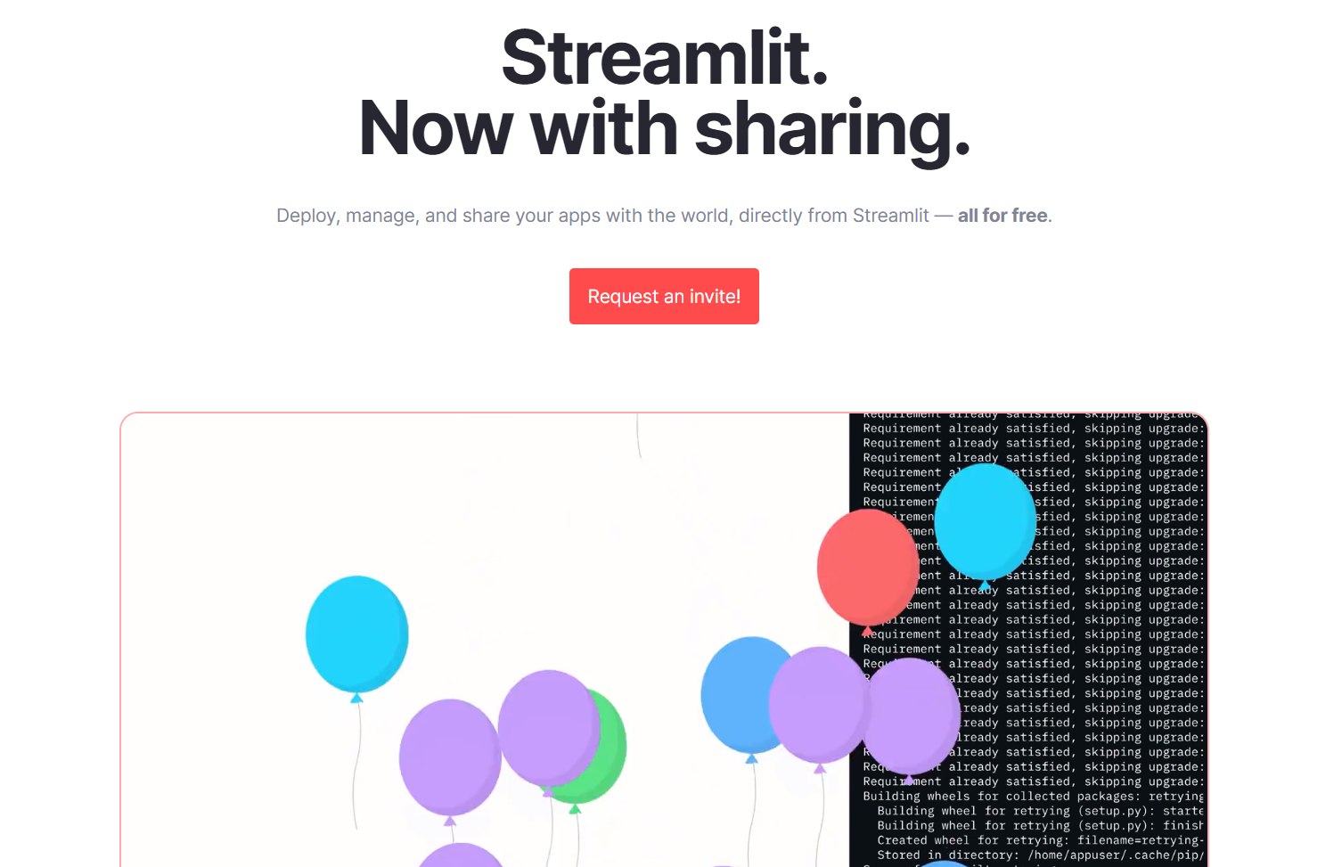
Streamlit sharing
Invite-based deployment.
All for free.
Deploy with same url.
Provides More Memory.
Paired with Github.
Better than others.

Slide 36
About our project
Requires 300+ MB (Hard Limit), 600+MB (Soft Limit) Memory
Requires accurate handling of imports.
Requires caching.
Requires saving and loading of the trained model.
Requires proper GUI.
Stay under the limits of deployment norms.

Slide 37
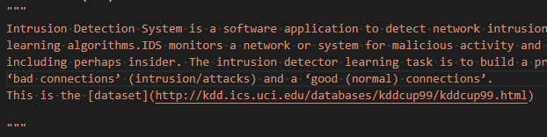
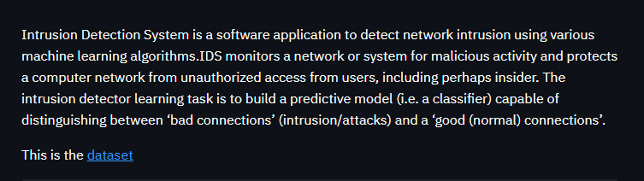
Code used
st.write() or ‘’’ ‘’’
Figure: Code snippet
Figure: Output

Slide 38
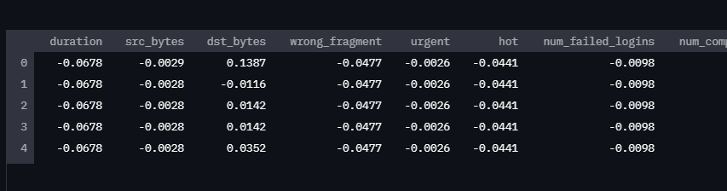
Code used
st.dataframe() or df
Figure: Code snippet
Figure: Output

Slide 39
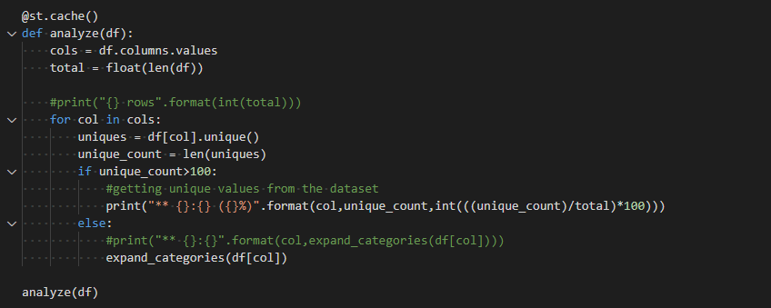
Code used
@st.cache()
Figure: Code snippet

Slide 40

Reduced TensorFlow Computing Power
Requires 300+ MB (Hard Limit), 600+MB (Soft Limit) Memory.
Reduced by removing GPU processes by
changing the imports.
Saving and Loading the test-training function
Figure: Code snippet

Slide 41
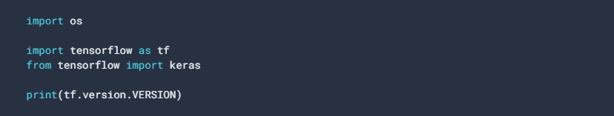
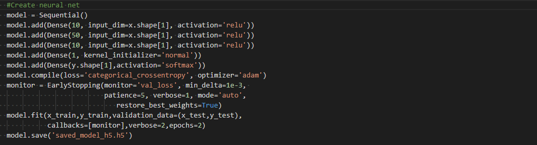
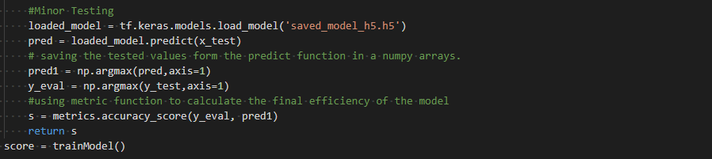
Saving & loading the tensorflow model
Figure: Code snippet of imports
Figure: Code snippet of saving the model
Figure: Code snippet of loading the model

Slide 42
Conclusion
Over the years, traditional intrusion detection system has been there in the industry. At last what we have achieved an automated intrusion detection system using neural networks. Our system can be used as core information extraction system for all types of information system having large databases.

Slide 43
Thank you!

