Slide 1
Artificial Neural Network 2431 An illustration of learning process
Sparisoma Viridi¹
¹Nuclear Physics and Biophysics Research Division, Faculty of Mathematics and Natural Sciences
¹Institut Teknologi Bandung, Bandung 40132, Indonesia
20230410-v4| https://doi.org/10.5281/zenodo.7839422

Slide 2
Outline
Architecture 3
Activation functions 6
Feedforward 10
Backprogpagation 14
TensorFlow playground 17
Assignment 27

Slide 3
Architecture

Slide 4




Neuron and layer types
input layer
hidden layer
output layer
Color
input neuron
hidden neuron
output neuron
Notation
is b-th neuron in a-th layer
$$⋮$$
$$⋮$$
$$x_{b}^{a}$$
$$x_{b}^{a}$$

Slide 5










2-4-3-1 network
$$x_{1}^{2}$$
$$x_{1}^{3}$$
$$x_{1}^{1}$$
$$x_{2}^{2}$$
$$x_{2}^{3}$$
$$x_{1}^{4}$$
$$x_{3}^{2}$$
$$x_{3}^{3}$$
$$x_{2}^{1}$$
$$x_{4}^{2}$$
Peter Bartus Leonard Meijer, “Neural Network Applications in Device and Subcircuit Modelling for Circuit Simulation”, PhD Thesis, Technische Universiteit Eindhoven, Eindhoven, Netherlands, May 1996, p 10, url https://doi.org/10.6100/IR459139.

Slide 6
Activation functions

Slide 7
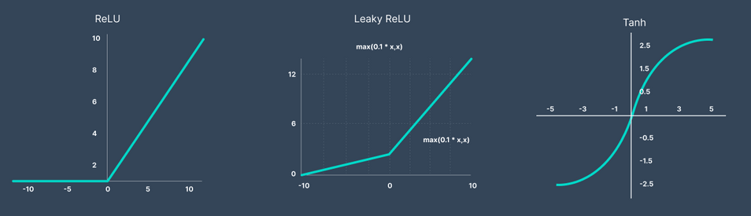



$$g\left(x\right)=max\left(0,x\right)⁡$$
$$g\left(x\right)=max\left(0.1x,x\right)⁡$$
$$g\left(x\right)=\frac{e^{x}−e^{−x}}{e^{x}+e^{−x}}$$
Pragati Baheti, “Activation Functions in Neural Networks [12 Types & Use Cases]”, V7Labs, 2 Mar 2023, url https://www.v7labs.com/blog/neural-networks-activation-functions [20230418].

Slide 8
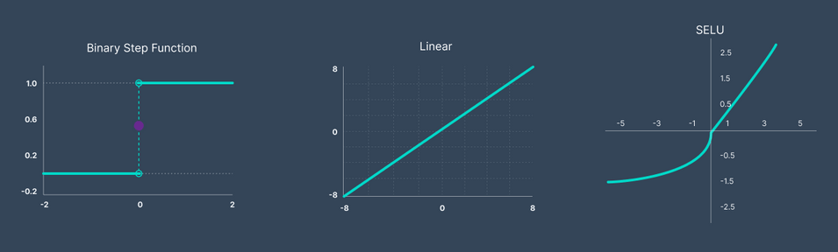
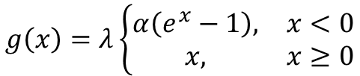

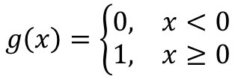
$$g\left(x\right)=\left\{\begin{matrix}0, & x<0 \\ 1, & x≥0\end{matrix}\right.$$
$$g\left(x\right)=λ\left\{\begin{matrix}α\left(e^{x}−1\right), & x<0 \\ x, & x≥0\end{matrix}\right.$$
$$g\left(x\right)=x$$
Pragati Baheti, “Activation Functions in Neural Networks [12 Types & Use Cases]”, V7Labs, 2 Mar 2023, url https://www.v7labs.com/blog/neural-networks-activation-functions [20230418].

Slide 9
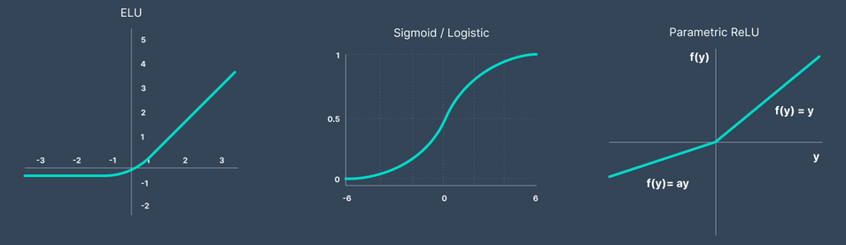

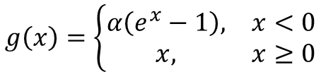

$$g\left(x\right)=\left\{\begin{matrix}α\left(e^{x}−1\right), & x<0 \\ x, & x≥0\end{matrix}\right.$$
$$g\left(x\right)=\frac{1}{1+e^{−x}}$$
$$g\left(x\right)=max\left(ax,x\right)$$
Pragati Baheti, “Activation Functions in Neural Networks [12 Types & Use Cases]”, V7Labs, 2 Mar 2023, url https://www.v7labs.com/blog/neural-networks-activation-functions [20230418].

Slide 10
Feedforward

Slide 11




Neuron in a layer as vector
From figure of 2-4-3-1 network there are following vectors representing each layers
$\vec{x_{2}}$= $\left[\begin{aligned}\begin{matrix}x_{1}^{2} \\ x_{2}^{2} \\ x_{3}^{2}\end{matrix} \\ x_{4}^{2}\end{aligned}\right]$
$\vec{x_{3}}$= $\left[\begin{matrix}x_{1}^{3} \\ x_{2}^{3} \\ x_{3}^{3}\end{matrix}\right]$
$\vec{x_{1}}$= $\left[\begin{matrix}x_{1}^{1} \\ x_{2}^{1}\end{matrix}\right]$
$\vec{x_{4}}$= $\left[x_{1}^{4}\right]$
Artem Oppermann, “Activation Functions in Deep Learning: Sigmoid, tanh, ReLU”, 14 Oct 2021, url https://artemoppermann.com/activation-functions-in-deep-learning-sigmoid-tanh-relu/ [20230418].

Slide 12


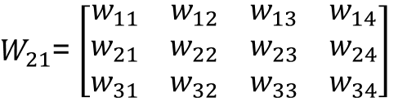
Weight as matrix
Weights connected two layers from previous network can be formulated as follow
$W_{21}$= $\left[\begin{aligned}\begin{matrix}w_{11} & w_{12}\end{matrix} \\ \begin{matrix}w_{21} & w_{22}\end{matrix} \\ \begin{matrix}w_{31} & w_{32}\end{matrix} \\ \begin{matrix}w_{41} & w_{42}\end{matrix}\end{aligned}\right]$
$W_{21}$= $\left[\begin{matrix}w_{11} & w_{12} & w_{13} & w_{14} \\ w_{21} & w_{22} & w_{23} & w_{24} \\ w_{31} & w_{32} & w_{33} & w_{34}\end{matrix}\right]$
$W_{32}$= $\left[\begin{matrix}w_{11} & w_{12} & w_{13}\end{matrix}\right]$
Artem Oppermann, “Activation Functions in Deep Learning: Sigmoid, tanh, ReLU”, 14 Oct 2021, url https://artemoppermann.com/activation-functions-in-deep-learning-sigmoid-tanh-relu/ [20230418].

Slide 13






Information propagation
Between two successive layers with $g$ is activation function
Final result then compared to observed value
$${\vec{x}}_{2}=g\left({W_{21}\vec{x}}_{1}\right)$$
$${\vec{x}}_{3}=g\left({W_{32}\vec{x}}_{2}\right)$$
$${\vec{x}}_{4}=g\left({W_{43}\vec{x}}_{3}\right)$$
$${\vec{x}}_{4}$$
$$\vec{y}$$

Slide 14
Backpropagation

Slide 15



Error and weight change
It can be defined as follow
Then, change of weight with is learning rate
$$ε={\left|{\vec{x}}_{4}−\vec{y}\right|}^{2}$$
$$Δw_{ij}=−η\frac{∂ε}{∂w_{ij}}$$
$$η$$

Slide 16


Weight modification
Using previous formulation, weight is updated using
The process continues until certain expected value of total
$$w_{ij}(new)=w_{ij}(old)+Δw_{ij}$$
$$ε$$

Slide 17
TensorFlow playground

Slide 18
A neural network playground
url https://playground.tensorflow.org/
It can help in visualizing how an ANN works
Let’s try the classification this time

Slide 19
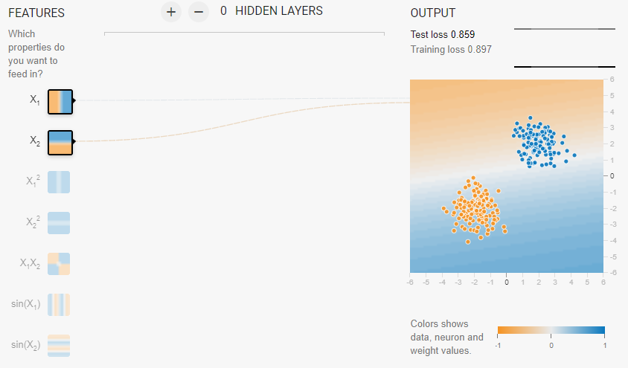
Case 1 (initial condition)

Slide 20
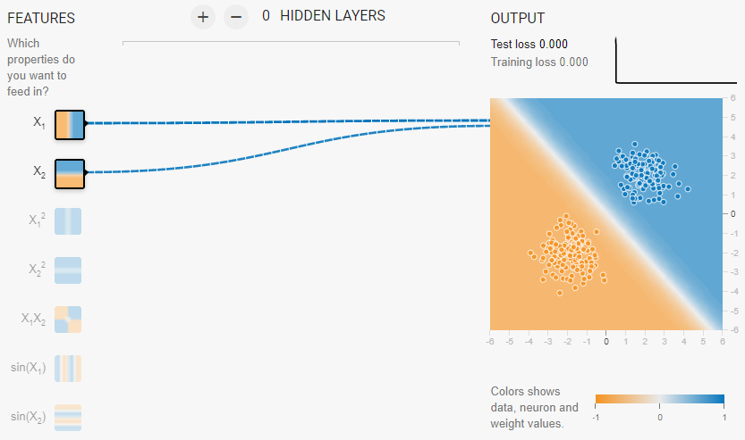
Case 1 (final condition)

Slide 21
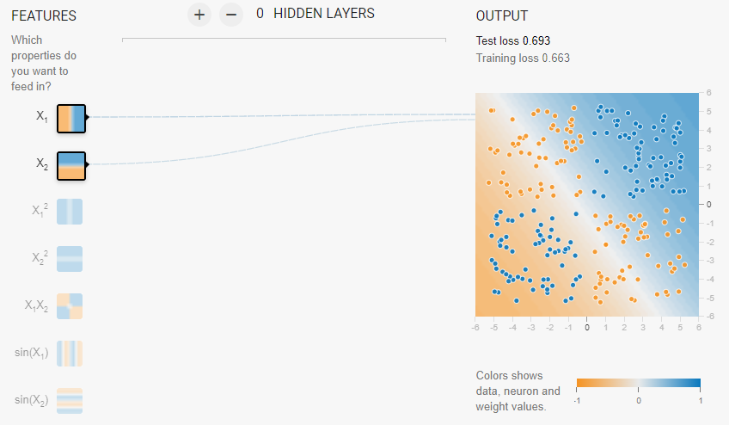
Case 2 (initial condition)

Slide 22
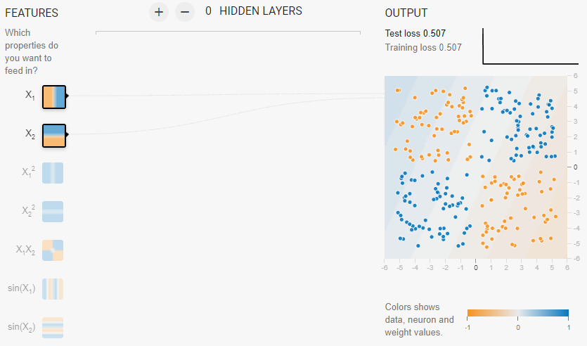
Case 2 (final condition)
It is not able to classify with current architecture

Slide 23
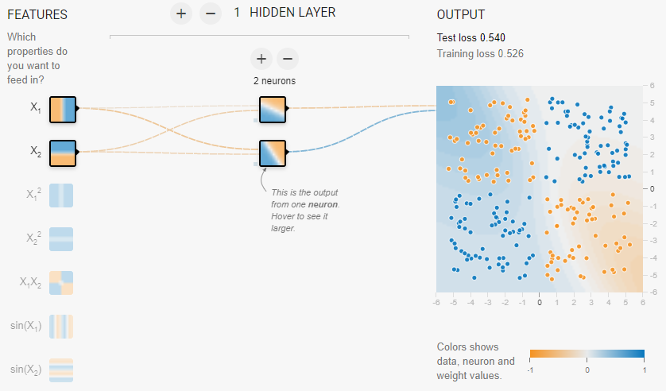
Case 2 (initial condition)

Slide 24
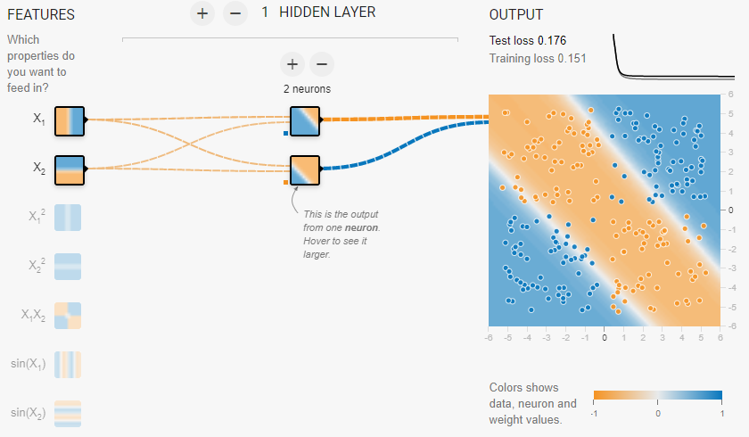
Case 2 (final condition)
It is able to classify with current architecture, but not fully right

Slide 25
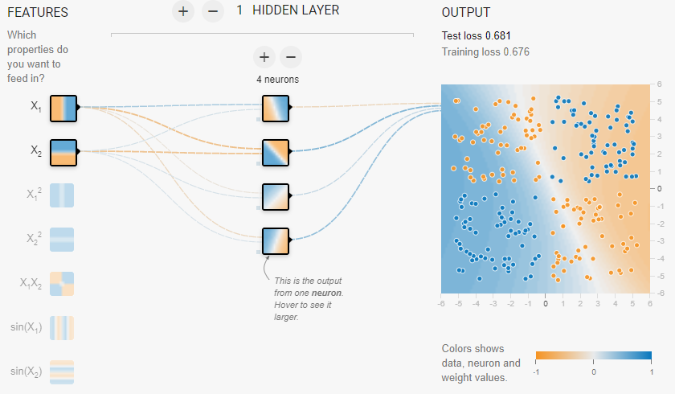
Case 2 (initial condition)

Slide 26
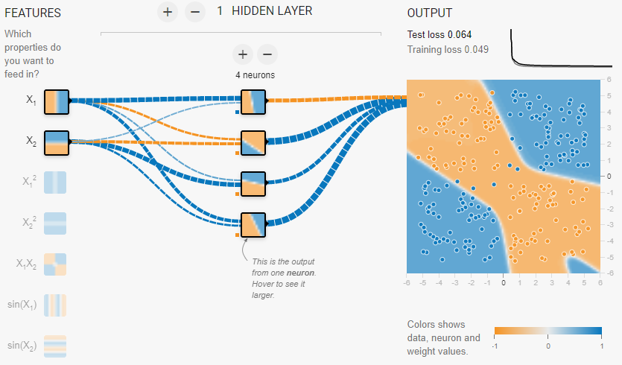
Case 2 (final condition)
It is better

Slide 27
Assignment

Slide 28
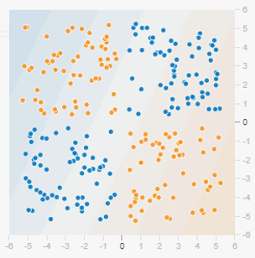
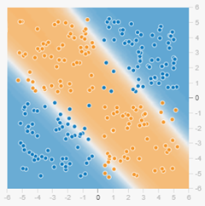
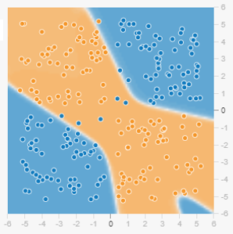
Background: Case 2
Current results
2 - 1
2 - 2 - 1
2 - 4 - 1

Slide 29
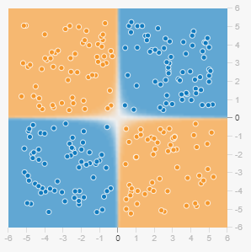
Problem: Architecture and features
Target:
Please provide:
Features? (x₁, x₂, ..)
Architecture? (e.g. 2-3-4-1, ..)
Learning rata?
Activation function?
Regularization?
Number of attemps?

Slide 30
Thank you
-

