Slide 1
WorldTree
Problems:
Objects interact with their close environment, don't care about what happens far away
Movement needs to know which objects could collide
AI wants to find an unblocked way to a target-point
Shoot bullets to objects targeted by crosshair
Requirement:
Speed
Solution:
Component that Objects can query for
Objects
Voxels
That intersect with
AABB, Capsule, Sphere
Ray / Line
24.03.2013
Gameprogramming 2013 - Voxellancer
<number>

Slide 2
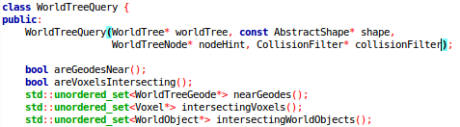

Implementation
OctTree with unbalanced depth and dynamic covered AABB
Split/Merge leafs depending on object-count
Objects know in which Leafs they are located
WorldTreeQuery:
AbstractShape:
24.03.2013
Gameprogramming 2013 - Voxellancer
<number>

Slide 3
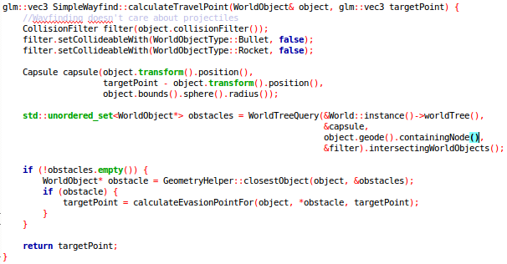
Usage
AI wants to know if path to waypoint is clear
Compose capsule that contains object during the movement
Ask WorldTreeQuery for objects colliding with this capsule
[Calculate intermediate waypoint to evade nearest obstacle]
24.03.2013
Gameprogramming 2013 - Voxellancer
<number>

