Slide 1



DSU Hackathon 2026
Team Shark

Slide 2

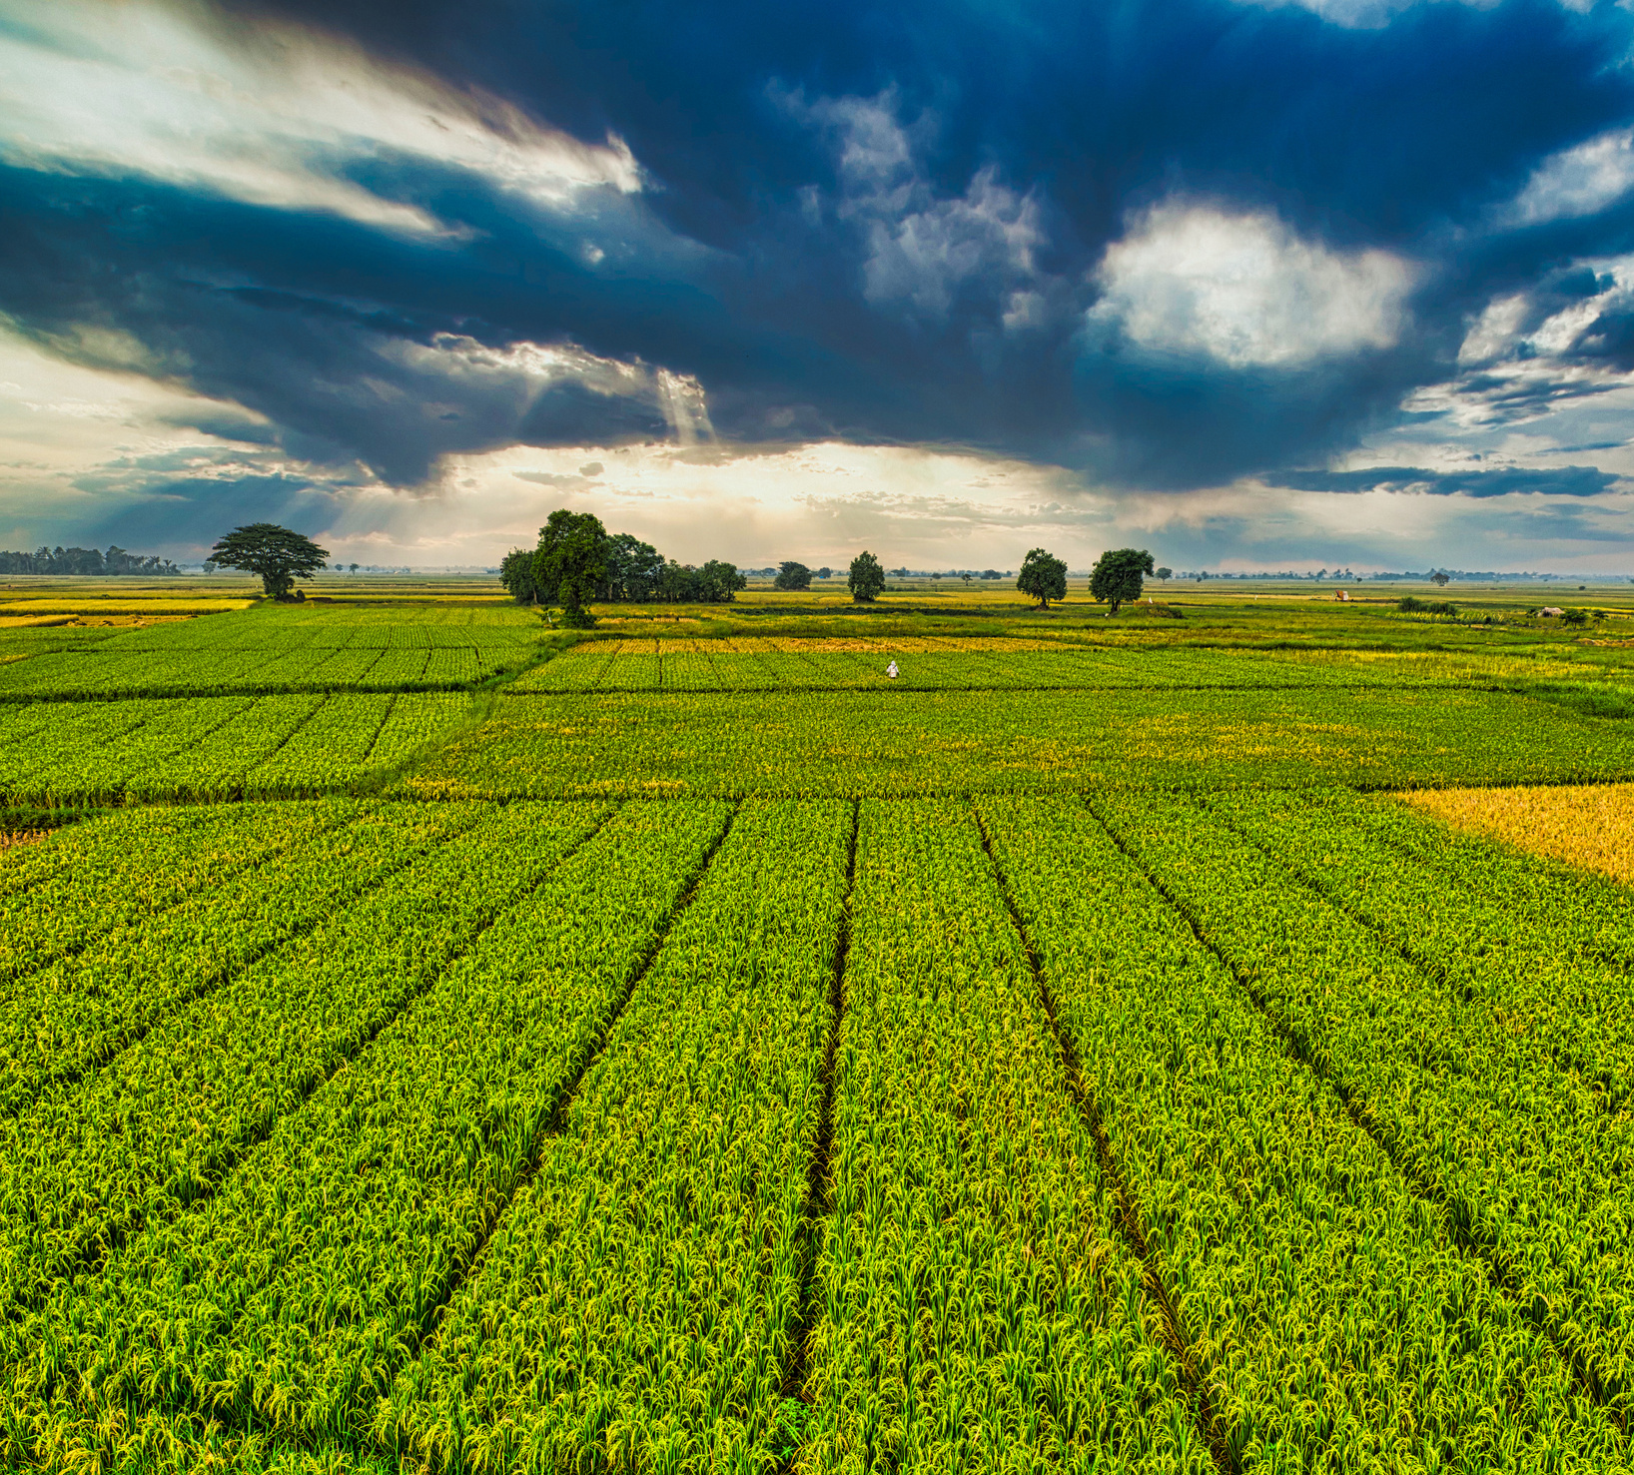
DSU Hackathon 2026
Team Shark
User and Problem statement:
User: Soil and Crop Resilience Planning: Soil conservation office
Problem Statement: The Soil Conservation Office needs to identify geographic areas where soil conservation efforts should be prioritized because it must direct limited resources toward locations where conservation interventions can most effectively reduce drought-related crop losses.

Slide 3
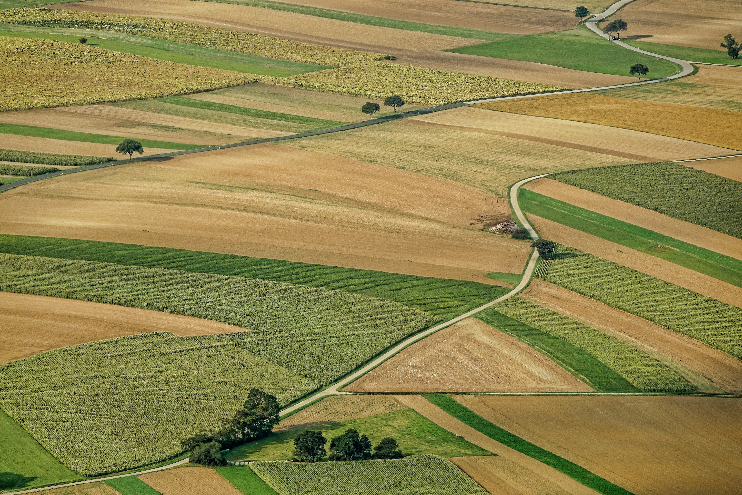
DSU Hackathon 2026
Team Shark
Why Iowa?
We chose Iowa to make our comparison more consistent. By focusing on one state where agriculture is predominantly rainfed, we reduce differences caused by irrigation and varying regional conditions. This helps us focus more directly on how drought and soil characteristics relate to crop yield anomalies.

Slide 4
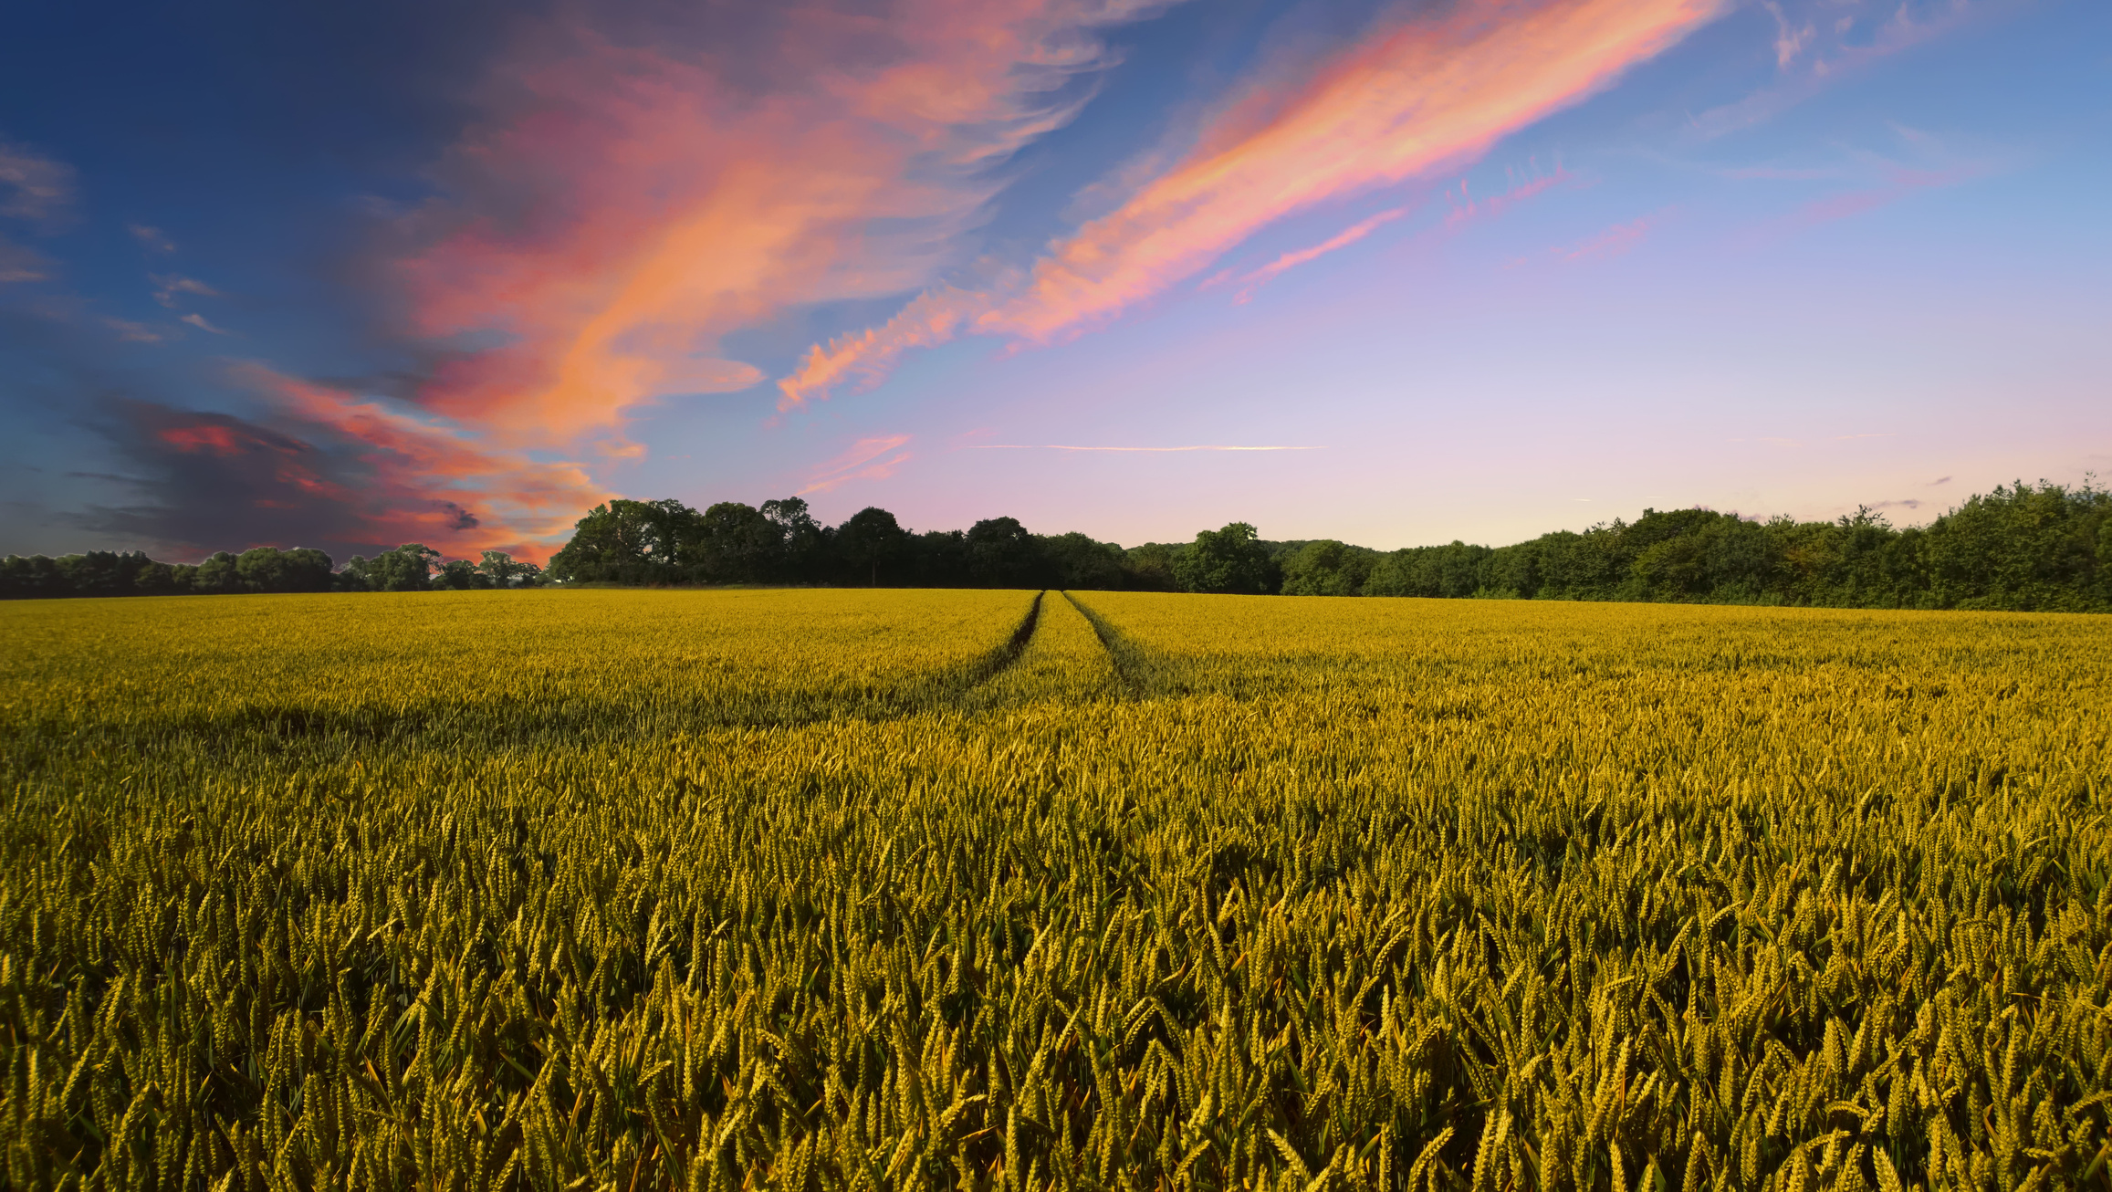
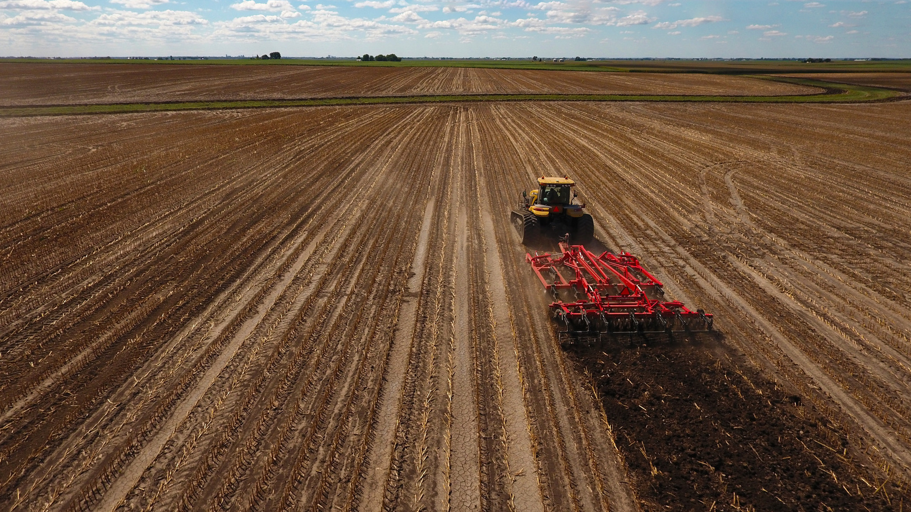
DSU Hackathon 2026
Team Shark
What we did and why:
We developed a data-driven tool to help soil conservation offices identify which Iowa counties should be prioritized for soil conservation efforts. Using county-level crop yield, drought, and soil data from 2000–2025 across 99 Iowa counties, focusing on corn and soybeans, our tool provides specific, evidence-based insights to support informed decisions about where resources may be most beneficial.

Slide 5
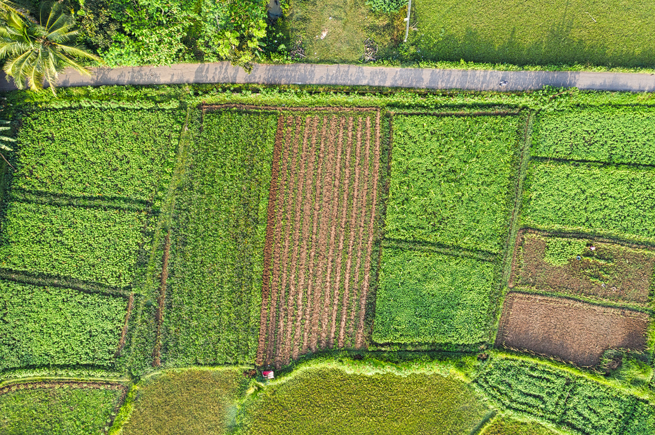

DSU Hackathon 2026
Team Shark
Why should a soil conservation office trust our analysis?
  Real data: County-level agricultural data from 2000–2025.
  Focused analysis: Iowa reduces regional differences and irrigation-related confounding.
  Evidence-based comparisons: Compare drought-year crop losses across low- and high-soil-water-storage counties.
  Transparent & tested: Measure uncertainty and test findings on unseen years.
  Honest limitations: Correlation doesn’t prove causation.

Slide 6
DSU Hackathon 2026
Team Shark
What the office does Monday morning:
1. Pick the crop and set how many counties it can allocate resources to.
2. Start outreach in the standard-confidence counties; verify the lower-confidence ones locally first.
3. Click any county for its drought record, soil and current practices.
One engine, two faces:
The app and the report notebook call the same code, so they can never disagree. Everything is reproducible from the repo.

Slide 7
DSU Hackathon 2026
Team Shark
Let’s now start our live demo

Slide 8
