Slide 1
Optimal sampling-based motion planning of a Dubins car
Course project
COM S 576 Motion Strategy Algorithms and Applications by Dr. Nok
Team member: Mohammad Hashemi
05/03/2023
Notes:
Hello everyone. My name is Mohammad Hashemi. This is my final project presentation on Deep learning-based prediction of bone degradation utilizing novel virtual database of cellular microstructures.

Slide 2
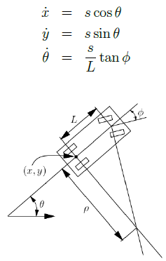
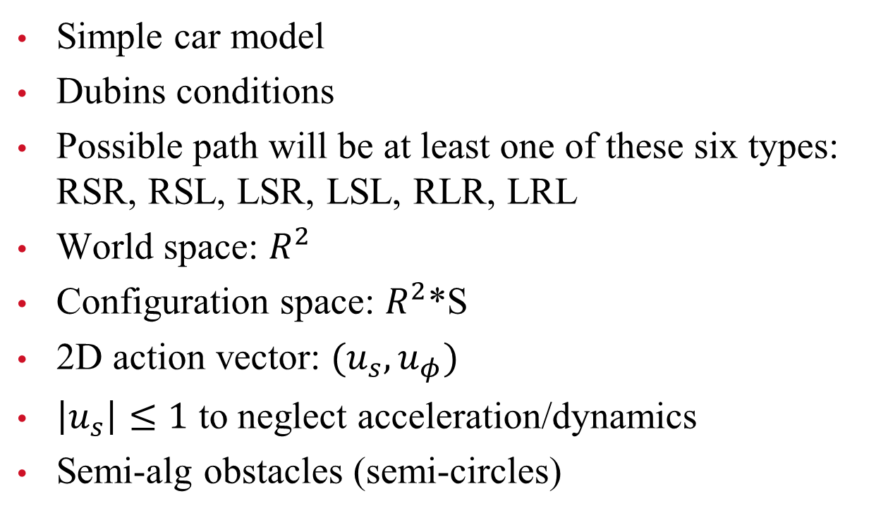
Problem formulation
Simple car model
Dubins conditions
Possible path will be at least one of these six types: RSR, RSL, LSR, LSL, RLR, LRL
World space: $R^{2}$
Configuration space: $R^{2}$*S
2D action vector: $(u_{s},u_{φ})$
$\left|u_{s}\right|≤1$ to neglect acceleration/dynamics
Semi-alg obstacles (semi-circles)

Slide 3
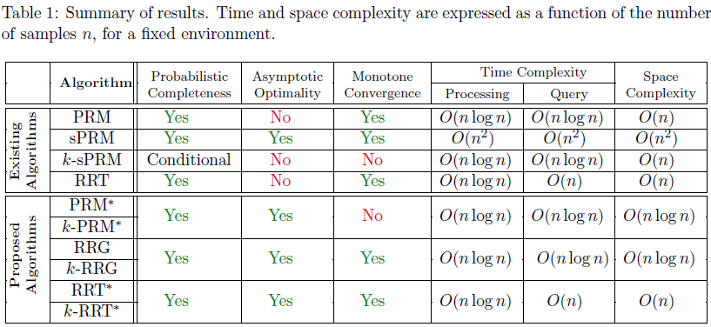
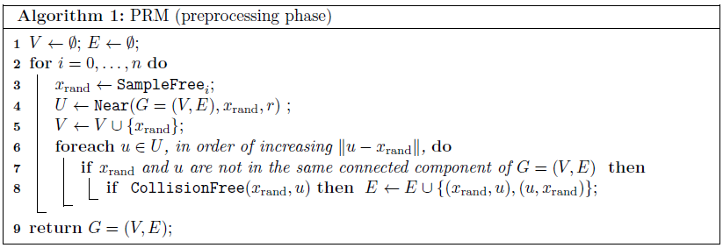
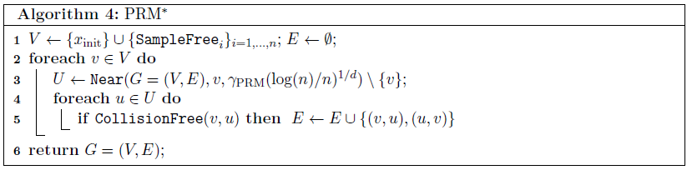
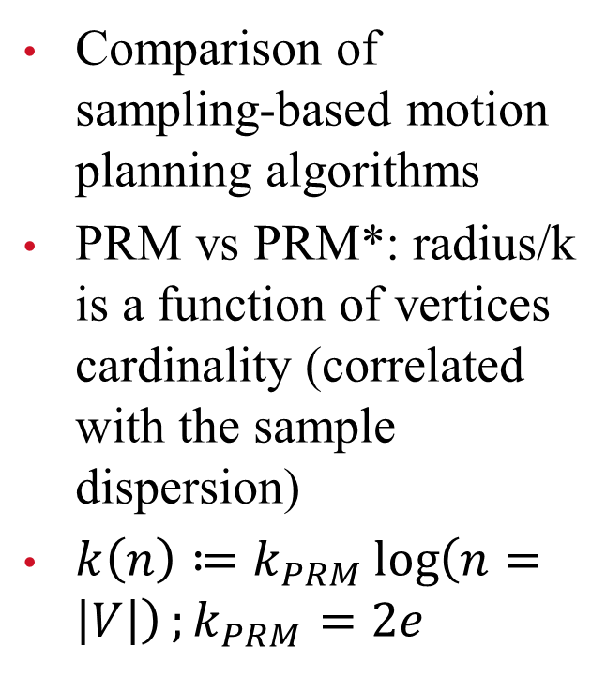
Approach
Comparison of sampling-based motion planning algorithms
PRM vs PRM*: radius/k is a function of vertices cardinality (correlated with the sample dispersion)
$k\left(n\right)≔k_{PRM}\log\left(n=\left|V\right|\right);k_{PRM}=2e$
Karaman & Frazzoli, 2011, International Journal of Robotics Research.

Slide 4
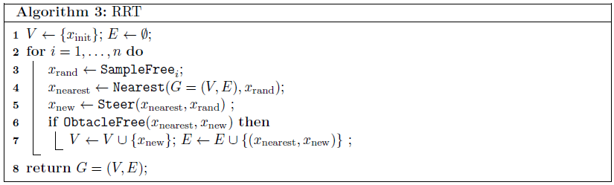
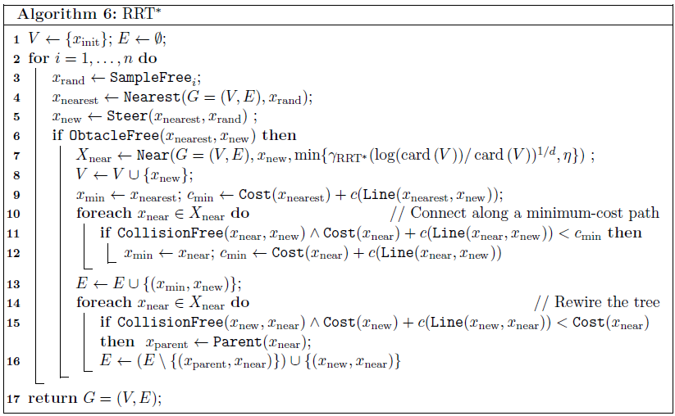
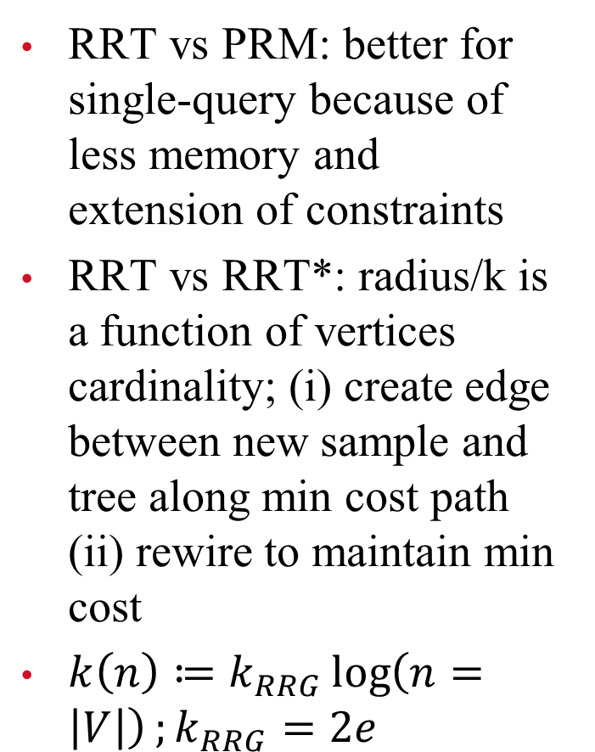
Approach (cont.)
RRT vs PRM: better for single-query because of less memory and extension of constraints
RRT vs RRT*: radius/k is a function of vertices cardinality; (i) create edge between new sample and tree along min cost path (ii) rewire to maintain min cost
$k\left(n\right)≔k_{RRG}\log\left(n=\left|V\right|\right);k_{RRG}=2e$
Karaman & Frazzoli, 2011, International Journal of Robotics Research.

Slide 5
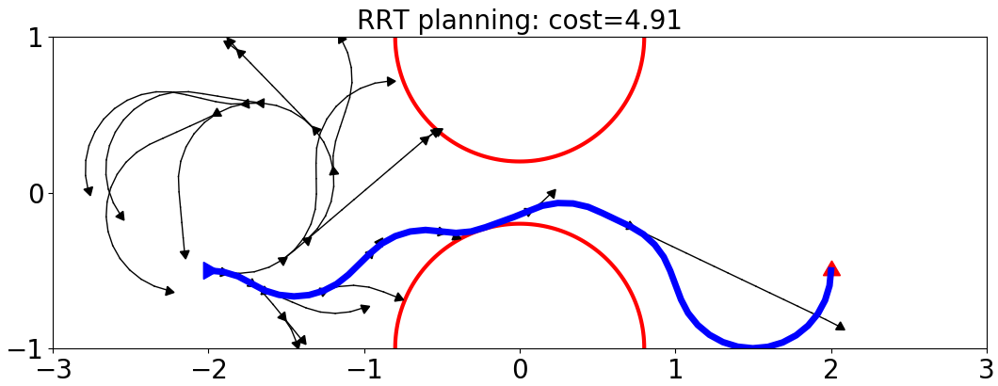
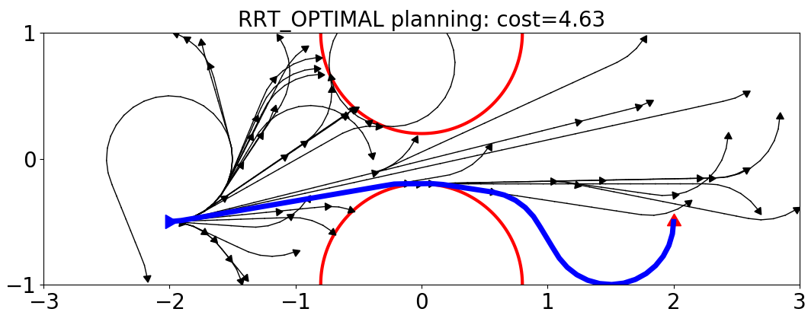
Results (RRT)

Slide 6
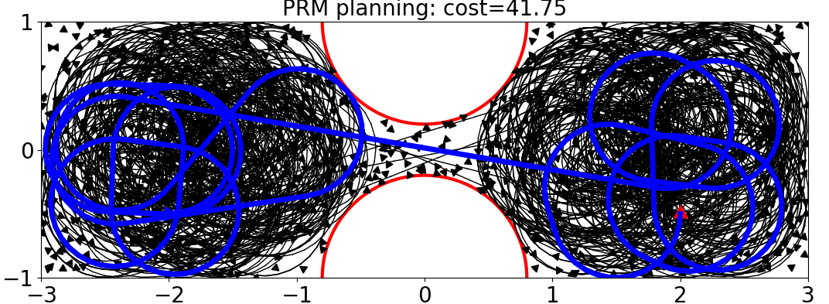
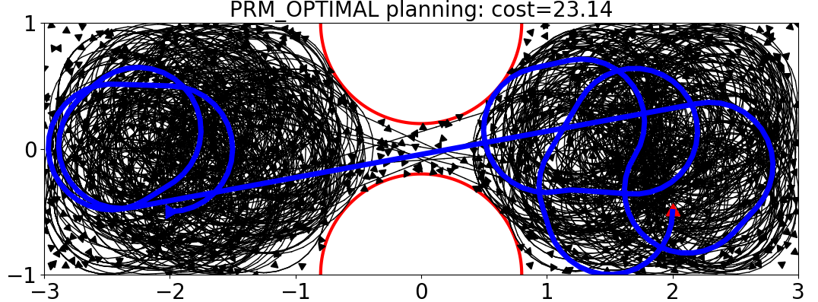
Results (PRM)

Slide 7
Conclusions
Implemented k-RRT* and k-PRM*
Applied the algs to a Dubins car motion planning problem
Optimal cost plans found in the experiment
PRM problems
Future work/improvements:
radius check instead of k-nearest methods
bi-directional trees in RRT*
more accurate (polygons) and efficient (van der Corput sequence) collision check

