Slide 1
What’s so great about quantum computing?
What is a quantum computer?
What is a qubit?
Why is there so much excitement about quantum computing?
What can they do that classical computers can’t?
Will they revolutionize computing?
Will they break cryptography?

Slide 2
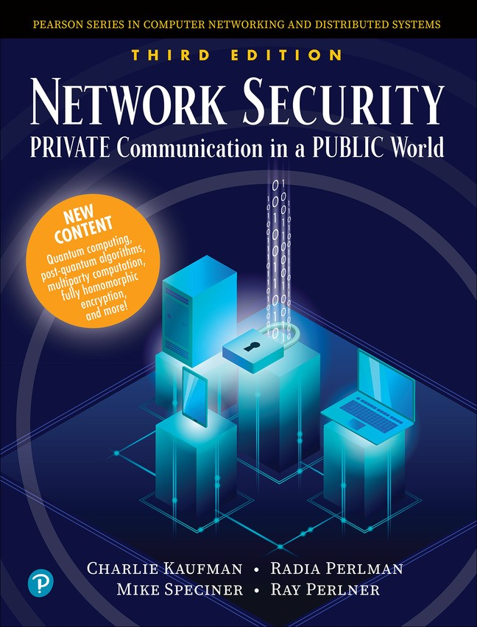

Slide 3
It’s a quantum world!
Quantum theory is remarkably successful at predicting the behavior of physical systems.
But our perception is classical.
What happens when classical perception meets quantum reality?
It seems that when we measure a quantum system, we get a classical result.

Slide 4
What is a quantum computer?
A computer has memory and a way to manipulate that memory.
Manipulation can proceed serially and/or in parallel, hardwired and/or under control of a program.
Both classical and quantum computers have classical program control, but quantum computers have additional capabilities for memory and manipulation of that memory.

Slide 5
What is a quantum computer?
A classical computer has a bunch of bits and a gaggle of gates to manipulate those bits. Each bit can be 0 or 1, and gates perform logical operations such as CLEAR, SET, NOT, AND, OR, XOR.
A quantum computer has a bunch of qubits and quantum gates to manipulate those qubits.
  Each qubit is a mixture of |0⟩ and |1⟩.
  Each quantum gate can perform an operation on one or a handful of qubits. Only certain kinds of operations are possible.
  Each qubit can also be measured (“read”), getting 0 or 1 and simultaneously forcing the qubit to become purely |0⟩ or |1⟩.

Slide 6
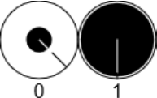
What is a qubit?
A qubit is a “superposition” of |0⟩ and |1⟩: α|0⟩+β|1⟩. α and β are complex numbers; they are called amplitudes and they each have a magnitude and a phase.
When you read α|0⟩+β|1⟩, you get 0 with probability |α|² and 1 with probability |β|². The process of reading destroys the superposition, leaving the state of the qubit as either |0⟩ or |1⟩, in agreement with what was read.

Slide 7
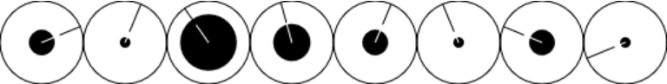
Multiple qubits
A single qubit is not of much use. Power lies in having lots of “entangled” qubits. For example, if you have three qubits, their state can be represented as
α|000⟩+β|001⟩+γ|010⟩+δ|011⟩+ε|100⟩+ζ|101⟩+η|110⟩+θ|111⟩
000 001 010 011 100 101 110 111
The basic idea of a quantum computation is to initialize the qubits to a desired input state and then apply a sequence of quantum gates so that when you finally read the qubits you get, with high probability, a useful result.

Slide 8
Quantum gates
Inputs are Outputs and Outputs are Inputs
Probability Preserving (sum of probabilities must remain 1)
Linear
Reversible
Can be represented as a matrix of complex numbers describing what happens to each classical state
Can create (and destroy) superposition and entanglement
Can’t clone qubits!!! (Copies are entangled with originals.)

Slide 9
Quantum gates
One-qubit gates
    X (NOT—exchange amplitudes of |0⟩ and |1⟩)
    Y (multiply amplitude of |0⟩ by i and amplitude of |1⟩ by −i,
    then exchange amplitudes of |0⟩ and |1⟩)
    Z (negate amplitude of |1⟩)
    Hadamard (mix amplitudes of |0⟩ and |1⟩—multiply each amplitude by 1/√2, then the sum is the new amplitude of |0⟩ and the difference is the new amplitude of |1⟩)
    phase change gates (change relative phase of |0⟩ and |1⟩)
      T (aka π/8)
      S = T² (aka π/4)
      Z = S²

Slide 10
Quantum gates
Two-qubit gates
    CNOT (XOR the first qubit into the second qubit)
Three-qubit gates
    CCNOT (if the first two qubits are 1, complement the third qubit)
    (aka Toffoli gate)

Slide 11
Why is there so much excitement?
It kind of looks like a quantum computer can compute on all classical bit combinations simultaneously. Something like a nondeterministic Turing machine. That would mean that NP complete problems could be solved in polynomial time—exponentially faster than on a classical computer (assuming P ≠ NP). We’ll get back to that in a minute.
There is some evidence:
    Grover’s algorithm can search for a single target in an n-bit space in time 2^{n/2}, whereas a classical algorithm takes time 2^{n}.
    Shor’s algorithm can factor integers and compute discrete logarithms exponentially more quickly than any known classical algorithm.

Slide 12
What can quantum computers do that classical computers can’t?

Slide 13
What can quantum computers do that classical computers can’t?
NOTHING!

Slide 14
What can quantum computers do that classical computers can’t?
NOTHING!
But sometimes much much faster.

Slide 15
What can quantum computers do that classical computers can’t?
A classical computer can simulate a quantum computer if it has a true random number generator (which modern processors tend to have). But the simulation would be exponentially slower than a real quantum computer and take exponentially more bits.

Slide 16
What can quantum computers do that classical computers can’t?
A classical computer can simulate a quantum computer if it has a true random number generator (which modern processors tend to have). But the simulation would be exponentially slower than a real quantum computer and take exponentially more bits.
So, some intractable computations may become practical with quantum computers.

Slide 17
Will quantum computers revolutionize computing?
    Quantum computers are very hard to build, and likely very expensive
    There are many engineering challenges
      A number of possible technologies, most of which require cryogenic temperatures
      Decoherence: superposition and entanglement tend to decay over time
      So, error correction is needed. And there are lots more kinds of errors than with classical bits. To get a single reliable logical qubit could take many physical qubits.
    Only certain problems are amenable to quantum computing

Slide 18
Will quantum computers revolutionize computing?
    Quantum computers are very hard to build, and likely very expensive
    There are many engineering challenges
      A number of possible technologies, most of which require cryogenic temperatures
      Decoherence: superposition and entanglement tend to decay over time
      So, error correction is needed. And there are lots more kinds of errors than with classical bits. To get a single reliable logical qubit could take many physical qubits.
    Only certain problems are amenable to quantum computing
So, probably not.

Slide 19
Will quantum computers break cryptography?
Grover’s algorithm allows you to do a brute-force breaking of an encryption scheme faster than with a classical computer. But doubling the key size or hash size is sufficient to thwart this. Modern encryption standards allow sufficiently large keys and hashes already.
Shor’s algorithm can break all currently deployed public key schemes (encryption, signing, key exchange), given a sufficiently large quantum computer (which doesn’t yet exist). But NIST is in the final stages of standardizing quantum-safe (“post-quantum”) public key schemes.
Secret key schemes are not vulnerable to Shor’s algorithm.

Slide 20
Questions?

Slide 21
Resources
    Network Security book: http://www.informit.com/title/9780136643609
    Quantum Computer Simulator: https://ms0.github.io/qc.html
    Grover’s Algorithm: https://github.com/ms0/docs/blob/main/gmovie.pdf
    Discrete Fourier Transforms (the heart of Shor’s Algorithm) https://raw.githack.com/ms0/docs/main/dft.html
    Math: https://github.com/ms0/docs/blob/main/math.pdf

