Slide 1
Tutorial: Image Processing with Python(I)
Course: Digital Image Processing(ELEC4245)
Tutor: Dong Jinping (RSC G96, jpdong@eee.hku.hk)
Venue: CB103
Date: 14 Mar, 2017

Slide 2
Outline
Brief Introduction of Python
Why Python
Vector Programming, Modular Programming
Digital Image Processing (DIP)
Windowed operation in
Spatial domain
Spectral domain(FFT)
Advanced Image Analysis (Histogram)
Color Space Conversion
Summary & Resources for further study

Slide 3
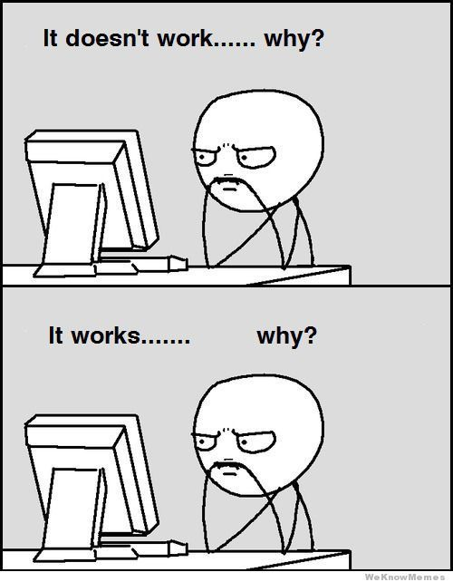
Why Python
Why not Photoshop/Image J
Powerful tools to deal with images
Only application of existing DIP techniques
Python
Programming
General-purpose language, open-source, object-oriented, etc.
Useful skill, help to find a job
For image processing
Help to understand DIP principles
Further development of DIP techniques
Batch processing, extensible, tunable, repeatable
Steep learning curve, frustration with bugs
Python(x,y)^{1,} Spyder (Scientific Python Development EnviRonment)
Numpy (linear algebra), Scipy (signal and image processing)
Matplotlib (interactive 2D/3D plotting), OpenCV-Python
Skimage (scikit-image, collection of image processing algorithms)
https://python-xy.github.io/

Slide 4
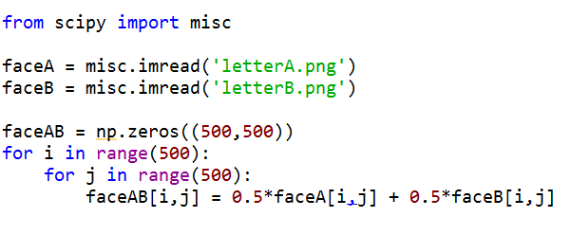
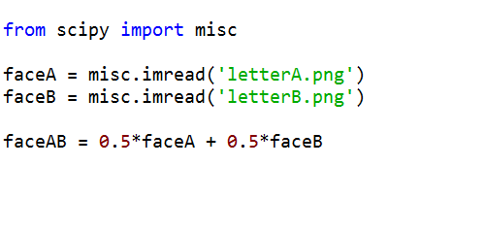
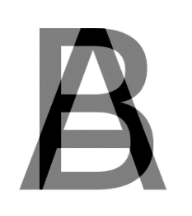
Vector Programming
C-style code vs Matlab-style code
VS
(A+B)/2=
Images from: http://graphemica.com/unicode/characters

Slide 5
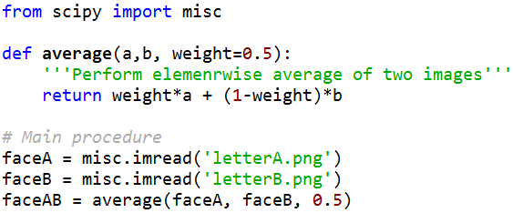
Modular Programming
1. Import Libraries and APIs (unlike Matlab)
2. Define Functions
VS
3. Main procedure
Tune parameters here
(A+B)/2=
Images from: http://graphemica.com/unicode/characters

Slide 6
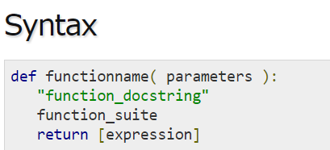
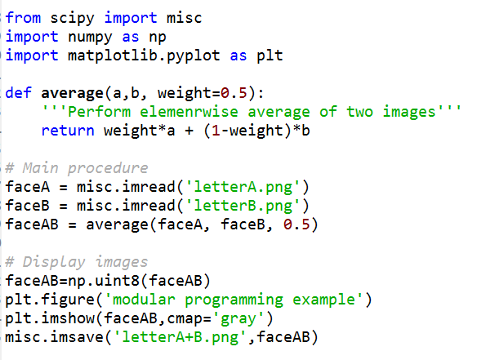
Practice I
5 mins
Start Python(x,y), enter Spyder
Run the two scripts for some basic ideas
A+B_c-style.py
A+B_matlab-style.py
Write the ‘modular programming’ code
Take average of two images
Tunable weight
Try to tune the weight parameter
Tips
%matplotlib qt
dir()

Slide 7


Windowed Operation in Spatial Domain
Gaussian filter, Median filter
Gaussian noise vs Salt & Pepper noise
Salt & Pepper noise
Median filter

Slide 8
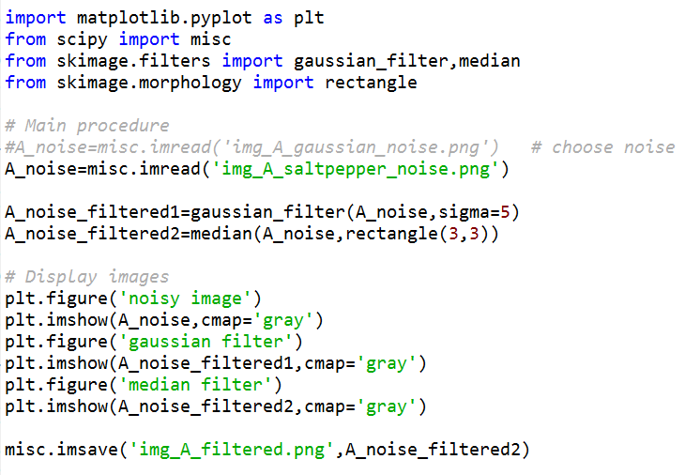
Practice II
15 mins
Add noise
Add to ‘letterA.png’
Gaussian noise, Salt & Pepper noise
skimage.util.random_noise
Save image
skimage.misc.imsave
Denoise
Complete denoise_g_m.py
Choose different noise for filtering
What have you observed?
Tips
help(skimage.filters)/ skimage.filters?

Slide 9



Windowed Operation in Spectral Domain(FFT)
Edge enhancing filter
Bandpass filter
Filtering
$i\left(x,y\right)=g\left(x,y\right)∗h\left(x,y\right)⟺I\left(f_{x},f_{y}\right)=G\left(f_{x},f_{y}\right)H\left(f_{x},f_{y}\right)$
Fast Fourier transform (FFT)

Slide 10
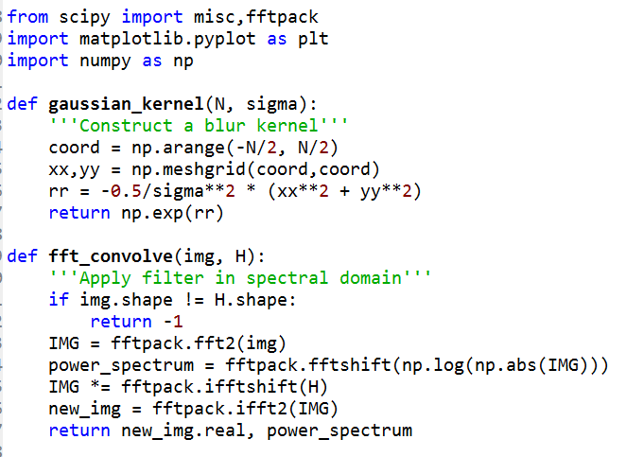
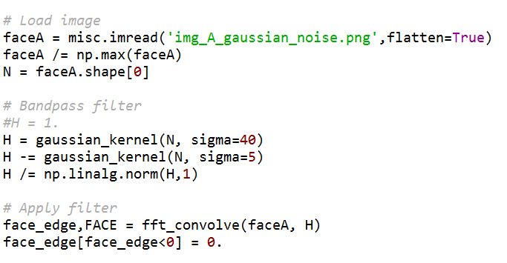
Practice III
15 mins
Bandpass filter & Convolution
Complete edge_enhance.py
Bandpass filter
From Gaussian kernel
bp_filter.py
Tips:
plt.subplot()
plt.axis(‘off’)

Slide 11
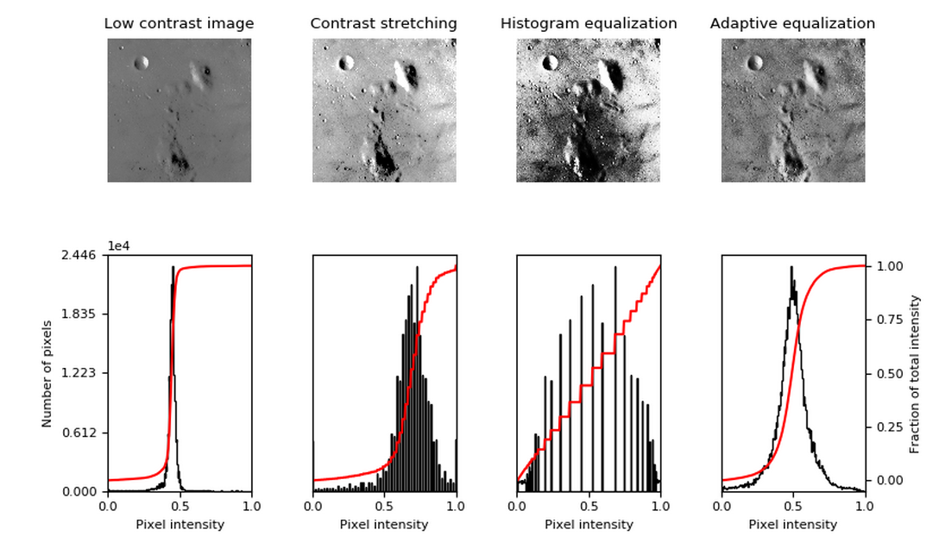
Advanced Image Analysis
Histogram analysis
Contrast stretching
Histogram equalization
Adaptive equalization
Images and histograms¹
http://scikit-image.org/docs/dev/auto_examples/color_exposure/plot_equalize.html#sphx-glr-auto-examples-color-exposure-plot-equalize-py

Slide 12
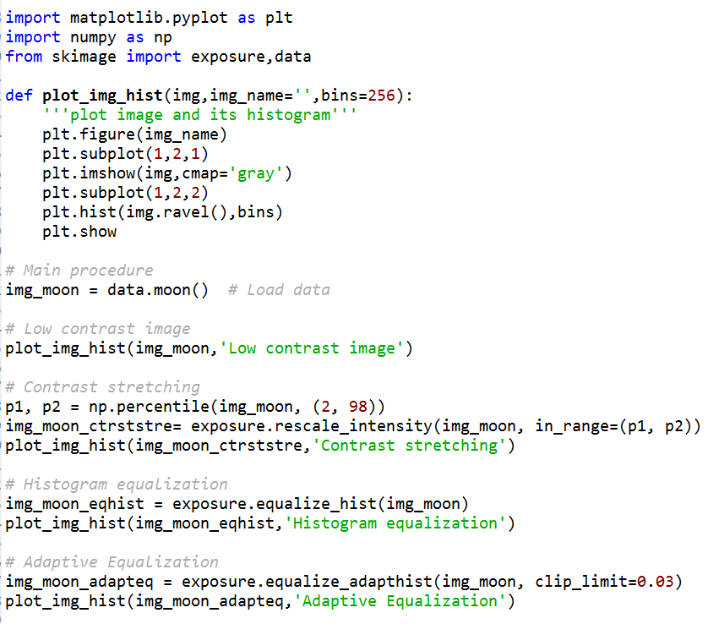
Practice IV
15 mins
Complete main procedure of hist.py
data.moon()
Plot image and its histogram of
Original image
Contrast stretching
Histogram equalization
Adaptive equalization
Which is the best? Metric?
Tips:
np.percentile(), exposure.rescale_intensity()
exposure.equalize_hist()
exposure.equalize_adapthist()

Slide 13
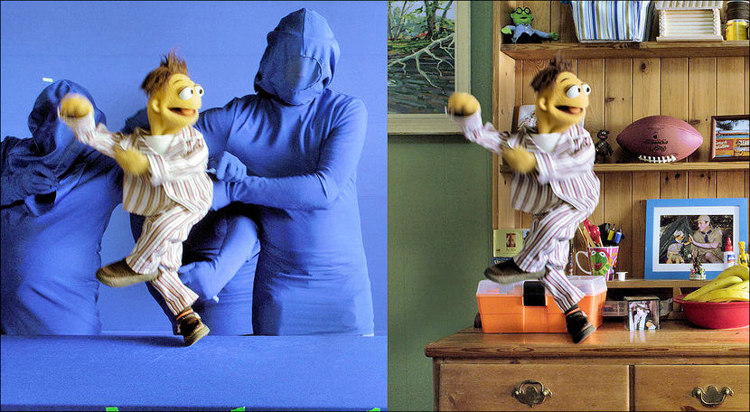
Color Space Conversion
Color space conversion
RGB to HSL/HSV²
Cartesian → Cylindrical
More intuitive for human
Easy to capture color using H
OpenCV-Python
cv2.cvtColor(input_image, flag)
HSV range³
Hue [0,179]
Saturation [0,255]
Value [0,255]
Image, Video
Example：Chroma Key¹
https://en.wikipedia.org/wiki/Chroma_key
https://en.wikipedia.org/wiki/HSL_and_HSV
http://opencv-python-tutroals.readthedocs.io/en/latest/py_tutorials/py_imgproc/py_colorspaces/py_colorspaces.html#converting-colorspaces

Slide 14
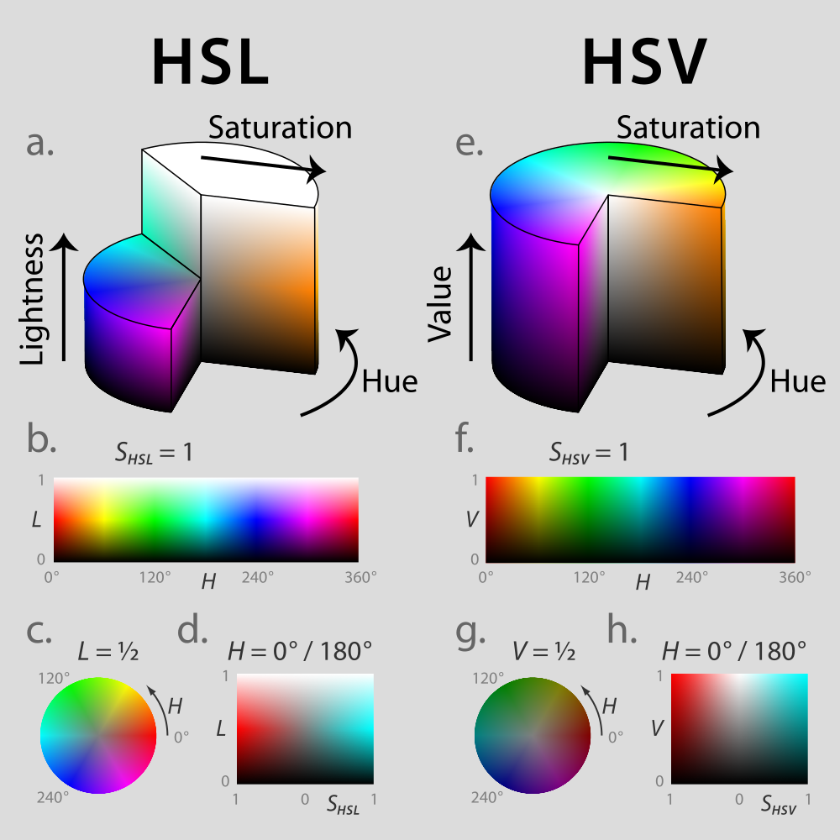
Color Space Conversion
Color space conversion
RGB to HSL/HSV¹
Cartesian → Cylindrical
More intuitive for human
Easy to capture color using H
OpenCV-Python
cv2.cvtColor(input_image, flag)
HSV range²
Hue [0,179]
Saturation [0,255]
Value [0,255]
Image, Video
HSL & HSV¹
https://en.wikipedia.org/wiki/HSL_and_HSV
http://opencv-python-tutroals.readthedocs.io/en/latest/py_tutorials/py_imgproc/py_colorspaces/py_colorspaces.html#converting-colorspaces

Slide 15
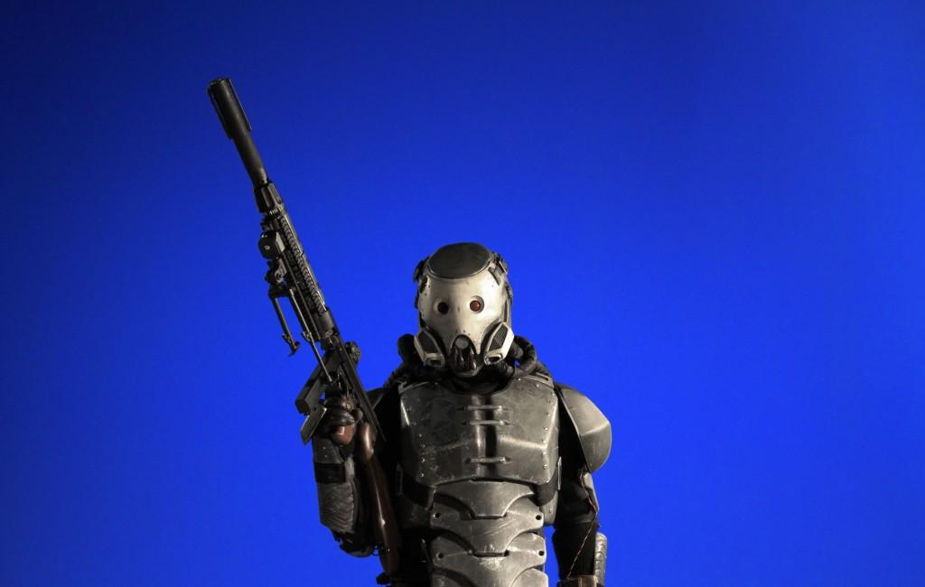
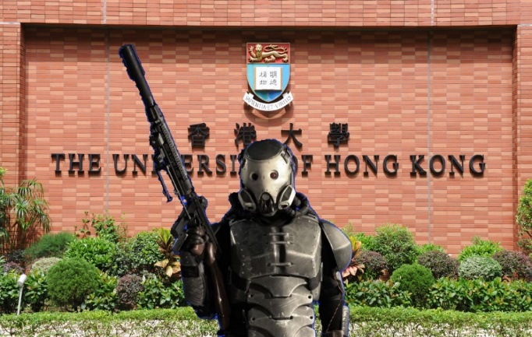
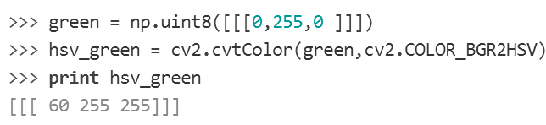
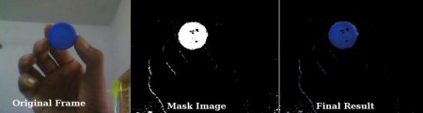
Practice V
20 mins
Fuse two images
Run opencv_img.py
What if the background is green?
HSV value of green?
How to change the background to green?
blue2other.py
Try to use the green one to fuse
Blue object tracking in real-time video¹
Turn on your camera
Run opencv_vid.py by double-click
Show a blue object to the camera
Track other color?
Tips
cv2.inRange(), cv2.bitwise_and()
cv2.cvtColor(input_image, cv2.COLOR_BGR2HSV)
Coordinates start from 0 in Numpy!
http://opencv-python-tutroals.readthedocs.io/en/latest/py_tutorials/py_imgproc/py_colorspaces/py_colorspaces.html#converting-colorspaces

Slide 16
Summary & Resources for further study
Summary
Numpy, Scipy, Matplotlib, Skimage, OpenCV-Python
Python programming
Help system, Python(x,y) documents
https://scipy.org/index.html
NumPy for Matlab users
https://docs.scipy.org/doc/numpy-dev/user/numpy-for-matlab-users.html#numpy-for-matlab-users
DIP
http://scikit-image.org/
https://opencv-python-tutroals.readthedocs.io/en/latest/

Slide 17
Acknowledgement
Parts of the materials were developed by Antony Chan in ELEC4245 tutorial of last year
Hope this tutorial is helpful, thank you!

