Slide 1
Artificial Intelligence
Assignment 2 Web Data Extraction

Slide 2
Outline
Your Works
Overview
Example
Assignment 2 Data
Submission
Grading

Slide 3
Outline
Your Works
Overview
Example
Assignment 2 Data
Submission
Grading

Slide 4
Your Works
TA-class practice
Calculate 2 example alignments by hand-writing
Deadline: Today before noon (下課前繳交)
Assignment 2
Try to design a search algorithm to reduce the time similarity and get the best alignment
Please implement in Python3 or Java
Deadline: 11/1 (Thu.) 23:59

Slide 5
Outline
Your Works
Overview
Example
Assignment 2 Data
Submission
Grading

Slide 6
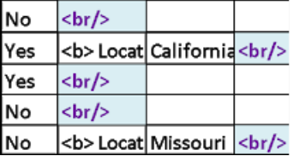
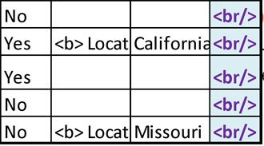
Data Node Alignment Problem Definition
We are given m sequences of data nodes. Sequence may have different numbers of data nodes. The problem is to align m sequences such that data nodes with similar nodes are aligned in the same column to get higher score.
For example, given 5 sequences of data nodes (a), the idea output for data alignment will be (b).
(a) Initial state
(b) Idea output

Slide 7
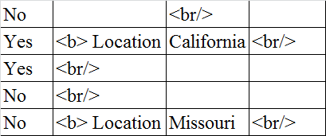
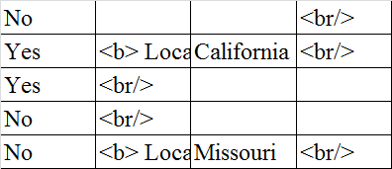
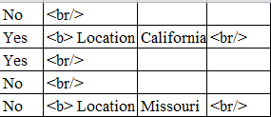
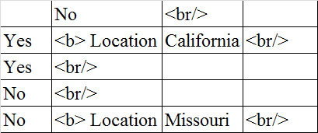
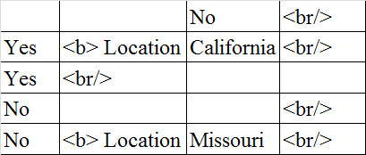
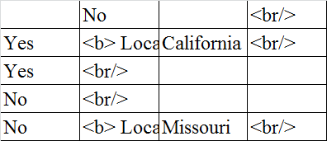
States and Actions to Move to Neighboring States
Pick one position in a page and shift data nodes to every possible/blank position while keeping the order of data nodes in the same sequence

Slide 8

Find the Best Alignment
We give a score to every state. The state with the highest score is the best alignment.
Two questions:
1. How many possible states?
2. How to define a score for each state?
Seq 1:
Seq 2: 1
Seq 3:
Seq 4:
Seq 5: 1

Slide 9
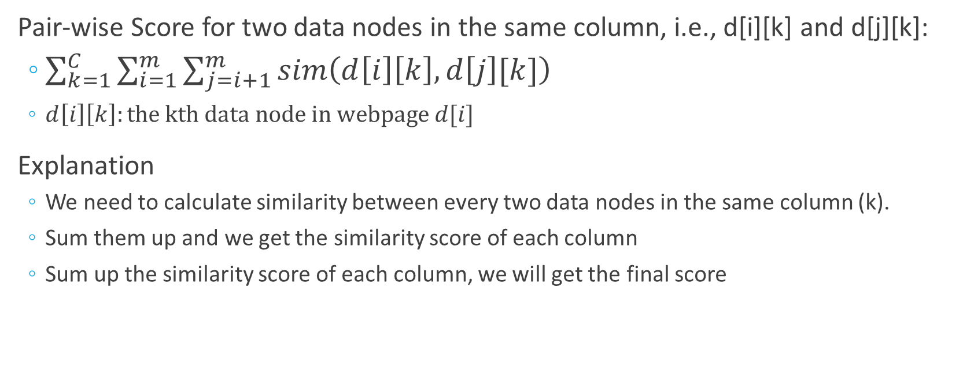
Reward Function Design
Pair-wise Score for two data nodes in the same column, i.e., d[i][k] and d[j][k]:
$\sum_{k=1}^{C}{\sum_{i=1}^{m}{\sum_{j=i+1}^{m}{sim\left(d\left[i\right]\left[k\right], d\left[j\right][k]\right)}}}$
$d\left[i\right]\left[k\right]:the kth data node in webpage d[i]$
Explanation
We need to calculate similarity between every two data nodes in the same column (k).
Sum them up and we get the similarity score of each column
Sum up the similarity score of each column, we will get the final score

Slide 10
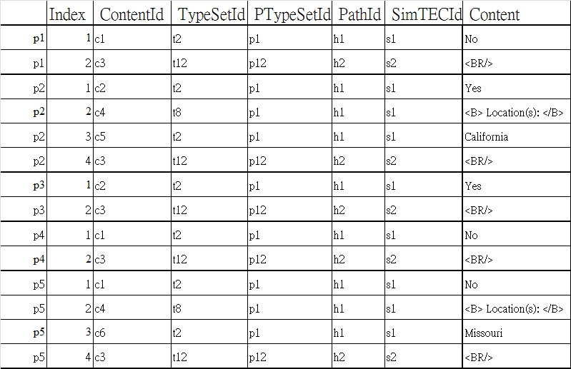
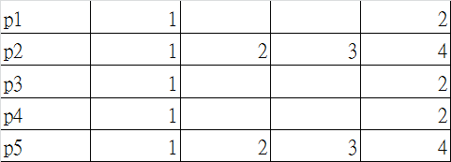
Input and Output Format for a Segment
SimSeqId

Slide 11
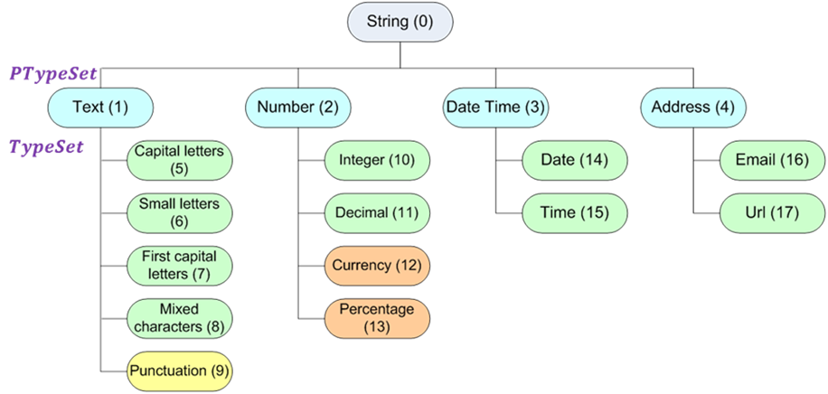
PTypeSetId & TypeSetId

Slide 12
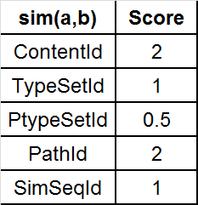
How to Define sim(A, B)?
- If a.ContentId=b.ContentId, then +2
- If a.TypeSetId=b.TypeSetId, then +1
- If a.PTypeSetId=b.PTypeSetId, then +0.5
- If a.PathId=b.PathId, then +2
- If a.SimSeqId=b.SimSeqId, then +1
- If one of the node is NULL, then -0.1
- If both A and B are NULL, then -0.2

Slide 13
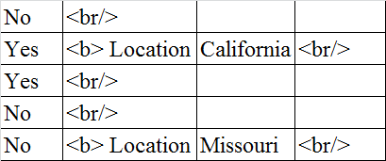
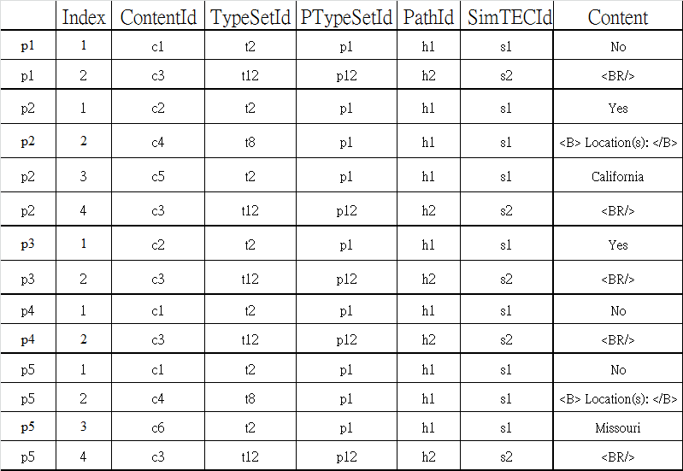
How to Define sim(A, B)?
2 1 0.5 2 1
SimSeqId
Column1: (4.5)*6+(5.5)*4=
6 pairs (Yes,No)= 1+0.5+2+1=4.5
1 pair (Yes,Yes)=2+1+0.5+2+1=5.5
3 pair (No,No)=2+1+0.5+2+1=5.5
Column3: (-0.1)*6+(-0.2)*3+(4.5)*1
3 pairs (California, -)=-0.1
6 pairs (-,-)= -0.2
1 (Carlifornia, Missouri)=4.5

Slide 14
Outline
Your Works
Overview
Example
Assignment 2 Data
Submission
Grading

Slide 15
Example
Pair-wise score:
Feature with equivalent value | Score
PtypeSetId | +0.5
TypeSetId | +1
ContentId | +2
PathId | +2
SimSeqId | +1
NotNULL with NULL | -0.1
NULL with NULL | -0.2
Content | PTypeSetId | TypeSetId | ContentId | PathId | SimSeqId
A | P1 | T2 | C1 | H1 | S1
B | P2 | T1 | C2 | H2 | S1
C | P1 | T2 | C3 | H1 | S2
NULL | / | / | / | / | /
Similarity between A and B: +1
Similarity between B and C: 0
Similarity between A and NULL: -0.1
Notes:
There is a easy example. This is a table about the similarity in each feature. If there are three contents, A, B and C, the similarity between A and B is 1. Because only SimSeqId between A and B is the same. And the similarity between B and C is 0, and the similarity between C and NULL is minus zero point one.

Slide 16
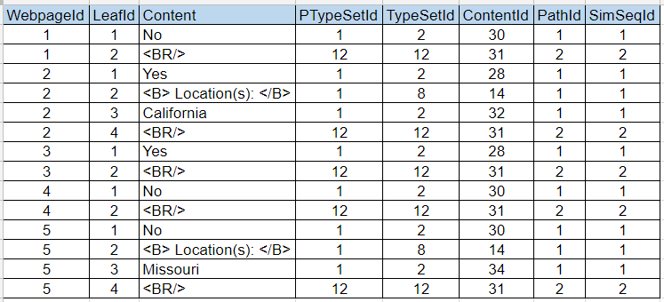
Example
There is a single segment.
Notes:
Let’s see another example. There is a single segment. In the table there are 5 webpages with different number of data nodes.

Slide 17

Example
Fill the table with contents from all webpages.
We align all contents to the left in default.
For each column, there are 10 combinations for each pair of contents. ($\frac{5∗4}{2}=10$)
Default Alignment
Webpage-01 | No | <BR/>
Webpage-02 | Yes | <B> Location(s): </B> | California | <BR/>
Webpage-03 | Yes | <BR/>
Webpage-04 | No | <BR/>
Webpage-05 | No | <B> Location(s): </B> | Missouri | <BR/>
Notes:
First, we make a table and fill the table with default alignment. There are 10 pair-wise combinations for each column.

Slide 18
Example
Feature with equivalent value | Score
PtypeSetId | +0.5
TypeSetId | +1
ContentId | +2
PathId | +2
SimSeqId | +1
NotNULL with NULL | -0.1
NULL with NULL | -0.2
There are 3 combinations in the first column:
“Yes” and “No”, “Yes” and “Yes”, “No” and “No”
Score = 6.5*1+6.5*3+4.5*6 = 53
Before Alignment
Webpage-01 | No | <BR/>
Webpage-02 | Yes | <B> Location(s): </B> | California | <BR/>
Webpage-03 | Yes | <BR/>
Webpage-04 | No | <BR/>
Webpage-05 | No | <B> Location(s): </B> | Missouri | <BR/>
Score | 53
Notes:
In first column, there are three combinations: … The similarity between “Yes” and “No” is 4.5 because all features between them are the same except for the ContentId. The similarity between yes and yes, no and no are 6.5. The score in first column is 53.

Slide 19
Example
There are 3 combinations in the second column:
“<BR/>” and “Location”, “Location” and “Location”, “<BR/>” and “<BR/>”
Score = 6.5*1+6.5*3+0*6 = 26
Before Alignment
Webpage-01 | No | <BR/>
Webpage-02 | Yes | <B> Location(s): </B> | California | <BR/>
Webpage-03 | Yes | <BR/>
Webpage-04 | No | <BR/>
Webpage-05 | No | <B> Location(s): </B> | Missouri | <BR/>
Score | 53 | 26
Notes:
In the second column, there are also three combinations: … The similarity between “BR” and “Location” is 0 because there is no equivalent feature between them. The similarity between location and location, BR and BR are 6.5. The score in second column is 26.

Slide 20
Example
There are 3 combinations in the third column:
“California” and “Missouri”, “California” and “”, Missouri” and “”, “” and “”
Score = 4.5+(-0.1)*3+(-0.1)*3 + (-0.2)*3 = 3.3
Before Alignment
Webpage-01 | No | <BR/>
Webpage-02 | Yes | <B> Location(s): </B> | California | <BR/>
Webpage-03 | Yes | <BR/>
Webpage-04 | No | <BR/>
Webpage-05 | No | <B> Location(s): </B> | Missouri | <BR/>
Score | 53 | 26 | 3.3
Notes:
In the third column, there are four combinations: … The similarity between “California” and space is minus and the similarity between space and space is minus 0.2. The score in the third column is 3.3.

Slide 21
Example
For the last column, there are 3 combinations:
“<BR/>” and “<BR/>”, “<BR/>” and “”, “” and “”
Score = 6.5*1+(-0.1)*6+(-0.2)*3 = 5.3
Before Alignment
Webpage-01 | No | <BR/>
Webpage-02 | Yes | <B> Location(s): </B> | California | <BR/>
Webpage-03 | Yes | <BR/>
Webpage-04 | No | <BR/>
Webpage-05 | No | <B> Location(s): </B> | Missouri | <BR/>
Score | 53 | 26 | 3.3 | 5.3
Notes:
In the last column, the score is 5.3.

Slide 22
Example
The final score of this alignment is 87.6.
Before Alignment
Webpage-01 | No | <BR/>
Webpage-02 | Yes | <B> Location(s): </B> | California | <BR/>
Webpage-03 | Yes | <BR/>
Webpage-04 | No | <BR/>
Webpage-05 | No | <B> Location(s): </B> | Missouri | <BR/>
Score | 53 | 26 | 3.3 | 5.3
Total | 87.6
Notes:
The total score is 87.6

Slide 23
Example
Change alignment by content words, the total score is 91.1.
Content Alignment
Webpage-01 |  | No |  |  |  | <BR/>
Webpage-02 | Yes |  | <B> Location(s): </B> | California |  | <BR/>
Webpage-03 | Yes |  |  |  |  | <BR/>
Webpage-04 |  | No |  |  |  | <BR/>
Webpage-05 |  | No | <B> Location(s): </B> |  | Missouri | <BR/>
Score | 5.3 | 18.7 | 5.3 | -1.6 | -1.6 | 65
Total | 91.1
Notes:
This is another alignment. We align the contents by there content. In means we put the same content in the same column. The score is 91.1.

Slide 24
Example
For this alignment, we can get the highest score 126.6.
Best Alignment
Webpage-01 | No |  |  | <BR/>
Webpage-02 | Yes | <B> Location(s): </B> | California | <BR/>
Webpage-03 | Yes |  |  | <BR/>
Webpage-04 | No |  |  | <BR/>
Webpage-05 | No | <B> Location(s): </B> | Missouri | <BR/>
Score | 53 | 5.3 | 3.3 | 65
Total | 126.6
Notes:
This is the best alignment with the highest score: one hundred and twenty six point six. So the target of this assignment is to find the best alignment with the highest score.

Slide 25
Outline
Your Works
Overview
Example
Assignment 2 Data
Submission
Grading

Slide 26
Assignment 2 Data
Input files
OXX-5.txt
OXX-10.txt
OXX-20.txt
OXX-30.txt
5, 10, 20, 30 denotes different data sizes
OXX denotes ID of webpages, there are totally 50 webpages (E01~E09 & T01~T41)
Goal
For all webpages, you need to calculate average similarity score over all segments
You need to fill in the average similarity score and time for all webpages in DataSummary.xlsx
Notes:
There are 4 input files with webpages Id and data sizes. There are 4 data size… OXX denotes ID of webpages. O maybe the E or T. XX between 1 to 9 or 1 to 41.

Slide 27
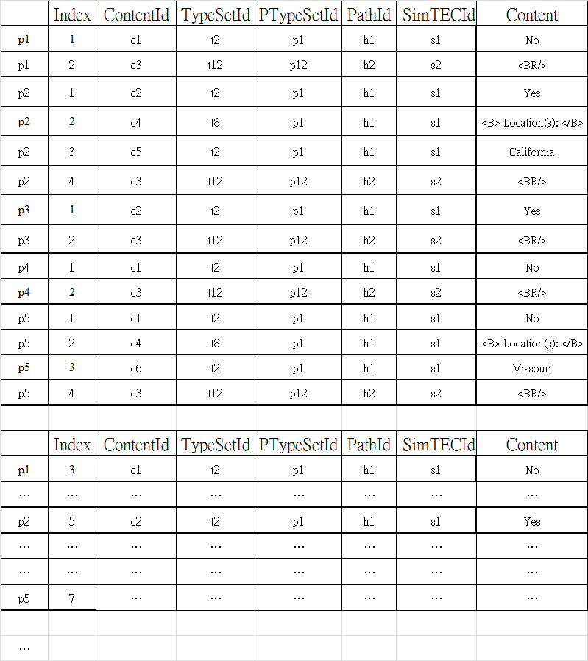
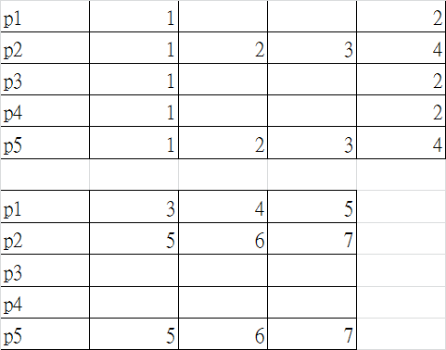
Assignment 2 Data
Input file
There might be more than one segment in a file, each separated by a new line.
Output file:
1st file: Alignment result for n segments
2nd file: Score, and time for n segments Fill in DataSummary.xlsx
There will be 50*4 input files:
M=5, 10, 20, 30
ID=E01~E09 & T01~T41
There will be 1 output files for each input file:
for best alignment
Output file 1
Notes:
There are 2 output file. First, you need to output the best alignment of every segments. Second, you need to calculate the score and time of each segment and output to a csv file.

Slide 28
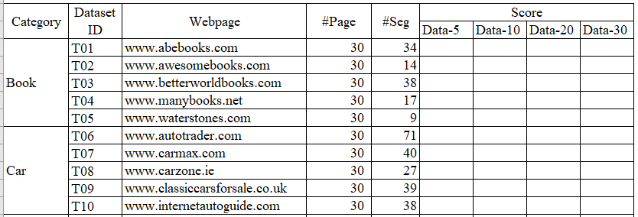
Assignment 2 Data
You have to fill the table in DataSummary.xlsx.
There are many segments in one file.
Calculate the score of each segment.
Calculate the average score of all segments in one file.
Fill the average score to DataSummary table.
Notes:
Besides, you have to fill the table in DataSummary.xlsx.

Slide 29
Outline
Your Works
Overview
Example
Assignment 2 Data
Submission
Grading

Slide 30
Submission
For TA-class practice
Answers with the computation process (計算過程&最終答案)
Deadline: Today before noon (下課前繳交)

Slide 31
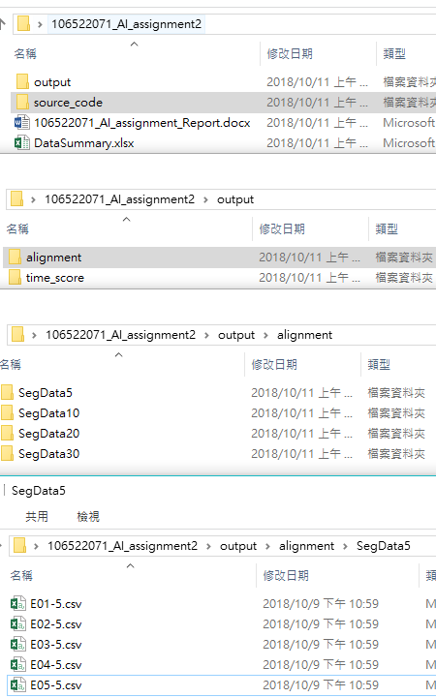
Submission
For Assignment 2
Source code of your search algorithm
Please implement in Python3 or Java
DataSummary.xlsx file
Alignment result by CSV file
total 400 files total 200 files
the name of output file must be the same with the input file
output format: see page 27
Report
Deadline: 11/1 (Thu) 23:59
You must put the files in the corresponding folders

Slide 32
Outline
Your Works
Overview
Example
Assignment 2 Data
Submission
Grading

Slide 33
Grading
Correctness of TA-class practice (10%)
The performance of your search algorithm for assignment 2 (70%)
Similarity score (40%)
Speed (30%)
Report (20%)
Explain the search algorithm you design

