Slide 1
MRSP Seminar Project
Maaz Saeed
Riaz Khan
Zain-ul-Abdin
Shakeel Mahmud
Zeeshan Ali

Slide 2
Introduction
Task 1: Preparing Audios (Zeeshan Ali)
Task 2: Perceptual Loss (Maaz Saeed)
Task 3: Preparing Mushra test (Zain-ul-Abdin)
Task 4: Conducting Mushra test (Riaz Khan)
Task 5: Comparative Evaluation of Objective and Subjective measurements. (Shakeel Mahmud)
Goal: Analysis of Loss Function Accuracy by Comparing to Perceived Audio Quality

Slide 3
Preparing the Audios
Collected 16-bit audio files.
Accordion
Guitar
Violin
Jazz
Trumpet
Room impulse responses (MIT database)
h005_Office_Small_44txts
h115_MovieTheater_1txts
h252_Auditorium_1txts
Reverberation: performed fftconvolve() function from scipy.signal

Slide 4
Perceptual Loss
Calculating loss between original audios and reverberated audios.
Loss functions
Mean Squared Error (MSE)
Psychoacoustic Model Pre-Filtering + MSE
Log Spectral Difference
Multi Scale Spectral Loss
Psycho-Acoustic Loss Function
Psycho-Acoustic Loss Function
New approch of perceptual loss
Most precise perceptual loss

Slide 5
Mushra Test
Comparison of original audios with reverberated audios by listening experiment.
Listening experiment
Platform: Scale
Participants: 20
Detailed instructions

Slide 6
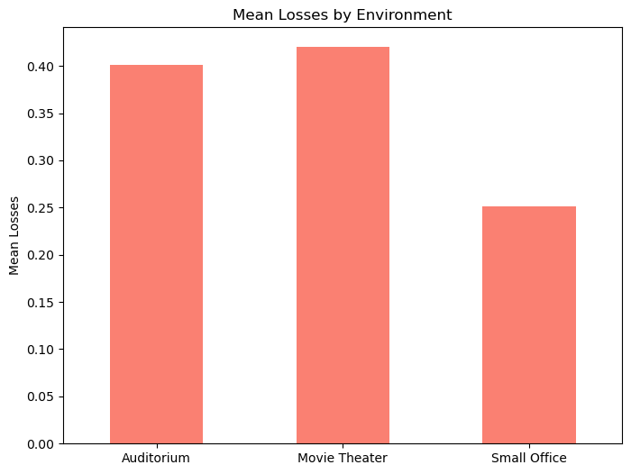
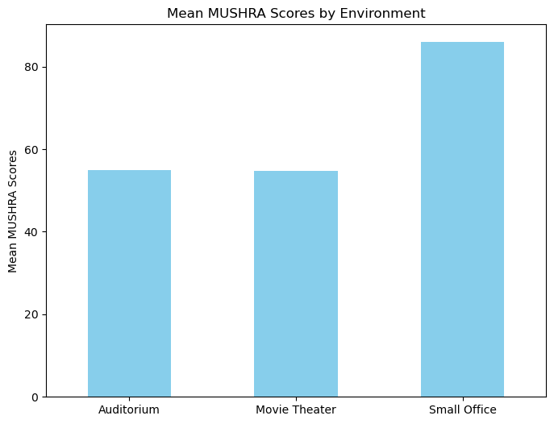
Analysis

Slide 7
Analysis
Analyzing difference and similarities between perceptual losses and mushra scores.
Finding
Red color scheme highlights loss. More loss more difference
Blue color scheme highlights perceived similarity. More score more similarity.
Small office shows less psycho-acoustic loss and high similarity in mushra scores indicating psycho-acoustic loss function’s accuracy

