Slide 1
VC Seminar Project
Maaz Saeed
Hasham javed

Slide 2
Introduction
Image compression
Reducing the size of image without losing visual quality. Making it easier to store and transmit
Lapped transform
Mathematical technique used in signal and image processing to achieve overlapping of blocks of data, reducing artifacts typically associated with block-based transforms
DCT
Technique used in image and signal processing to represent an image as a sum of cosine functions oscillating at different frequencies. It is particularly known for its application in JPEG image compression.

Slide 3
Image compression using lapped transform
Effective image compression
Training convolutional filters that act as the lapped transform and its inverse
Creating neural network, defining a loss function, and optimizing the filters based on training data.
Convolutional Layer
Filter: matrix of weights
Stride: The step size of filter to move
Padding: Adding border to input image to control spatial size
Activation function: Non-Linear functions to add non-linearity into the model

Slide 4
Image compression using lapped transform
Transposed convolutional layer
Applies the inverse transform filters to reconstruct the image
The input channels of this will be equal to the output channels of convolutional layer
The output channels will be 3 (RGB) the desired output channels of out reconstructed image
Kernal size, stride and padding will be same

Slide 5
Steps of Compression
Data preprocessing
Convolutional layer
Training the model
Compression
Transformation with convolutional layer
Quantization
Conversion to Byte Stream
Decompression
Byte Stream to quantized
Dequantization
Inverse transformation

Slide 6
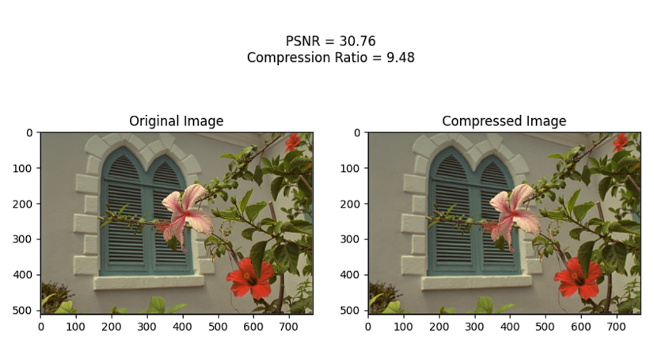
Results using DCT

Slide 7
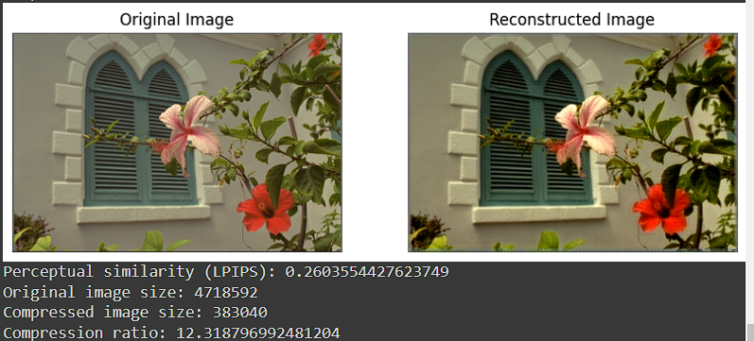
Results using lapped transform

