Slide 1
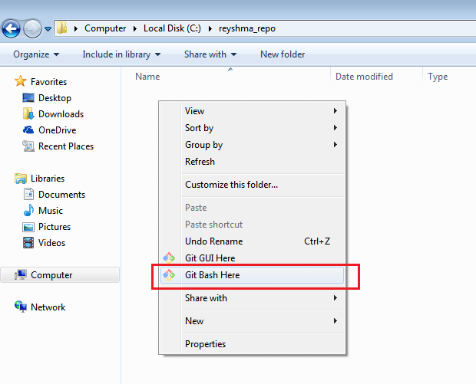
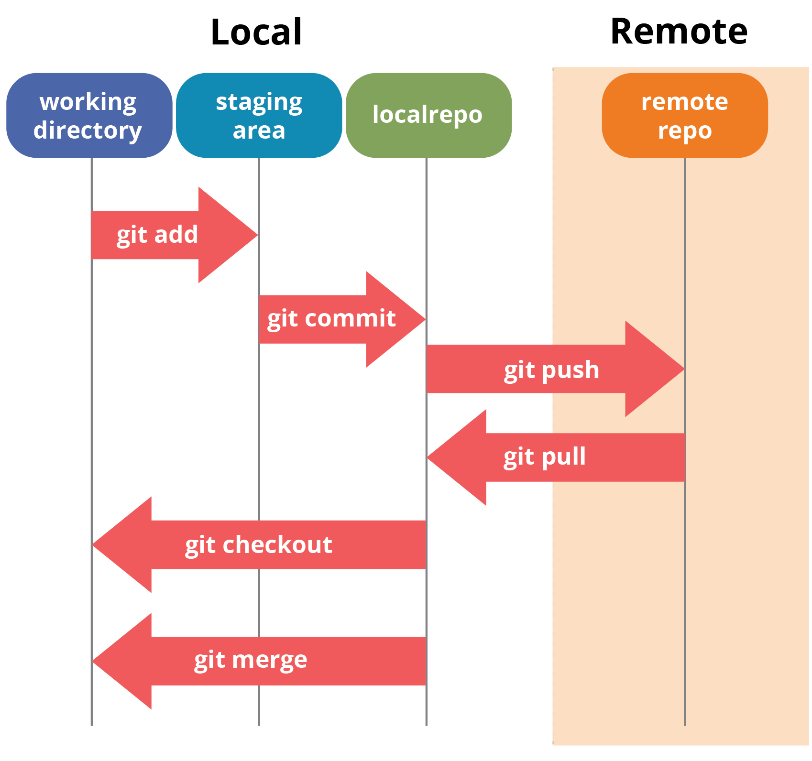

Slide 2
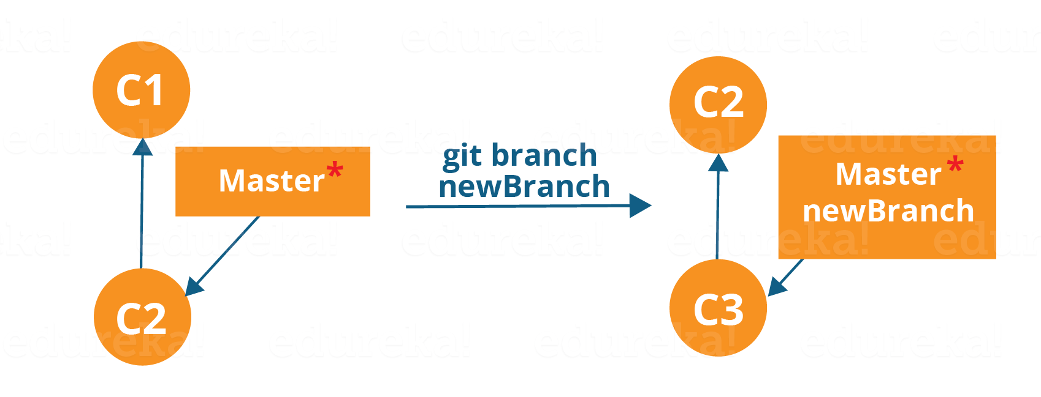
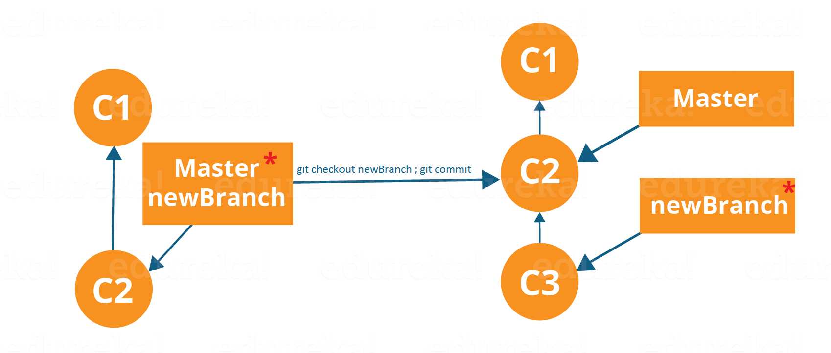

Slide 3
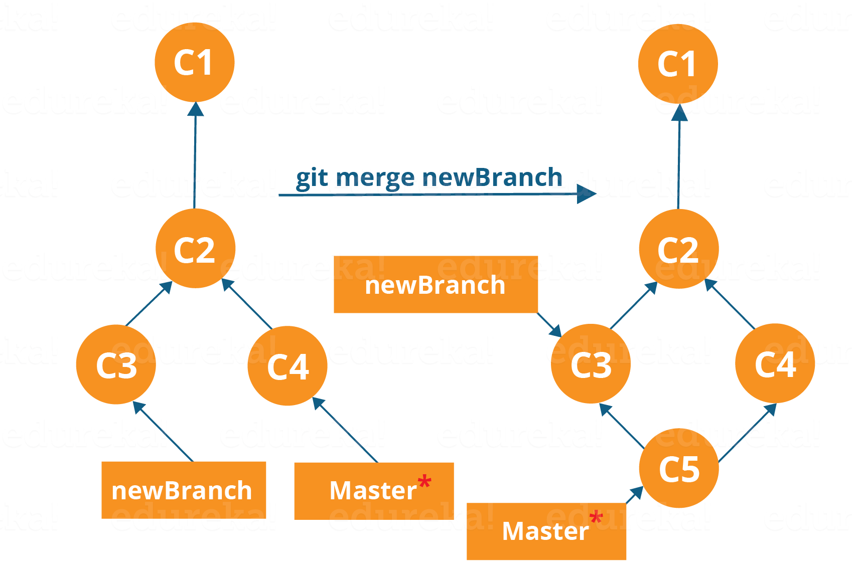
Merging is the way to combine the work of different branches together. This will allow us to branch off, develop a new feature, and then combine it back in.
The diagram above shows us two different branches-> newBranch and master. Now, when we merge the work of newBranch into master, it creates a new commit which contains all the work of master and newBranch.
git merge <branch_name>
It is important to know that the branch name in the above command should be the branch you want to merge into the branch you are currently checking out. So, make sure that you are checked out in the destination branch.

Slide 4
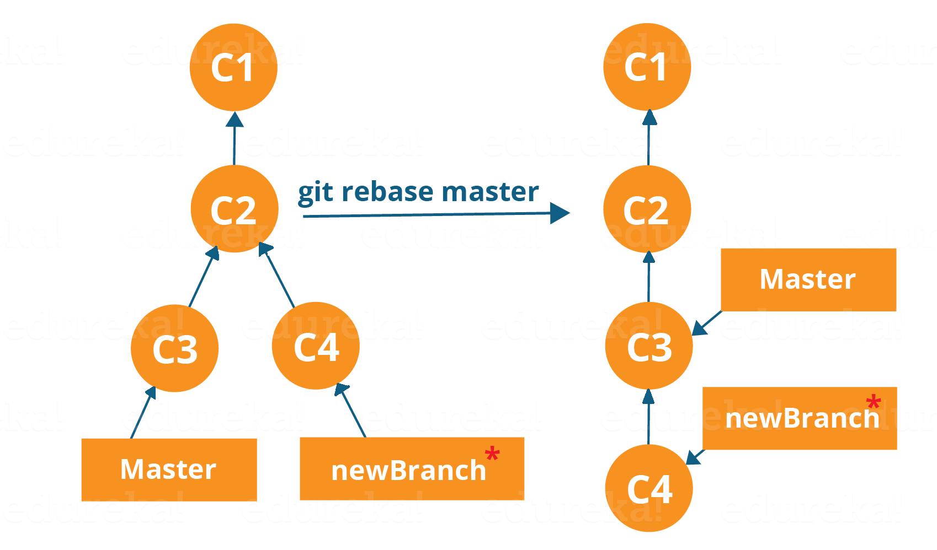
Rebasing
This is also a way of combining the work between different branches. Rebasing takes a set of commits, copies them and stores them outside your repository.
The advantage of rebasing is that it can be used to make linear sequence of commits. The commit log or history of the repository stays clean if rebasing is done.
Now, our work from newBranch is placed right after master and we have a nice linear sequence of commits.
Note: Rebasing also prevents upstream merges, meaning you cannot place master right after newBranch.
Now, to rebase master, type the command below in your Git Bash:
git rebase master

