Slide 1

Hollinswood Shopping Center
Investor Presentation
May 2026
1
Notes:
Recreated from user-supplied photograph IMG_2359(1).jpeg, original presentation slide 1. Original: Hollinswood Shopping Center - Investor Presentation, Singh Capital Partners, May 2026. Repeated confidentiality footer removed at user request. Source viewer shows 22 slides; this reconstruction includes the 20 supplied slides. Figures and projections are reproduced as shown and have not been independently verified.

Slide 2
Confidentiality
This presentation has been prepared by SCP Real Estate for the exclusive use of the party to which SCP delivers this presentation (together with its subsidiaries
and affiliates, the “Recipient’). SCP does not make any representation or warranty, either express or implied, as to the accuracy, completeness or reliability of the
information contained in this presentation. Any estimates or projections as to events that may occur in the future are based upon the best judgment of SCP as of
the date of this presentation. There is no guarantee that any of these estimates or projections will be achieved. Actual results will vary from the projections and
such variations may be material. Nothing contained herein is, or shall be relied upon as, a promise or representation as to the past or future. SCP expressly
disclaims any and all liability relating or resulting from the use of this presentation.
This presentation has been prepared solely for informational purposes and is not to be construed as a solicitation or an offer to buy or sell any securities or related
financial instruments. The recipient should not construe the contents of this presentation as legal, tax, accounting or investment advice or a recommendation. The
recipient should consult its own counsel, tax and financial advisors as to legal and related matters concerning any transaction described herein. This presentation
does not purport to be all-inclusive or to contain all of the information, that the recipient may require. No investment or other financial decisions or actions should
be based solely on the information in this presentation.
This presentation has been prepared on a confidential basis solely for the use and benefit of the recipient; provided that the recipient and any of its employees,
representatives, or other agents may disclose to any and all persons, without limitation of any kind, the tax treatment and tax structure of the transaction and all
materials of any kind (including opinions or other tax analyses) that are provided to the recipient relating to such tax treatment and tax structure. Distribution of
this presentation to any person other than the recipient and those persons retained to advise the recipient, who agree to maintain the confidentiality of this
material and be bound by the limitations outlined herein, is unauthorized. This material must not be copied, reproduced, distributed or passed to others at any
time without the prior written consent of SCP.
2
Notes:
Recreated from user-supplied photograph IMG_2360(1).jpeg, original presentation slide 2. Original: Hollinswood Shopping Center - Investor Presentation, Singh Capital Partners, May 2026. Repeated confidentiality footer removed at user request. Source viewer shows 22 slides; this reconstruction includes the 20 supplied slides. Figures and projections are reproduced as shown and have not been independently verified.

Slide 3
Table of Contents
Section | Slide
Executive Summary | 4
Property Overview | 5
Investment Highlights | 6–9
Major Tenant Summary | 10
Major Tenant Profiles | 11
Location | 12–13
Competitive Properties | 14
Market Overview | 15
Demographics | 16
Comparable Sales | 17
Financial Summary | 18
Terms | 19
Team | 20
3
Notes:
Recreated from user-supplied photograph IMG_2361(1).jpeg, original presentation slide 3. Original: Hollinswood Shopping Center - Investor Presentation, Singh Capital Partners, May 2026. Repeated confidentiality footer removed at user request. Source viewer shows 22 slides; this reconstruction includes the 20 supplied slides. Figures and projections are reproduced as shown and have not been independently verified.

Slide 4
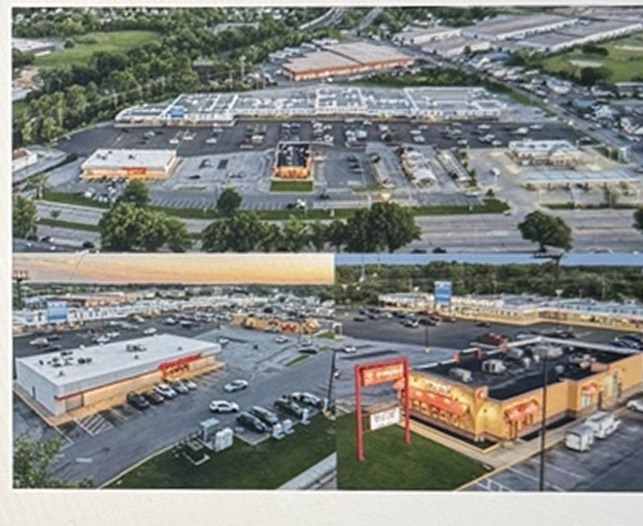
Executive Summary
Hollinswood Shopping Center is a 112,671-square-foot grocery-anchored retail center in Baltimore, Maryland. The property is anchored by LA Mart and is located just north of Baltimore Washington International Airport along West Patapsco Avenue.
Property metric | Summary
Address | 2157 W Patapsco Avenue, Baltimore, MD 21230
Rentable building area | 112,671 SF
Purchase price | $20.2M
Price per square foot | $181 PSF
Cap rate | 9.6%
Land area | 15.1 acres
Year built / renovated | 1965
Occupancy | 100% leased
WALT | 5.0 years
4
Notes:
Recreated from user-supplied photograph IMG_2362(1).jpeg, original presentation slide 4. Original: Hollinswood Shopping Center - Investor Presentation, Singh Capital Partners, May 2026. Repeated confidentiality footer removed at user request. Source viewer shows 22 slides; this reconstruction includes the 20 supplied slides. Figures and projections are reproduced as shown and have not been independently verified.

Slide 5
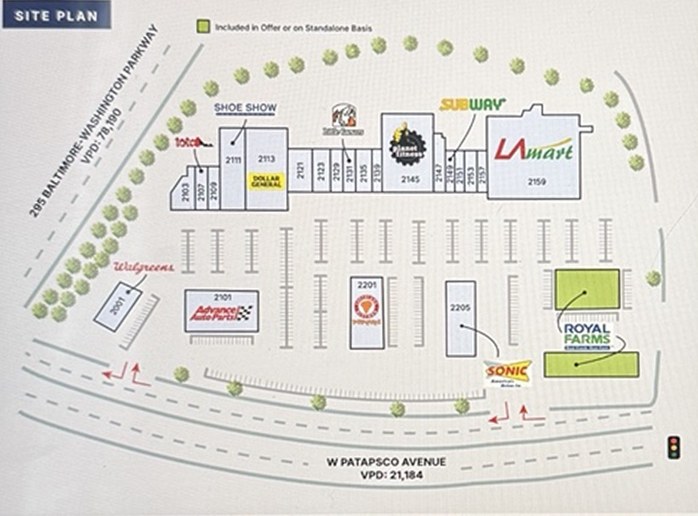
Property Overview
Suite | Tenant | SF
2139 | Nails One | 1,200
2129 | Chicken Shack Deli | 1,500
2153 | Le’s Barber Shop | 1,855
2109 | Bargain Outlet | 2,646
2131 | Little Caesar’s Pizza | 1,920
2113 | Dollar General | 12,286
2157 | Shanghai Carryout | 1,125
2121 | Hollins Beauty | 3,600
2107 | Total by Verizon (ABC Phones) | 1,229
2149 | Subway | 1,125
2103 | Healthy Dental | 3,188
ATM | Bank of America (ATM) | –
2135 | Famous Pawn Gold Broker | 2,880
2205 | Sonic Drive In (PAD) | 2,290
2147 | Cricket Wireless (LO) | 2,470
2001 | Walgreens (PAD) | 2,955
2159 | LA Mart | 30,030
2123 | CBI of MD Laundromat | 3,600
2151 | Cash Depot | 1,500
2201 | Popeyes Chicken (PAD) | 5,291
2141/2145 | Planet Fitness | 15,118
2111 | Shoe Show | 7,815
2101 | Advance Auto (PAD) | 7,950
PAD | Royal Farms (PAD) | –
5
Notes:
Recreated from user-supplied photograph IMG_2363(1).jpeg, original presentation slide 5. Original: Hollinswood Shopping Center - Investor Presentation, Singh Capital Partners, May 2026. Repeated confidentiality footer removed at user request. Source viewer shows 22 slides; this reconstruction includes the 20 supplied slides. Figures and projections are reproduced as shown and have not been independently verified.

Slide 6
Investment Highlights
Value-Add Opportunity: Walgreens Pad Site
Core Location
Strong Cap Rate Entry
Although Walgreens continues to fulfill its rent obligations, the store has ceased operations following a nationwide corporate restructuring. This presents an opportunity to negotiate an early lease termination and re-tenant the pad site.
Situated along the Baltimore City and County line, Hollinswood Shopping Center occupies a high-traffic corridor that draws a diverse customer base from both the urban core and neighboring suburbs.
By acquiring Hollinswood at a 9.6% cap rate in a market where assets typically trade around 7% cap rates, SCP is positioned to generate significant cash flow.
6
Notes:
Recreated from user-supplied photograph IMG_2364(1).jpeg, original presentation slide 6. Original: Hollinswood Shopping Center - Investor Presentation, Singh Capital Partners, May 2026. Repeated confidentiality footer removed at user request. Source viewer shows 22 slides; this reconstruction includes the 20 supplied slides. Figures and projections are reproduced as shown and have not been independently verified.

Slide 7
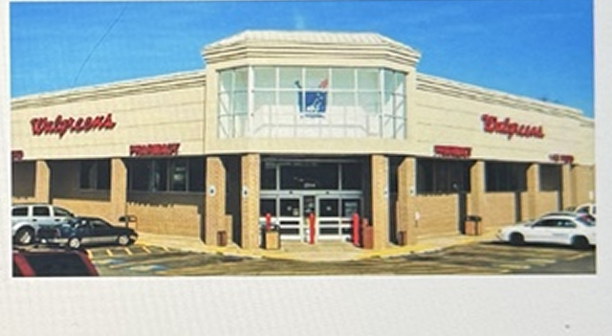
Investment Highlights - Walgreens Pad Site
SCP has the opportunity to negotiate an early lease termination and re-tenant the Walgreens pad site.
• Walgreens closed this location as part of a national corporate restructuring. In late 2024, the company announced approximately 1,200 closures through 2027, representing about 13%–15% of its U.S. footprint.
• The tenant remains legally bound by its lease and continues to pay rent. A dark store, however, reduces foot traffic for neighboring tenants.
• The 2,955-SF pad pays $38.50 PSF, or $113,768 annually. The lease expires in September 2030; remaining lease revenue is approximately $550,000.
• Lease buyout: negotiate a lump-sum payment, mitigating the tenant’s longer-term rent liability and providing immediate liquidity.
• Value-add re-leasing: renovate the pad with a drive-through and secure a creditworthy tenant on a new 10-year lease, potentially improving terminal value.
7
Notes:
Recreated from user-supplied photograph IMG_2365(1).jpeg, original presentation slide 7. Original: Hollinswood Shopping Center - Investor Presentation, Singh Capital Partners, May 2026. Repeated confidentiality footer removed at user request. Source viewer shows 22 slides; this reconstruction includes the 20 supplied slides. Figures and projections are reproduced as shown and have not been independently verified.

Slide 8
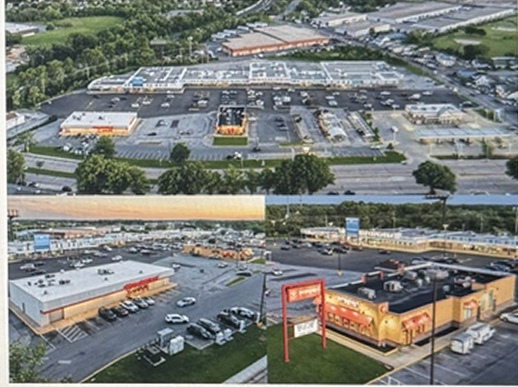
Investment Highlights - Core Location
Located just north of Baltimore Washington International Airport, just inside the City/County line, the center sits along West Patapsco Avenue, attracting over 21,000 vehicles daily.
• High-visibility intersection of West Patapsco Avenue and Hollins Ferry Road, with approximately 35,000 vehicles per day at the primary corner. The property is less than a mile from major interstates, including I-95, I-696 and I-895, and is bordered by the Baltimore–Washington Parkway (I-295), with over 78,000 VPD.
• Over 18,000 residents live within one mile and over 130,000 within three miles. Average household income within three miles is $81,000, with projected annual growth of 2.4% through 2030.
• The Baltimore City/Baltimore County border location captures neighborhood shoppers from Lakeland and Cherry Hill and suburban commuters from Lansdowne and Baltimore Highlands.
• The border position serves an under-retailed area where residents converge for essential services, supporting repeat foot traffic.
8
Notes:
Recreated from user-supplied photograph IMG_2366(1).jpeg, original presentation slide 8. Original: Hollinswood Shopping Center - Investor Presentation, Singh Capital Partners, May 2026. Repeated confidentiality footer removed at user request. Source viewer shows 22 slides; this reconstruction includes the 20 supplied slides. Figures and projections are reproduced as shown and have not been independently verified.

Slide 9
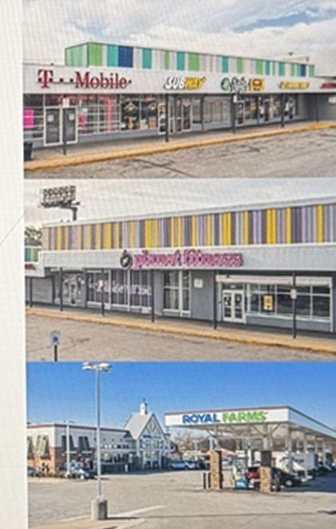
Investment Highlights - Strong Cap Rate Entry
A 9.6% acquisition cap rate, compared with approximately 7% market cap rates, supports the property’s cash-flow potential.
• The property has an attractive five-year WALT and 2.54% CAGR, supported by approximately 3% contractual annual rent escalations. Year-one NOI is projected at $1.96 million, excluding re-leasing of the Walgreens pad.
• Additional income includes percentage rent (approximately $9,000), EVgo charging stations (approximately $21,000), and solar revenue (approximately $17,000).
• The acquisition benefits from recent capital expenditures, including roof and façade renovations, parking-lot repaving in 2024, and a comprehensive roof replacement program.
9
Notes:
Recreated from user-supplied photograph IMG_2367(1).jpeg, original presentation slide 9. Original: Hollinswood Shopping Center - Investor Presentation, Singh Capital Partners, May 2026. Repeated confidentiality footer removed at user request. Source viewer shows 22 slides; this reconstruction includes the 20 supplied slides. Figures and projections are reproduced as shown and have not been independently verified.

Slide 10
Major Tenant Summary
Tenant | SF | % total | Lease expires | Health ratio | Current $/SF | Market $/SF
LA Mart | 30,030 | 26.7% | 10/31/2030 | 3.1% | $11.01 | $12.00
Planet Fitness | 15,118 | 13.4% | 1/31/2031 | 38.8% | $13.00 | $13.00
Dollar General | 12,286 | 10.9% | 7/31/2027 | – | $13.21 | $13.00
Advance Auto (PAD) | 7,950 | 7.1% | 2/28/2034 | – | $12.75 | $17.00
Shoe Show | 7,815 | 6.9% | 1/31/2034 | – | $6.50 | $14.00
Popeyes Chicken (PAD) | 5,291 | 4.7% | 1/31/2031 | 4.2% | $15.63 | $17.00
CBI of MD Laundromat | 3,600 | 3.2% | 11/30/2030 | 41.3% | $21.18 | $23.00
Hollins Beauty | 3,600 | 3.2% | 1/31/2029 | – | $22.51 | $23.00
Healthy Dental | 3,188 | 2.8% | 1/31/2030 | – | $12.75 | $13.00
Walgreens (PAD) | 2,955 | 2.6% | 9/30/2030 | – | $38.50 | $35.00
Major tenants | 91,833 | 81.5% | – | – | $13.46 | $14.83
Other tenants | 20,838 | 18.5% | – | – | $22.58 | $25.25
Vacant | 0 | 0.0% | – | – | – | –
TOTAL | 112,671 | 100.0% | – | – | – | –
Current rent as of October 1, 2025. Market rent reflects initial rent for new tenants.
Tenant Sales Trends
Tenant | SF | Health | 2024 sales / PSF | 2023 sales / PSF | 2022 sales / PSF | 2021 sales / PSF
Le’s Barber Shop | 1,855 | 53.1% | $108,050 / $58 | $111,250 / $60 | $108,250 / $58 | $135,050 / $73
Sonic Drive In (PAD) | 2,290 | 6.9% | $937,454 / $409 | $791,367 / $346 | $990,357 / $432 | $1,241,053 / $542
Popeyes Chicken (PAD) | 5,291 | 4.2% | $2,827,287 / $534 | $2,545,015 / $481 | $2,757,635 / $521 | $2,929,231 / $554
Nails One | 1,200 | 27.8% | $189,663 / $158 | $180,970 / $151 | $159,084 / $133 | $192,660 / $161
CBI of MD Laundromat | 3,600 | 41.3% | – | – | $261,044 / $73 | $248,463 / $69
Cash Depot | 1,500 | 13.4% | – | – | $302,149 / $201 | $280,844 / $187
LA Mart | 30,030 | 3.1% | $17,912,152 / $596 | $17,793,955 / $593 | $18,054,127 / $601 | $18,836,829 / $627
Planet Fitness | 15,118 | 38.8% | – | $750,041 / $50 | $563,852 / $37 | $416,653 / $28
Nails One 2022 sales are based on 11 months annualized.
10
Notes:
Recreated from user-supplied photograph IMG_2368(1).jpeg, original presentation slide 10. Original: Hollinswood Shopping Center - Investor Presentation, Singh Capital Partners, May 2026. Repeated confidentiality footer removed at user request. Source viewer shows 22 slides; this reconstruction includes the 20 supplied slides. Figures and projections are reproduced as shown and have not been independently verified.

Slide 11
Major Tenant Profiles
LA Mart
Planet Fitness
Dollar General
Family-owned international supermarket chain specializing in global groceries, including Latin, Asian and Middle Eastern products. Six stores across Maryland and Virginia.
Large fitness-center franchise serving casual gym-goers. The source presentation lists 2,896 clubs globally.
American variety-store chain offering affordable retail goods. The source presentation lists over 20,000 stores in 48 states.
Suite 2159 | 30,030 SF
Lease: October 2006 – October 2030
Suite 2145 | 15,000 SF
Lease: January 2021 – January 2031
Suite 2113 | 12,286 SF
Lease: July 2010 – July 2027
Shoe Show
Popeyes
Advance Auto Parts
American footwear retailer founded in 1960, focused on accessible pricing across suburban and rural markets. Over 1,100 stores in 47 states.
Global fast-food chain founded in New Orleans in 1972, specializing in Louisiana-style chicken. Over 4,300 locations globally.
Aftermarket automotive-parts retailer with over 4,300 stores and branches across the United States, Canada, Puerto Rico and the U.S. Virgin Islands.
Suite 2111 | 7,815 SF
Lease: January 2024 – January 2034
Suite 2201 | 5,291 SF
Lease: December 2015 – January 2031
Suite 2101 | 7,950 SF
Lease: January 2007 – February 2034
11
Notes:
Recreated from user-supplied photograph IMG_2369(1).jpeg, original presentation slide 11. Original: Hollinswood Shopping Center - Investor Presentation, Singh Capital Partners, May 2026. Repeated confidentiality footer removed at user request. Source viewer shows 22 slides; this reconstruction includes the 20 supplied slides. Figures and projections are reproduced as shown and have not been independently verified.

Slide 12
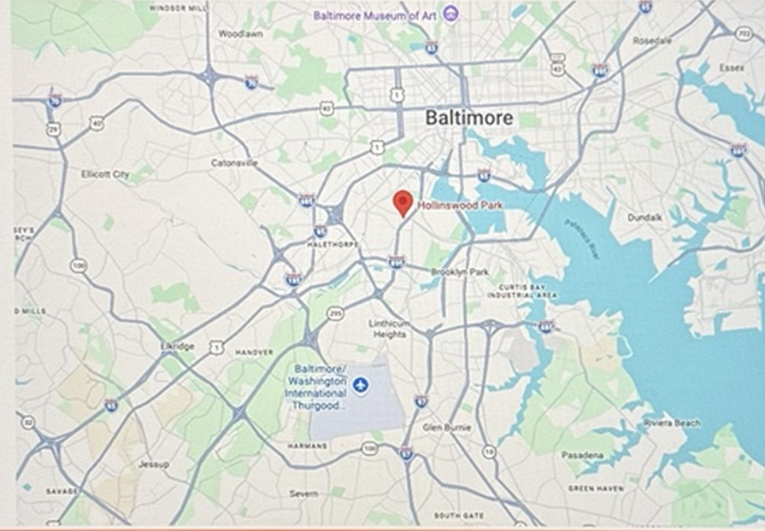
Location
12
Notes:
Recreated from user-supplied photograph IMG_2370(1).jpeg, original presentation slide 12. Original: Hollinswood Shopping Center - Investor Presentation, Singh Capital Partners, May 2026. Repeated confidentiality footer removed at user request. Source viewer shows 22 slides; this reconstruction includes the 20 supplied slides. Figures and projections are reproduced as shown and have not been independently verified.

Slide 13
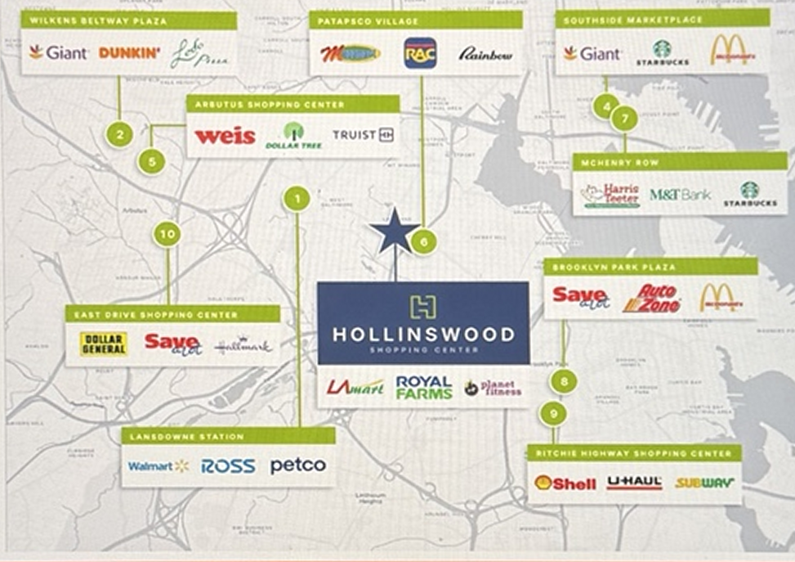
Location - Surrounding Retail
13
Notes:
Recreated from user-supplied photograph IMG_2371(1).jpeg, original presentation slide 13. Original: Hollinswood Shopping Center - Investor Presentation, Singh Capital Partners, May 2026. Repeated confidentiality footer removed at user request. Source viewer shows 22 slides; this reconstruction includes the 20 supplied slides. Figures and projections are reproduced as shown and have not been independently verified.

Slide 14
Competitive Properties
Hollinswood benefits from its diverse tenant mix, high visibility, easy access from the Baltimore–Washington Parkway, and LA Mart’s two-decade presence in the community.
# | Property | Major tenants | Visits
1 | Lansdowne Station | Walmart, Ross, Petco | 5.6M
2 | Wilkens Beltway Plaza | Giant, Ledo Pizza | 2.6M
3 | Hollinswood Shopping Center | LA Mart, Planet Fitness, Dollar General | 1.7M
4 | Southside Marketplace | Giant, Starbucks, McDonald’s | 1.5M
5 | Arbutus Shopping Center | Weis, Dollar Tree, Truist | 1.3M
6 | Patapsco Village | Megamart, RAC, Rainbow | 1.1M
7 | McHenry Row | Harris Teeter, M&T Bank, Starbucks | 1.1M
8 | Brooklyn Park Plaza | Save a Lot, AutoZone, McDonald’s | 1.1M
9 | Ritchie Highway Shopping Center | Shell, U-Haul, Subway | 782K
10 | East Drive Shopping Center | Dollar General, Save a Lot, Hallmark | 707K
14
Notes:
Recreated from user-supplied photograph IMG_2372(1).jpeg, original presentation slide 14. Original: Hollinswood Shopping Center - Investor Presentation, Singh Capital Partners, May 2026. Repeated confidentiality footer removed at user request. Source viewer shows 22 slides; this reconstruction includes the 20 supplied slides. Figures and projections are reproduced as shown and have not been independently verified.

Slide 15
Market Overview
Baltimore, Maryland
Largest employers | Industry | Employees
Baltimore County Public Schools | Government | 15,778
U.S. Social Security Administration | Government | 11,479
Amazon | E-commerce | 9,000
Baltimore County Government | Government | 7,580
University System of Maryland | University | 5,688
MedStar Franklin Square Hospital | Hospital | 4,747
Center for Medicare & Medicaid Services | Healthcare | 4,282
Greater Baltimore Medical Center | Hospital | 3,289
BD Life Sciences | Medical | 2,950
Community College of Baltimore County | University | 2,444
University of MD St. Joseph Medical Center | Healthcare | 2,366
Sheppard Pratt Health System | Hospital | 2,250
T. Rowe Price Associates | Finance | 2,183
McCormick & Company | Consumer goods | 2,093
Centric Business Systems | Wholesale | 1,964
Baltimore is Maryland’s largest city and the northeastern hub of the Baltimore–Washington combined statistical area. The source presentation describes a city population of more than 565,000 and a wider combined region of approximately 10 million people. The Baltimore–Columbia–Towson MSA has approximately 2.859 million people and includes Baltimore City, Baltimore County, Anne Arundel, Carroll, Howard, Harford and Montgomery counties.
Economic Overview
Key industries include healthcare and life sciences, education and research, finance, technology, manufacturing, and maritime activity. Johns Hopkins University and Johns Hopkins Hospital support substantial local employment. The Port of Baltimore handled 45.9 million tons of cargo in 2024, while cruise operations served more than 444,000 passengers.
Corporate presence: Under Armour, T. Rowe Price, McCormick, Constellation, and CareFirst.
Maryland Fortune 500 companies: Lockheed Martin, CareFirst, and Marriott.
Professional sports: Baltimore Ravens and Baltimore Orioles.
15
Notes:
Recreated from user-supplied photograph IMG_2373(1).jpeg, original presentation slide 15. Original: Hollinswood Shopping Center - Investor Presentation, Singh Capital Partners, May 2026. Repeated confidentiality footer removed at user request. Source viewer shows 22 slides; this reconstruction includes the 20 supplied slides. Figures and projections are reproduced as shown and have not been independently verified.

Slide 16
Demographics
Demographic | 1 mile | 3 miles | 5 miles
2024 population | 18,647 | 132,743 | 392,666
2029 population | 18,276 | 130,454 | 386,702
2024 average household income | $59,650 | $81,081 | $81,797
Baltimore / Washington International
Thurgood Marshall Airport
4.5 miles from the property
3,596 acres
27 million passengers annually
Largest Universities in Maryland
University | Students
University of Maryland University College | 55,838
University of Maryland College Park | 40,792
Johns Hopkins University | 31,275
Towson University | 19,793
Montgomery College | 17,137
Community College of Baltimore County | 15,319
University of Maryland Baltimore County | 13,991
Prince George’s Community College | 10,192
Morgan State University | 9,101
5 of the 9
largest universities on this list are in the Baltimore Metro.
16
Notes:
Recreated from user-supplied photograph IMG_2374(1).jpeg, original presentation slide 16. Original: Hollinswood Shopping Center - Investor Presentation, Singh Capital Partners, May 2026. Repeated confidentiality footer removed at user request. Source viewer shows 22 slides; this reconstruction includes the 20 supplied slides. Figures and projections are reproduced as shown and have not been independently verified.

Slide 17
Comparable Sales
Metric | Highlandtown Village Shopping Center | Fairfax Court | Livingston Square | Hollinswood Shopping Center
Sale date | December 2025 | June 2025 | October 2025 | May 2026
Location | Baltimore, MD | Fairfax, VA | Fort Washington, MD | Baltimore, MD
Tenancy | Hazlo, Dollar Tree, Domino’s | Great Wall Supermarket, Burlington, LA Fitness, Dollar Tree | Giant, KFC, Taco Bell | LA Mart, Planet Fitness, Dollar General, Popeyes, Advance Auto Parts
GLA | 57,524 | 239,508 | 71,166 | 112,671
Occupancy | 100% | 100% | 100% | 100%
Sale price | $12,100,000 | $52,000,000 | $27,250,000 | $20,400,000
Price / SF | $210 | $217 | $245 | $179
Cap rate | 9.50% | 7.00% | 6.50% | 9.60%
17
Notes:
Recreated from user-supplied photograph IMG_2375(1).jpeg, original presentation slide 17. Original: Hollinswood Shopping Center - Investor Presentation, Singh Capital Partners, May 2026. Repeated confidentiality footer removed at user request. Source viewer shows 22 slides; this reconstruction includes the 20 supplied slides. Figures and projections are reproduced as shown and have not been independently verified.
Source inconsistency preserved: comparable-sales slide shows $20.4M and $179/SF for Hollinswood; executive summary and financial model show $20.2M. No silent correction was made.

Slide 18
Financial Summary
Sources | Amount
Debt | $15,150,000
Partners equity | $6,450,000
Total sources | $21,600,000
7-year model | 2026 H2 | 2027 | 2028 | 2029 | 2030 | 2031 | 2032
Net rental revenue | 967,893 | 2,004,942 | 2,059,161 | 2,086,749 | 2,085,497 | 2,194,561 | 2,312,760
Expense recoveries | 493,209 | 940,083 | 959,927 | 968,276 | 985,454 | 987,111 | 1,011,161
Total revenue | 1,461,102 | 2,945,025 | 3,019,088 | 3,055,025 | 3,070,952 | 3,181,673 | 3,323,922
Real estate tax | 120,767 | 248,835 | 252,568 | 256,356 | 260,202 | 264,105 | 268,066
CAM expenses | 213,701 | 403,627 | 409,682 | 415,827 | 422,064 | 428,395 | 434,821
Insurance | 32,800 | 62,562 | 63,814 | 65,090 | 66,392 | 67,720 | 69,074
Utilities | 128,396 | 244,902 | 249,800 | 254,796 | 259,892 | 265,090 | 270,392
Miscellaneous | 7,038 | 7,322 | 7,469 | 7,618 | 7,771 | 7,926 | 8,085
Management fee | 33,686 | 64,253 | 65,538 | 66,849 | 68,186 | 69,550 | 70,941
Total operating expenses | 536,389 | 1,031,503 | 1,048,870 | 1,066,537 | 1,084,506 | 1,102,788 | 1,121,378
Operating cash flow | 924,714 | 1,913,522 | 1,970,217 | 1,988,488 | 1,986,445 | 2,078,888 | 2,202,543
NOI yield | – | 9.47% | 9.75% | 9.84% | 9.83% | 10.29% | 10.90%
TI & leasing commissions | 36,000 | 61,320 | – | 108,000 | – | 351,750 | 210,570
Debt service | 574,317 | 1,148,633 | 1,148,633 | 1,148,633 | 1,148,633 | 1,148,633 | 1,148,633
Senior DSCR | 1.61x | 1.67x | 1.72x | 1.73x | 1.73x | 1.81x | 1.92x
Levered FCFE | 314,397 | 703,569 | 821,584 | 731,855 | 837,812 | 578,505 | 843,340
Levered FCFE yield | n.a. | 10.9% | 12.7% | 12.0% | 13.7% | 9.5% | 13.8%
LP preferred return | 258,000 | 516,000 | 516,000 | 516,000 | 516,000 | 516,000 | 516,000
Capex | 28,168 | 29,013 | 29,883 | 30,780 | 31,703 | 32,654 | 33,634
Real estate value | 21,600,000 | 21,600,000 | 21,600,000 | 21,600,000 | 21,600,000 | 21,600,000 | 27,531,789
Cash reserve | 28,229 | 186,786 | 462,487 | 647,562 | 937,671 | 967,522 | 1,261,228
Debt | 15,038,235 | 14,804,196 | 14,555,413 | 14,290,956 | 14,009,840 | 13,711,013 | 13,393,360
Equity + cumulative dividends | 6,847,995 | 7,756,590 | 8,797,074 | 9,762,605 | 10,849,831 | 11,694,595 | 18,753,657
Gross MOIC | 1.06x | 1.20x | 1.36x | 1.51x | 1.68x | 1.81x | 2.91x
Uses | Amount
Real estate | $20,200,000
Closing costs | $1,400,000
Total uses | $21,600,000
Model inputs | Assumption
Purchase price | $20,200,000
Initial interest rate | 6.13%
LTV | 75.00%
Exit cap rate | 8.00%
Interest-only financing; rate resets every three years.
27-year amortization; 20-year term.
Projected gross return: 20.2% IRR and 2.9x MOIC over approximately seven years.
Located in a qualified opportunity zone.
Gross 7-year IRR: 20.21%
18
Notes:
Recreated from user-supplied photograph IMG_2376(1).jpeg, original presentation slide 18. Original: Hollinswood Shopping Center - Investor Presentation, Singh Capital Partners, May 2026. Repeated confidentiality footer removed at user request. Source viewer shows 22 slides; this reconstruction includes the 20 supplied slides. Figures and projections are reproduced as shown and have not been independently verified.
Values transcribed from the photographed exhibit. Currency amounts are USD. 2026 covers June 30–December 31. Figures retain source rounding; this deck does not reconstruct spreadsheet formulas.

Slide 19
Terms
Term | Description
Name | SCP Real Estate Opportunity IX LP
Manager | SK Property Management, LLC
Purpose | The SPV will acquire Hollinswood Shopping Center and provide working capital, maintenance capex, and acquisition costs. It will receive earnings after expenses and maintenance capital expenditures, plus property sale proceeds.
SPV size | Seeking aggregate investments of up to $5.5 million.
SPV objective | Limited partnership to acquire, develop, and operate 2157 W Patapsco Avenue, Baltimore, MD 21230.
Asset fee | 0.50% of asset value.
Financing and acquisition fees | Financing and acquisition expenses passed through to LPs at cost; a 1.5% acquisition fee is rolled over as equity into the deal post-close.
GP carried interest | 8.0% preferred return, followed by a 20% profit split with the GP, with catch-up.
19
Notes:
Recreated from user-supplied photograph IMG_2377(1).jpeg, original presentation slide 19. Original: Hollinswood Shopping Center - Investor Presentation, Singh Capital Partners, May 2026. Repeated confidentiality footer removed at user request. Source viewer shows 22 slides; this reconstruction includes the 20 supplied slides. Figures and projections are reproduced as shown and have not been independently verified.

Slide 20
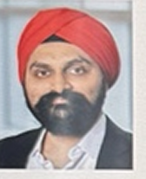
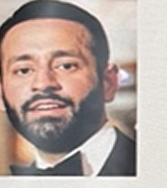
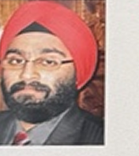
Team
Manpreet Singh, Chief Investment Officer
Manpreet Singh, CFA, is the founder and CIO of Singh Capital Partners, a multifamily office investing in venture capital, private equity, and real estate. SCP invests on behalf of Fortune 500 CXOs, unicorn founders, and operators across North America, Europe, and Asia. He co-founded TalkLocal, serving customers in 49 states and placing over two million contractor calls. At Profit Investment Management, he helped grow AUM from $20 million to over $2 billion. He holds an MBA from Wharton and a B.S. in Finance from the University of Maryland, and is a CFA charterholder.
Vishal Khosla, Partner
Vishal Khosla has worked in real estate since 2011 and is President and Managing Principal of KPI Commercial & KPI Management in Bethesda, Maryland. His experience spans development, acquisition, financing, and sales/lease transactions exceeding $1 billion. His DMV relationships support local off-market sourcing and value-add execution. Previously, he worked as an investment advisor at Wells Fargo Advisors and Morgan Stanley and held Series 7 and 66 licenses. He holds a B.A. in Economics from the University of Maryland.
Gurpreet Singh, Partner
Gurpreet “GP” Singh is CEO and Co-Founder of TalkLocal. He has invested directly in residential, retail, office, and industrial real estate for almost 20 years and has experience with Section 8 housing in Montgomery County, Maryland. He serves as a director of the LaKan Foundation and supports Maryland nonprofits. He holds an M.S. in Computer Science with a concentration in Artificial Intelligence from Johns Hopkins University and a B.S. in Computer Science from the University of Maryland.
20
Notes:
Recreated from user-supplied photograph IMG_2378(1).jpeg, original presentation slide 20. Original: Hollinswood Shopping Center - Investor Presentation, Singh Capital Partners, May 2026. Repeated confidentiality footer removed at user request. Source viewer shows 22 slides; this reconstruction includes the 20 supplied slides. Figures and projections are reproduced as shown and have not been independently verified.

