Slide 1
Agentic AI: Revenue & Token Usage
The most useful time series across sectors
Compiled August 23, 2026 | Data: agentic_ai_revenue_token_usage_2026.xlsx (Equity-research repo)

Slide 2
Key takeaways from the time series
Coding agents are the sector — ~$30.4B of ~$35.0B tracked agentic revenue (86.9%). Claude Code scaled $1B -> $15.1B tracked ARR in ~9 months; Codex ~$0 -> $8.8B in ~7 months.
Model providers repriced in months — Anthropic run-rate $14B (Feb '26) -> $65B (Jul '26); OpenAI $20B (Dec '25) -> $40B+ (Aug '26). Enterprise/agents are now the majority of both mixes.
Exits followed the ramps — SpaceX agreed to buy Cursor's parent Anysphere for $60B (Jun '26) at ~15x its $4B ARR, 31 months after Cursor's first $1M.
Verticals compound from smaller bases — Harvey, OpenEvidence, Glean and Sierra each reached $200-300M ARR, growing 2-6x in 12-18 months on outcome- and usage-based pricing.
Enterprise platforms hit the S-curve — Agentforce ARR +205% YoY to $1.2B; tokens +152% QoQ to 28.6T/quarter. M365 Copilot seats doubled to 30M+ in six months.
Token demand is the leading indicator — Google: 9.7T -> 3.2 quadrillion tokens/month in two years (~330x). Agentic requests burn ~15x the tokens of chat; coding agents ~1,000x.

Slide 3
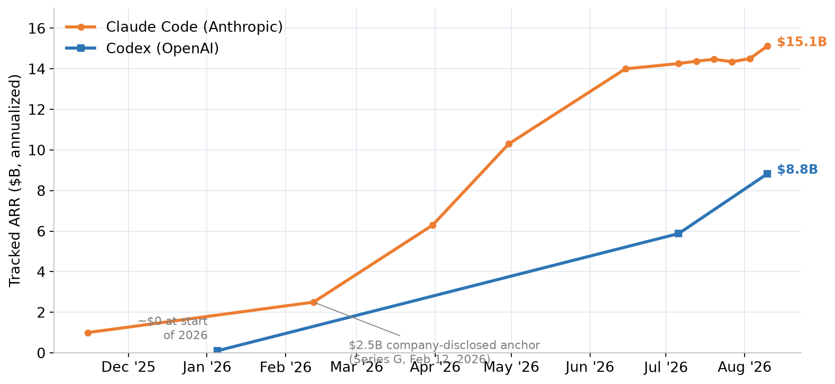
Coding agents: Claude Code vs Codex tracked ARR
Third-party tracked estimates (TickerTrends), anchored to Anthropic's $2.5B disclosure; weekly points Jul-Aug 2026
Source: TickerTrends (Aug 10, 2026); Anthropic Series G; Sacra [#3, 4, 5] | # refs -> Sources sheet, agentic_ai_revenue_token_usage_2026.xlsx

Slide 4
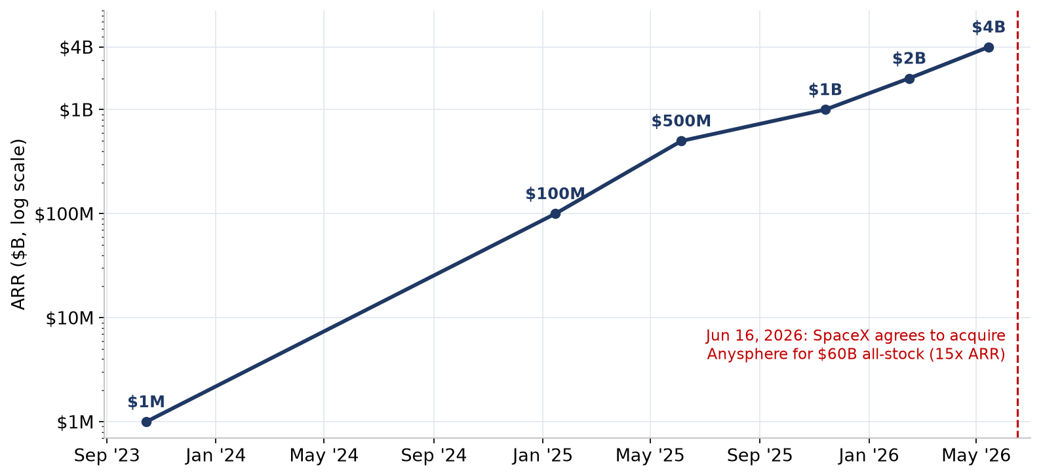
Cursor: $1M to $4B ARR in 31 months, then a $60B exit
Fastest-measured B2B software ramp; ~65% of revenue now enterprise contracts (~$2.6B)
Source: Anysphere disclosures; Bloomberg; Sacra; SpaceX deal announcement [#1, 2, 40] | # refs -> Sources sheet, agentic_ai_revenue_token_usage_2026.xlsx

Slide 5
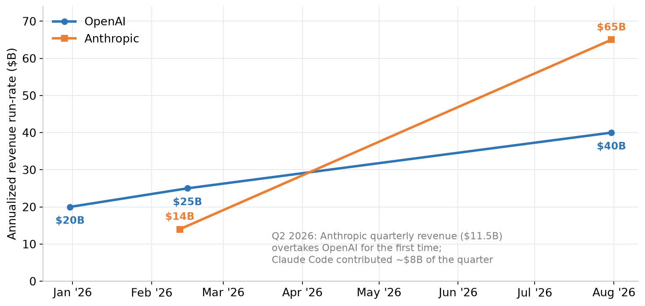
Model providers: agentic demand repriced both leaders
Annualized revenue run-rate; Anthropic's Q2 2026 quarterly revenue overtook OpenAI's for the first time
Source: Bloomberg (Aug 13, 2026); CNBC; Forkast/Bloomberg internal docs; Sacra [#6, 29, 30, 31] | # refs -> Sources sheet, agentic_ai_revenue_token_usage_2026.xlsx

Slide 6
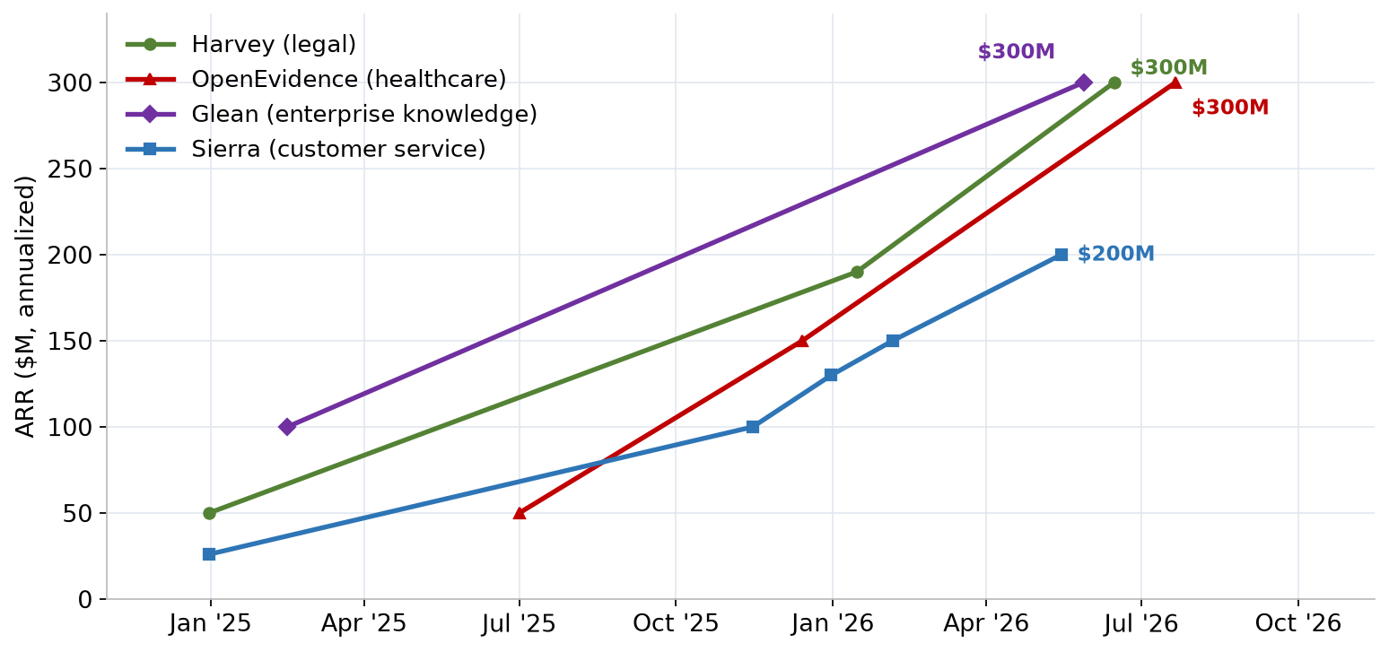
Vertical & knowledge agents: the $200-300M ARR club
Legal, healthcare, enterprise knowledge and customer service all crossed from pilots to production
Source: AgentMarketCap; ARR Club; TechCrunch; Sacra [#9-14, 35, 39] | # refs -> Sources sheet, agentic_ai_revenue_token_usage_2026.xlsx

Slide 7
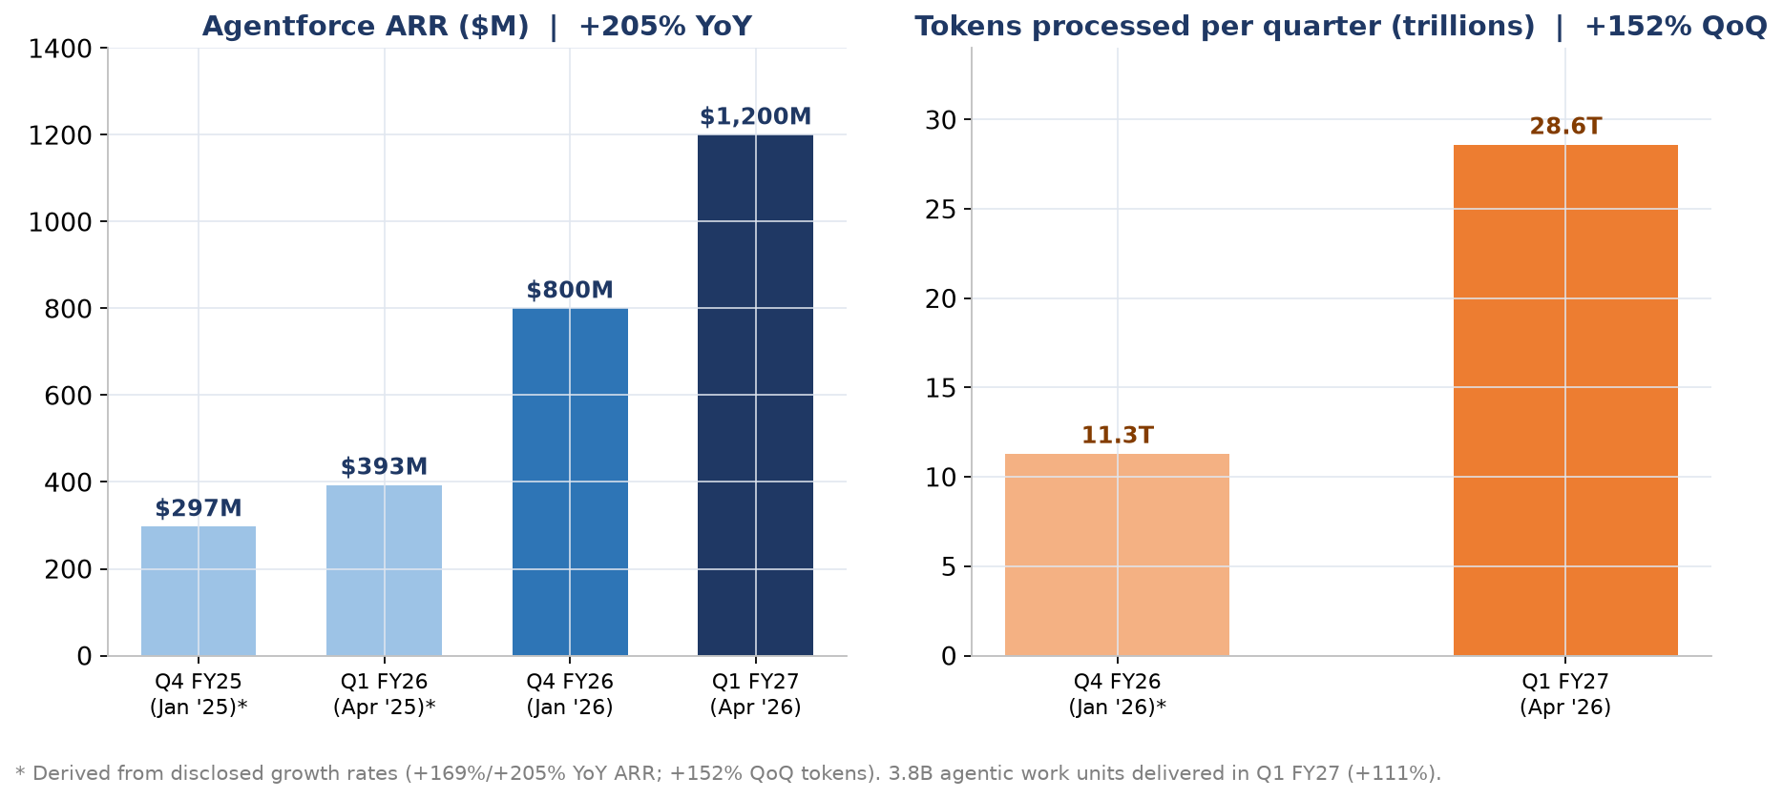
Salesforce Agentforce: revenue and tokens compounding together
First enterprise platform agent to $1B+ ARR; token volume growing faster than revenue
Source: Salesforce Q1 FY2027 results via CX Today / CXM [#17, 18] | # refs -> Sources sheet, agentic_ai_revenue_token_usage_2026.xlsx

Slide 8
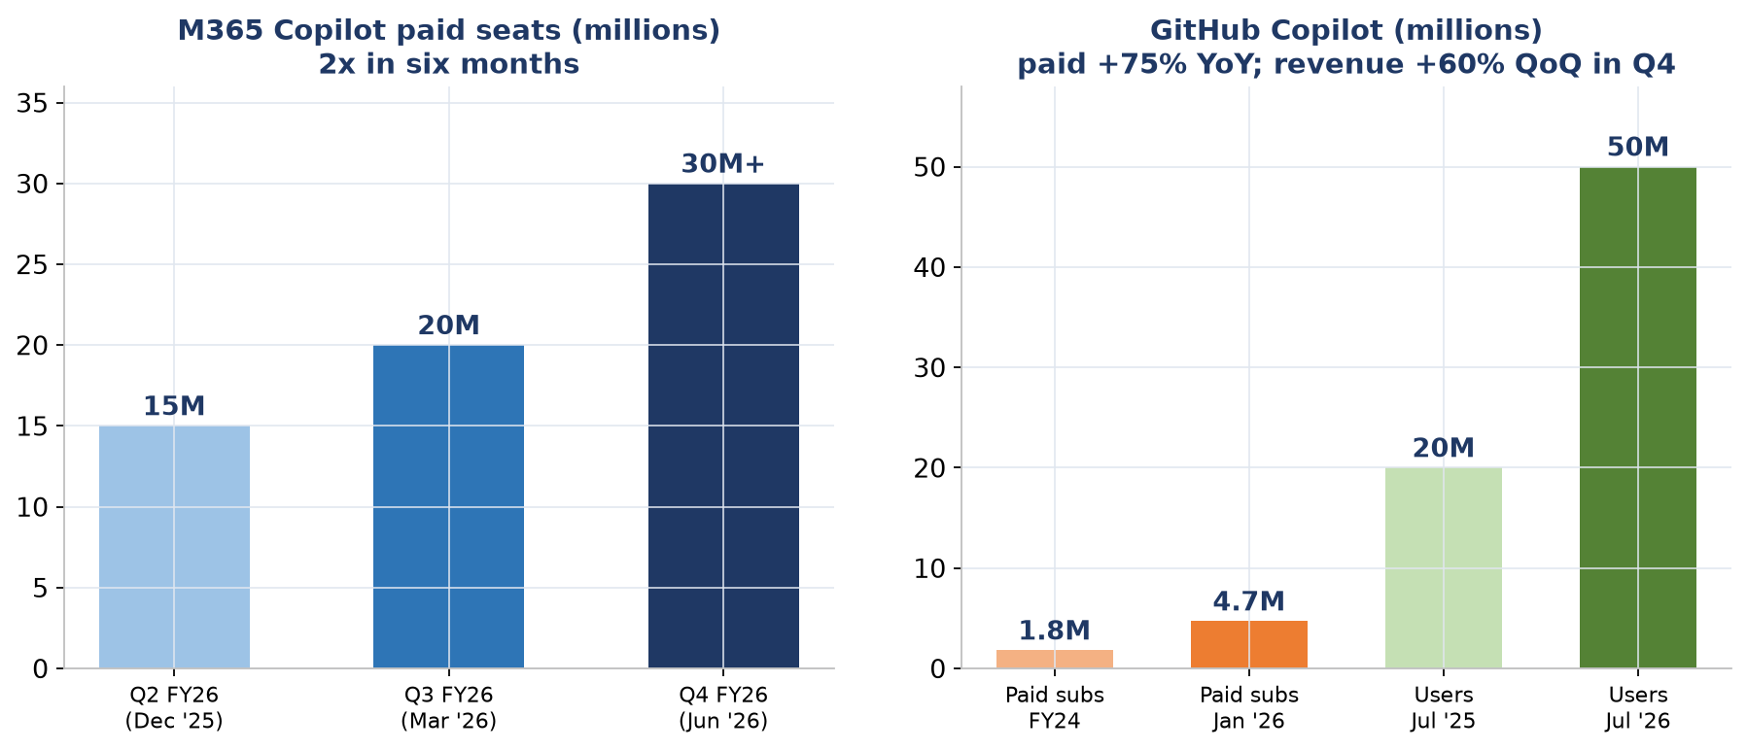
Microsoft: agent adoption at platform scale
M365 Copilot seats and GitHub Copilot users/subscribers; Agent 365 registered ~40M agents in its first two months
Source: Microsoft FY26 Q2/Q3/Q4 earnings; Axis Intelligence [#7, 36, 37] | # refs -> Sources sheet, agentic_ai_revenue_token_usage_2026.xlsx

Slide 9
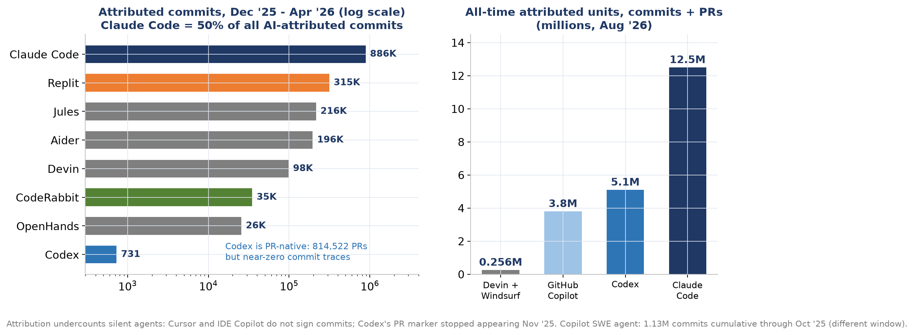
GitHub commits: which agents actually ship code
Multi-method census of 180M repositories (WoC V2604) plus all-time attribution tracking; channels differ by agent
Source: arXiv 2606.24429 census; Amplifying.ai; JetBrains survey [#41, 42, 43] | # refs -> Sources sheet, agentic_ai_revenue_token_usage_2026.xlsx

Slide 10
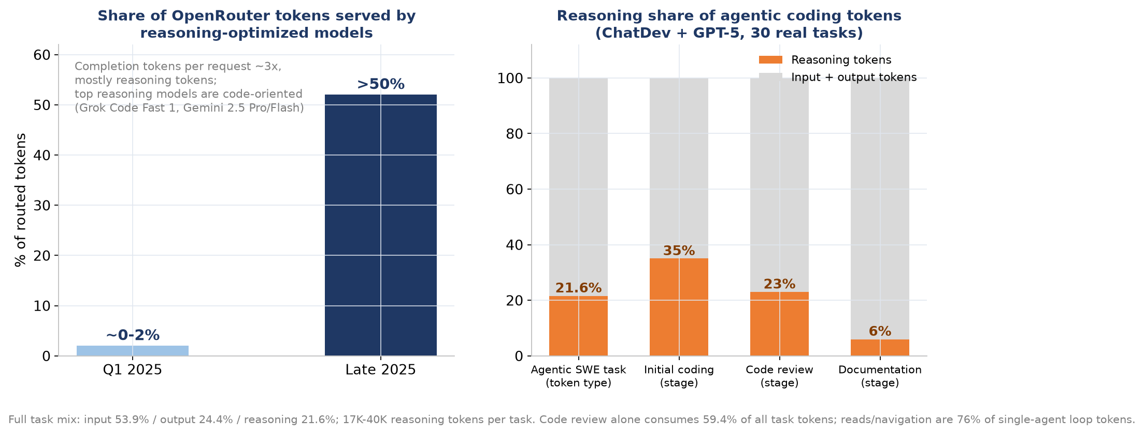
Reasoning tokens: now the default mode for agentic work
Reasoning-optimized models serve the majority of routed tokens; ~22% of agentic coding task tokens are reasoning
Source: OpenRouter State of AI; arXiv 2601.14470 Tokenomics study [#26, 44, 45] | # refs -> Sources sheet, agentic_ai_revenue_token_usage_2026.xlsx

Slide 11
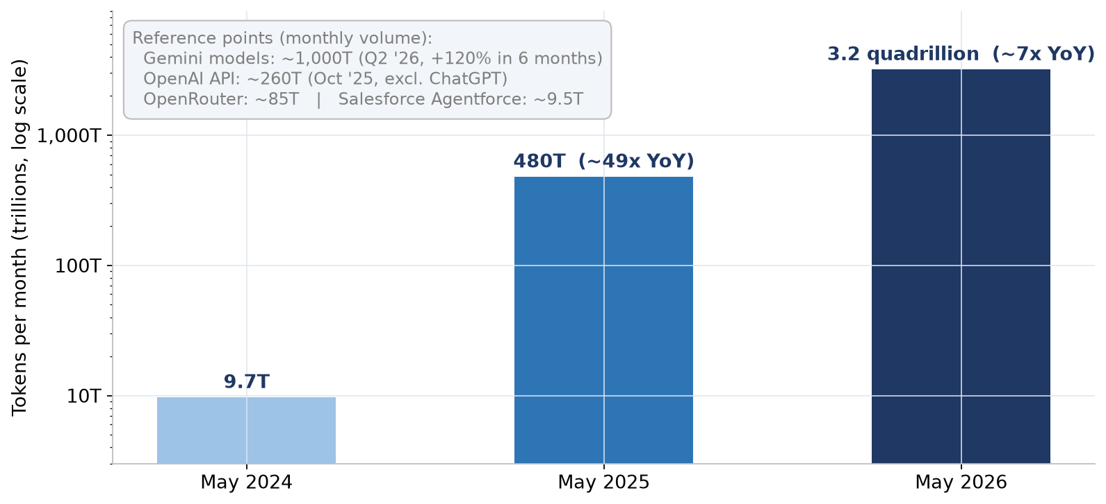
Token throughput: the clearest demand signal
Google platform-wide monthly tokens, ~330x in two years; agentic workloads are the driver (do not sum reference points)
Source: Google I/O 2026; Q2 2026 earnings; OpenAI DevDay; OpenRouter; Salesforce [#17, 21, 22, 23, 26] | # refs -> Sources sheet, agentic_ai_revenue_token_usage_2026.xlsx

Slide 12
Notes, methodology & caveats
- All series are assembled from the Growth trajectory and token columns of agentic_ai_revenue_token_usage_2026.xlsx; source numbers [#] map to its Sources sheet (40 references).
- Confidence varies by series: company-disclosed (Agentforce, M365 Copilot seats, Google tokens, Cursor to $2B) vs third-party tracked (Claude Code, Codex - TickerTrends) vs analyst estimates (Sacra: Sierra, Abridge, Cursor $4B).
- Annualized run-rates extrapolate the latest period x12 and can move sharply; several curves will moderate as they lap larger bases.
- Agentforce bars marked * are derived from disclosed growth rates, not directly reported figures.
- Double-counting warning: provider totals (OpenAI, Anthropic) include their agent products (Codex, Claude Code) and the API revenue paid to them by application-layer companies (Cursor, Replit, Lovable).
- Token metrics are heterogeneous (platform-wide vs API-only vs router-visible) and are shown for scale, not for summation.
- Regenerate this deck: python3 scripts/build_presentation.py

