Slide 1

Individual Meeting
Spring Term
Year 2024 -2025

Slide 2
Objective:
Training SBI to learn the relationship between Manning’s values and streamflow data from Baseline run.

Slide 3
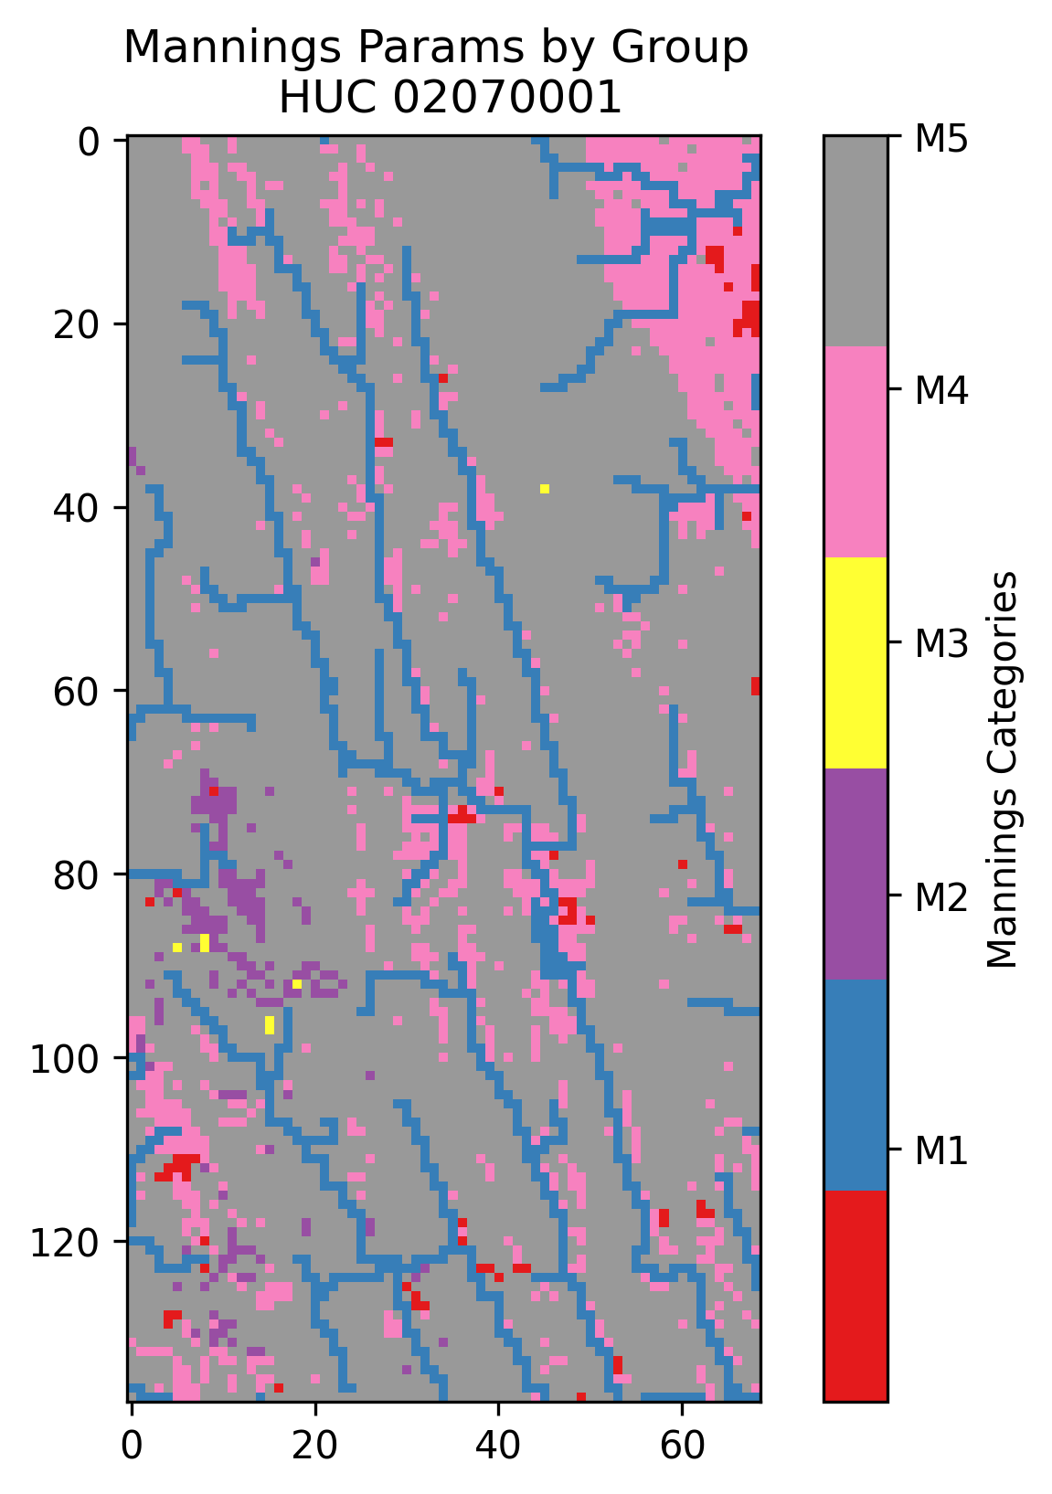
HUC : 02070001

Slide 4
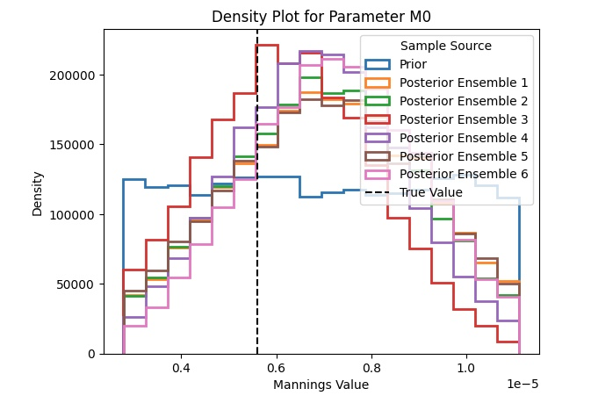
Density Plot for M₀

Slide 5
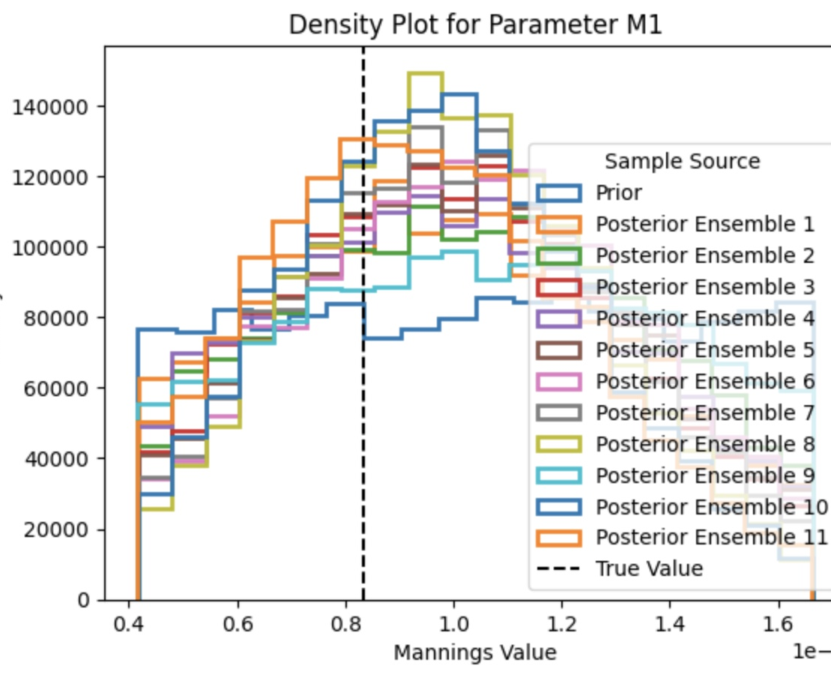
Density plot for M₁

Slide 6
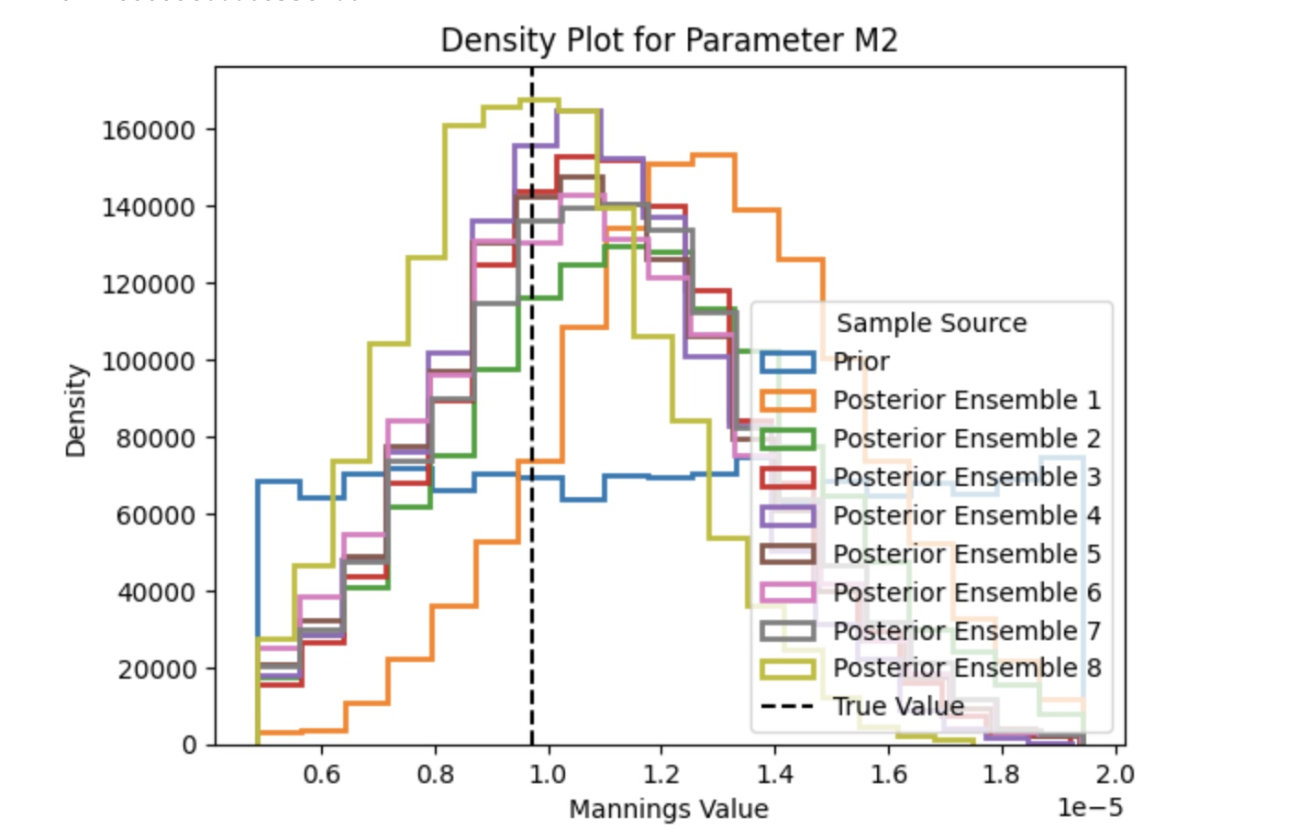
Density plot for M₂

Slide 7
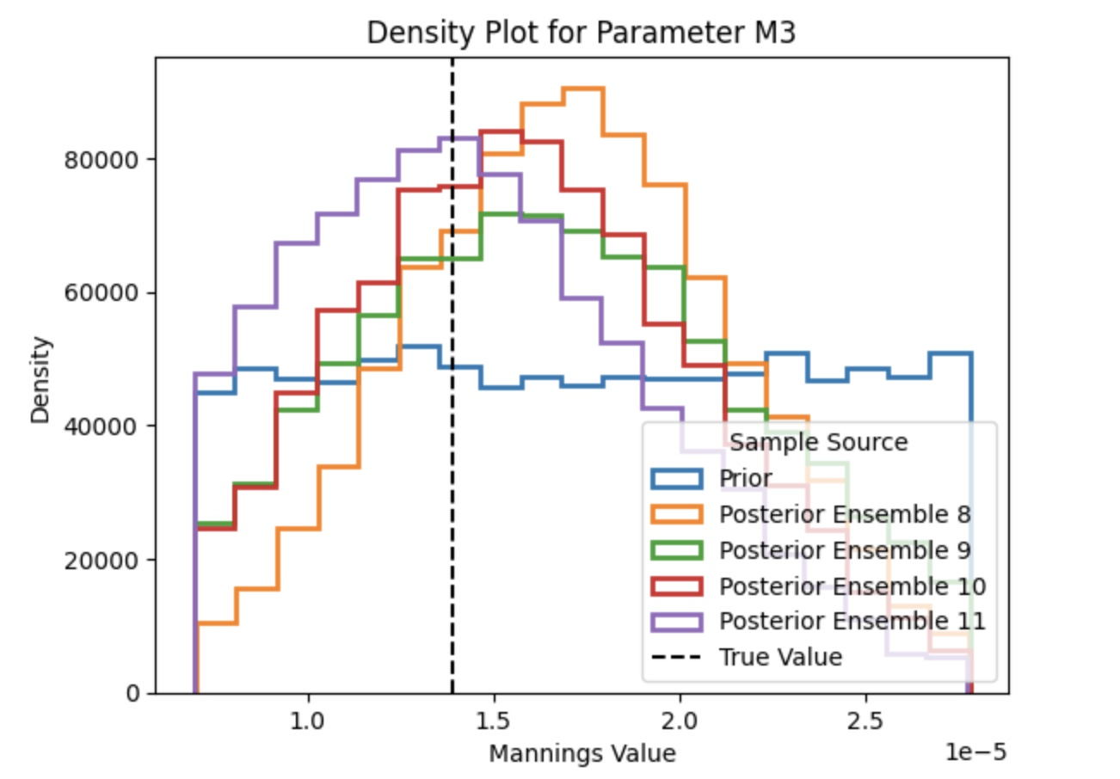
Density plot for M₃

Slide 8
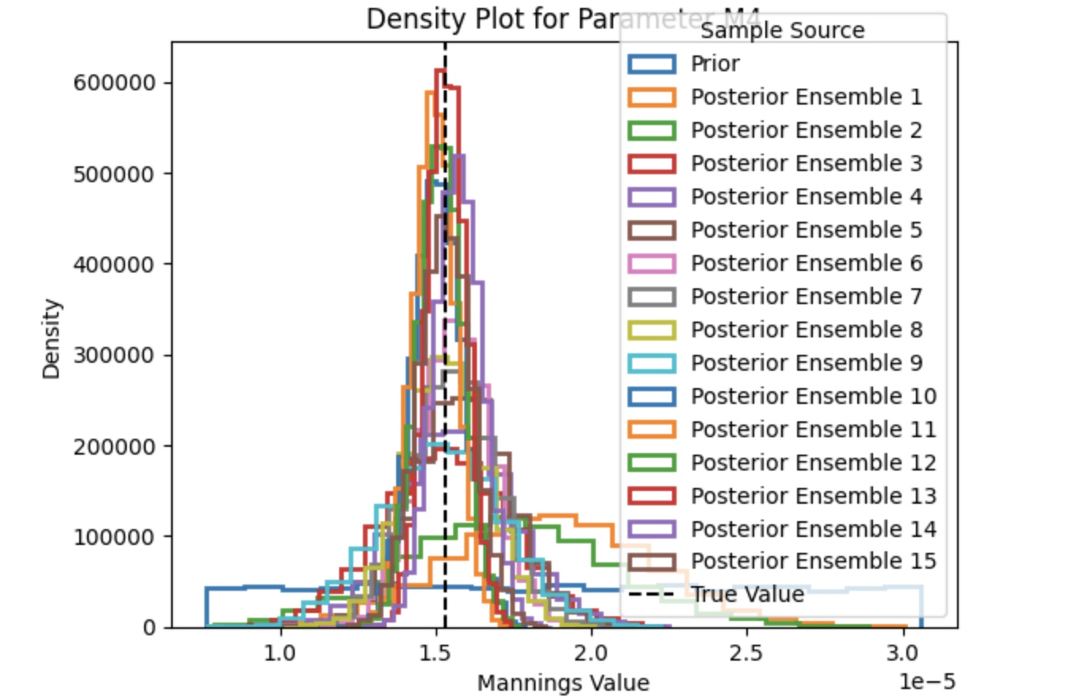
Density plot for M₄

Slide 9
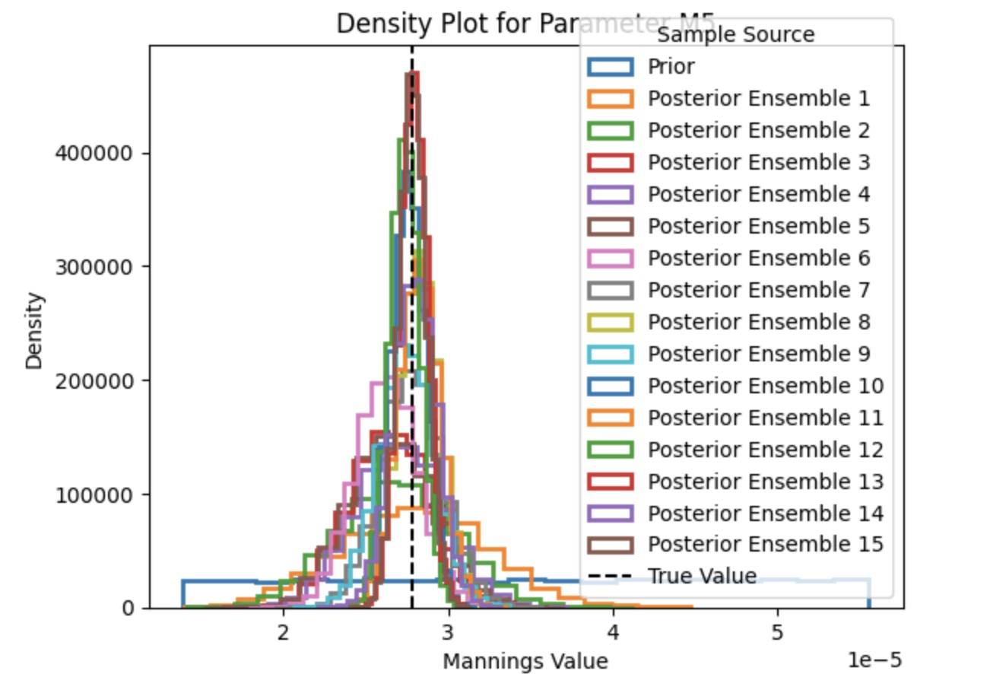
Density plot for M₅

Slide 10
Objective
Getting The Posterior Density Estimation for the Manning’s given that the observed is the streamflow from Hydrodata

Slide 11
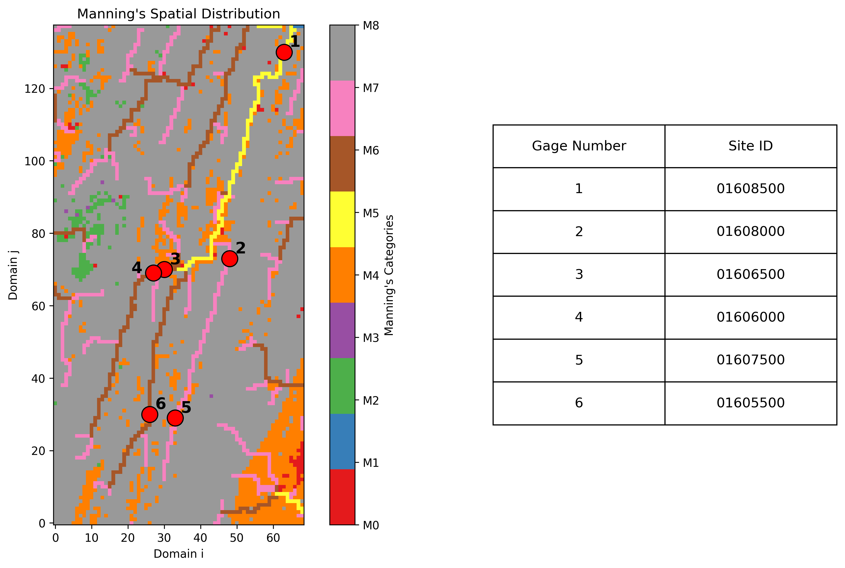
HUC 02070001

Slide 12
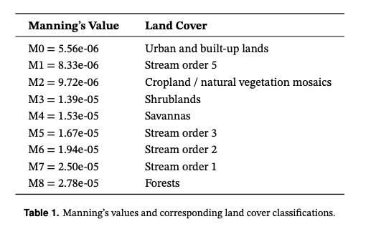
Manning’s Value and Land Cover

Slide 13
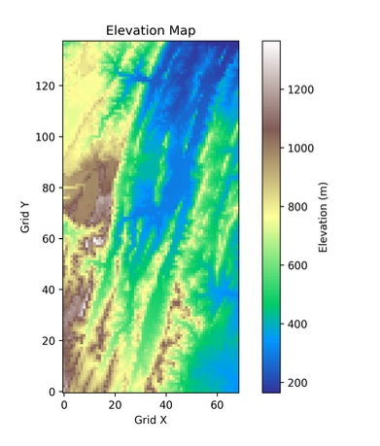
Elevation Mapping

Slide 14
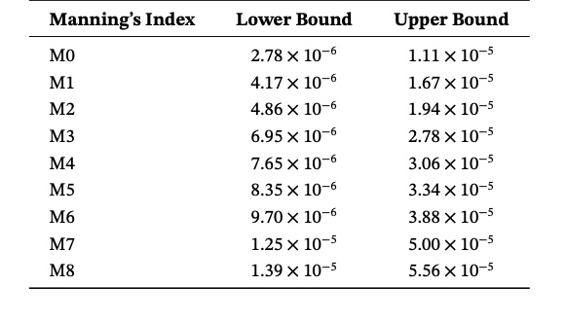
Prior Distribution
The prior distribution is initially defined as a uniform distribution, constructed based on Manning’s values derived from the static input data.
Its range is determined as follows:
The lower bound is set as the Manning’s value divided by a scalar of 2.
The upper bound is set as the Manning’s value multiplied by 2.

Slide 15
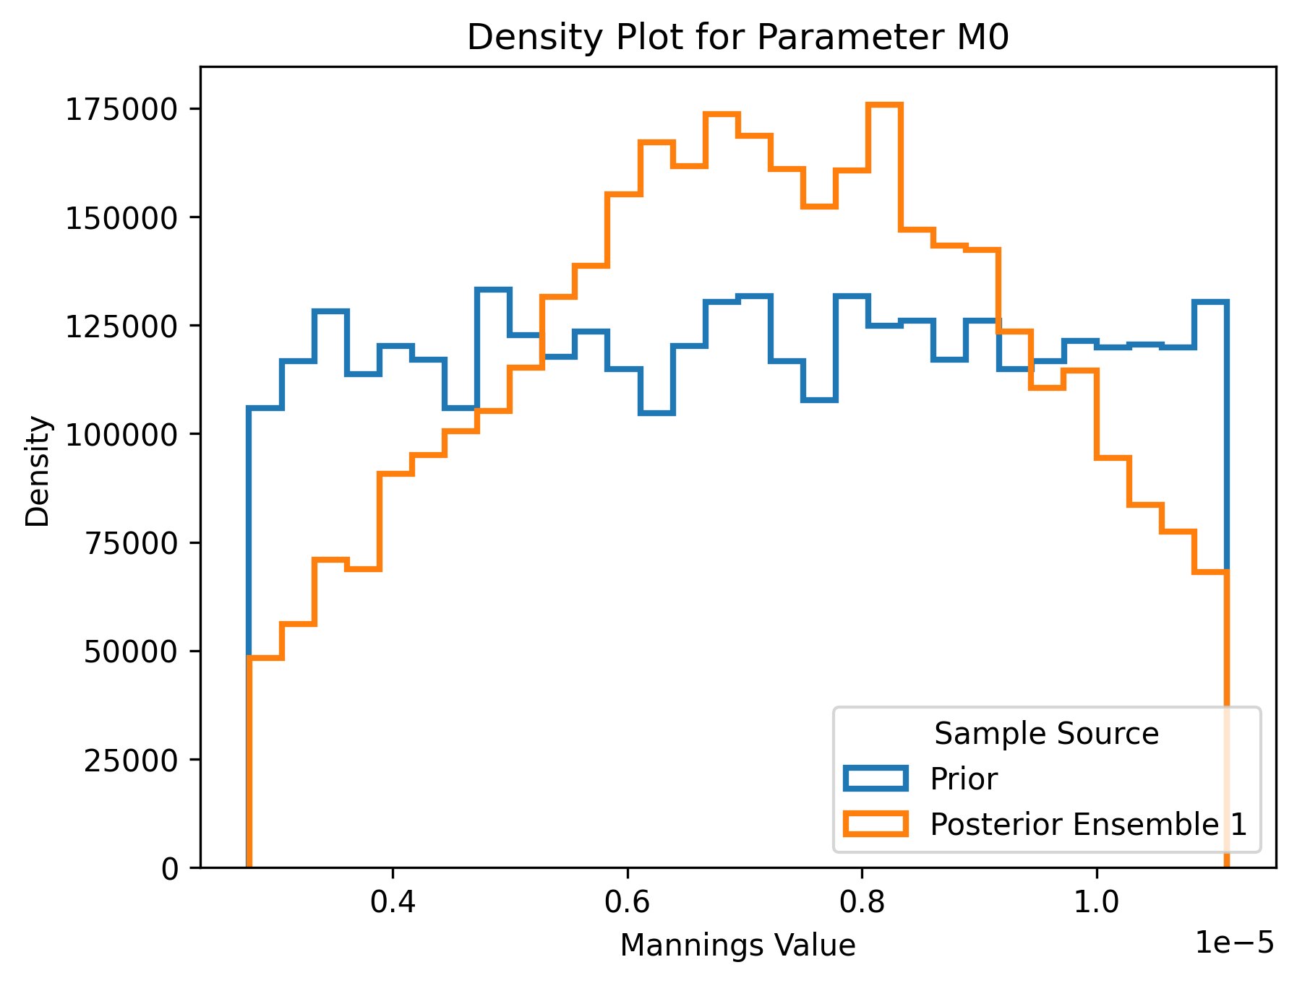
M0: Posterior Distribution
Notes:
Not

Slide 16
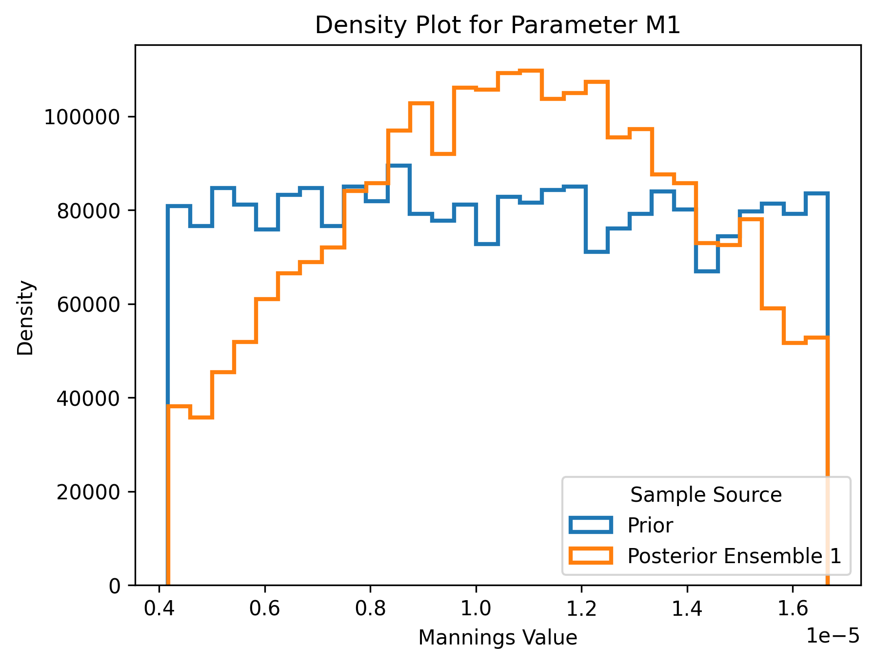
M1: Posterior Distribution
Notes:
Sampling 400 simulations
Posterior distribution that is presented is from the first iteration

Slide 17
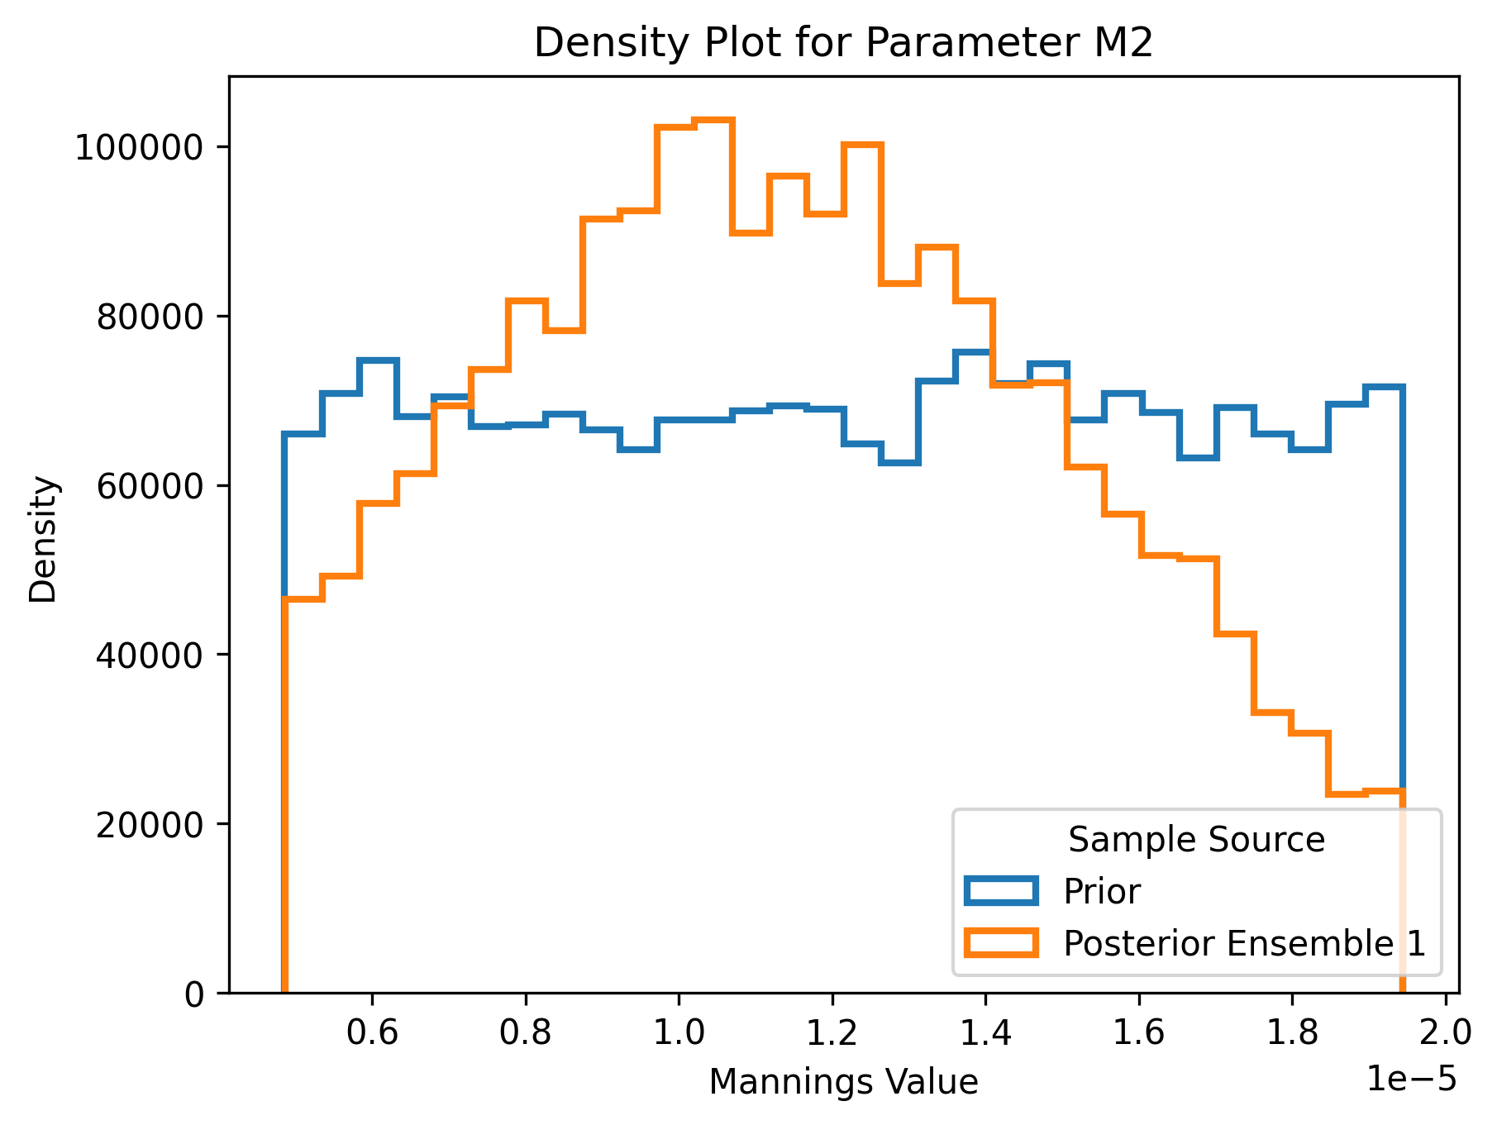
M2: Posterior Distribution
Notes:
Sampling 400 simulations
Posterior distribution that is presented is from the first iteration

Slide 18
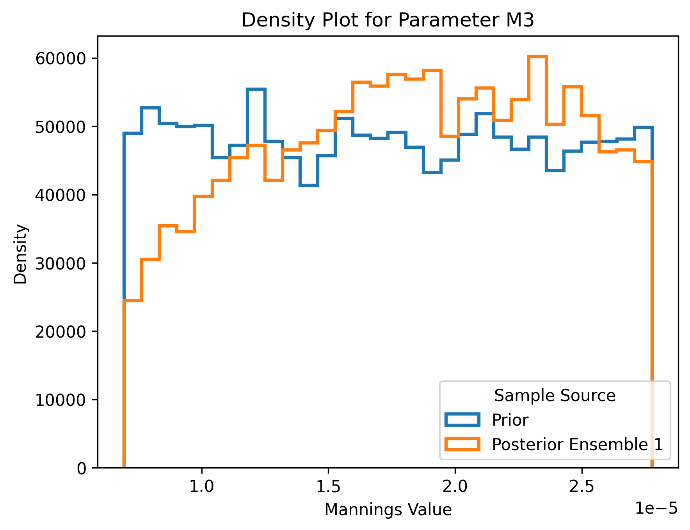
M3: Posterior Distribution
Notes:
Sampling 400 simulations
Posterior distribution that is presented is from the first iteration

Slide 19
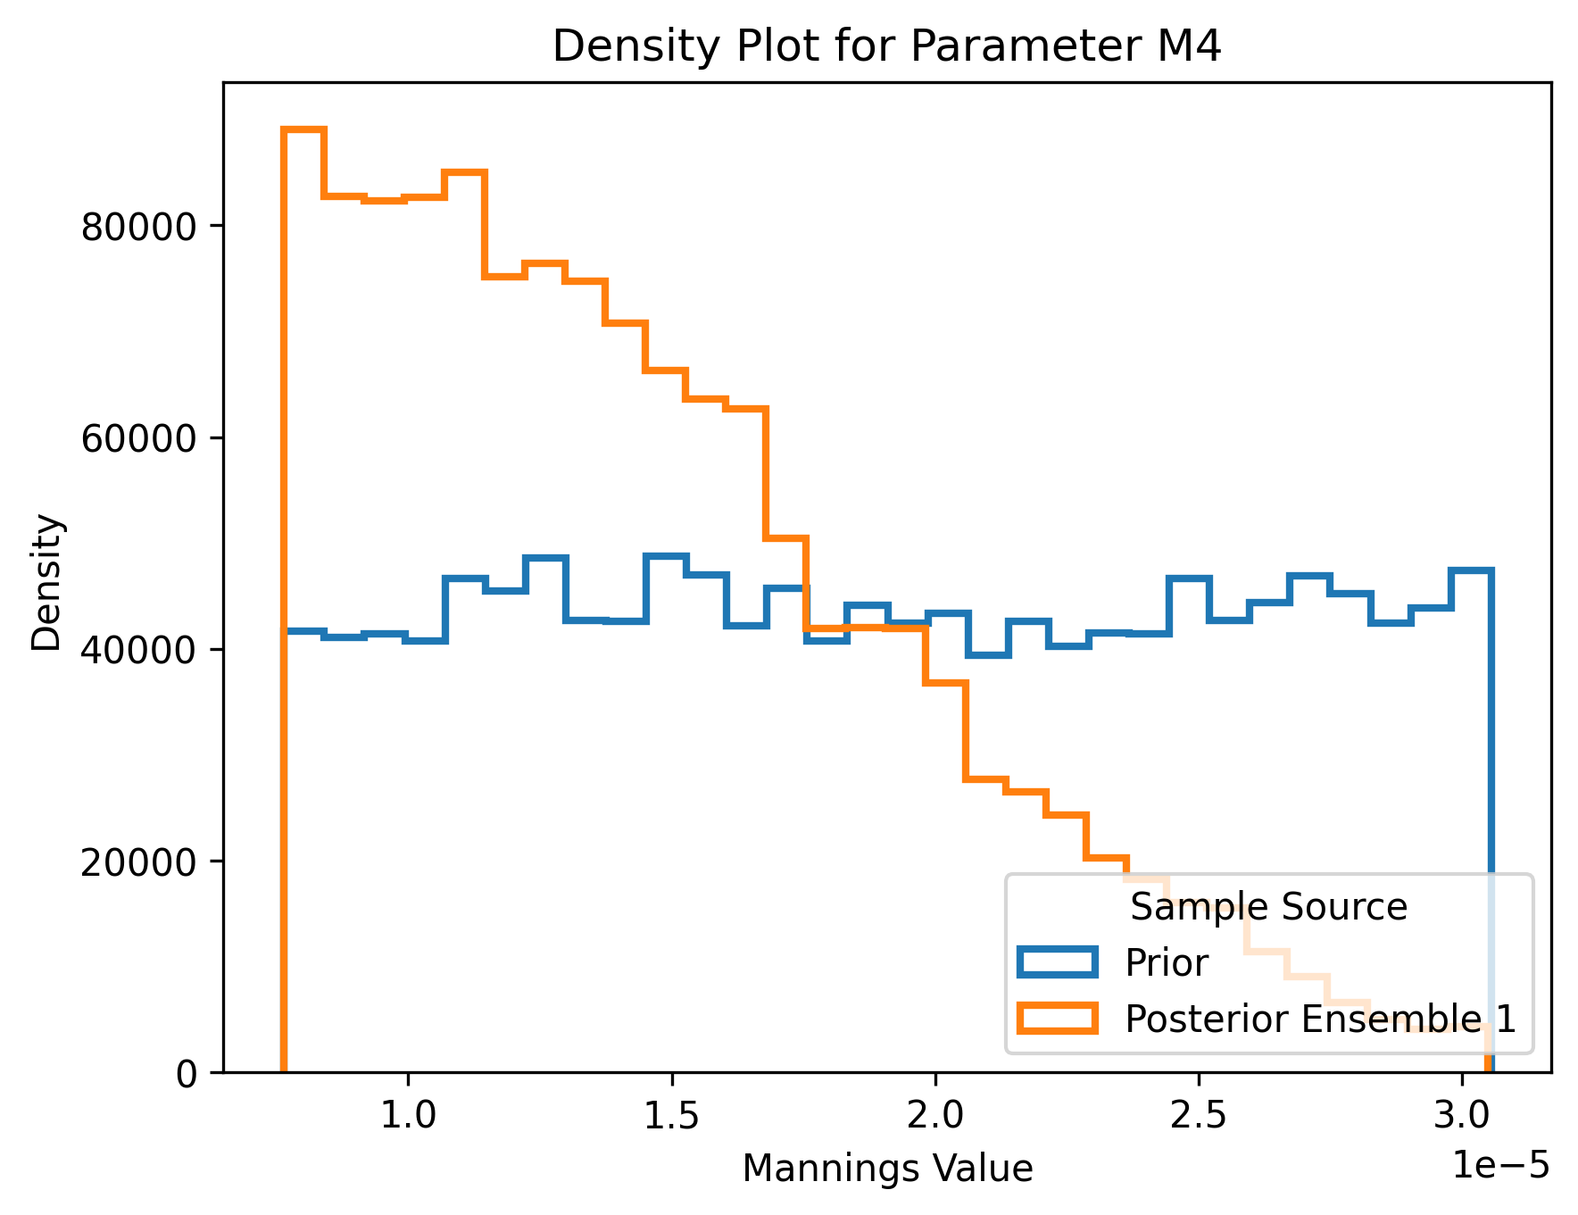
M4: Posterior Distribution
Notes:
Sampling 400 simulations
Posterior distribution that is presented is from the first iteration

Slide 20
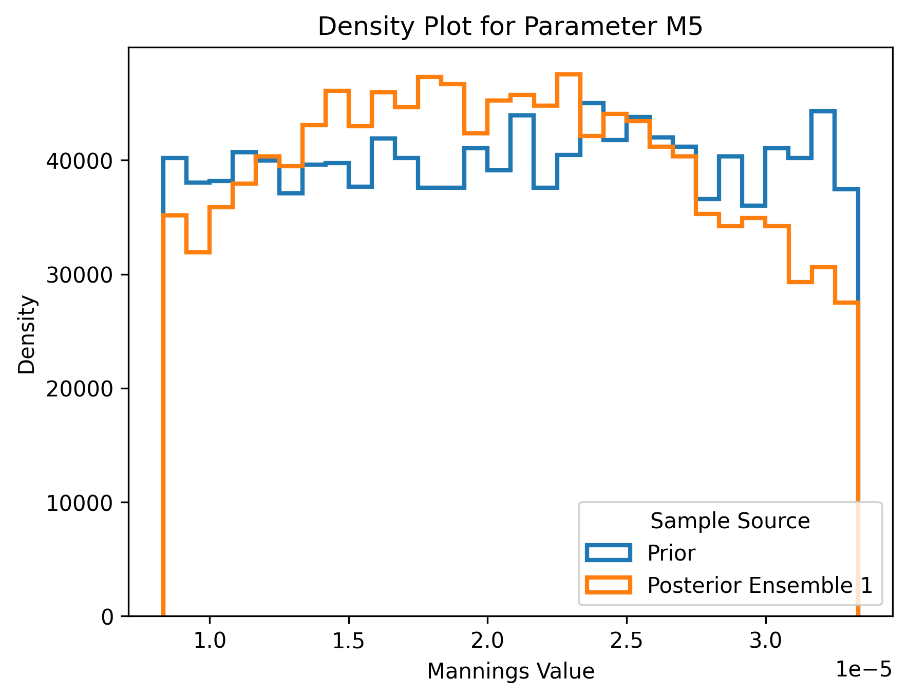
M5: Posterior Distribution
Notes:
Sampling 400 simulations
Posterior distribution that is presented is from the first iteration

Slide 21
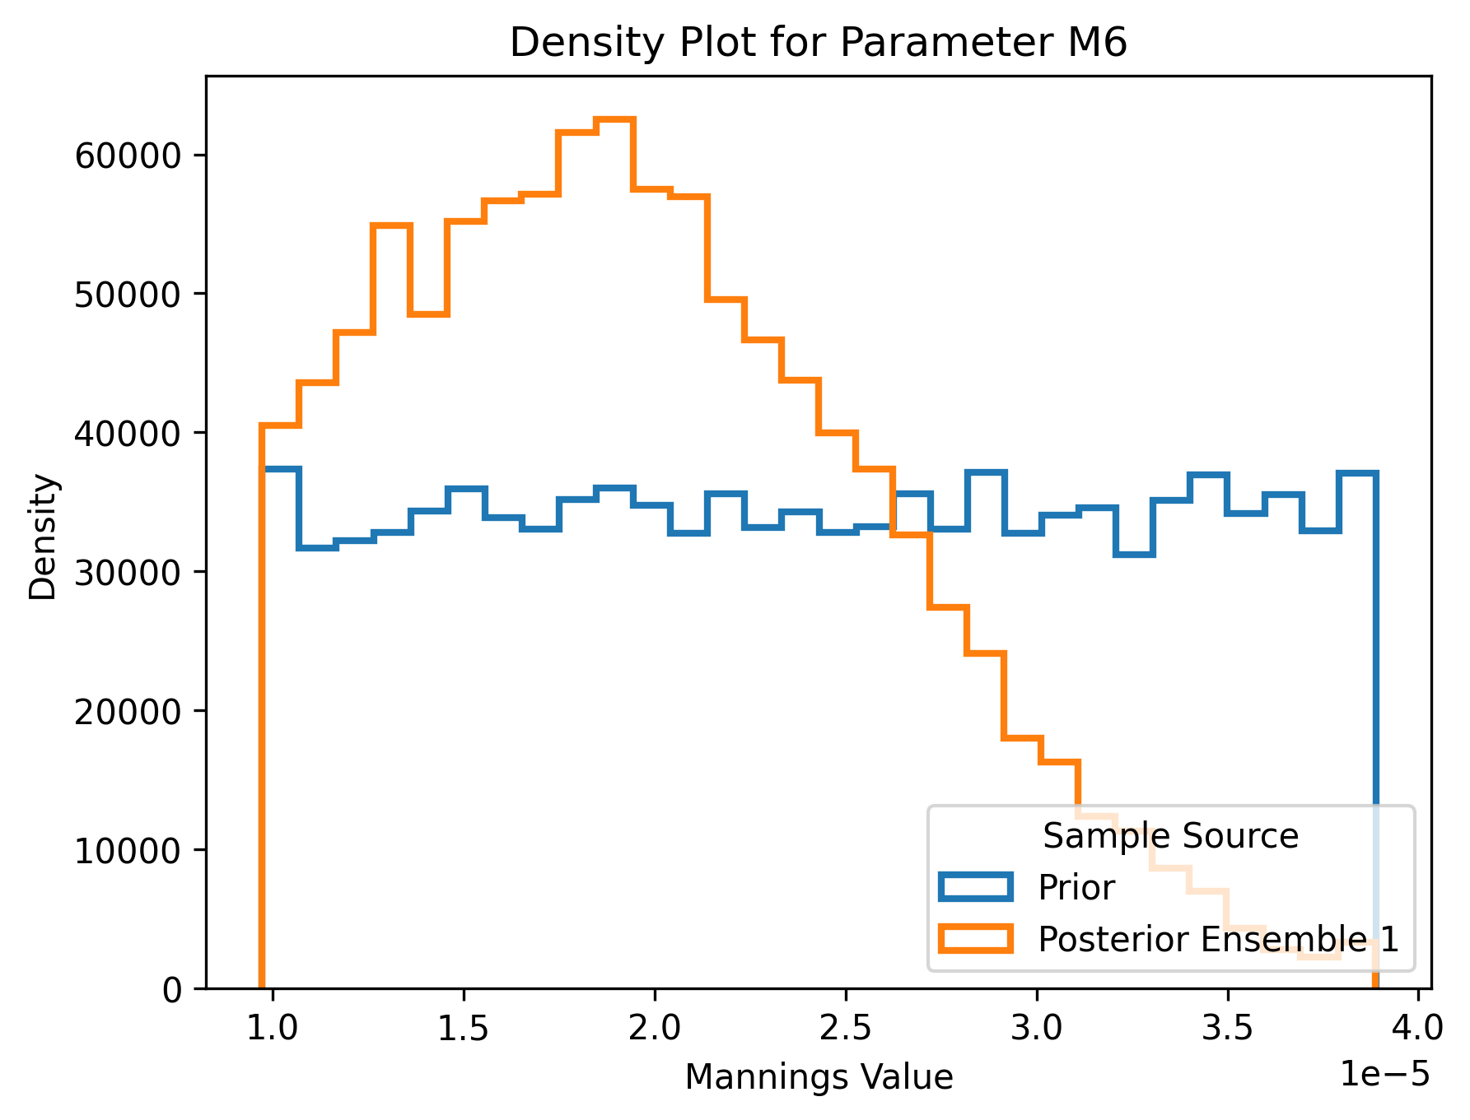
M6: Posterior Distribution
Notes:
Sampling 400 simulations
Posterior distribution that is presented is from the first iteration

Slide 22
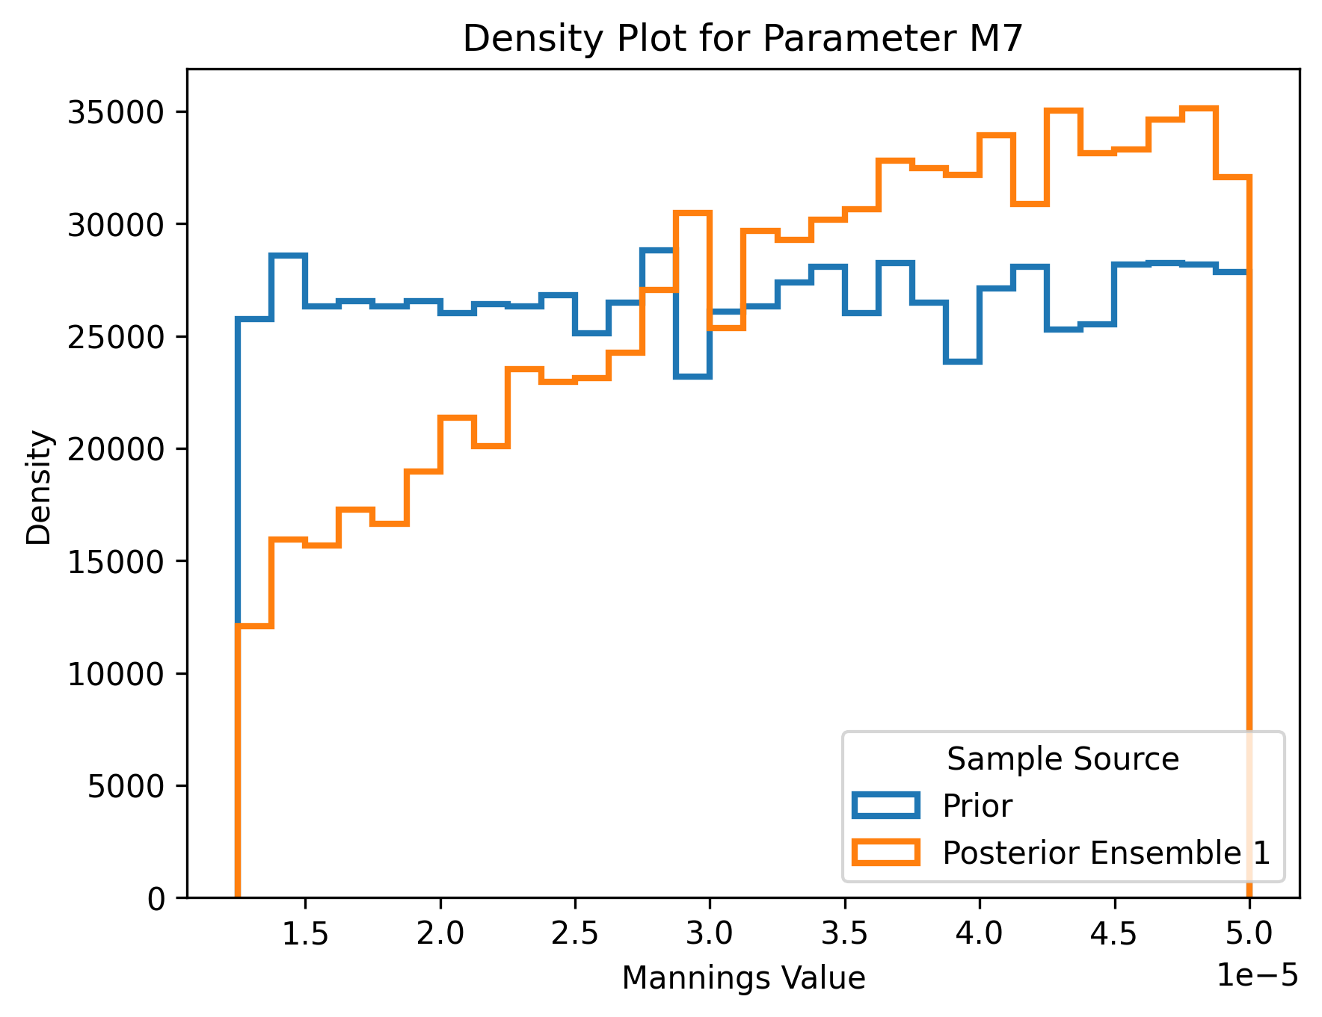
M7: Posterior Distribution
Notes:
Sampling 400 simulations
Posterior distribution that is presented is from the first iteration

Slide 23
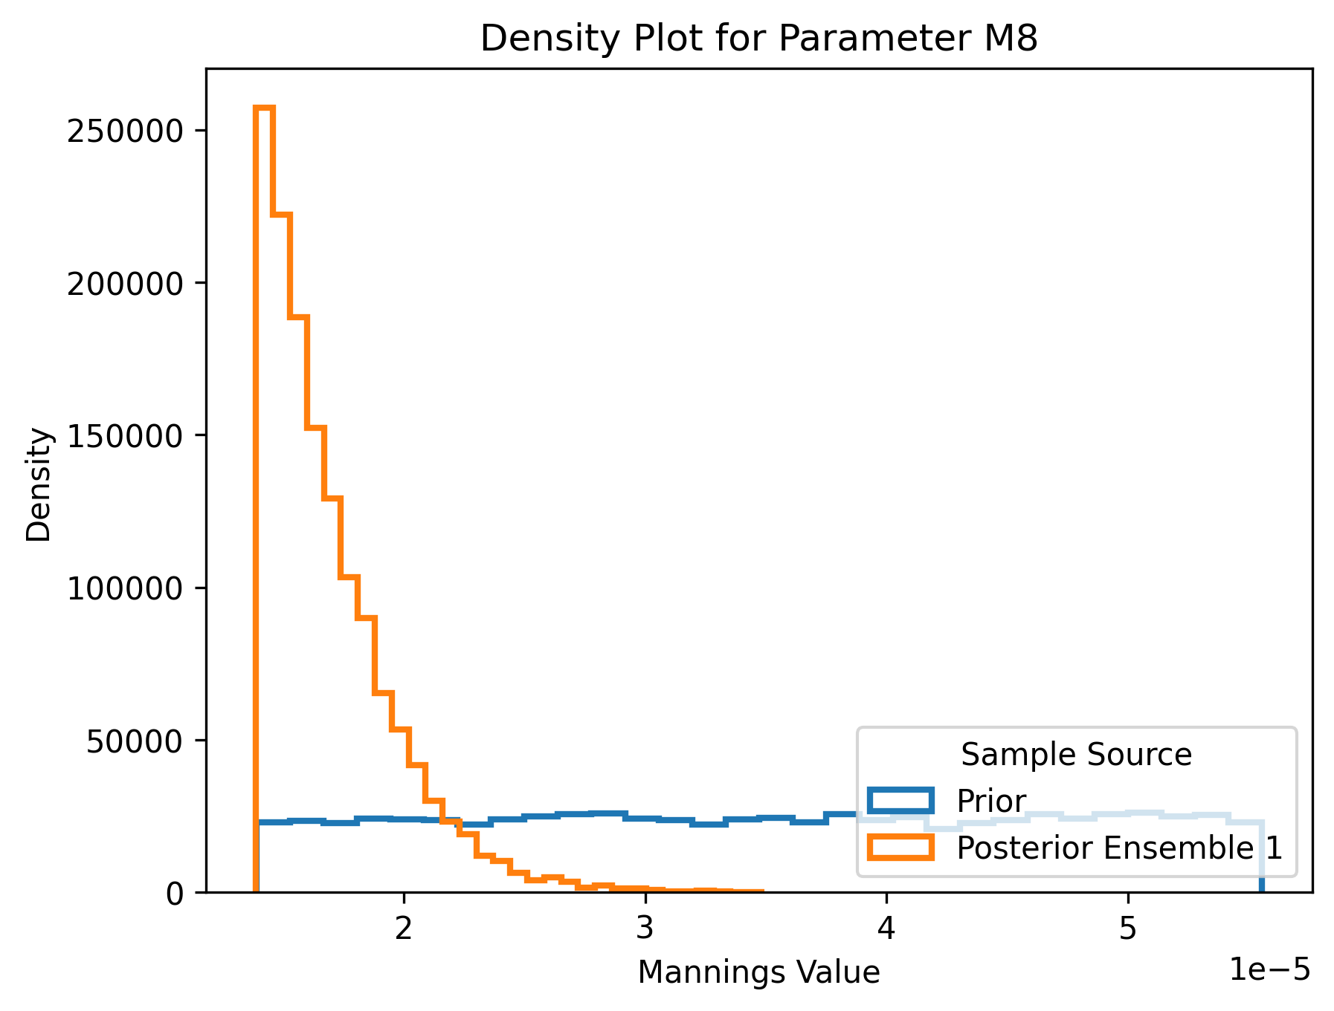
M8: Posterior Distribution
Notes:
Sampling 400 simulations
Posterior distribution that is presented is from the first iteration

Slide 24
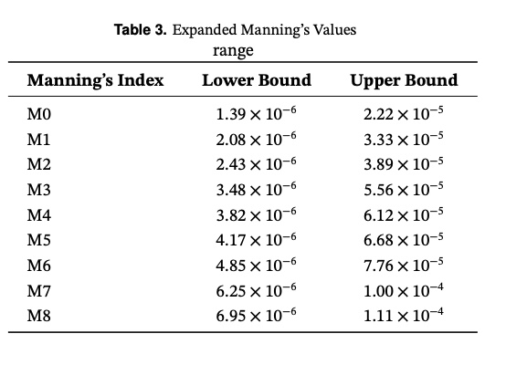
Calibrating The Prior Distribution
To expand the boundaries and facilitate broader exploration of the parameter, the scalar has now been increased to 4.
This adjustment effectively doubles the prior range, ensuring a more comprehensive coverage of possible Manning’s values and enhancing the flexibility of the model.

Slide 25
After Calibrating the prior ditstribution

Slide 26
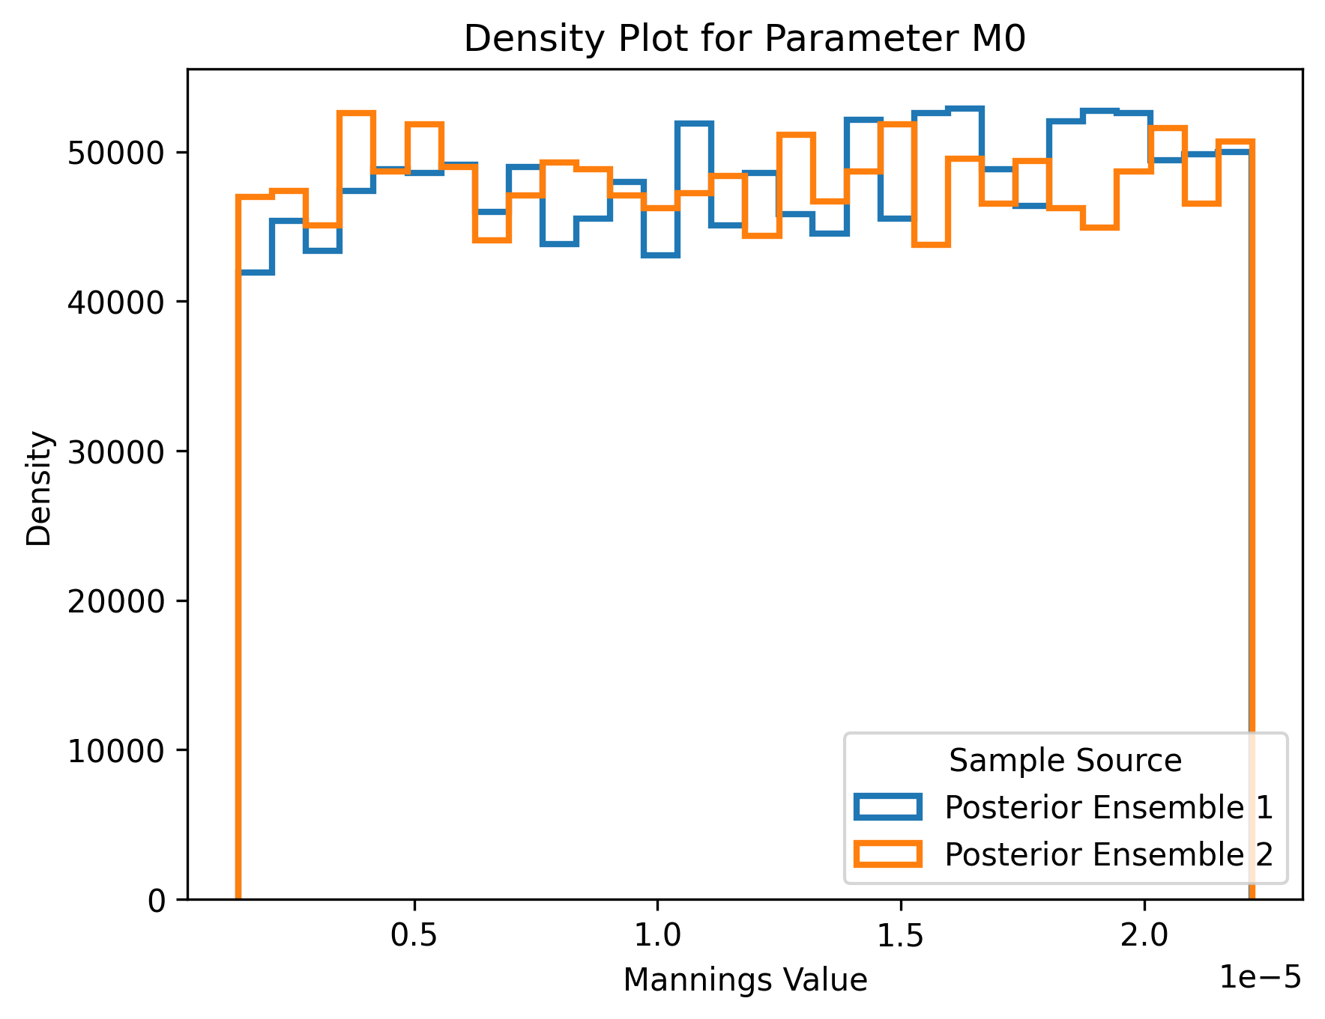
M0: Posterior Distribution
Notes:
Sampling 400 simulations
Posterior distribution that is presented is from the first iteration

Slide 27
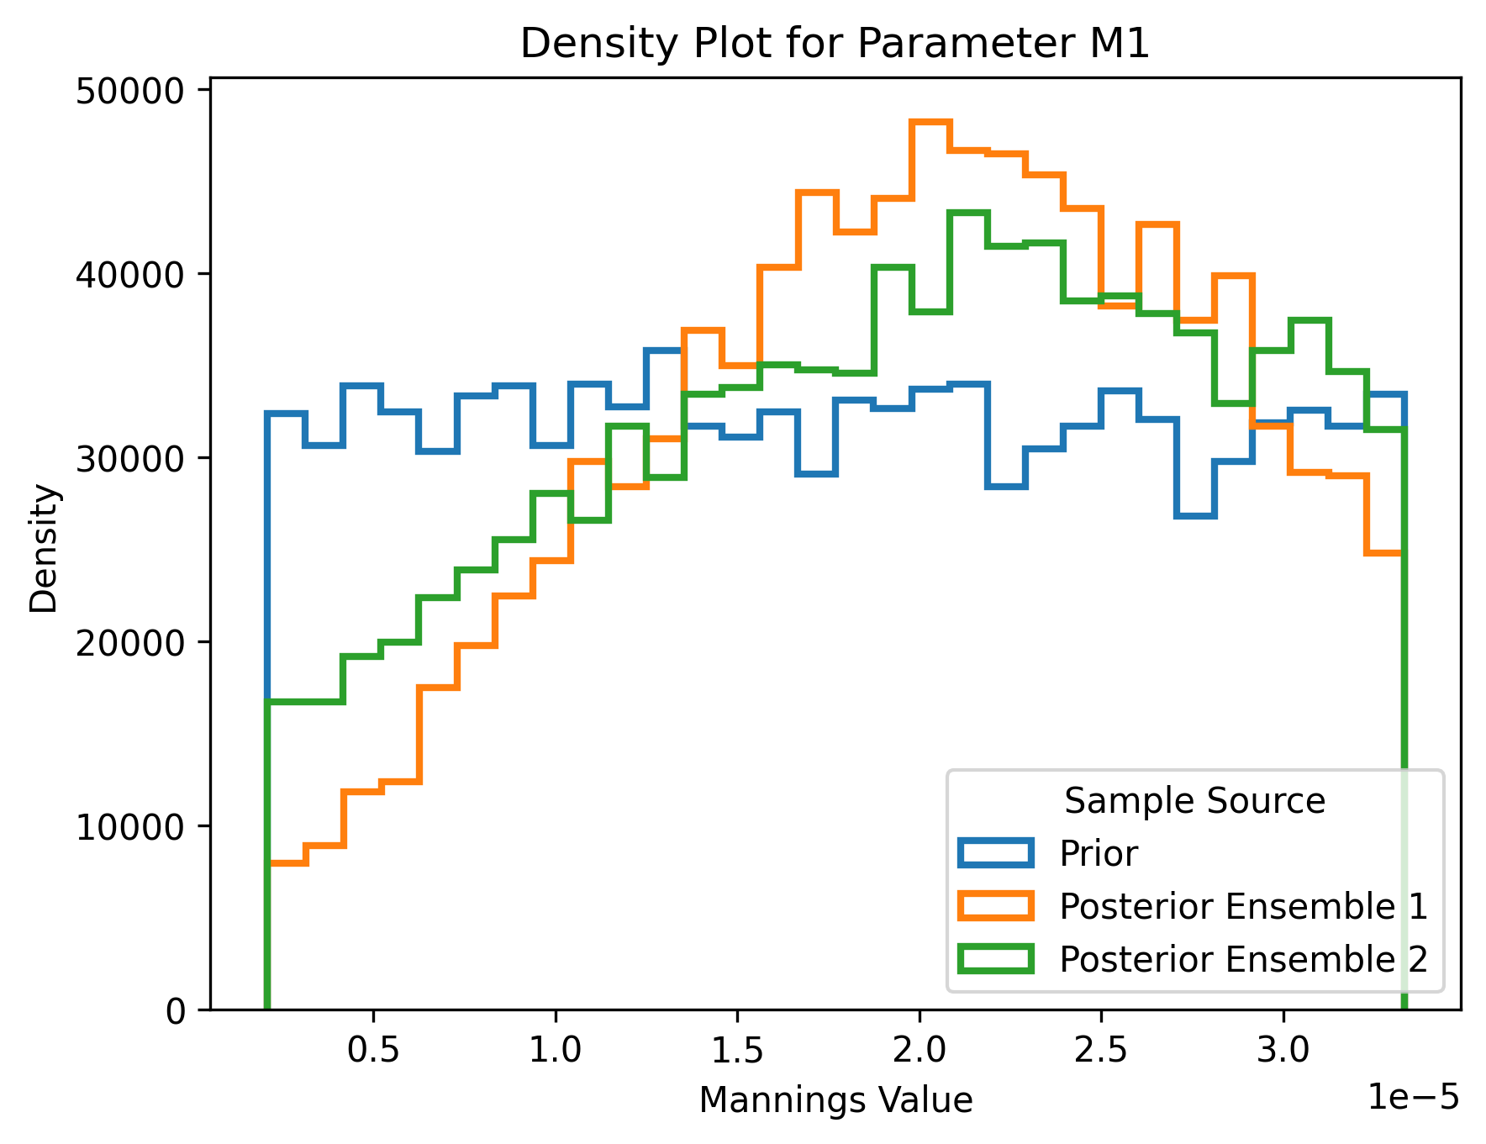
M1: Posterior Distribution
Notes:
Sampling 400 simulations
Posterior distribution that is presented is from the first iteration

Slide 28
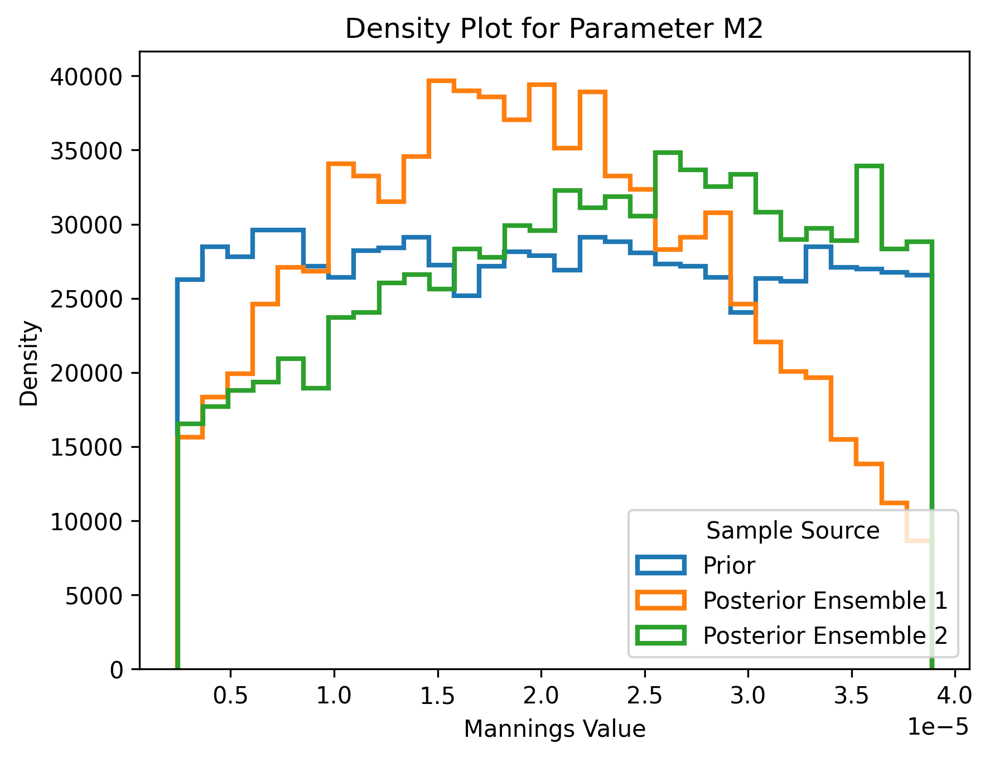
M2: Posterior Distribution
Notes:
Sampling 400 simulations
Posterior distribution that is presented is from the first iteration

Slide 29
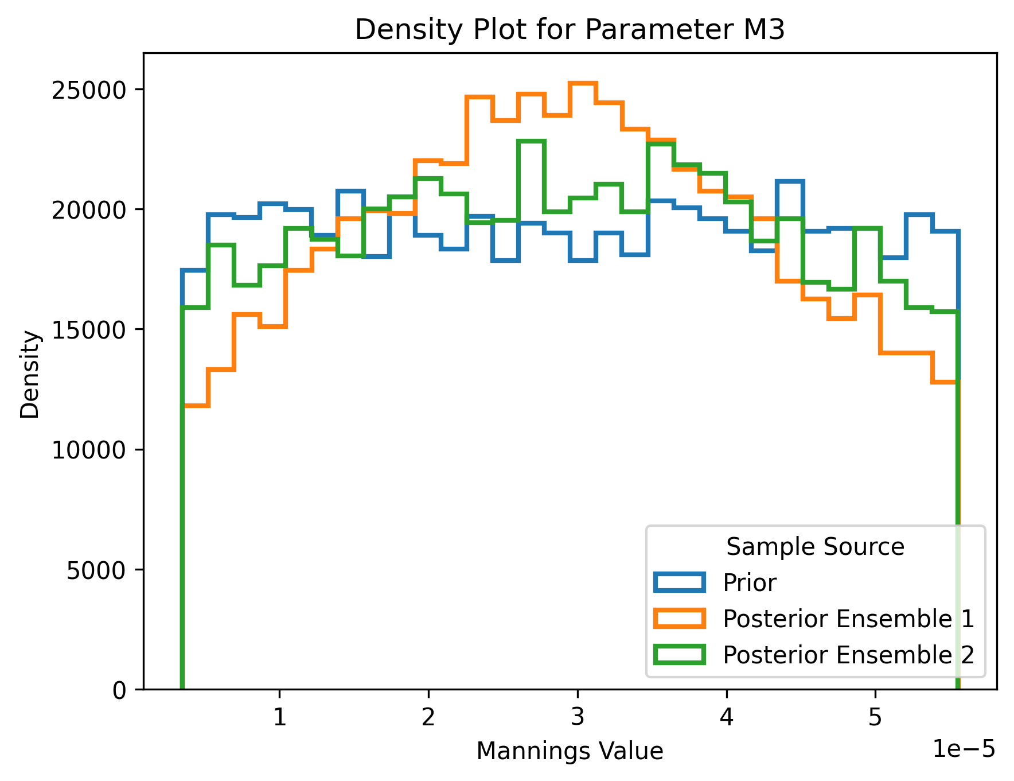
M3: Posterior Distribution
Notes:
Sampling 400 simulations
Posterior distribution that is presented is from the first iteration

Slide 30
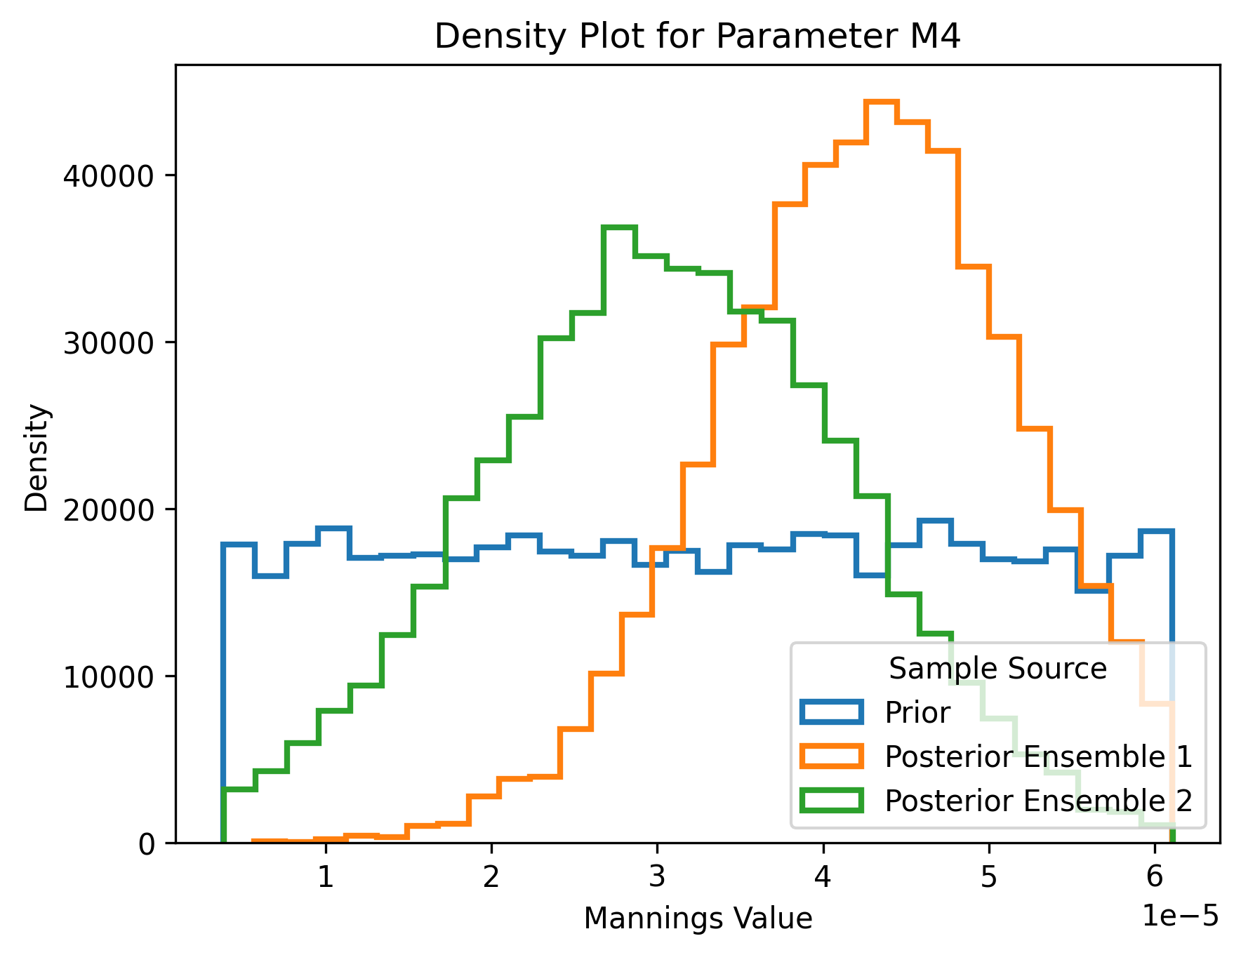
M4: Posterior Distribution
Notes:
Sampling 400 simulations
Posterior distribution that is presented is from the first iteration

Slide 31
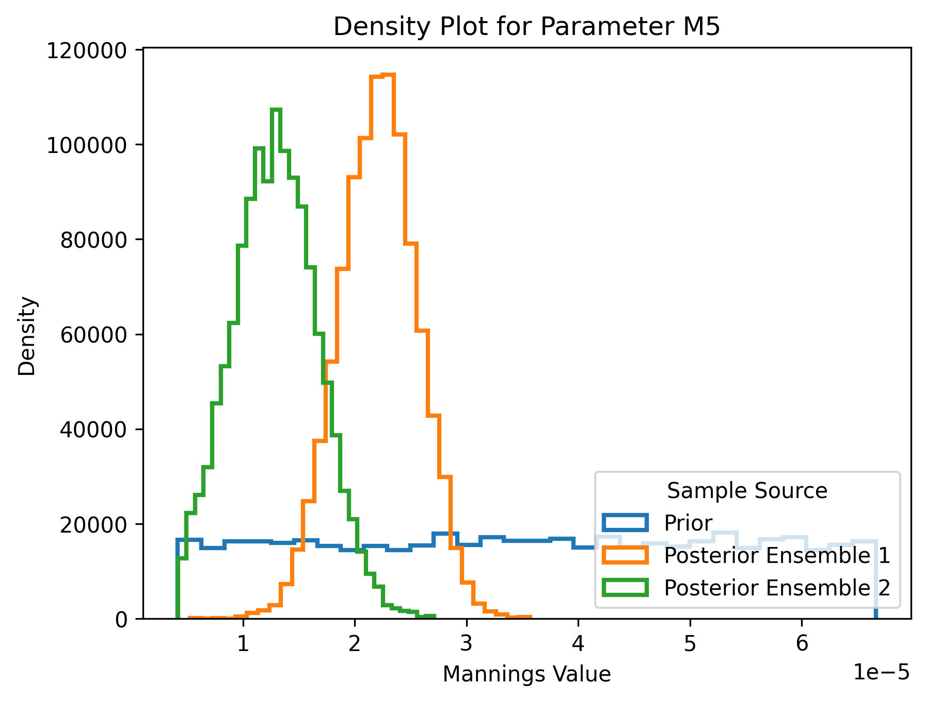
M5: Posterior Distribution
Notes:
Sampling 400 simulations
Posterior distribution that is presented is from the first iteration

Slide 32
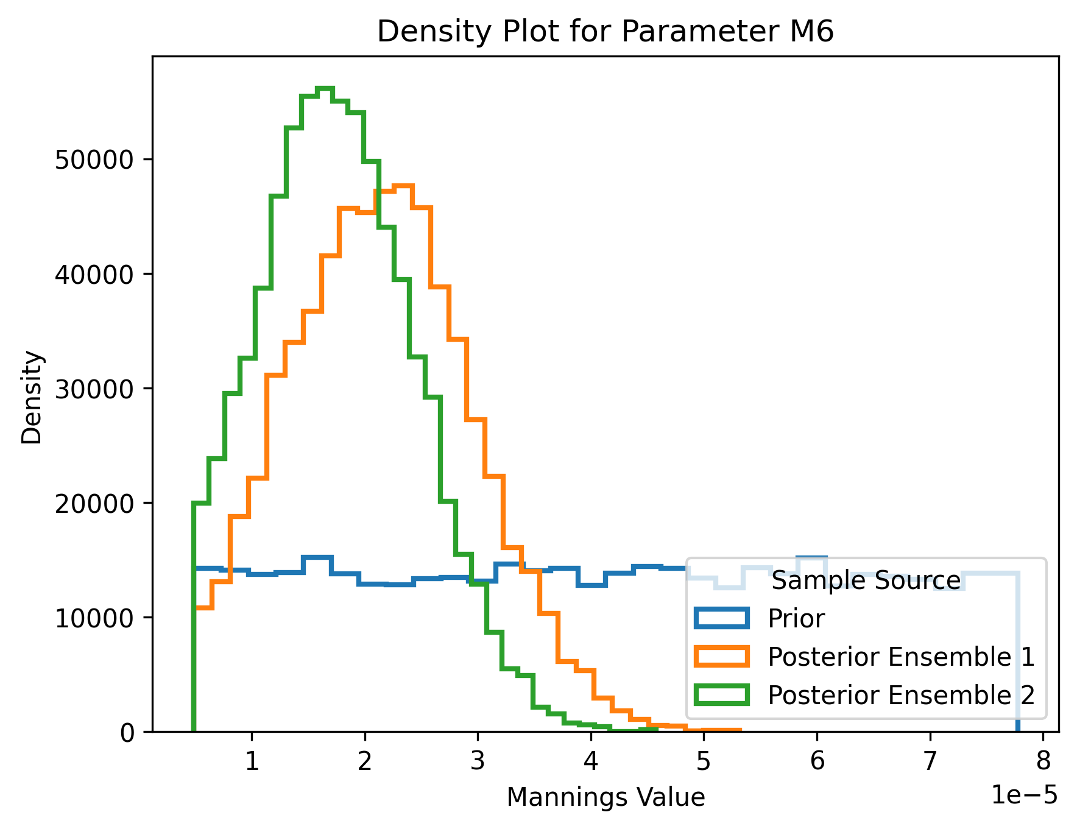
M6: Posterior Distribution
Notes:
Sampling 400 simulations
Posterior distribution that is presented is from the first iteration

Slide 33
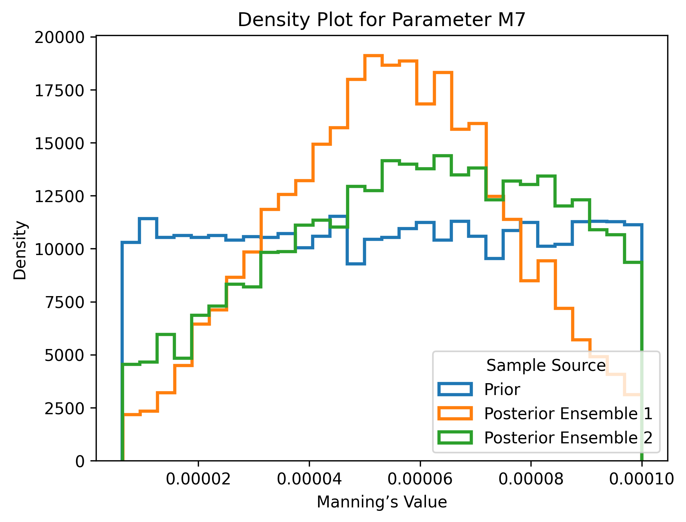
M7: Posterior Distribution
Notes:
Sampling 400 simulations
Posterior distribution that is presented is from the first iteration

Slide 34
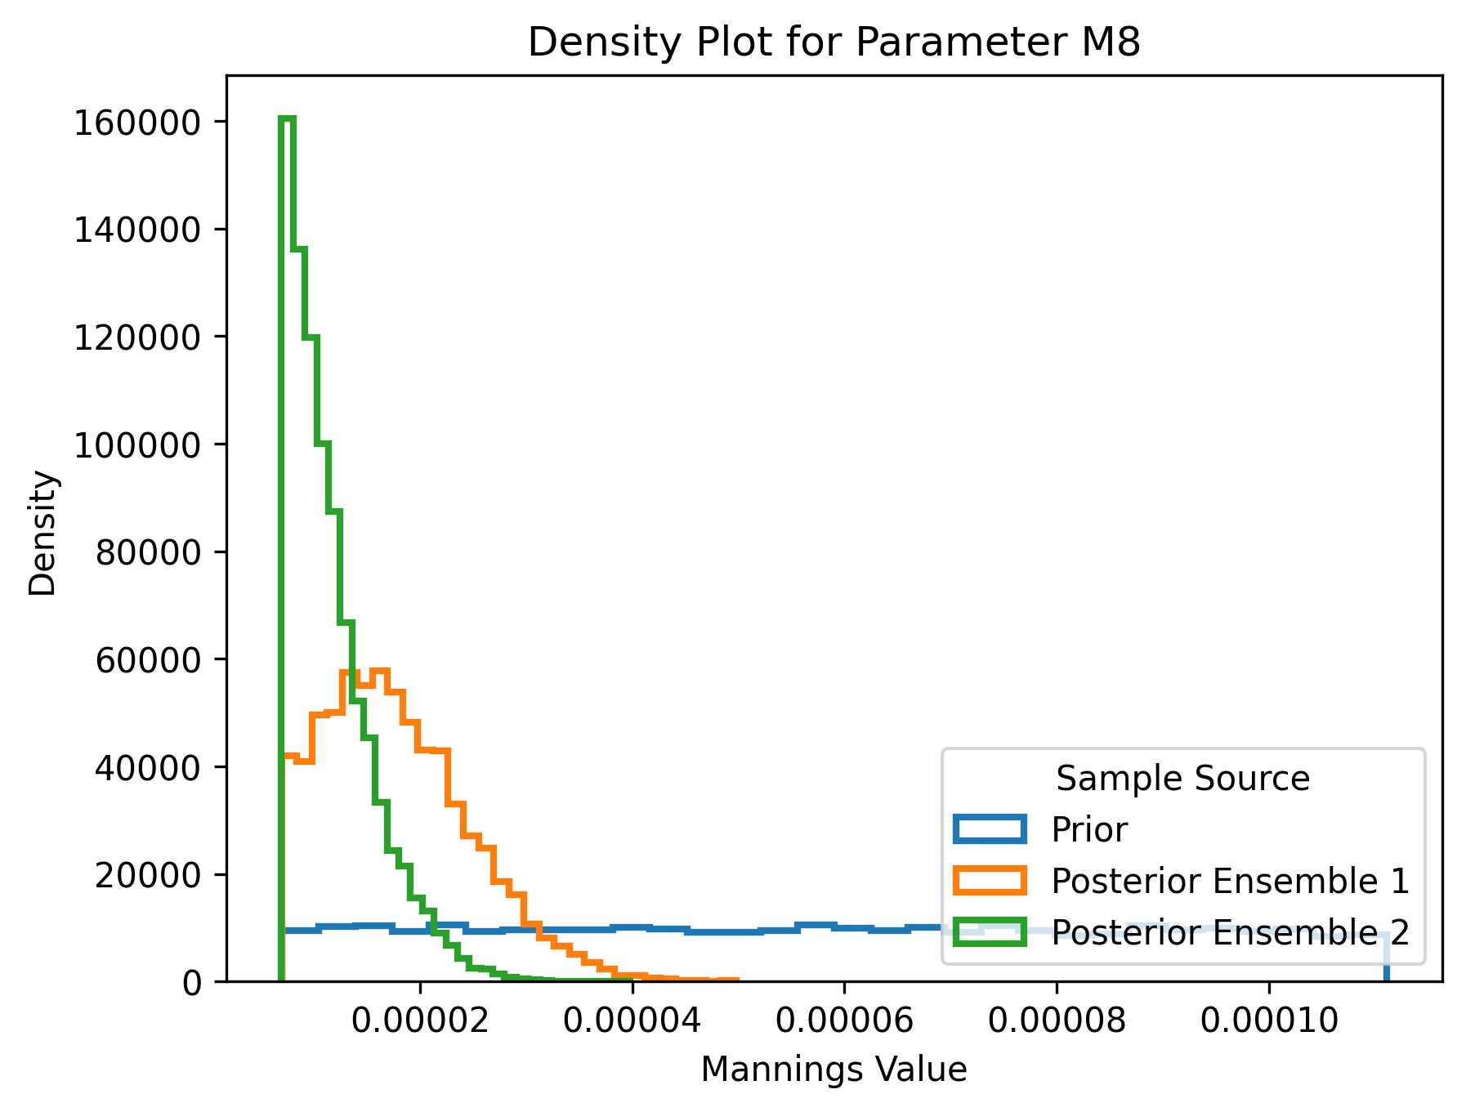
M8: Posterior Distribution
Notes:
Sampling 400 simulations
Posterior distribution that is presented is from the first iteration

Slide 35
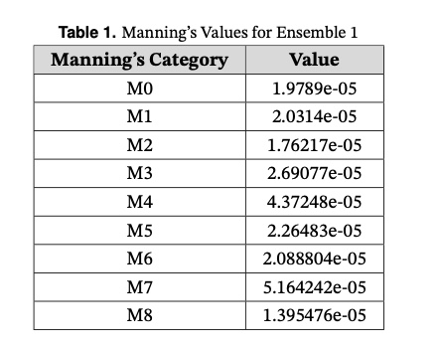
Ensemble 1: Manning’s values with the highest density estimation

Slide 36
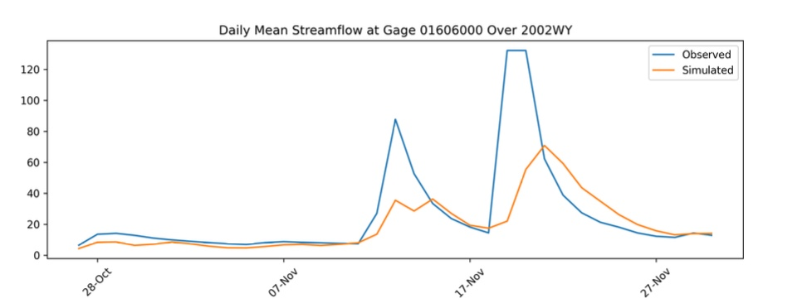
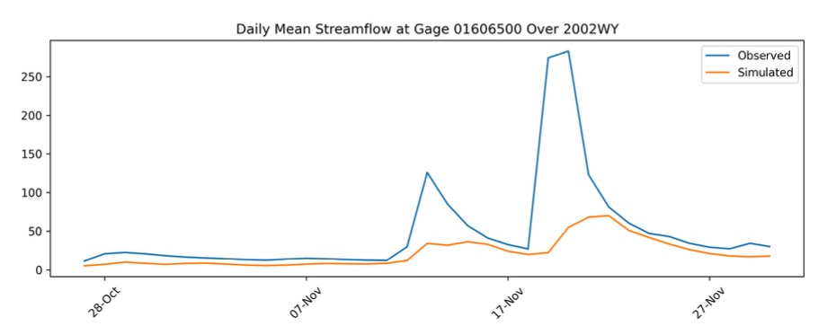
Hydrograph Ensemble 1

Slide 37
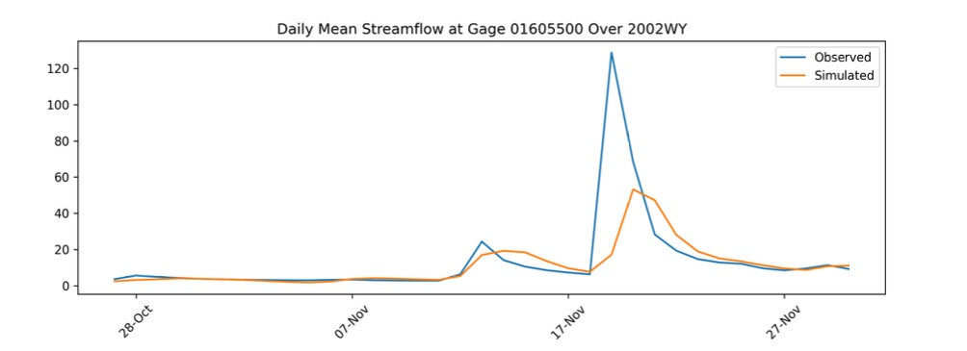
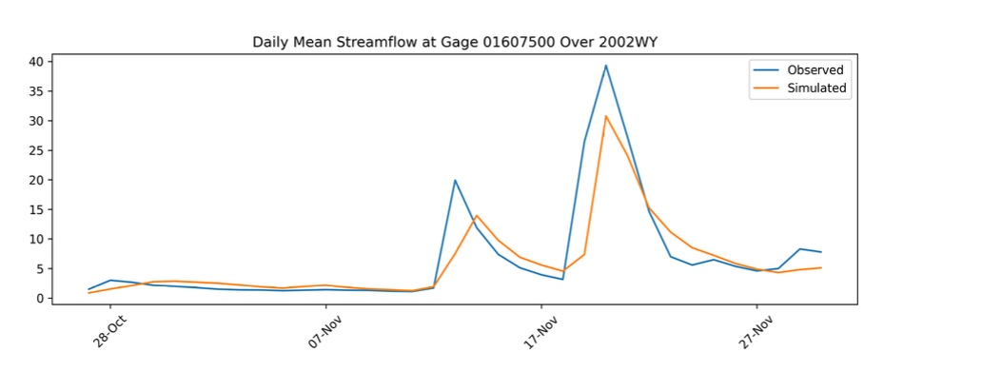
Hydrograph Ensemble 1

Slide 38
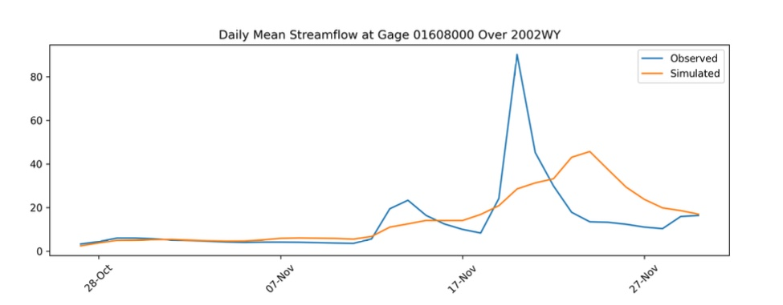
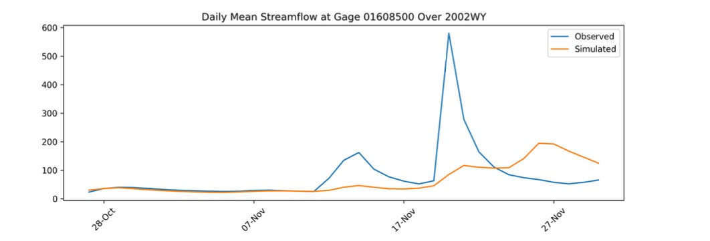
Hydrograph Ensemble 1

Slide 39
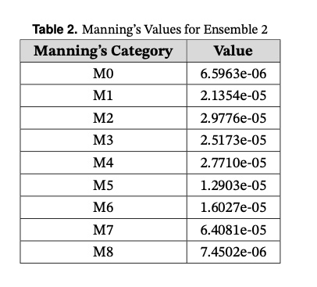
Ensemble 2: Manning’s values with the highest density estimation

Slide 40
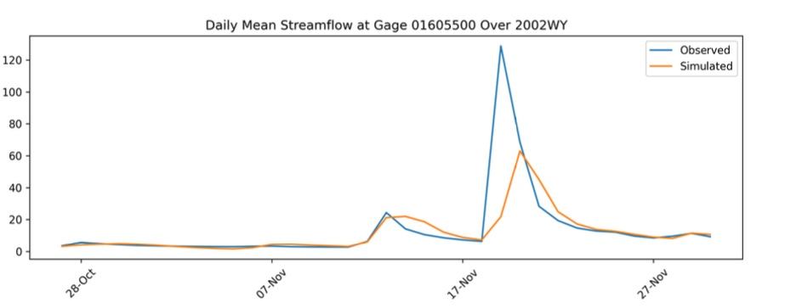
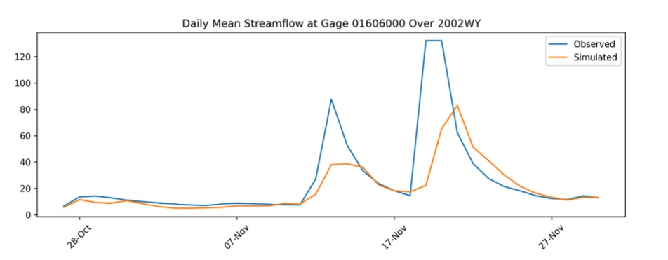
Hydrograph Ensemble 2

Slide 41
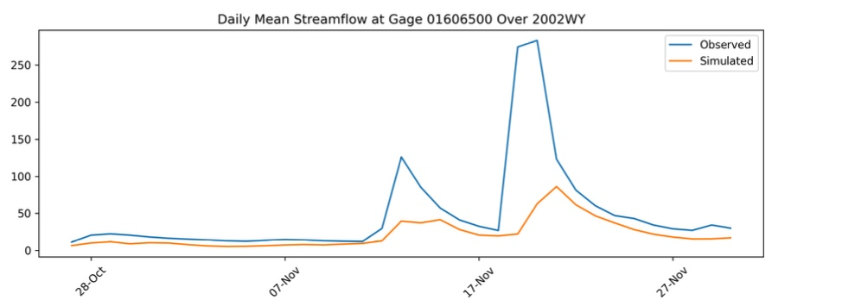
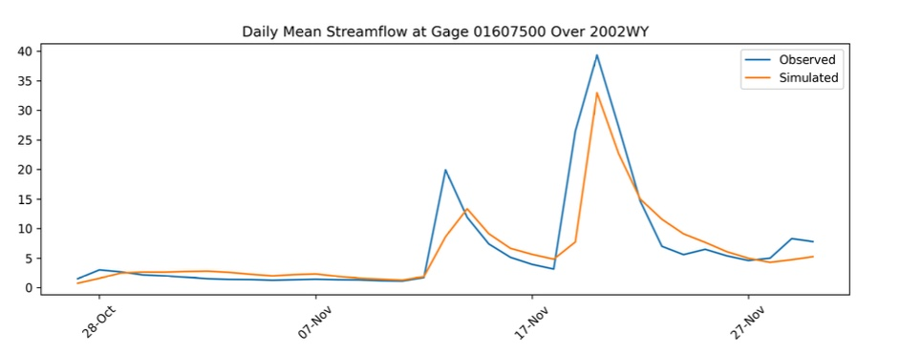
Hydrograph Ensemble 2

Slide 42
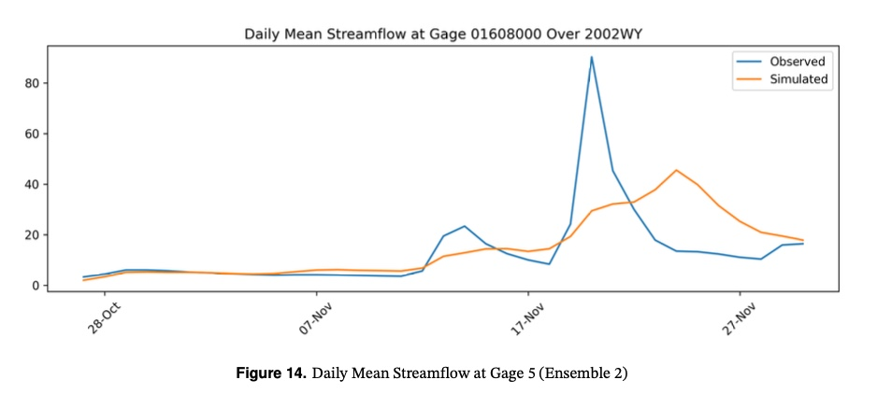
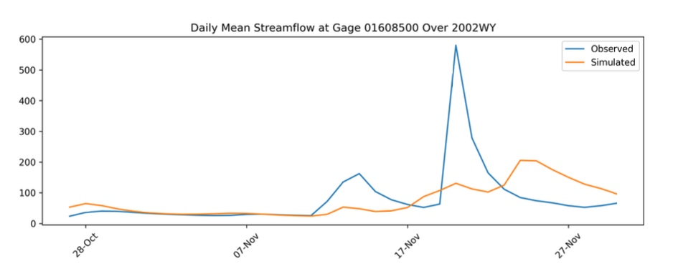
Hydrograph Ensemble 2

Slide 43
Objective
Plotting Noise Distribution for the first ensemble as well as for the second ensemble after calibrating the prior distribution

Slide 44
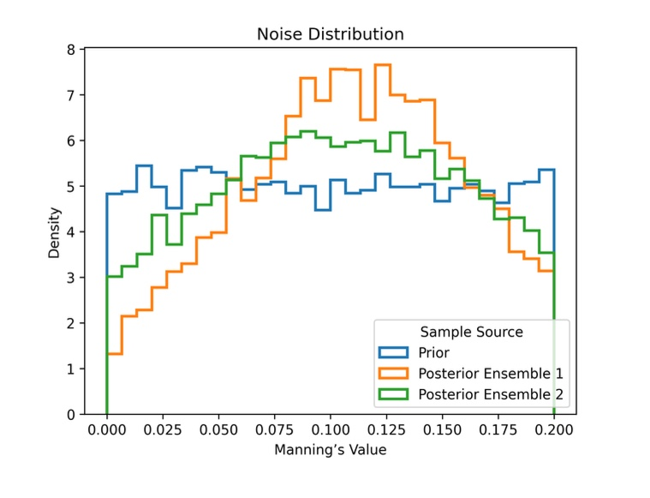
Noise Distribution

