Slide 1


NTI • SUMMER TRAINING
DATA ANALYSIS
PROJECT
From Raw Data to Business Insights
SQL • SSIS • Data Warehouse • Power BI
Project Presentation | 2026

Slide 2









Our Project Team
Omar
Yousef
Ahmed
Abdelrahman
Mohammed

Slide 3
Project Overview
• Project objective and business requirements
• SQL Server: staging, ODS, and data warehouse
• SSIS: ETL, transformation, and data loading
• Dimensional modeling and Star Schema
• Power BI: DAX, KPIs, visualizations, and dashboards
2

Slide 4
1. Business Objective
• Analyze Superstore sales data to understand business performance.
• Transform raw transactional data into a reliable analytical model.
• Build a Data Warehouse optimized for reporting and analysis.
• Create interactive Power BI dashboards for decision support.
• Answer measurable business questions using KPIs and visual analysis.
3

Slide 5
2. Data Collection
• Source: Superstore Sales Dataset (Kaggle).
• Raw data was reviewed to understand columns, data types, missing values, and duplicates.
• Sales and order-related fields were selected as the foundation for analytical modeling.
4

Slide 6
3. End-to-End Data Pipeline
SSIS
STG/DWH
Power BI Dashboard
Kaggle Dataset
→
SQL Server ODS
→
→
Cleaned &
Modeled Data
→
A complete pipeline from raw data ingestion to business intelligence.
5

Slide 7
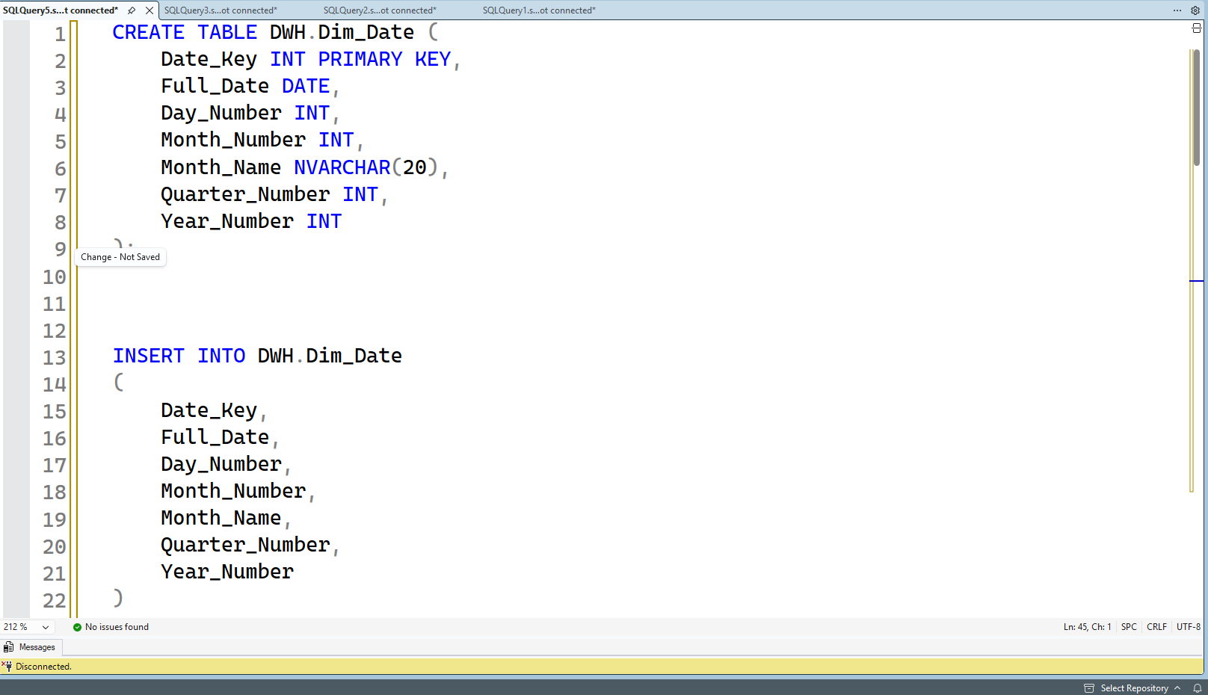
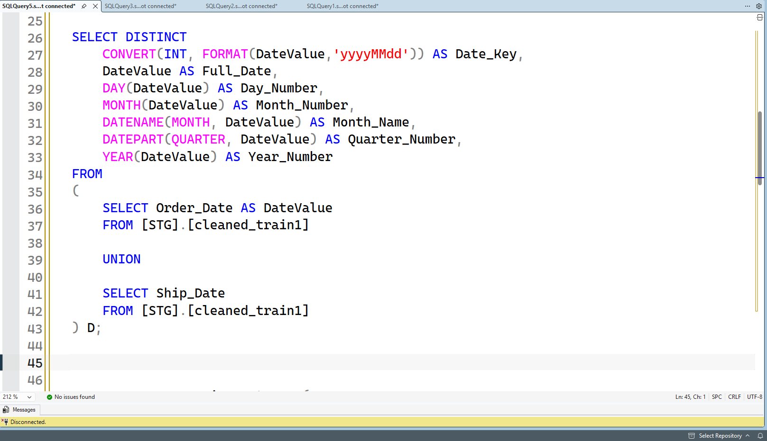
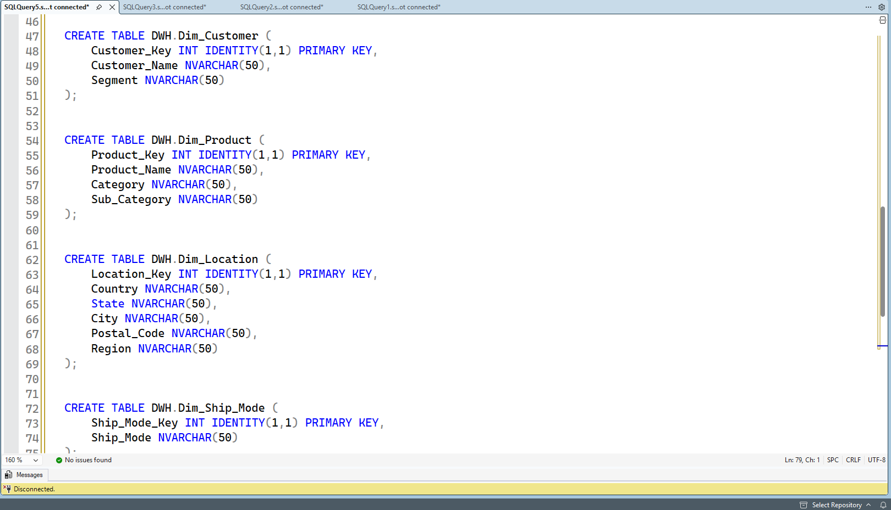
4. SQL Server – Data Preparation
• SQL Server was used as the central platform for data storage.
• ODS (Operational Data Store) stores incoming/raw data before transformation.
• STG (Staging) provides a cleaner and more structured layer.
• DWH (Data Warehouse) stores the final analytical model.
• SQL DDL was used to create schemas, tables and keys.
6

Slide 8
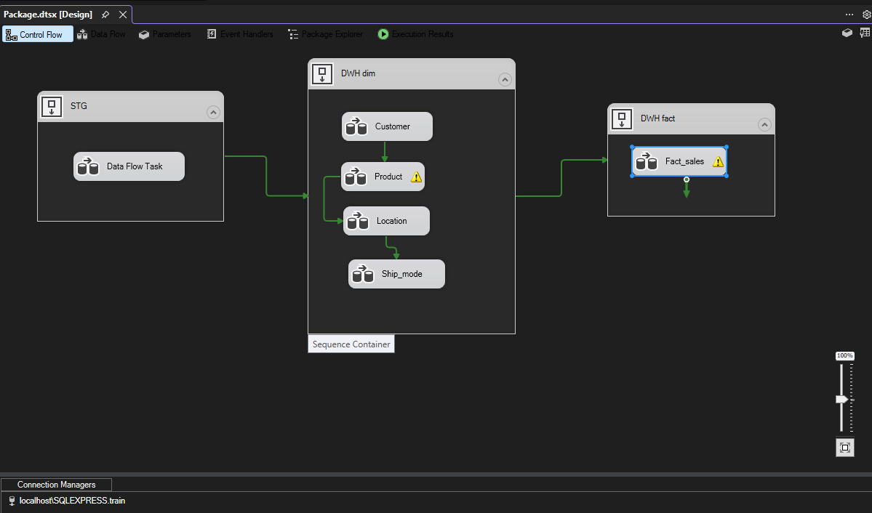
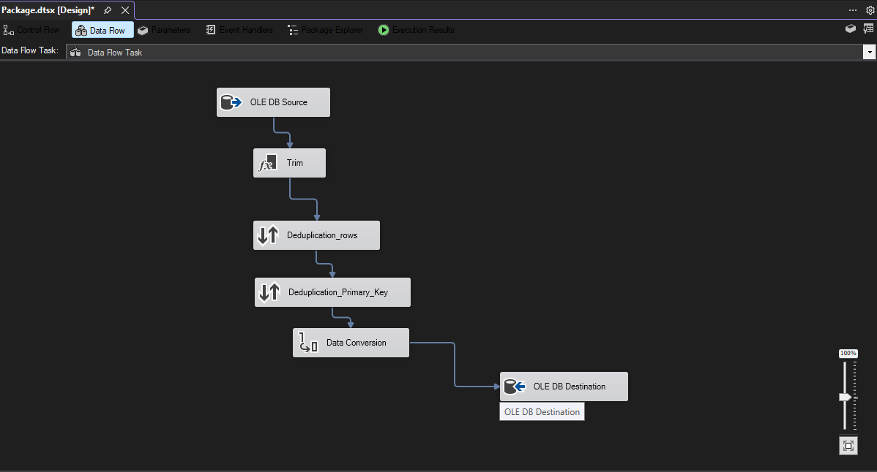
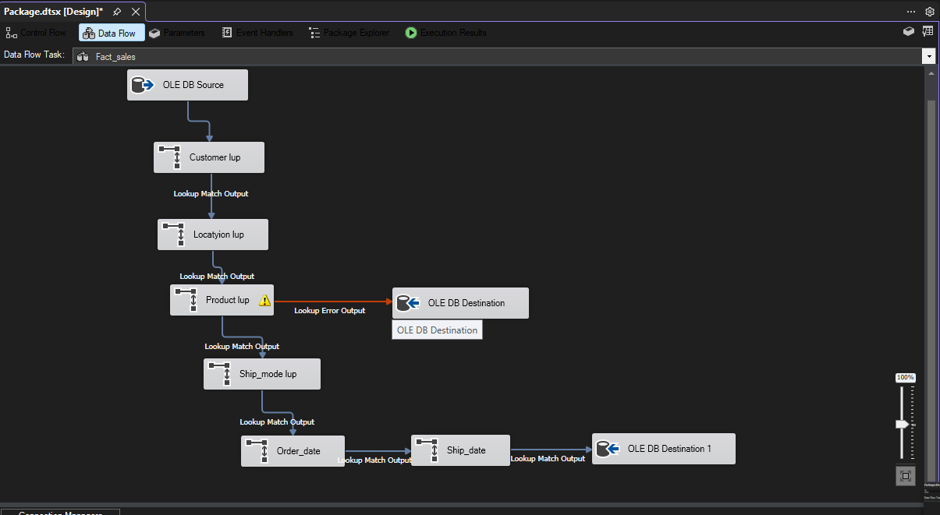
5. SSIS – ETL Process
• SSIS was used to automate the Extract, Transform, and Load process.
• Extract: read data from the source/ODS layer.
• Transform: clean, convert, validate, and map data into the target structure.
• Load: populate STG/DWH tables while preserving data quality and consistency.
7

Slide 9
6. Why a Data Warehouse?
• Separates analytical workloads from operational/raw data.
• Integrates cleaned and transformed data into a consistent structure.
• Improves reporting performance and makes historical analysis easier.
• Provides a single source of truth for Power BI and business reporting.
Separation of concerns (SoC) is a core software design principle that divides a computer programinto distinct sections, such that each section addresses a separate responsibility or feature.
8

Slide 10
7. Dimensional Modeling – Star Schema
Dim_Customer
Dim_Product
Fact_Sales Central Fact Table
Dim_Location
Dim_Date
Dim_Ship_Mode
One-to-many relationships enable efficient slicing, filtering, and aggregation.
9

Slide 11
8. Key Performance Indicators
Total Sales
Total Orders
Transactions
$2,261,536.78
4,922
9,800
These KPIs provide the high-level snapshot used throughout the dashboard.
10

Slide 12
9. Power BI & DAX
• Power BI connects to the final analytical model in the Data Warehouse.
• DAX measures calculate KPIs and support dynamic analysis.
• Filters and slicers allow users to explore performance by different dimensions.
• The dashboard combines cards, charts, maps, treemaps, and other visuals.
11

Slide 13
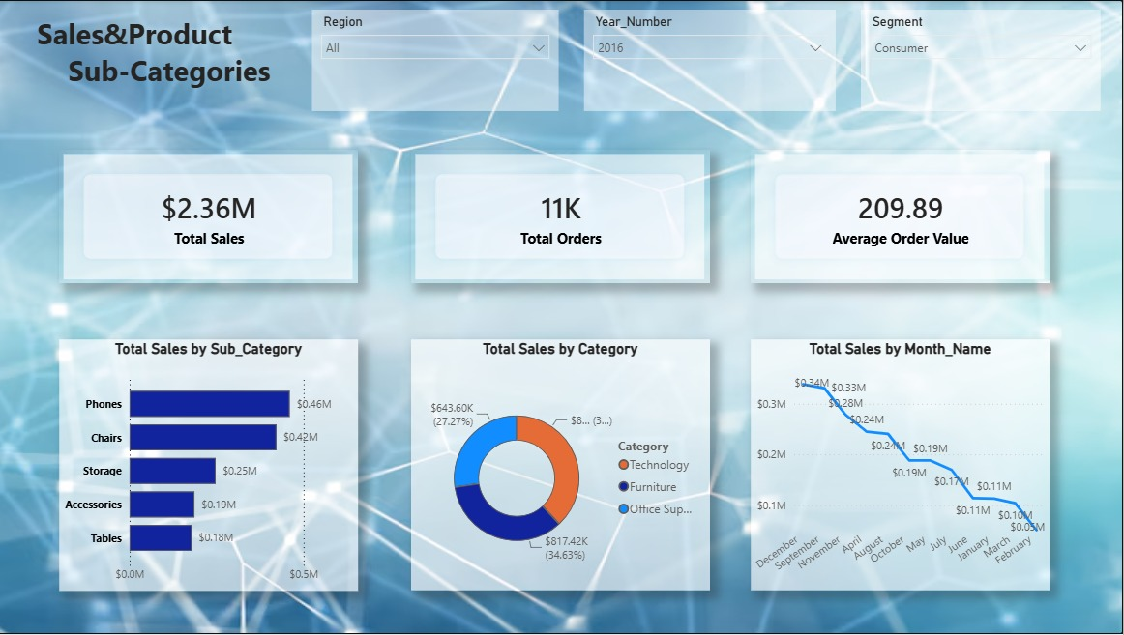
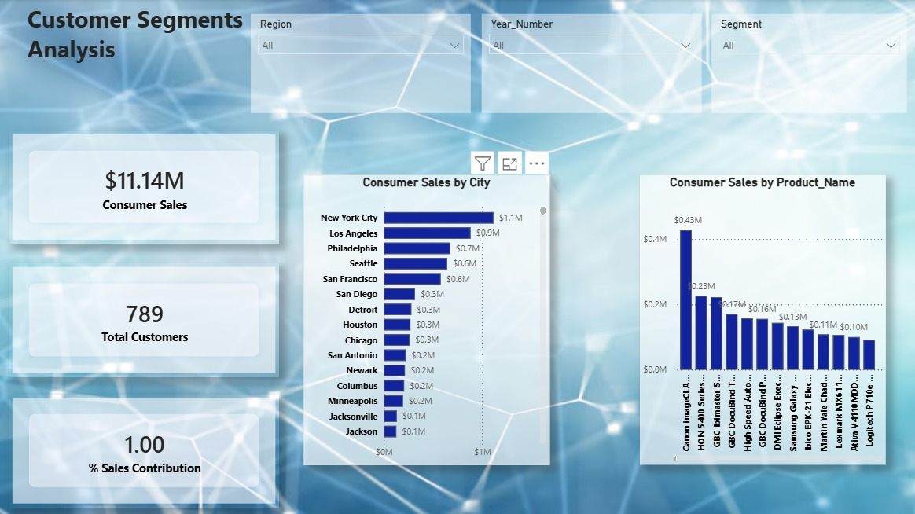
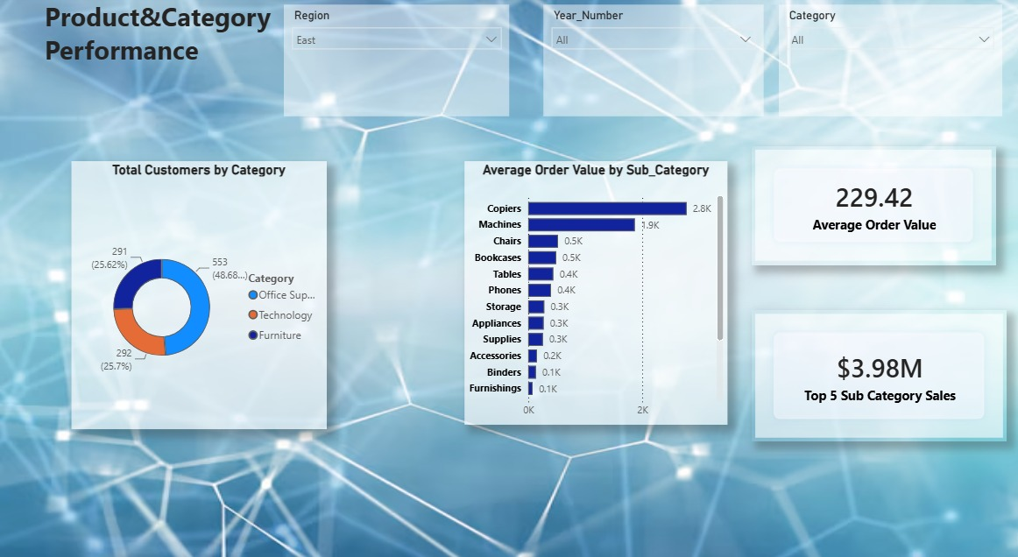
10. Power BI Dashboard
Replace the placeholders with your final Power BI dashboard screenshots.
12

Slide 14
11. Conclusion
• The project demonstrates a complete Data Analytics and BI workflow.
• Raw data was transformed into a structured Data Warehouse through ETL.
• Star Schema modeling made the data easier and faster to analyze.
• Power BI converted the analytical model into interactive business dashboards.
• The final solution supports data-driven decision making.
14

Slide 15
THANK YOU
Questions & Discussion
NTI Final Project • Data Analysis & Business Intelligence
15

