Slide 1

LiFi
2018920008 컴퓨터과학부 김민서

Slide 2


LiFi의 개념
LiFi(Light Fidelity): LED에서 나오는 빛의 파장을 이용하여 정보를 전달하는 가시광 통신 기술의 보조 방식

Slide 3
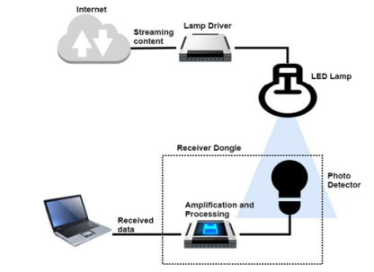
Basic Concept Diagram LiFi
LED Lamp
- Data transmission unit
Photo Detector
- Data receiver
Lamp Driver
- Device for Lamp
Amplification and Processing
- Responsible to manage the signal that comes from photo detector

Slide 4
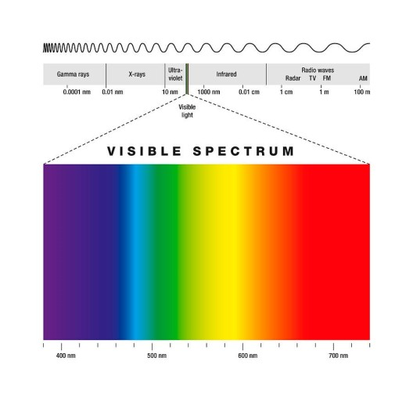
Basic Concept Diagram LiFi
Rate of LiFi
- 14Gbps(RGB diodes)
Max 100Gbps(visible spectrum)

Slide 5
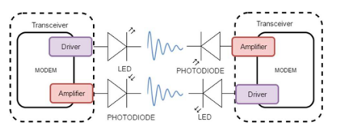
Transceiver LiFi based on VLC
Analog
Analog
Digital
Digital
Analog
Analog
VLC: low data rate, unidirectional, point-to-point communication
vs
LiFi: high-speed wireless, fully networked, bidirectional

Slide 6
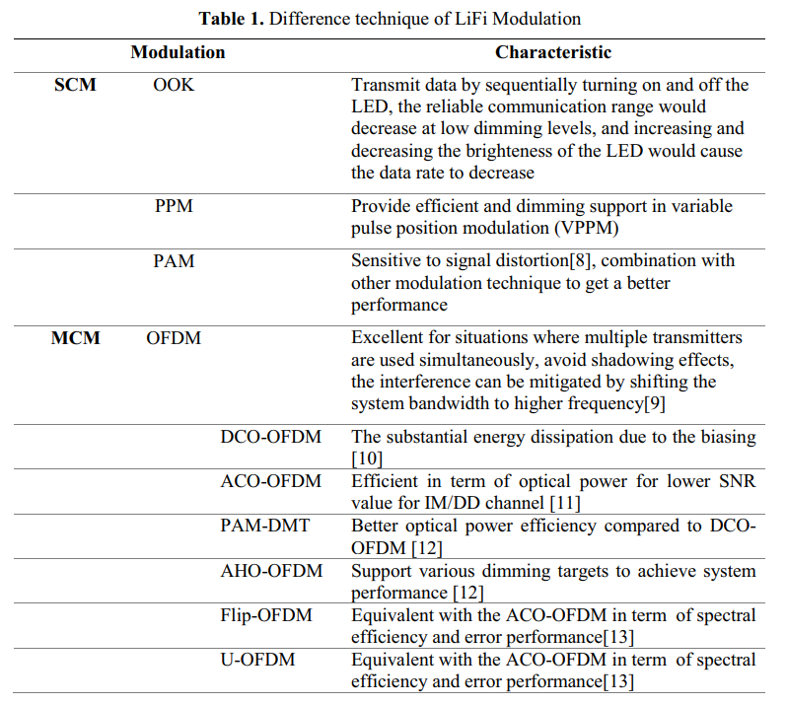
Transceiver LiFi based on VLC
Single Carrier Modulation(SCM)
: using microwave as an optical carrier
On-Off Keying
Pulse-Position Modulation
Pulse-Amplitude Modulation
Multiple Carrier Modulation
: supplement SCM’s disadvantages
- require complex equalization
- performance degrees as efficiency increase

Slide 7
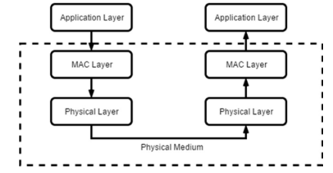
The architecture of LiFi
IEEE 802.15.7

Slide 8
The architecture of LiFi
IEEE 802.15.7
Peer to peer
Star
Broadcast

Slide 9
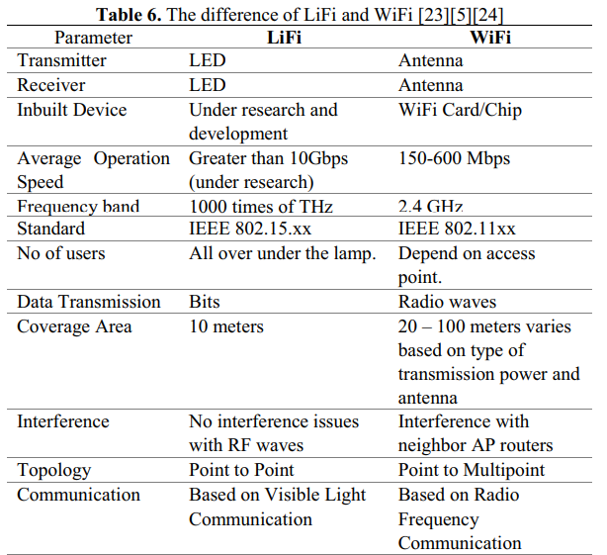
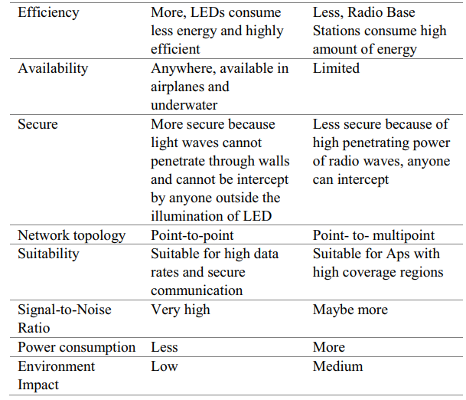
The architecture of LiFi

