Slide 1


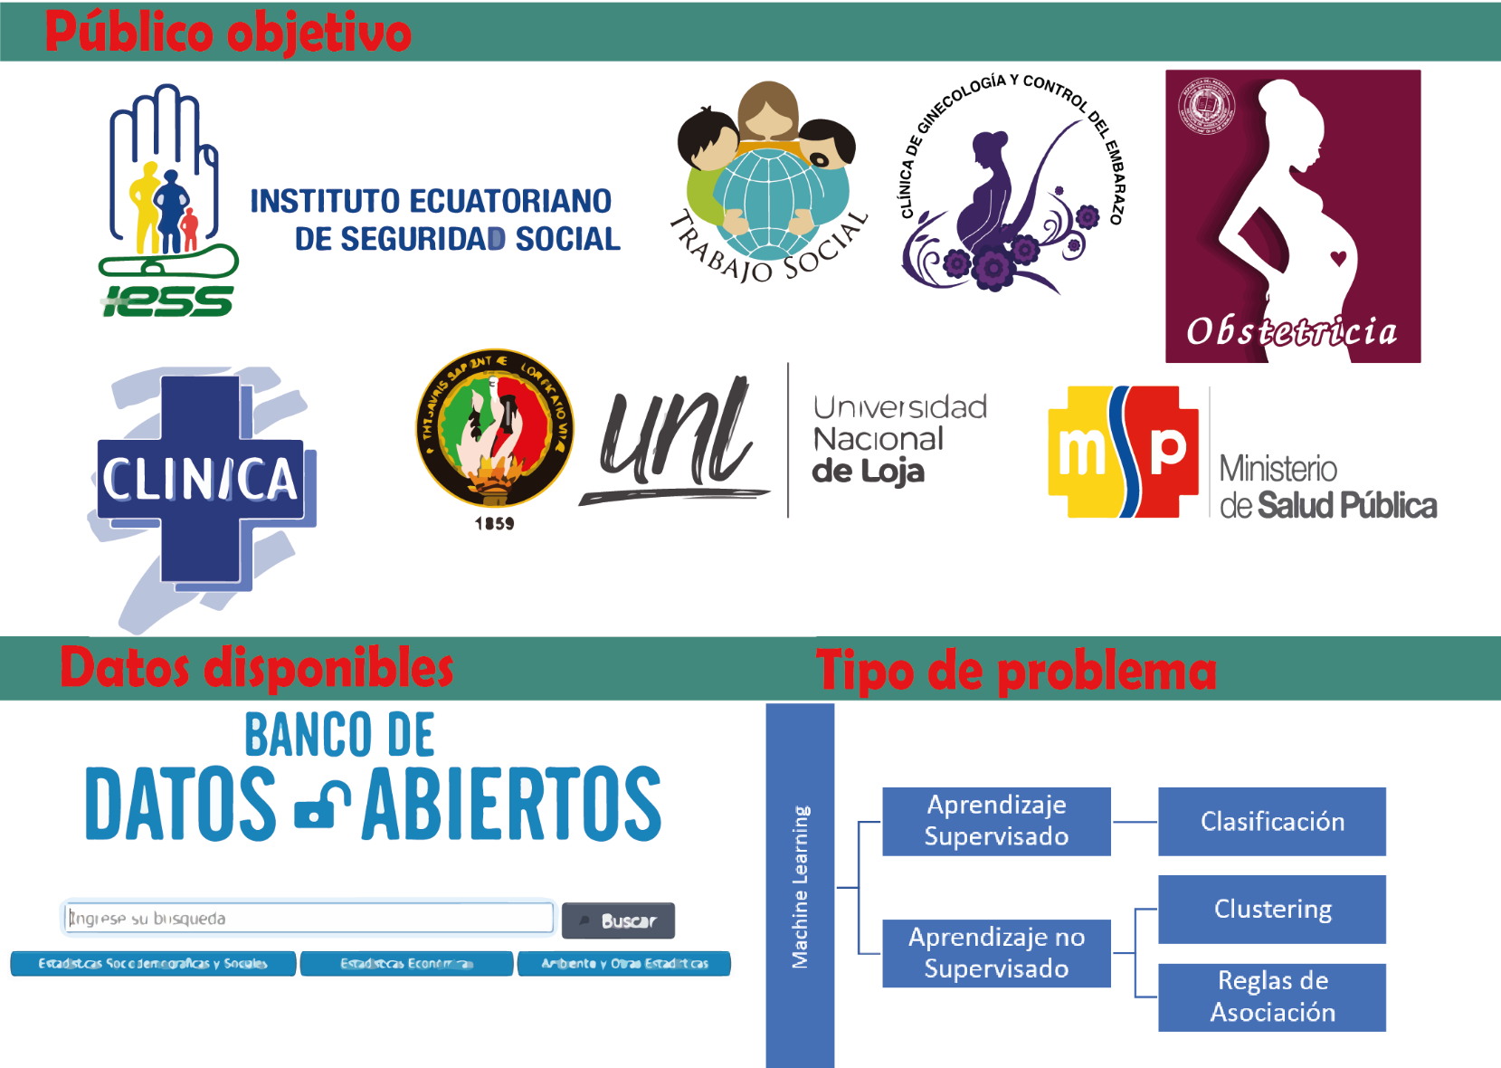
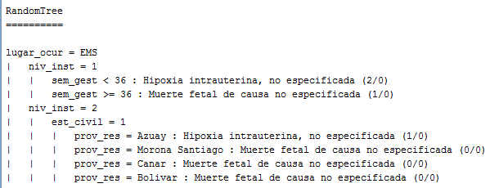
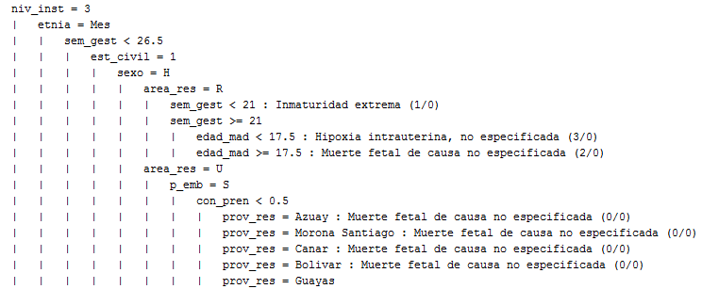
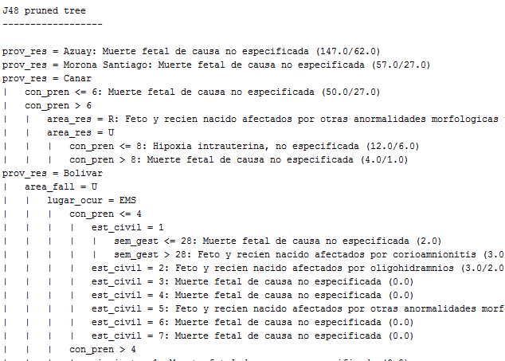
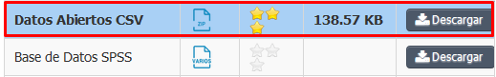


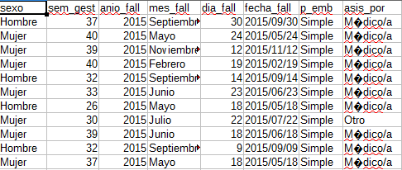



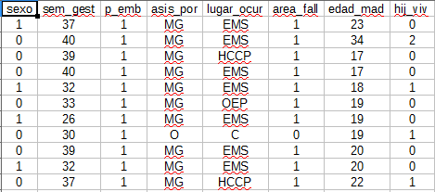
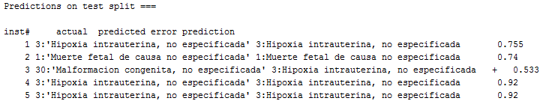
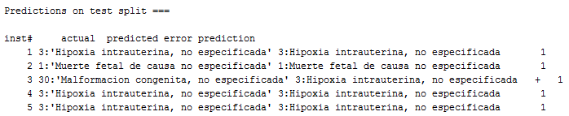

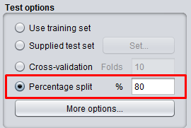
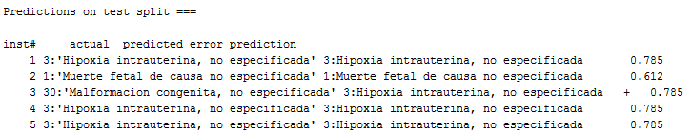
Supervised and unsupervised machine learning: case study "fetal deaths" using the open database of the "INEC - Ecuador".
Facultad de Energía, Carrera de Ingeniería en Sistemas
Steeven Armijos-Bravo
Abstract
In the present project, three Supervised Learning (Classification) algorithms were applied: RandomTree, RandomForest, J48, in order to predict the main cause of fetal deaths in the year 2020: Clustering (SimpleKMeans), to group the most likely disease causing fetal deaths according to common characteristics, and Association Rules (Apriori) to obtain dataset-based rules to aid in decision making, for example in medical diagnostics. This involved a process of problem definition, data collection (obtained from the INEC Open Data Bank, .csv files were downloaded for the years 2015-2018), data preparation (deletion of check marks, special characters, outliers), data division (80% for training and 20% for testing), training (the 3 classification algorithms mentioned above were trained) and model validation (data were collected in a table with the predictive accuracy of each classification algorithm). Finally, it was obtained that the main cause of fetal deaths is caused by the disease: intrauterine hypoxia, unspecified.
1. Problem
5. Training a model
What is the main cause of fetal deaths in the year 2020?
2. Data collection
http://aplicaciones3.ecuadorencifras.gob.ec/BIINEC-war/index.xhtml
Clustering: SimpleKMeans
Modelo | Características | Full Data (5298) | Clúster 0 (2845) | Clúster 1 (1098) | Clúster 2 (472) | Clúster 3 (883)
SimpleKMeans | sexo | H | H | M | M | H
 | p_emb | S | S | S | S | S
 | asis_por | MG | MG | MG | MG | MG
 | lugar_ocurr | EMS | EMS | EMS | EJB | EMS
 | area_fall | U | U | U | U | U
 | etnia | Mes | Mes | Mes | Mes | Mes
 | est_civil | 5 | 5 | 1 | 5 | 1
 | niv_inst | 12 | 12 | 12 | 12 | 13
 | prov_res | Guayas | Guayas | Guayas | Guayas | Pichincha
 | area_res | U | U | U | U | U
 | causa_fetal | Hipoxia intrauterina, no especificada | Hipoxia intrauterina, no especificada | Hipoxia intrauterina, no especificada | Hipoxia intrauterina, no especificada | Muerte fetal, no especificada
3. Data Preparation
Después
Reglas de Asociación: Apriori
Instancias: 5298
Atributos: 11
Instancias mínimas soportadas (2384)
Mejores reglas encontradas: 100
1. area_res=U causa_fetal=Hipoxia intrauterina, no especificada 2417 ==> area_fall=U 2405 <conf:(1)>
2. asis_por=MG causa_fetal=Hipoxia intrauterina, no especificada 2524 ==> area_fall=U 2503 <conf:(0.99)>
3. causa_fetal=Hipoxia intrauterina, no especificada 2648 ==> area_fall=U 2621 <conf:(0.99)>
4. sexo=H p_emb=S area_res=U 2411 ==> area_fall=U 2386 <conf:(0.99)>
5. sexo=H area_res=U 2578 ==> area_fall=U 2550 <conf:(0.99)>
6. p_emb=S etnia=Mes area_res=U 3863 ==> area_fall=U 3821 <conf:(0.99)>
7. p_emb=S asis_por=MG area_res=U 3940 ==> area_fall=U 3897 <conf:(0.99)>
8. p_emb=S causa_fetal=Hipoxia intrauterina, no especificada 2473 ==> area_fall=U 2446 <conf:(0.99)>
9. asis_por=MG area_res=U 4232 ==> area_fall=U 4185 <conf:(0.99)>
10. p_emb=S asis_por=MG etnia=Mes area_res=U 3596 ==> area_fall=U 3556 <conf:(0.99)>
Antes
6. Model validation
 | Instancias = 1060: 80% de entrenamiento y 20% test
 | RandomForest |  | RandomTree |  | J48
 | Correctos | Incorrectos | Correctos | Incorrectos | Correctos | Incorrectos
 | 563 | 497 | 461 | 599 | 539 | 521
Precisión | 53.11% | 46.89% | 43.49% | 56.51% | 50.85% | 49.15%
RandomForest
RandomTree
4. Data splitting
J48
Artificial Intelligence (2019-2020)
“Noveno ciclo”
smarmijosb@unl.edu.ec
https://github.com/ms96Armijos/Proyecto_IA

