Slide 1
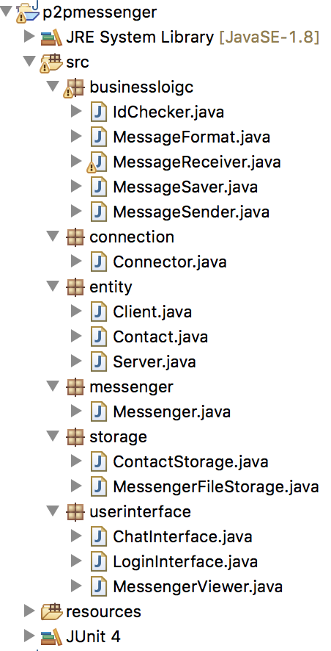
Requirement
Socket Communication
File Handler
Peer to Peer
Distributing Roles of Class & Method
Simultaneous Chat
Addition Feature
Object Transmission
Check Connection
Show Friend List
Show Connected User
Block Unknown User
Modify Contact
Time Format

Slide 2
<<messenger>>
Messenger
<<userinterface>>
MessengerViewer
<<userinterface>>
LoginInterface
<<storage>>
ContactStorage
<<entity>>
Contact
<<businesslogic>>
IdChecker
<<userinterface>>
ChatInterface
loadContactFile()
:PlayerDatabase
setContacts()
:Contact
check()
:IdChecker
ContactDB
<<entity>>
Server
<<connection>>
Connector
<<entity>>
Client
<<businesslogic>>
MessegeReceiver
<<businesslogic>>
MessegeSender

Slide 3
Problem
Handle of server thread is difficult
Problems with stream reuse
Inside connector, connection retry to remote client’s socket is difficult
Don’t know how to easily debug
Solution
Study of server thread handle
Use of parallel streams
Restructuring of connector
Study of how to debug

