Slide 1
javastory
File
Edit
window
Help
new
open
save
close
search
modify
delete
cancle
minimum
fullscreen
support
TravelClubView
§Club
• TravelClubView
• MemberView
•ClubMembershipView
• BoardView
•PostingView
§Buget
• TravelView
• CashBookView
• AccountYearlyDueView
Search
New

Slide 2
javastory
TravelClub
Member
ClubMembership
Board
Posting
Search Area
Search
New
Console Area
TravelClubView
• Name :
• Info :
Register
Modify
Delete
Cancle

Slide 3
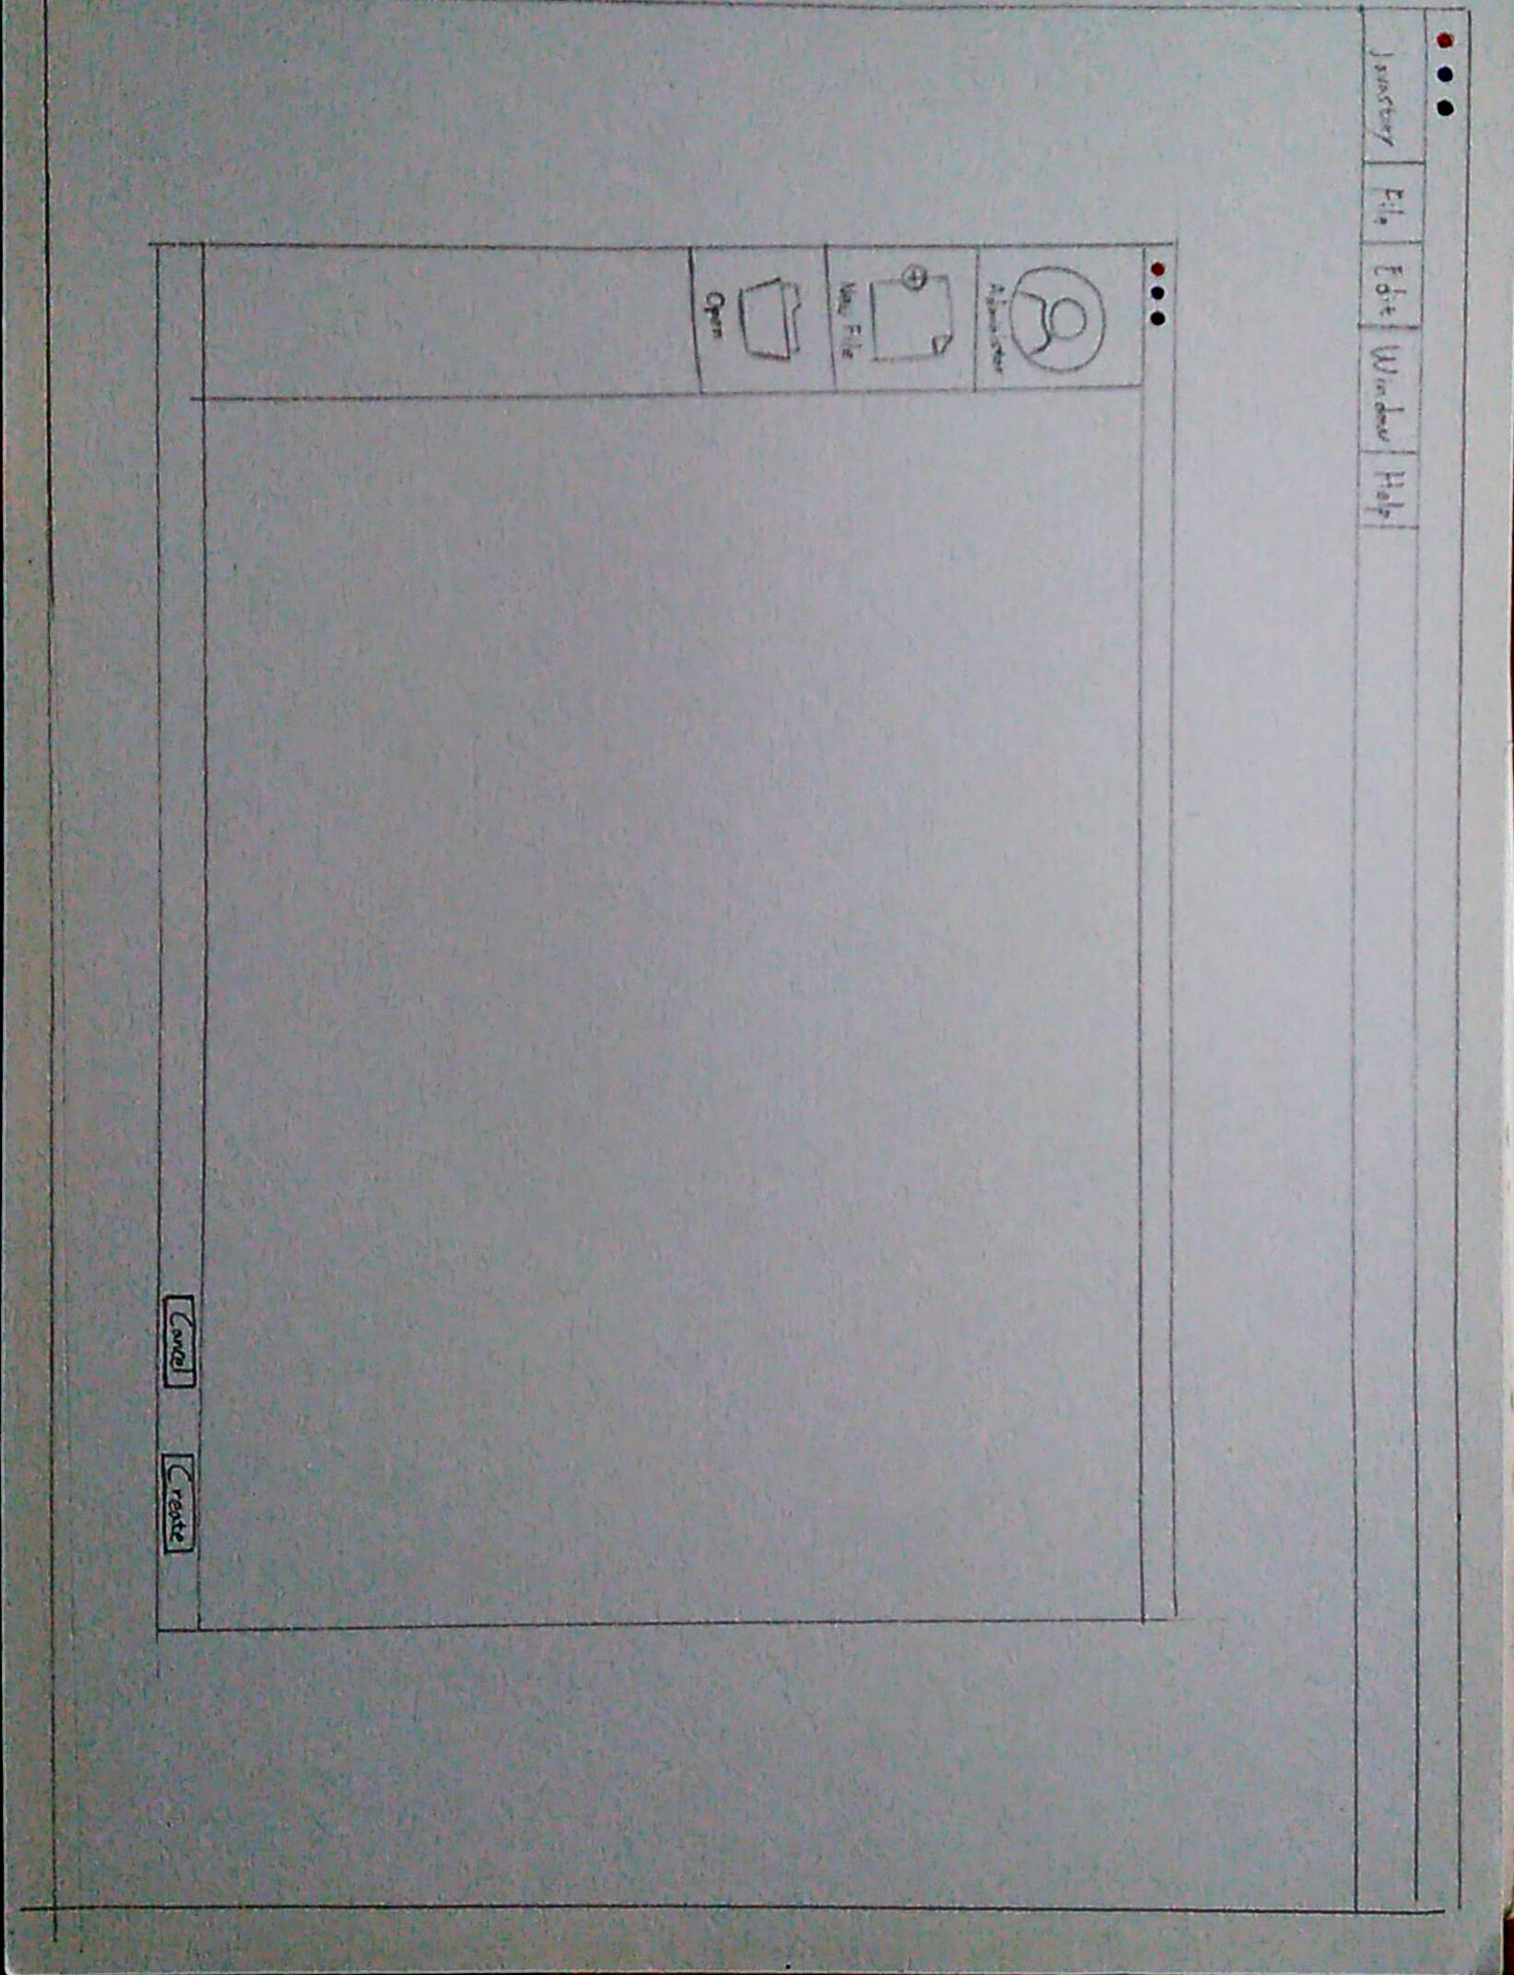

Slide 4
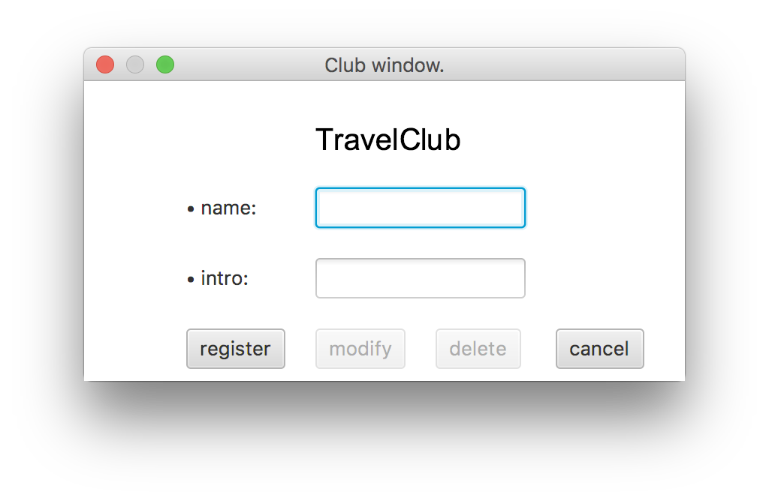
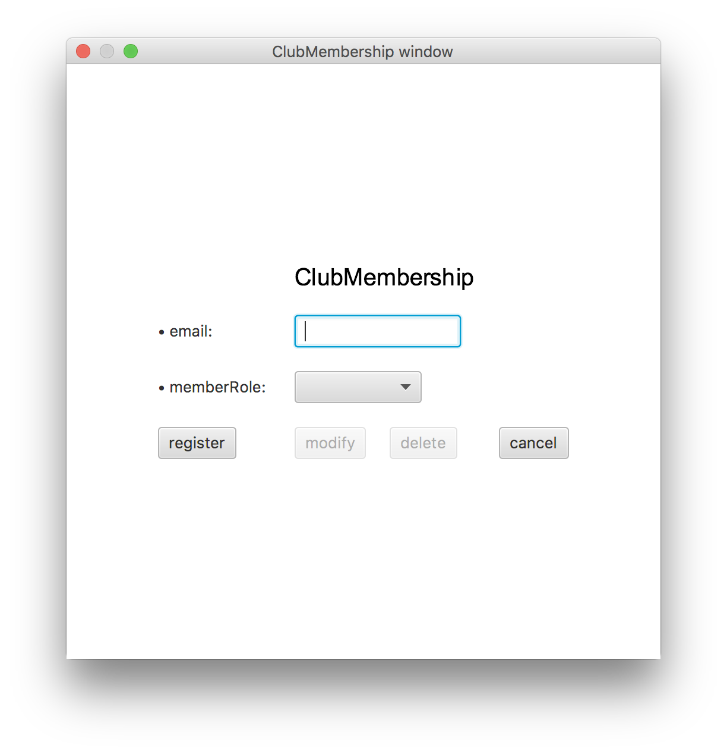
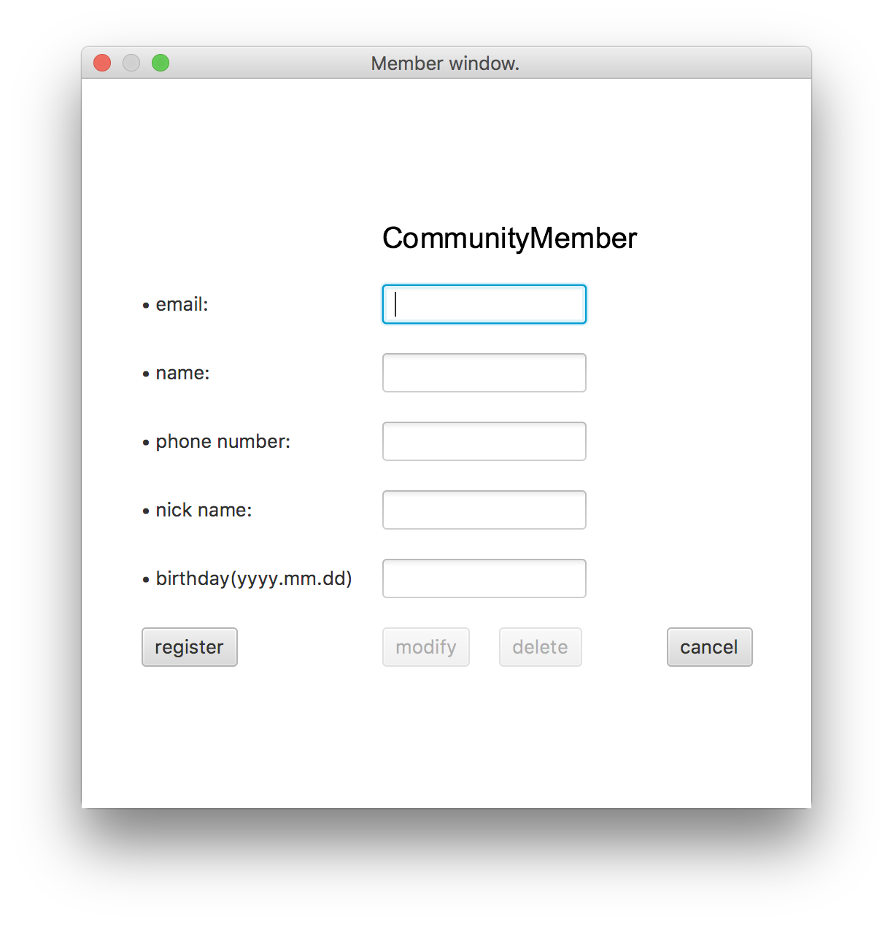
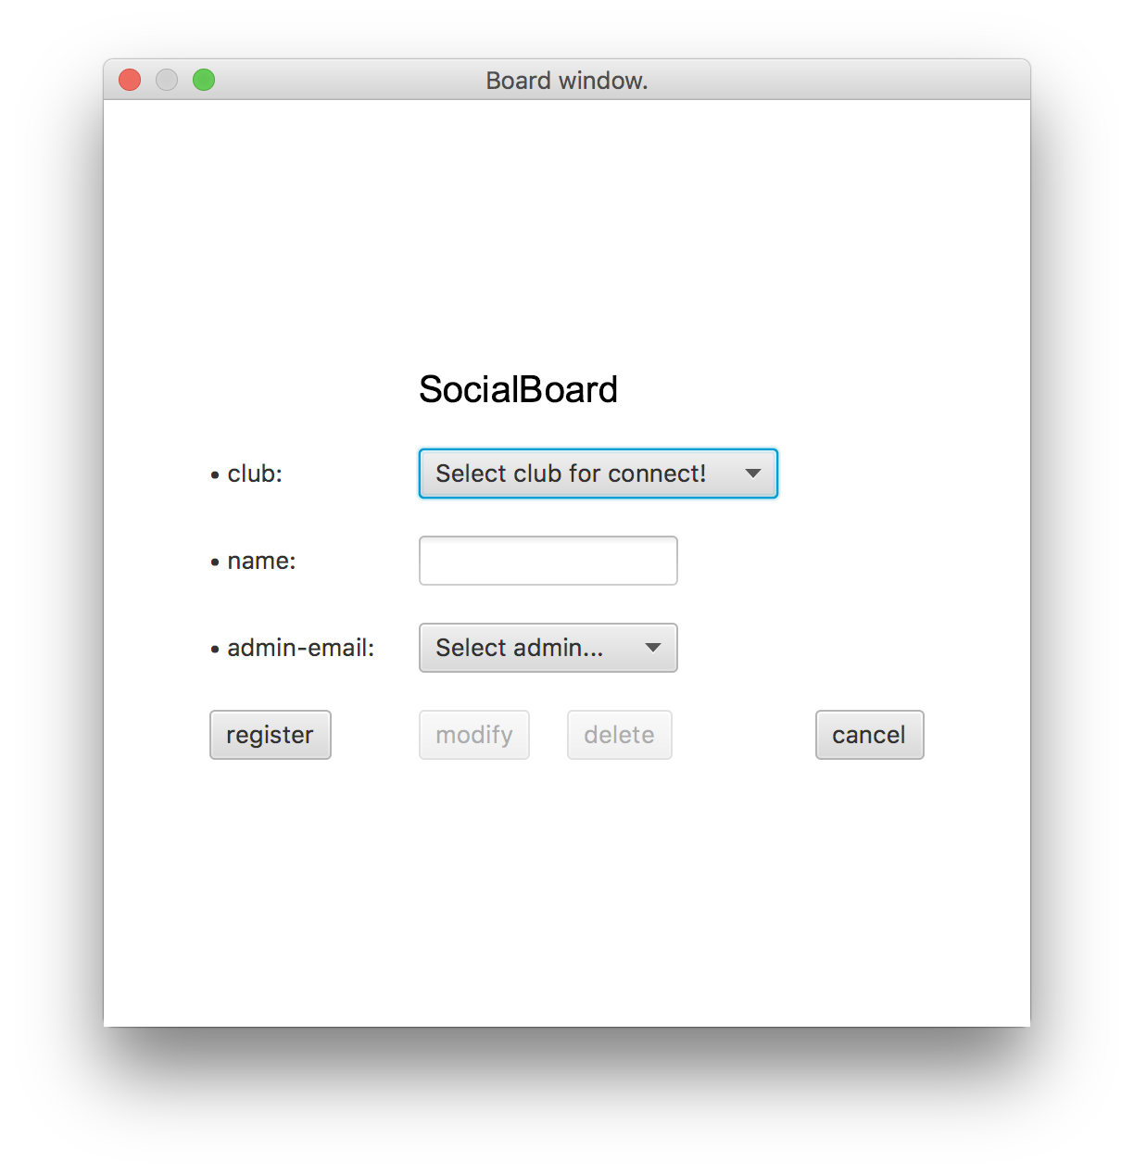
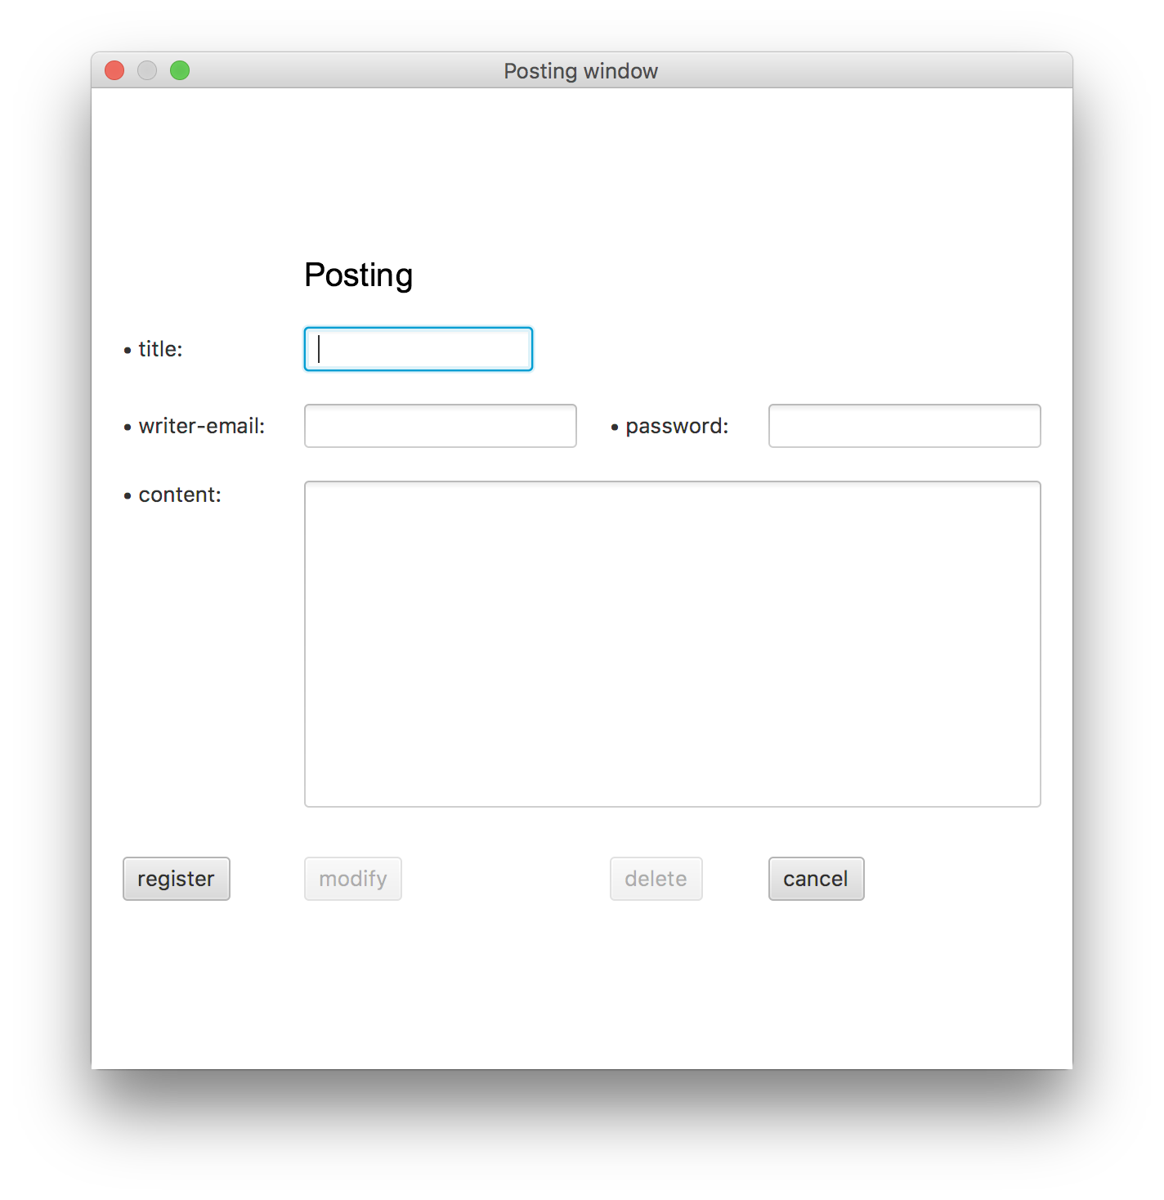
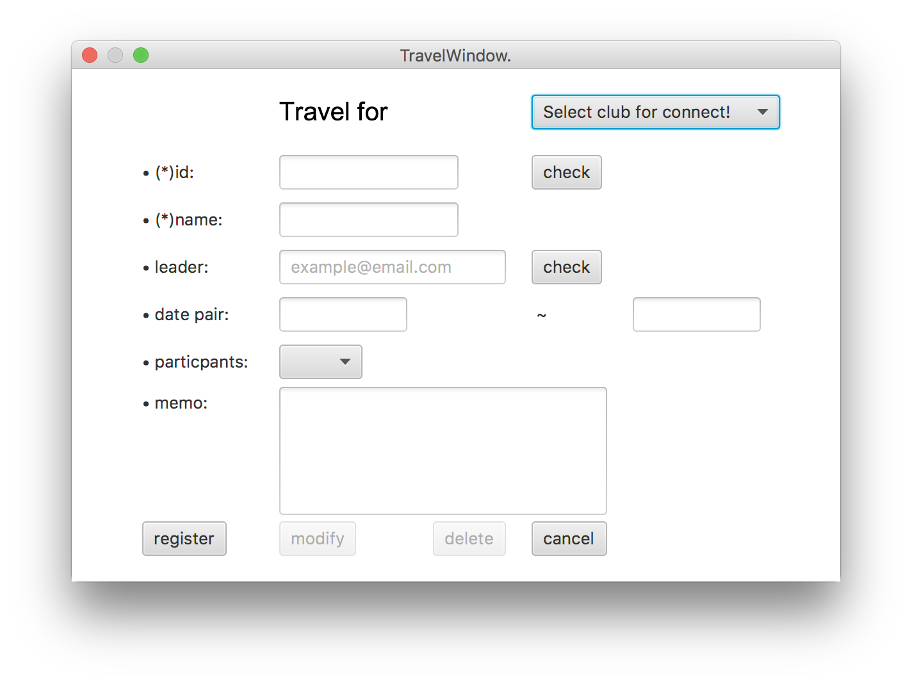
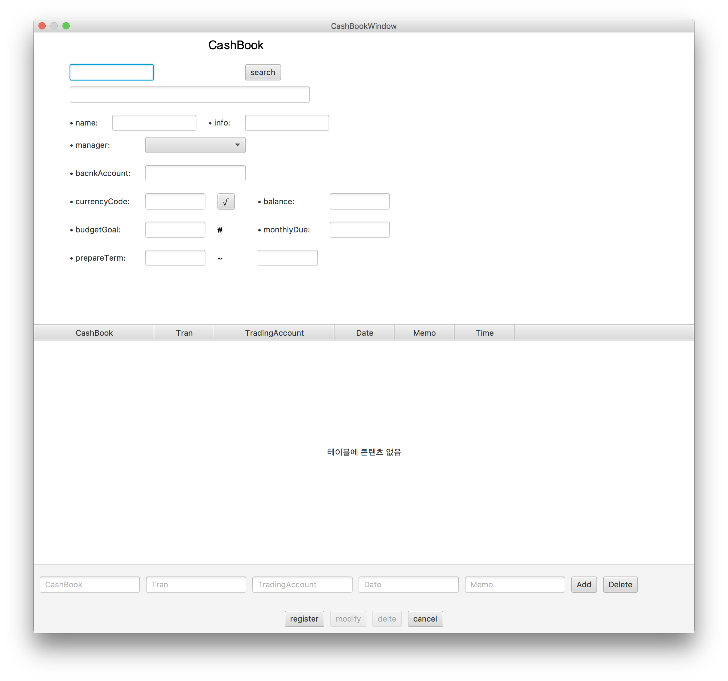
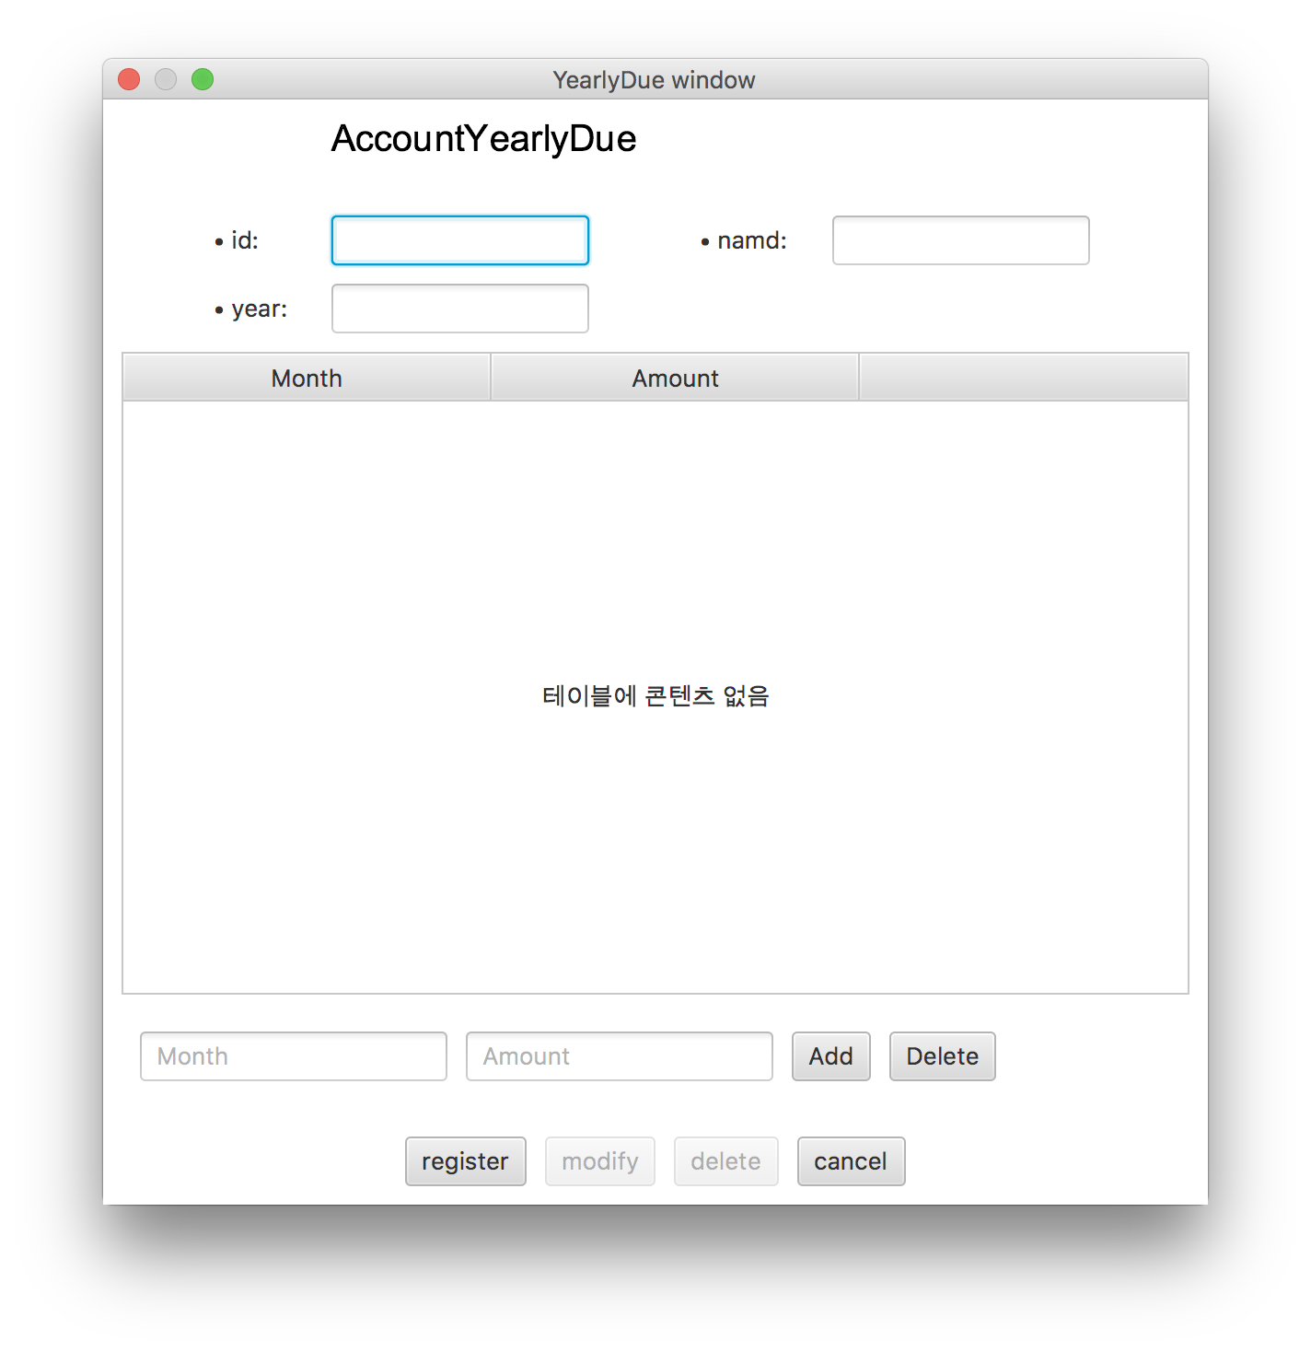
javastory
File
Edit
window
Help
New
Cancel
Create

Slide 5
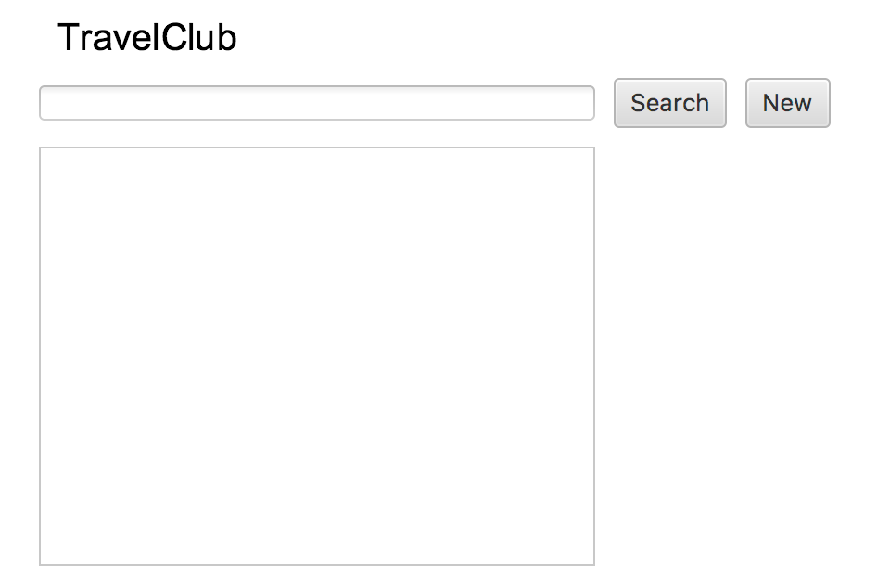
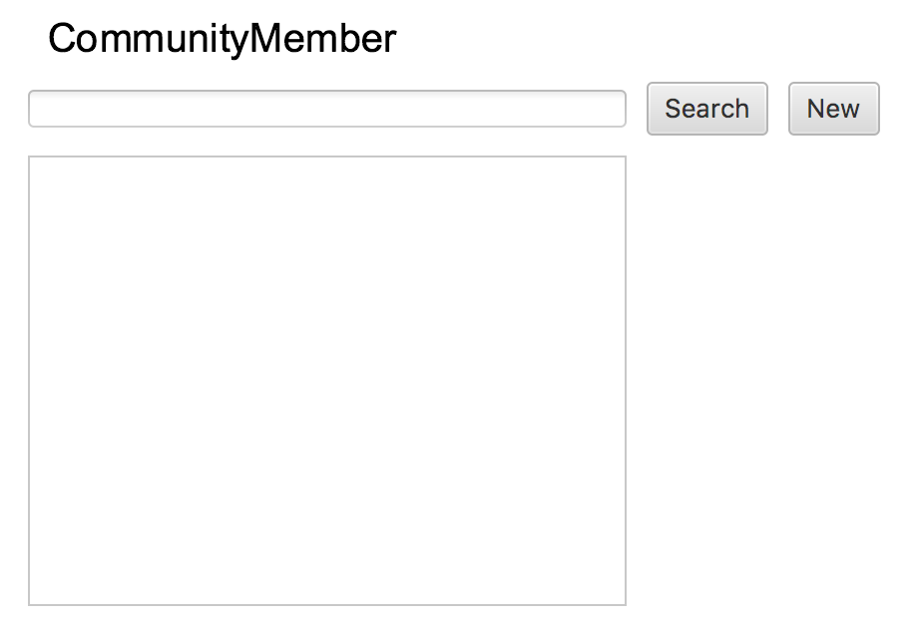
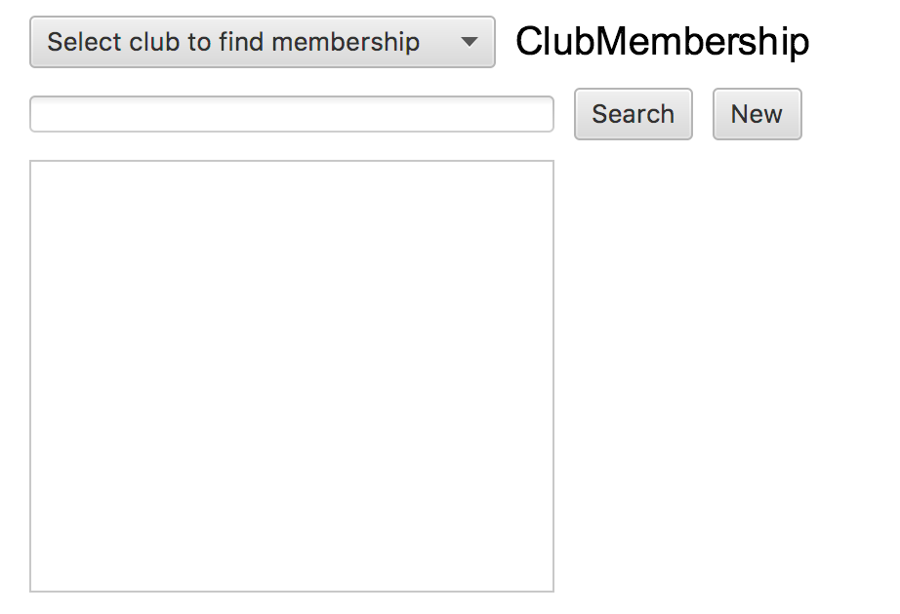
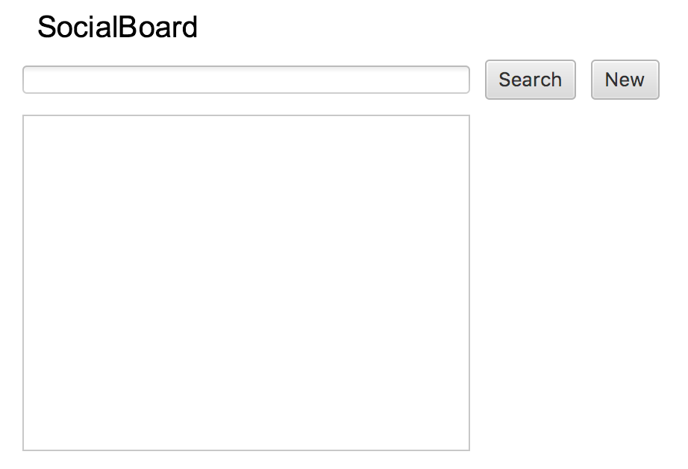
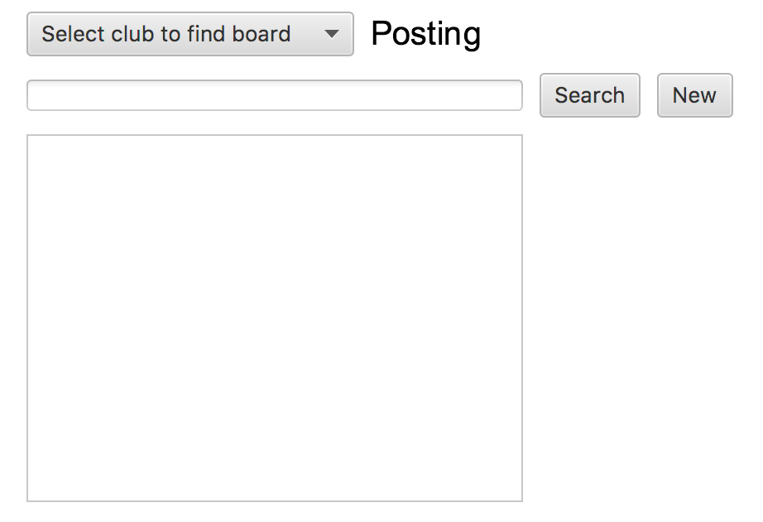
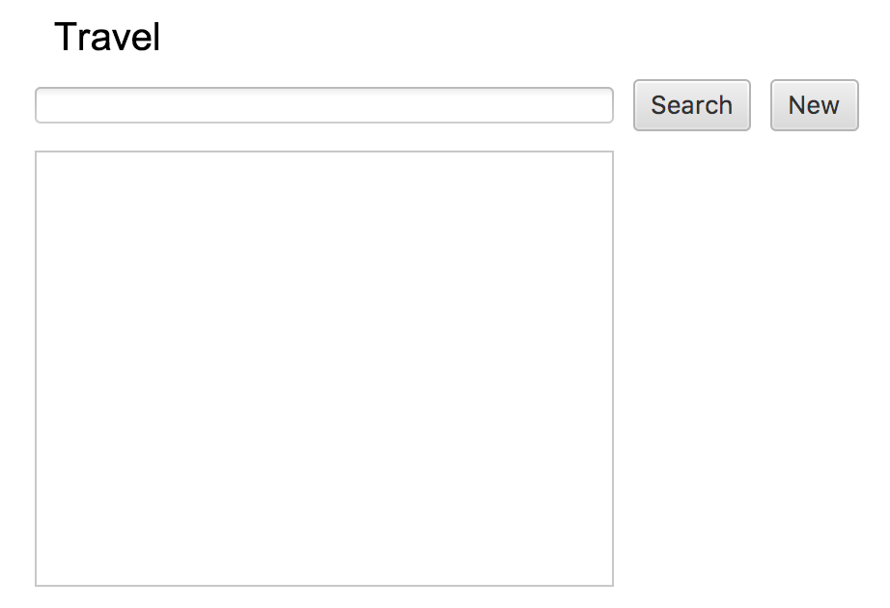
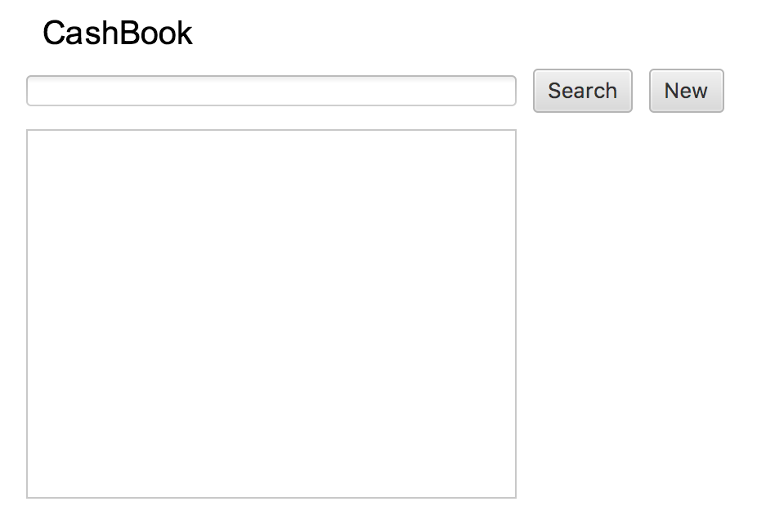
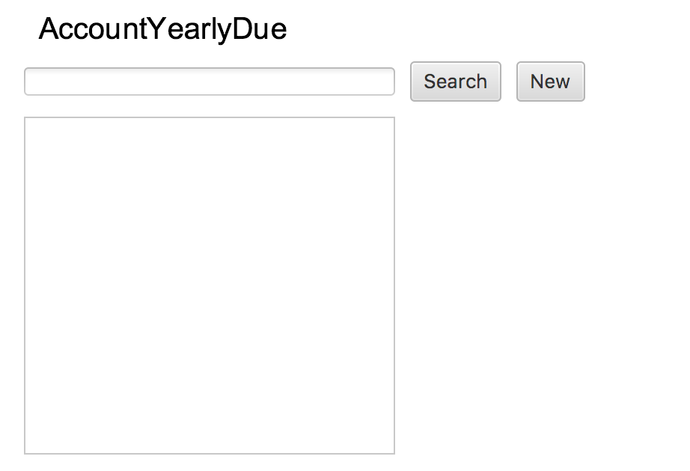
javastory
File
Edit
window
Help
Open
Cancel
Open

