Slide 1
library
한민수
Incomplete version

Slide 2
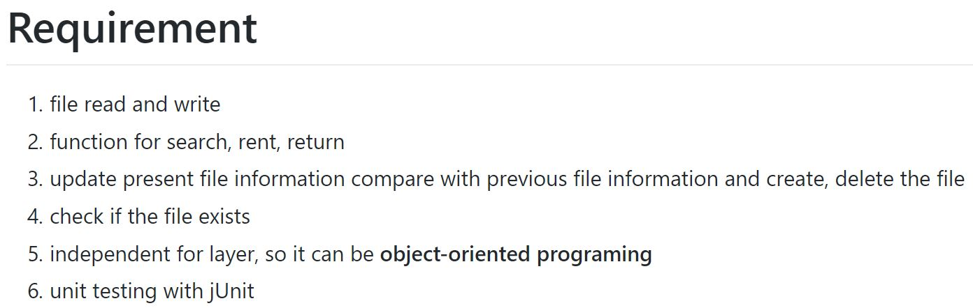

Slide 3
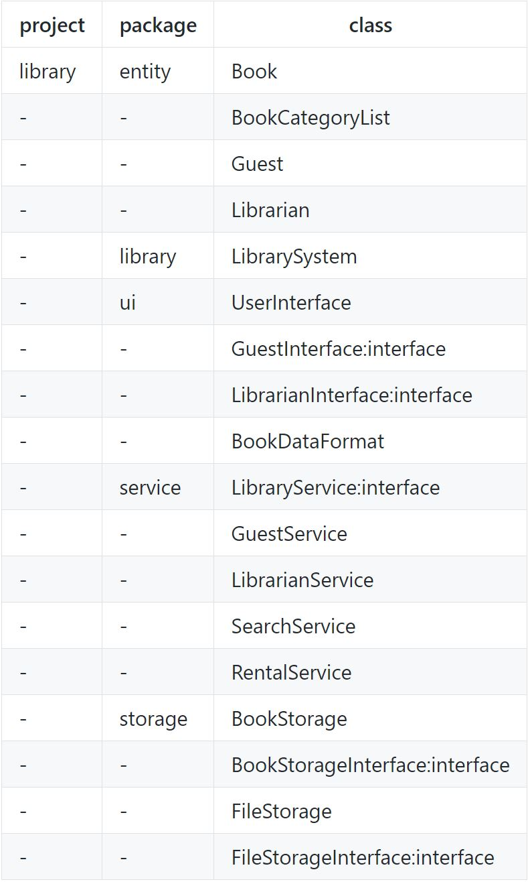

Slide 4
package library;
import ui.UserInterface;
public class LibrarySystem {
public static void main(String[] args) {
// TODO Auto-generated method stub
UserInterface ui = new UserInterface();
while(true) {
ui.showAlternative();
ui.setUser();
ui.excuteMode();
}
}
}

Slide 5
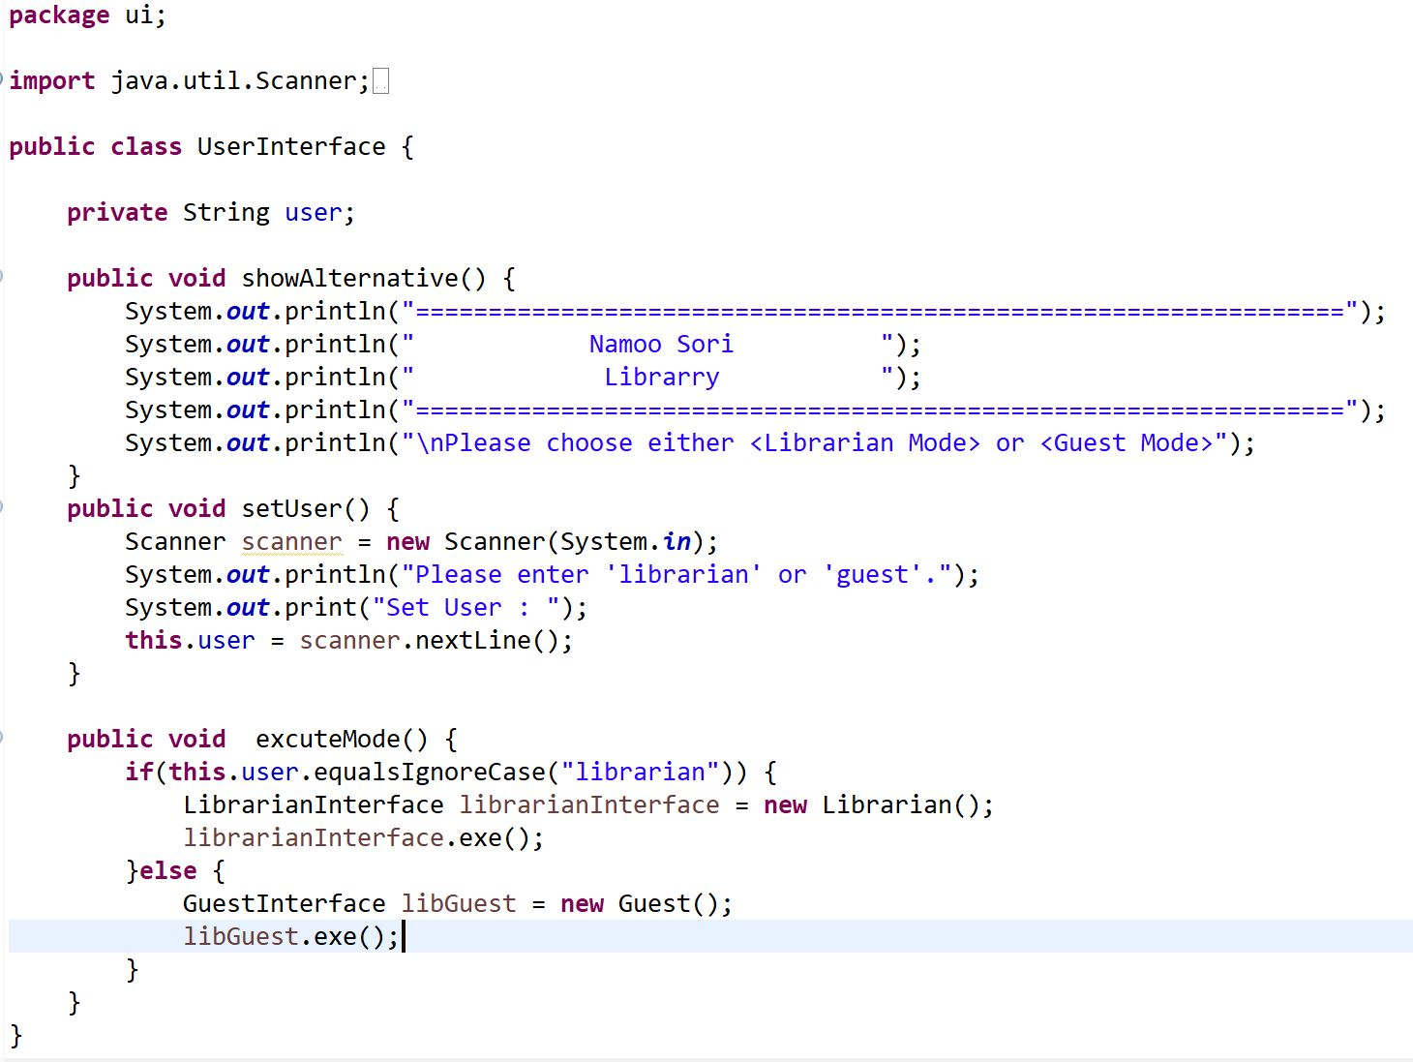

Slide 6
package ui;
public interface LibrarianInterface {
public void exe();
}

Slide 7
package entity;
import service.LibrarianService;
import ui.LibrarianInterface;
public class Librarian extends LibrarianService implements LibrarianInterface {
@Override
public void exe() {
// TODO Auto-generated method stub
System.out.println("\nRunning Librarian Mode...\n");
this.excuteMenu();
}
}

Slide 8
package service;
import java.util.Scanner;
public interface LibraryService {
public void showMenu();
public void selectMenu();
public void excuteMenu();
default public String keybordIn() {
Scanner keybordIn = new Scanner(System.in);
String inputData = keybordIn.nextLine();
return inputData;
}
}

Slide 9
package ui;
public interface GuestInterface {
public void exe();
}

Slide 10
package entity;
import service.GuestService;
import ui.GuestInterface;
public class Guest extends GuestService implements GuestInterface{
@Override
public void exe() {
// TODO Auto-generated method stub
System.out.println("\nRunning Guest Mode...\n");
this.excuteMenu();
}
}

Slide 11
package service;
import storage.BookStorage;
import storage.BookStorageInterface;
import storage.FileStorage;
import storage.FileStorageInterface;
public class LibrarianService implements LibraryService {
private String selectedMenu;
private FileStorageInterface fsi;
private BookStorageInterface bsi;
public LibrarianService() {
super();
// TODO Auto-generated constructor stub
fsi = new FileStorage();
bsi = new BookStorage();
}
@Override
public void showMenu() {
// TODO Auto-generated method stub
System.out.println("\n\t<Librarian Menu>");
System.out.println("1. Registrate Book");
System.out.println("2. Edit Book");
System.out.println("3. Delete Book");
System.out.println("0. Exit");
}
@Override
public void selectMenu() {
// TODO Auto-generated method stub
System.out.print("\nPlease enter menu number.\t");
System.out.println("ex) <Librarian> : 1");
System.out.print("<Librarian> : ");
selectedMenu = keybordIn();
}
@Override
public void excuteMenu() {// TODO Auto-generated method stub
while(true) {
this.showMenu();
this.selectMenu();
switch(Integer.parseInt(selectedMenu)) {
case 1:
// FileStorage.loadFile
// BookStorage.addBookList
fsi.loadFile();
break;
case 2:
//BookStorage.editBookList
//FileStorage.updateFile
fsi.saveFile(bsi.editBookList());
break;
case 3:
//BookStorage.removeBookList
//FileStorage.saveFile
fsi.saveFile(bsi.deleteBookList());
break;
case 0:
//recall UserInterface
break;
}
if(Integer.parseInt(selectedMenu)==0)
break;
}
}
}

Slide 12
package storage;
import java.util.ArrayList;
import entity.Book;
public interface FileStorageInterface {
public void loadFile();
public void saveFile(ArrayList<Book> bookList);
}

Slide 13
package storage;
/* import */
public class FileStorage extends BookStorage implements FileStorageInterface{
private String fileLocation;
private File file;
public FileStorage() {
super();
fileLocation = "./src/libraryBook.dat";
file = new File(fileLocation);
}
@Override
public void loadFile() {
if(file.exists()==false) {
try {
file.createNewFile();
} catch (IOException e) {
e.printStackTrace();
}
}
try {
br = new BufferedReader(new FileReader(fileLocation));
this.makeBookList();
} catch (FileNotFoundException e) {
// TODO Auto-generated catch block
e.printStackTrace();
}
}
@Override
public void saveFile(ArrayList<Book> bookList) {
// TODO Auto-generated method stub
// BufferedWriter, FileWriter, bookList
}
}

Slide 14
package storage;
import java.util.ArrayList;
import java.util.List;
import entity.Book;
public interface BookStorageInterface {
public void makeBookList();
public ArrayList<Book> editBookList();
public ArrayList<Book> deleteBookList();
public ArrayList<Book> getBookList();
}

Slide 15
package storage;
/* import */
public class BookStorage implements BookStorageInterface{
private ArrayList<Book> bookList;
protected BufferedReader br;
public BookStorage() {
super();
// TODO Auto-generated constructor stub
bookList = new ArrayList<Book>();
}
@Override
public void makeBookList() {
// TODO Auto-generated method stub
try {//set book list & book info
String line="";
while((line = br.readLine()) != null) {
String bookInfo[] = line.split(";");
Book book = new Book();
book.setBookNumber(bookInfo[0]);
book.setBookName(bookInfo[1]);
book.setAuthor(bookInfo[2]);
book.setCategoryName(bookInfo[3]);
book.setRentPossible(Boolean.parseBoolean(bookInfo[4]));
book.setNumberOfBorrowed(Integer.parseInt(bookInfo[5]));
bookList.add(book);
}
br.close();
} catch (IOException e) {
// TODO Auto-generated catch block
e.printStackTrace();
}
}
@Override
public ArrayList<Book> editBookList() {
// TODO Auto-generated method stub
//edit
return (ArrayList<Book>) bookList;
}
@Override
public ArrayList<Book> deleteBookList() {
// TODO Auto-generated method stub
//delete
return (ArrayList<Book>) bookList;
}
@Override
public ArrayList<Book> getBookList() {
// TODO Auto-generated method stub
return bookList;
}
}

Slide 16
package service;
import ui.BookDataFormat;
public class GuestService implements LibraryService{
private String selectedMenu;
private SearchService search;
private RentalService rental;
private BookDataFormat bdf;
public GuestService() {
super();
search = new SearchService();
rental = new RentalService();
bdf = new BookDataFormat();
}
@Override
public void showMenu() {
// TODO Auto-generated method stub
System.out.println("\n\t<Guest Menu>");
System.out.println("1. Search by Book Name.");
System.out.println("2. Search by Book Category.");
System.out.println("3. Rent Books.");
System.out.println("4. Return Books.");
System.out.println("5. Most Popular Book.");
System.out.println("0. Exit.");
}
@Override
public void selectMenu() {
// TODO Auto-generated method stub
System.out.print("\nPlease enter menu number.\t");
System.out.println("ex) <Guest> : 1");
System.out.print("<Guest> : ");
selectedMenu = keybordIn();
System.out.println();
}
@Override
public void excuteMenu() {
while(true) {
this.showMenu();
this.selectMenu();
switch(Integer.parseInt(selectedMenu)) {
case 1:
System.out.println("Please enter book name");
//SearchService.bookName
search.bookName();
break;
case 2:
System.out.println("Please enter book category");
//SearchService.bookCategory
search.bookCategory();
break;
case 3:
System.out.println("Please enter book Id for rent");
//RentalService.rent
rental.rentBook();
break;
case 4:
System.out.println("Please enter book Id for return");
//RentalService.return
rental.returnBook();
break;
case 5:
System.out.println("Now Most Popular Book is...");
//SearchService.mostPopular
bdf.showMostPopularBook(search.numberOfBorrowed());
break;
case 0:
//exit
break;
}
if(Integer.parseInt(selectedMenu)==0)
break;
}}}

Slide 17
package service;
/* import */
public class SearchService {
private BookDataFormat bdf; private Scanner scanner; private BookStorage bs; private ArrayList<Book> bookList;
public SearchService() {
super(); bdf = new BookDataFormat(); scanner = new Scanner(System.in);
bs = new BookStorage(); bookList = new ArrayList<Book>();
bookList = bs.getBookList();
}
public void bookCategory() {
//request book category for search
System.out.println("--------------------------------------------------------------------------------");
System.out.println("<Search by bookCategory>");
System.out.print("<Category Index> : ");
String index = scanner.nextLine();
//input format
bdf.windowFormat();
try {//bring and show category list
for(BookCategoryList category : BookCategoryList.values()) {
int categoryIndex = category.ordinal() +1;
String categoryName = category.name();
//Show and find books matching category
if(categoryIndex == Integer.parseInt(index)) {
for(Book book : bookList){
if(book.getCategoryName().equalsIgnoreCase(categoryName)) {
bdf.dataFormatting(book);
}}}}
}catch(Exception e) {
System.out.println("Check again Category Index");
}}
public void bookName(){
//request book name for search
System.out.println("--------------------------------------------------------------------------------");
System.out.println("<Search by bookName>");
System.out.print("<bookName> : ");
String bookName = scanner.nextLine();
//input format
bdf.windowFormat();
//find book contained the word that user input
for(Book book : bookList){
if(book.getBookName().contains(bookName)){
bdf.dataFormatting(book);//show book found
}}}
public Book numberOfBorrowed(){
//input format
System.out.println("--------------------------------------------------------------------------------");
System.out.println("<Search by number of borrowed>");
int maxValue=0;
//compare book's number of borrowed
for(Book book : bookList){
if(book.getNumberOfBorrowed() > maxValue){
maxValue = book.getNumberOfBorrowed();//set max value of book list
}}
Book popularBook = new Book();
for(Book book : bookList){//find the book that matches max value
if(book.getNumberOfBorrowed() == maxValue){
popularBook = book;
}}
return popularBook;
}
}

Slide 18
public void rentBook(){//request book number for return
System.out.println("--------------------------------------------------------------------------------");
System.out.println("<Search by bookNumber>");
System.out.print("<bookNumber> : ");
String bookNumber = scanner.nextLine();
//input format & bring book list
bdf.windowFormat();BookStorage bs = new BookStorage();ArrayList<Book> bookList = new ArrayList<Book>(); bookList = bs.getBookList();
//find book that match the requested book number
for(Book book : bookList){
if(book.getBookNumber().equalsIgnoreCase(bookNumber)){
bdf.dataFormatting(book);//show the book found
System.out.println("--------------------------------------------------------------------------------");
System.out.println("[ Book rental ]");
try{//according to book's rent state change the rent state
if(book.isRentPossible()){
book.setRentPossible(false);
int count =book.getNumberOfBorrowed();
book.setNumberOfBorrowed(count++);
System.out.println(book.getBookNumber() + " Rental is complete.");
System.out.println("--------------------------------------------------------------------------------");
}else{
System.out.println(book.getBookNumber() + " is already rented.");
System.out.println("--------------------------------------------------------------------------------");
}
}catch(Exception e){
System.out.println("Something is wrong! please check again!");
System.out.println("--------------------------------------------------------------------------------");
}
}else{
System.out.println(bookNumber+" undetected");
}}}
public void returnBook(){//request book number for return
System.out.println("--------------------------------------------------------------------------------");
System.out.println("<Search by bookNumber>");
System.out.print("<bookNumber> : ");
String bookNumber = scanner.nextLine();
//input format & bring book list
bdf.windowFormat();BookStorage bs = new BookStorage(); ArrayList<Book> bookList = new ArrayList<Book>();
bookList = bs.getBookList();
//find book that match the requested book number
for(Book book : bookList){
if(book.getBookNumber().equalsIgnoreCase(bookNumber)){
bdf.dataFormatting(book);//show the book found
System.out.println("--------------------------------------------------------------------------------");
System.out.println("[ Return books ]");
try{//according to book's rent state change the rent state
if(!book.isRentPossible()){
book.setRentPossible(true);
System.out.println(book.getBookNumber() + " Return is complete.");
System.out.println("--------------------------------------------------------------------------------");
}else{
System.out.println(book.getBookNumber() + " is already returned.");
System.out.println("--------------------------------------------------------------------------------");
}
}catch(Exception e){
System.out.println("Something is wrong! please check again!");
System.out.println("--------------------------------------------------------------------------------");
}
}else{
System.out.println(bookNumber+" undetected");
}}}}

Slide 19
package ui;
import entity.Book;
import entity.BookCategoryList;
public class BookDataFormat {
public void dataFormatting(Book book){//output formatted book information
String rent;
if(book.isRentPossible()) {
rent = "Rent Possible";
}else {
rent = "Rent Impossible";
}
System.out.println(rent + " " + book.getBookNumber() + " " + book.getCategoryName() + " "+ book.getBookName());
}
public void windowFormat(){//table format
System.out.println("--------------------------------------------------------------------------------");
System.out.println("<Rent> <BookNumber> <BookCategory> <BookName>");
}
public void showCategoryList() {//show category list
for(BookCategoryList category : BookCategoryList.values() ) {
int index = category.ordinal()+1;
System.out.print(index+"\t");
System.out.println(category);
}
}
public void showMostPopularBook(Book book){//show formatted most popular book information
System.out.println("--------------------------------------------------------------------------------");
System.out.println("[ Most popular book ]");
System.out.println("Book number" + "\t|\t" + book.getBookNumber());
System.out.println("Book category" + "\t|\t" + book.getCategoryName());
System.out.println("Book name" + "\t|\t" + book.getBookName());
System.out.println("Book author" + "\t|\t" + book.getAuthor());
if(book.isRentPossible()){
System.out.println("* Rental available.");
}else{
System.out.println("* This book is currently being rented.");
}}}

Slide 20
package entity;
public enum BookCategoryList {
Novel, Essay, Magazine, Webtoon;
}

Slide 21
package entity;
public class Book {
private String bookNumber;
private String bookName;
private String author;
private String categoryName;
private boolean rentPossible;
private int numberOfBorrowed;
public Book() {
super();
// TODO Auto-generated constructor stub
//Do I have to initialize the field?
}
public String getBookNumber() {
return bookNumber;
}
public void setBookNumber(String bookNumber) {
this.bookNumber = bookNumber;
}
public String getBookName() {
return bookName;
}
public void setBookName(String bookName) {
this.bookName = bookName;
}
public String getAuthor() {
return author;
}
public void setAuthor(String author) {
this.author = author;
}
public String getCategoryName() {
return categoryName;
}
public void setCategoryName(String categoryName) {
this.categoryName = categoryName;
}
public boolean isRentPossible() {
return rentPossible;
}
public void setRentPossible(boolean rentPossible) {
this.rentPossible = rentPossible;
}
public int getNumberOfBorrowed() {
return numberOfBorrowed;
}
public void setNumberOfBorrowed(int numberOfBorrowed) {
this.numberOfBorrowed = numberOfBorrowed;
}}

