Slide 1
Anti-Slytherin: A Fairness-Centered Approach to Team Formation
Mark Annett, JD, MS BME
Professor of Practice
New Jersey Institute of Technology (NJIT)
Email: msa223@NJIT.edu

Slide 2
Real-World Problem
Asynchronous
30 students → Startup Teams
Individual assignments too much
3-4 per Startup team (real world)

Slide 3

Problem
Anti-
When groups form
Usually - proximity based
Always someone “unhappy” in Slytherin
Want no one in Slytherin

Slide 4
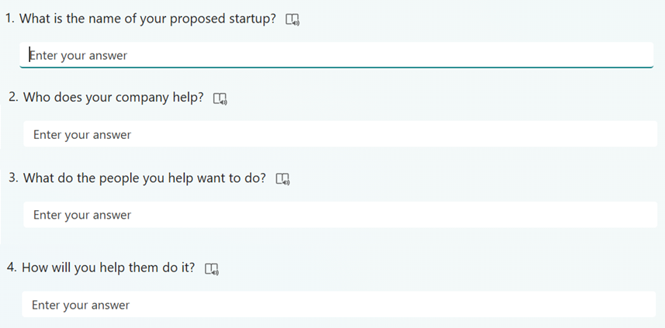
Solution
Anti-
Everyone propose a startup idea.

Slide 5
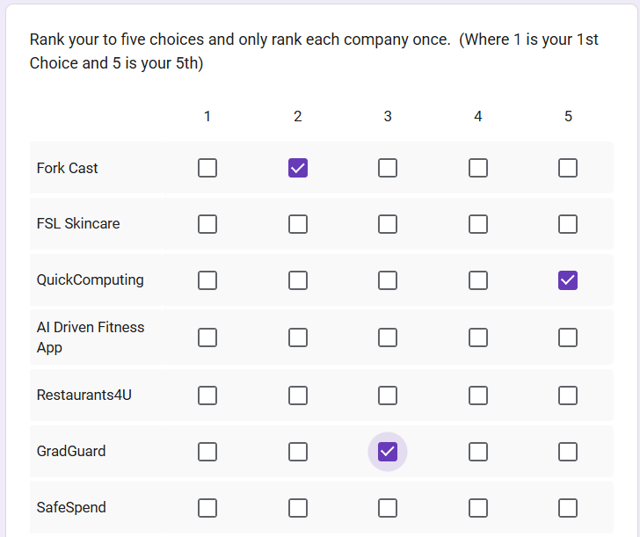
Solution
Anti-
Everyone propose a startup idea.
Everyone vote on top 5 choices
Google Form
Enforce one company/rank

Slide 6
Solution
Anti-
Everyone propose a startup idea.
Everyone vote on top 5 choices
Goal - Develop an algorithm(s)…

Slide 7
The Initial Algorithms
Anti-
No one in Slytherin was priority #1
Phase 1 – Select the Startup Pool
Phase 2 – Sorting (Three Algorithms)
Fill First (company centric/fewest)
Rank First (student centric/highest)
Best First (hybrid best/company)
Tie break rules crucial (least opportunity)

Slide 8
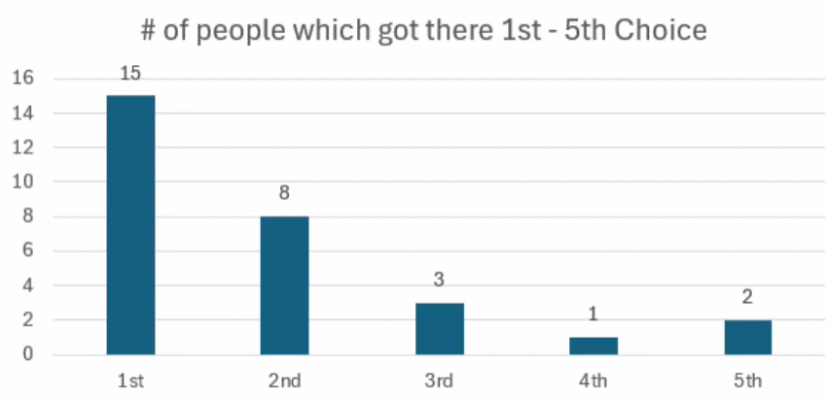
Real-World Test
Success! (FIRST TRY)
Questions
Brilliant ???
Lucky ???
Student ranking is Special ???

Slide 9
Monte Carlo Simulation
Randomly (key) generate data
Any # of startup companies
Any # of students
Ranking of companies (1-5)
Specify # companies (seats)
Run any # of simulation
Profile of vote distribution/trial
Viability of Pool (possible)
Success of the placements
30 Students/
10 Startups 3 Seats/Per

Slide 10

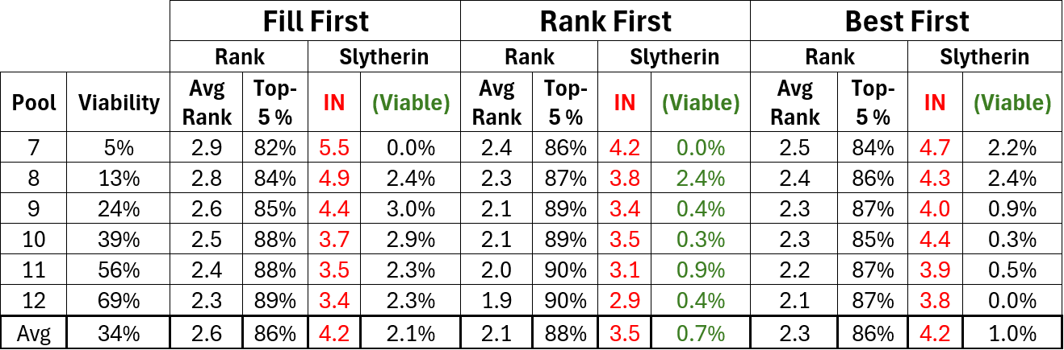
Results of 1,000 Trials 30 students / 30 proposals / X companies
Popularity

Slide 11
Results of 1,000 Trials 30 students / 30 proposals / X companies
Popularity

Slide 12

Results of 1,000 Trials 30 students / 30 proposals / X companies

Slide 13
Results of 1,000 Trials 30 students / 30 proposals / X companies

Slide 14

Results of 1,000 Trials 30 students / 30 proposals / X companies
Popularity
Problem

Slide 15
Disappointing
Brilliant ???
Lucky ???
Student ranking is Special ???
Big Issue: Viability (Lacking)

Slide 16
Algorithm Structure
Phase 1 - Select Pool (Popularity)
Phase 2 - Place Using Algorithms

Slide 17
New Strategy
(NEW) Phase 1 - Select Companies (Criticality)
compared to every other
how dangerous is removal
# of assignment become impossible
Ties -> 2nd order
Repeat till pool is filled
Phase 2 - Added Fragility (Mirror of Criticality)

Slide 18
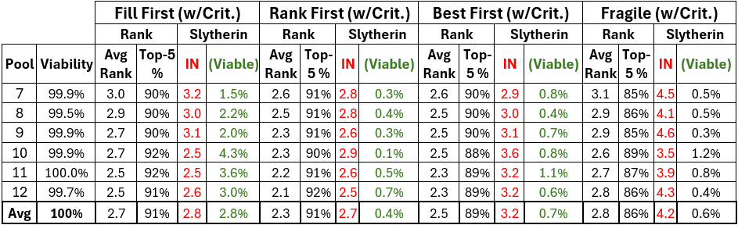
Results of 1,000 Trials (Criticality) 30 students / 30 proposals / X companies
Fixed
+.64%

Slide 19
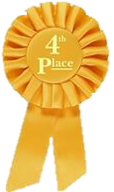
Results of 1,000 Trials (Criticality) 30 students / 30 proposals / X companies

Slide 20
Results of 1,000 Trials (Criticality) 30 students / 30 proposals / X companies
Fixed
+.64%
+.7%
-.3%
-.3%

Slide 21
Still Not Close to Swappable
Viability -> Swappable
Swapping -> 30 students into 10 companies
From the start ≈ 5.6 × 10¹⁸ possible assignments
If close then Swap Chains:
Most repairs require chains of length ≤ 3
(choices per step)³ ≈ 15³ = 3375
Goal < 3 swapping chains needed →→→
Anti-

Slide 22
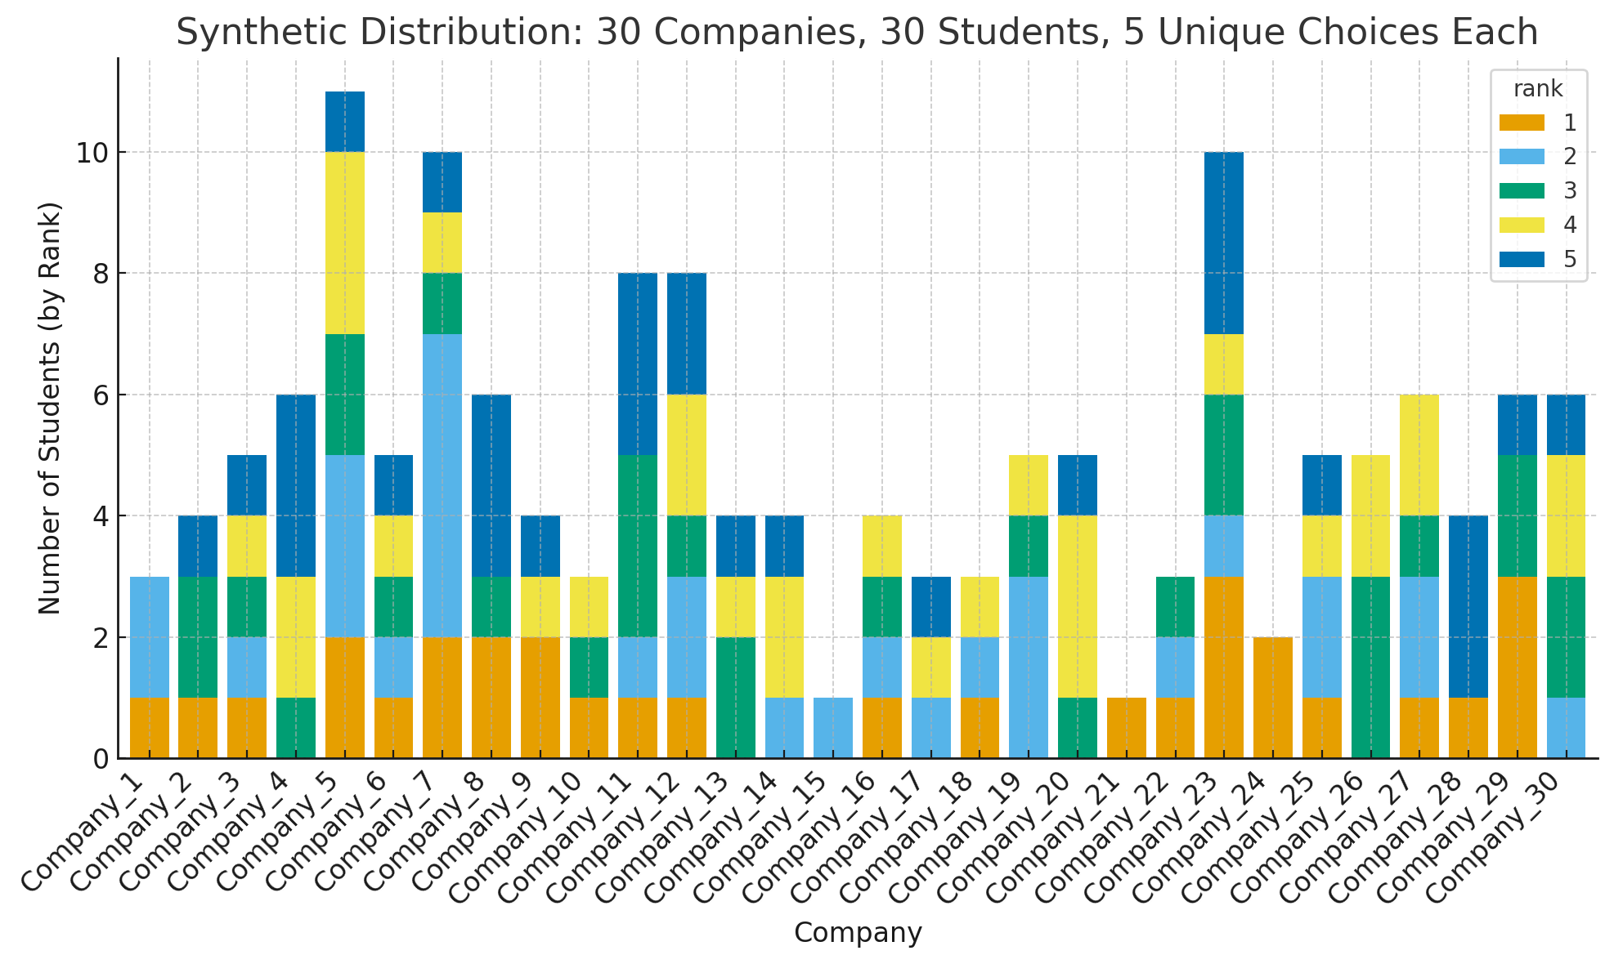
Getting Radical
Fill First (Viability)
Stable across trials
Works when low entropy
Goal Stabilize the data
Pre Assignment Process
Dual Outlier Matching (DOM)
Outlier Companies (few picked)
With Outlier Students (few options)
Fills the DOM Companies Completely
Then send remainder to normal Phase 1-2
Swap if necessary
Clumping Preferred

Slide 23
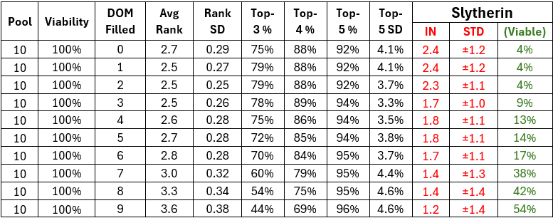
Exciting Results
SWAPPABLE

Slide 24
Exciting Results

Slide 25
Exciting Results

Slide 26
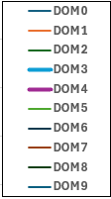
Exciting Results
Sweet Spot DOM = 1/3

Slide 27
Future Direction (Exciting)
Implement Swapping
Anti-Slytherin
Ranking improvement
Relook at fragility (improved endgame)
Understand the full behavior (<>30)
Finding a graduate student ???
Make the tool accessible to others
Anti-
Anti-

Slide 28

Anti-Slytherin: A Fairness-Centered Approach to Team Formation
Mark Annett, JD, MS BME
Professor of Practice
New Jersey Institute of Technology (NJIT)
Email: msa223@NJIT.edu

