Slide 1

Introduction to Embedded Software Engineering
Day 1

Slide 2
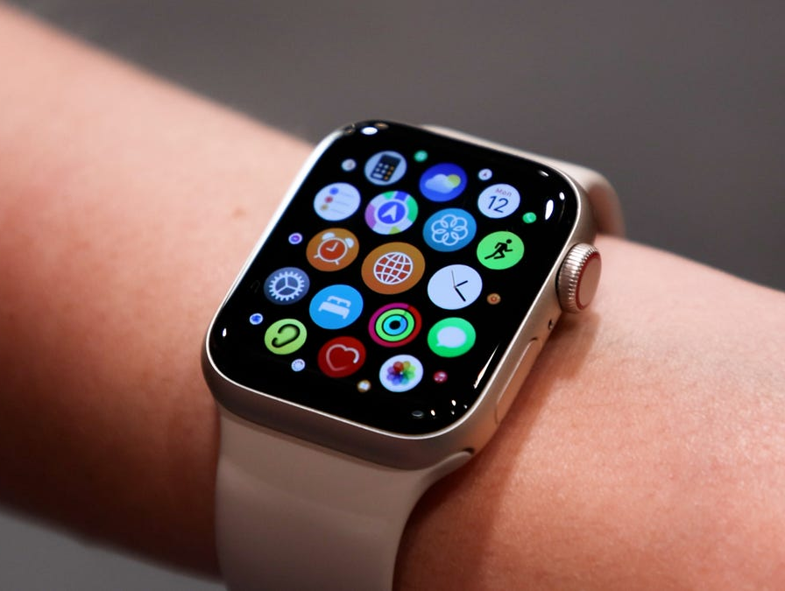
What is Embedded Software?
Embedded software runs on devices that do not fit the typical impression of a computer.

Slide 3
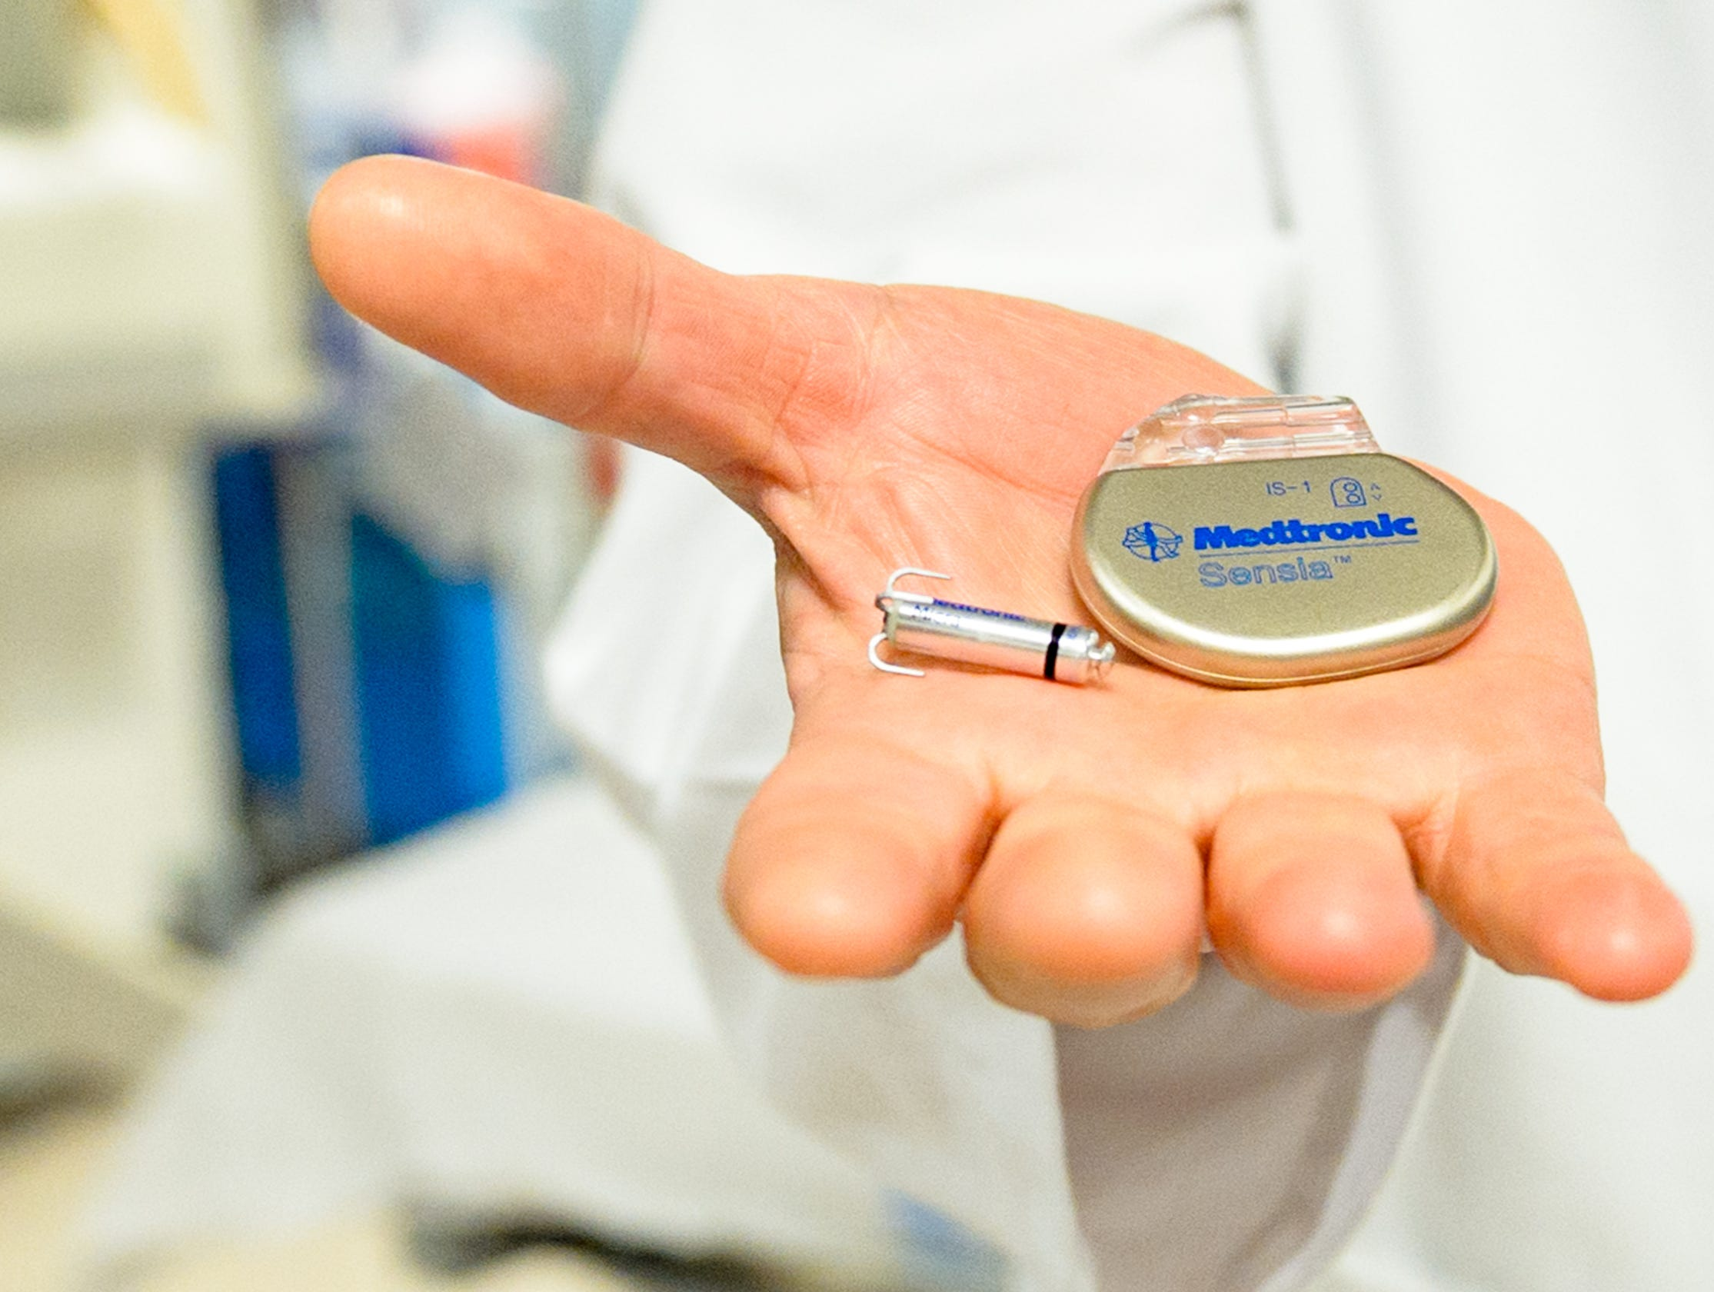
The challenges of Embedded Software
Low power (often 5V, 3.3V, even 1.8V)
Low memory and storage (less space for code)
Real time (timing and precision required)

Slide 4
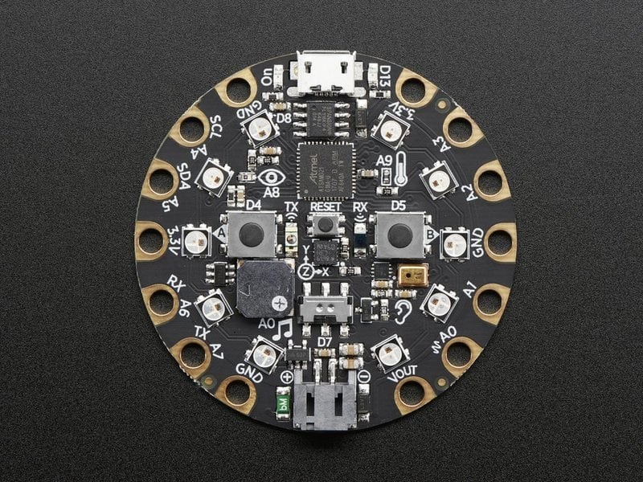
Circuit Playground
Adafruit board for experimenting with hardware and software interactions.
Overview | Adafruit Circuit Playground Express | Adafruit Learning System

Slide 5
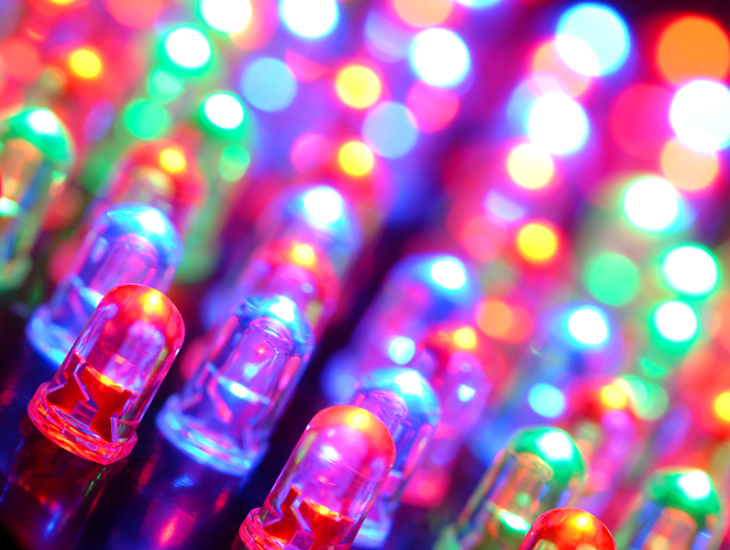
Light Emitting Diodes (LEDs)
Emits light when current (electricity) flows through.
Semiconductor like silicon
Vary in colors and brightness.

Slide 6
Capacitive Touch
There are two main types of touch sensors – capacitive vs resistive.
Capacitive touch allows items containing water to trip the sensor.
Resistive touch relies on pressure to trip the sensor.
Capacitive sensors can be tripped not just by your finger, but also by items like fruit.

Slide 7
View the Example Code
Plug your Circuit Playground into the computer.
1
Navigate to the device and open the code.py file.
You can open the file in any IDE (Visual Studio Code, Replit, even Notepad).
2
To make changes, save the file. It must always be named code.py
3

Slide 8
Understand Example Code
The example code pre-loaded onto the board takes capacitive touch input from the user, and lights corresponding LEDs.
The LEDs have two primary settings
Brightness: from 0.0 to 1.0
Color: OFF (0,0,0) to WHITE (255, 255, 255)

Slide 9
Challenges
Change
Change the colors of the LEDs
Change
Change the brightness of the LEDs
Do not directly look at the LEDs above brightness 0.2. Use the provided paper above the LED.
Identify
Identify at least one area of the code which could be optimized for space. (For example, using a for loop instead of repeating lines)

Slide 10
References
What is an LED? | All About LEDs | Adafruit Learning System
Using Capacitive Touch | Make It Sense | Adafruit Learning System
Overview | Adafruit Circuit Playground Express | Adafruit Learning System

Slide 11
Introduction to Embedded Software Engineering
Day 2

Slide 12
Review Day 1
Questions?

Slide 13
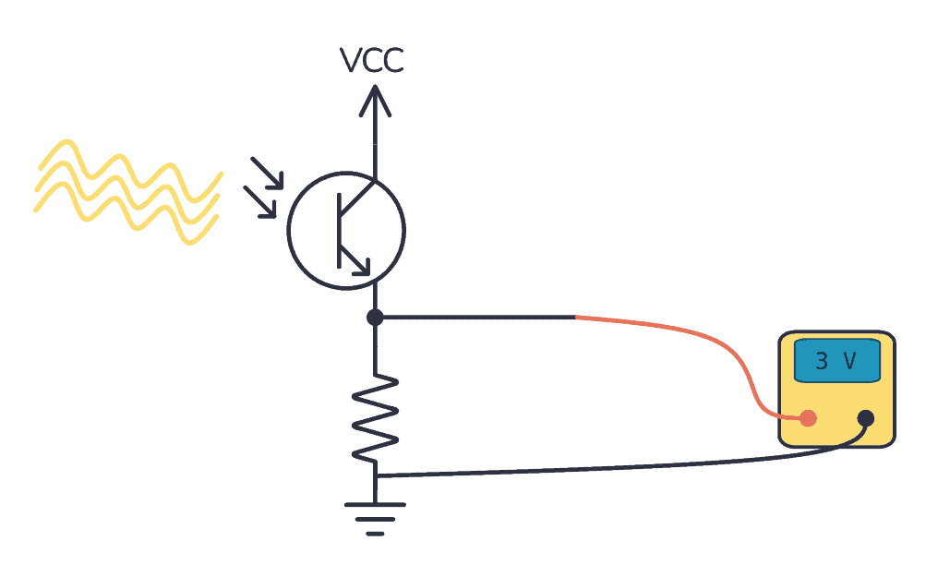
Phototransistors
Convert the amount of light received into current.
Generally can detect differences like
light vs dark but not differences in color
like blue vs red.

Slide 14
View the Example Code
Plug your Circuit Playground into the computer.
1
Navigate to the device and open the code.py file.
You can open the file in any IDE (Visual Studio Code, Replit, even Notepad).
2
To make changes, save the file. It must always be named code.py
3

Slide 15
Understand Example Code
The example code measures the input to the light sensor, and changes the color of an LED dependent on the amount of light seen by the sensor.

Slide 16
Challenges
Understand
What is the maximum value of the light sensor reading?
Change
Change the code to have more than two states (light vs no light)
Identify
Identify at least one area of the code which could be optimized for space. (For example, using a for loop instead of repeating lines)

Slide 17
References
Playground Light Sensor | Adafruit Circuit Playground Express | Adafruit Learning System
Phototransistor - A Newbie's Guide (build-electronic-circuits.com)

Slide 18
Introduction to Embedded Software Engineering
Day 3

Slide 19
Review Day 2
Questions?

Slide 20
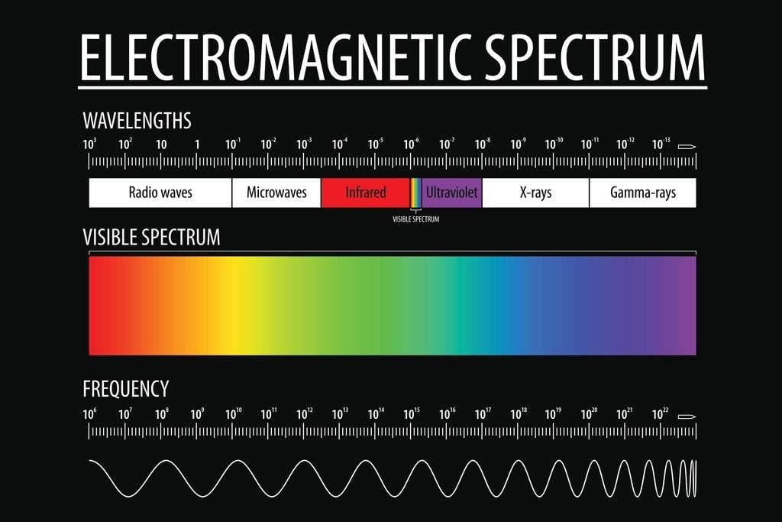

Slide 21
View the Example Code
Plug your Circuit Playground into the computer.
1
Navigate to the device and open the code.py file.
You can open the file in any IDE (Visual Studio Code, Replit, even Notepad).
2
To make changes, save the file. It must always be named code.py
3

Slide 22
Understand Example Code
The example code detects the IR code transmitted by the remote, and toggles the color of the LED associated with that button, if applicable.
Values for the IR transmission are an array of 4 8 bit numbers.

Slide 23
Challenges
Understand
What is the maximum value of each of the transmission values?
Change
Use the volume up/down buttons to change the intensity of the lights.
Identify
Identify at least one area of the code which could be optimized for space. (For example, using a for loop instead of repeating lines)

Slide 24
References
Overview | Infrared Receive and Transmit with Circuit Playground Express | Adafruit Learning System
Electromagnetic spectrum - Wikipedia

