Slide 1
LICENSE PLATE RECOGNITION SYSTEM YOLO(You Look Only Once)v3
Google Optical Character Recognition Microsoft Azure Optical Character Recognition (OCR)
SAARTHAK MAHAJAN

Slide 2
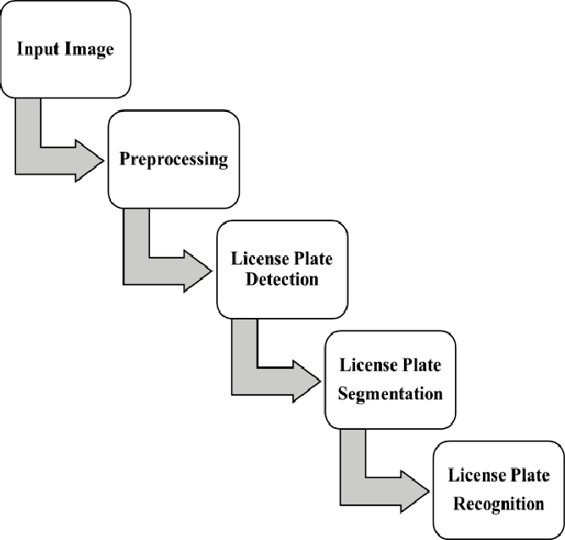
Introduction
License Plate Recognition(LPR) system is used to identify the license plates of a vehicle by using various techniques.
The British Police Scientific Development Branch first invented License Plate Recognition Technology in 1976.
Basic flow: License Plate Detection, Segmentation, Recognition.
Used in law enforcement, traffic regulation and vehicle management.

Slide 3
DESIGN
Conventional designs to LPR handle the whole problem as one.
The problem can be split into two components: Object Detection and Number Plate Recognition.
It makes the problem simpler and more efficient.
Object Detection (License plate) is done using Yolov3.
Character Recognition is done using Google Cloud Vision API and Microsoft Azure Cognitive Services API.

Slide 4
YOLO: You Only Look Once
YOLO (You Only Look Once), is a network for object detection. The object detection task consists in determining the location on the image where certain objects are present, as well as classifying those objects.
Previous methods for this, like R-CNN and its variations, used a pipeline to perform this task in multiple steps. This can be slow to run and hard to optimize, because each individual component must be trained separately. YOLO, does it all with a single neural network.
Take an image as input, pass it through a neural network that looks like a normal CNN, and you get a vector of bounding boxes and class predictions in the output.

Slide 5
YOLO: You Only Look Once
YOLO algorithm divides any given input image into SxS grid system. Each grid on the input image is responsible for detection on object. Now the grid cell predicts the number of boundary boxes for an object.
For every boundary box has five elements (x, y, w, h, confidence score). X and y are the coordinates of the object in the input image, w and h are the width and height of the object respectively.
Confidence score is the probability that box contains an object and how accurate is the boundary box.

Slide 6


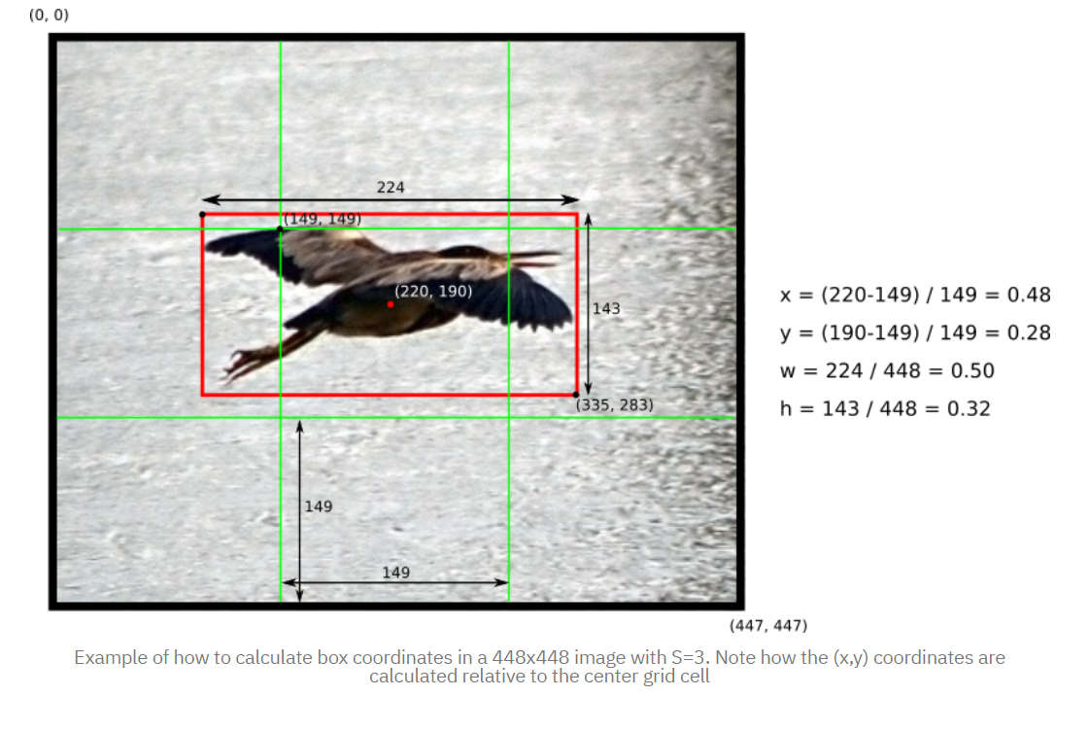




Slide 7
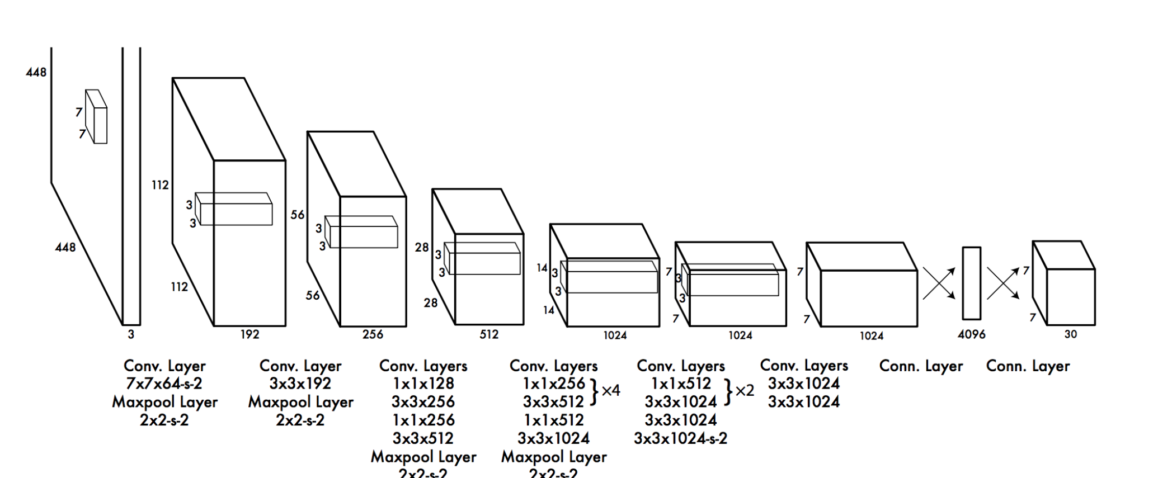
YOLOv1
YOLO has 24 convolutional layers followed by 2 fully connected layers (FC).
It cannot not find small objects if they are appeared as a cluster.
This architecture found difficulty in generalization of objects if the image is of other dimensions different from the trained image.
The major issue is localization of objects in the input image.

Slide 8
YOLOv2 (YOLO9000)
The second version of the YOLO is named as YOLO9000 which has been published by Joseph Redmon and Ali Farhadi at the end of 2016. The improvements are as follows:
Batch Normalization - By adding batch normalization to convolutional layers in the architecture MAP (mean average precision) has been improved by 2%.
Higher Resolution Classifier – improves mAP by 4%.
Anchor boxes - YOLO v2 does classification and prediction in a single framework. These anchor boxes are responsible for predicting bounding box and this anchor boxes are designed for a given dataset by using clustering(k-means clustering).

Slide 9
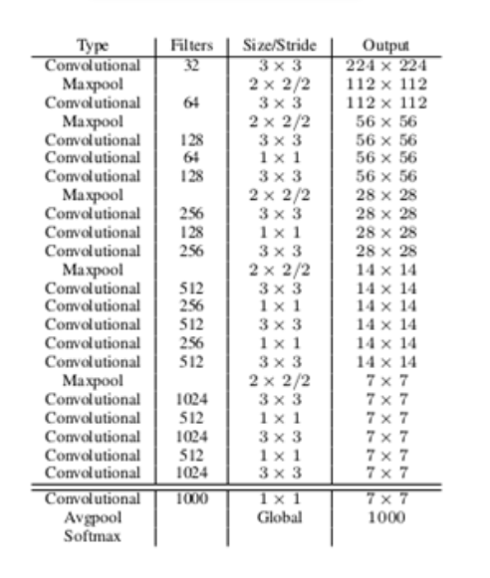
YOLOv2 (YOLO9000)
YOLO v2 uses Darknet 19 architecture with 19 convolutional layers and 5 max pooling layers and a softmax layer for classification objects.
Darknet is a neural network framework written in C language and CUDA. It’s really fast in object detection which is very important for predicting in real-time.

Slide 10
YOLOv3
The competition is all about how accurate and quickly objects are detected. YOLO v3 has all we need for object detection in real-time with accurately and classifying the objects.
Bounding Box Predictions: In YOLO v3 it gives the score for the objects for each bounding boxes. It uses logistic regression to predict the objectiveness score.
In YOLO v3 it uses logistic classifiers for every class instead of softmax which has been used in the previous YOLO v2. By doing so in YOLO v3 we can have multi-label classification.
Feature Pyramid Networks (FPN): YOLO v3 makes predictions similar to the FPN where 3 predictions are made for every location the input image and features are extracted from each prediction. By doing so YOLO v3 has the better ability at different scales.

Slide 11
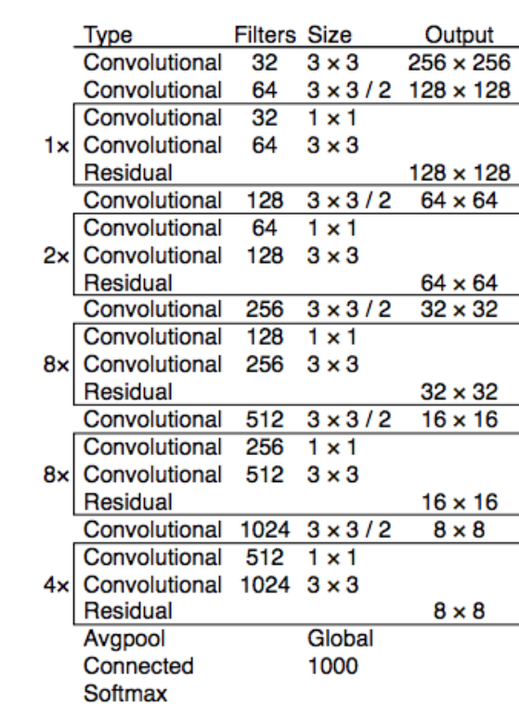
YOLOv3
Darknet-53: the predecessor YOLO v2 used Darknet-19 as feature extractor and YOLO v3 uses the Darknet-53 network for feature extractor which has 53 convolutional layers.
It is much deeper than the YOL v2 and also had shortcut connections. Darknet-53 composes of the mainly with 3x3 and 1x1 filters with shortcut connections.

Slide 12
METHODOLOGY & IMPLEMENTATION

Slide 13
RESULTS & CONCLUSIONS
Yolov3 displayed the highest performance among all object detection algorithms so far with a mAP of 99.16%.
In comparison to other object detection algorithms, Yolov3 displays higher accuracy, lowest inference or processing time.
Accuracy of Microsoft Vision API – 92%
Accuracy of Google Cloud Vision API – 95%
The performance of OCR applications are very competitive, and it also depends on various factors such as angle, clarity of the image or video.

Slide 14
ADVANTAGES
YOLO v3 has more layers(106 layers ) as compared to YOLOv2(30 layers) & YOLOv1(26 layers)
YOLOv3 predicts smaller objects better(3 scaled versions of the same image passed) as compared to other versions.
9 anchor boxes taken than YOLOv2(3 anchors) and YOLOv1(No anchors) helping in better detection.
Improved loss function for YOLOv3.
Multilabel detections as compared to multiclass(YOLOv2 & YOLOv1).

Slide 15
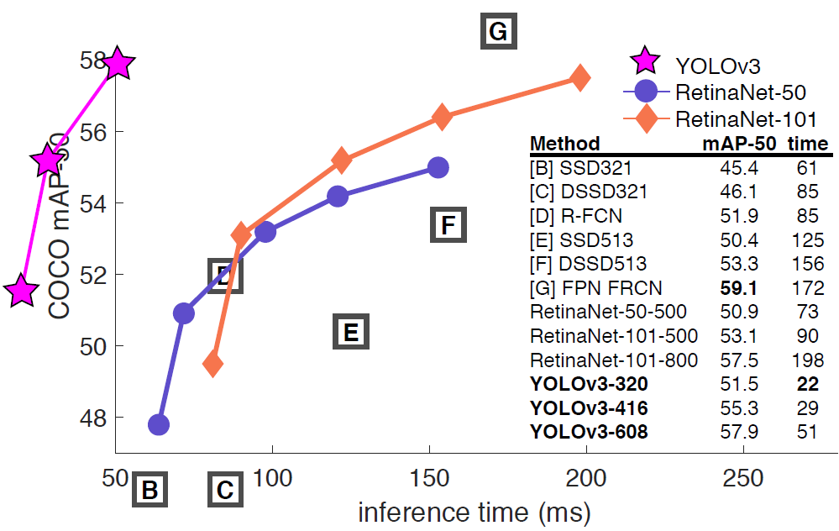

Slide 16
REFERENCES
1. Redmon, Joseph, et al. "You only look once: Unified, real-time object detection." Proceedings of the IEEE conference on computer vision and pattern recognition. 2016.
2. Redmon, Joseph, and Ali Farhadi. "YOLO9000: better, faster, stronger." Proceedings of the IEEE conference on computer vision and pattern recognition. 2017.
3. Redmon, Joseph, and Ali Farhadi. "Yolov3: An incremental improvement." arXiv preprint arXiv:1804.02767 (2018).

