Slide 1
Simulation of a 2D SIR Model Using OpenMP, MPI, and Hybrid Parallelism
Izzy Moore and Michael Saban
COMP 464
12/10/25
Notes:
MS

Slide 2
Background: SIR Model
3 States
Susceptible (chance to become infected if there are infected neighbors)
Infected (can infect neighbors, will eventually become resistant)
Resistant (no chance to become infected, but will eventually become susceptible)
Why it’s a good HPC problem
2D Grid
Stencil update
Large problem sizes
Highly parallelizable
https://github.com/VictorGordan/sir_model
Notes:
MS
Explanation of SIR epidemiological model
How it relates to GOL (similarities and differences)

Slide 3
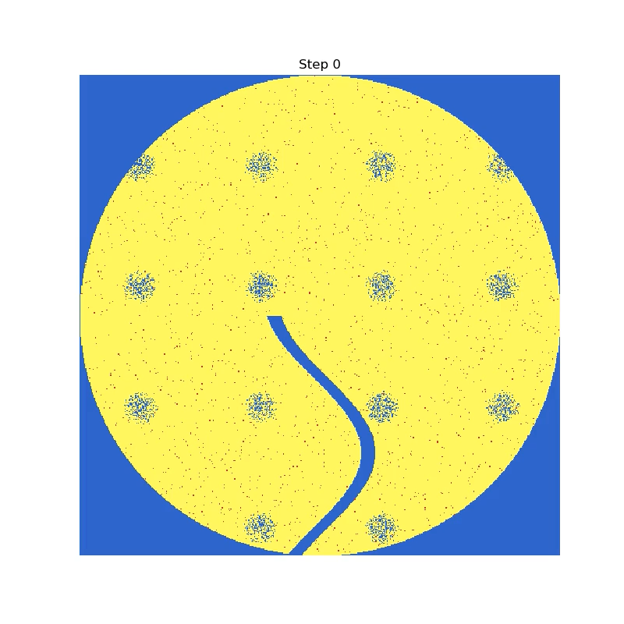
Original Baseline Code
Started from Victor Gordan’s SIR Model repo
Removed GUI
Replaced image-based updates with synthetic data generation
2D grid of size N x N
initialInfectious = % of initial infected cells
infectiousTime = # steps a cell is infectious before turning resistant
resistantTime = # steps a cell is resistant before turning susceptible
Cell updates based on neighbors at each step
https://github.com/VictorGordan/sir_model
Notes:
MS

Slide 4

Quick Reference to Conway's GOL rules
Local neighborhood
Cells can be in an "alive" or "dead" State, each step in the algorithm checks the following rules to update the next state of the cell :
Any alive cell with fewer than two live neighbors becomes dead.
Any alive cell with (2-3) alive neighbors persists.
Any alive cell with (>3) alive neighbors becomes dead.
Any dead cell with exactly 3 live neighbors becomes alive.
cell
Notes:
IM

Slide 5
Quick Reference to Conway's GOL rules
Cells can be in an "alive" or "dead" State, each step in the algorithm checks the following rules to update the next state of the cell :
Any alive cell with fewer than two live neighbors becomes dead.
Any alive cell with (2-3) alive neighbors persists.
Any alive cell with (>3) alive neighbors becomes dead.
Any dead cell with exactly 3 live neighbors becomes alive.
ex #1
Notes:
IM

Slide 6
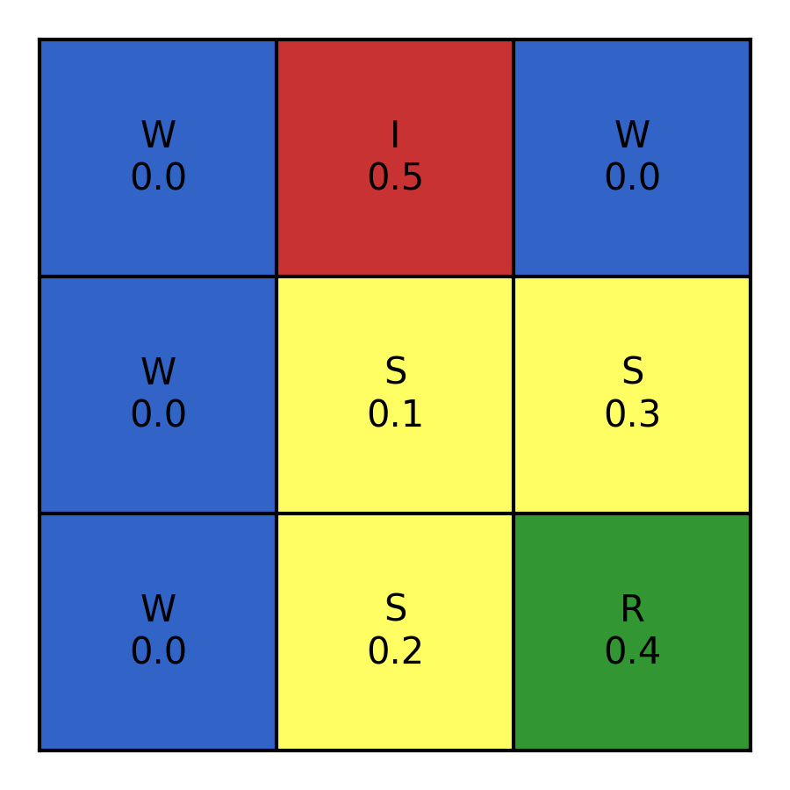
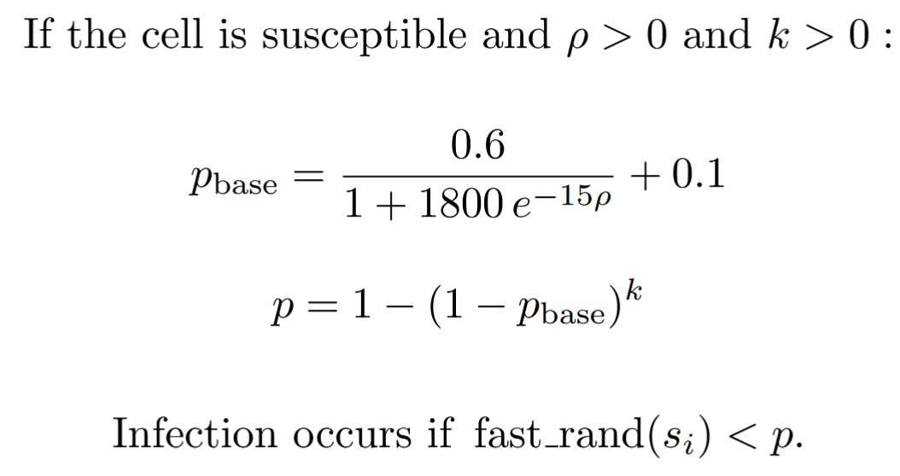


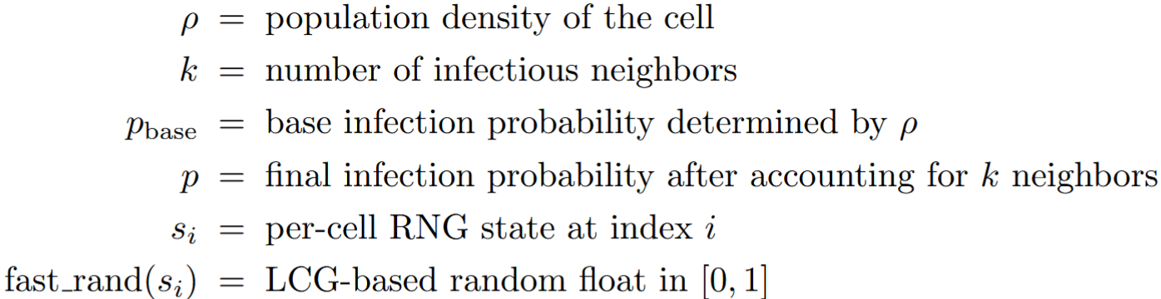
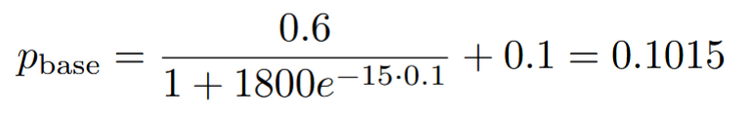

Update Example
Notes:
MS

Slide 7
Parallelization Overview and Benchmark Design
OpenMP (shared memory)
MPI (distributed memory)
Blocking
Non-blocking
Hybrid (MPI + OpenMP)
Benchmark Design
Grid Sizes | 500, 1000, 2000, 5000, 10000, 20000
Steps | 1000
OpenMP Threads | 1, 2, 4, 8, 16
MPI Processes | 1, 2, 4, 8, 16, 32, 64
Notes:
MS

Slide 8



OpenMP Design and Performance
initialize()
Splits loop iterating over each cell into equal-sized chunks
print_stats()
Parallelizes state counting while preventing race conditions
update()
Merges nested loop over rows and columns into 1 iteration and divides iteration equally over threads
Notes:
MS

Slide 9
OpenMP Design and Performance
initialize()
Splits loop iterating over each cell into equal-sized chunks
print_stats()
Parallelizes state counting while preventing race conditions
update()
Merges nested loop over rows and columns into 1 iteration and divides iteration equally over threads
Notes:
MS

Slide 10
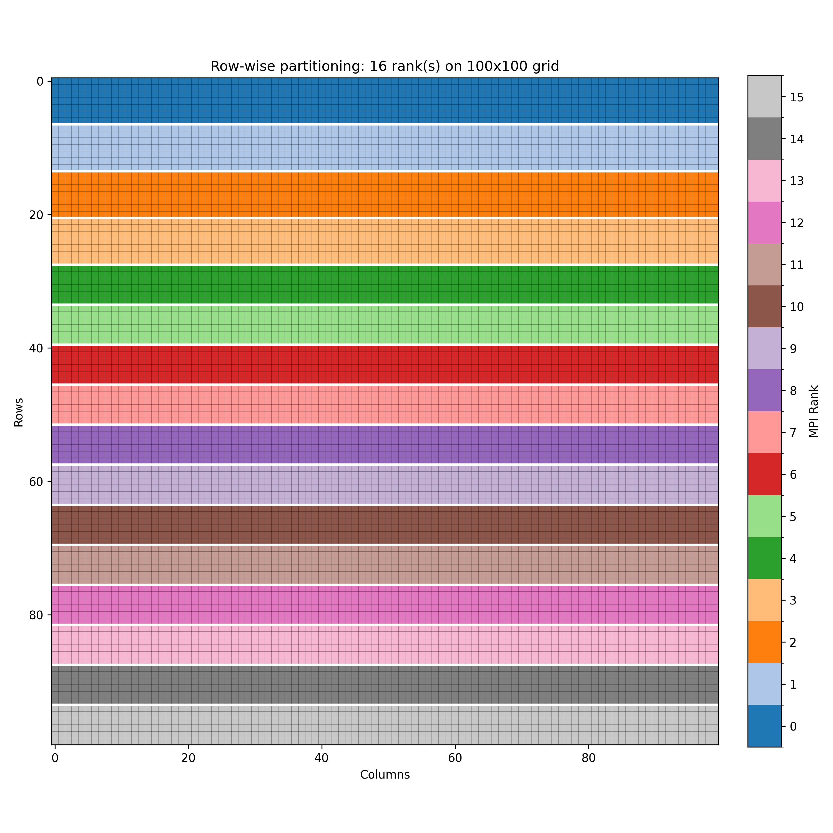
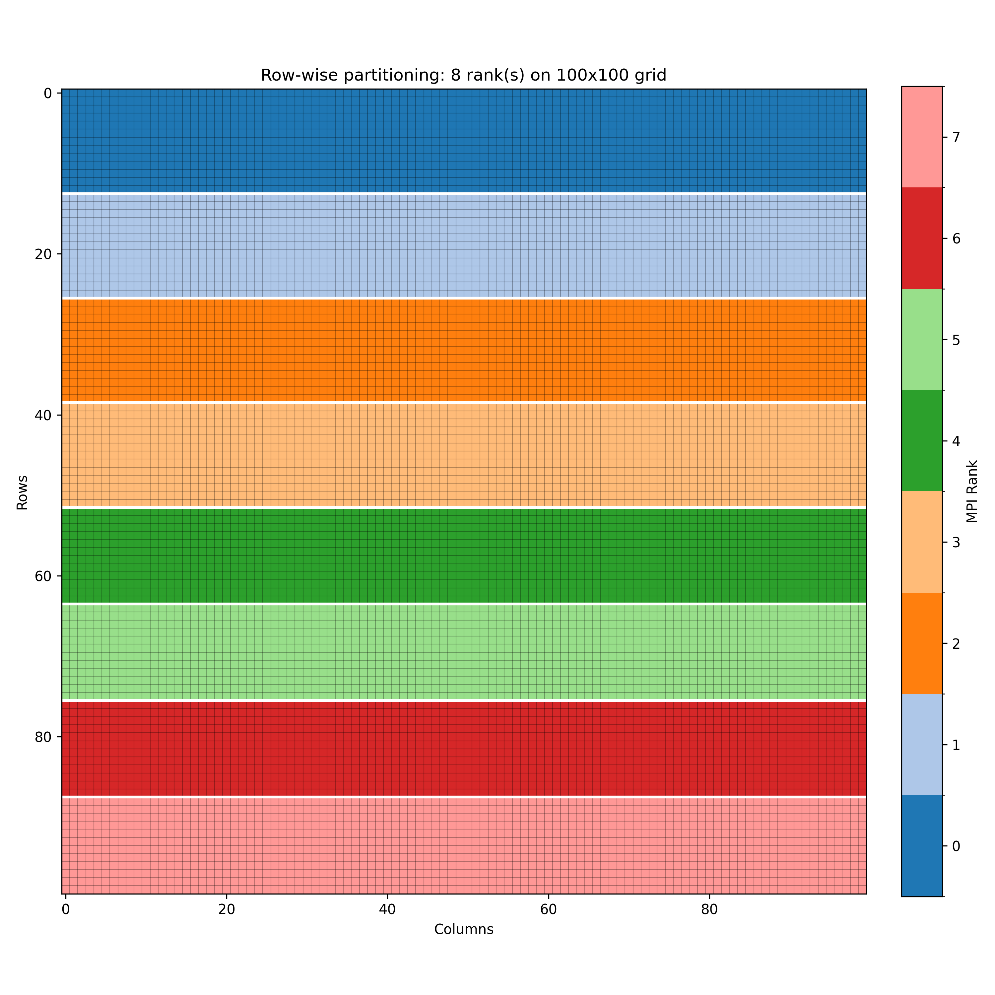
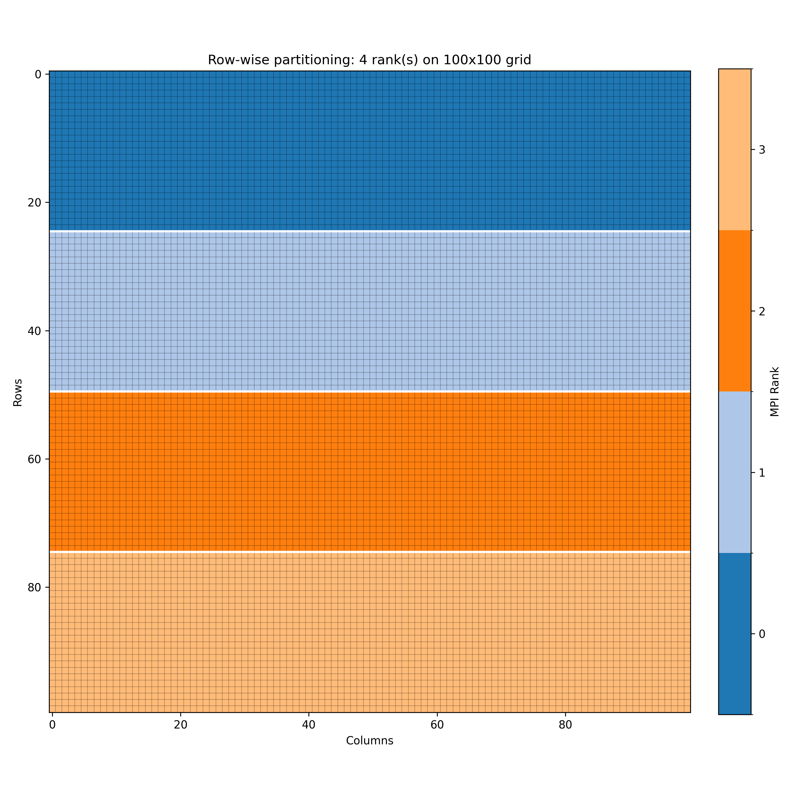
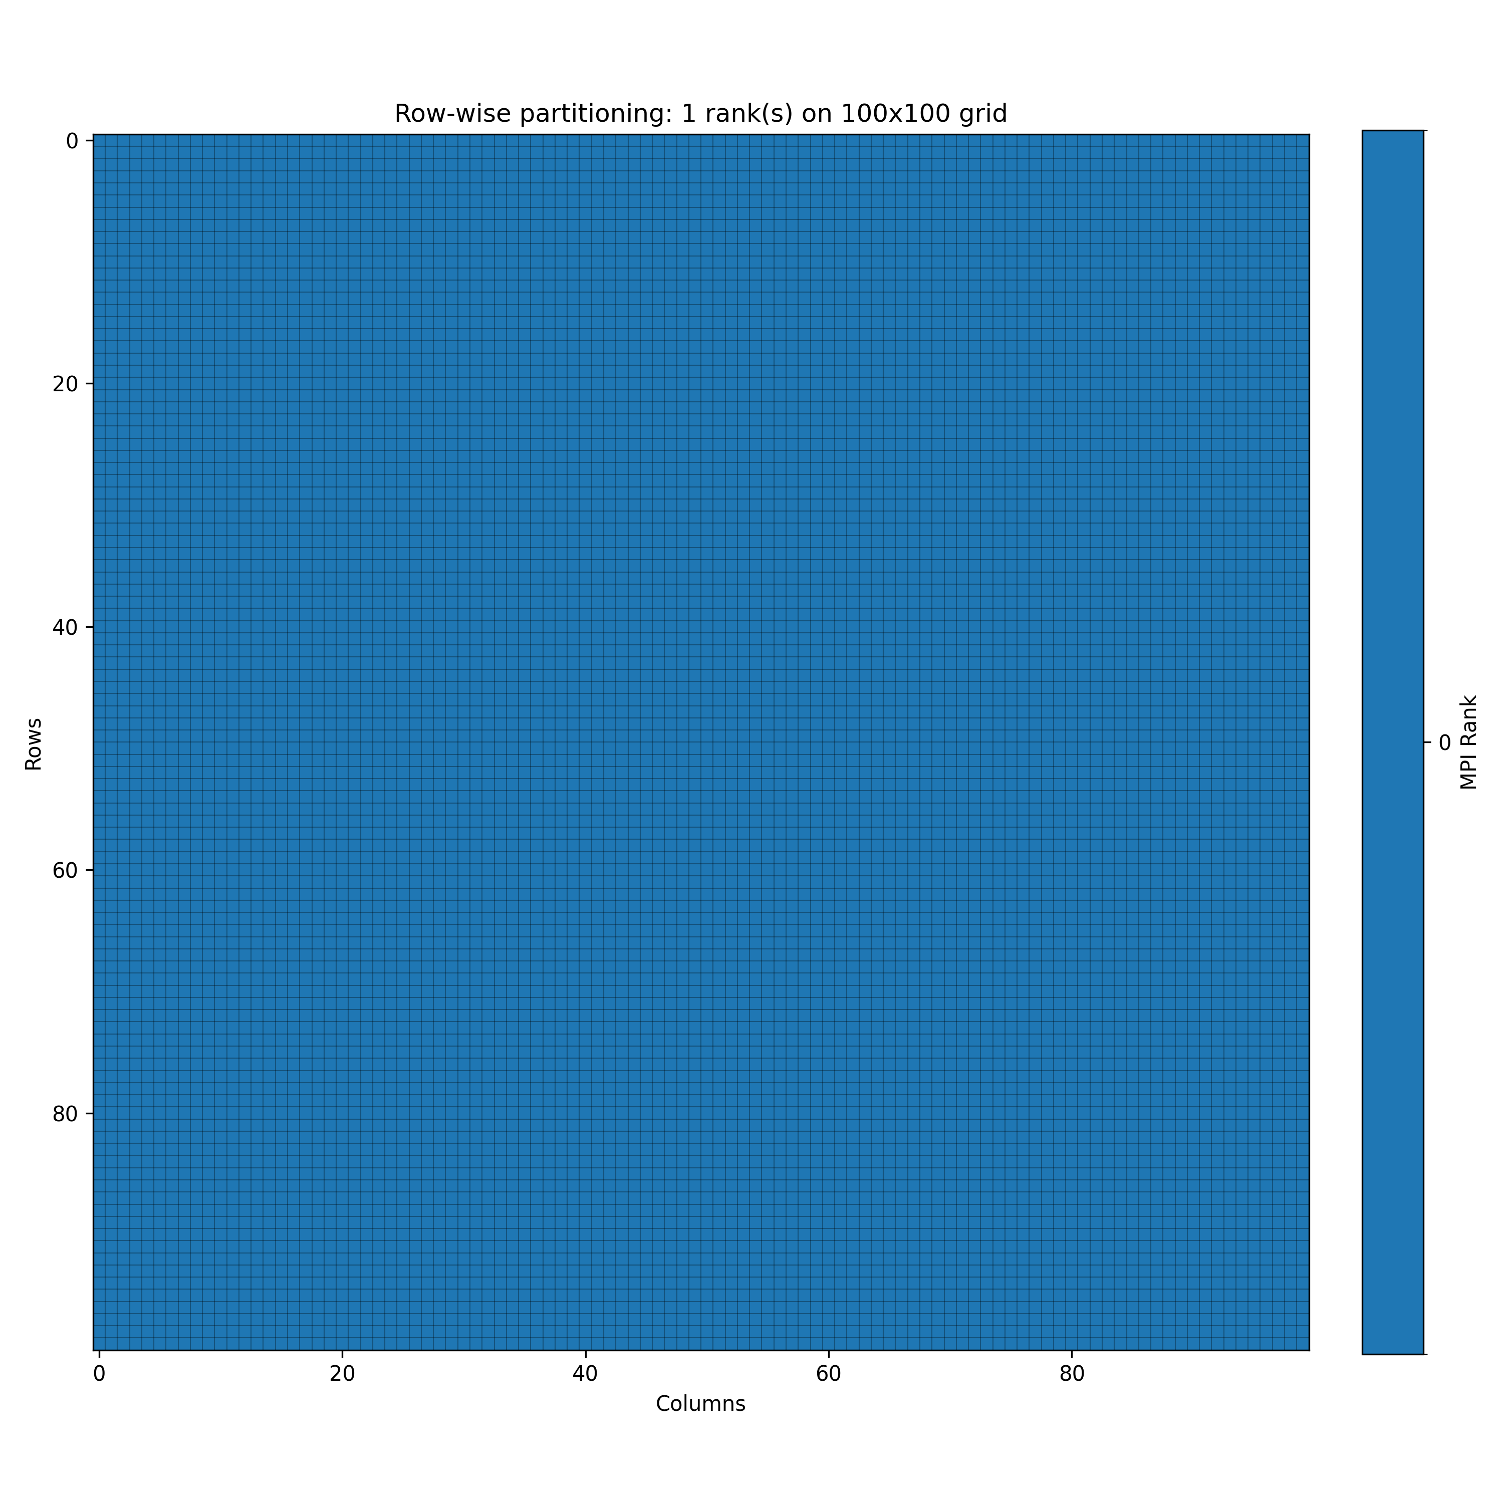
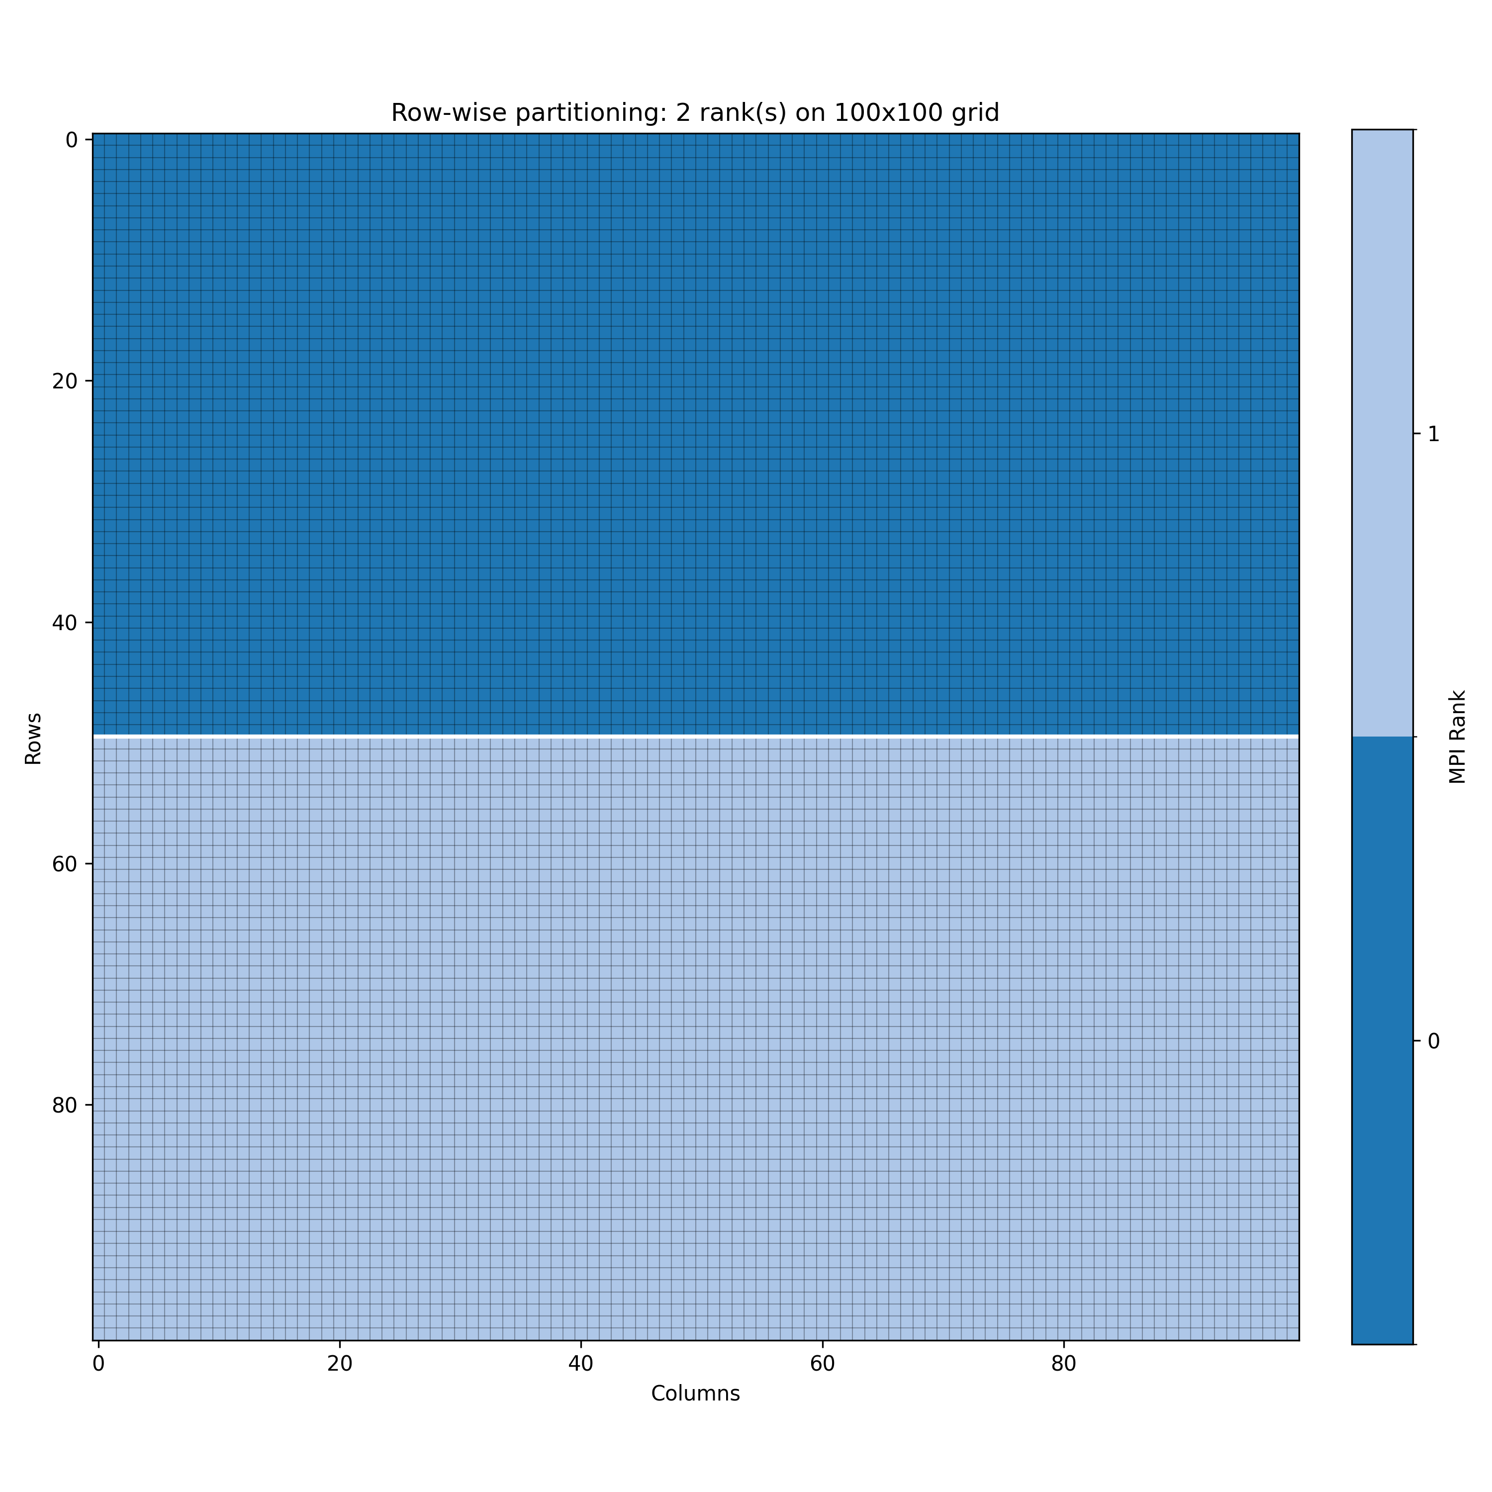

MPI Design
We chose a horizontal partition for halo row exchanges
Partition #1
updated row
Halo row
Halo row
updated row
Partition #2
Notes:
both

Slide 11
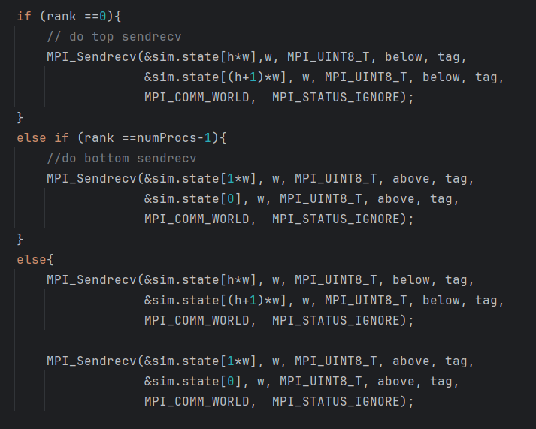
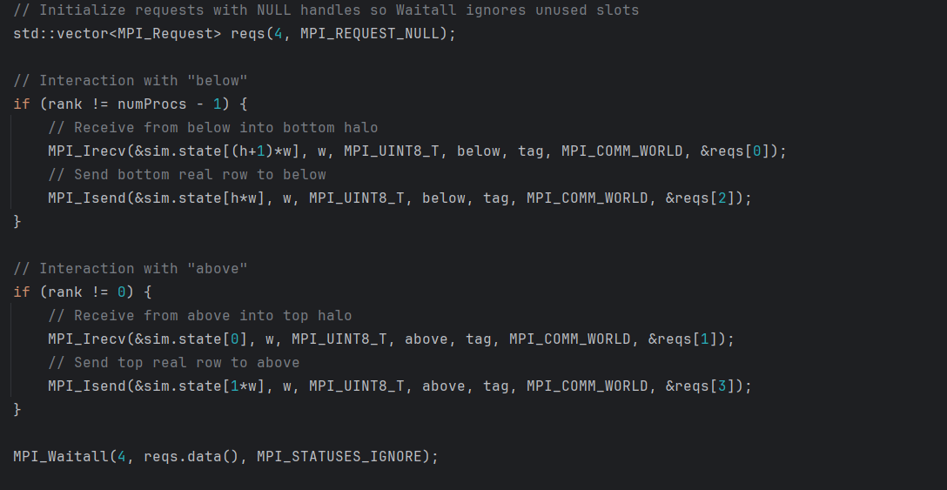
MPI Design
Blocking: MPI_Sendrecv
Non-Blocking: MPI_Isend / MPI_Irecv
Notes:
IM

Slide 12
MPI Performance – Total Time
Blocking
Non-Blocking
Notes:
IM

Slide 13
MPI Performance - Speedup
Blocking
Non-Blocking
Notes:
MS

Slide 14
MPI Performance - Efficiency
Blocking
Non-Blocking
Notes:
MS

Slide 15
Hybrid MPI + OpenMP Design and Performance
The Hybrid design is inspired by section 2.6.4 of Eijkhout
Essentially MPI is used for communication across multiple nodes/processes on the cluster and then each process is parallelized and executes as multiple threads using OpenMP.
There were not many changes necessary to adopt this to our problem since our partitioning with MPI was roughly independent of the OpenMPI pragmas invoked in the core section of the algorithm.
Notes:
IM

Slide 16
Hybrid Performance
Speed-up
Total Time
Efficiency
Notes:
IM

Slide 17
Hybrid Performance for Largest Gridsize
p | t | Time (s)
64 | 8 | 186.069
64 | 4 | 186.748
64 | 16 | 195.931
32 | 4 | 259.722
32 | 8 | 263.556
32 | 16 | 272.647
16 | 4 | 367.259
8 | 8 | 368.945
4 | 16 | 386.057
32 | 1 | 386.943
16 | 8 | 392.943
8 | 16 | 405.168
Notes:
IM

Slide 18
Overall Comparisons
Grid Width | Serial Time (s) | OpenMP 16 Time (s) | OpenMP Speedup | MPI 64 Time (s) | MPI Speedup | MPI-NB 64 time (s) | MPI-NB Speedup | Hybrid 64 Time (s) | Hybrid 64 Speedup
500 | 10.15 | 1.43 | 7.07x | 0.24 | 42.41x | 0.21 | 47.87x | - | -
1000 | 37.58 | 5.16 | 7.28x | 0.73 | 51.86x | 0.93 | 40.46x | - | -
2000 | 153.69 | 14.94 | 10.29x | 3.4 | 45.98x | 3.09 | 49.83x | - | -
5000 | 984.98 | 105.21 | 9.36x | 18.62 | 52.91x | 15.45 | 63.75x | - | -
10000 | 3715.41 | 397.68 | 9.34x | 68.76 | 54.04x | 62.80 | 59.17x | - | -
20000 | 15741.20 | 1428.63 | 11.02x | 311.21 | 50.58x | 232.90 | 67.59x | 186.07 | 84.60x
4.4 hours
3.1 minutes
Notes:
MS

Slide 19
Lessons Learned / Next Steps
MPI debugging is hard!
Parallelism does not guarantee speedup
How you decide to partition your data for dispersal/collection with MPI makes significant changes to your algorithm necessary.
Notes:
MS

Slide 20
Thank you! Questions?

