Slide 1
SVD - SNR Enhancement for multiple gathers
lexicographic transform shots (matrices) to vectors
combine all shots (vectors) in a large data matrix
apply svd to the data matrix
undo lexicographic ordering (back to matrices)

Slide 2
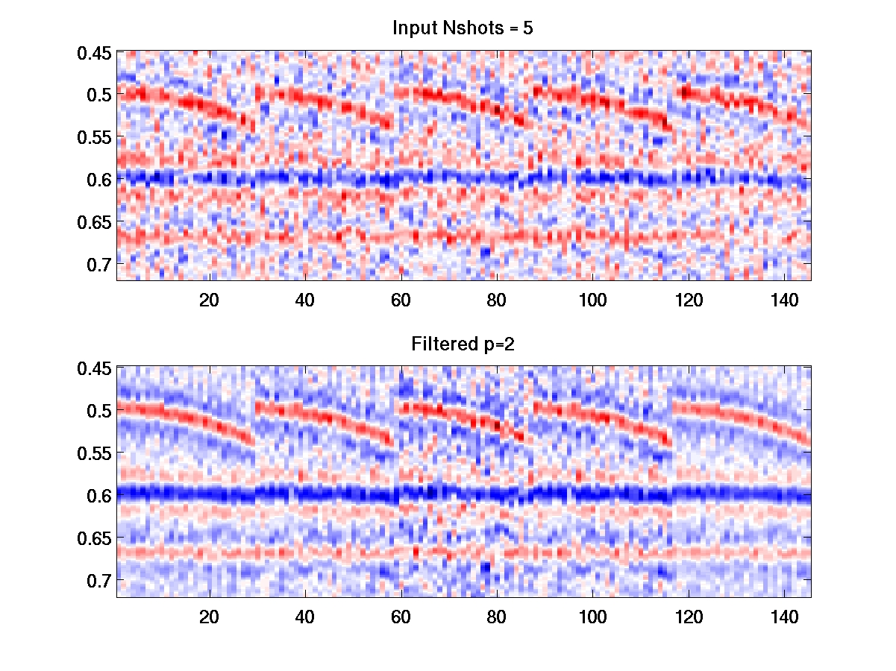
5 shots

Slide 3
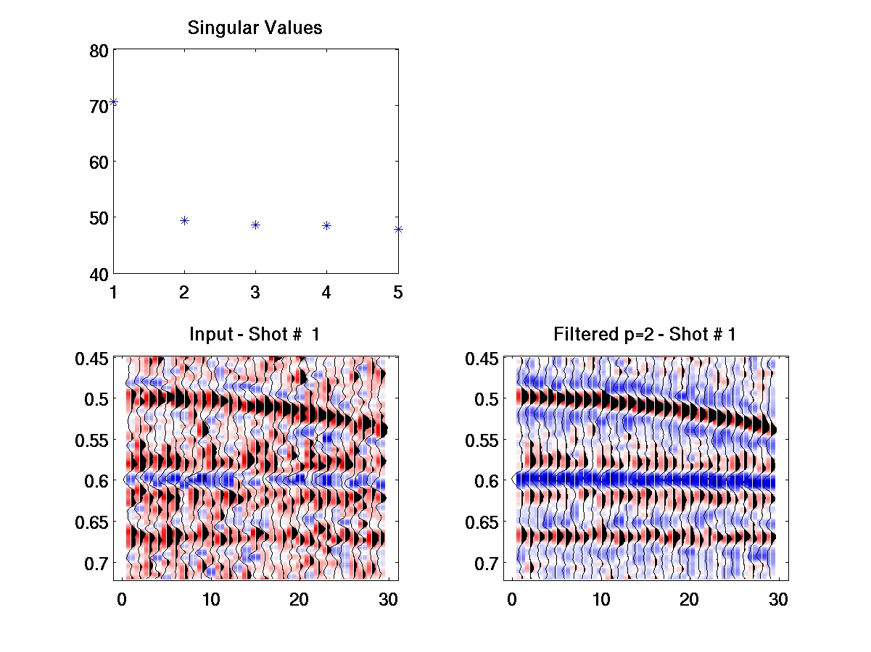
5 shots

Slide 4
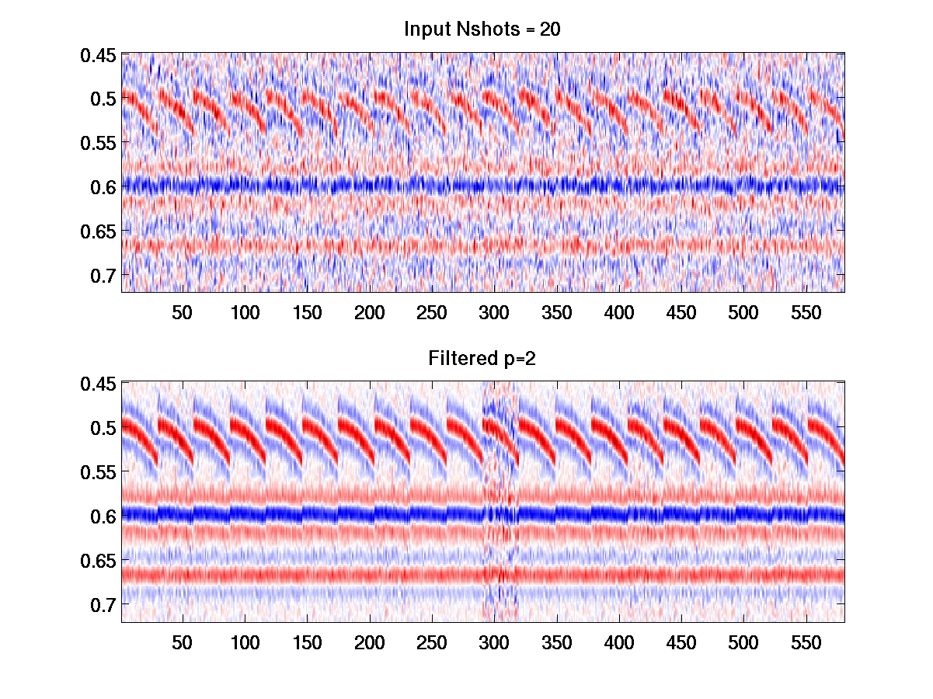
20 shots

Slide 5
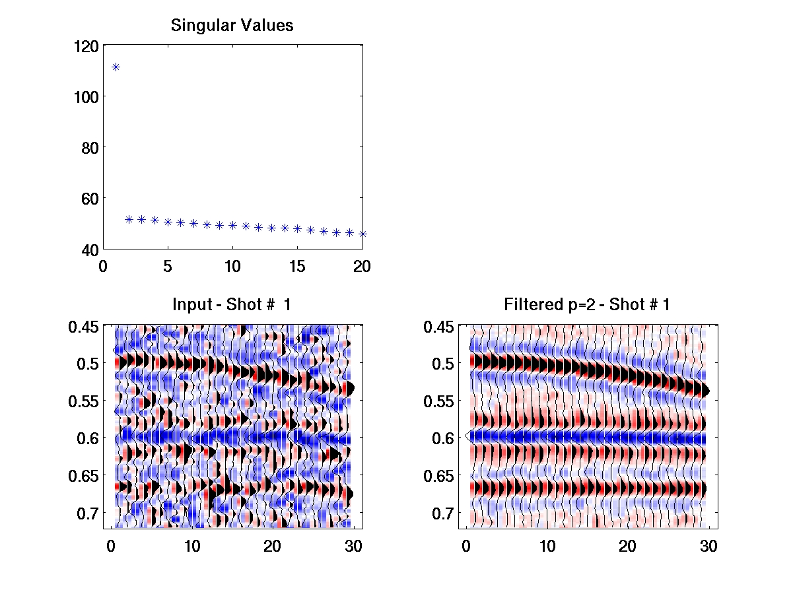
20 shots

Slide 6
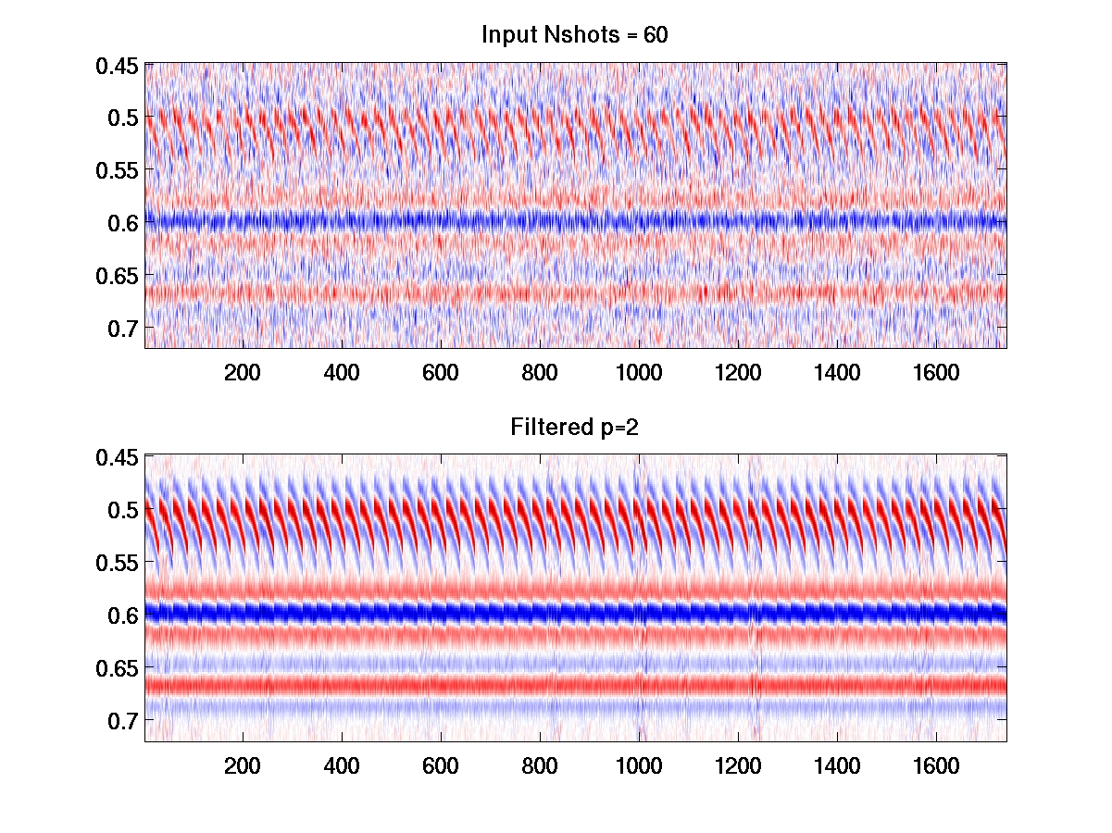
60 shots

Slide 7
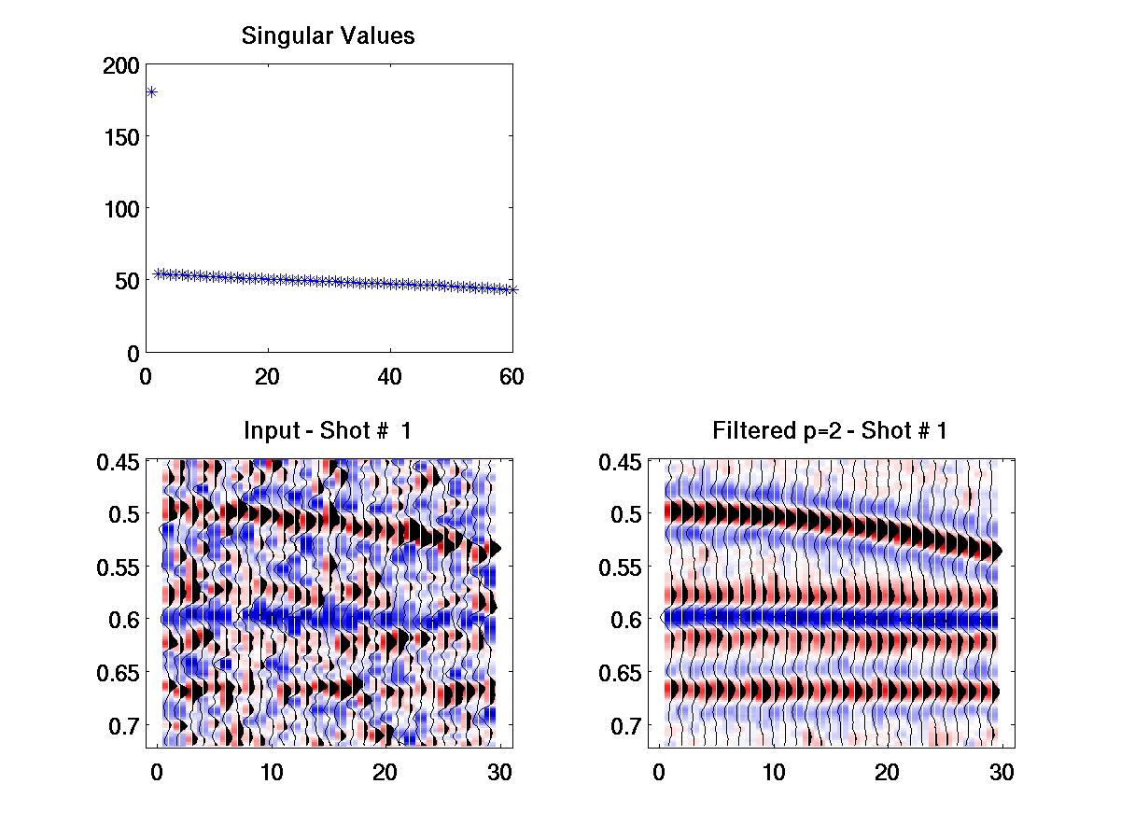
20 shots

Slide 8
So simple..
x = reshape(D, nt*nx,nshots);
[U,S,V]=svd(x,0);
p = 2;`
U = U(:,1:p);
V = V(:,1:p);
Sf = S(1:p,1:p);
xr = U*Sf*V';
Dr = reshape(xr,nt,nx*nshots);

