Slide 1
Map Reduce
MapReduce is a programming model for parallel data processing. It handles parallelization, data distribution, fault tolerance.
User runs a program on the client computer
Job contains:
Input data
Map / Reduce program
Configuration information
Two types of daemons that control job execution:
Job Tracker (master node)
The Job-Tracker is responsible for accepting jobs from clients, dividing those jobs into tasks, and assigning those tasks to be executed by worker nodes.
Task Trackers (slave nodes)
Task-Tracker is a process that manages the execution of the tasks currently assigned to that node. Each Task Tracker has a fixed number of slots for executing tasks (two maps and two reduces by default).

Slide 2
MapReduce - Input Format
How the input files are split up and read is defined by the InputFormat class.
Selects the files that should be used for input
Defines InputSplit for a file defines a slice of work for each map task
Provides a factory for RecordReader objects that read the file
Input Split
An input split describes a unit of work that comprises a single map task in a MapReduce program
By default, the InputFormat breaks a file upto 64MB splits
By dividing the file into splits, we allow several map tasks to operate on a single file in parallel
If the file is very large, this can improve performance significantly through parallelism
Each map task corresponds to a single input split
Record Reader
The input split defines a slice of work but does not describe how to access it
The RecordReader class actually loads data from its source and converts it into (K, V) pairs suitable for reading by Mappers
The RecordReader is invoked repeatedly on the input until the entire split is consumed
Each invocation of the RecordReader leads to another call of the map function defined by the programmer

Slide 3
Mapper and Reducer
The Mapper performs the user-defined work of the first phase of the MapReduce program.
A new instance of Mapper is created for each split.
Map function
Operate on set of key, value pairs
Map is applied in parallel on input data set
This produces output keys and list of values for each key depending upon the functionality
The Reducer performs the user-defined work of the second phase of the MapReduce program.
A new instance of Reducer is created for each partition.
For each key in the partition assigned to a Reducer, the Reducer is called once.
Reduce function
Operate on set of key, value pairs
Reduce is then applied in parallel to each group, again producing a collection of key, values.
Total number of reducers can be set by the user.

Slide 4
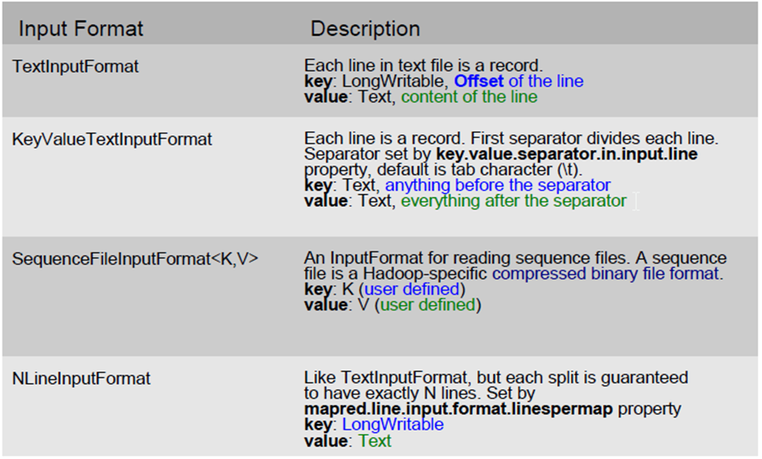
MapReduce API - InputFormats

Slide 5


















MR Execution
1. Copy Input Files
DFS
Job.xml. Job.jar.
Input Files
3. Get Input Files’ Info
5. Upload Job Information
Client
2. Submit Job
User
4. Create Splits
8. Read Job Files
6. Submit Job
DFS
Job Tracker
Input Spilts
As many maps as splits
Task Tracker - H2
Job Tracker
11. Picks Tasks
(Data Local if possible)
9. Create maps and reduces
Task Tracker – H4
Maps
Reduces
Task Tracker -
H1
10. Heartbeat
12. Assign Tasks
11. Picks Tasks
(Data Local if possible)
Task Tracker - H2
10. Heartbeat
H4
7. Initialize Job
Job Queue

Slide 6
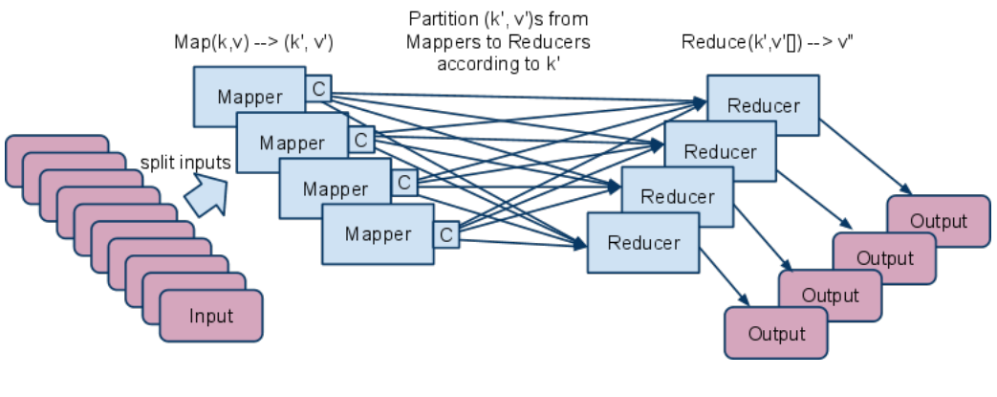
Combiner & Partitioner
Combiner
Apply reduce function to map output before it is sent to reducer
Reduces number of records outputted by mapper!
Partitioner
Each mapper may produce (K, V) pairs to any partition.
Therefore, the map nodes must all agree on where to send different pieces of intermediate data.
The partitioner class determines which partition a given (K,V) pair will go to.
The default partitioner computes a hash value for a given key and assigns it to a partition based on this result.

Slide 7
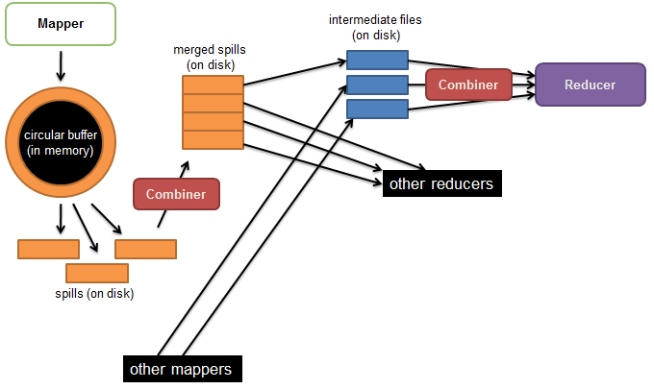
Shuffle and Sort
Probably the most complex aspect of MapReduce and heart of the map reduce!
Map side
Map outputs are buffered in memory in a circular buffer.
When buffer reaches threshold, contents are “spilled” to disk.
Spills merged in a single, partitioned file (sorted within each partition): combiner runs here first.
Reduce side
First, map outputs are copied over to reducer machine.
“Sort” is a multi-pass merge of map outputs (happens in memory and on disk): combiner runs here again.
Final merge pass goes directly into reducer.

Slide 8
Output Format
The OutputFormat class defines the way (K,V) pairs produced by Reducers are written to output files
The instances of OutputFormat provided by Hadoop write to files on the local disk or in HDFS
Several OutputFormats are provided by Hadoop:
TextOutputFormat - Default; writes lines in "key \t value" format
SequenceFileOutputFormat - Writes binary files suitable for reading into subsequent MR jobs
NullOutputFormat - Generates no output files

Slide 9
Fault Tolerance
MapReduce can guide jobs toward a successful completion even when jobs are run on a large cluster where probability of failures increases
The primary way that MapReduce achieves fault tolerance is through restarting tasks
If a TT fails to communicate with Application Manager for a period of time (by default, 1 minute in Hadoop), JT will assume that TT in question has crashed
If the job is still in the map phase, JT asks another TT to re-execute all Mappers that previously ran at the failed TT
If the job is in the reduce phase, Application Manager asks another TT to re-execute all Reducers that were in progress on the failed TT

Slide 10
Speculative Execution
A MapReduce job is dominated by the slowest task
MapReduce attempts to locate slow tasks (stragglers) and run redundant (speculative) tasks that will optimistically commit before the corresponding stragglers
This process is known as speculative execution
Only one copy of a straggler is allowed to be speculated
Whichever copy (among the two copies) of a task commits first, it becomes the definitive copy, and the other copy is killed by JT

Slide 11
Map Reduce – Again Closure look
Node 1
Node 2
Files loaded from local HDFS store
Files loaded from local HDFS store
InputFormat
InputFormat
file
Split
Split
Split
Split
Split
Split
file
file
file
RecordReaders
RR
RR
RR
RR
RR
RR
RecordReaders
Input (K, V) pairs
Input (K, V) pairs
Map
Map
Map
Map
Map
Map
Intermediate (K, V) pairs
Shuffling
Process
Intermediate
(K,V) pairs
exchanged by
all nodes
Intermediate (K, V) pairs
Partitioner
Partitioner
Sort
Sort
Reduce
Reduce
Final (K, V) pairs
Final (K, V) pairs
OutputFormat
OutputFormat
Writeback to local HDFS store
Writeback to local HDFS store

Slide 12
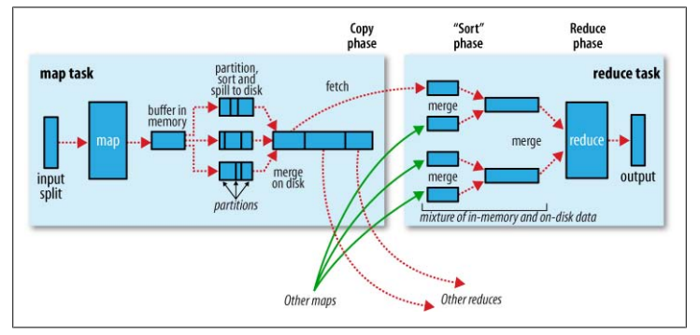
MapReduce Execution - One Picture

Slide 13
Counters
Counters are a useful channel for gathering statistics about the job: for quality control or for application-level statistics.
Task counters
Task counters gather information about tasks over the course of their execution, and the results are aggregated over all the tasks in a job.
The MAP_INPUT_RECORDS counter, for example, counts the input records read by each map task and aggregates over all map tasks in a job, so that the final figure is the total number of input records for the whole job.
Task counters are maintained by each task attempt, and periodically sent to the application master so they can be globally aggregated.
Job counters
Job counters are maintained by the application master, so they don’t need to be sent across the network, unlike all other counters, including user-defined ones. They
measure job-level statistics, not values that change while a task is running. For example, TOTAL_LAUNCHED_MAPS counts the number of map tasks that were launched over the course of a job (including tasks that failed).
User-Defined Java Counters
MapReduce allows user code to define a set of counters, which are then incremented as desired in the mapper or reducer. Counters are defined by a Java enum.

Slide 14
JOINS
MAP-JOIN
A map-side join between large inputs works by performing the join before the data reaches the map function. For this to work, though, the inputs to each map must be partitioned and sorted in a particular way. Each input dataset must be divided into the same number of partitions, and it must be sorted by the same key (the join key) in each source. All the records for a particular key must reside in the same partition. This may sound like a strict requirement (and it is), but it actually fits the description of the output of a MapReduce job.
Distributed Cache
It is preferable to distribute datasets using Hadoop’s distributed cache mechanism which provides a service for copying files to the task nodes for the tasks to use them when they run. To save network bandwidth, files are normally copied to any particular node once per job.
Reducer side –JOIN
Reduce-side join is more general than a map-side join, in that the input datasets don’t have to be structured in any particular way, but it is less efficient because both datasets have to go through the MapReduce shuffle. The basic idea is that the mapper tags each record with its source and uses the join key as the map output key, so that the records with the same key are brought together in the reducer.

Slide 15
Thank You

