Slide 1
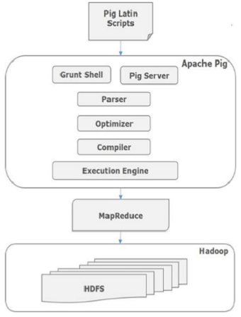
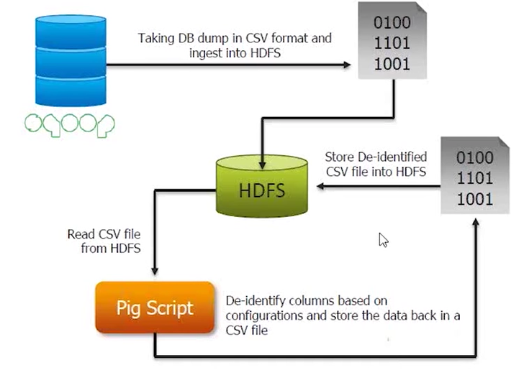
PIG Latin
Pig Latin is a data flow language used for exploring large data sets.

Slide 2
Introducing data types
Data type is a data storage format that can contain a specific type or range of values.
Scalar types : int, long,float, double, chararray, bytearray, boolean, datetime, biginteger, bigdecimal
Complex types : Tuple, Bag, Map
A = LOAD 'student.txt' USING PigStorage() AS (name:chararray, age:int, gpa:float);
DUMP A;
store B into ‘/hdfspath’;
Use schemas to assign types to fields. If you don't assign types, fields default to type bytearray and implicit conversions are applied to the data depending on the context in which that data is used.
If types are not specified in the load statement, Pig assumes the type of double for numeric computations. A lot of the time, your data would be much smaller, maybe, integer or long. Specifying the real type will help with speed of arithmetic computation.
--Query 1
A = load 'myfile' as (t, u, v);
--Query 2
A = load 'myfile' as (t: int, u: int, v);
B = foreach A generate t + u;
The second query will run more efficiently than the first. In some of our queries with see 2x speedup.
B = foreach A generate (name, age); // tuple construction
B = foreach A generate {(name, age)}, {name, gpa}; //bag construction
B = foreach A generate [name, gpa]; //MAP construction

Slide 3
PIG Latin Statements
A Pig Latin statement is an operator that takes a relation as input and produces another relation as output.
This definition applies to all Pig Latin operators except LOAD and STORE command which read data from and write data to the file system.
In PIG when a data element is null it means its unknown.
Pig Latin statements can span multiple lines and must end with a semi-colon ( ; )
The names (aliases) of relations A, B, and C are case sensitive.
The names (aliases) of fields f1, f2, and f3 are case sensitive.
Function names PigStorage and COUNT are case sensitive.
Keywords LOAD, USING, AS, GROUP, BY, FOREACH, GENERATE, and DUMP are case insensitive. They can also be written as load, using, as, group, by, etc.
Pig Latin statements are generally organized in the following manner:
A LOAD statement reads data from the file system.
A series of "transformation" statements process the data.
A STORE statement writes output to the file system;
A DUMP statement displays output to the screen
Diagnostic operator
DESCRIBE: Prints a relation’s schema.
EXPLAIN: Prints the logical and physical plans.
ILLUSTRATE: Shows a sample execution of the logical plan, using a generated subset of the input.

Slide 4
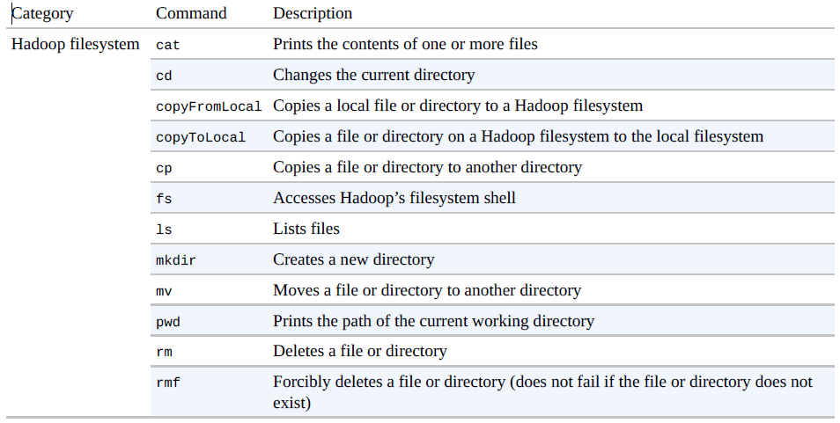
File System Commands

Slide 5
Relational Operator
FileA.txt
1 2 3
4 2 1
8 3 4
4 3 3
7 2 5
8 4 3
FileB.txt
2 4
8 9
1 3
2 7
2 9
4 6
4 9
FILTER
X = FILTER A BY a3 == 3;
X = FILTER A BY $1 is not null;
Removes duplicate tuples in a relation.
X = FOREACH A GENERATE $2;
Y = DISTINCT X;
Computes the cross product of two or more relations.
X = CROSS A, B;
To Union two datasets
C = UNION A,B;
Split a relation into two or more relations.
SPLIT A INTO X IF $1 > 3, Y IF $1<= 7;
To display only 100 records
B = limit A 100;
Foreach generate
S1 = foreach A generate $0, $1;
K = foreach A generate $1, $2, $1*$2;
Sort
B = ORDER A BY $0, $1 DESC;

Slide 6
Relational Operator
Group
Groups the data in one relations.
B = GROUP A BY age;
DUMP B;
C = FOREACH B GENERATE group, COUNT(A);
C = FOREACH B GENERATE $0, $1.name;
COGROUP is used in statements involving two or more relations
X = COGROUP A BY $0, B BY $0;
X = COGROUP A BY $0 INNER, B BY $0 INNER;
Flatten un-nests tuples as well as bags.
Example, consider a relation (a, (b, c)).
GENERATE $0, flatten ($1) – will end up in (a, b, c)
Example, consider a bag ({(b,c),(d,e)})
GENERATE flatten($0), will end up with two tuples (b,c) and (d,e)
JOIN:
X= JOIN A BY $0, B BY $0;
which is equivalent to:
X = COGROUP A BY $0 INNER, B BY $0 INNER;
Y = FOREACH X GENERATE FLATTEN(A), FLATTEN(B);
Student.txt
John,18,4.0
Mary,19,3.8
Bill,20,3.9
Joe,18,3.8

Slide 7
Types of JOIN
Skewed join
Skewed join can be used when the user needs a control over the allocation of reducers to counteract the skew.
It should also be used when the data associated with a given key is too large to fit in memory.
big = LOAD 'big_data' AS (b1,b2,b3);
massive = LOAD 'massive_data' AS (m1,m2,m3);
C = JOIN big BY b1, massive BY m1 USING ‘skewed’;
Currently PIG do not support more than two datasets for skewed join. Specifying three-way (or more) joins will fail validation. For such joins, break them into two-way joins
Replicated Joins
Replicate join is a special type of join that works well if one or more relations are small enough to fit into main memory. In such cases, Pig can perform a very efficient join because all of the hadoop work is done on the map side.
big = LOAD 'big_data' AS (b1,b2,b3);
tiny = LOAD 'tiny_data' AS (t1,t2,t3);
mini = LOAD 'mini_data' AS (m1,m2,m3);
res = JOIN big BY b1, tiny BY t1, mini BY m1 USING 'replicated';
In this example, a large relation is joined with two smaller relations. Note that the large relation comes first followed by the smaller relations; and, all small relations together must fit into main memory, otherwise an error is generated.
Merge Joins
Often user data is stored such that both inputs are already sorted on the join key. In such case, it is possible to join the data in the map phase of a MapReduce job.
This provides a significant performance improvement as it avoids to pass all the data through sort and shuffle phases.
C = JOIN A BY a1, B BY b1, C BY c1 USING 'merge';
(It works on pre-sorted data, and does not sort data for you.)

Slide 8
Functions
AVG
A = LOAD 'student.txt' AS (name:chararray, term:chararray, gpa:float);
B = GROUP A BY name;
DUMP B;
C = FOREACH B GENERATE A.name, AVG(A.gpa);
DUMP C;
CONCAT
X = FOREACH A GENERATE CONCAT(name,term);
DUMP X;
TOKENIZE
Use the TOKENIZE function to split a string of words
A = LOAD 'data' AS (f1:chararray);
X = FOREACH A GENERATE TOKENIZE(f1);
DUMP X;
({(Here),(is),(the),(first),(string.)})
({(Here),(is),(the),(second),(string.)})
({(Here),(is),(the),(third),(string.)})
(John,fl,3.9F)
(John,wt,3.7F)
(John,sp,4.0F)
(John,sm,3.8F)
(Mary,fl,3.8F)
(Mary,wt,3.9F)
(Mary,sp,4.0F)
(Mary,sm,4.0F)
(Here is the first string.)
(Here is the second string.)
(Here is the third string.)

Slide 9
HCatalog
Using Hive tables with HCatalog
HCatalog (which is a component of Hive) provides access to Hive’s metastore, so that Pig queries can reference schemas each time.
pig -useHCatalog
grunt> records = LOAD 'records' USING org.apache.hcatalog.pig.HCatLoader();
grunt> DESCRIBE records;
grunt> DUMP records;
Parameter Substitution
Pig supports parameter substitution, where parameters in the script are substituted with values supplied at runtime.
Parameters are denoted by identifiers prefixed with a $ character; for example, $input and $output are used in the following script to specify the input and output paths:
records = LOAD '$input' AS (year:chararray, temperature:int);
STORE records into '$output';
Parameters can be specified when launching Pig using the -param option, once for each parameter:
pig -param input=/user/tom/input/ncdc/micro-tab/sample.txt -param output=/tmp/out /path/max_temp_param.pig

Slide 10
Sample programs
Write WordCount Program
x = load '/user/sandeepm/SampleDataFile/WordCountSample.txt';
y = foreach x generate flatten (TOKENIZE ((chararray) $0)) as word;
z = group y by word;
counter = foreach z generate COUNT(y), group;
store counter into ‘/NewPigData/WordCount’;
Find Maximum Score (i/p: CricketScore.txt)
a = load '/user/cloudera/SampleDataFile/CricketScore.txt' using PigStorage('\t');
b = foreach a generate $0, $1;
c = group b by $0;
d = foreach c generate group, max(b.$1);
dump d;
WebCount
records = LOAD ‘webcount’ using PigStorage (‘\t’) as (country:chararray, name:chararray, pagecount:int, year:int);
filtered_records = filter records by country == ‘en’;
grouped_records = group filtered_records by name;
results = foreach grouped_records generate group, SUM (filtered_records.pagecount);
sorted_result = order results by $1 desc;
store sorted_result into ‘/hivetable’; -- Hive external table path
En,google.com,70,2012
En,yahoo.com,60,2013
Us,google.com,80,2012
En,google.com,40,2014
Us,google.com,80,2012

Slide 11
Macro
Macro is a kind of function written in Pig for reusability of scripts.
10,Balu,10000,15
15,Bala,20000,25
30,Sai,30000,15
40,Nirupam,40000,35
Example without Macro
emp = load '/data/employee‘ using PigStorage(',') as (eno,ename,sal,dno);
B = filter emp by dno==15;
Create a macro
DEFINE myfilter (a, b, val) returns x { $x = filter $a by $b == $val; };
Use of macro
A = load '/user/cloudera/SampleDataFile/Employee 'using PigStorage(',') as (eno,ename,sal,dno);
B = myfilter( A, dno,15);
Macro code can be a separate file to use in different scripts.
Save it as myfilter.macro
Import macro file in another pig Latin script file.
IMPORT '/path/to/myfilter.macro‘
emp = load '/data/employee‘ using PigStorage(',') as (eno,ename,sal,dno);
empres=myfilter(emp, dno,15);

Slide 12
UDF Sample Program
package myudfs;
import java.io.IOException;
import org.apache.pig.EvalFunc;
import org.apache.pig.data.Tuple;
public class UPPER extends EvalFunc<String>
{
public String exec(Tuple input) throws IOException {
if (input == null || input.size() == 0)
return null;
try{
String str = (String)input.get(0);
return str.toUpperCase();
}
catch(Exception e){
throw new IOException("Caught exception processing input row ", e);
}
}
}
Pig provides extensive support for user defined functions (UDFs) to specify custom processing.
REGISTER - Registers the JAR file with PIG runtime.
REGISTER myudfs.jar;
//JAR file should be available in local LINUX.
A = LOAD 'student_data‘ using PigStorage(‘,’) AS (name: chararray, age: int, gpa: float);
B = FOREACH A GENERATE myudfs.UPPER(name);
DUMP B;

Slide 13
Logical vs. Physical Plan
When the Pig Latin interpreter sees the first line containing the LOAD statement, it confirms that it is syntactically and semantically correct and adds it to the logical plan, but it does not load the data from the file (or even check whether the file exists). Pig validates the each statements, and adds them to the logical plan without executing them. The trigger for Pig is the DUMP. At that point, the logical plan is compiled into a physical plan and executed.
Multiquery execution
A = LOAD 'input/pig/multiquery/A';
B = FILTER A BY $1 == 0;
C = FILTER A BY $1 != 0;
STORE B INTO 'output/b';
STORE C INTO 'output/c';
Relations B and C are both derived from A, so to save reading A twice, Pig can run this script as a single MapReduce job by reading A once and writing two output files .
Exec Vs. Run.
exec runs the script in batch mode in a new Grunt shell, so any aliases defined in the script are not accessible to the shell after the script has completed.
On the other hand, with run, it is as if the contents of the script had been entered manually, so the command history of the invoking shell contains all the statements.

Slide 14
Performance Tuning
Pig does not (yet) determine when a field is no longer needed and drop the field from the row. For example, say you have a query like:
Project Early and Often
A = load 'myfile' as (t, u, v);
B = load 'myotherfile' as (x, y, z);
C = join A by t, B by x;
D = group C by u;
E = foreach D generate group, COUNT($1);
There is no need for v, y, or z to participate in this query. And there is no need to carry both t and x past the join, just one will suffice. Changing the query above to the query below will greatly reduce the amount of data being carried through the map and reduce phases by pig.
A = load 'myfile' as (t, u, v);
A1 = foreach A generate t, u;
B = load 'myotherfile' as (x, y, z);
B1 = foreach B generate x;
C = join A1 by t, B1 by x;
C1 = foreach C generate t, u;
D = group C1 by u;
E = foreach D generate group, COUNT($1);

Slide 15
Performance Tuning
As with early projection, in most cases it is beneficial to apply filters as early as possible to reduce the amount of data flowing through the pipeline.
Filter Early and Often
-- Query 1
A = load 'myfile' as (t, u, v);
B = load 'myotherfile' as (x, y, z);
C = filter A by t == 1;
D = join C by t, B by x;
E = group D by u;
F = foreach E generate group, COUNT($1);
-- Query 2
A = load 'myfile' as (t, u, v);
B = load 'myotherfile' as (x, y, z);
C = join A by t, B by x;
D = group C by u;
E = foreach D generate group, COUNT($1);
F = filter E by C.t == 1;
The first query is clearly more efficient than the second one because it reduces the amount of data going into the join.

Slide 16
Performance Tuning
Remove null values before join.
A = load 'myfile' as (t, u, v);
B = load 'myotherfile' as (x, y, z);
C = join A by t, B by x;
is rewritten by Pig to
A = load 'myfile' as (t, u, v);
B = load 'myotherfile' as (x, y, z);
C1 = cogroup A by t INNER, B by x INNER;
C = foreach C1 generate flatten(A), flatten(B);
Since the nulls from A and B won't be collected together, when the nulls are flattened we're guaranteed to have an empty bag, which will result in no output. But they will not be dropped until the last possible moment.
Hence the previous query should be rewritten as
A = load 'myfile' as (t, u, v);
B = load 'myotherfile' as (x, y, z);
A1 = filter A by t is not null;
B1 = filter B by x is not null;
C = join A1 by t, B1 by x;
Now nulls will be dropped before the join. Since all null keys go to a single reducer, if your key is null even a small percentage of the time the gain can be significant.

Slide 17
Performance Tuning
You can set the number of reduce tasks for the MapReduce jobs generated by Pig using parallel reducer feature.
set default parallel command is used at the script level.
In this example all the MapReduce jobs gets launched use 20 reducers.
SET default_parallel 20;
A = LOAD ‘myfile.txt’ USING PigStorage() AS (t, u, v);
B = GROUP A BY t;
C = FOREACH B GENERATE group, COUNT(A.t) as mycount;
D = ORDER C BY mycount;
PARALLEL clause can be used with any operator like group, cogroup, join, order by, distinct that starts reduce phase.
A = LOAD 'myfile' AS (t, u, v);
B = GROUP A BY t PARALLEL 18;
Use Joins appropriately.
Understand Skewed Vs. Replicated vs. Merge join.

Slide 18
Thank You

