Slide 1
20461C
Querying Microsoft® SQL Server®

Slide 2

Welcome!
Thank you for joining us today.
We’ve worked together with Microsoft Learning Partners and Microsoft IT Academies to bring you a world-class learning experience, including:
Microsoft Certified Trainers + Instructors. Your instructor is a premier technical and instructional expert who meets ongoing certification requirements.
Customer Satisfaction Guarantee. Our Partners offer a satisfaction guarantee and we hold them accountable for it. At the end of class, please complete an evaluation of
today’s experience. We value your feedback!
Certification Benefits. After training, consider pursuing a Microsoft Certification, to help distinguish your technical expertise and experience. Ask your instructor about available exam promotions and discounts.
We wish you a great learning experience and ongoing career success!

Slide 3
Hello
Instructor: <Instructor Name>
<Title or other credentials, e.g. Microsoft Certified Trainer>
<Affiliation/Company>
<A few words about my technical and professional experience>
Notes:
Fill in the information on this slide and provide your own details.

Slide 4
Student Introductions
Name
Company affiliation
Title/function
Job responsibility
Office 365 experience
Exchange, SharePoint and Lync experience
Active Directory experience
Your expectations for the course

Slide 5
Facilities
Class hours
Building hours
Parking
Restrooms
Meals
Phones
Messages
Smoking
Recycling

Slide 6
About This Course
Audience
Course Prerequisites
Course Objectives
What You Can Expect
Notes:
Audience
This course is intended for database professionals who need to create and support a data warehousing solution. Primary responsibilities include:
Implementing a data warehouse.
Developing SSIS packages for data extraction, transformation, and loading.
Enforcing data integrity by using Master Data Services.
Cleansing data by using Data Quality Services.
Student Prerequisites
This course requires that you meet the following prerequisites:
At least 2 years’ experience of working with relational databases, including:
Designing a normalized database.
Creating tables and relationships.
Querying with Transact-SQL.
Some exposure to basic programming constructs (such as looping and branching).
An awareness of key business priorities such as revenue, profitability, and financial accounting is desirable.

Slide 7
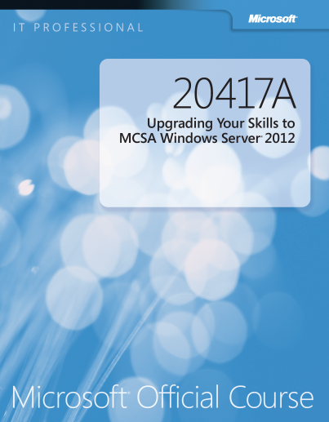
Your Course Materials
Designed to optimize your classroom learning experience.
And support you back on the job.
Microsoft Official Course Handbook
Organized by Modules
Includes Labs + Lab Answer Keys
Module Reviews + Takeaways—great for on-the-job reference

Slide 8
Course Outline
Module 1, “Introduction to Microsoft SQL Server 2014”
Module 2, “Introduction to T-SQL Querying”
Module 3, “Writing SELECT Queries”
Module 4, “Querying Multiple Tables”
Module 5, “Sorting and Filtering Data”
Module 6, “Working with SQL Server 2014 Data Types”
Module 7, “Using DML to Modify Data”
Module 8, “Using Built-In Functions”
Module 9, “Grouping and Aggregating Data”
Module 10, “Using Subqueries”

Slide 9
Course Outline (Contd.)
Module 11, “Using Table Expressions”
Module 12, “Using Set Operators”
Module 13, “Using Window Ranking, Offset, and Aggregate Functions”
Module 14, “Pivoting and Grouping Sets”
Module 15, “Executing Stored Procedures”
Module 16, “Programming with T-SQL”
Module 17, “Implementing Error Handling”
Module 18, “Implementing Transactions”
Module 19, “Improving Query Performance”
Module 20, “Querying SQL Server Metadata”

Slide 10
Related Courses
20461: Querying Microsoft SQL Server
20462: Administering Microsoft SQL Server Databases
20463: Implementing a Data Warehouse with Microsoft SQL Server
20464: Developing a Microsoft SQL Server Database
20465: Designing a Data Solution with SQL Server
20466: Implementing Data Models and Reports with Microsoft SQL Server
20467: Designing Self-Service Business Intelligence and Big Data Solutions
See the full line of Microsoft Training and Certification resources at: http://www.microsoft.com/learning/

Slide 11
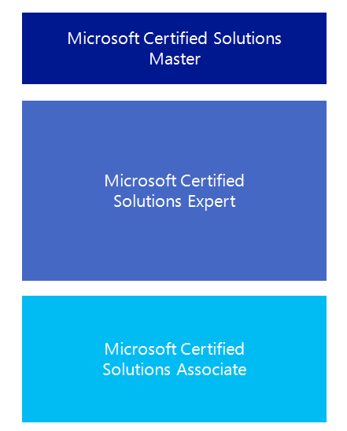

Microsoft Certification Program
Get trained. Get certified.
Get ahead.
Microsoft Certifications demonstrate you have the skills to design, deploy, and optimize the latest technology solutions.
Ask your Microsoft Learning Partner how you can prepare for certification.
Also see:
http://www.microsoft.com/learning/
certification

Slide 12

Preparing for the Labs
Your lab activities will be centered around Adventure Works Cycles, a fictitious manufacturer and seller of cycles and related products.
To complete the labs, you will work in a virtual machine (VM) environment.

Slide 13




Virtual Machine Environment
Virtual Machine Name: | Use as:
20461C-MIA-DC | Domain controller
20461C-MIA-SQL | Database and BI server
ADVENTUREWORKS.MSFT
MIA-DC
MIA-SQL
Notes:
All modules use the same virtual machines for the labs; students should log on to MIA-SQL for all. The lab files are located in the D:\Labfiles folder, in subfolders named Lab01, Lab02, and so on. The demonstration files are located in the D:\Demofiles folder in subfolders named Mod01, Mod02, and so on.
For all labs, students should log on as ADVENTUREWORKS\Student with the password Pa$$w0rd.
Each lab includes a Setup.cmd script to reset the lab environment, so there is no need for students to revert the virtual machines to a previous snapshot between labs. However, it is recommended that students take a snapshot of both virtual machines during the following demonstration, so that if necessary, they can revert to a clean starting environment.

Slide 14
Demonstration: Using Hyper-V Manager
In this demonstration, you will learn how to:
Open Hyper-V Manager
Navigate the various sections/panes within Hyper-V Manager
Virtual Machines, Snapshots, and Actions: Server-specific and VM-specific
Identify the VMs used in the labs for this course
Take a Snapshot and Apply a Snapshot
Connect to a VM
Start and log on to a VM
Switch between full screen and window modes
Revert to the previous Snapshot
Shut down a VM
When to use Shut Down or Turn off
Close Hyper-V Manager

