Slide 1
Course DP-080: Querying Data with Microsoft Transact-SQL

Slide 2
About This Course
Learn how to write queries using SQL Server and Azure SQL Database
This course focuses on learning core Transact-SQL syntax used to work with data for reporting and application development
Using SELECT to retrieve columns from a table
Sorting and filtering query results
Using joins and subqueries to retrieve data from multiple tables
Using built-in functions, aggregations, and groupings
Inserting, updating, and deleting data
Additional learning materials are available on Microsoft Learn

Slide 3
Course Agenda
Module 1: Getting Started with Transact-SQL
Module 2: Sorting and Filtering Query Results
Module 3: Using Joins and Subqueries
Module 4: Using Built-in Functions
Module 5: Modifying Data
Notes:
Module 1: Getting Started with Transact-SQL
Module 2: Sorting and Filtering Query Results
Module 3: Using Joins and Subqueries
Module 4: Using Built-in Functions
Module 5: Modifying Data

Slide 4
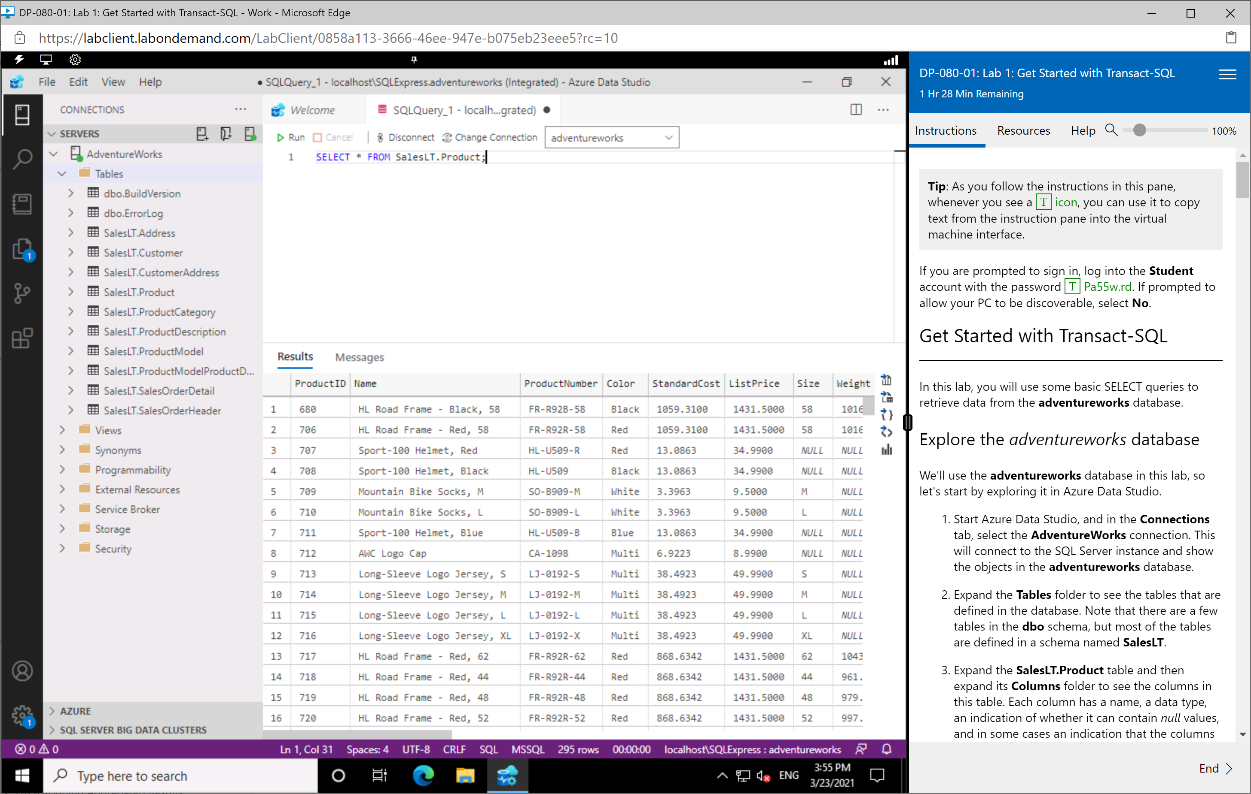
Lab Environment
Hosted Virtual Machine
Windows 10
SQL Server Express
Azure Data Studio
Bring your own environment:
https://microsoftlearning.github.io/dp-080-Transact-SQL/

Slide 5
Closing slide

